Slide 1


The Impact of Total Quality Management on Corporate Sustainability in the Healthcare Sector, Corporate Social Responsibility as a Mediator
Supervisor:
Dr. Mohammad Othman
Students:
Diaa Quddomi
Muna Tamimi
Mohammad Habash
Nada Fitian
Tareq Arafat
An-Najah National University Graduation Project 2
Faculty of Engineering

Slide 2
OUTLINE
Introduction & Objectives
Recommendations
Interviews & Questionnaires analysis
Methodology
Research limitations & Future research directions
Theoretical frameworks & Framework
Discussions & Conclusions

Slide 3
Introduction
Problem Statement:
Corporate sustainability in healthcare
Challenges face Palestinian healthcare
Solution (TQM)
TQM
CSR
CS

Slide 4
Objectives
OBJECTIVE 1
To determine the level of implementation of TQM practices in Palestinian healthcare organizations.
OBJECTIVE 2
To investigate the relationships between TQM and corporate sustainability in Palestinian healthcare organizations.
OBJECTIVE 3
To develop a framework that can assist in implementing TQM in Palestinian healthcare organizations.
OBJECTIVE 4
To clarify the mediating effect of CSR in the relationship between TQM and CS.

Slide 5
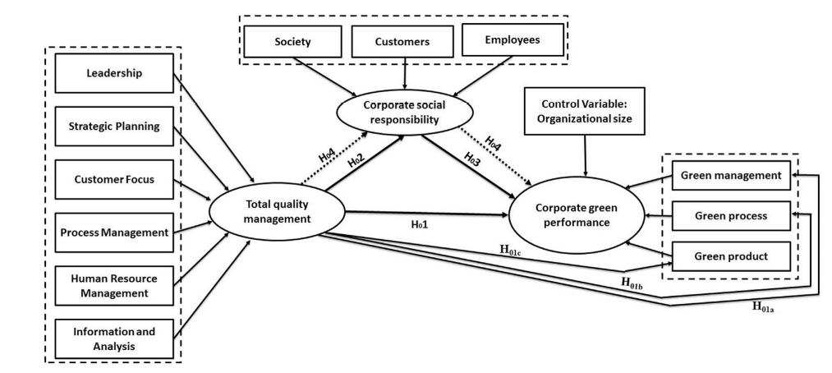
Theoretical frameworks

Slide 6
Framework
Commitment & Leadership
Employees
Patients
Community
Teamwork
CSR
Relationship between TQM & CSR
Customer satisfaction
Relationship between CSR & CS
Environmental performance
Continuous improvement
TQM
CS
Social performance
Resource management
Relationship between TQM & CS
Economic performance
Training & Education
H1: TQM has a significant and positive impact on CS in the Palestinian HC sector.
H2: TQM has a positive impact on CSR activities in the Palestinian HC sector.
H3: CSR activities have a positive impact on CS in the Palestinian HC sector.
H4: CSR mediates the relationship between TQM and CS in the Palestinian HC sector
Organizational culture and values
Process management

Slide 7
Methodology
Data collection
101 were distributed;
86 valid were collected
Questionnaire
Pilot study
Sampling technique
Mixed method
Interviews
Thematic analysis
Measurement development
Model of the study
Measurement scale

Slide 8
Interviews analysis
Themes:
Sustainable Environmental Performance.
Sustainable Social Performance.
Sustainable Economic Performance.
Challenges.
Total Quality Management.
Corporate Social Responsibility.
Success Factors.
The mediating effect of Corporate Social Responsibility.

Slide 9
Questionnaires analysis: Assessment of measurement models, Convergent Validity.
Reflective constructs | CR > 0.7 | AVE > 0.5
ET | 0.889 | 0.617
TW | 0.882 | 0.6
L | 0.879 | 0.55
CI | 0.916 | 0.611
CU | 0.94 | 0.722
CuS | 0.865 | 0.563
RM | 0.87 | 0.528
PM | 0.872 | 0.578
E | 0.901 | 0.696
P | 0.903 | 0.651
C | 0.832 | 0.556
EnP | 0.839 | 0.512
EcP | 0.851 | 0.59
SP | 0.899 | 0.643
Assessment of measurement models
Convergent Validity
CR
AVE
Discriminant validity
Variable correlations
cross Loading
Factor loading

Slide 10
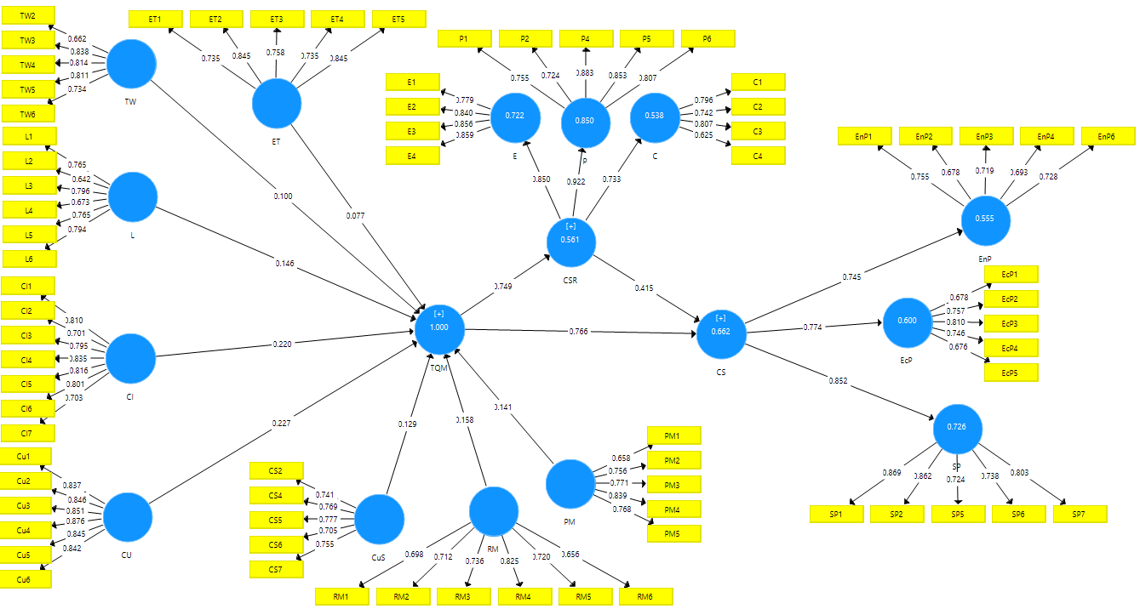
Factor loading > 0.6

Slide 11
Discriminant validity
Example of cross Loading:
 | ET | TW | L | CI | CU | CuS | RM | PM | E | P | C | EnP | EcP | SP
ET1 | 0.735 | 0.548 | 0.325 | 0.366 | 0.258 | 0.175 | 0.231 | 0.27 | 0.12 | 0.094 | 0 | 0.048 | 0.088 | 0.164
ET2 | 0.845 | 0.708 | 0.458 | 0.485 | 0.386 | 0.362 | 0.291 | 0.424 | 0.194 | 0.205 | 0.025 | 0.24 | 0.113 | 0.205
ET3 | 0.758 | 0.477 | 0.272 | 0.322 | 0.231 | 0.233 | 0.188 | 0.435 | 0 | 0.08 | 0.089 | 0.443 | 0.156 | 0.125
ET4 | 0.735 | 0.478 | 0.329 | 0.321 | 0.296 | 0.43 | 0.212 | 0.355 | 0.131 | 0.172 | 0.043 | 0.225 | 0.121 | 0.204
ET5 | 0.845 | 0.641 | 0.497 | 0.556 | 0.451 | 0.484 | 0.4 | 0.57 | 0.299 | 0.398 | 0.168 | 0.41 | 0.167 | 0.275
TW2 | 0.556 | 0.662 | 0.408 | 0.4 | 0.427 | 0.416 | 0.376 | 0.334 | 0.178 | 0.287 | 0.03 | 0.385 | 0.2 | 0.314
TW3 | 0.555 | 0.838 | 0.638 | 0.588 | 0.555 | 0.399 | 0.424 | 0.398 | 0.404 | 0.328 | 0.232 | 0.353 | 0.245 | 0.265
TW4 | 0.557 | 0.814 | 0.498 | 0.488 | 0.361 | 0.365 | 0.305 | 0.378 | 0.228 | 0.312 | 0.044 | 0.318 | 0.212 | 0.191
TW5 | 0.579 | 0.811 | 0.559 | 0.501 | 0.445 | 0.259 | 0.232 | 0.425 | 0.321 | 0.198 | 0.073 | 0.277 | 0.2 | 0.202
TW6 | 0.613 | 0.734 | 0.49 | 0.558 | 0.484 | 0.427 | 0.308 | 0.397 | 0.421 | 0.301 | 0.183 | 0.104 | 0.17 | 0.317

Slide 12
Cont.
Variable correlations:
 | C | CI | CU | CuS | EcP | ET | E | EnP | L | PM | P | RM | SP | TW
C | 0.746
CI | 0.394 | 0.782
CU | 0.439 | 0.768 | 0.85
CuS | 0.339 | 0.726 | 0.64 | 0.75
EcP | 0.332 | 0.495 | 0.527 | 0.405 | 0.735
ET | 0.091 | 0.54 | 0.43 | 0.448 | 0.166 | 0.785
E | 0.44 | 0.649 | 0.67 | 0.528 | 0.461 | 0.203 | 0.834
EnP | 0.349 | 0.514 | 0.499 | 0.605 | 0.413 | 0.358 | 0.384 | 0.715
L | 0.369 | 0.769 | 0.769 | 0.561 | 0.343 | 0.496 | 0.544 | 0.391 | 0.742
PM | 0.396 | 0.738 | 0.664 | 0.661 | 0.497 | 0.538 | 0.546 | 0.678 | 0.599 | 0.76
P | 0.575 | 0.66 | 0.639 | 0.605 | 0.424 | 0.267 | 0.661 | 0.528 | 0.624 | 0.648 | 0.807
RM | 0.522 | 0.691 | 0.681 | 0.684 | 0.504 | 0.348 | 0.594 | 0.551 | 0.639 | 0.655 | 0.662 | 0.726
SP | 0.442 | 0.628 | 0.678 | 0.547 | 0.477 | 0.257 | 0.607 | 0.442 | 0.552 | 0.621 | 0.774 | 0.585 | 0.802
TW | 0.153 | 0.661 | 0.593 | 0.483 | 0.266 | 0.7 | 0.409 | 0.369 | 0.676 | 0.5 | 0.37 | 0.428 | 0.334 | 0.775

Slide 13
Assessment of structural models
Coefficient of Determination (R^2):
Effect Size (f^2):
Blindfolding and Predictive Relevance (Q^2):
variables | R Square | described
CSR | 0.561 | moderate
CS | 0.664 | moderate
R^2
F^2
Q^2
GoF
H°
variables | CS | CSR
TQM | 0.268 | 1.28
CSR | 0.229
variables | SSO | SSE | Q^2
CSR | 1118 | 846.172 | 0.234
CS | 1290 | 1000.255 | 0.255

Slide 14
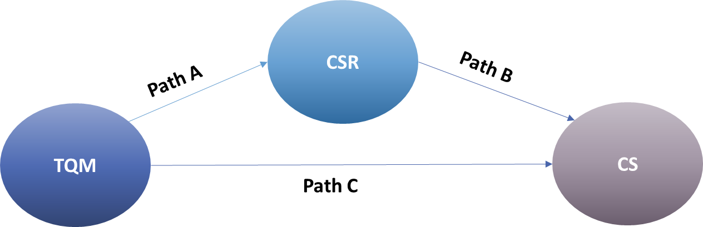
Cont.
Goodness-of-fit index (GoF):
Path Coefficients –Hypotheses test:
 | Sum R^2 | Sum AVE | Arithmetic average (R^2) | Arithmetic average (AVE) | Gof | described
GoF | 1.225 | 8.417 | 0.6125 | 0.601214286 | 0.60683 | Large
Path | Hypo | Std.Beta | Std.Error | T-value | P-value | decision
TQM--->CS | H1 | 0.454 | 0.135 | 3.354 | 0.001 | Supported
TQM--->CSR | H2 | 0.749 | 0.058 | 13.002 | 0.000 | Supported
CSR--->CS | H3 | 0.415 | 0.140 | 2.964 | 0.003 | Supported
 | Path a | Path b | Indirect Effect | SE | t-value | 95% LL | 95% UL | Decision
H4 | 0.749 | 0.415 | 0.311 | 0.135 | 2.302 | 0.046 | 0.575 | Mediation

Slide 15
Discussion & Conclusions
Results revealed that TQM practices are highly implemented in healthcare organizations, in Palestine.
The results also showed that the following items from TQM scored the highest levels of implementation:
Resource management
Customer satisfaction
Continuous improvement and Teamwork .
While the results showed that the lowest level of implementation from the TQM bundle were:
Leadership and Employee training
Organizational culture
Process management
There is a statistically positive and significant association between TQM bundle and sustainable performance, with Social sustainability having the highest score.
The findings indicate that if an organization can efficiently manage its TQM activities, it will enhance the workers’ skills, capabilities, and motivation level to use the resources in efficient manners, therefore achieving sustainability.
The findings have also indicated a significant relationship between TQM and CSR. TQM practices have a significant positive impact on the CSR in the Palestinian healthcare organizations and help these organizations to be more committed to their community, employees and patients.
CSR has a significant positive impact on the CS in the Palestinian healthcare organizations and helps to maintain its constructs.
Corporate social responsibility mediating the relationship between total quality management and corporate sustainability was highly significant. In which CSR towards patients scored the highest level of implementation.
The CSR had nearly the same attention from the Palestinian healthcare organizations with a high level of implementation, especially regarding the social performance, but with less attention comparing to TQM and CS.

Slide 16
Recommendations
We recommend the following:
To implement TQM and CSR since they have high enhancement on economic, social and environmental sustainability.
To recognize the gained value such as financial benefits and other like competitive advantage, reputation, satisfaction, etc.
To give support and leadership for quality managers or others who can make changes.
To redesign processes to improve workflow and reduce the negative impact on environment.
MOH & EQA communicate to solve disposal problem, build environmental protocol, audit performance.
Healthcare centers to review their performance toward environment and seek to get ISO 14001.
Create quality department.
Practice CSR in a systematically manner and address different stakeholder groups demands.

Slide 17
Research limitations & Future research directions
Constraints:
Covid-19.
Research in Palestine is difficult in all aspects because of the occupation.
Lack of understanding of some terms in some health institutions, which requires clarification of some details and information on the subject.
Future research directions:
It may work on changing the mediating factor or adding another mediator to study the relationship between TQM & CS.
More studies should be done on the effect of TQM and another mediator on the sustainable performance of healthcare organization.
The hypotheses proposed in this study should be tested in the health care sector in other developing countries to popularize the proposed framework.

Slide 18
Thank you
Any questions?

