Slide 1
Mzad Palestine
Waleed Bilal Jameel Dweikat | 12112594
Saad Eldin Ziad Odeh | 12011579
Karim Samer Qasem Mithqal | 12116015
Supervisor:
Dr. Emad Saadeh
An-Najah National University – Faculty of Information Technology
And AI
Department of : Computer Science
Date: [Add Presentation Date Here]

Slide 2
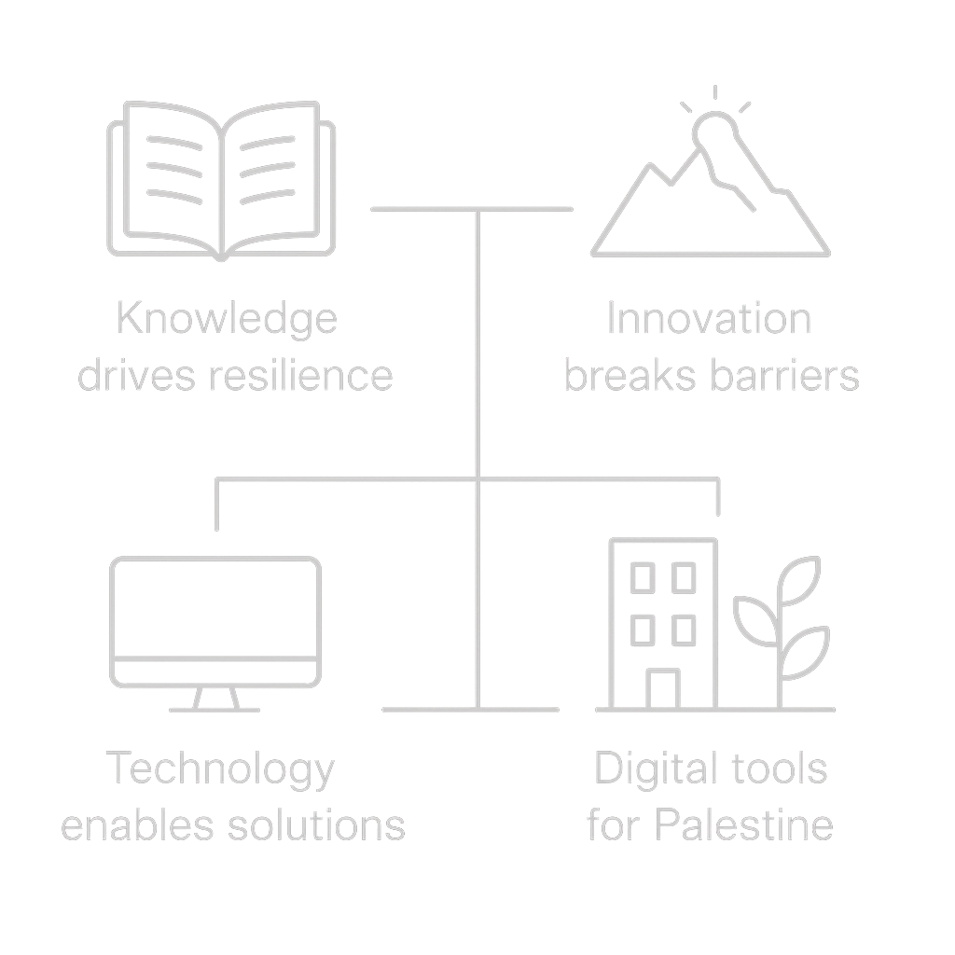
Introduction

Slide 3
Project Overview
01

Slide 4
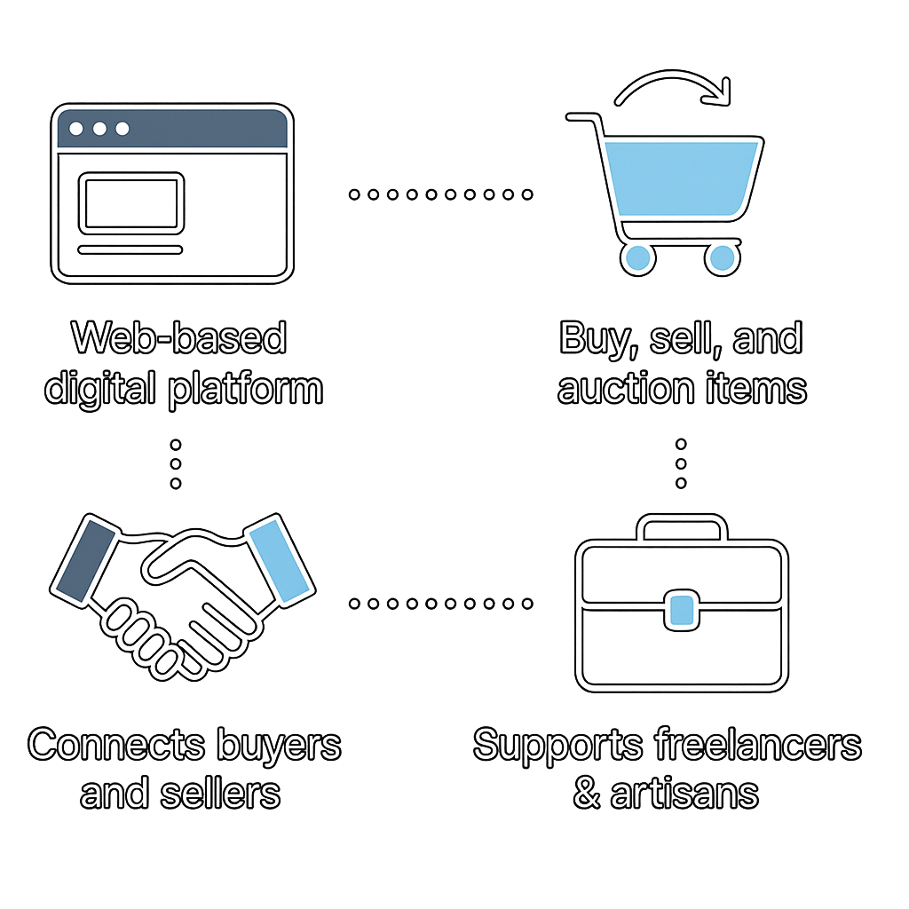
Definition of the
Mzad Palestine

Slide 5
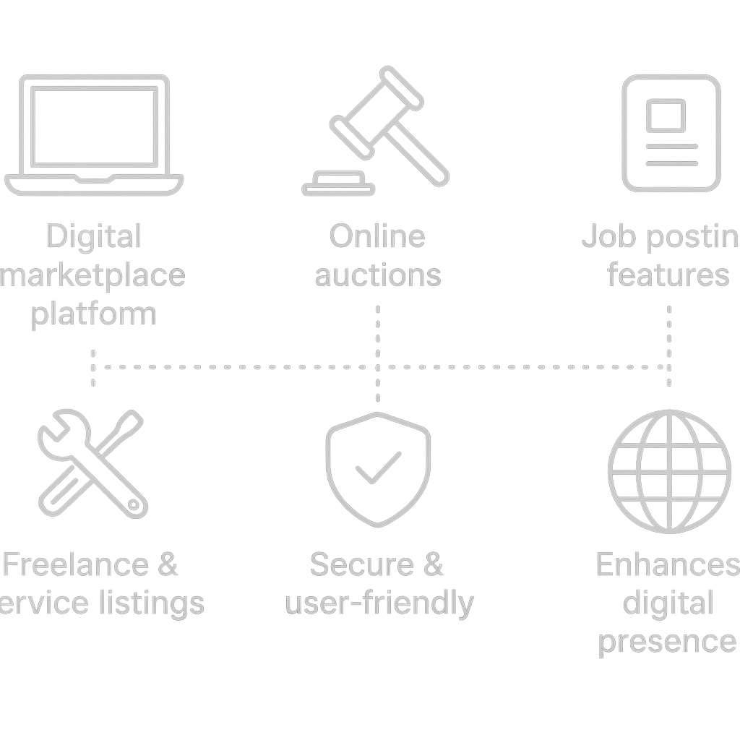
Features of Mzad Palestine
g
S

Slide 6

Market necessity
There is a significant lack of comprehensive digital marketplaces in Palestine, hindering the promotion of local services and products. The existing fragmented online solutions are often unsafe and do not cater specifically to the needs of the Palestinian community. This platform addresses these challenges by providing a robust and secure environment for users to engage in commerce.

Slide 7
02
Technical Aspects

Slide 8

Technologies utilized

Slide 9

System workflow

Slide 10


Slide 11

Challenges faced
Throughout development, various challenges emerged, including internet limitations impacting service integration, handling bid conflicts, and ensuring database consistency. Significant lessons were learned, particularly emphasizing the importance of teamwork, debugging under pressure, and thorough planning and testing processes.

Slide 12
Conclusions
Mzad Palestine stands as a pioneering effort to fulfill the digital marketplace needs of Palestinians, creating opportunities for growth and innovation through technology. Its successful implementation can significantly enhance e-commerce adoption in the region, empowering users and fostering economic development.

Slide 13
Thank you!
Do you have any questions?

