Slide 1


Controlling Robot Car via Smartphone
Faculty of Engineering
Telecommunication Engineering
Graduation project “2”
Supervisor: Dr. Jamal Kharousheh
Prepared by: Hamza Qaddara
Esmat Hedariya
Hareth Hanani

Slide 2

Outline
Introduction
Objectives
View the final project
Parts of the project
Constrains

Slide 3
Introduction
Robot Car is a System designed for robot controlling implemented with many features, and is a robot that can be controlled via Smartphone . This system uses microcontroller interfaced with modules such as Wifly module, Bluetooth module and DC motors, sensors to detect obstacles and the movement of objects.
When anyone wants to use this robot all he can do is to have smart phone (Android device) that connect to Bluetooth then Bluetooth module will send the data serially to the microcontroller and the controller will send the command to motor to rotate and control the robot. this enable users to control their robot from distance up to 10-20 meter and user can read the status of the robot on their app when they send the command to the robot car.

Slide 4
Objectives of the project
Controlling robot car using smart phone.
Design a system performs specific functions.
Dealing with different modules interface with microcontroller.
Dealing with different sensors interface with microcontroller.

Slide 5

Video to summarize the project within this semester

Slide 6
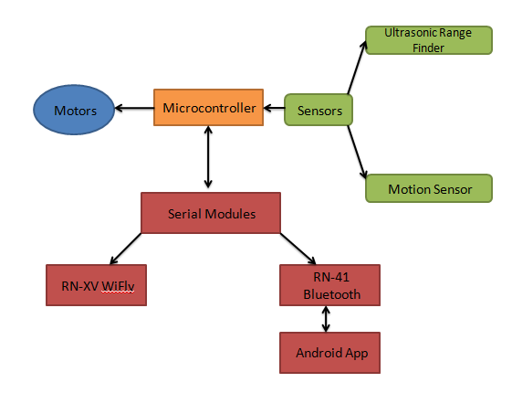
The figure below shows the flow of our system and how does it work.

Slide 7
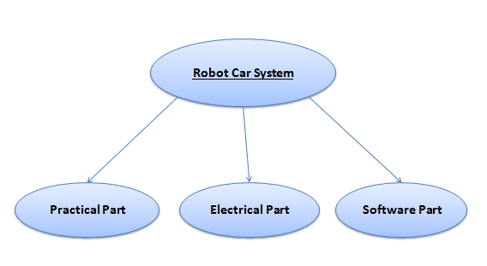
Parts of the project
The following figure shows the main parts of the project.

Slide 8
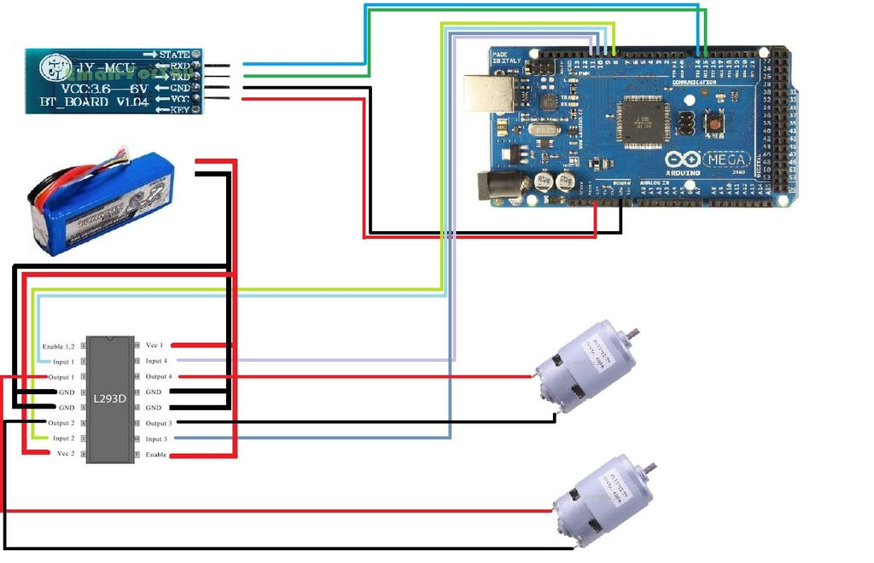
Practical Part

Slide 9
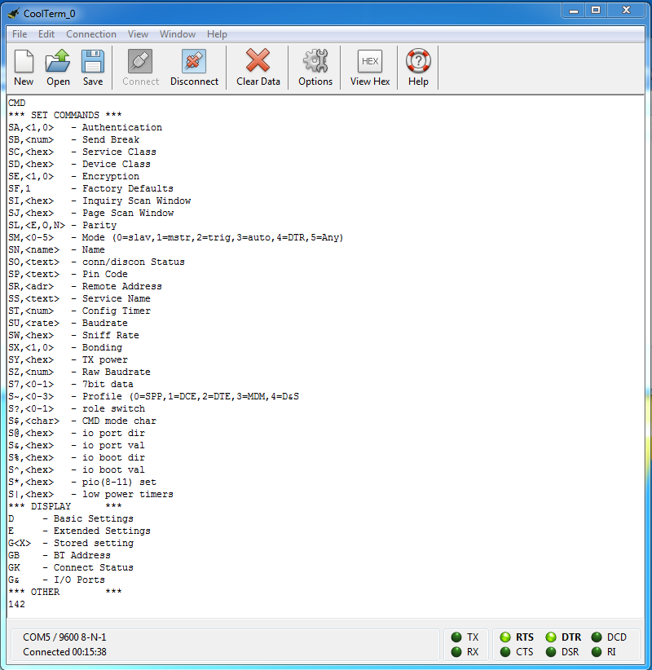
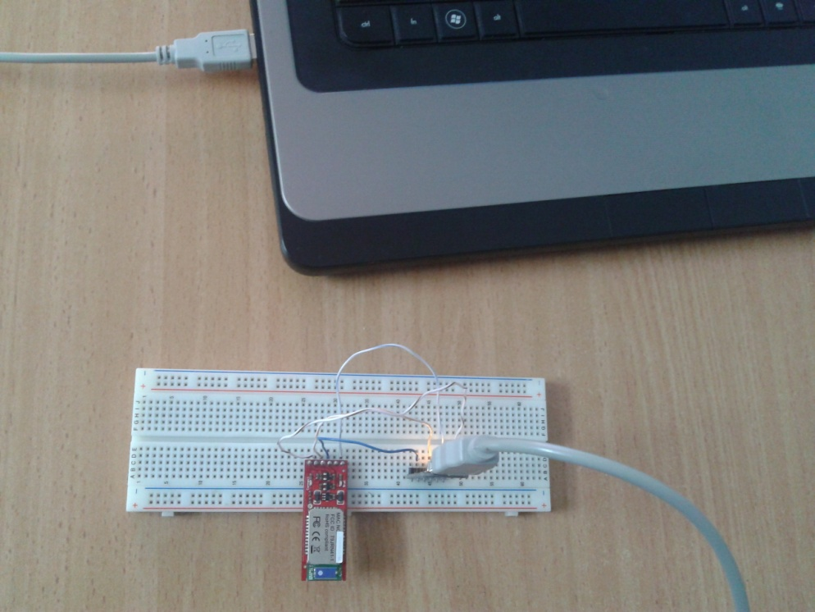
Configuration of bluetooth

Slide 10
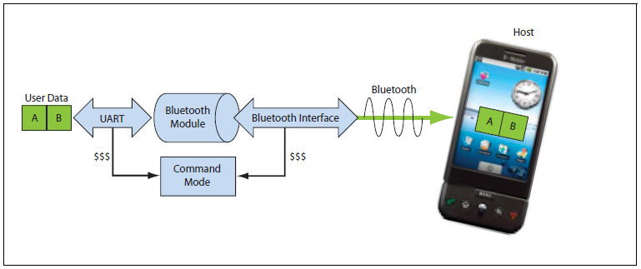
DATA & COMMAND MODES

Slide 11
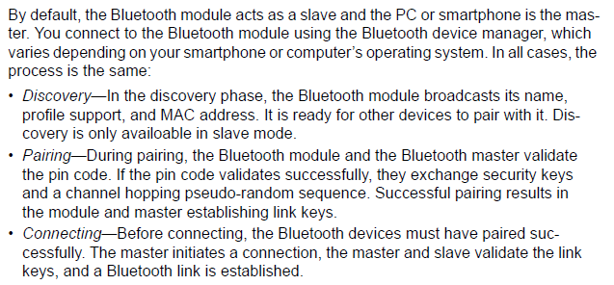
Making a bluetooth connection

Slide 12
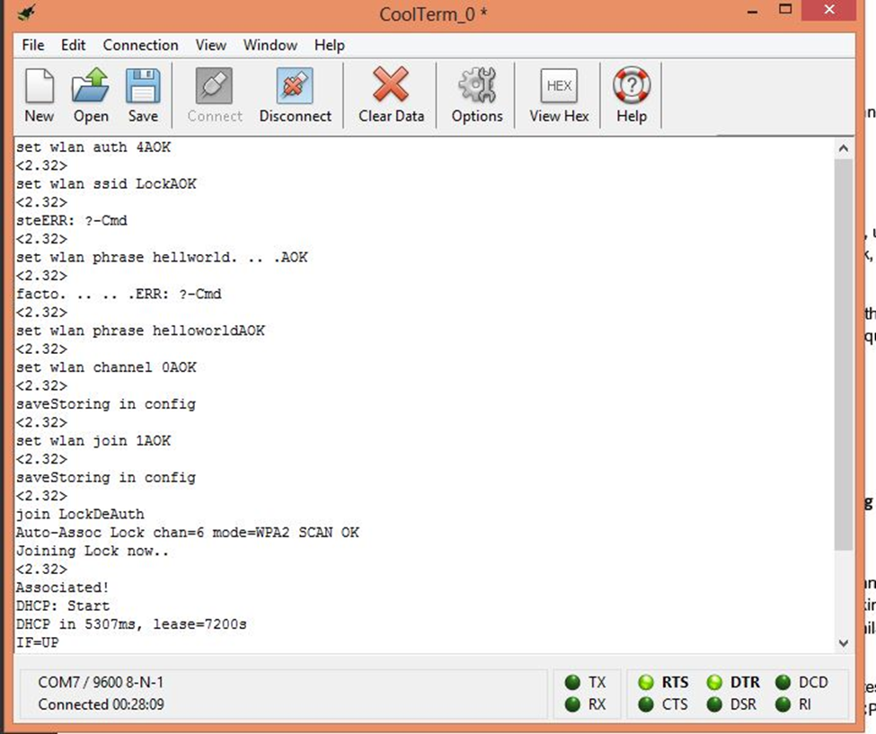
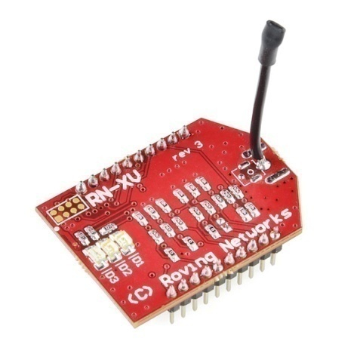
We configure the wifly module using specific commands from its datasheet .
We make it able to associate wireless Access point, after that it take an ip address , DNS , GW.

Slide 13
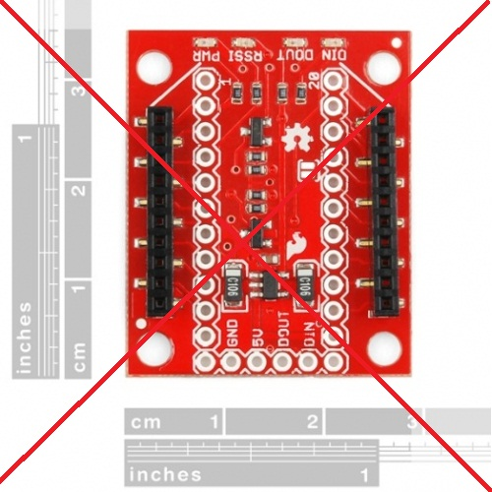
Constrains
How do we configure Wi-Fly Module ?
At first stage , this module operates on 3.3 voltage and so we use regulated breakout that support 3.3 voltage for all input (Pwr,TX,RX) of Wifly module .
But it was nightmare , we found this breakout isn’t compatible with RN-171 wifly.

Slide 14
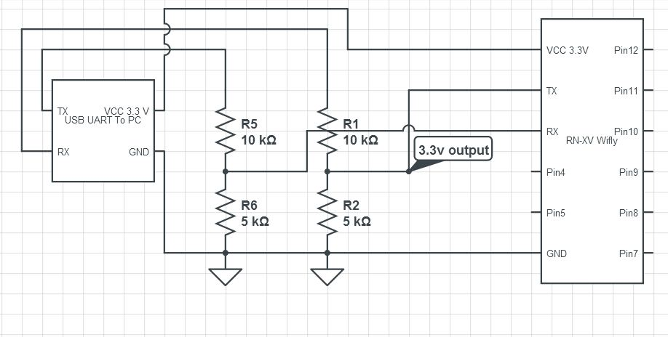
Now we must configure wifly module in order to connect local wireless network.
We built the following circuit that interface our computer serially and entering command mode for this module .

Slide 15
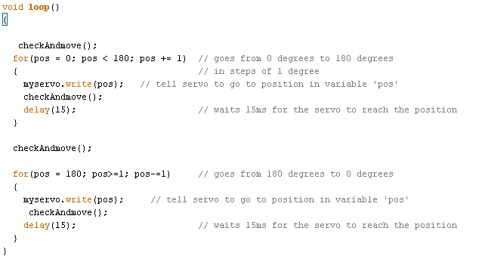
Delay problem
void checkAndmove(){
char toSend;
………..
}

Slide 16
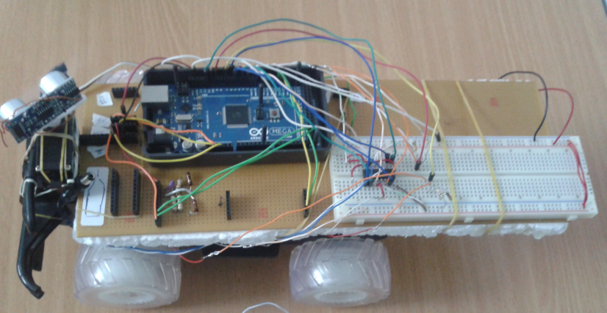

Slide 17
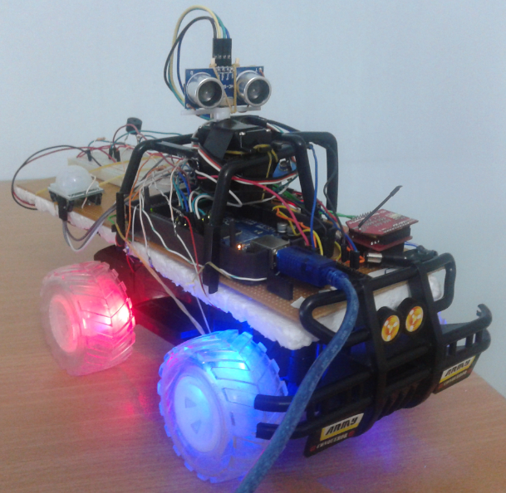

Slide 18
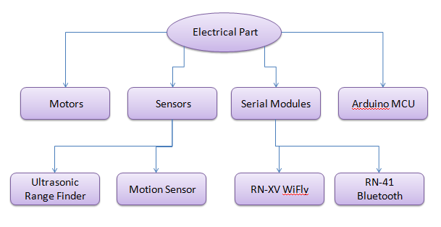
2.Electrical part
The following figure shows all these electrical pieces.

Slide 19
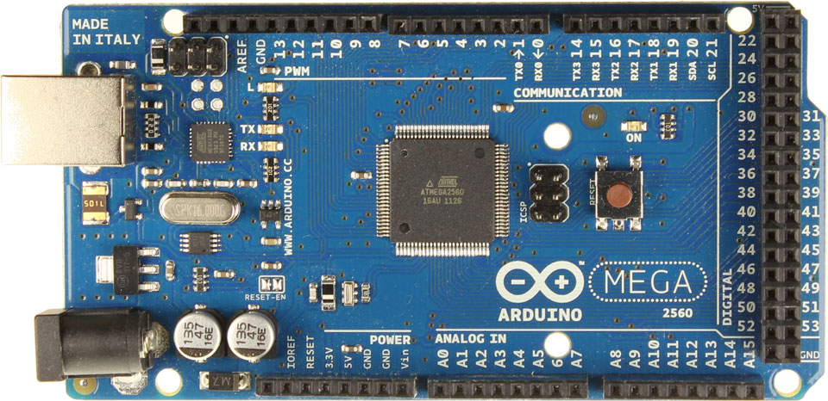
Microcontroller
Our system use Arduino Mega 2560 which is based on the ATmega2560 AVR microcontroller.
The main feature for this which is support multi hardware serial pins and of course multi software serial .

Slide 20
Wireless Module
Robot connect to the internet via wireless wifi module.
We use RN-XV Wi-Fly module .
The RN-XV module is based upon Roving Networks' robust RN-171 Wi-Fi module.
Incorporates 802.11 b/g radio .

Slide 21
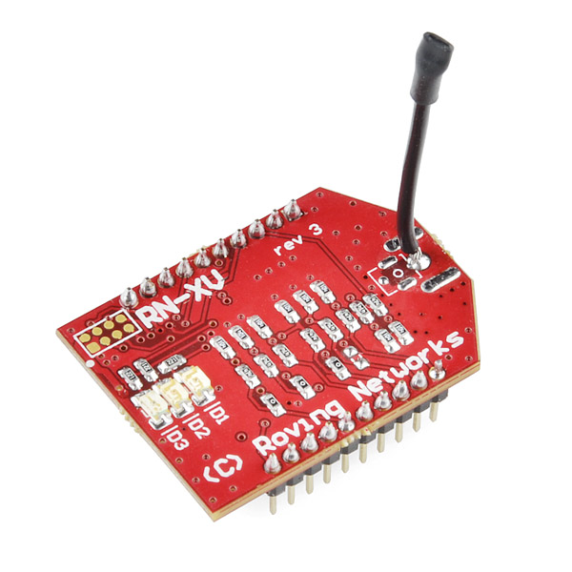
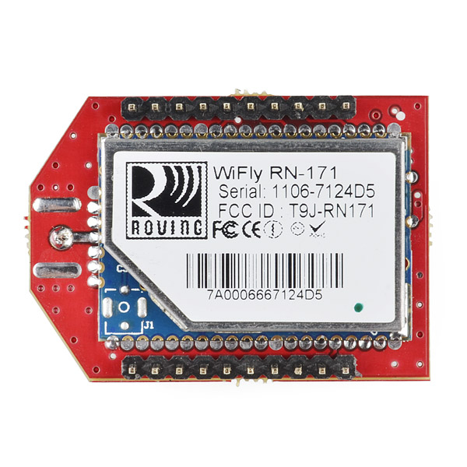
In the simplest configuration, the hardware only requires four connections (PWR, TX, RX and GND) to create a wireless data connection.

Slide 22
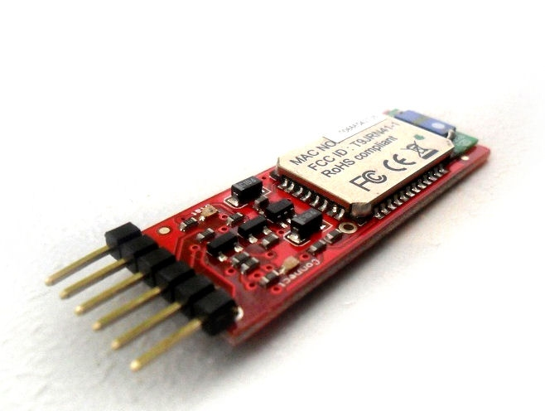
Bluetooth Module
Our system uses Bluetooth communication to connect any smartphone.
We use RN-41 Bluetooth model from Roving Network.

Slide 23
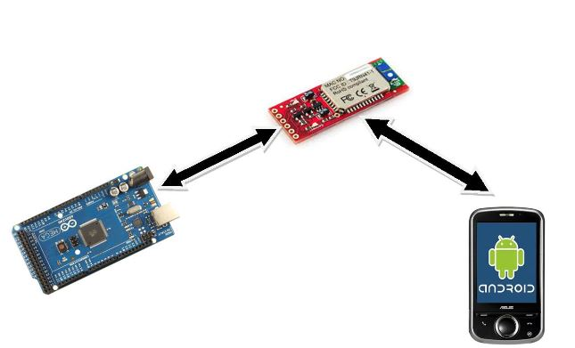
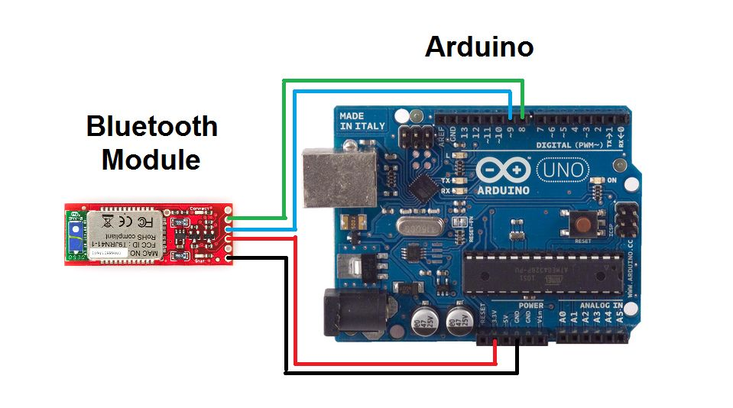
How Robot operate via Bluetooth

Slide 24
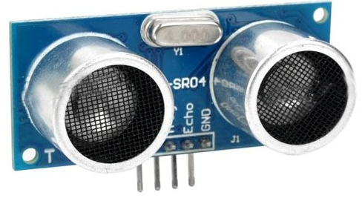
The sensors
1- Ultrasonic Ranging HC-SR04
provides 2cm - 400cm non-contact measurement function, the ranging accuracy can reach to 3mm. The modules includes ultrasonic transmitters, receiver and control circuit.

Slide 25
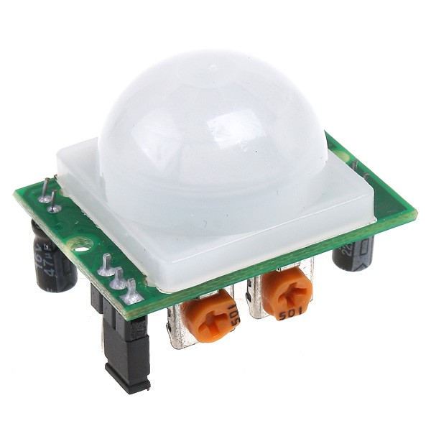
2- PIR Motion Sensor
This is a simple to use motion sensor. Power it up and wait 1-2 seconds for the sensor to get a snapshot of the still room. If anything moves after that period, the 'alarm' pin will go low.

Slide 26
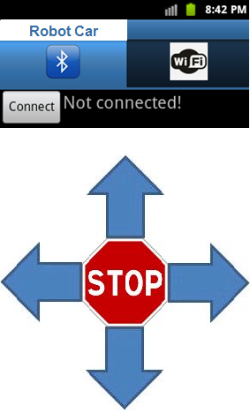
3.Software part
At this part we will focus on the software and library that we will use in both MCU part and on the PC side.
1- MCU Part
2- The mobile Application

Slide 27
Thank You
For
Your Time

