Slide 1

Effect of Compliance with Health and Safety Management
System Among Contractor in road projects

Slide 2
01
Initial planning and desk research
02
Questionnaire preparation
Choosing respondents
TABLE OF CONTENTS
03
04
Distributing and collecting questionnaire form
Analyze the data
05
In project -1-
In project -2-
In project -2-
In project -2-
In project -2-
Conclusion
06
In project -2-

Slide 3

Initial planning and desk research
01

Slide 4


Safety management in road projects
Safety management in road projects is an ongoing process that aims to protect all people, property, and the environment from harm during the planning, construction, and maintenance of roads.
The safety of road-workers is a high priority for occupational health and road safety authorities and, especially, for the workers themselves and the organizations which employ and represent them.

Slide 5

Project Importance
Project Benefits
About the project
Target Audience
Expected Impact
Emphasis the importance of Compliance Health and Safety Management System.
Decreasing Number of Accidents.
Raising awareness among workers.
Improving safety technologies.
Supporting scientific research.
Helping stakeholders in decisions.
Reduce Work-Related Injuries and Accidents in projects.
Improving project efficiency and increasing productivity.
Reducing the costs of insurance, lawsuits, medical treatment, and repairs.
Improve Reputation and Public Image of the company
Improve decision-making
Compliance with laws and regulations related to project safety.
Short-term costs , Long-term benefits.
Employers in various sectors.
Workers in various fields.
Engineers and architects.
Safety consultants.
Students in universities and colleges
Increase Workers Productivity and Morale.
Cost Savings
Environmental Benefits
Improve Job Satisfaction

Slide 6
3.1 Overview
3.2 Procedure
Chapter 3: Methodology
This study assessed the impact of compliance with health and safety management systems among contractors in Palestinian road projects. It utilized a holistic approach, including literature review, data collection via questionnaires, and analysis of findings from Palestine and neighboring Arab countries to formulate conclusions and recommendations.
3.2.1 Identifying the Target Audience and Preparing the Questionnaire
3.2.2 Questionnaire Distribution and Data Collection:

Slide 7
CH.4
Data Analysis

Slide 8
4.1 Overview
In this section, we will present a comprehensive analysis of the data collected from the
questionnaires distributed for the study on road engineering projects in Palestine, with a focus
on safety adherence. The dataset comprises responses from 50 samples, and our analysis aims
to uncover insights into the current state of safety measures, identify areas for improvement,
and provide actionable recommendations.

Slide 9
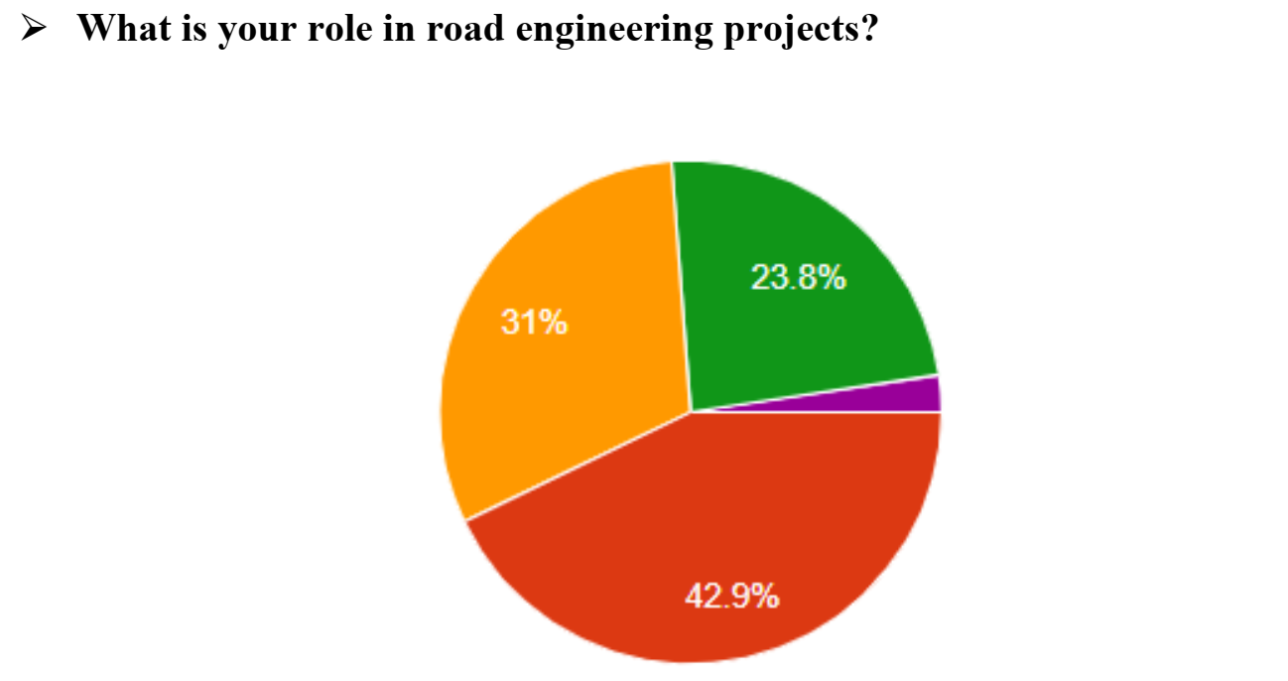
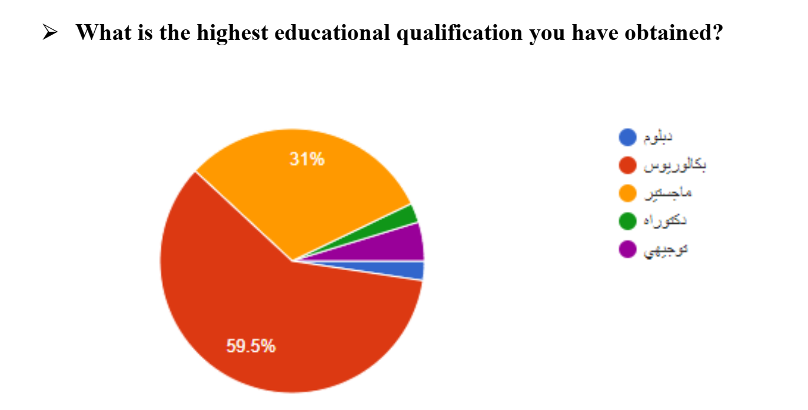
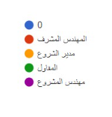
4.2 Sections Analysis:
1. Personal Information Section

Slide 10
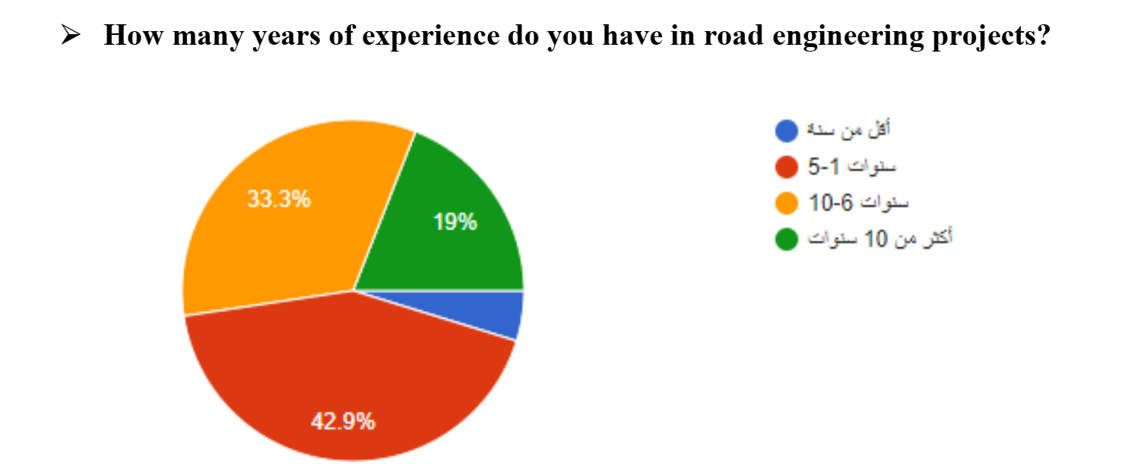
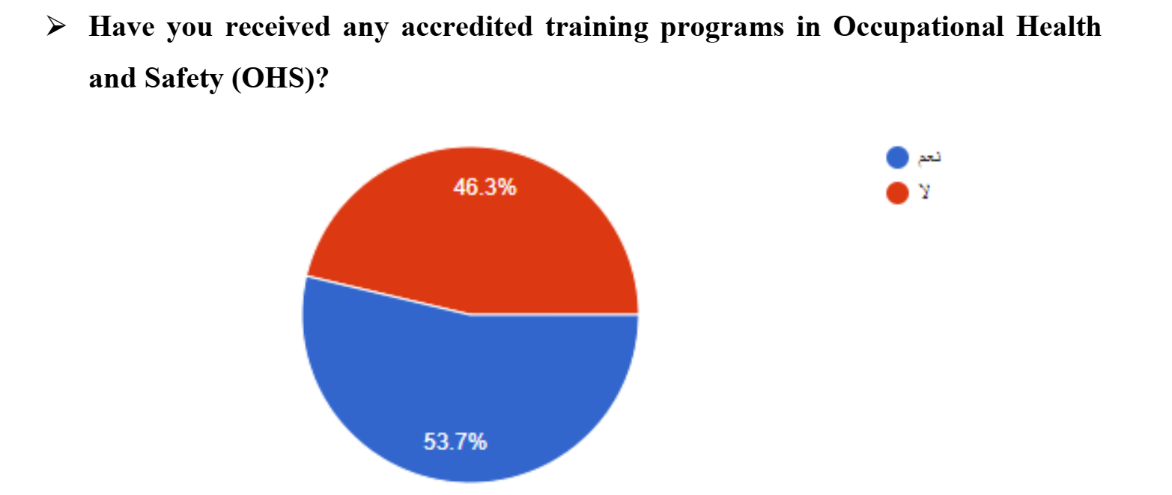
4.2 Sections Analysis:
1. Personal Information Section

Slide 11
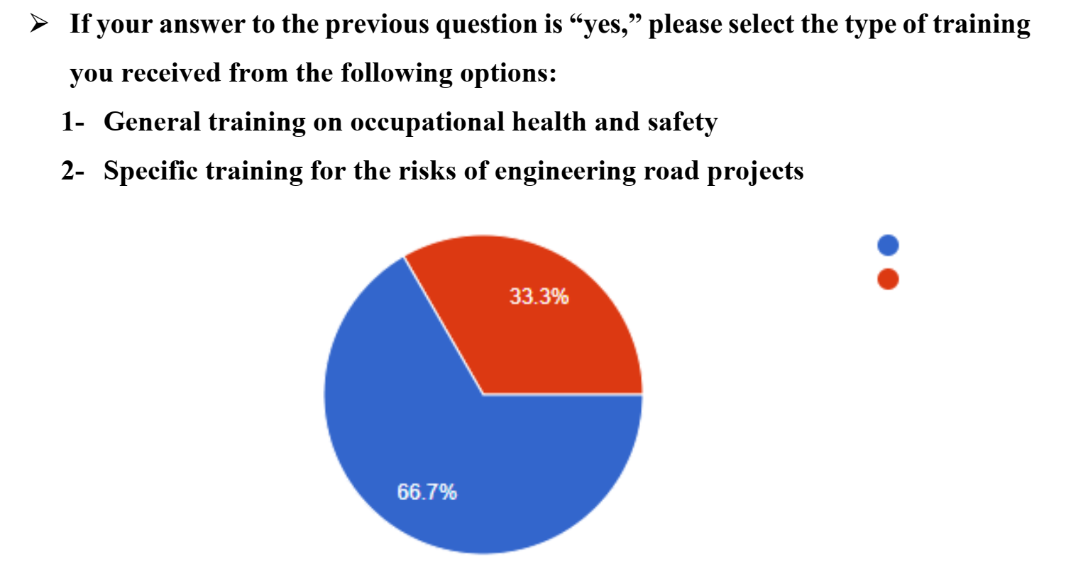

4.2 Sections Analysis:
1. Personal Information Section

Slide 12
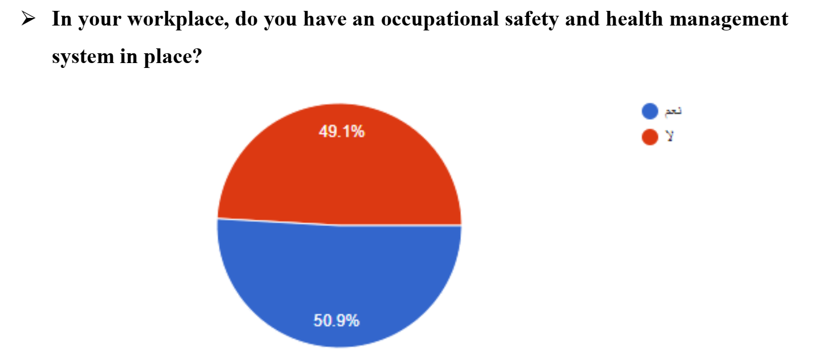
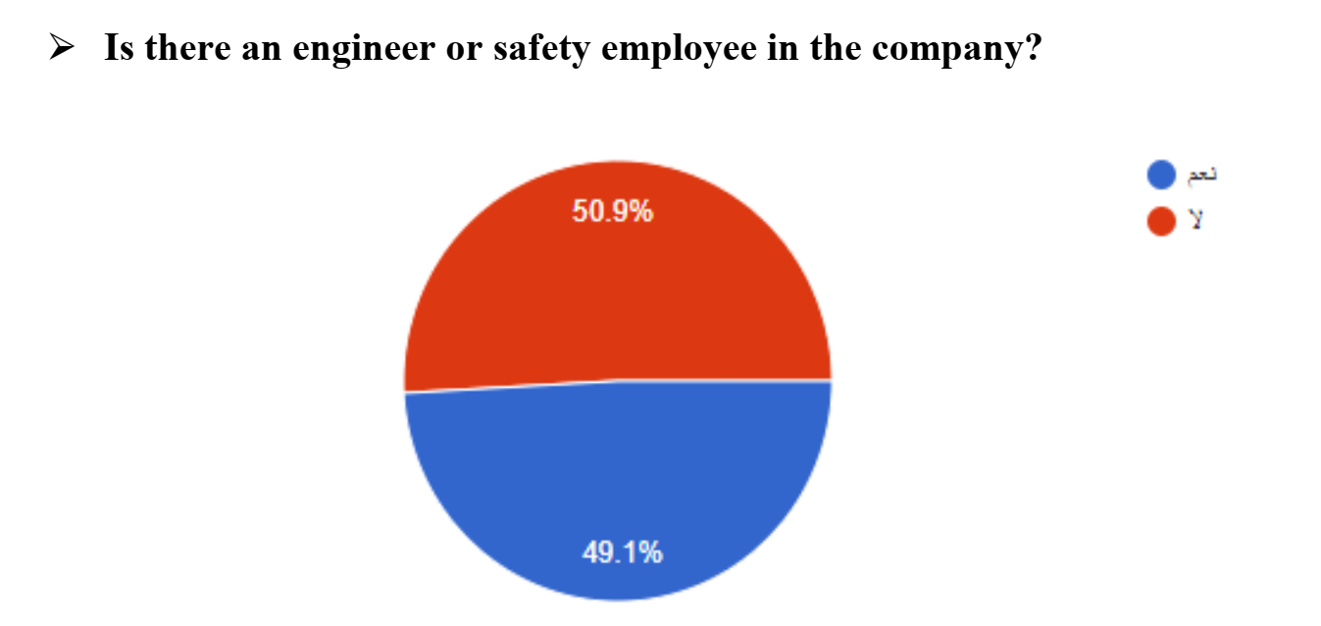
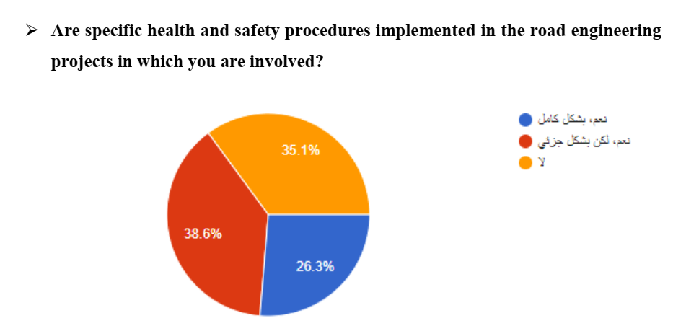
4.2 Sections Analysis:
2. General Questions Section:

Slide 13
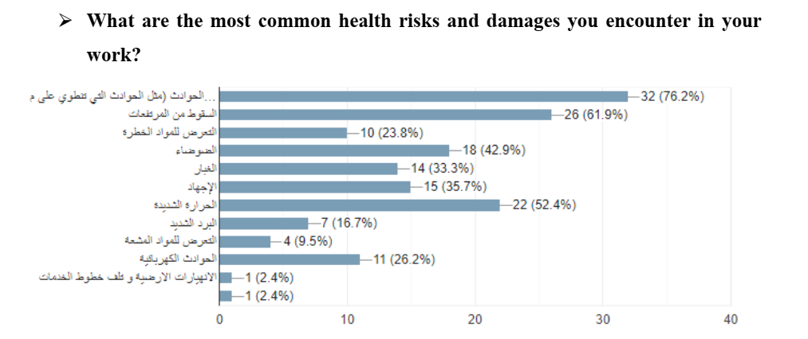
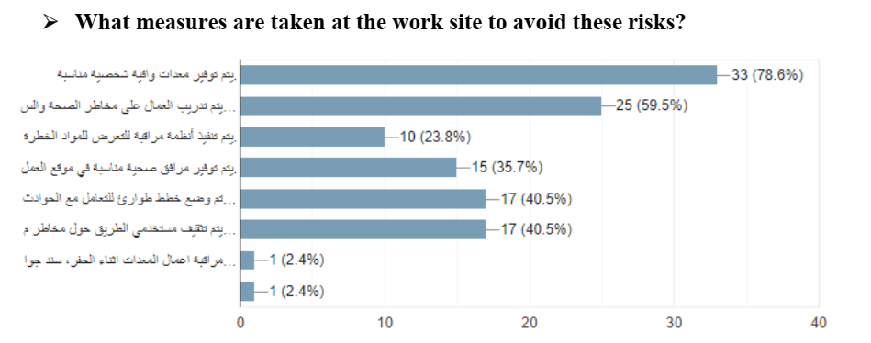
4.2 Sections Analysis:
2. General Questions Section

Slide 14
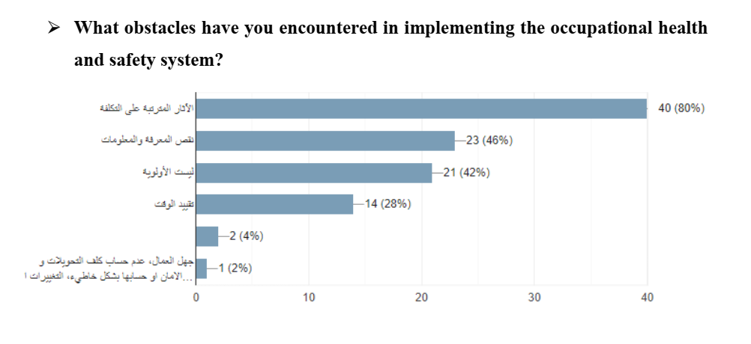
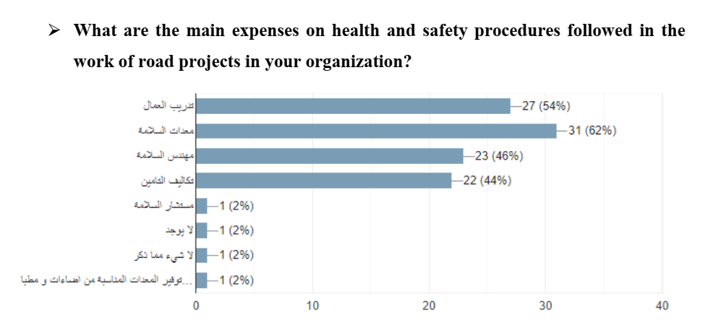
4.2 Sections Analysis:
2. General Questions Section

Slide 15
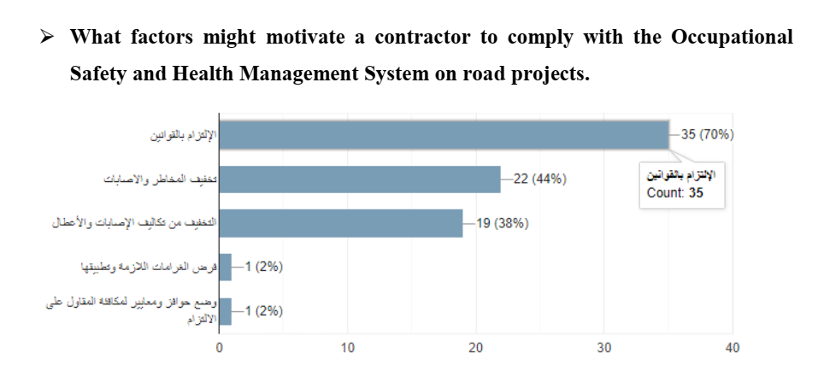
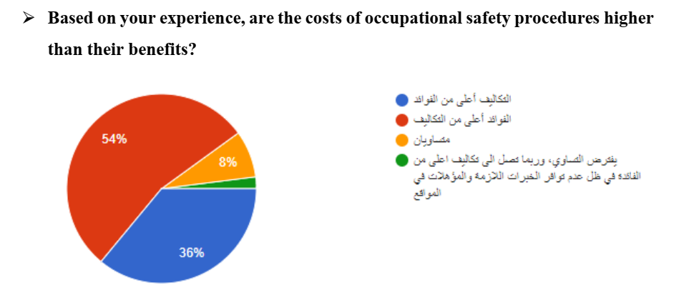
4.2 Sections Analysis:
2. General Questions Section

Slide 16
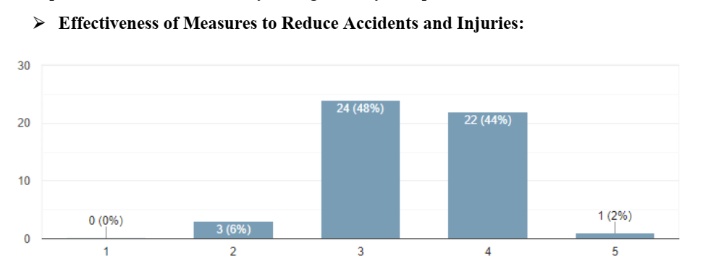
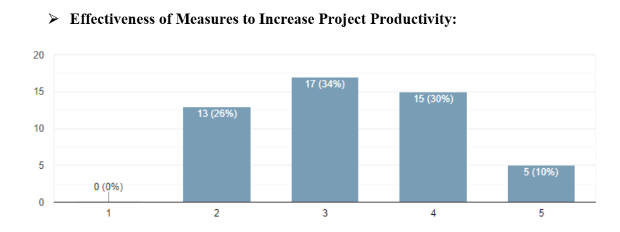
4.2 Sections Analysis:
3. Positive Impact Evaluation Section

Slide 17
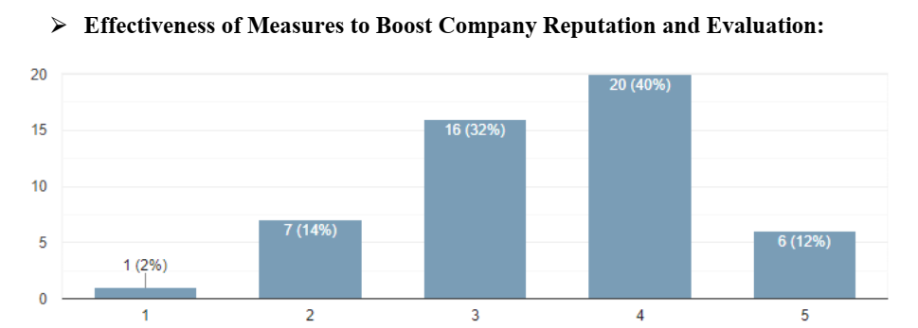
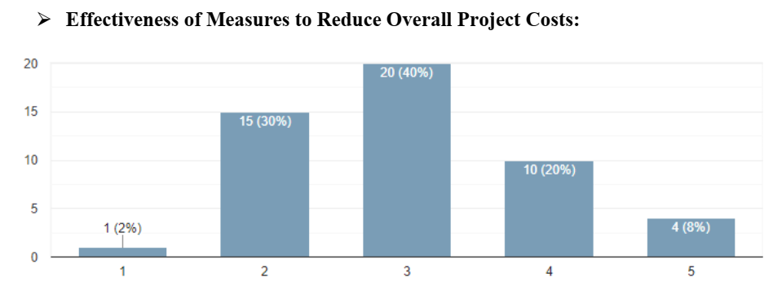
4.2 Sections Analysis:
3. Positive Impact Evaluation Section

Slide 18
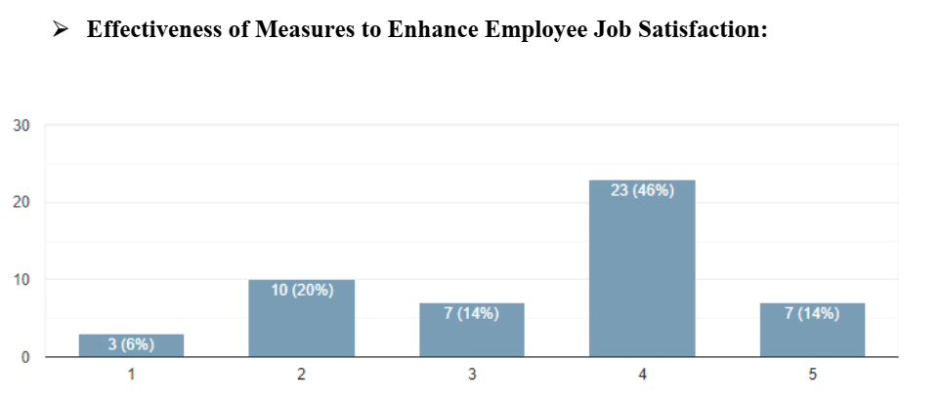
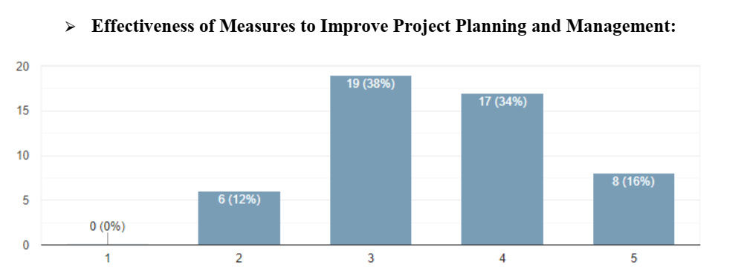
4.2 Sections Analysis:
3. Positive Impact Evaluation Section

Slide 19

CH.5
Conclusion & Recommendations

Slide 20

Conclusion & Recommendations
Training Programs
Safety Systems
Safety Costs
Enhance Training Programs
Mandatory Training
Provide Resources and Information
Encourage Participation
Review and Evaluate Current Programs
Periodic Awareness Campaigns
Establish Safety Systems
Hire Dedicated Safety Personnel
Provide Training for All Employees
Conduct Regular Safety Audits
Develop a Safety Culture
Invest in Safety Equipment and Technology
Highlight Long-Term Benefits
Leverage Financial Incentives
Promote Cost-Effective Solutions
Integrate Safety into Existing Processes
Cost Sharing and Collaboration
Showcase Successful Case Studies
Evaluation of Implemented Procedures
Health and Safety Risks and Procedures
Maintain Current Safety Standards
Continuous Improvement
Regular Training and Retraining
Use of Technology
Regular Safety Audits and Inspections
Emergency Preparedness
1- Increase Productivity:
Enhance Technology and Tools
Employee Training
2- Enhance Reputation and Compliance:
Transparent Communication
Compliance with Standards
3- Reduce Project Costs:
Resource Management Optimization
Financial Analysis
4- Increase Job Satisfaction:
Positive Work Environment
Incentive Programs
5- Improve Project Planning:
Use of Planning Tools
Regular Evaluations

Slide 21


THANK YOU
FOR YOUR TIME

