Slide 1
Assessment and Design of the Proposed Underpass of Faisal/Haifa Street in Nablus City
{ THE MILE TUNNEL }
Under Supervision of Professor: Sameer Abu-Eisheh
Prepared by: Abdullah M. Salahat, Ahmad H. Abu Ya’qoub, Osama K. Kamal

Slide 2
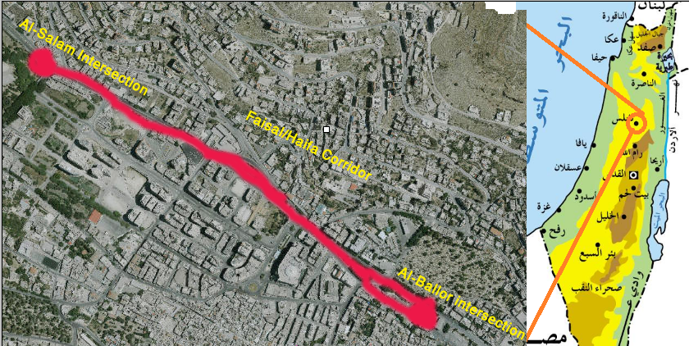
Remember What in Project 1
Study Area: Nablus City

Slide 3
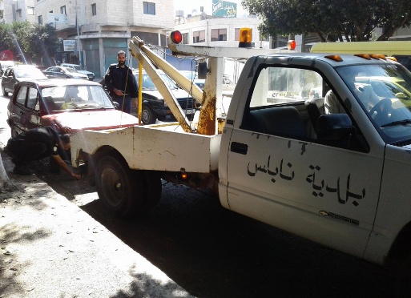
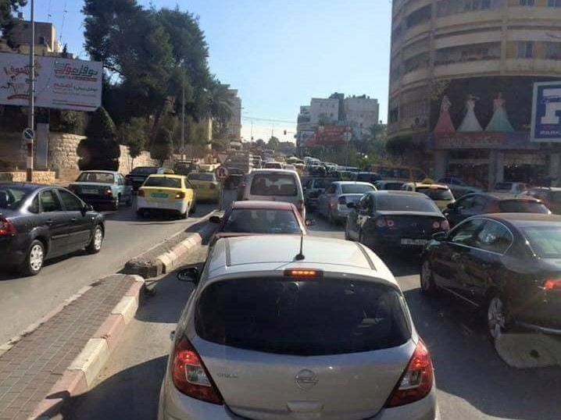
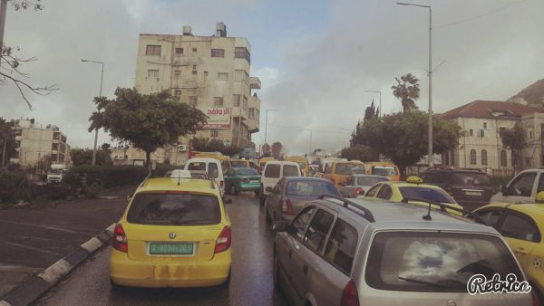
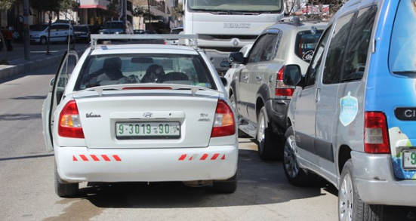
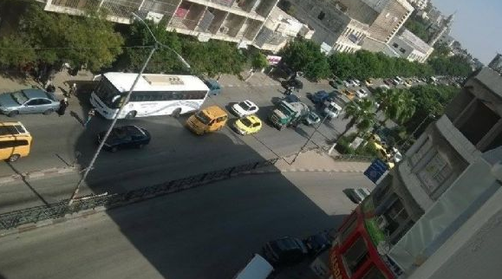
Problems Observed
Remember What in Project 1
Ignoring the Rules
Congestion
Lack of Facilities

Slide 4
Objectives…
Remember What in Project 1
To increase the capacity of Faisal/Haifa Corridor and double it if possible.
To reduce the congestion at Faisal/Haifa Street when it’s passing cross the CBD area.
To properly design the underpass horizontally and vertically, as well as for the cross-sections.
To estimate the cost and try to justify it to be suitable for the government budget.

Slide 5
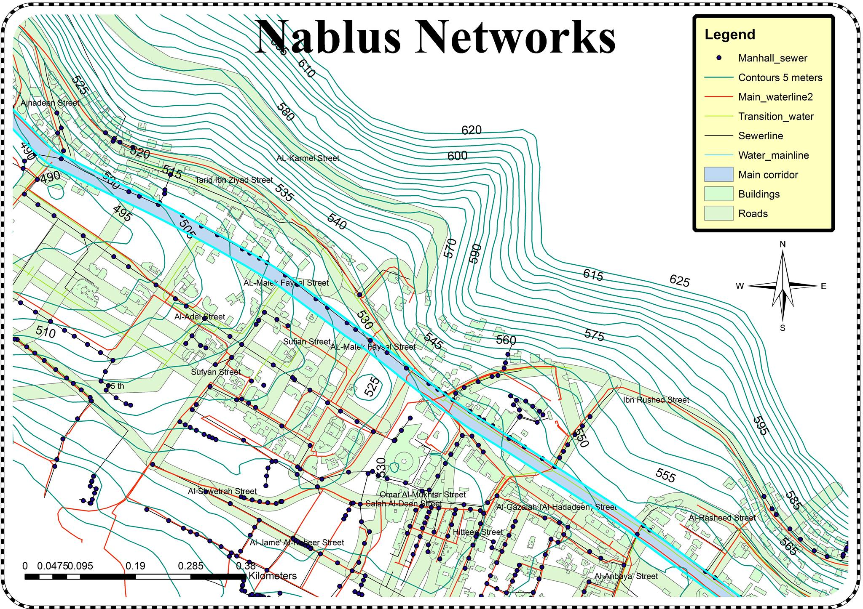
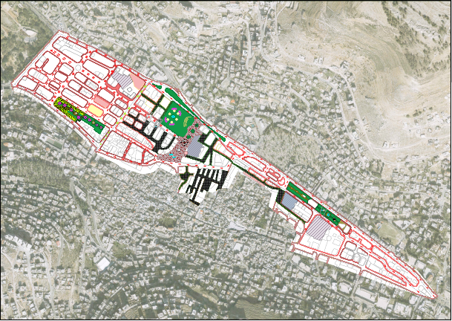
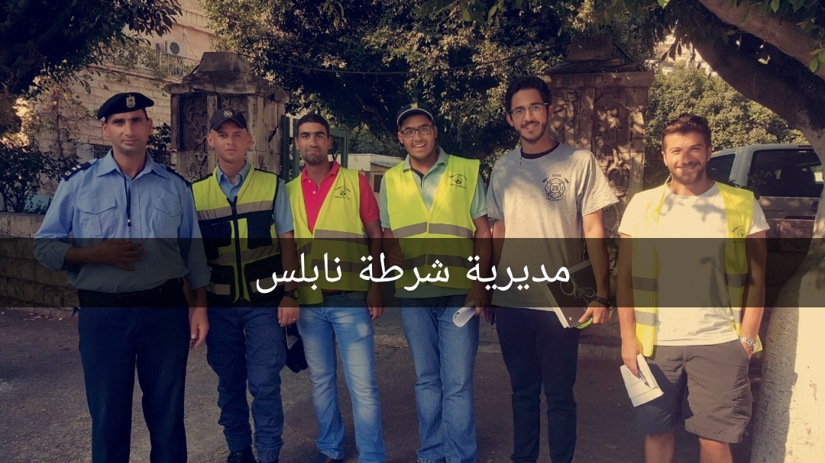
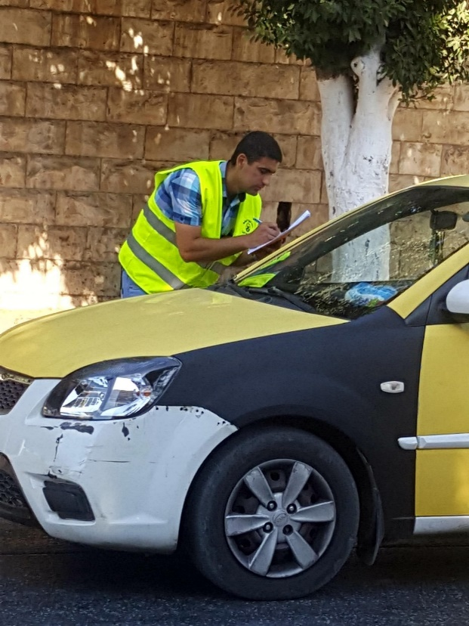
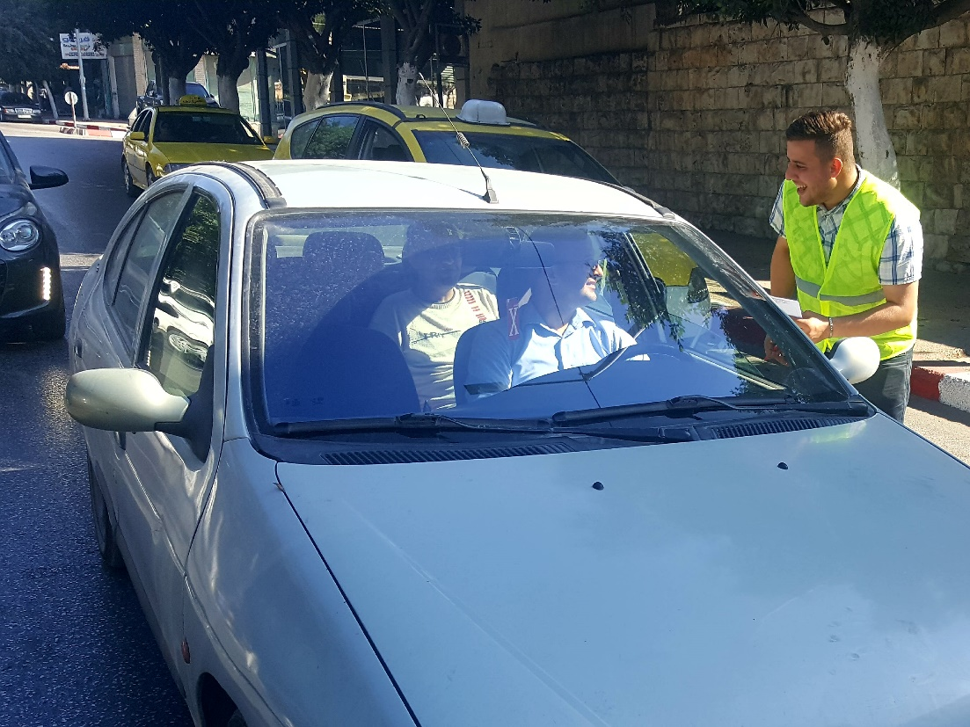
Data Collection
Remember What in Project 1

Slide 6
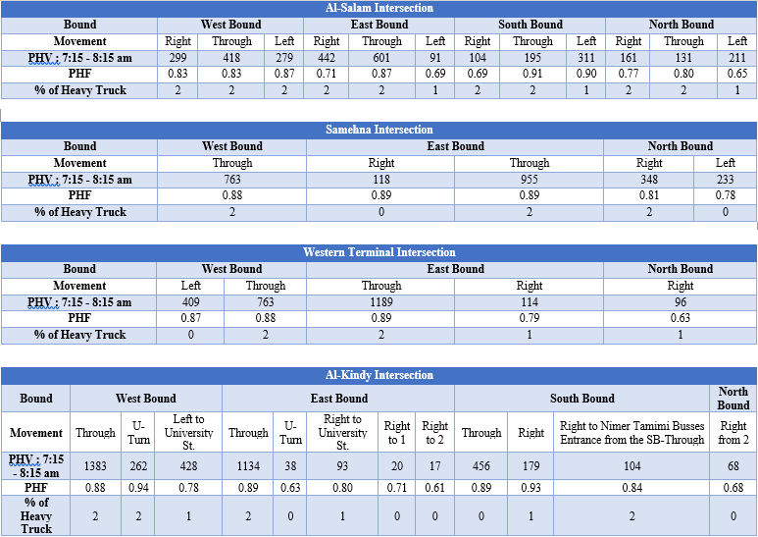
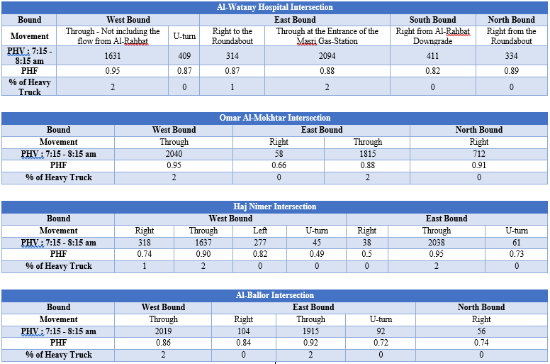
Unified Peak Hour Data
Remember What in Project 1

Slide 7
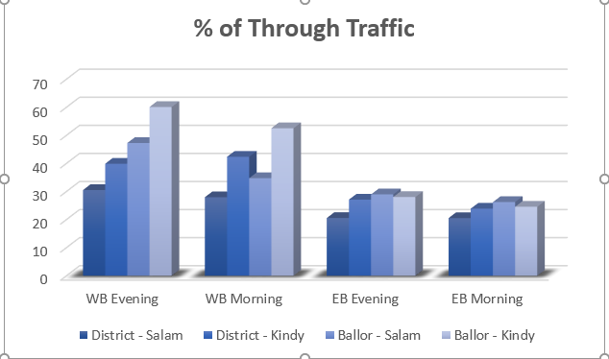
Remember What in Project 1
Peak Periods Interview Outcomes:

Slide 8
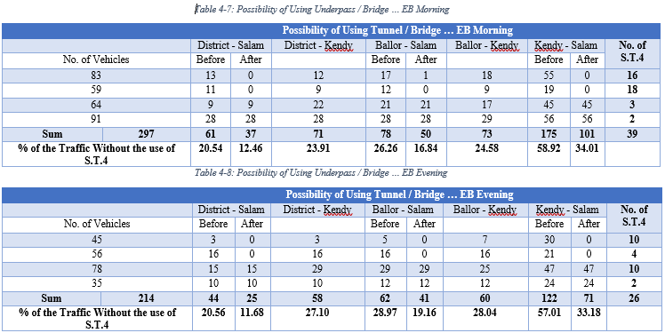
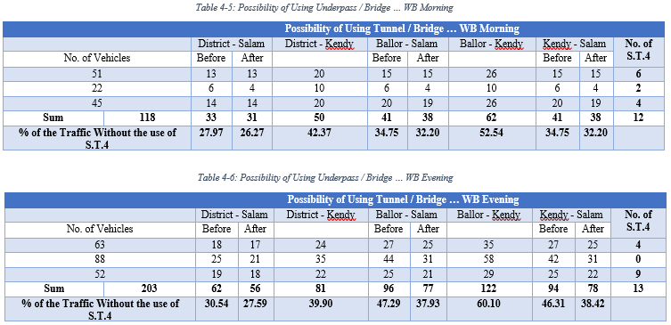
Peak Periods Interview Outcomes: WB
Remember What in Project 1

Slide 9
Peak Periods Interview Outcomes: EB
Remember What in Project 1

Slide 10
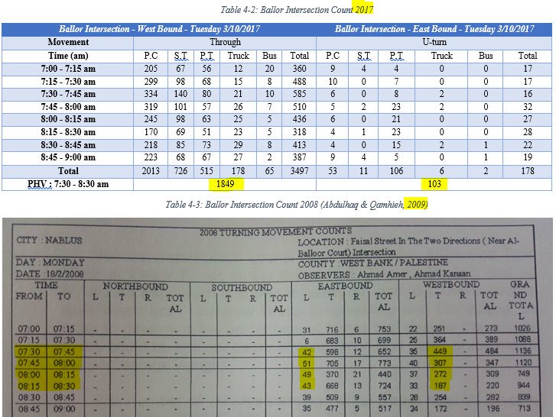
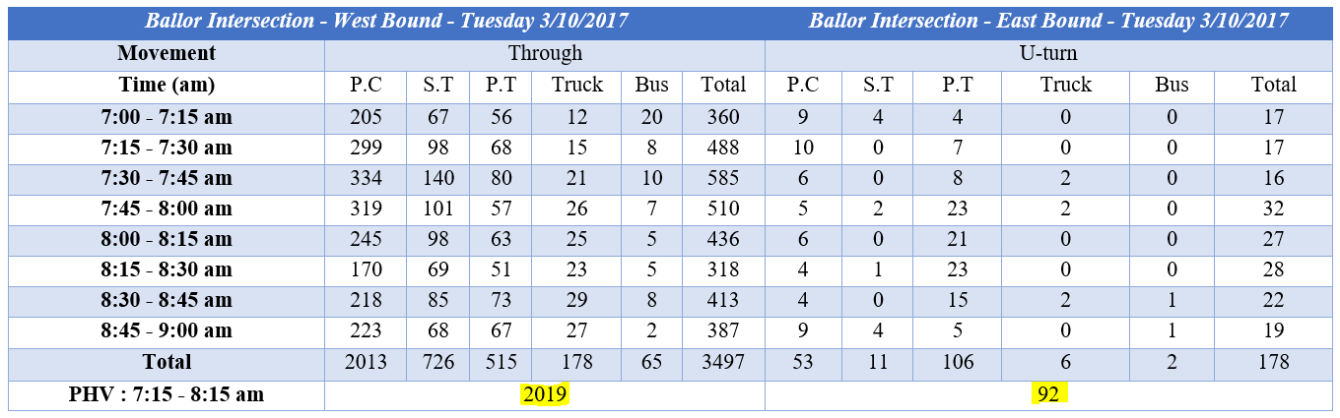
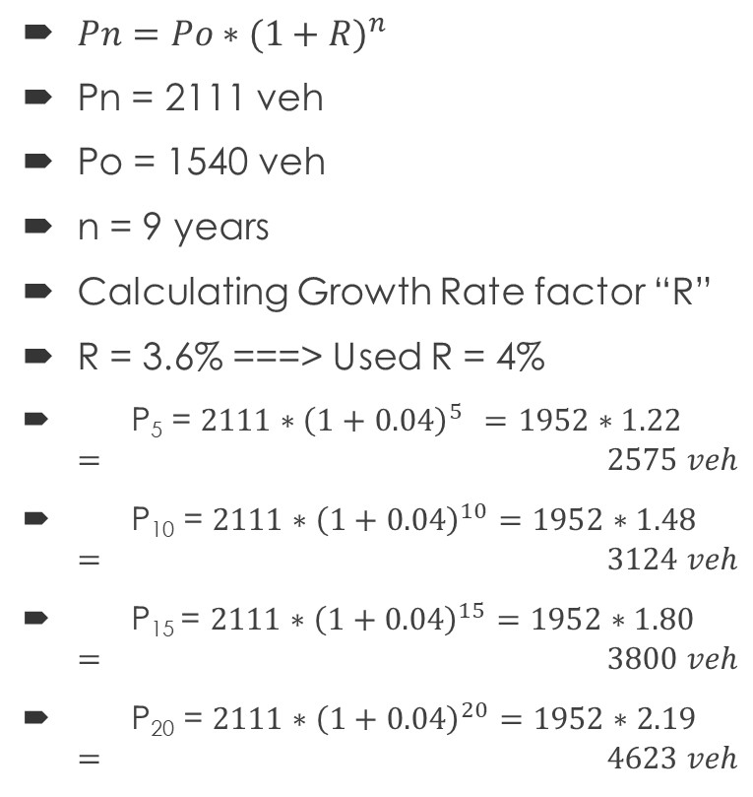
Growth Rate Factor
Remember What in Project 1
$Pn=Po∗{(1+R)}^{n}$
Pn = 2111 veh
Po = 1540 veh
n = 9 years
Calculating Growth Rate factor “R”
R = 3.6% ===> Used R = 4%
P₅ = $2111∗{\left(1+0.04\right)}^{5 }=1952∗1.22= 2575 veh$
P₁₀ = $2111∗{\left(1+0.04\right)}^{10}=1952∗1.48= 3124 veh$
P₁₅ = $2111∗{\left(1+0.04\right)}^{15}=1952∗1.80= 3800 veh$
P₂₀ = $2111∗{\left(1+0.04\right)}^{20}=1952∗2.19 = 4623 veh$

Slide 11
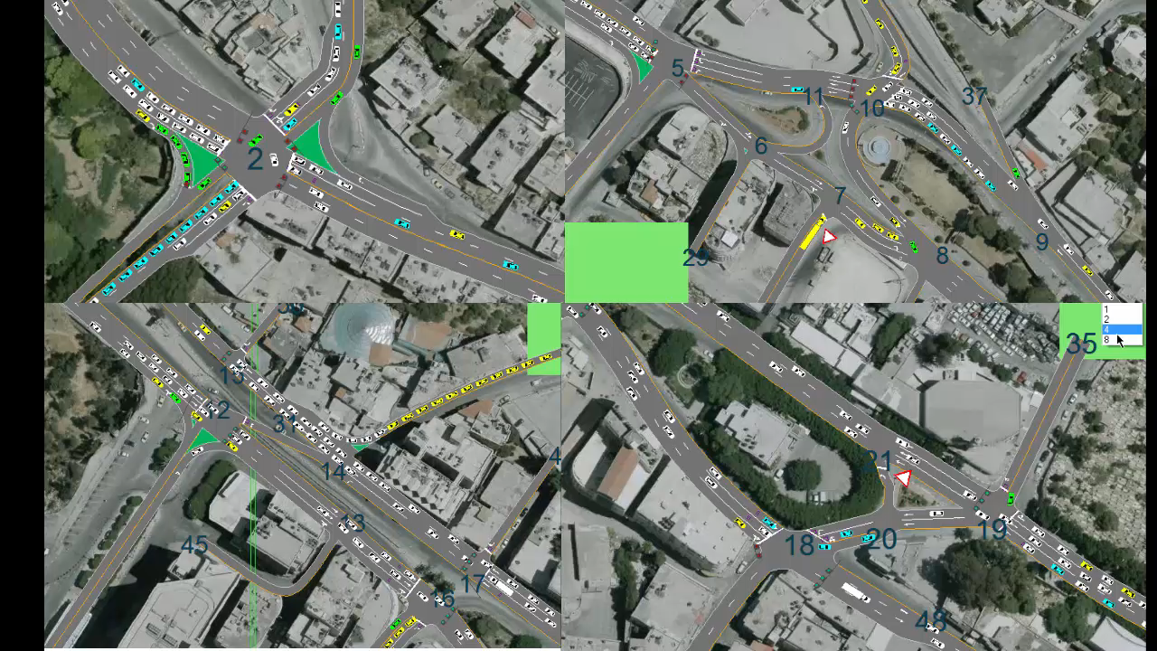
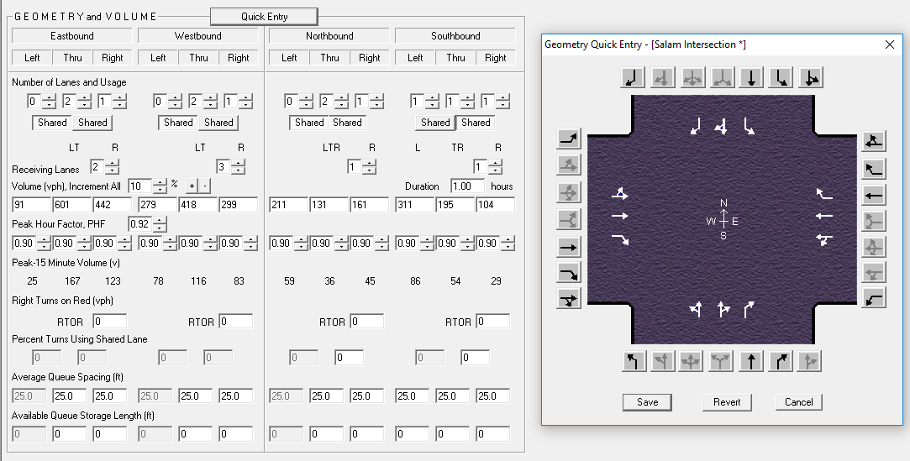
SYNCHRO & HCS Modelling
Remember What in Project 1

Slide 12
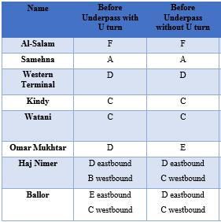

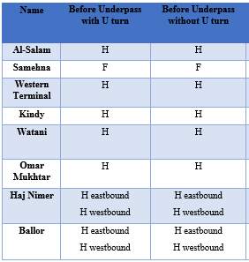
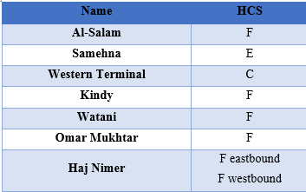
Results of the Analysis
Remember What in Project 1
From SYNCHRO & HCS:
After 5 Years
After 20 Years
Nowadays

Slide 13
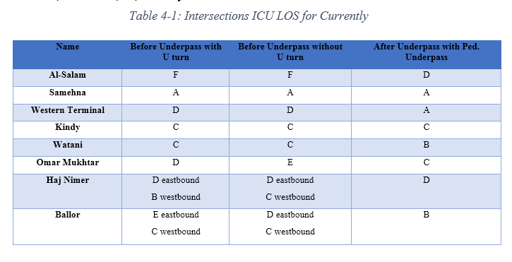
Remember What in Project 1
Results of the Analysis
Results from SYNCHRO

Slide 14
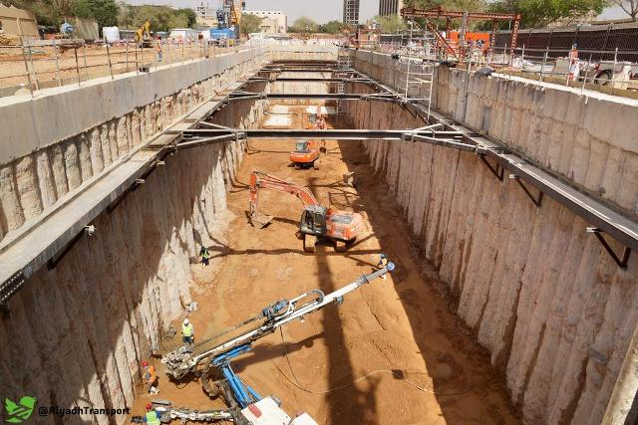
Proposed Solutions
Remember What in Project 1
Open underpass under the corridor
Underpass for pedestrians in front of Al-Watani Hospital
Redesign signals

Slide 15
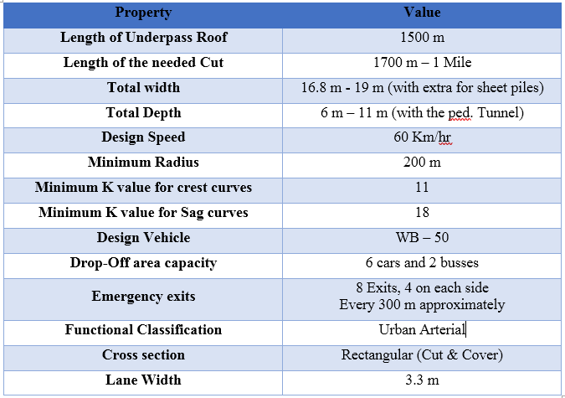
Underpass Characteristics

Slide 16
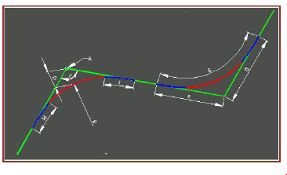
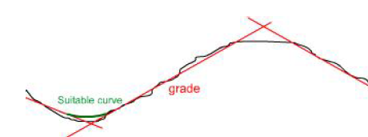
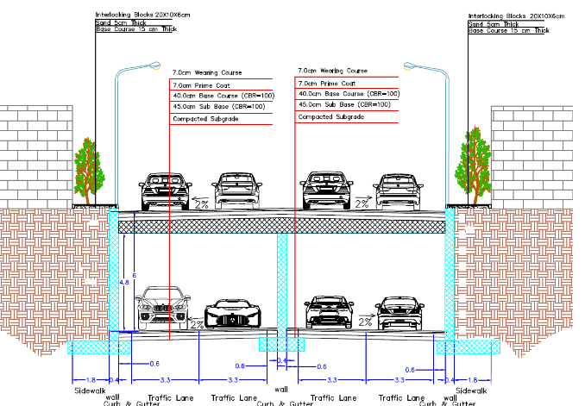
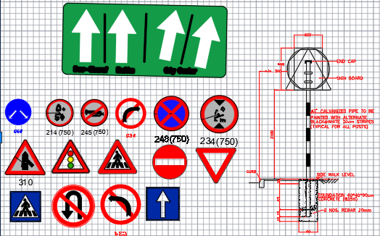
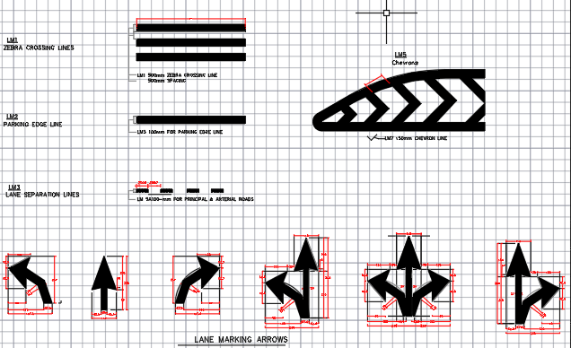
Design of the Proposed Underpass
Design of:
Geometry:
  Horizontal Alignment
  Vertical Alignment
  Cross Sections
Pavement
Traffic Control Devices

Slide 17
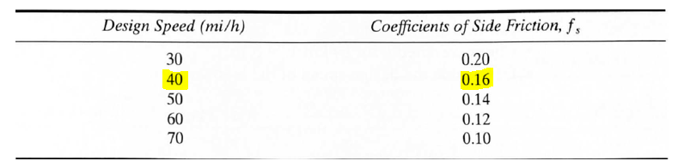
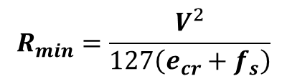
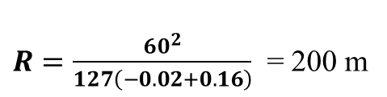
Geometric Design
Horizontal Alignment
1. Design speed: 60 km/hr.
2. Posted speed: 50 km/hr.
3. Superelevation: No Superelevation in this project.
4. Side friction:
5. Minimum radius:
$$R_{min}=\frac{V^{2}}{127\left(e_{cr}+f_{s}\right)}$$
$R=\frac{60^{2}}{127\left(−0.02+0.16\right)}$ = 200 m

Slide 18
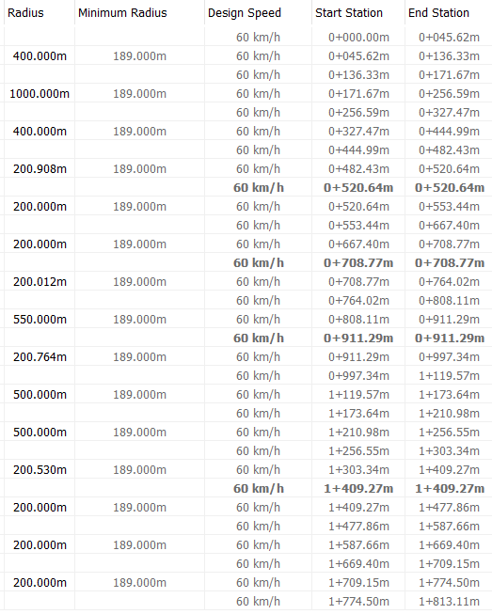
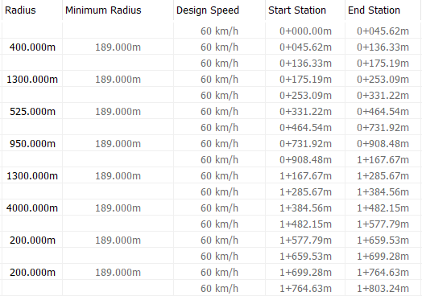
Geometric Design
Ventilated Alignment
Horizontal Alignment
Closed Alignment

Slide 19
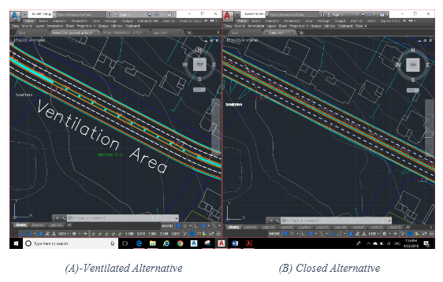
Geometric Design
Horizontal Alignment Alternatives of Ventilation

Slide 20
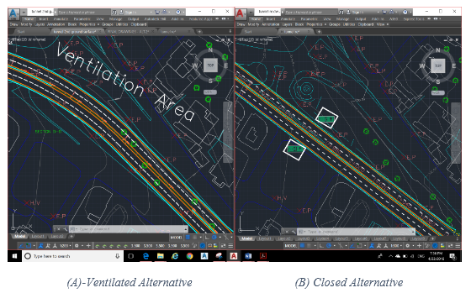
Geometric Design
Horizontal Alignment Alternatives of Ventilation

Slide 21
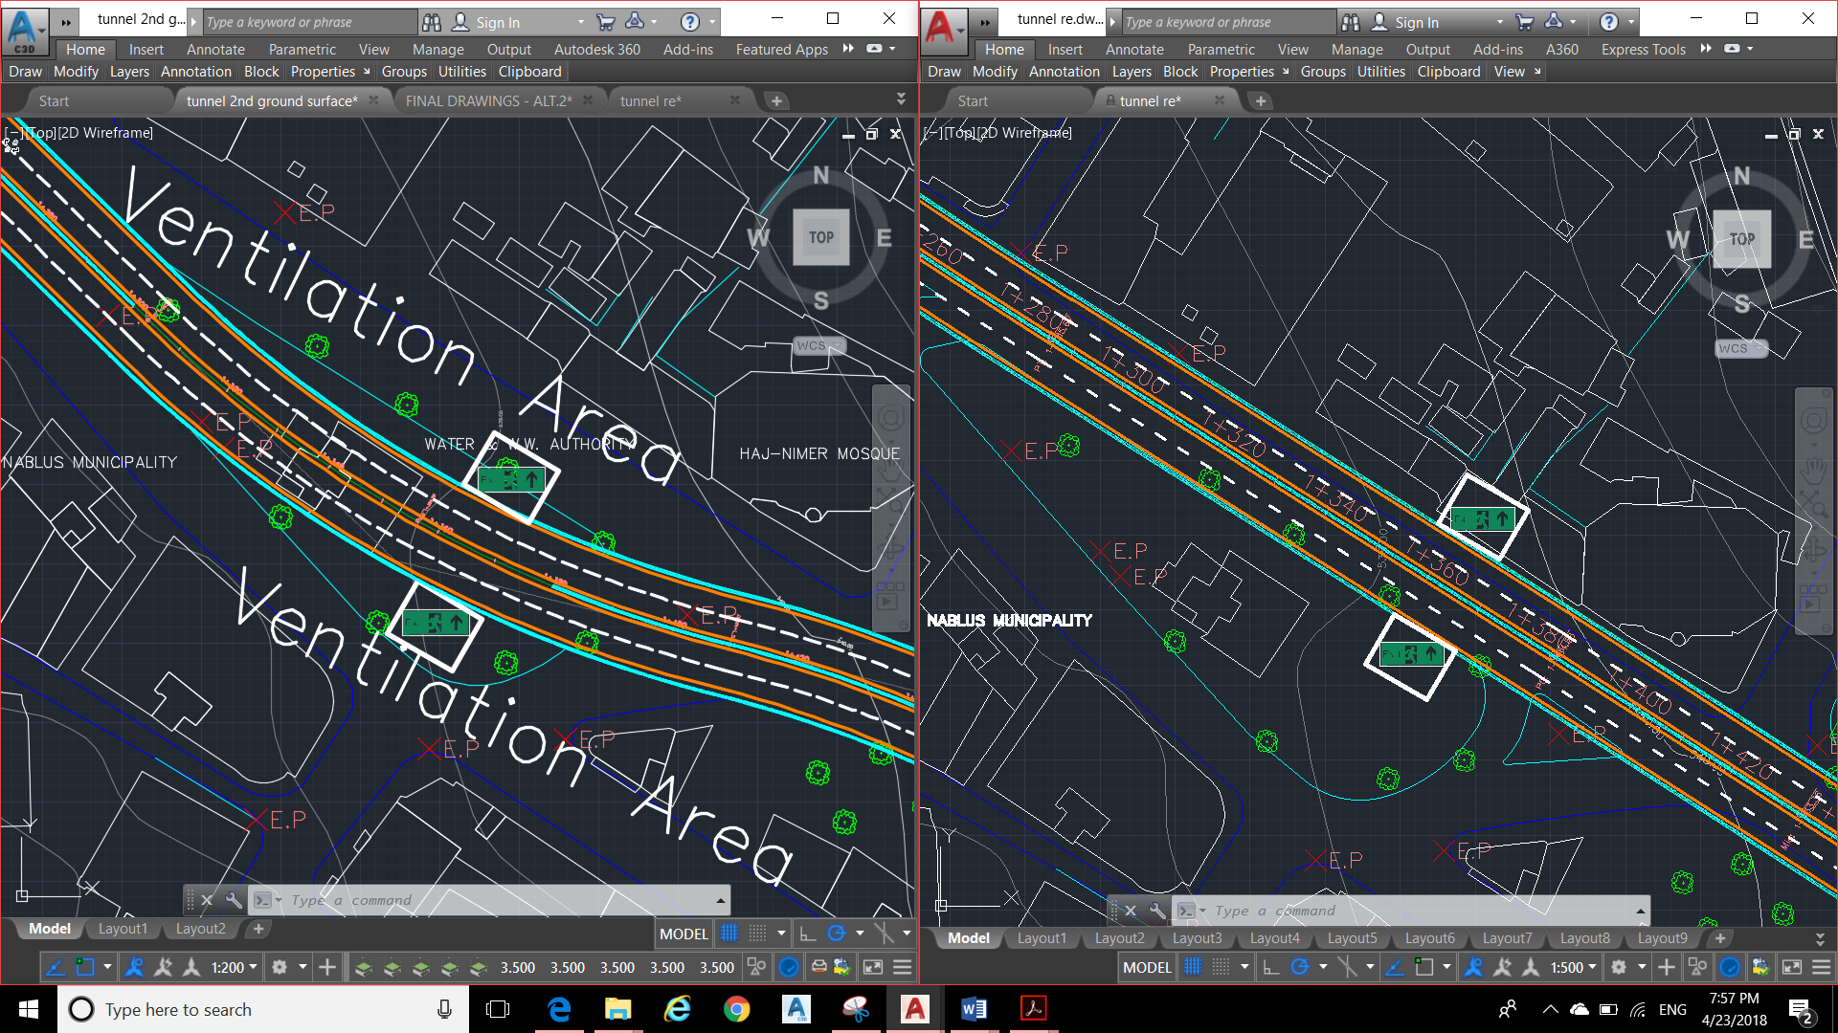
Geometric Design
Horizontal Alignment Alternatives of Ventilation

Slide 22
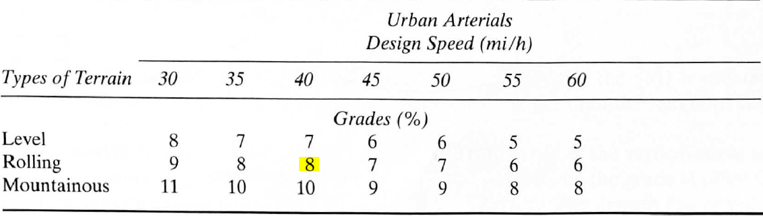
Geometric Design
Vertical Alignment
Grades
Maximum grade:
Minimum grade:
It is customary to use a minimum of 0.5% which is considered for requirements for drainage of the highway in the longitudinal direction.

Slide 23
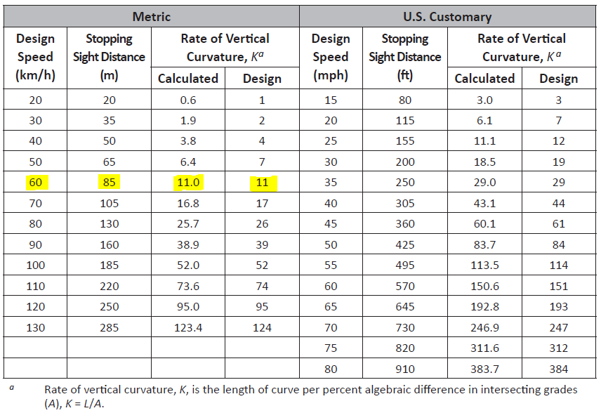
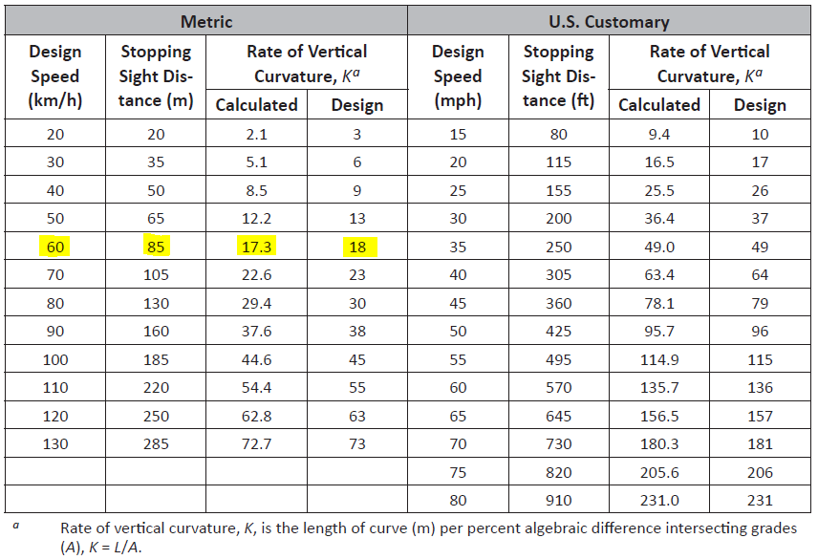
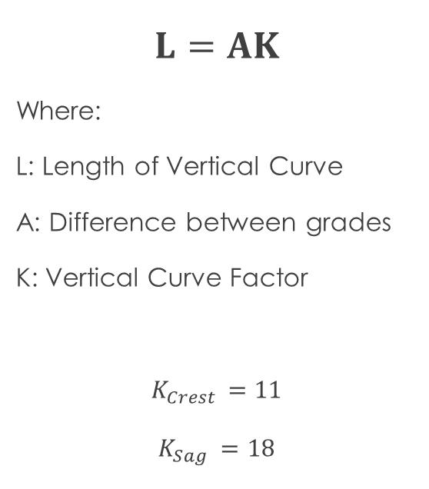
Geometric Design
Vertical Alignment
Crest and Sag Curves
$$L=AK$$
Where:
L: Length of Vertical Curve
A: Difference between grades
K: Vertical Curve Factor
$$K_{Crest }=11$$
$$K_{Sag }=18$$

Slide 24
Geometric Design
Cross sections

Slide 25
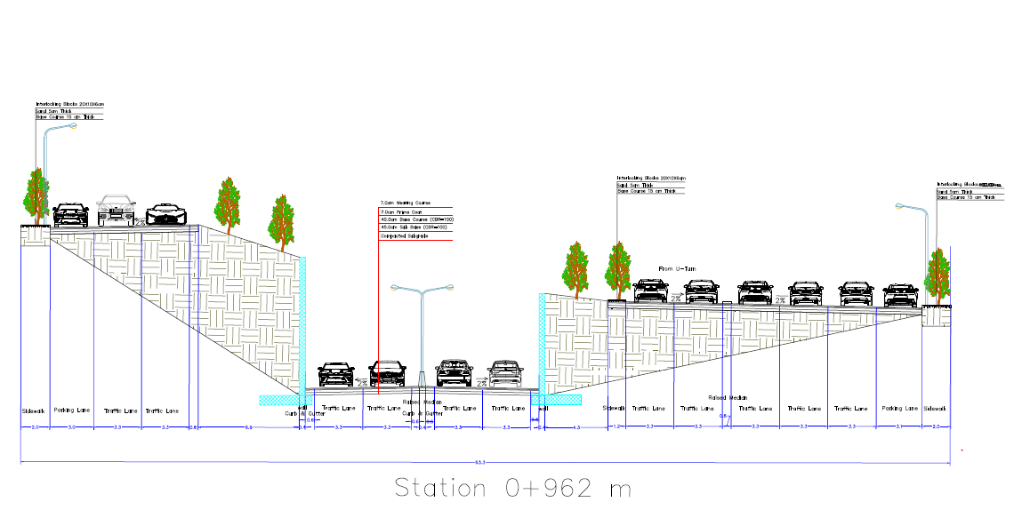
Geometric Design
Cross sections

Slide 26
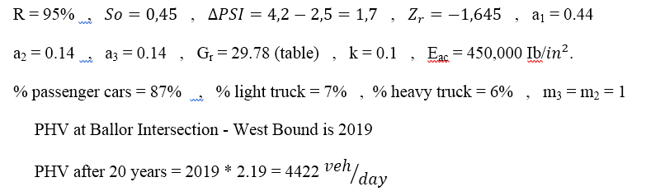
Pavement Design

Slide 27
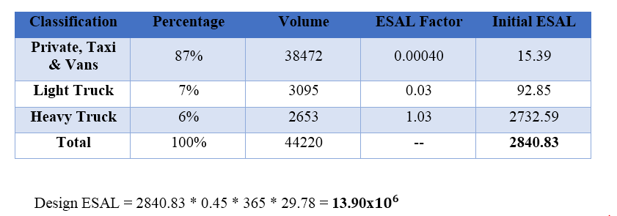
Pavement Design

Slide 28
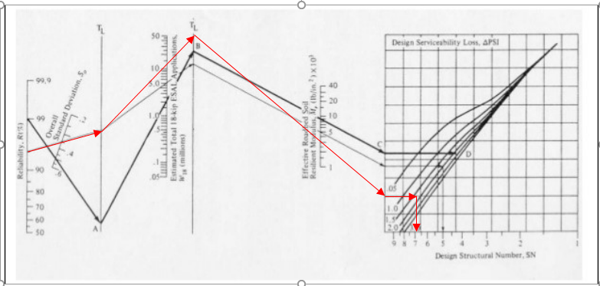
Pavement Design

Slide 29
Pavement Design
Asphalt Thickness = 5.51 inch = 14 cm
Base Course = 15.75 inch = 40 cm
Sub-Base Course = 17.72 inch = 45 cm

Slide 30
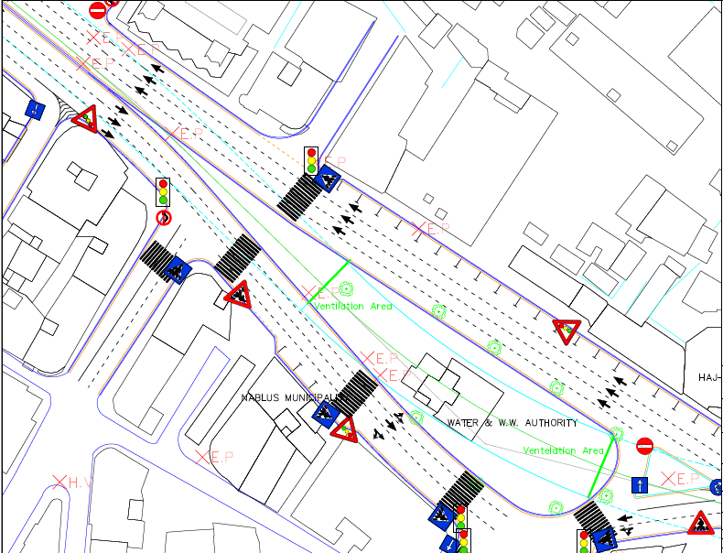
Traffic Control Design
Signing & Marking

Slide 31
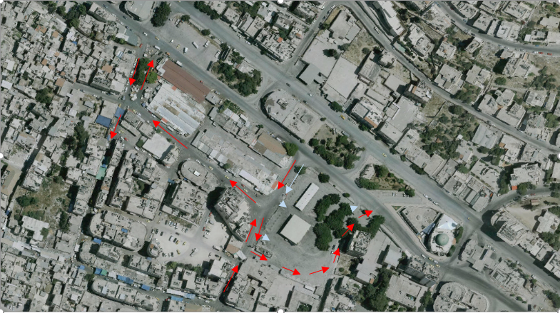
Facilitating the Eastern Exit of the Underpass

Slide 32
Summarized Bill Of Quantities:
Item | Unit | Quantity | Unit cost | Unit | Total
Excavation Works | m³ | 300,000 | 3 | $/m³ | 900,000
Sub Base & Base Coarse | m³ | 28,500 | 5 | $/m³ | 142,500
Pavement Area with thickness 7 cm | m² | 5,500 | 14 | $/m² | 77,000
Concrete | m³ | 40,452 | 100 | $/m³ | 4,045,236
Reinforcement | Ton | 6,312 | 815 | $/ton | 5,348,031
Curb Stone | m | 3,526 | 16 | $/m | 56,416
Marking | m | 10,000 | 1.5 | $/m | 15,000
Import and installing the traffic signs | unit | 17 | 150 | $/unit | 2,550
Sidewalk tiles | m² | 400 | 20 | $/unit | 8,000
Total Direct Cost | - | - | - | - | 10,594,000$
Indirect Cost | % | - | 20 | - | 2,118,800$
Total | - | - | - | - | 12,712,800$

Slide 33
Recommendations

Slide 34
Recommendations
It is recommended to:
    Take the underpass solution into considerations and to start searching for funding agencies to fund this project.
    Construct the underpass in phases which can be determined according to the available budget of the funding government.
    Make studies for reconstructing / relocating the infrastructure and operation systems.
    testing the soil beneath the corridor surface to the required depths.

Slide 35


Recommendations
Traffic on the corridor while constructing the underpass

Slide 36


Recommendations
Changes in Traffic plans

Slide 37


Recommendations
Better Transportation system in Nablus City
Ring Road
BRT System

Slide 38
Thank You

