Slide 1
Re-design of fine arts faculty in An-Najah University
Ala’ Sa’EED
Ayman Hamdan
Nimer Sawaftah
Yousef Kan’an

Slide 2
Contents
Site Plan.
Architectural design.
Structural design.
Electrical Design.
Environmental Design.
Mechanical Design.

Slide 3
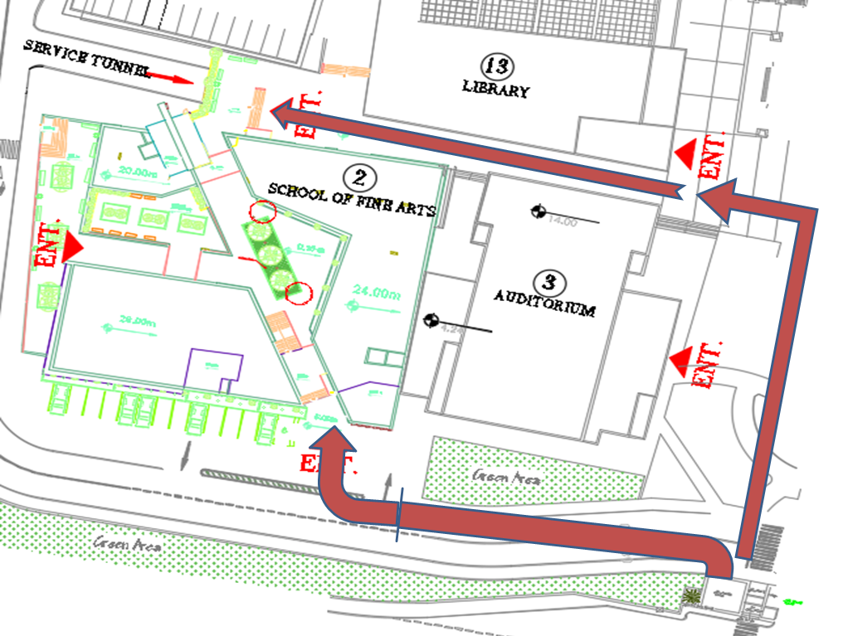
Site Plan

Slide 4
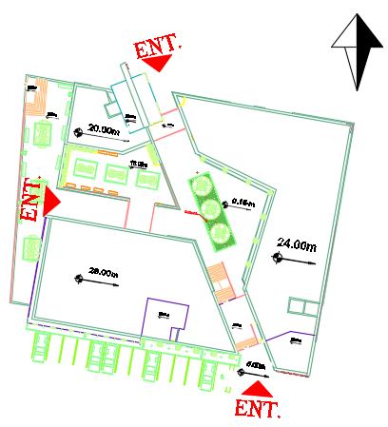
Architectural Design
Site Plan

Slide 5
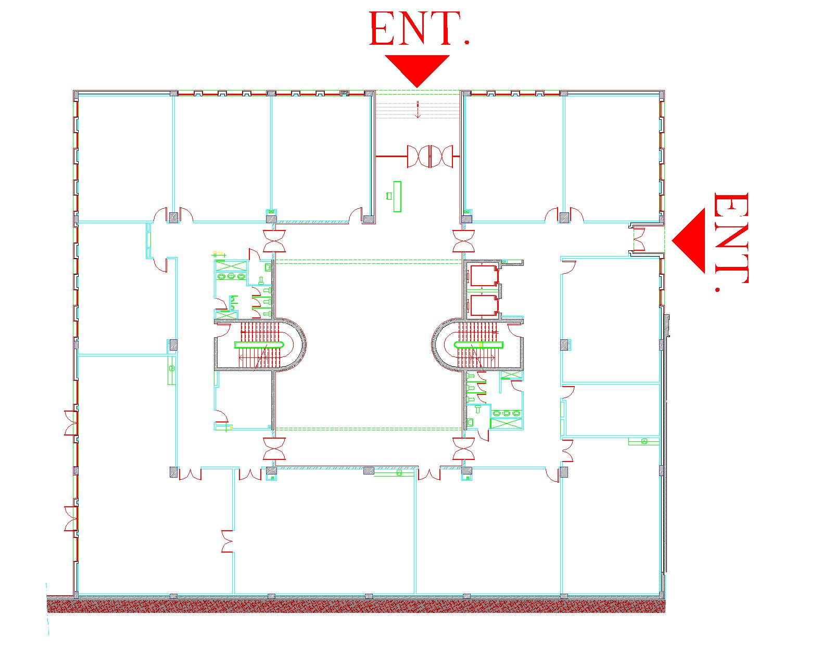
Architectural Design
Ground Floor Plan Before Redesign

Slide 6
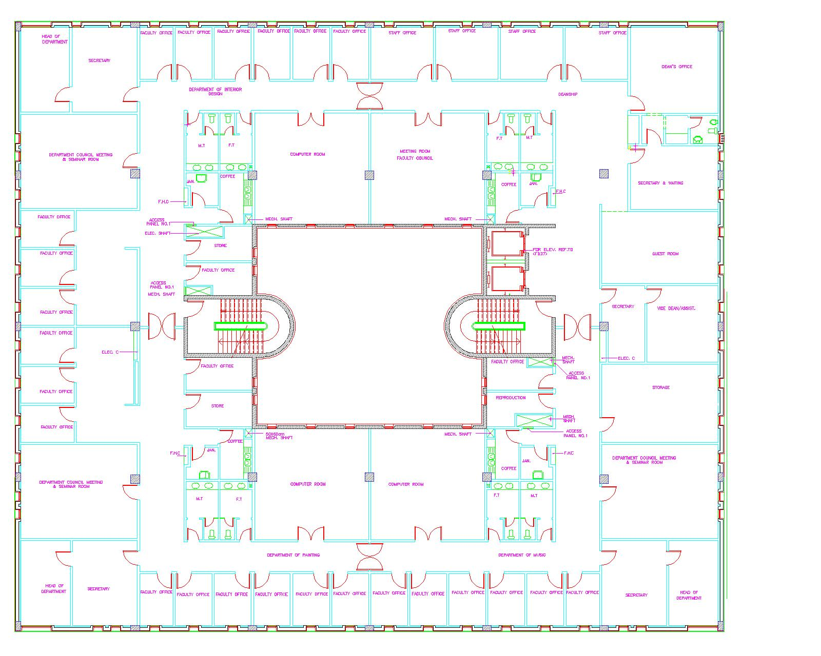
Architectural Design
Third Floor Plan Before Redesign

Slide 7
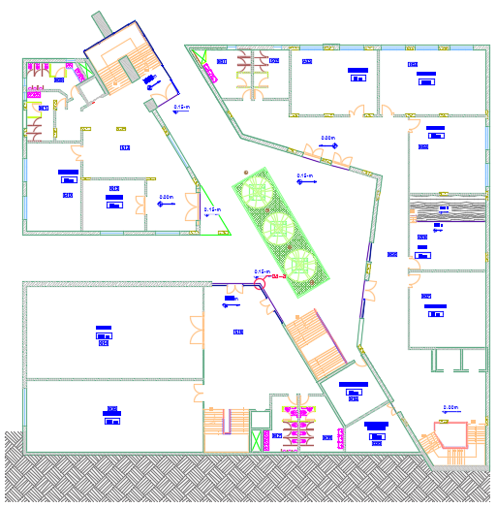
Architectural Design
Ground Floor Plan After Redesign

Slide 8
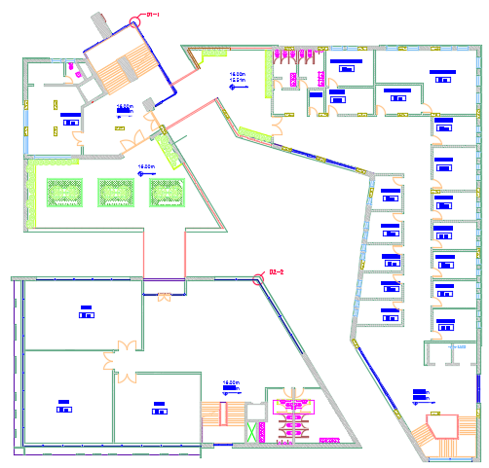
Architectural Design
Fourth Floor Plan After Redesign

Slide 9
Architectural Design
Spaces in first building
Number | Room Name | Number of rooms | Area m² | Floor
1 | Class room | 14 | 64-80 | GF,1st,2nd,3d
2 | Computer lab | 3 | 65 | GF,1st,2nd
3 | stage | 1 | 64 | GF
4 | staff offices | 26 | 12-22 | 4th,5th
5 | Heed of department | 3 | 21-22 | 4th,5th
6 | Heed of college | 1 | 59 | 4th
7 | Secretary | 3 | 16 | 4th,5th
8 | Bathroom (for student) | 24 | 17-21 | GF,1st,2nd,3d
9 | Bathroom for special needs | 8 | 2 | 2 bath for each floor except 4th floor
10 | Bathroom for employees | 11 | 10-21 | 4th,5th
11 | Kitchen | 2 | 4-10 | 4th,5th
12 | store | 1 | 12 | 5th
13 | store of music equipment | 1 | 28 | GF

Slide 10
Architectural Design
Spaces in second building.
Number | Room Name | Number of rooms | Area m² | Floor
1 | Class room | 3 | 54-64 | GF,3d
2 | Computer lab | 1 | 60 | 2nd
3 | Music room | 12 | 12-14 | GF
4 | Group music room | 1 | 60 | 3d
5 | Bathroom (for student) | 24 | 15 | GF,1st,2nd,3d
6 | Bathroom for special needs | 8 | 2 | 2 bath for each floor except 4th floor
7 | Stationery | 1 | 36 | GF
8 | maintenance room | 1 | 48 | 3th
9 | Guest room | 1 | 35 | 4th

Slide 11
Architectural Design
Spaces in third building.
Number | Room Name | Number of rooms | Area m² | Floor
1 | Museum | 1 | 184 | GF
2 | workshops | 4 | 102-144 | GF,2nd
3 | Cafeteria | 1 | 400 | 1st
4 | Mini market | 1 | 25 | 1st
5 | Studios | 14 | 68-91 | 3d,4th,5th,6th
6 | Bathroom (for student) | 36 | 16-24 | All floor except 1sh floor
7 | Bathroom for special needs | 12 | 2 | 2 bath for each floor except 1st floor

Slide 12
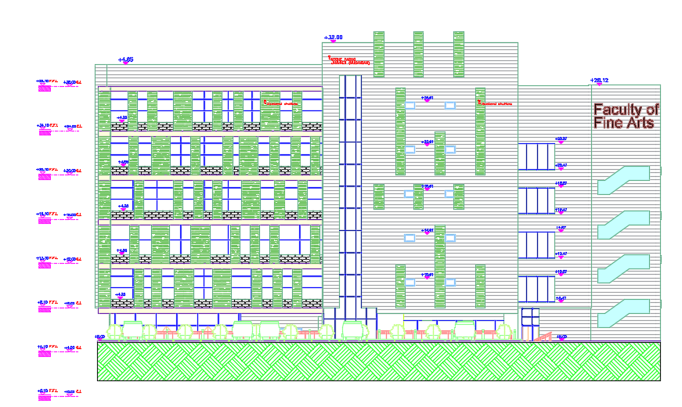
Architectural Design
Southern facade

Slide 13
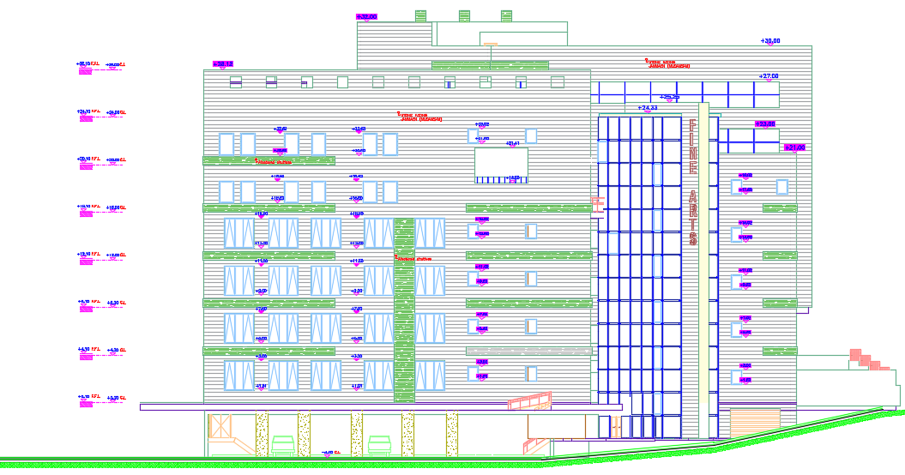
Architectural Design
Northern facade

Slide 14
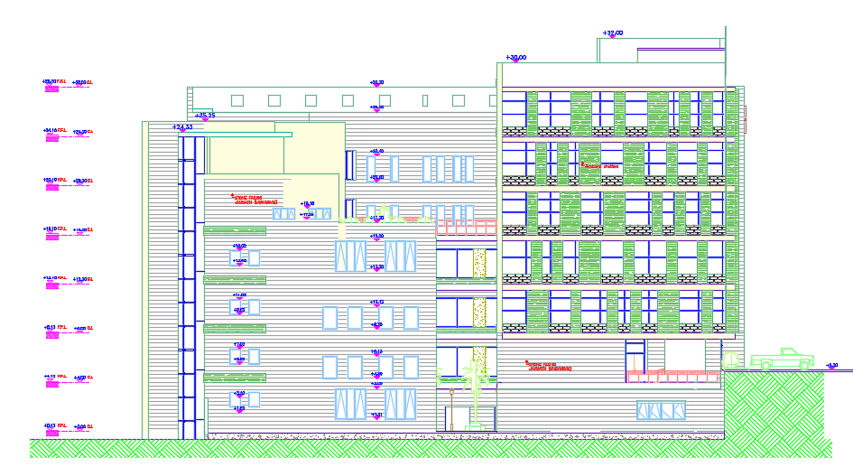
Architectural Design
West facade

Slide 15
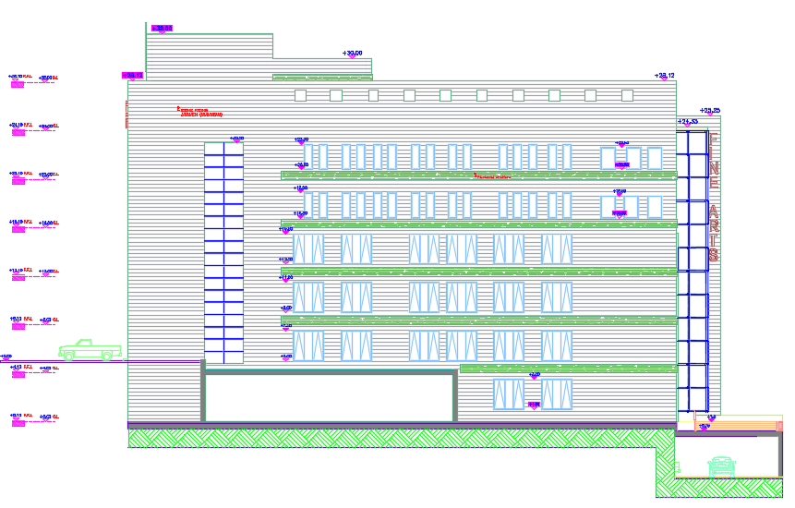
Architectural Design
Eastern facade

Slide 16
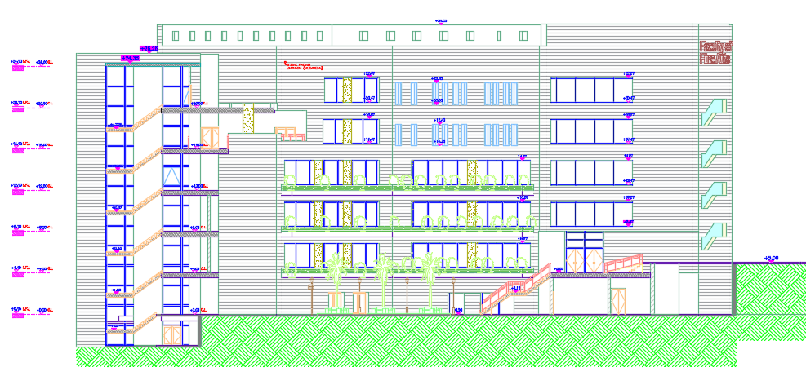
Architectural Design
Section A-A

Slide 17
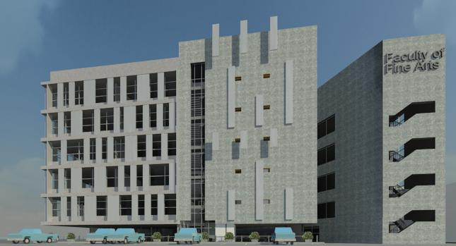
Architectural Design
3D shot for Southern facade

Slide 18
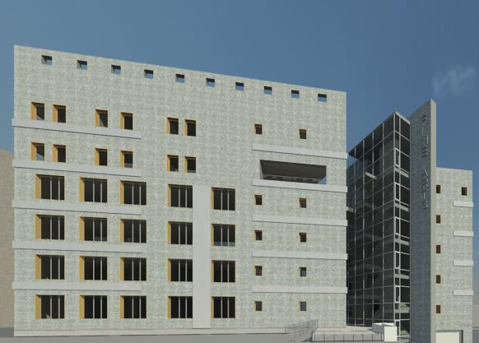
Architectural Design
3D shot for Northern facade

Slide 19
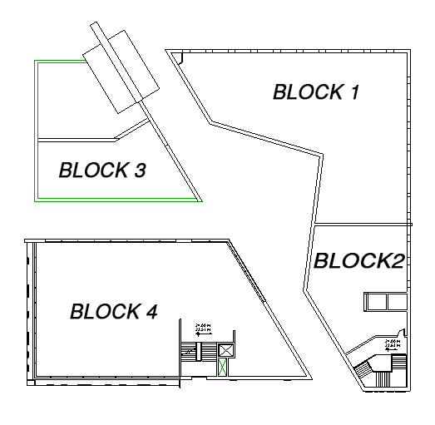
STRUCTURAL DESIGN

Slide 20
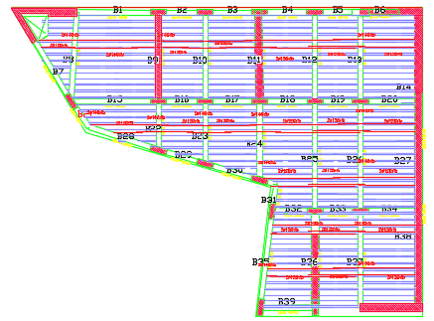
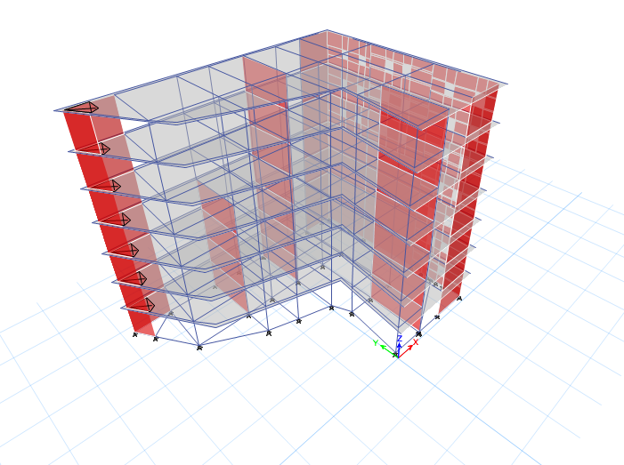
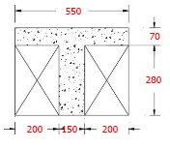
BLOCK 1

Slide 21
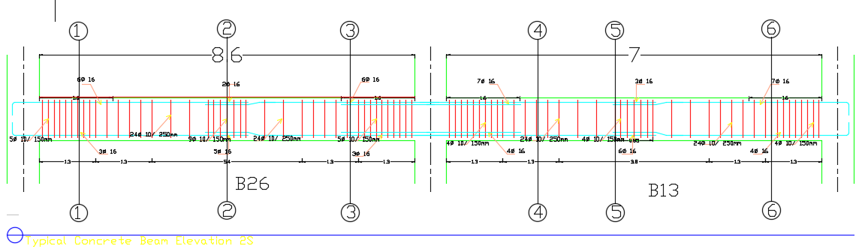
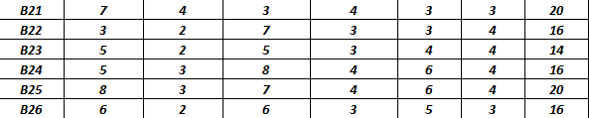

Slide 22
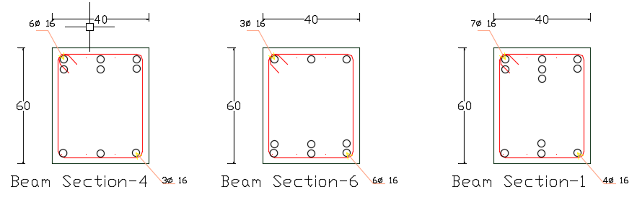
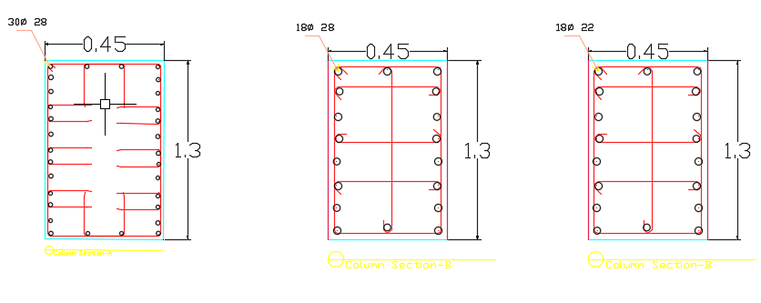

Slide 23
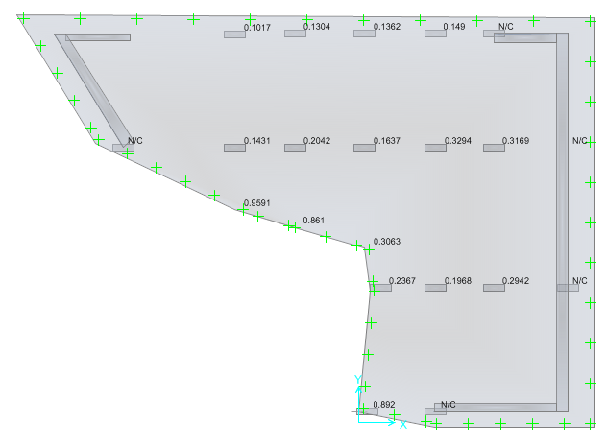
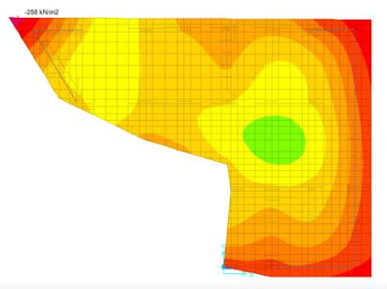
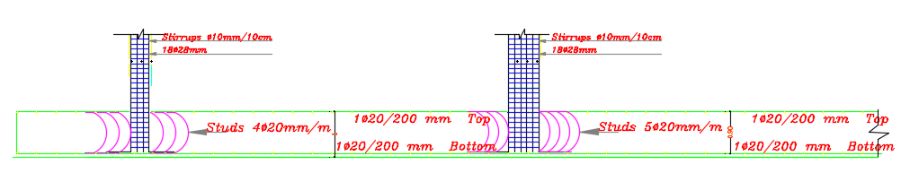
Mat foundation

Slide 24
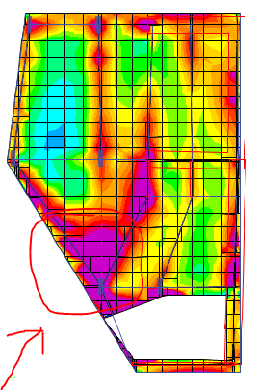
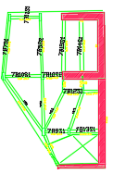
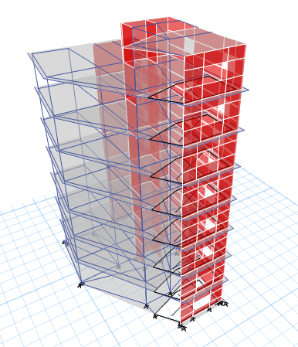
BLOCK 2

Slide 25
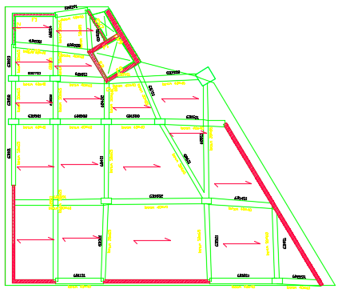
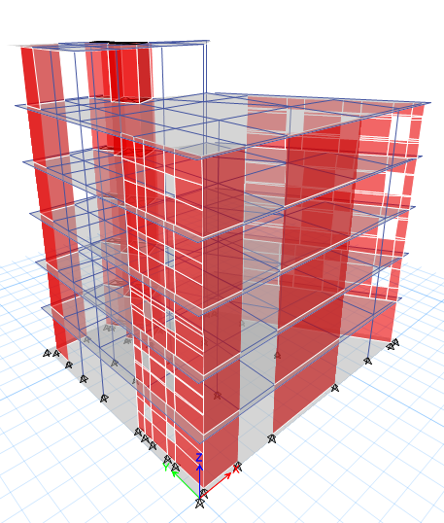
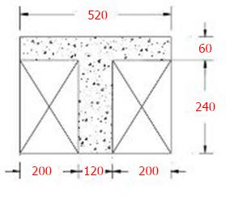
BLOK 3

Slide 26
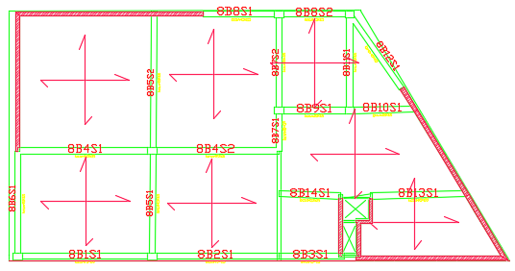
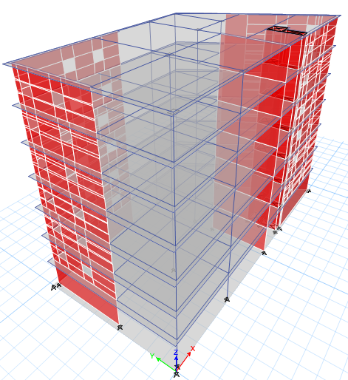
BLOCK 4

Slide 27
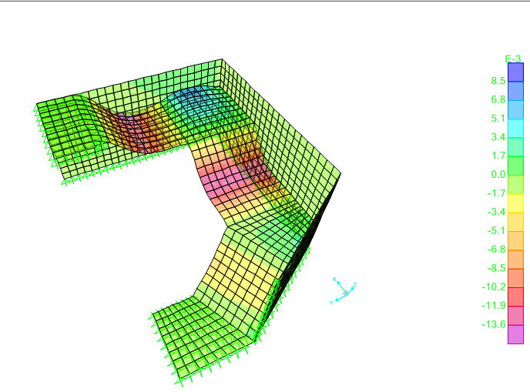
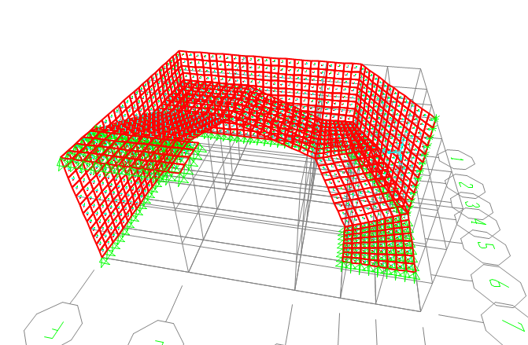
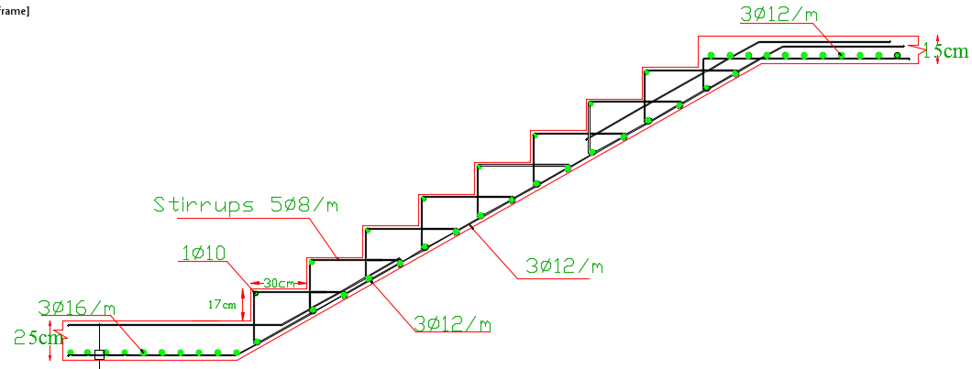
Staircases design

Slide 28
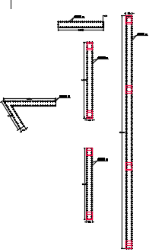
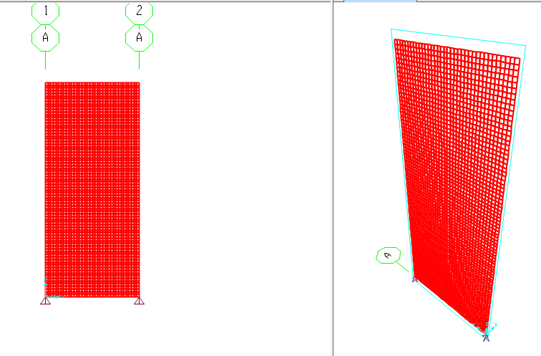
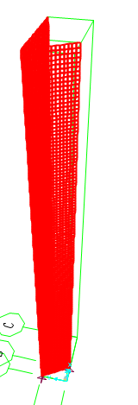
SHEAR WALL

Slide 29
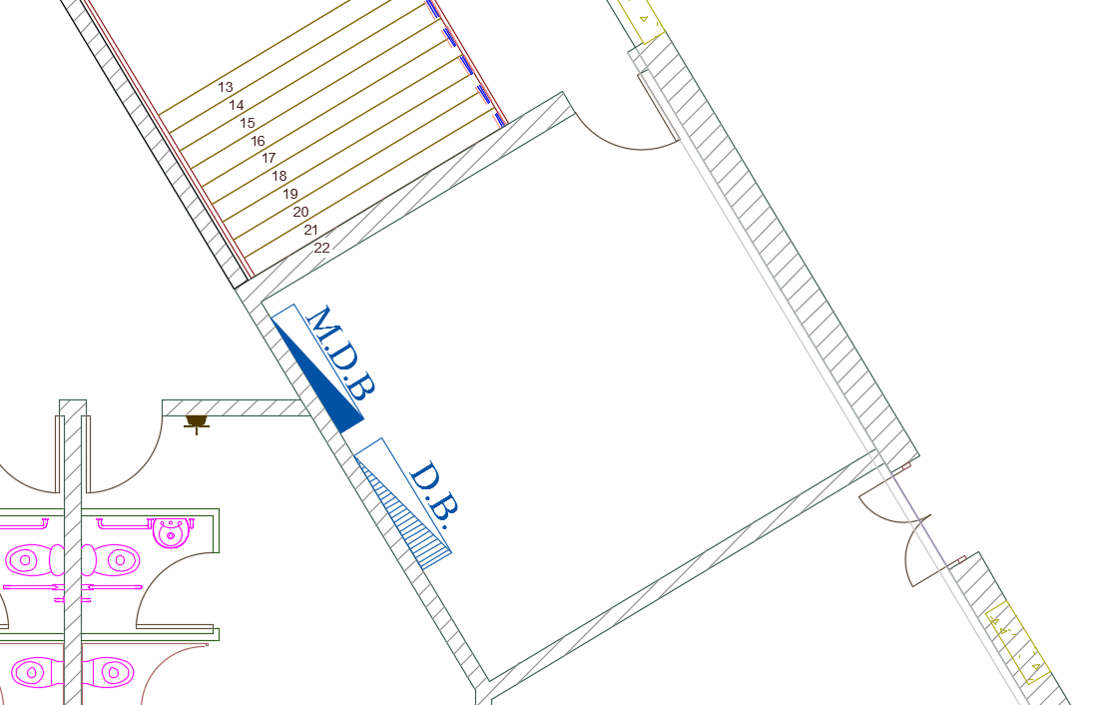
Electrical Design
Main distribution board and sub distribution board.

Slide 30
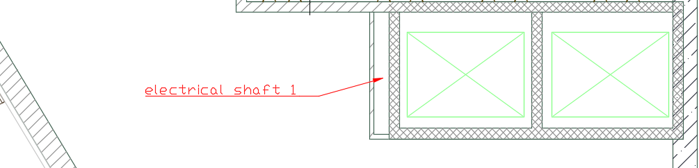
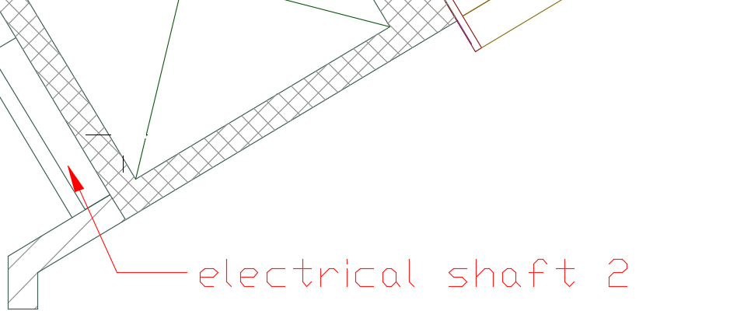
Electrical Shafts

Slide 31
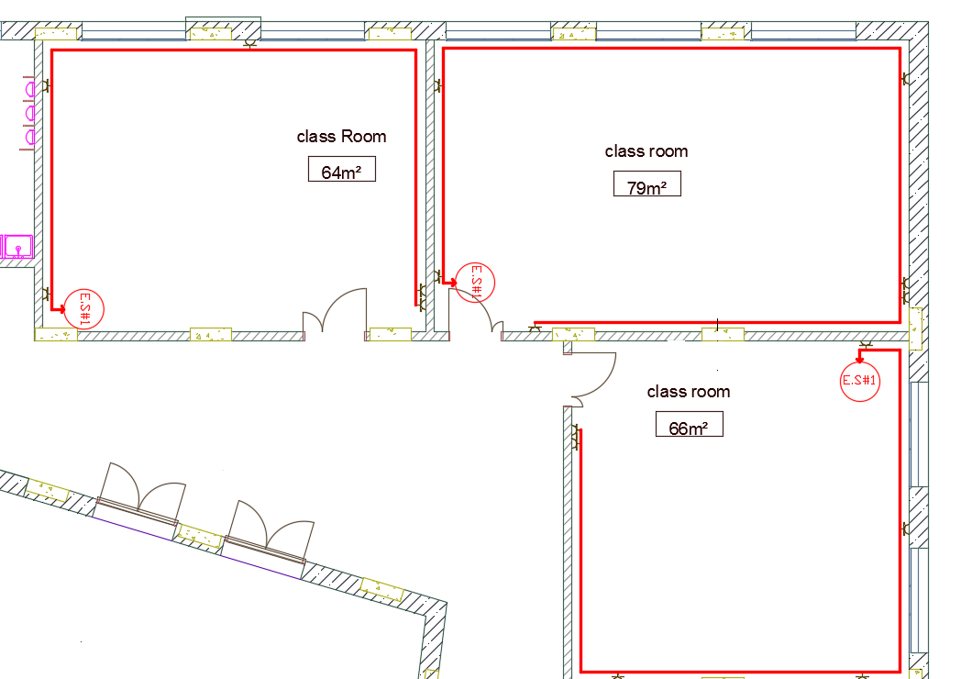
Electrical Design

Slide 32
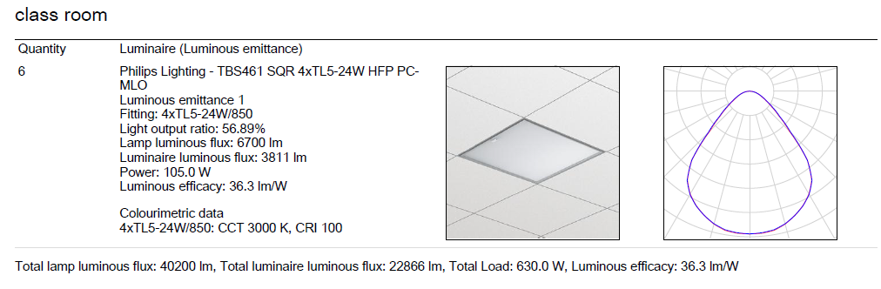
Electrical Design
Type of lamp in class room:

Slide 33
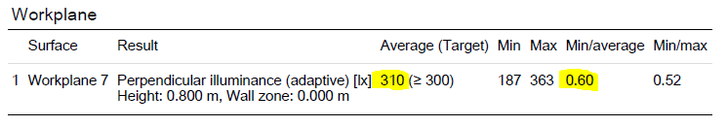
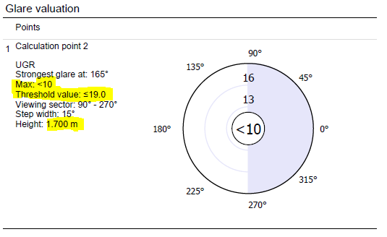
Electrical Design
Results:
Uniformity in classroom= 0.6
Unified Glare Rating (UGR)<10

Slide 34
Environmental Design
Southern Facade Design:
Use overhang on windows by slab cantilever .
Use Alcobond shutters.
Use double glazing with air gap.

Slide 35
Environmental Design
Structural Elements:
Element | U-value w/m2.k in old building | U-value w/m2.k in new building
External wall | 1.43 | 0.67
Internal wall | 2.04 | 1.82
Roof | 2.1 | 0.42
PVC | 0.16 | -
Windows | 5.60 | 3.15

Slide 36
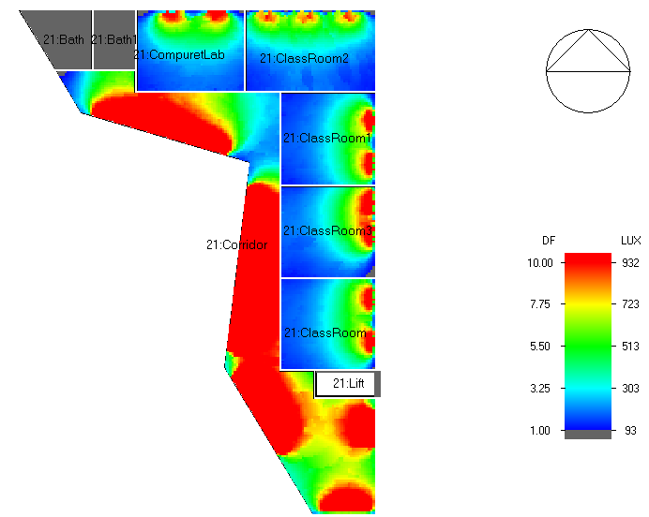
Environmental Design
Natural lighting:
Space | Average DF%
Staff Offices | 1.8
Class room | 3.5
Music room | 4.00
Studio | 5-8

Slide 37
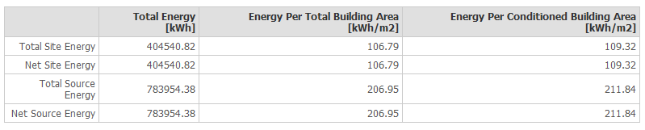

Environmental Design
Total Energy
Energy per meter square in first building.
Energy per meter square in third building.

Slide 38
Environmental Design
Heating & cooling load
In first Building
 | District Cooling Intensity [kWh/m2] | District Heating Intensity [kWh/m2]
Total End Uses | 69.73 | 28.84
In second Building
 | District Cooling Intensity [kWh/m2] | District Heating Intensity [kWh/m2]
Total End Uses | 87.40 | 37.61
In Third Building
 | District Cooling Intensity [kWh/m2] | District Heating Intensity [kWh/m2]
Total End Uses | 92.07 | 17.92

Slide 39
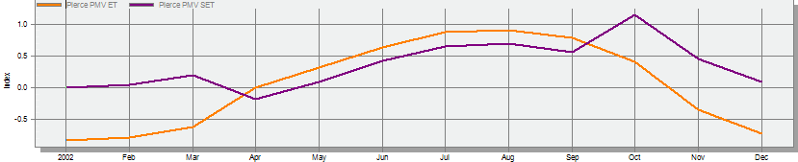
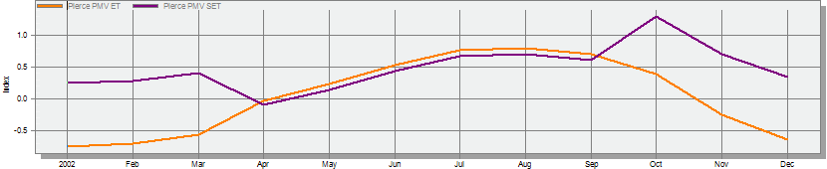
Environmental Design
Thermal comfort:
PMV value ranges from (-0.8 - 0.88)
PMV value ranges from (-0.75 - 0.81)

Slide 40
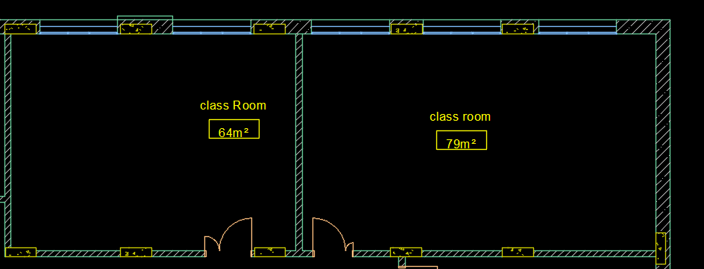
Acoustical design
AutoCAD plan for Class room

Slide 41

Acoustical design
IIC for ceiling

Slide 42

Acoustical design
STC for external walls

Slide 43

Acoustical design
STC for internal walls

Slide 44

Acoustical design
Ecotect plan for class room

Slide 45

Acoustical design
reverberation time for classroom

Slide 46

Acoustical design
RT60 Values for classroom

Slide 47
Mechanical Design
HVAC system.
Water Usage.
Water Supply.
Water Drainage.
Firefighting System.
The Elevators.

Slide 48

Mechanical Design
VRF system

Slide 49

HVAC design

Slide 50

HVAC design
cooling load in block 2

Slide 51

HVAC design
heating load in block 2

Slide 52

HVAC design
distributed diffuser unites in GF

Slide 53

HVAC design
distributed diffuser unites in computer lab

Slide 54
HVAC design
Total heating capacity = 4.7KW
Total cooling capacity =11.01KW
The fan we used provides 12.6 KW cooling and 17.5 KW heating, thus we need 1 fan coil units.
In the computer lab and I have 4diffuser.
Ѷ =846L/s.
V =5m/s.

Slide 55

HVAC design

Slide 56
Water Usage
Number of students in the college = 1000 students.
percentage of students presence in the college = 60% .
Number of employees = 43 employees.
daily consumption per person = 6 liter per day.
Refilling duration is about 2 to 3 days.
It is suitable to use tank with volume of 10 cubic meters.

Slide 57


Slide 58

Water Supply

Slide 59

Water Supply

Slide 60

Water Supply

Slide 61
Water Drainage
Gray Water .
Black Water.
Total Number of stacks is 21 stacks.
9 stacks for gray water drainage.
12 stacks for black water drainge.

Slide 62

Water Drainage

Slide 63




Slide 64


Slide 65

Roof Drainage

Slide 66
Firefighting system
Two types for fighting systems were designed for the building:
Hoses.
Sprinklers.

Slide 67

Hoses

Slide 68

Sprinklers

Slide 69

Elevators

