Slide 1
Playground Cleaner
Supervisor: Dr. Raed Al-Qadi
Prepared by: Dalia Jumah
Reem Saabnah

Slide 2
Outlines :
Introduction.
Hardware Components.
Robot design.
Image Processing.
Optimal way.
Problems.
Future Works.
Demo.

Slide 3
Introduction
This project is an application for playgrounds. It will provide a way to facilitate cleaning playground by removing solid waste from it's ground. The most important aspects in our project is take a picture of the playground and detect the locations of waste .Then the robot will move to these locations and use its arm to catch the waste and put it in the basket.

Slide 4
Hardware components
Raspberry pi3 and its camera.
Arduino UNO.
Two Stepper Motors.
Servo Motors
Two Dual H-Bridges [L298N]
Bluetooth
Compass sensor
Batteries.

Slide 5
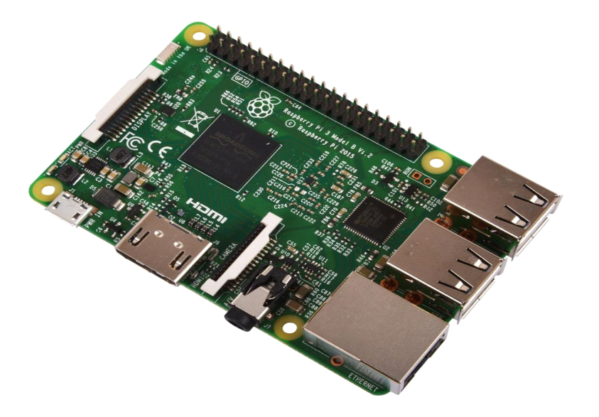
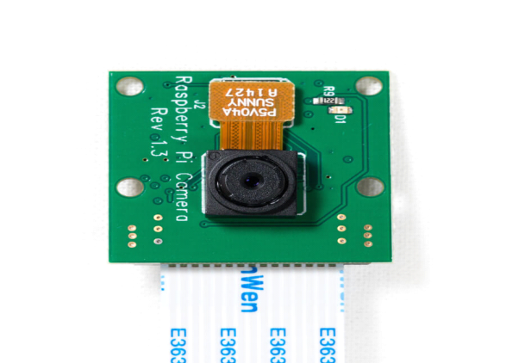
Raspberry pi & camera
Raspberry pi is a small computer with 64-bit quad core processor, Bluetooth and Ethernet support. We installed raspbian [linux] on 16 G SDCard. Then when installed opencv3 and python 2 using a sequence of commands in linux terminal.

Slide 6
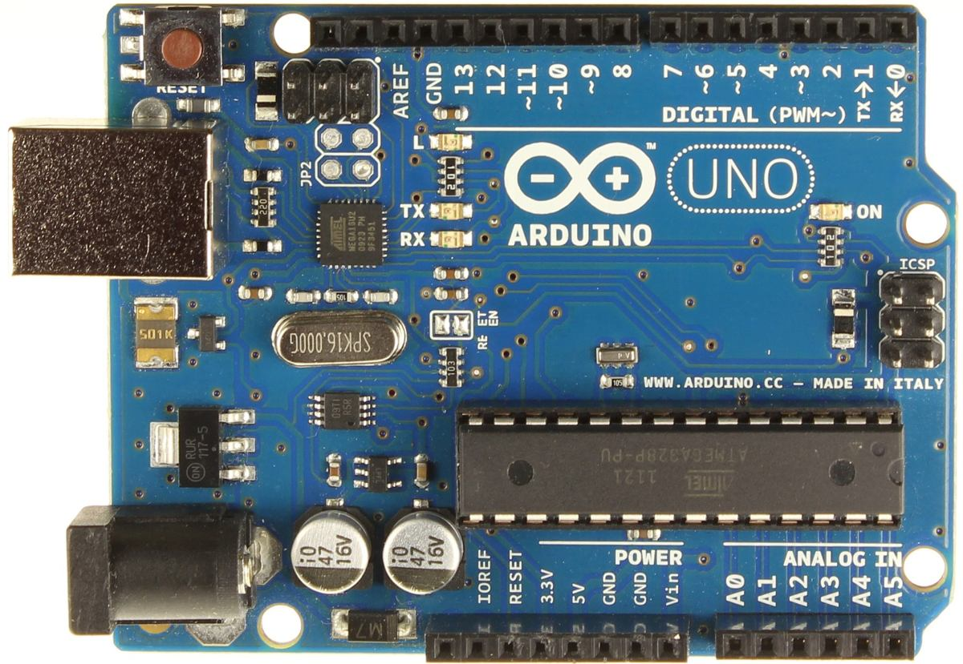
Arduino
An Open Source Platform.
Consists of both Hardware and Software.
Uses C++.
Very Flexible

Slide 7
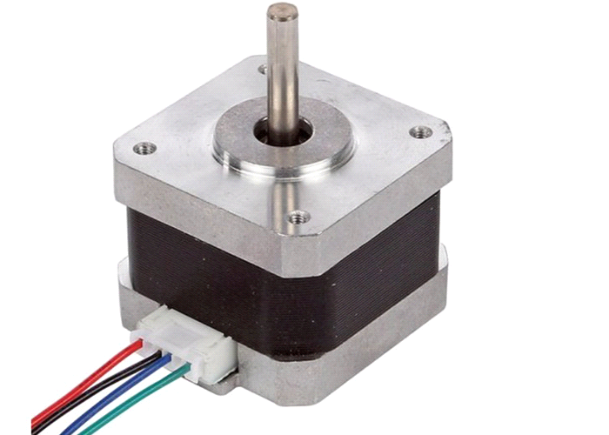
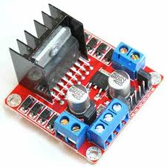
Stepper Motors & drivers
two stepper motors connected to the robot wheels. We used 2 H- Bridge drivers to control steppers by arduino

Slide 8
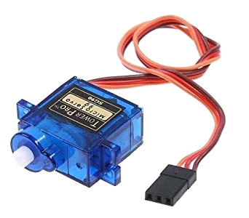
Servo motors
Two motors to move arm up and down , and one to open and close clipper while picking object.

Slide 9
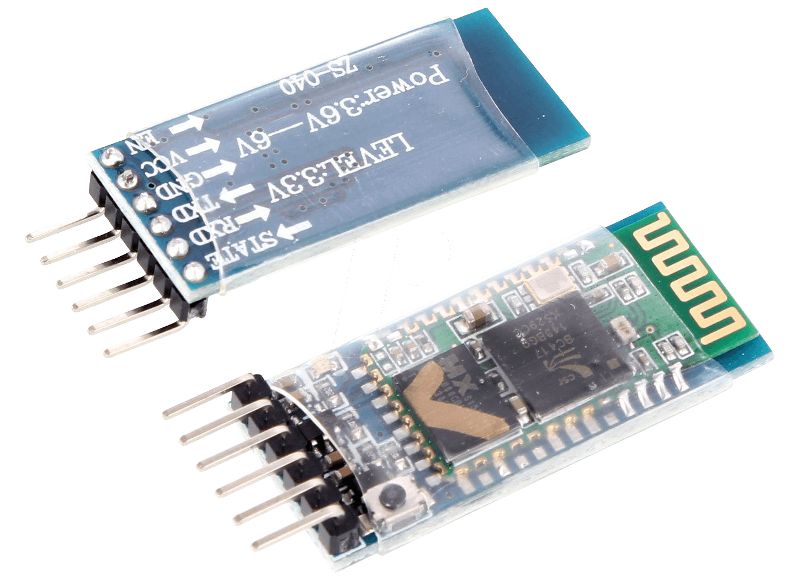
Bluetooth
Bluetooth module used to make communication between Raspberry pi and Arduino.

Slide 10
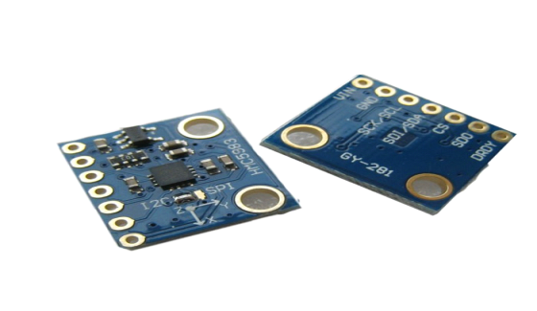
Compass Sensor
Compass put on the robot to know where exactly is it. It used when rotate the robot until reach the required angle [ the angle at which th object is ].

Slide 11
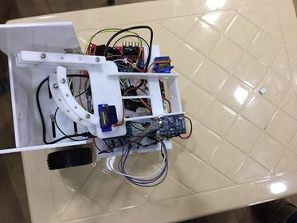
Robot design
we used 3D printer to make the design of robot and arm .

Slide 12
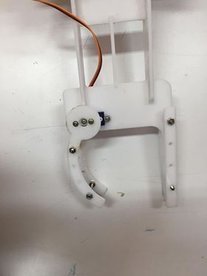
Arm design

Slide 13
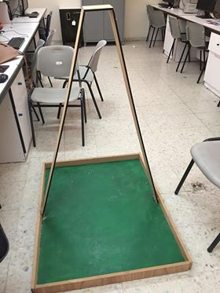
Playground model

Slide 14
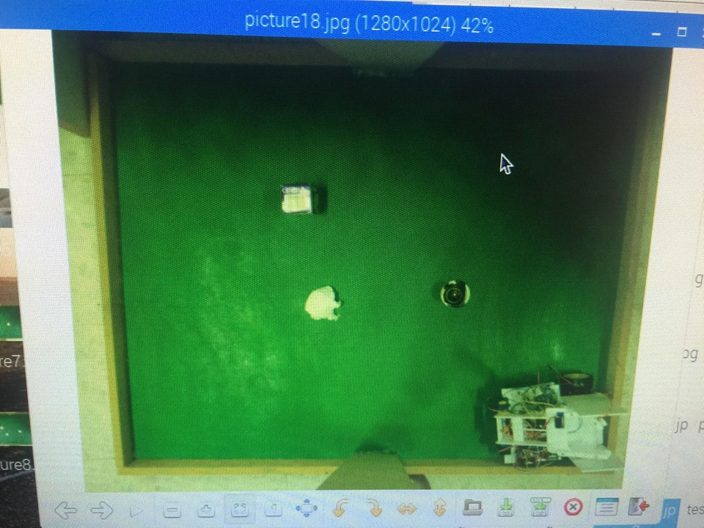
Playground photo

Slide 15
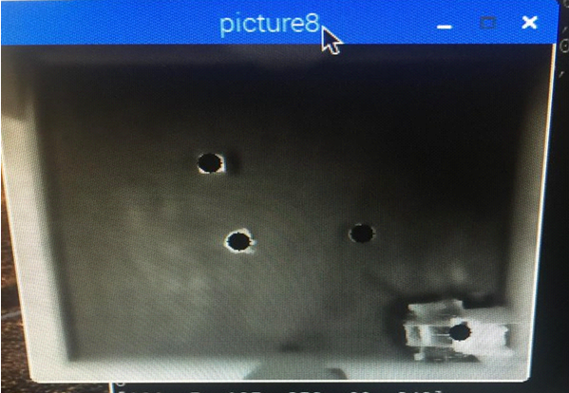
Object detection

Slide 16
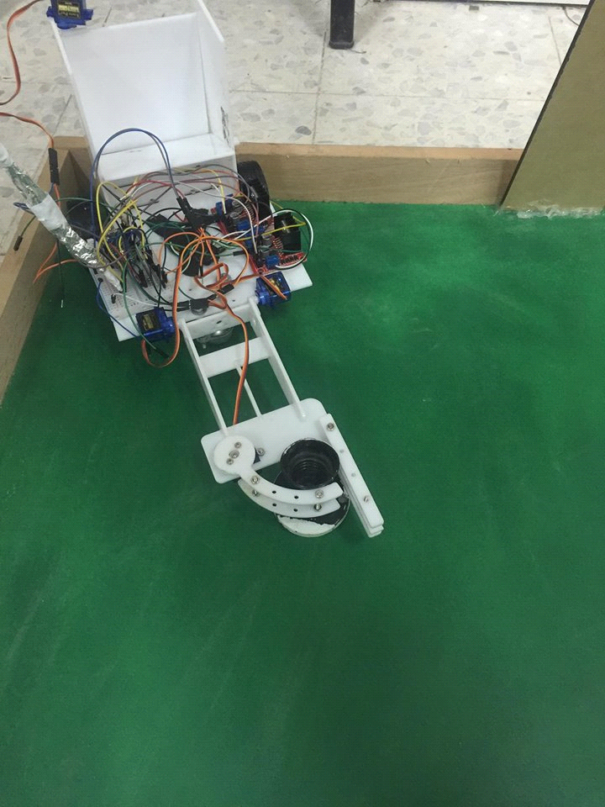
Catch the object

Slide 17
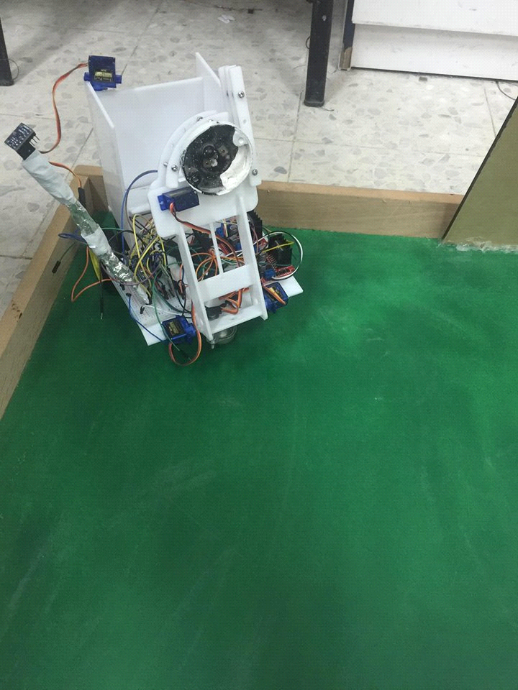
Put it in the box

Slide 18
Difficulties and constrains
Process bad quality images which taken by raspberry pi camera.
Compass sensor give not accurate reading

Slide 19
Future Work
more general and can used in small gardens and closed halls.
we will improve the design of the robot and arm to support more weight.
we will broadcase a live video to the robot work

