Slide 1

An-Najah National University
Civil Engineering Department
Graduation Project
Al-Khader Water Distribution ,Waste, and Storm Water Collection Networks
Done by :
Ahmad A. Sarhan
Bashar Y. Damra
Ahmad I. Dadou
Supervised By :
Dr. Mohammad N. Almasri

Slide 2
Outline :
Introduction
Conclusions & Recommendations
Objectives
Study Area
Methodology
WWCN
ArcHydro
SWCN

Slide 3
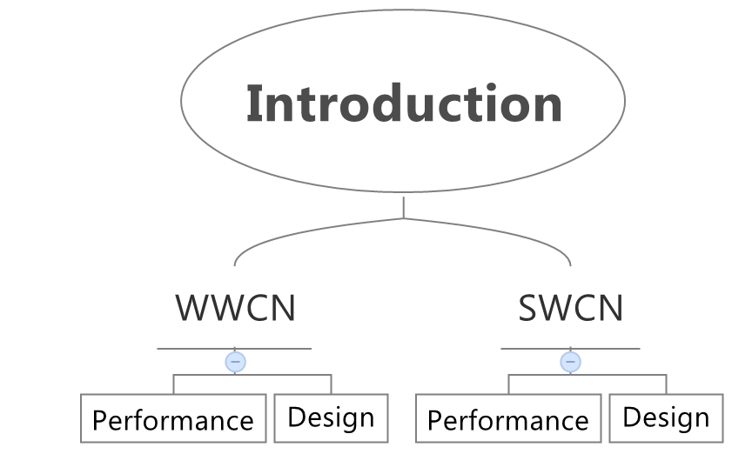

Slide 4
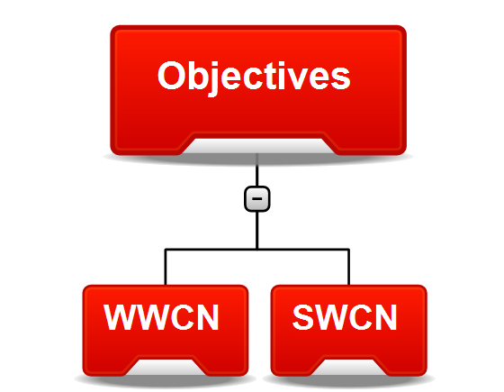

Slide 5
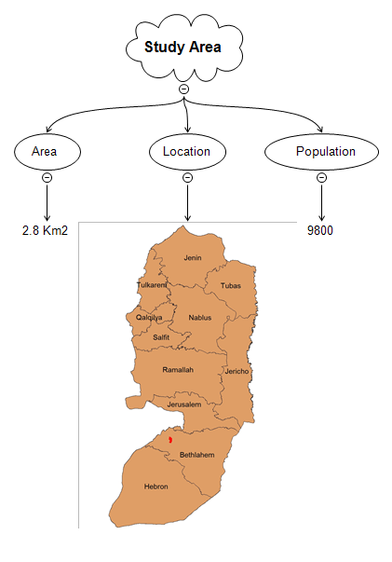
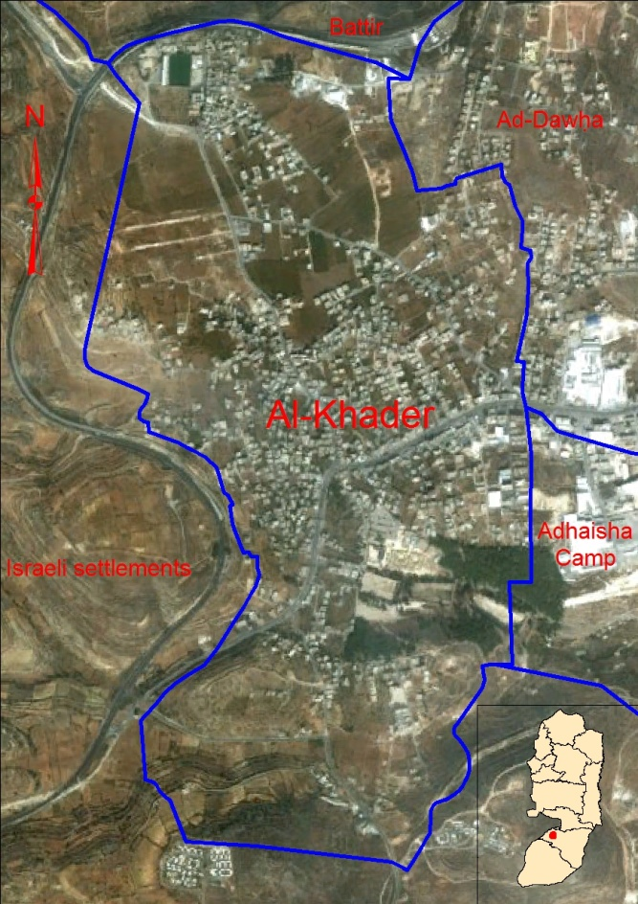

Slide 6
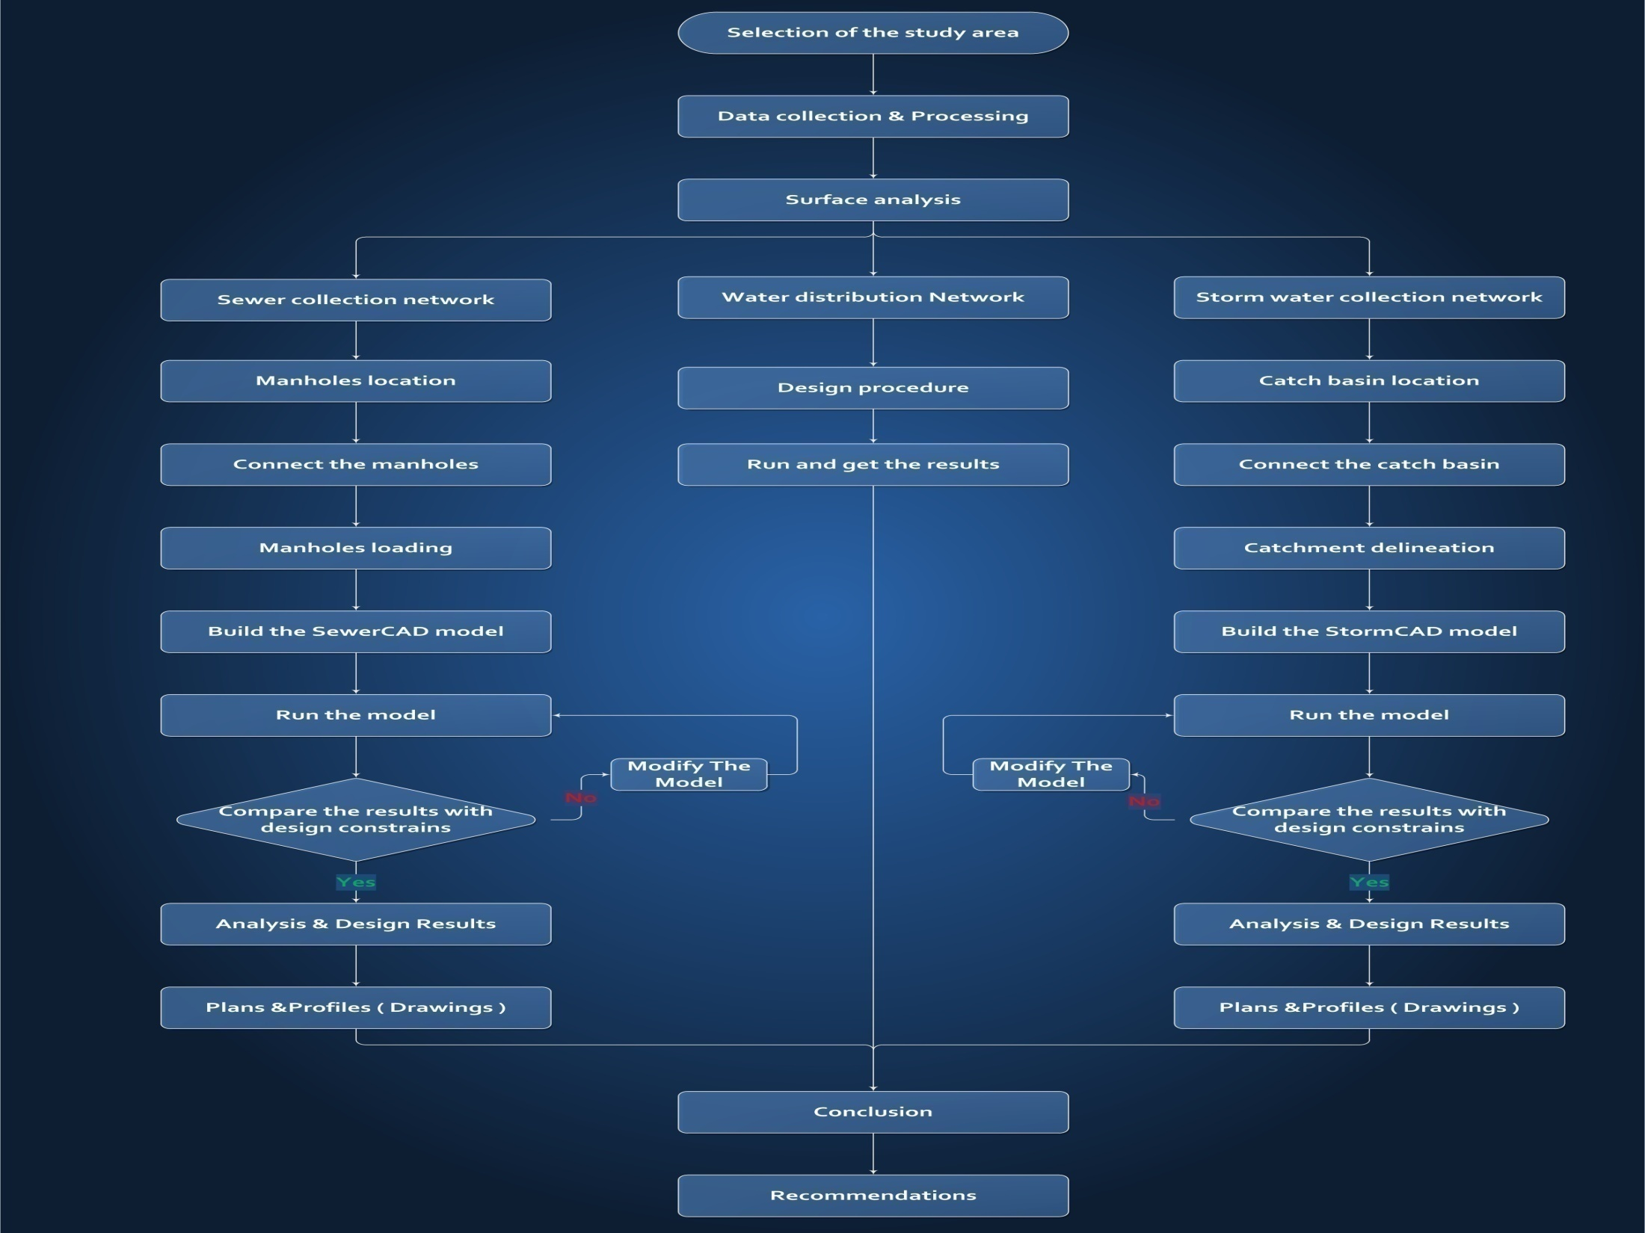
.

Slide 7
ArcHydro

Slide 8

Problem
Assumption
Solution

Slide 9
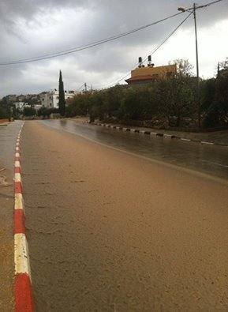
Problem
Assumption
Solution

Slide 10
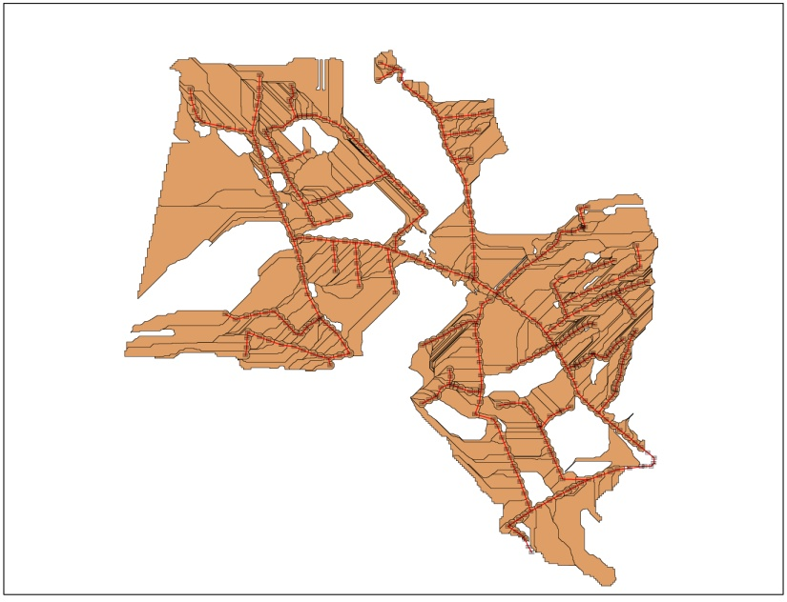
Problem
Assumption
Solution

Slide 11
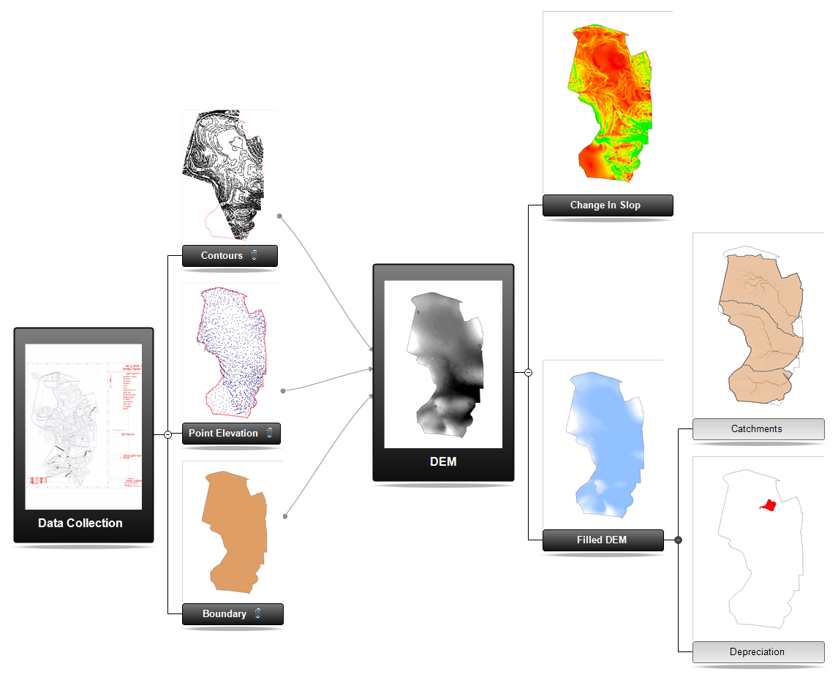

Slide 12
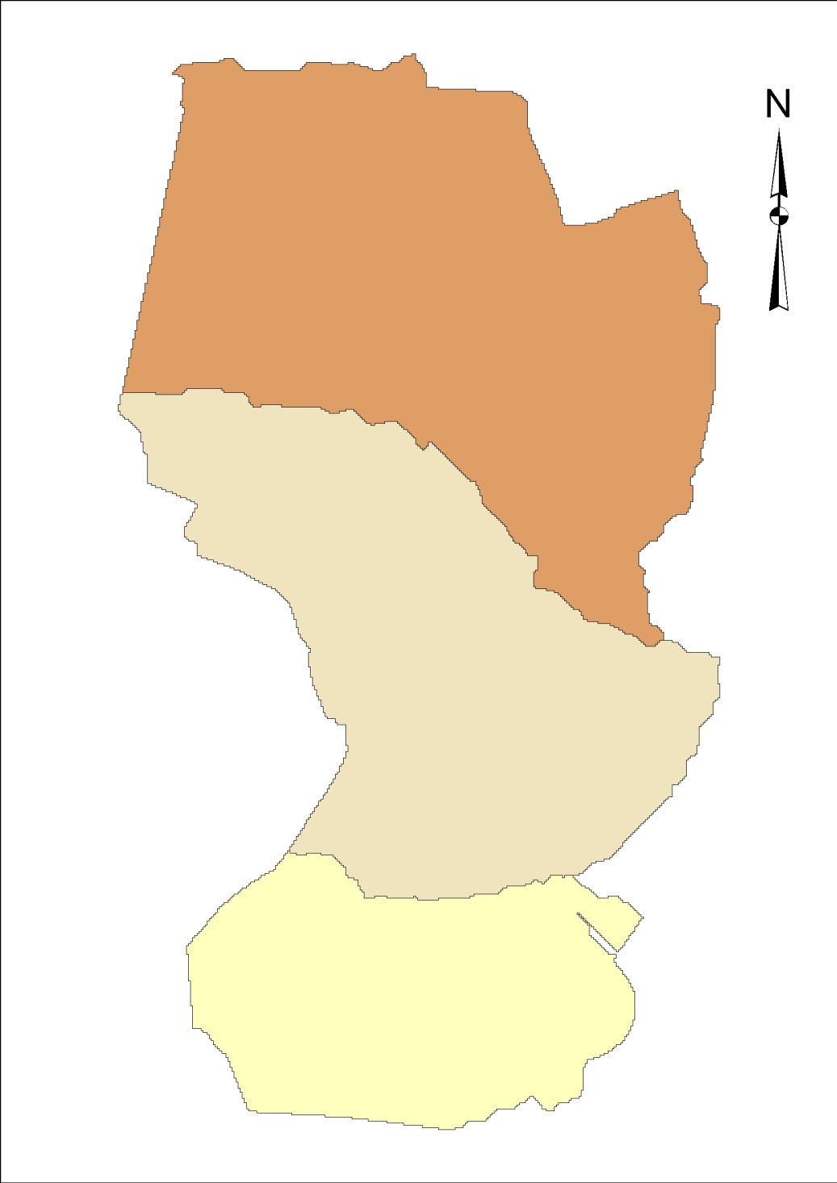
Main Catchments

Slide 13
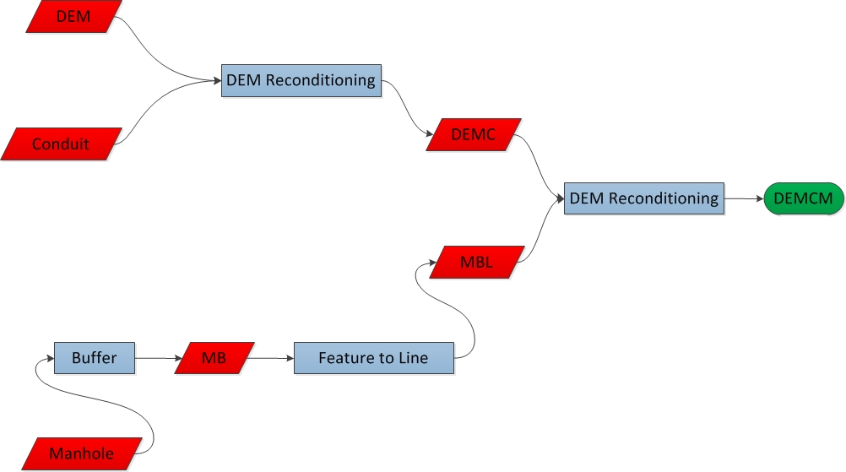
Workflow :-

Slide 14
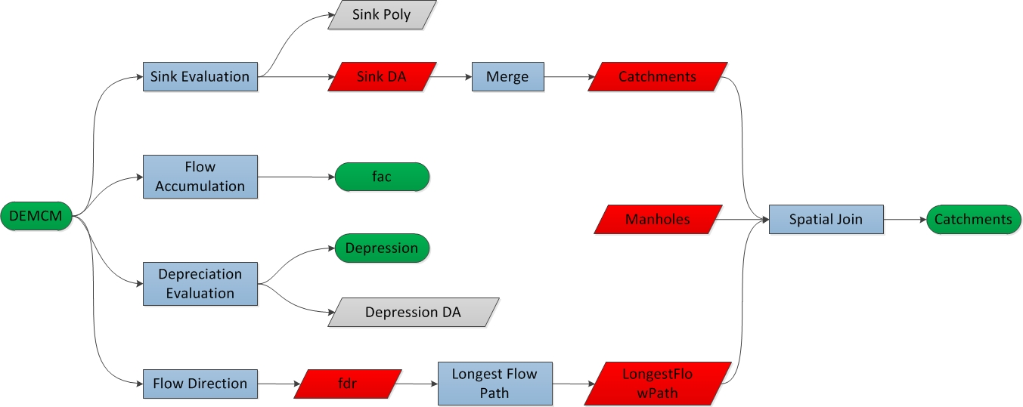

Slide 15
Wastewater
Collection Network

Slide 16
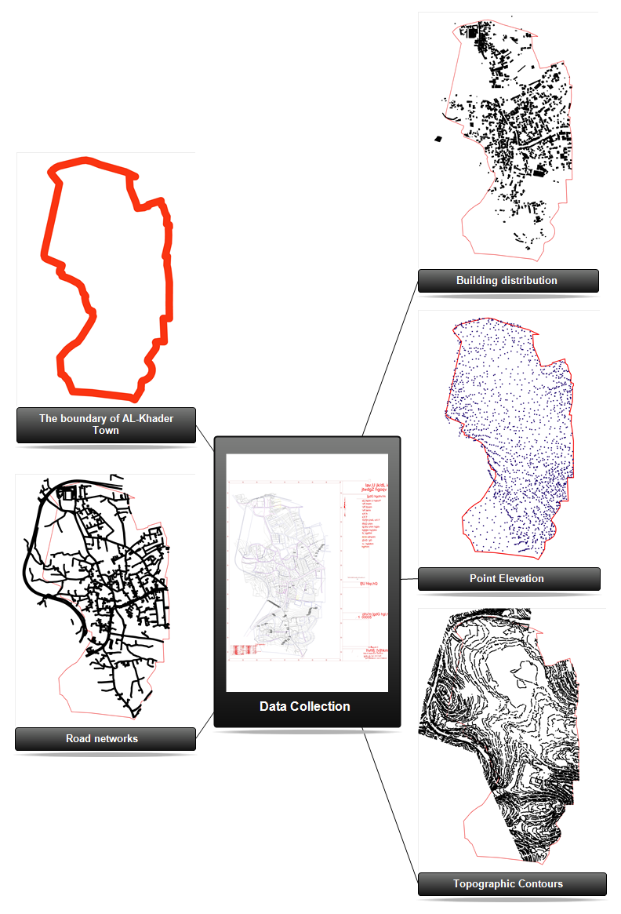

Slide 17
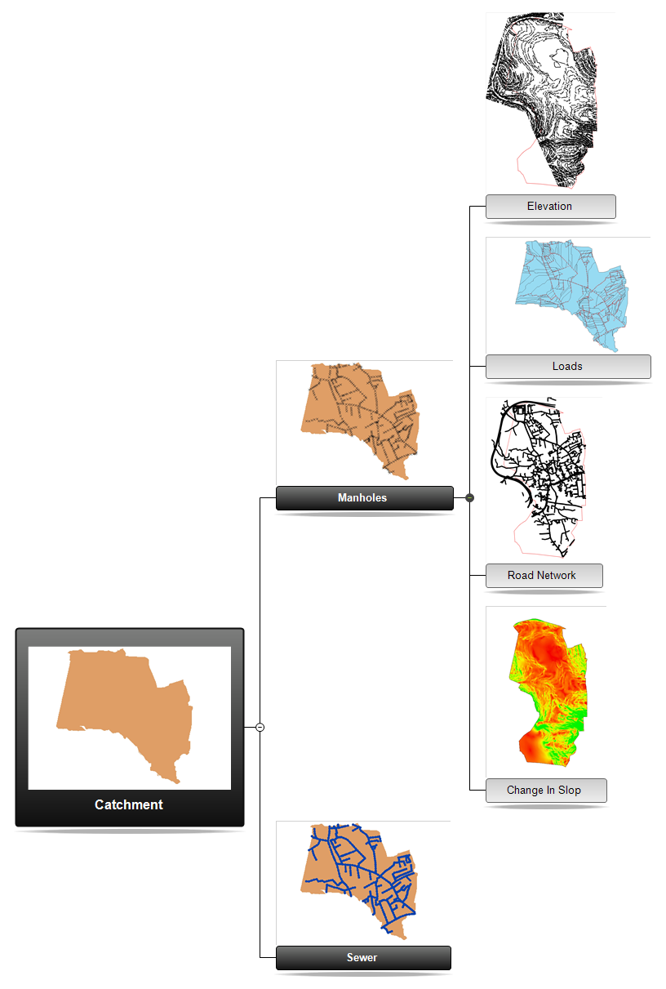

Slide 18
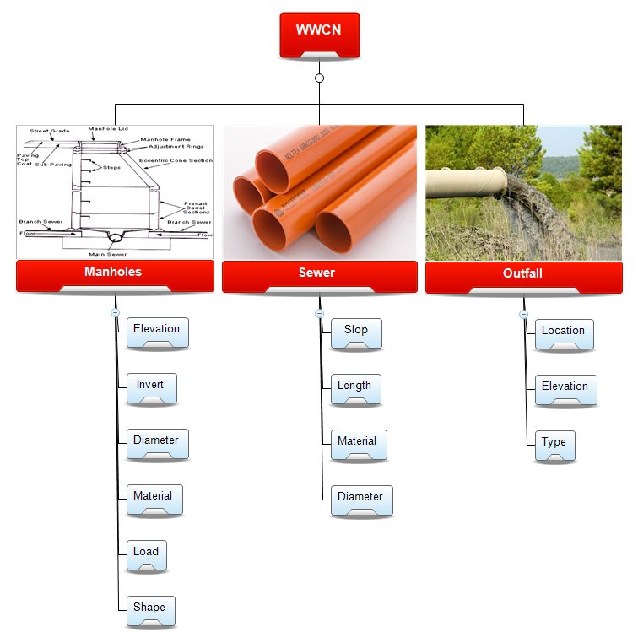
e

Slide 19
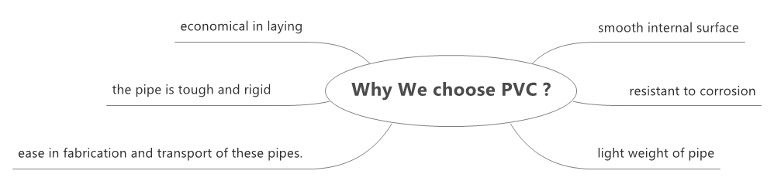

Slide 20
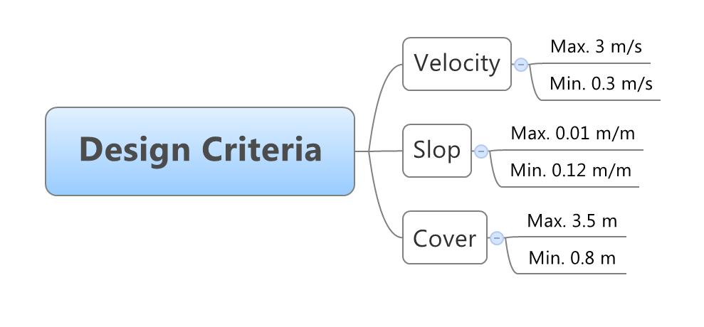

Slide 21
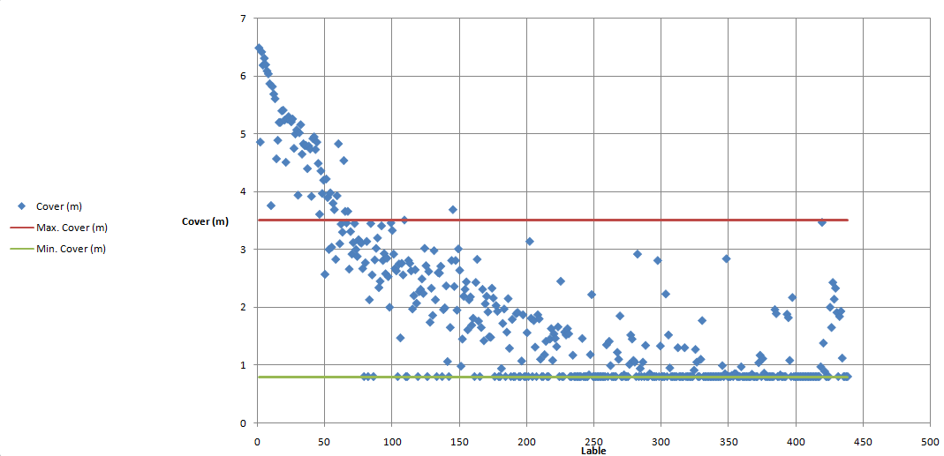

Slide 22
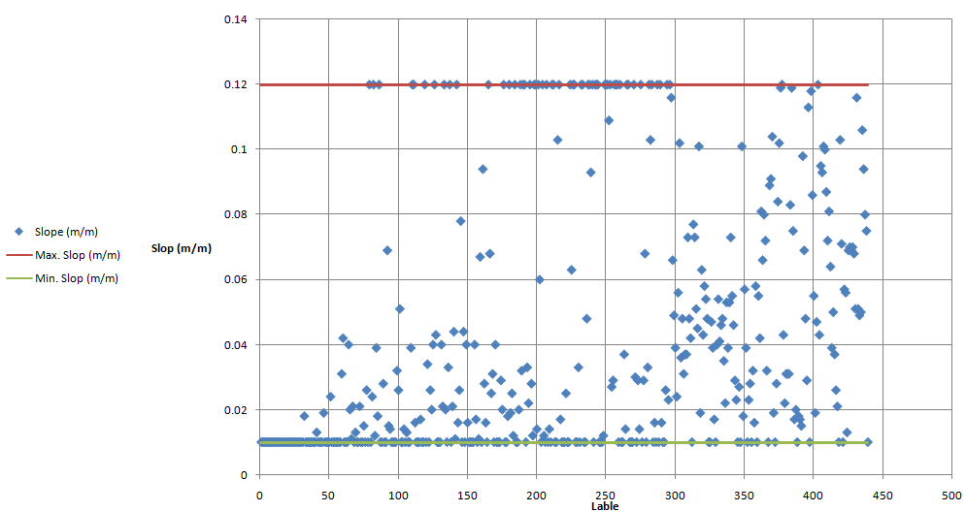

Slide 23
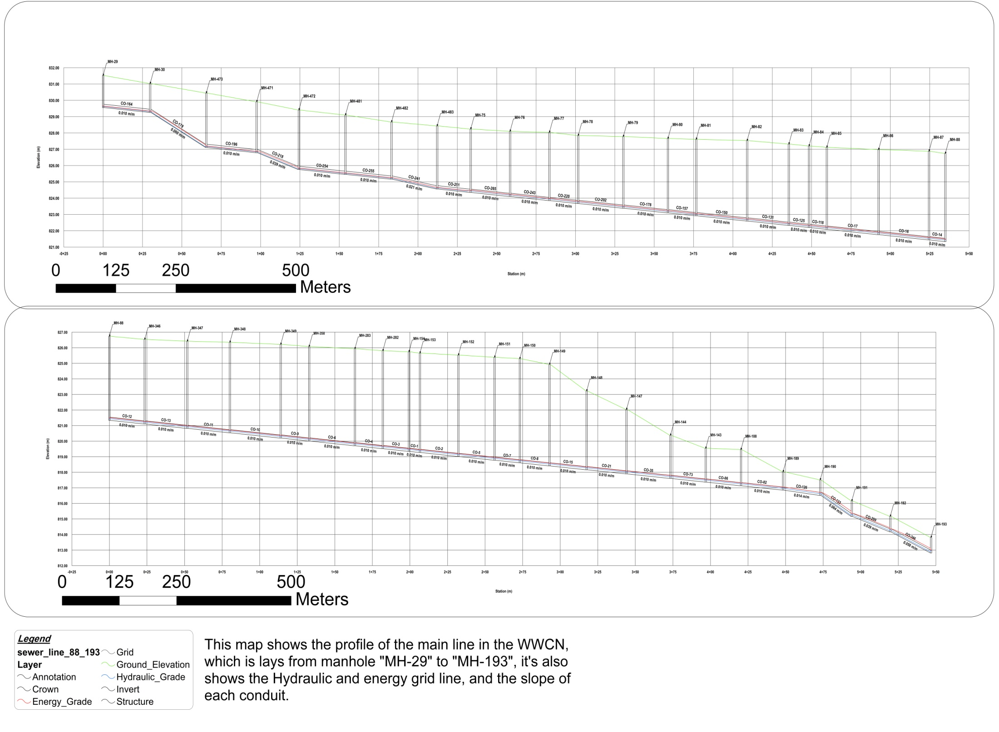

Slide 24
BOQ
Cost percent | Cost ($) |  | Item description
24.2 | 187,800 | 8 inch | Supply of PVC pipes
1.3 | 9,725 | 10 inch
35.9 | 278,865 | - | Excavation and pipe laying
22.3 | 172,800 | - | Sewer manholes
16.3 | 126,596 | - | Miscellaneous foe the sewerage network
100 | 775,786 | - | Total cost

Slide 25
Stormwater
Collection Network

Slide 27
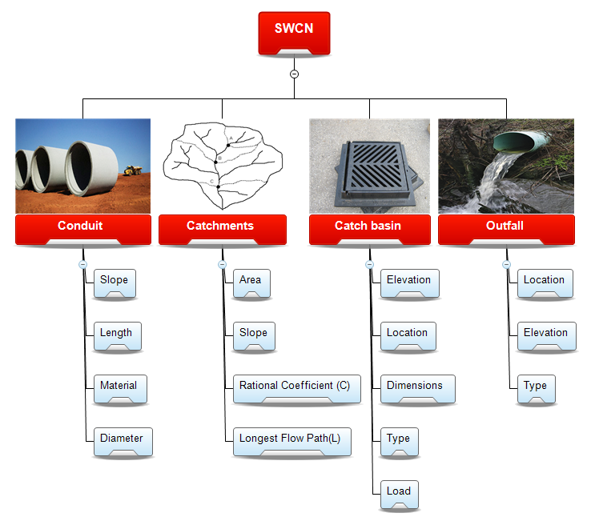

Slide 28
IDF

Slide 29
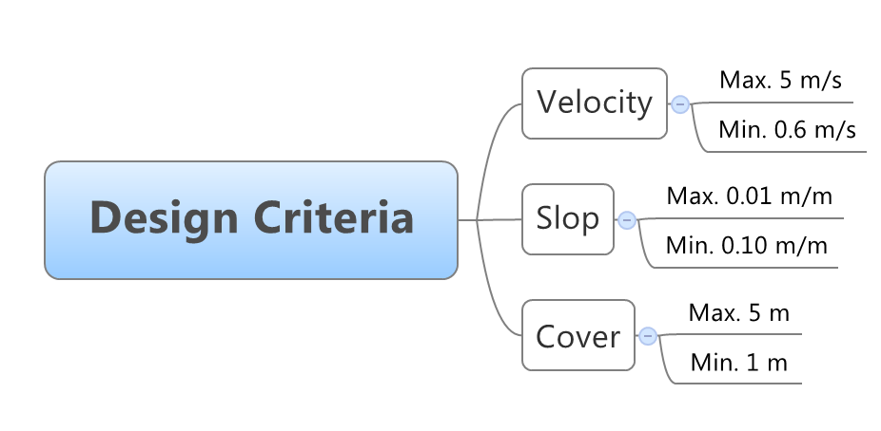

Slide 30
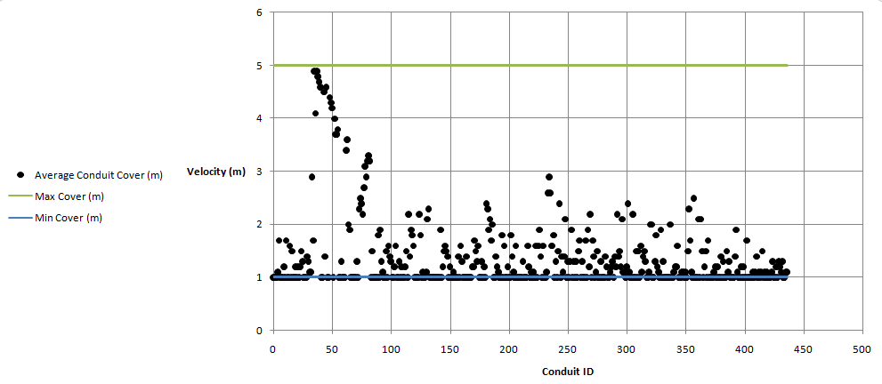
Cover (m)

Slide 31
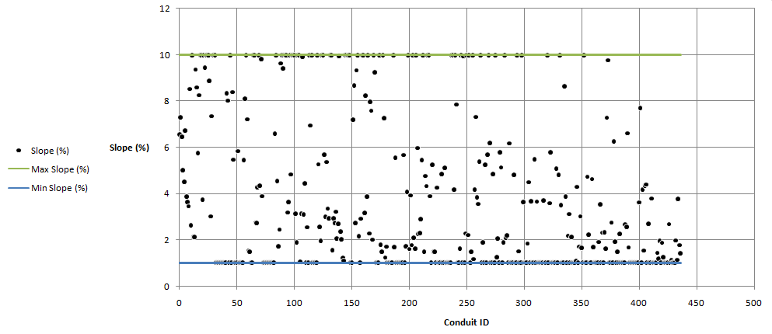

Slide 32
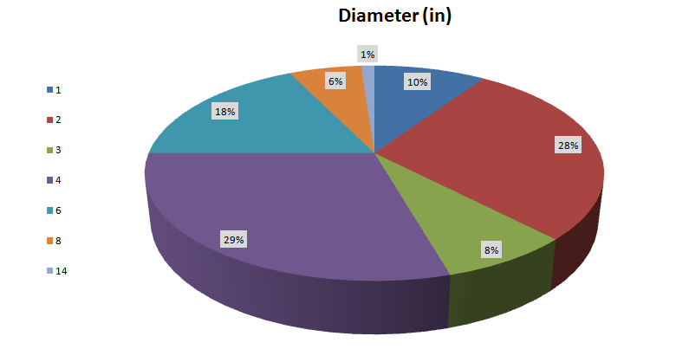
Conclusion

Slide 33
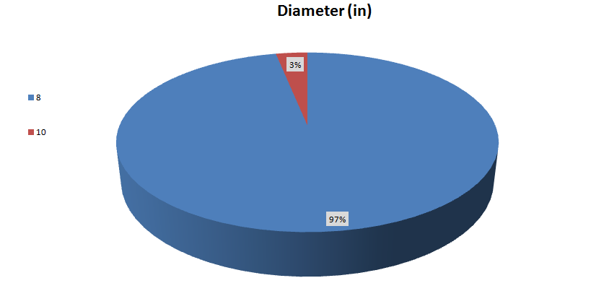

Slide 34
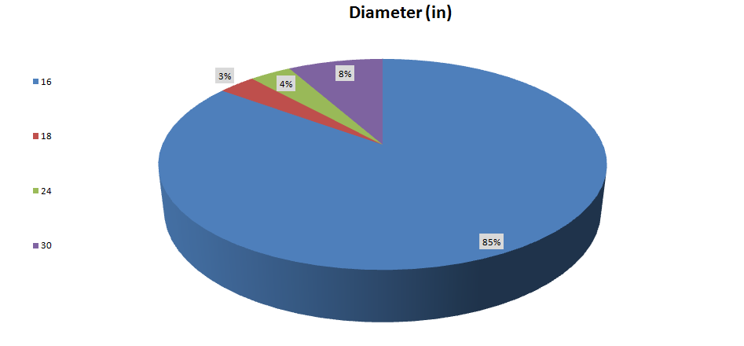

Slide 35
Recommendations
Site investigation must be done in order to the nature of the study area.
If possible treatment plant is considered as a feasible project.
We recommend to civil engineering department to but the Arc Hydro tools in GIS course plan, because it saves a lot of time, give more accurate results, and the design process will be easier.

Slide 36


