Slide 1
Analysis and design of KFC restaurant-Nablus branch
Prepared by:
Maha Horani - Nirmeen Jomaa
Supervised by:
Dr: Riyad Awad

Slide 2
Contents
Project description and the modified plans
Design criteria (Codes and materials)
Loads
3-D modeling
3-D analysis and Design

Slide 3
Project description and the modified plans

Slide 4
Description
The project is design of KFC building near
Al-Academia street which is 590 m above mean sea level. It’s a building of Four floors basement , ground , first and second floor with height of 3.25 m for the basement and 4.25 m for the other floors.
.

Slide 5
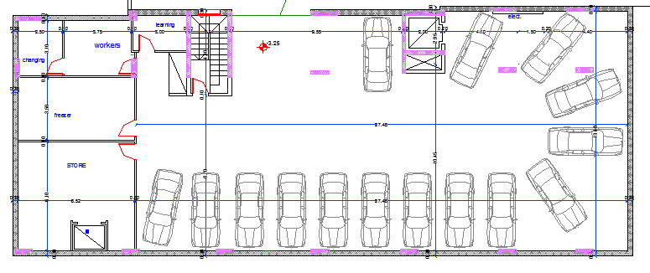
Original Plans:
Basement plan:

Slide 6
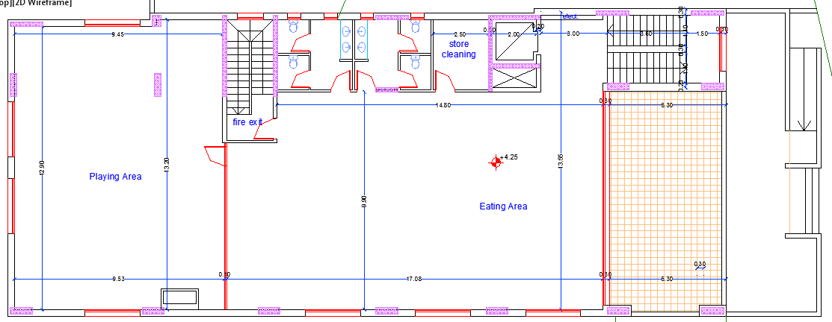
Original Plans:
First floor plan:

Slide 7
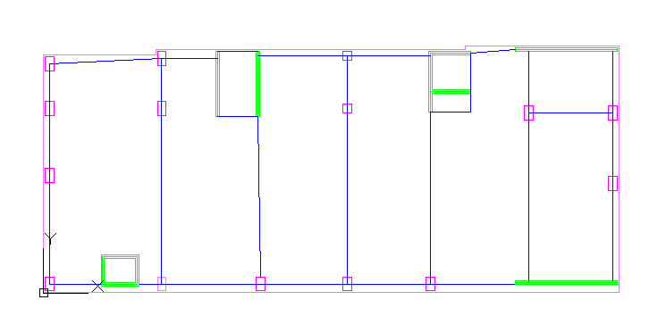
Modified Plan:
All the floors will have the following plan with rotating the columns as follows and with adding the following shear walls (the reasons will be discussed later):

Slide 8
Design criteria (Codes and materials)

Slide 9
Design Criteria:
Codes:
American Society of Civil Engineering code (ASCE 7-10).
Jordanian Code – 2006.
International building code 2012 (IBC 2012).
American Concrete Institute code (ACI 318-14).

Slide 10
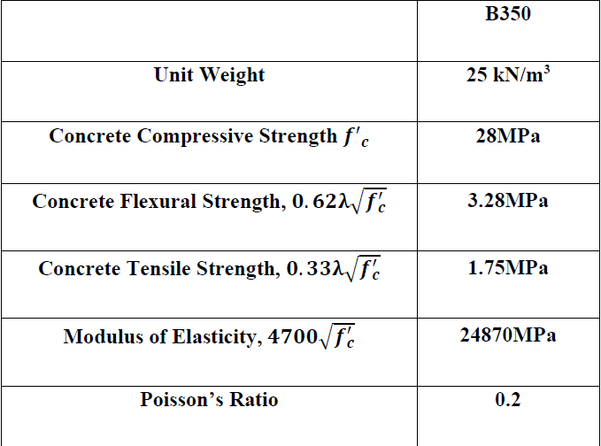
Design Criteria:
Materials:
Concrete:

Slide 11
Design Criteria:
Materials:
Steel:
Reinforced steel:
The same steel type will be used for all structural elements which is ASTM A955 Grade 60, and this type has a tensile strength of 620MPa and a yield strength of 420 MPa.

Slide 12
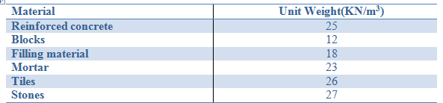
Design Criteria:
Materials:

Slide 13
Loads

Slide 14
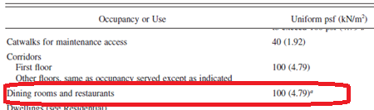
Gravity Loads:
Live Load: It is a load produced by the use and occupancy of the building, From chapter 4 in ASCE7-10 and from Table 1.2 the live load for residential buildings mainly dining rooms and restaurants = 4.79 KN/m2. Also, assuming that one m2 can contain 4 persons with average weights of 80 Kg, weight for one person=80*10/1000=0.8 KN, for four persons/m2=0.8*4=3.2 KN/m2,To be more conservative , the live load will be taken to be 5.5 KN/m2.

Slide 15
Gravity Loads:
SD in the Slab= 5 KN/m2
SD in the exterior beams=27 KN/m
Dead Load and Super imposed dead :
Unit weight(KN/m3) | Thickness | Material
26 | 30 mm | Tiles
23 | 20 mm | Mortar
18 | 100 mm | Filling material
23 | 15 mm | Plastering
Masonry wall
27 | 50mm | Masonry stone
23 | 150 mm | Plain concert
12 | 100 mm | Blocks
23 | 15 mm | Plastering

Slide 16
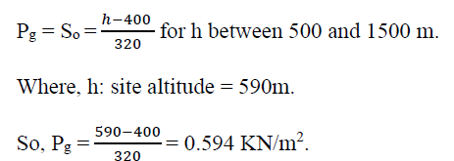
Gravity Loads:
Snow load: it depends on the location and the altitude
Ground snow :From the Jordanian code depending on the altitude above mean see level which is 590m amsl.

Slide 17
Gravity Loads:
Snow load:
For Flat roof:
Ce= 1.1 , Ct=1.3 , I=1 , Pg=0.594
Pf=0.6 KN/m2 on the roof

Slide 18
Lateral loads:
Seismic loads:3 procedures to analyze seismic loads:
1-Equivalent lateral force analysis (equivalent static)
2-Modal response spectrum analysis
3- Seismic response history procedure (time history)

Slide 19
Lateral loads:
Seismic loads:
Site class is D(the allowable bearing capacity is 120KN/m2)
Risk category || and importance factor=1
The design parameters that will be used is the maximum from the mapped values and scientific research values:
For Nablus Z=0.2
S1=1.25 Z=0.25 , Ss=2.5Z=0.5
SDS = SMS = 0.7and SD1 = SM1 = 0.475

Slide 20
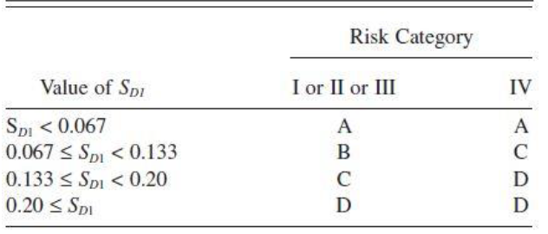
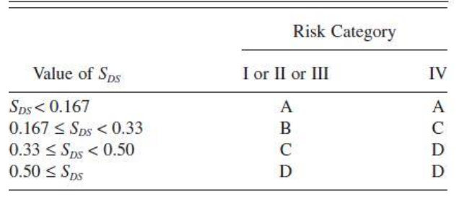
Lateral loads:
Seismic design category D
So, its permitted to use response spectrum and time history only.
Use response spectrum .

Slide 21
Lateral loads:
Seismic loads:
The structure will be designed as building frame system:
Response modification factor:R=6
Deflection Amplification Factor (Cd) =5
System Over Strength Factor (Ω0)=2.5
The response spectrum results should be larger than 80% ELF results.

Slide 22
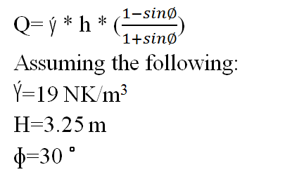

Lateral loads:
Soil pressure in basement wall:

Slide 23
3-D Modeling

Slide 24
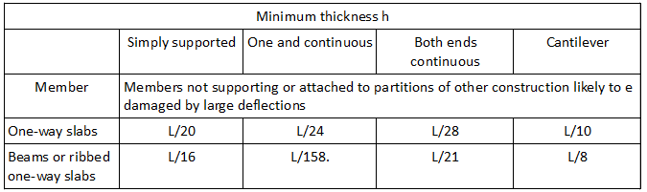
3-D modeling:
Preliminary Dimensions:
depth | Width | Member
300 mm | 1000 mm | Slab(one way solid)
400 mm | 350 mm | Beam 1
550 mm | 500 mm | Beam 2
600 mm | 500 mm | Beam 3
350 mm | 300 mm | Beam 4

Slide 25
3-D modeling:
Preliminary Dimensions:
depth | Width | Member
800 mm | 500 mm | Column 1
500 mm | 500 mm | Column 2
200 mm | - | Shear walls
300 mm | - | Basement wall
The columns are rotated because the load is transferring at the x
direction( to have larger moment of inertia in the direction of the load)
The shear walls added to prevent torsion in the fundamental mode
Fundamental mode = 0.661 sec in the y-direction.

Slide 26
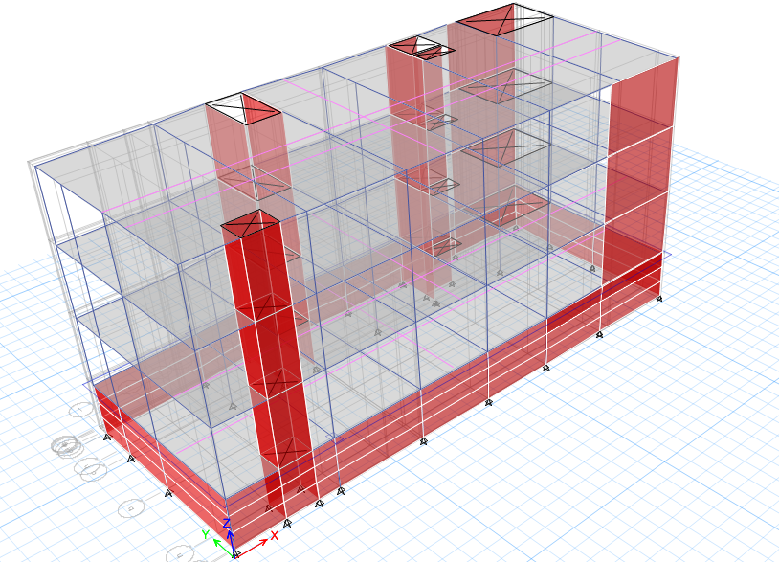
3-D modeling:

Slide 27
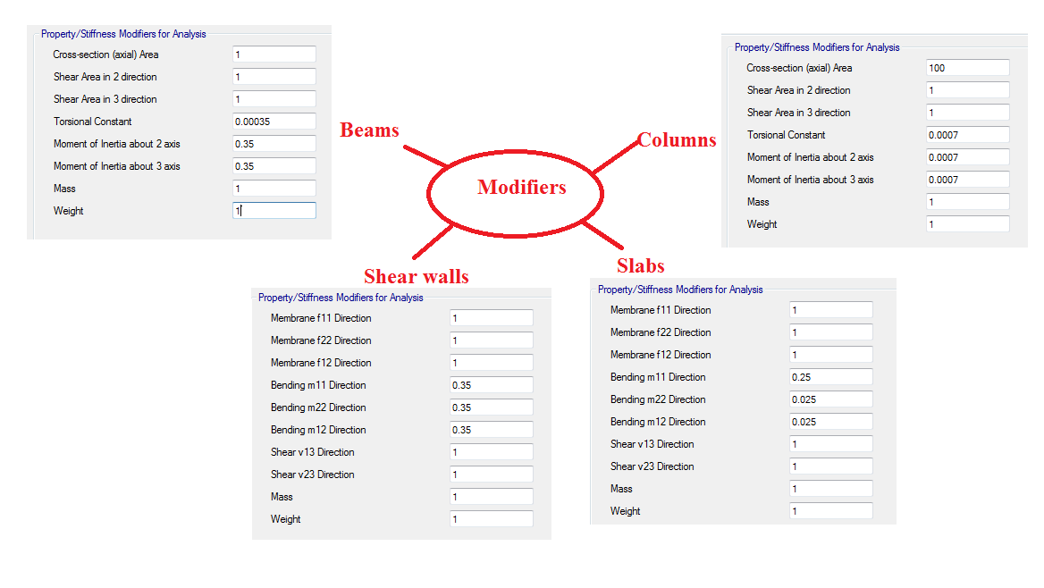
3-D modeling:

Slide 28
3-D Analysis and design

Slide 29
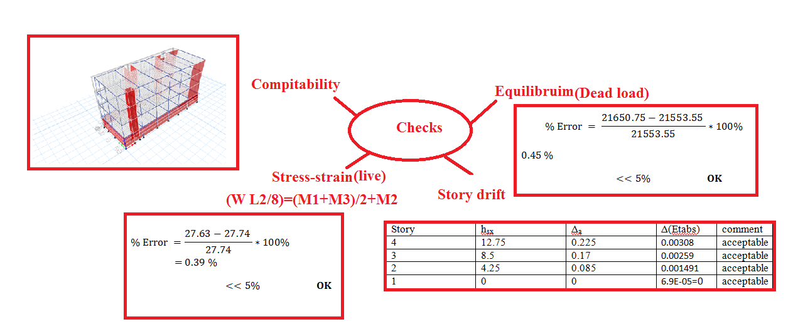
3-D analysis(checks):

Slide 30
3-D Design:
Slab Design:
Main steel (at x-direction):
ɸ12/90 mm Top bars and ɸ12/120 mm bottom bars
Shrinkage steel(y-direction):
ɸ12/160 mm top and bottom bars

Slide 31
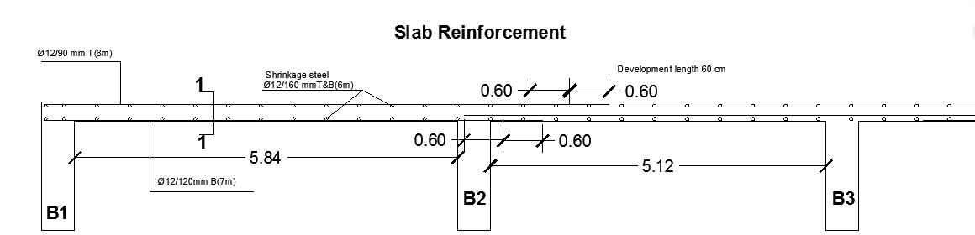
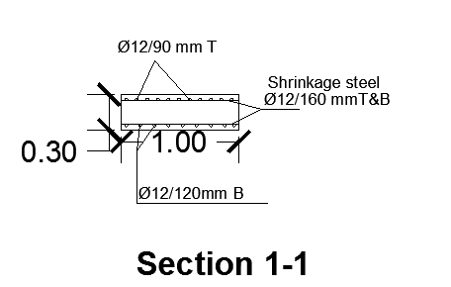
3-D Design:

Slide 32
3-D Design:
Columns Design:
Column 500×500 for example:
P=1%, As=2500 mm2
Use 8 bars ɸ20 mm and 2ɸ10 stirrup /160 mm for length 600 mm from the beam column joint and 2ɸ10/320mm for the rest length of the column.

Slide 33
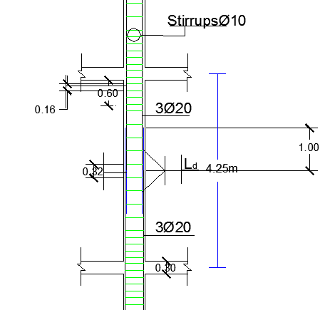
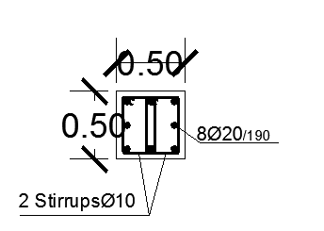

Slide 34
3-D Design:
Beams Design:
For beams have section 500×600 mm as an example
Pu=0.1 Ag F’c=840 KN> Axial at all beams , so design it as beams

Slide 35
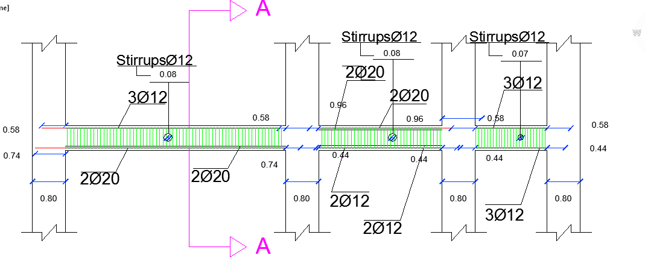
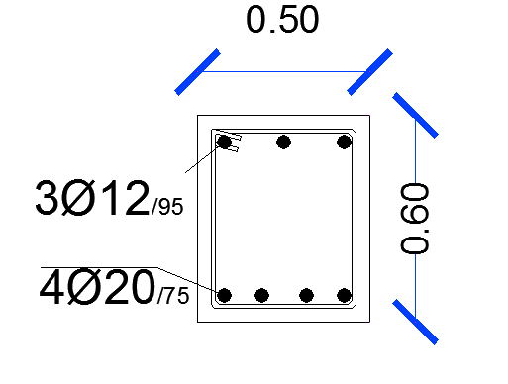

Slide 36
Footing Design:
The footing is mat foundation with thickness of 70 cm .
Use 70 cm base coarse to increase the bearing capacity of soil
Punching is checked for this thickness and its ok
Area of the mat = area of the building +1 m2 from all around the building

Slide 37
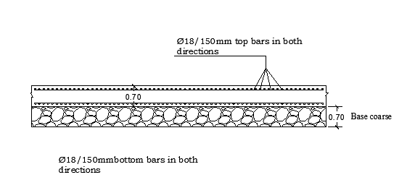
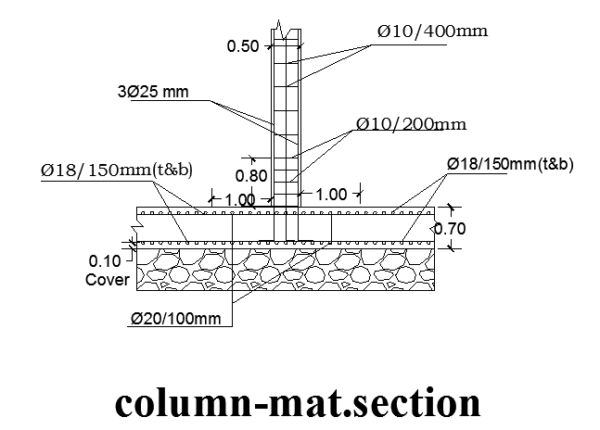
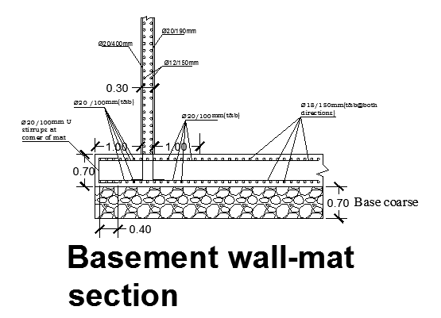

Slide 38


