Slide 1
Suitecase Carrier
Presented by: Ayman Abu-Eideh
Zaid Habiba
Supervisor: Dr.Luai Malhis
Dr.Mona Demaidi

Slide 2
Outline
What is Suitecase Carrier.
Motivation.
How does it work.
Technical choices.
Methods & Techniques.
System Design and Architecture
Line Following logic
Future work.

Slide 3
What is SuiteCase Carrier ?
SuiteCase Carrier is a robot that helps travellers in their travel by carrying their suitecase.
It can be controlled via mobile.

Slide 4
Motivation
People tend to use more technology in order to save time and effort.
Travelers have problems when the have many suitecases.

Slide 5
How does it work?
By sending commands using the phone.
The robot avoids colliding with obstacles while moving.
The user has the option to use the line following mode or manual mode.

Slide 6
Technical choices
Control using phone:
  Bluetooth module.
Moving the wheels:
  DC Motors.
  Dual H-Bridge

Slide 7
Data Receiver and Processing:
  Arduino uno.
Obstacle Avoidance :
  Ultrasonic sensor
Line following:
  IR-Sensor

Slide 8
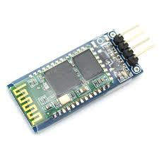
Control using phone :
  Bluetooth module
  Connected to UART of Arduino Mega.
  To send voice commands, tools selection options and DC Motor movement commands to the Arduino Mega.

Slide 9
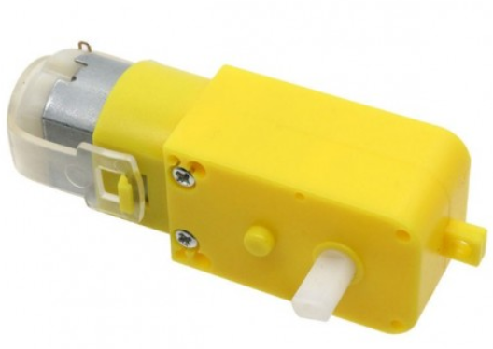
Moving the wheels:
DC-motor:
  Four DC motors to move the wheels of the robot.
  The direction of movement will be determined by processing the command from phone or by following the line.

Slide 10
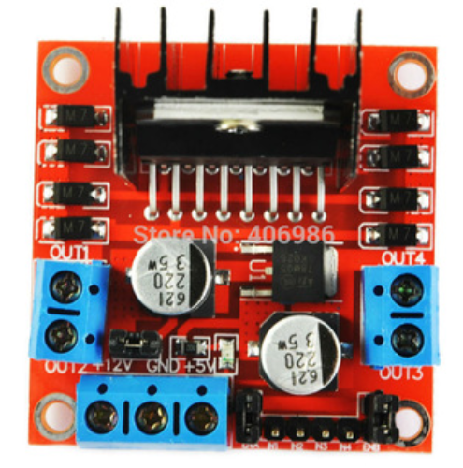
Dual H-Bridge:
  Two DC motors to move the wheels of the robot.
  The direction of movement will be determined by detecting the movement of the user’s wrist by using the accelerometer sensor.

Slide 11
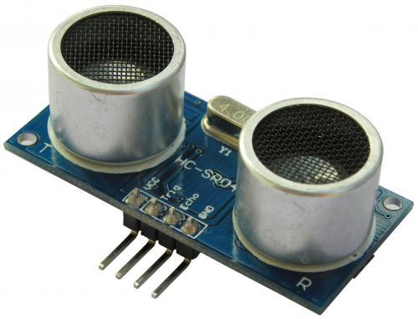
Obstacles avoidance
  Ultrasonic Sensor:
  Sense certain distance of its surroundings.
  Locates in the front side of the robot, so that it can avoid hitting with walls or random obstacles.

Slide 12
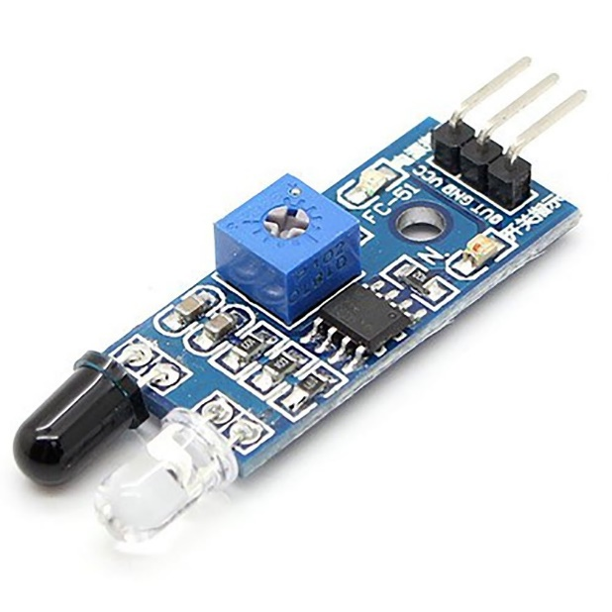
Line Following
  IR Sensors:
  Sense White and Black colors.
  Locates the Line in the front side of the robot, so that it’ll follow the Line.

Slide 13
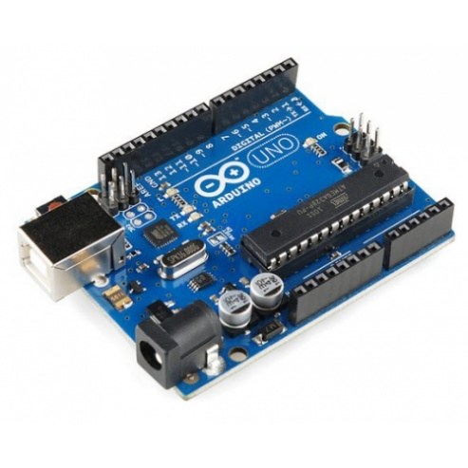
Data Receiver:
  Arduino Uno:
  Data from Mobile Bluetooth, Ultrasonic sensot and the IR sensors will be stored in the serial port of the Arduino Uno.

Slide 14
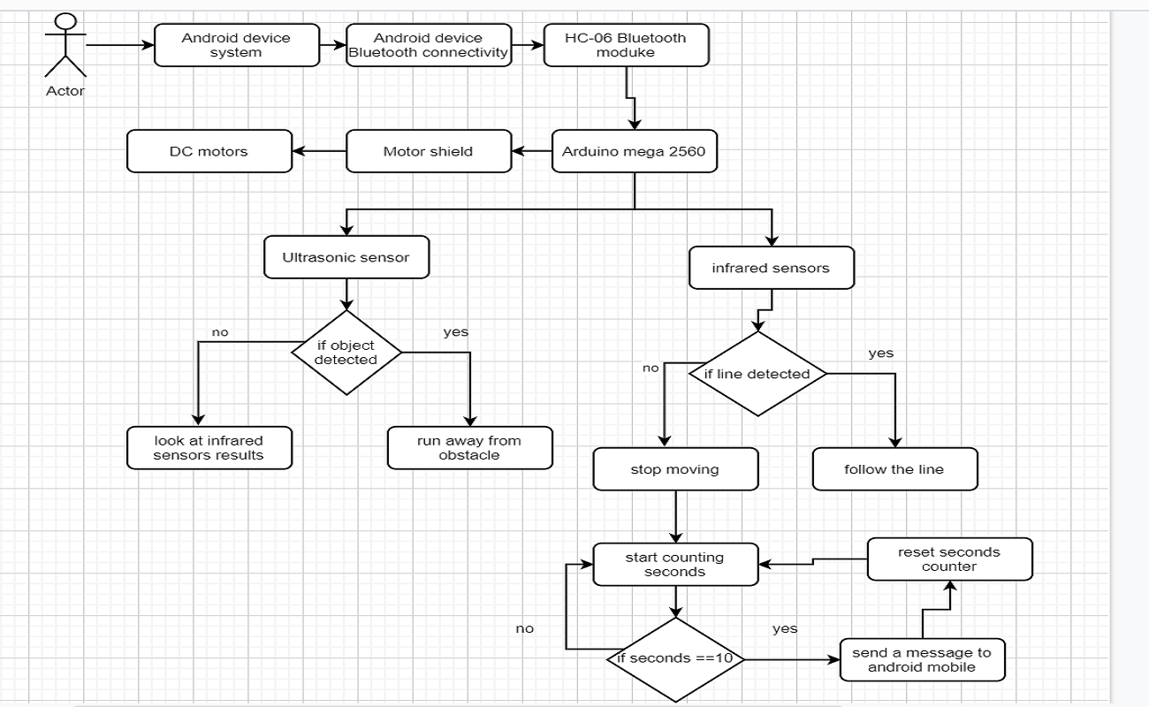
System design and Archetichture

Slide 15
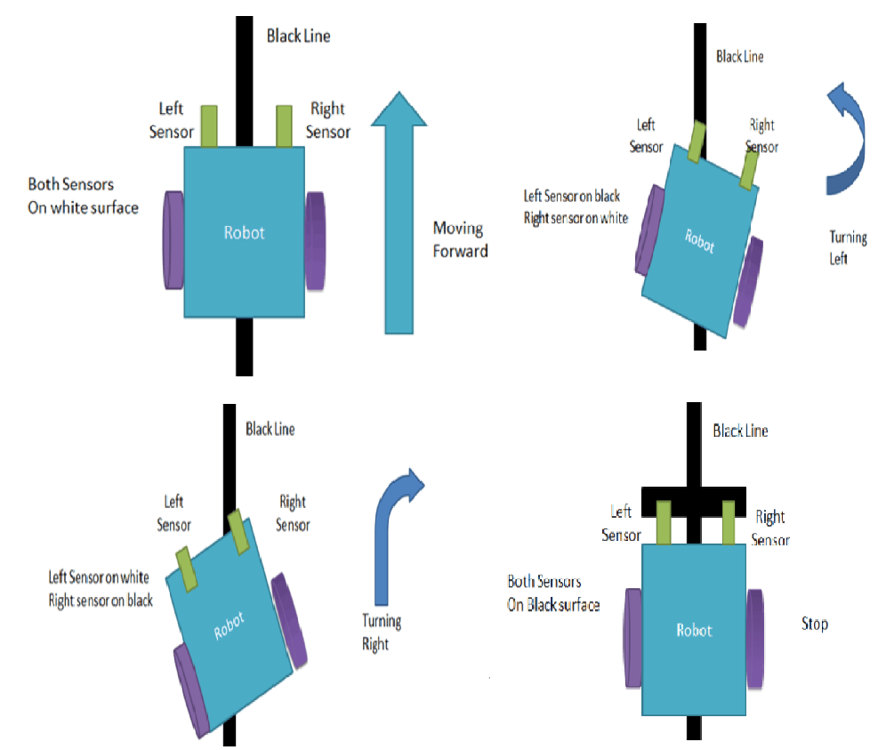
Line Following Logic

Slide 16
Future work
Enhance object avoidance algorithm.
Enhance the model design.
Make the robot follows the user automatically.

