Slide 1

FACULTY OF ENGINEERING
DEPARTMENT OF MECHANICAL & MECHATRONICS ENGINEERING
Liquid Food Packaging and Filling Line
Supervisor:
Dr.Bashir Nouri
Group Members:
Ibrahem Jauysi (12028740)
Ayesh Khatatbe (12028841)
Nabil Masood (11924352)

Slide 2
Contents
🟡Introduction
🟡Motivation
🟡Literature Review
🟡Model Design
🟡Electrical Design
🟡CONTROL Design
🟡Testing and Implementation
🟡FeasibilityStudy
🟡Conclusion & Recommendations

Slide 3
Introduction
overview of the Project:
🟡Designing an automated liquid food packaging and filling line.
🟡Focus on efficiency, precision, and compliance with regulations.
Key Goals:
🟡Enhance production throughput.
🟡Maintain regulatory compliance under food safety standards.
🟡Improve quality control and operational efficiency.

Slide 4
Motivation
🟡 Increased Demand
The growing need for bottled beverages and sauces drives innovation in filling systems.
🟡 Efficiency & Automation
The importance of efficient and automated systems to meet production demands.
🟡 Sustainability
A focus on eco-friendly practices to ensure sustainable food packaging.
🟡 Food Safety Standards
Compliance with strict regulations to guarantee food safety and hygiene.

Slide 5
Motivation
Objectives
🟡 Waste Reduction
Reducing material waste and lowering operational costs.
🟡 Improved Quality
Enhancing product shelf life and maintaining high-quality standards.
🟡 Automation Focus
Minimizing manual labor while increasing automation for greater efficiency.

Slide 6
Challenges
🟡 Precision in Liquid Filling – How to ensure accurate volume per bottle?
🟡 Synchronization of Motors – Achieving smooth coordination between components.
🟡 Choosing the Right Control System – PLC or Microcontroller?
🟡 Ensuring System Efficiency & Stability – Reducing errors and optimizing performance.

Slide 7
Literature Review
Key Topics:
🟡Food packaging and filling technologies.
🟡Classification of food products (liquids, semi-liquids, powders).
🟡Components of food filling production lines (hoppers, conveyors, nozzles).
Insights:
🟡Analysis of current technologies and market trends.
🟡Focus on automation and integration.

Slide 8
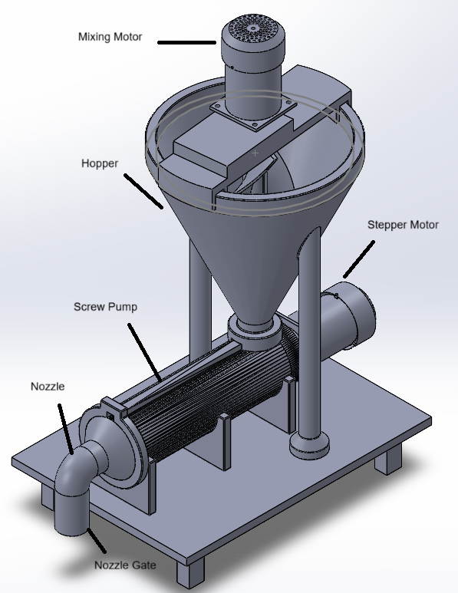
Model Design
Materials:
🟡Stainless steel for durability, hygiene, and resistance to corrosion.

Slide 9
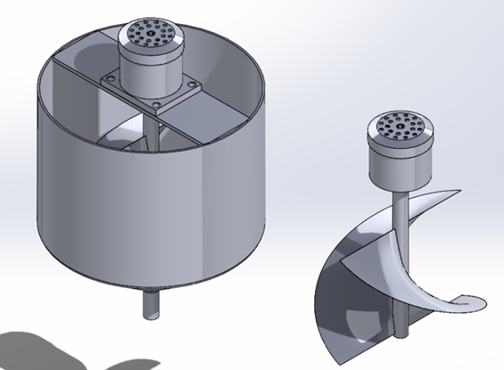
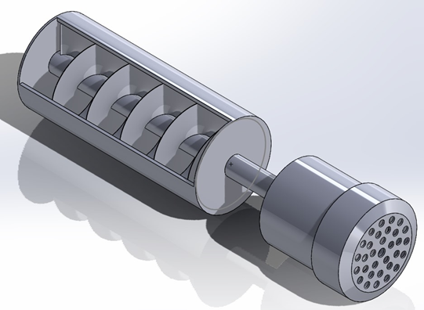
Model Design
Core Components:
🟡 Hopper: Conical shape, 30L capacity, designed for smooth discharge.
🟡Screw Pump: Positive displacement pump for viscous liquids.

Slide 10
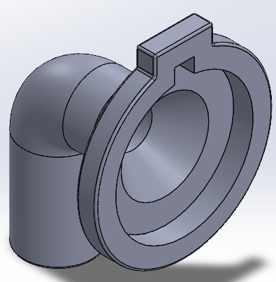
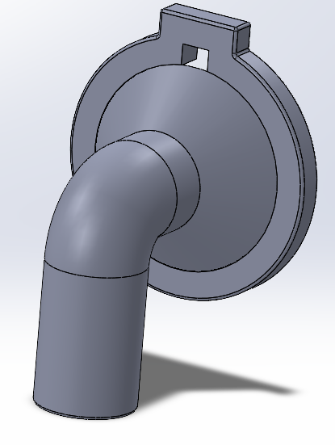
Model Design
🟡Filling Nozzle: Ensures accurate and drip-free dispensing.

Slide 11
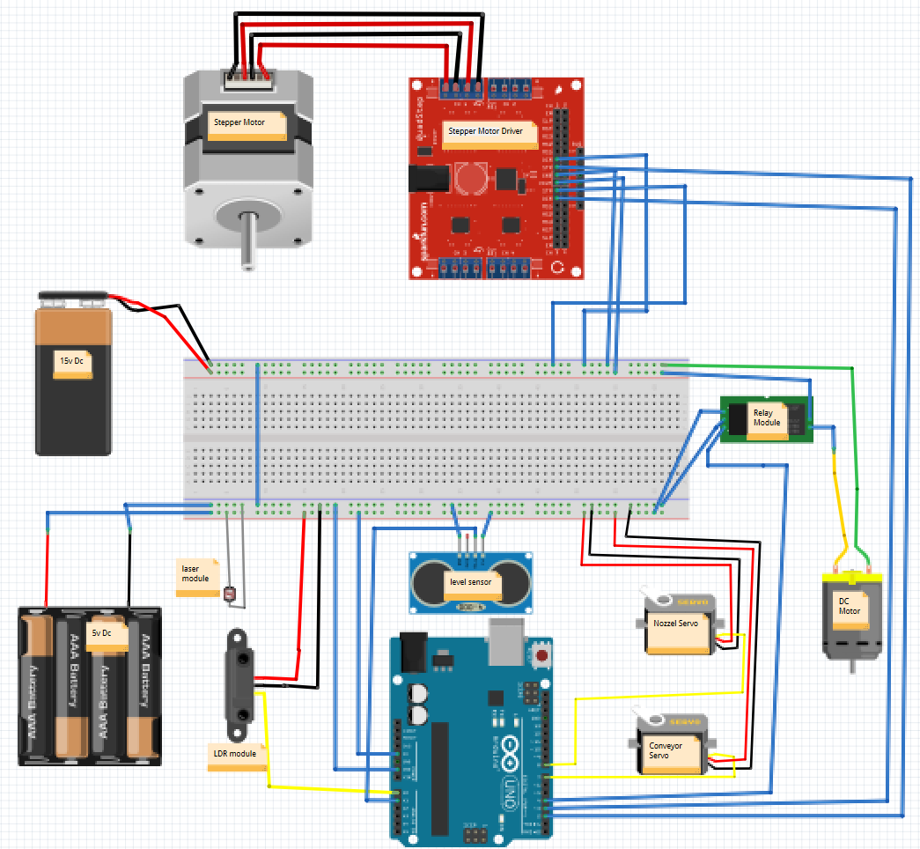
Electrical Design
🟡Main Components:

Slide 12
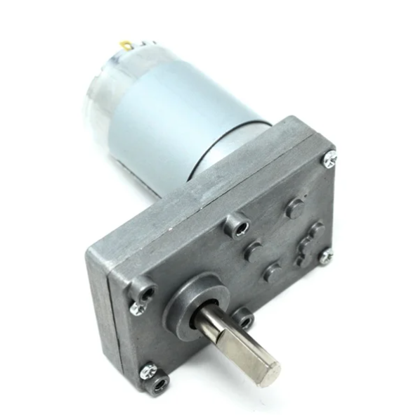
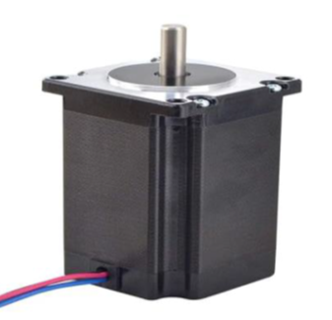
Electrical Design
🟡 DC Motor: For continues mixing through the process.
🟡Stepper Motor: For precise movement of the screw pump.

Slide 13
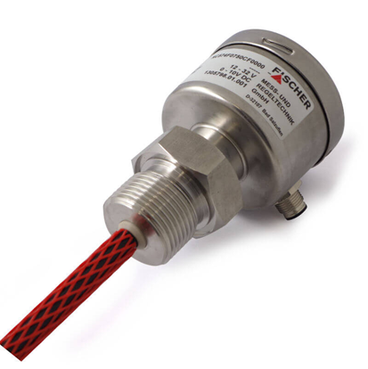
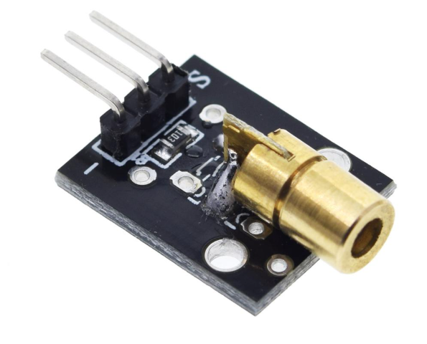
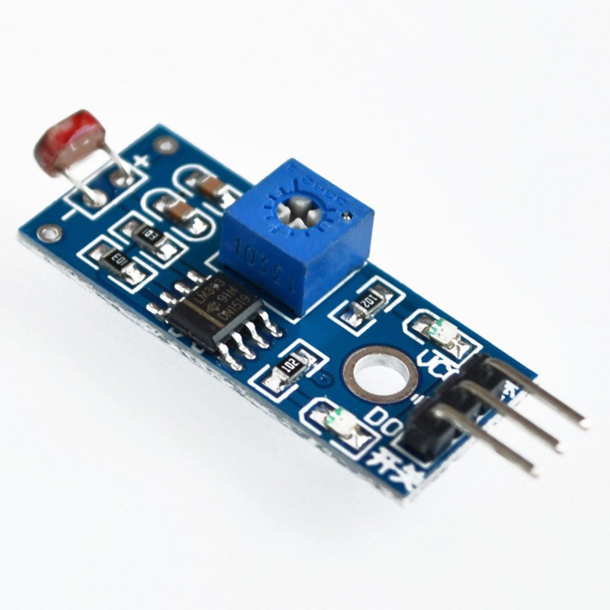
Electrical Design
🟡Sensors: Includes Fischer NC57 capacitive level sensor for monitoring.
🟡 Laser & LDR modules: They are used to detect the containers.

Slide 14
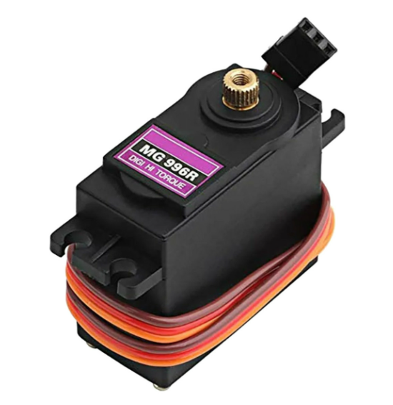
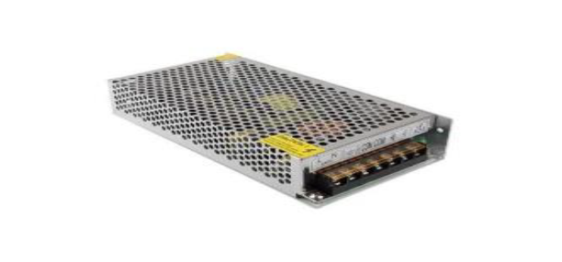
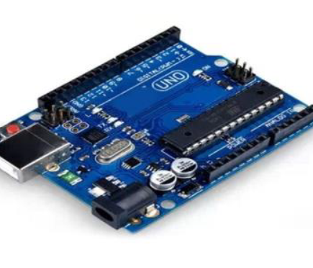
Electrical Design
🟡Servo motors: Used to move the conveyer belt, also for the nozzle.
🟡 Arduino Uno Microcontroller: Central control unit.
🟡Power Supply: Regulated to ensure stability and efficiency.

Slide 15
CONTROL DESIGN
Operational Workflow:
🟡 The system starts by transporting empty containers via the conveyor.
🟡 The pump is activated to fill the container with the specified amount upon detection.
🟡 The mixer speed is controlled to ensure product consistency.
🟡 The nozzle valve is precisely operated to prevent dripping and ensure process cleanliness.

Slide 16
Testing and Implementation
🟡 Assembled key components and integrated control system
🟡 Achieved high filling accuracy for labneh
🟡 Filling Accuracy: ±4% deviation from the target
🟡 Cycle Time: 5 ~ 6 seconds per fill
Modifications Implemented:
🟡 Reduced peristaltic pump speed → minimized foaming
🟡 Adjusted nozzle motor position → improved sealing
🟡 Added temporary mixing cycle → lowered power consumption

Slide 17
Machine Analytics
Performance Analysis:
Efficiency metrics: Reduced waste, optimized throughput.
Energy consumption: Focus on sustainability and cost reduction.
Data Insights:
Real-time monitoring through sensors.
Feedback loops for improved accuracy and reliability.

Slide 18
Feasibility Study
🟡 Technical: Precise filling (±1%) and reliable, low-maintenance operation
🟡 Economic: Budget-friendly (~1650 USD) with 2–3 months payback
🟡 Operational: Easy to use, 96% accuracy within ±4% error
🟡 Legal: Fully compliant with food safety regulations
🟡 Environmental: Low energy use, minimal waste, and easy to clean

Slide 19
Conclusions & Recommendations
🟡 Proven technical effectiveness and real-world potential
🟡 Successful integration of key systems: mixing, pumping, valve control
🟡 Cost-effective, hygienic, and modular solution for small/medium dairy producers
🟡 Recommendations: Enhance materials, automation, hygiene, safety, and calibration
🟡 Future Work: Focus on full automation, energy efficiency, and global certification

Slide 20
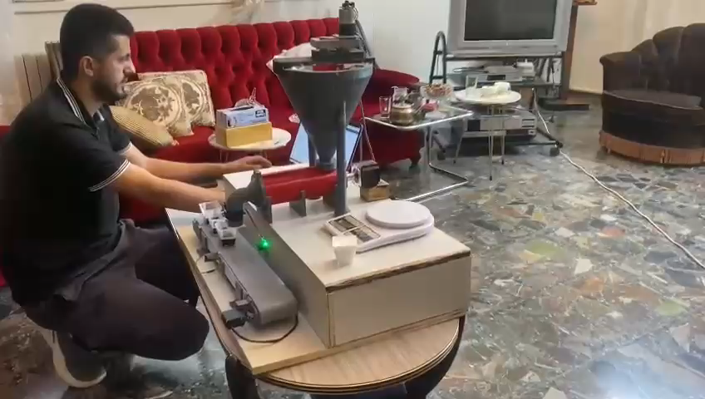

Slide 21
Thank You

