Slide 1
Multi criteria analysis for Palestine energy mix
Prepared by : Ahd Khuffash
Saleh Zyoud
Supervised by: Dr. Mohammad Alsayed

Slide 2
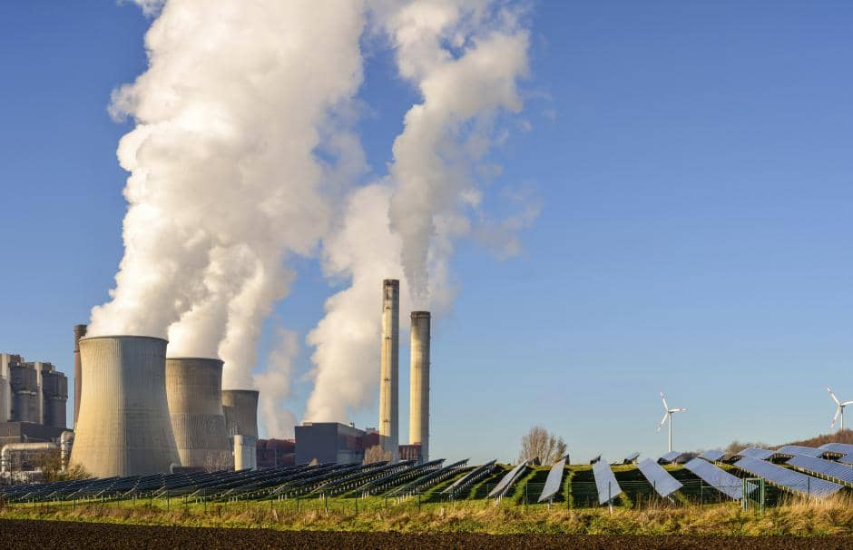
To meet country energy needs we use the types of energy available to it in differing proportions, this is what we call ENERGY MIX .
Palestine doesn't make its own energy due to the complicated geopolitical situation
So consumed energy in Palestine is supplied from different sources

Slide 3
Energy consumed in Palestine sources
IEC (GWH) | Palestinian electric company(GWH) | Imported from Jordan and Egypt (GWH) | Total (GWH)
5461 | 370 | 116 | 5947

Slide 4
Energy sector indicators
Indicator | In 2017
Peak load (MW) | 1350
Available Capacity (MW) | 4463.8
Consumed Energy (GWh) | 5136.886
Imported Energy (GWh) | Total | 5576.864
 | IEC | 5461.155
 | Jordan&Eygpt | 115.71
Loss Percentage (%) | 22%
Average (kWh) Consumed Per Capita | 1138.3
No. Of Consumers | 502310

Slide 5
PENRA's renewable targets
Renewable energy source | 2020 target(Mw) | Achieve by 2017(Mw)
Rooftops solar | 25 | 1.5
Utility scale PV and CSP | 40 | 16
Wind | 44 | 0
Biomass(Animal and Landfill) | 21 | 0.5
Total | 130 | 18

Slide 6
Solar energy
Palestine also have a great potential for some renewable energy sources
Solar energy is the most used and important source of renewable and sustainable energy, in which the energy from the fallen solar radiation is used and converted into energy
potentials, where the annual average of solar radiation is estimated to be around 5.4 kW h/m²/ day and also the presence of the sun during the day is about 8 hours, 3000 hours during the year.
We have an area available for utility scale PV with a potential to produce 4011 MW

Slide 7
Wind energy
Wind energy is one of the most important renewable and sustainable energy sources, as it depends mainly on wind speed and also on energy density
but at the present time in Palestine this source has not been utilized yet as there are no projects based on production and provision of wind energy.
Research team calculated the density of the energy generated by the wind in the Palestinian lands (West Bank and Gaza Strip) and classified these areas for four classifications at an altitude of 40 and 80 meters and it was found that the eastern lands of the city of Hebron are the most appropriate and most suitable for the exploitation and production of energy

Slide 8
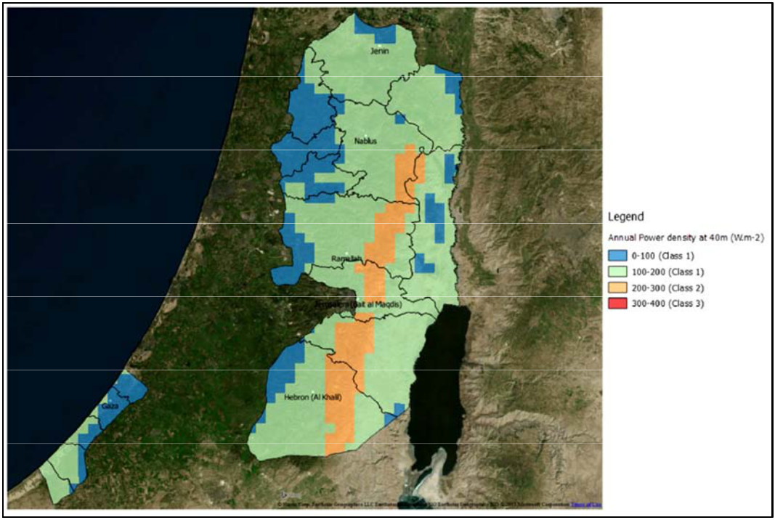
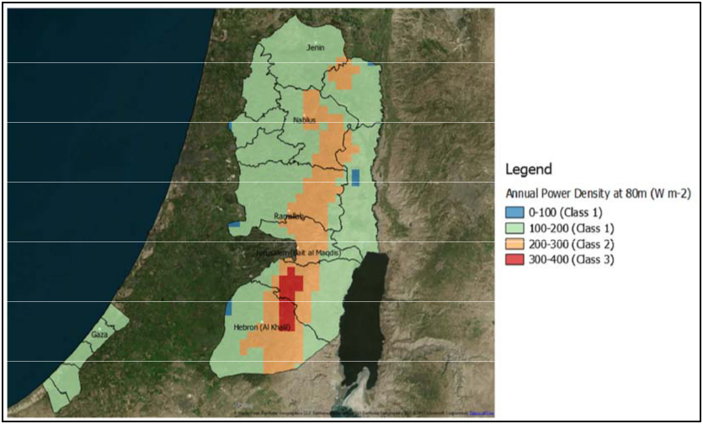

Slide 9
Biomass Energy:
Biomass is important to be included in any energy mix for Palestine because of the high potential and the simplicity of using it .
The sources of this energy in Palestine are either from :
agricultural wastes resulting after harvesting crops or from the resulting waste from industries dependent on agricultural materials(Argo-Industry)
animal waste from animal manure, or from household waste(municipal waste)
Municipal waste can be used in the production of biogas to power combined heat and power.

Slide 10
Animal waste
Animal Type | The number | Residue/animal (ton/head) | Residues (ton) | Total Solids TS % | Volatile Solids VS % | Biogas yield (m3/kg VS) | VS (ton) | Biogas (m3) | Electricity produced per fresh ton (Kwh) | The Annual electricity produced(Gwh)
Cow | 40749 | 13.51 | 550518.99 | 9 | 80 | 0.25 | 39637.4 | 9909350 | 63.1 | 34.72
Sheep and Goats | 884300 | 1.2 | 1061160 | 3 | 87 | 0.87 | 27696.3 | 24095781 | 79.54 | 84.4
Chicken | 53000000 | 0.04 | 2120000 | 20 | 75 | 0.5 | 318000 | 159000000 | 263 | 557

Slide 11
Municipal waste
Region | Total daily waste production (ton) | Average daily waste production from Palestinian families (Kg)
North of the west bank | 711.5 | 3.2
Middle of the west bank | 564.5 | 3.4
South of the west bank | 560 | 3.0
Total | 1835 | 3.2

Slide 12
Agricultural waste
Crop | Mass of wt residue(tn) | Total Solids TS % | Volatile Solids VS % | Biogas yield (m3/kg VS) | VS (t0n) | Biogas (m3) | The Annual electricity produced(Gwh)
Vegetables and Wheat crops
Wheat | 43283 | 70 | 90 | 0.4 | 27268.3 | 10907316 | 38.2
Barley | 10324 | 70 | 90 | 0.4 | 6504.12 | 2601648 | 9.12
Potato | 33334 | 80 | 90 | 0.2 | 24000.5 | 4800096 | 16.8
Chick peas | 3952 | 70 | 90 | 0.4 | 2489.76 | 995904 | 0.014
Cucumber | 62454 | 80 | 90 | 0.2 | 44966.9 | 8993376 | 0.23
Squash | 14552 | 80 | 90 | 0.2 | 10477.44 | 2095488 | 0.05
Tomato | 62268 | 80 | 90 | 0.2 | 44832.69 | 8966592 | 0.22
Maize | 37443 | 70 | 90 | 0.4 | 23589.1 | 9435636 | 0.13
Cabbage | 55940 | 80 | 90 | 0.2 | 40276.8 | 8055360 | 28.2
Total |  |  |  |  |  |  | 93.1

Slide 13
Economic
Fossil Fuels |  |  |  | Renewable Energies
Unit |  | Oil | Nat.Gas | Wind | Rooftops PV | Utility scale PV | Biomass
LCOE | $/Kwh | 0.12 | 0.09 | 0.045 | 0.18 | 0.14 | 0.089
Levelized Capital Cost | $/Kw | 800 | 1150 | 1863 | 2591 | 1646 | 3942
Energy Payback Ratio | Ratio | 3 | 3 | 34 | 7 | 6 | 27

Slide 14
Environmental
Fossil Fuels |  |  |  | Renewable Energies
Unit |  | Oil | Nat.Gas | Wind | Rooftops PV | Utility scale PV | Biomass
Total Life Cycle Emission | T-CO2/GWh | 625 | 500 | 22 | 71.5 | 71.5 | 50
Land Used | Km2 /MWp | 0.002 | 0.002 | 270 | 10 | 56
Water Consumption | Gallons/MWh | 826 | 240 | 0 | 26 | 26 | 235

Slide 15
Social
Fossil Fuels |  |  |  | Renewable Energies
Unit |  | Oil | Nat.Gas | Wind | Rooftops PV | Utility scale PV | Biomass
Import Dependence | Scale | Complete | Complete | None | None | None | None
Jobs Created | Jobs/500MW | 0-500 | 0-500 | 2000-2500 | 1500-2000 | 1500-2000 | 0-500
Social Acceptability | Scale | Neutral | Neutral | High | High | High | Neutral
Accident Impact | $/Mwh | 5.6E-0.02 | 2.8E-0.02 | 4.2E-0.04 | 5.6E-0.05 | 5.6E-0.05 | 2.8E-0.03
Accident Fatality | Deaths/TW-y | 385 | 85 | 103 | 3 | 3 | 0

Slide 16
Technical
Fossil Fuels |  |  |  | Renewable Energies
Unit |  | Oil | Nat.Gas | Wind | Rooftops PV | Utility scale PV | Biomass
Average Efficiency | % | 38-44 | 39 | 35 | 15 | 15 | 22-28
Capacity Factor | % | 85 | 88 | 35 | 20 | 20 | 83
Dispatchable | Yes/No | Yes | Yes | No | No | No | No

Slide 17
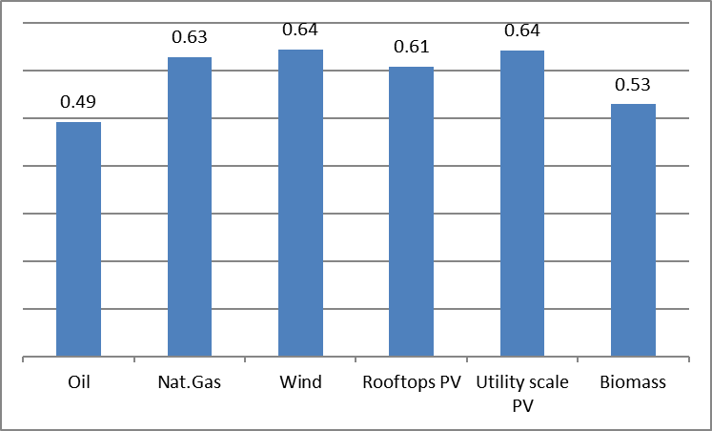
Scenario 1 (ideal case)

Slide 18
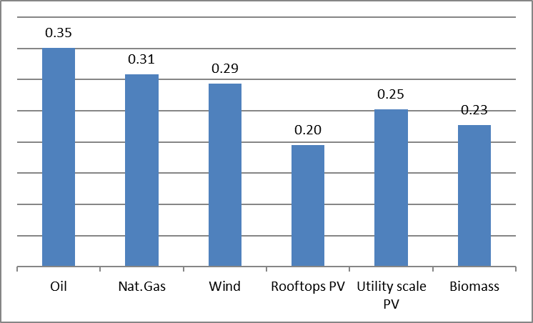
Scenario 2(economic)

Slide 19
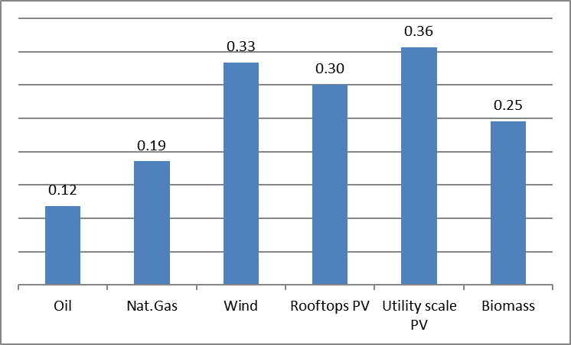
Scenario 3(environmental)

Slide 20
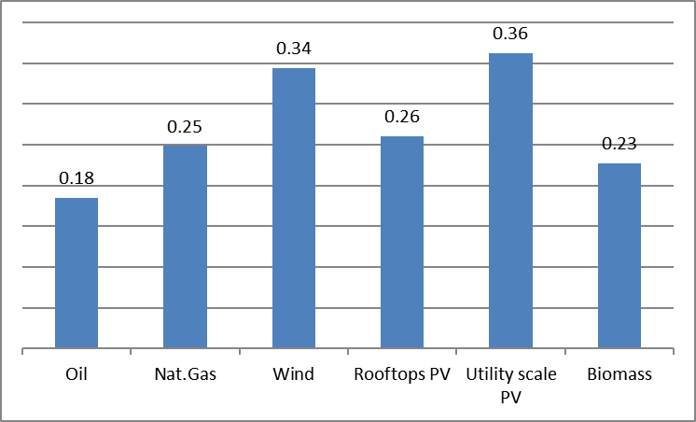
Scenario 4 (social)

Slide 21
Conclusion
In the multi criteria decision making process and after analyzing the results for each scenario we came to the conclusion that wind energy and utility scale PV are the best renewable sources to generate energy in Palestine followed by roof tops PV and biomass
And natural gas-based generation plants should be highly considered during to its efficiency and environmental effect which consider low compared to oil generators
A mix based on natural gas, wind and PV with minor local biomass application with some not clean but cheap oil sources will form the base stone to independent energy sector in Palestine .

Slide 22
Thanks for your time

