Slide 1

Cleaning Robot
Students: Ahmad Dar Saleh
Ameer Dweikat
Supervisor : Aladdin Masri

Slide 2
outline
Idea
Features
Hardware Components
Software Algorithm
Problems
Future Work

Slide 3
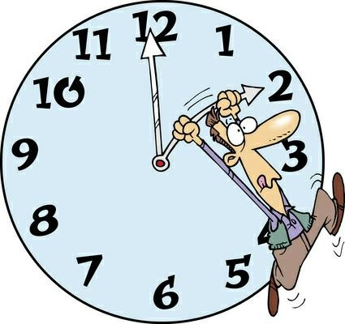
Idea
Most of the people are working and they did not have enough time to clean.
Notes:
في الوقت الحالي ومع التطور التكنلوجي , اصبح الناس يبحثون عن ادوات تساعدهم في اعمالهم اليومية , وتوفر عليهم الوقت والجهد

Slide 4
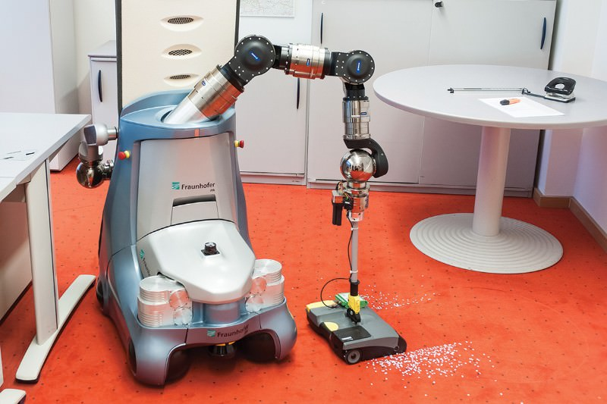
Idea cont…
Most of vacuum robots in the market are expensive and may be large in size
Notes:
ولانو اغلب المكانس الكهربائية المتوفرة حاليا حجمها كبير نوعا ما , ف بحثنا عن امكانية تصغير حجم مكنسة الكهرباء,
وهي يدوية

Slide 5
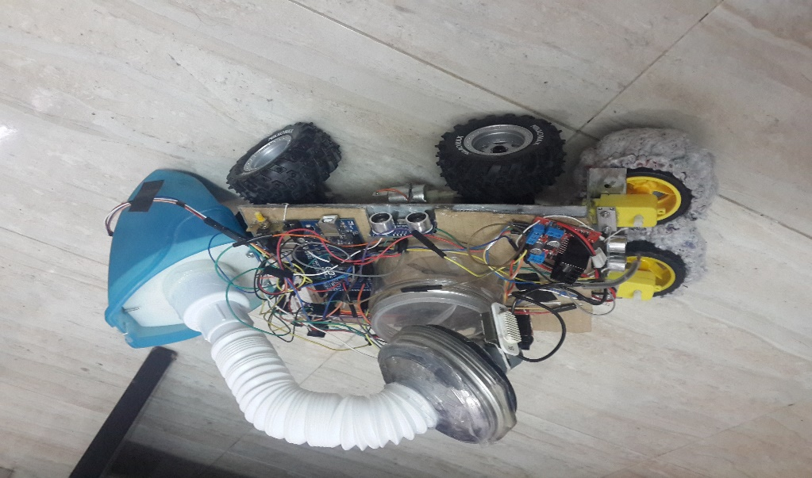
Idea cont…
Therefore…
This project is built to be one of the advantages for human to clean the floor.
Notes:
وهون طلعت فكرة هاد المشروع , في البداية فكرنا كيف نخلييه يكون اسهل اشي لليوزر , ف حكينا اسهل شي انو اليوزر بس يشغلو , وهو يستخدم كاميرا وايميج بروسسنج عشان يدور وين في منطقة وسخة و ينظفها , لكن بعد البحث تبين انها شبه مستحيلة , لانو احنا بننظف الارض , وكل ارض الها لون بلاط مختلف , وفي منو بكون عليه اشكال ف الايميج بروسسنج بكون صعب
تاني حل انو نعمل تطبيق اندرويد ونخلي اليوزر هو يتحكم فيها مانيوالي , بس حكينا بما انو هدفنا توفير الوقت برضو على الناس ف هيك همي بكونو كانهم بنظفو بايديهم يعني جزء من وقتهم ضايع , وكمان اذا كان ل حدا كبير بالعمر ما بعرف يسنخدم الجوال ف الروبوت بهاي الحالة بكون بلا فائدة
ف
الحل الاخير الي لقيناه انو نخلي اليوزر بس يشتغل الروبوت وهو اوتوماتيكلي بنظف الغرفة كلها

Slide 6
Features
Automatic cleaning, the user just run it.
Low cost, cost of body, the sensors, Arduino and the motors.
It’s size allow it to enter a small area.
Two functionalities: suck up dust and dirt and sweeps the ground.

Slide 7
Features
A void any obstacle at any corner of the room.

Slide 8
Features cont…
A void any obstacle at the center of the room, which may be discrete or continuous.
Discrete Continuous

Slide 9
Features cont…
Four starting points , and this to avoid more obstacles through our algorithm.

Slide 10
Hardware Components
Robot Body
Robot Body is the mechanical part of the robot which contains wheels and vacuum
Microcontroller
In our project we Arduino Mega microcontroller.

Slide 11
Hardware Components cont…
DC Motors
In our project we use one dc motor, to control back wheels.
H-Bridge Motor Driver
In our project we use two H-Bridge one for Dc Motor and one for Floor cloth Motors.
Notes:
L298n is a dual H-Bridge motor driver, so with one IC we can interface two DC motors which can be controlled in both clockwise and counter clockwise .

Slide 12
Hardware Components cont…
Sensors :
1. sensors are used to detect obstacles.
2. We used Four Ultrasonic sensors, in front, left, right and back
Switch's:
  We Use 3 switch's one for run the robot and one
  for vertical/horizontal cleaning, and one for the vaccum

Slide 13
Hardware Components cont…
Water switch
  we use water switch for water tank to close
  control tank or open it.
Servo Motor
We used it to control the front wheels direction.

Slide 14
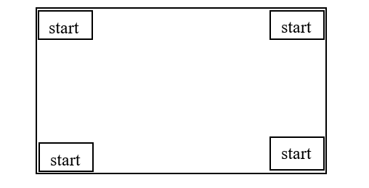
Software Algorithm
We classify the problems depends on the position of obstacles to three cases :
Case1 :No obstacle at all the room

Slide 15
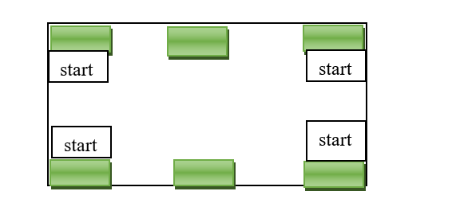
Software Algorithm cont…
Case2 :No obstacle at the center of the room and all obstacles are only in the corners or at the center of two ends only.

Slide 16
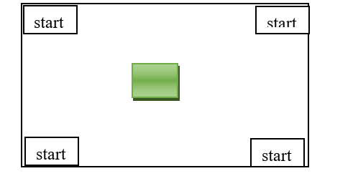
Software Algorithm cont…
Case3: there is obstacles in the center.

Slide 17
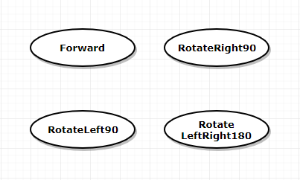
Software Algorithm cont…
Our Algorithm has 4 states:

Slide 18
Software Algorithm cont…
This algorithm solve all previous cases. The coming flow chart will illustrate the algorithm.

Slide 19
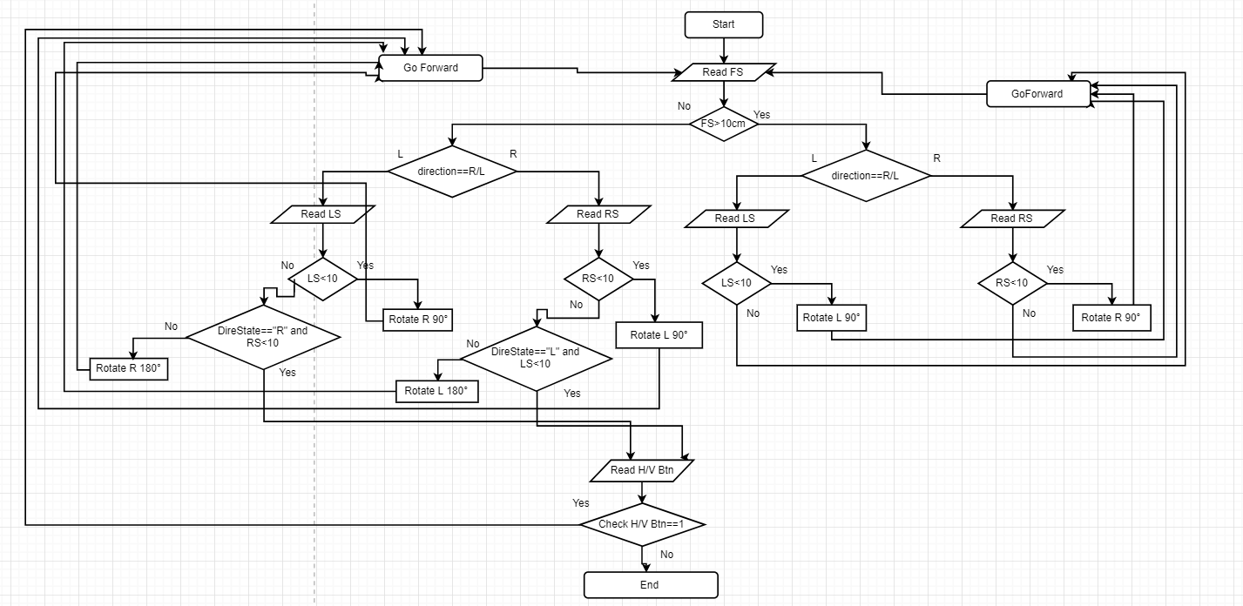
Software Algorithms cont…

Slide 20
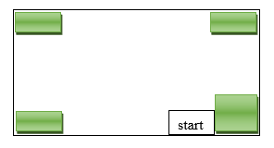
Software Algorithm Example

Slide 21
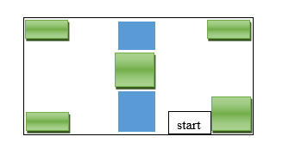
Software Algorithm Example cont…

Slide 22
Problems
Use Image processing to detect the garbage.
The Algorithm that will make the car move smoothly.
The problem of unavailable Electronic parts.
The problem of find a suitable toy car that will carry the vacuum and water module.
Notes:
like A small vacuum cleaner which we used instead of it the Vacuum cleaner used for cleaning cars Where we took what we needed from it.

Slide 23
future Work
Control the robot use mobile app.
Make the robot respond to voice commands.
Make the robot work for the carpet.

Slide 24

Demo

Slide 25


Slide 26

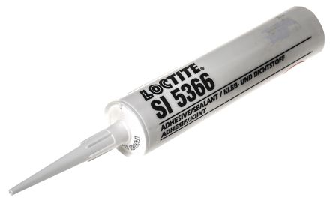
Before Thank You ?

Slide 27


Any Questions?

