Slide 1

ONS
Prepared by: Shahd Fakhouri & Raya BreakSupervisor: Dr. Raed Al-Qadi

Slide 2
Why Elderly Care is a Problem
Gaps in Existing Solutions
Health risks, loneliness, emergencies
Families struggle to monitor remotely
Most apps solve one problem only
No unified system for:
  Health
  Communication
  Safety
  Emotional support

Slide 3
What is ONS?
Main Objectives
All in one elderly care platform
Connects elders, families, caregivers, retirement homes
Improve elderly safety
Simplify care coordination
Support mental & emotional well-being
Respect privacy & consent

Slide 4
System Users: Role-Based Access for Tailored Experiences
ONS supports five main user roles, each with distinct permissions to ensure data security and relevance. This role-based access control (RBAC)
ensures each user sees only what they are authorized to see.
Elders
Family Members
Caregivers
Retirement Homes
Admins

Slide 5
Technical Architecture and Development Stack
Development Environment & Version Control
Android Studio
Visual Studio Code
GitHub
Core Frontend & Backend Languages
Flutter (Dart)
Node.js
Python
Database & API Testing
XAMPP & MySQL
MongoDB
Postman
Navigation & Location Services
Android GPS Services
Google Maps API
AI & Communication Services
OpenAI API
Twilio
Twilio SendGrid
Payments
PayPal

Slide 6








Core Features: A Holistic Approach to Eldercare
ONS integrates essential functionalities to provide comprehensive support for elders and their care network.
Emergency System
Health Monitoring
Medication Tracking
Payments & Reports
Location Tracking
Community & Communication
AI Companion

Slide 7
Administrator Module
Administrative Dashboard
Administrator Authentication
Caregiver Approval & Retirement Home
Matching Requests Management
Payments and Financial Management
Health Logs Monitoring & Notifications and
Alerts
User Management & Weekly Reports & Elder
Assignments
Analytics and System Statistics

Slide 8
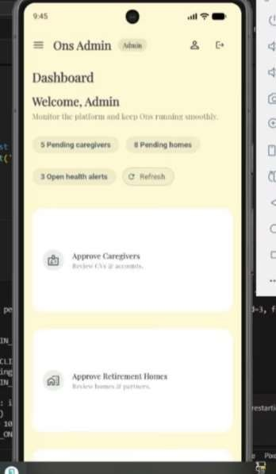
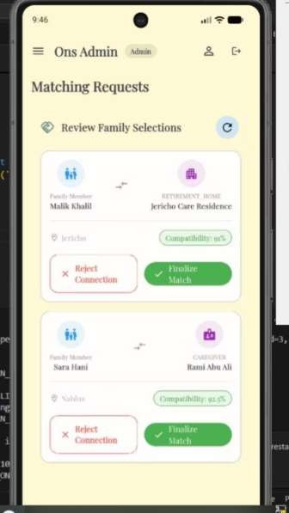
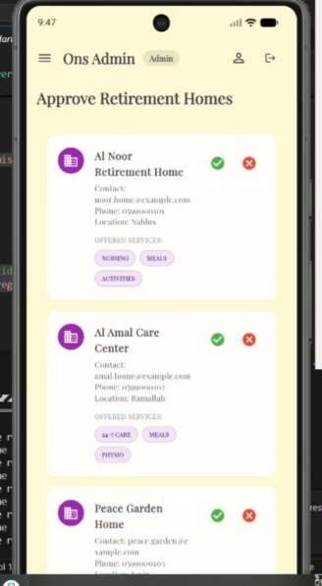
Platform Features For Admin

Slide 9
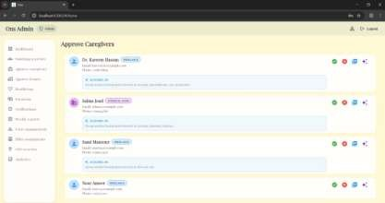
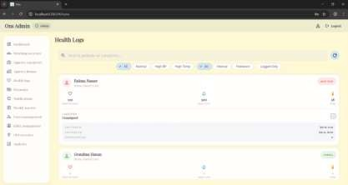
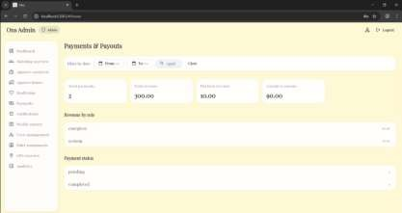
Platform Features For Admin

Slide 10
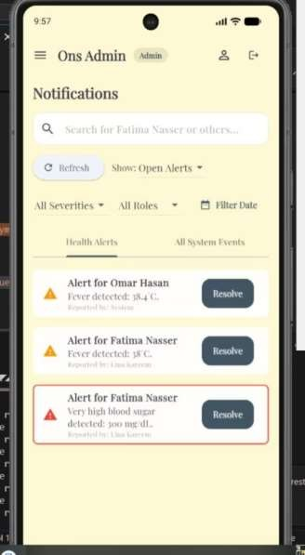
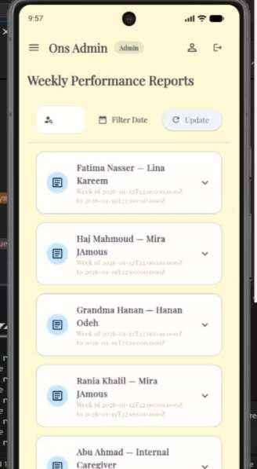
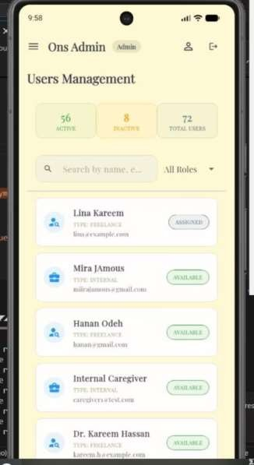
Platform Features For Admin

Slide 11
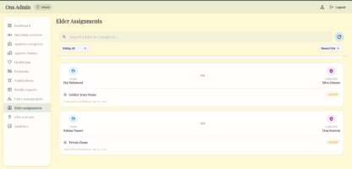
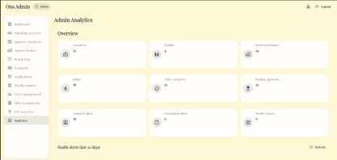
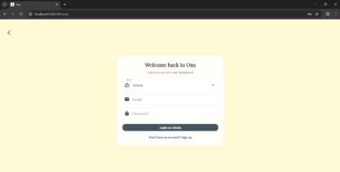
Platform Features For Admin

Slide 12
Caregiver Module
Caregiver Authentication
Caregiver Dashboard and Profile Management
Chat With Family Members
Health Alerts and Emergency
Notifications
Shift Management and Time
Tracking
Earnings and Payments
Elder Management

Slide 13
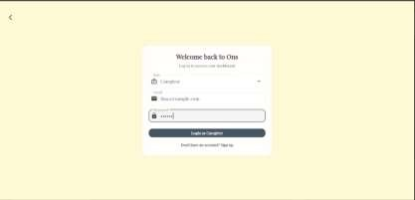
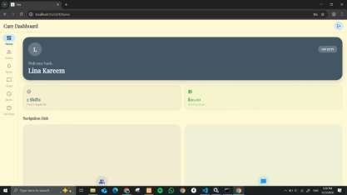
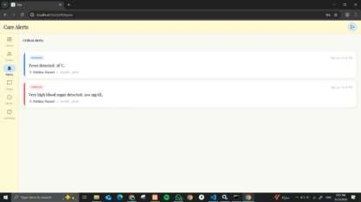
Platform Features For Caregivers

Slide 14
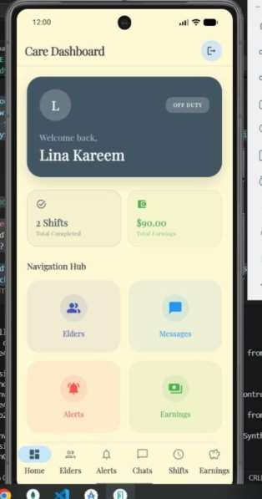
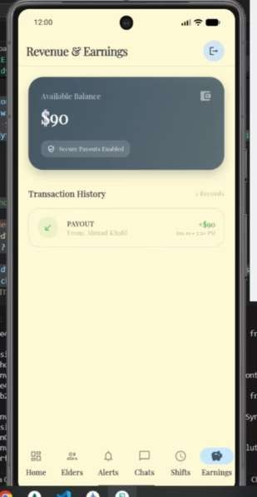
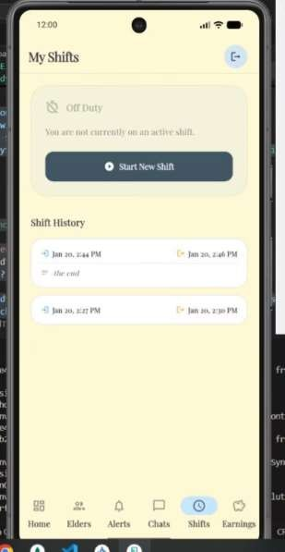
Platform Features For Caregivers

Slide 15
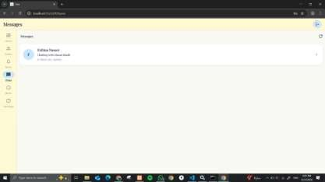
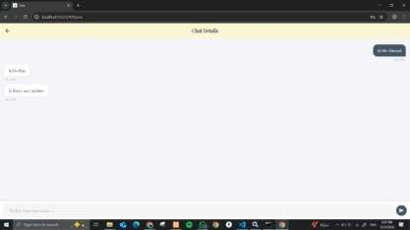
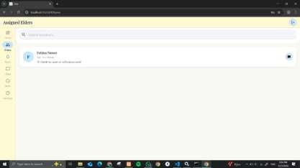
Platform Features For Caregivers

Slide 16
Elder Management
Overview
Health
Meds
Summary
Location
Alerts
Incidents
Visits
Family

Slide 17
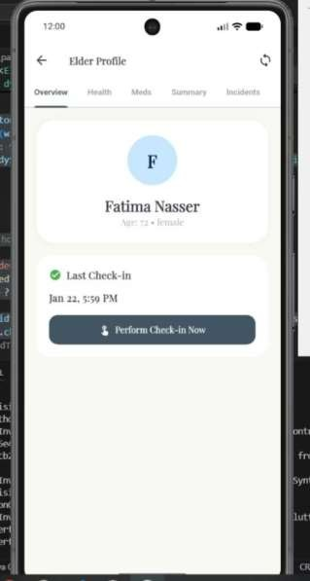
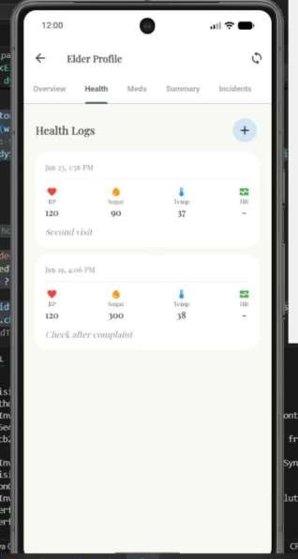
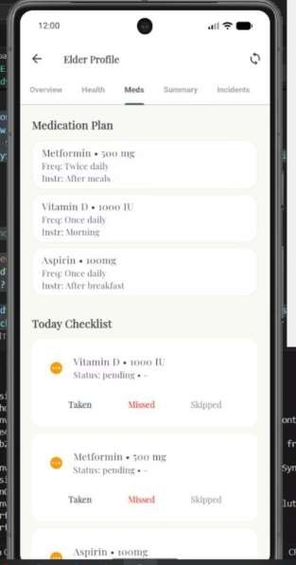
Platform Features For Caregivers (ELDERS)

Slide 18
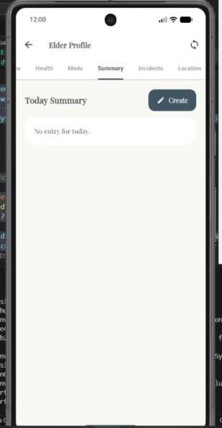
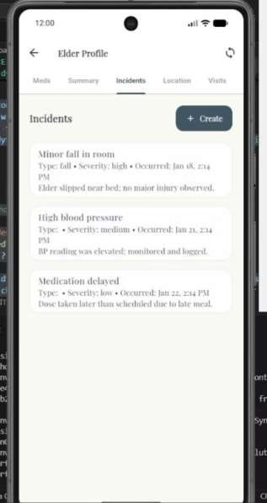
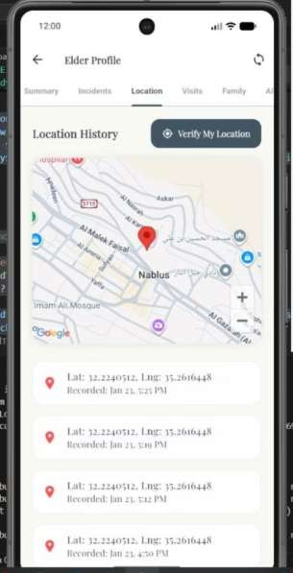
Platform Features For Caregivers (ELDERS)

Slide 19
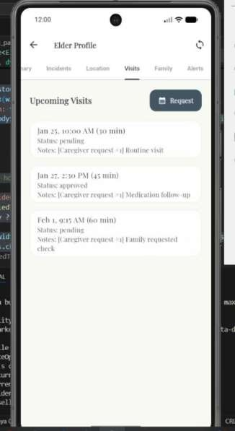
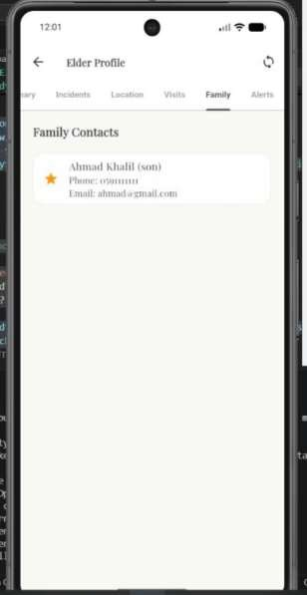
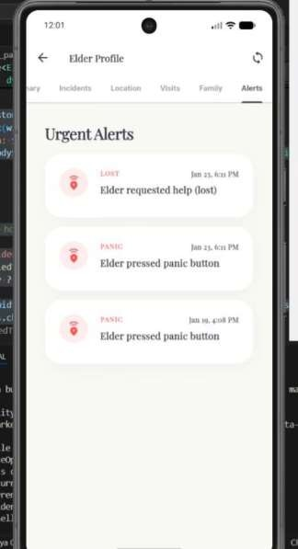
Platform Features For Caregivers (ELDERS)

Slide 20
The Family Module
The Unified Care Interface (Overview)
Elder Management & Transparency
Real-Time Safety & Crisis Awareness
Multi-Channel Communication (Chat & Voice)
Care Coordination (Calendar & Scheduling)
Smart Matching & Personalized Care
Financial Management & Accountability

Slide 21
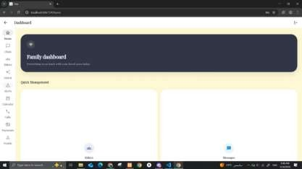
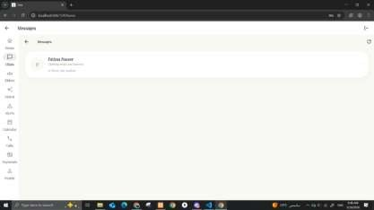
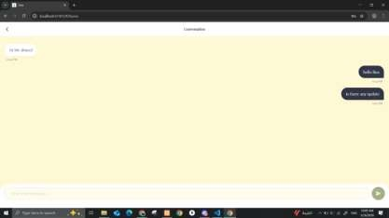
Platform Features For Family

Slide 22
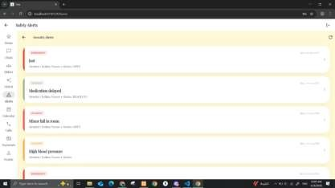
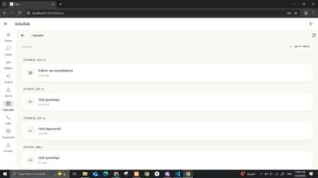
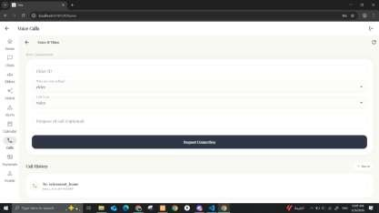
Platform Features For Family

Slide 23
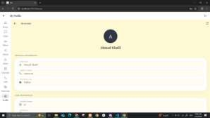
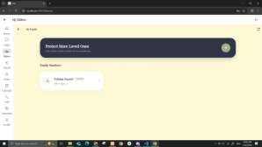
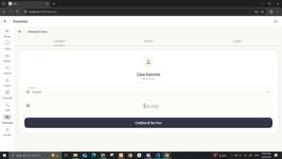
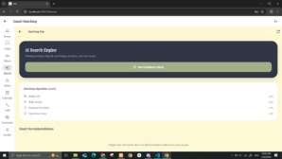
Platform Features For Family

Slide 24
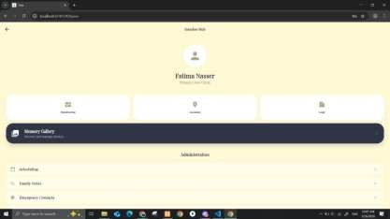
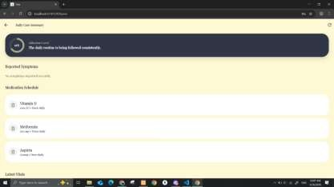
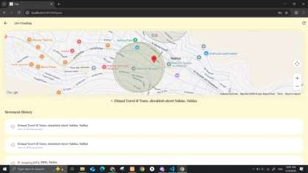
Platform Features For Family (ELDERS)

Slide 25
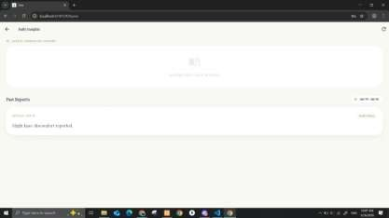
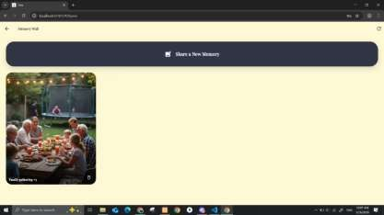
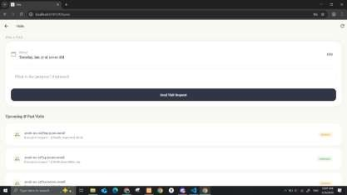
Platform Features For Family (ELDERS)

Slide 26
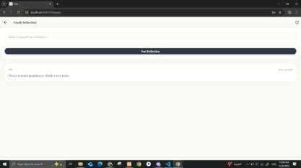
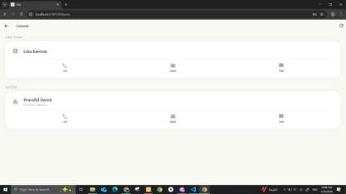
Platform Features For Family (ELDERS)

Slide 27
The Elders Module
The Heart of ONS (Overview)
The Accessible Dashboard
Proactive Health & Medication Tracking
Safety & Crisis Management
Meaningful Connection
(Communication & AI)
Engagement & Community
Dignity through Privacy & Personalization

Slide 28
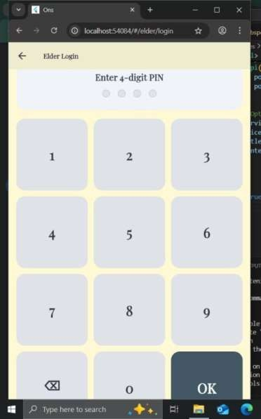
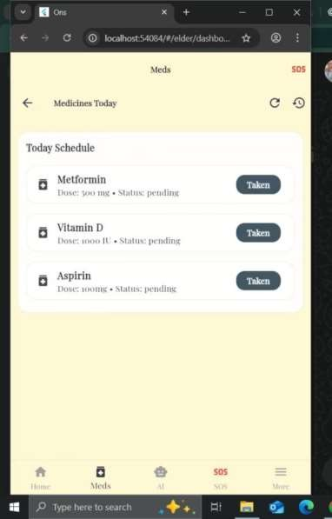

Platform Features For Elders

Slide 29




Platform Features For Elders

Slide 30




Platform Features For Elders

Slide 31



Platform Features For Elders

Slide 32
The Retirement Home Module
The Institutional Command
Center (Overview)
Facility Dashboard & Status
Summary
Intelligent Staff & Workload
Management
Real-Time Resident Monitoring
Operational Logistics (Shifts &
Attendance)
The Emergency Dispatch Center
Safety Governance (Alerts & Incident Tracking)
Financial Management & Sustainability

Slide 33



Platform Features For Retirement Home

Slide 34



Platform Features For Retirement Home

Slide 35



Platform Features For Retirement Home

Slide 36
Privacy & Security
ONS follows a privacy-first design:
JWT authentication
Elder consent controls
Role-based access control
Secure databases

Slide 37
Challenges & Achievements
Challenges
What We Achieved
Real elderly data
Full working platform
System complexity
Multi-role system
SMS Delivery
Realistic healthcare workflow

Slide 38
Future Enhancements
More wearables
Multi-Language Expansion
Integration with Hospital Systems
Voice Commands

Slide 39
Conclusion
ONS is not just a monitoring tool; it is a complete eldercare ecosystem.
It improves:
Safety
Communication
Accountability
Quality of life
for elders and everyone involved in their care.

Slide 40
Thank You

