Slide 1
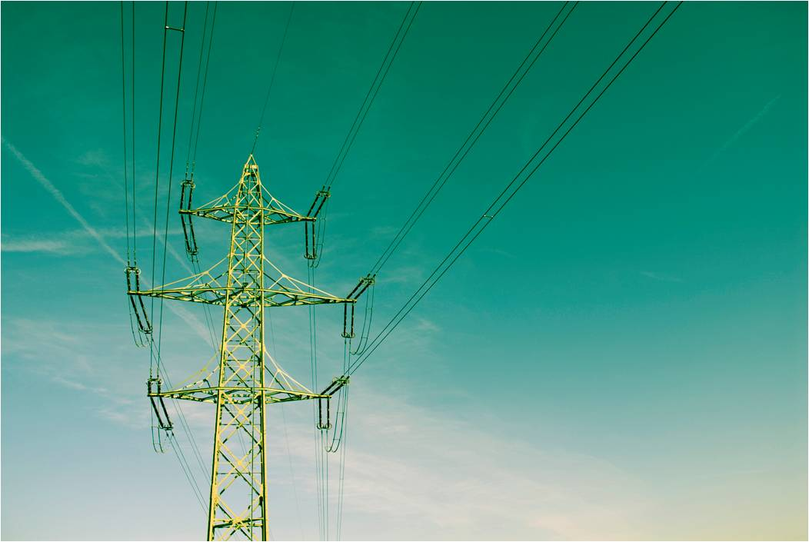

An-Najah National University
Faculty of Engineering
Electrical Engineering Department
Optimum Performance For
Aqraba Electrical Network
Supervisor:
Dr. Imad Breik
Prepared By:
Jehad Yahya
Mohammad Shihab
2013-2014

Slide 2
Outlines:
The objectives of this project .
Description of Aqraba Electrical Network .
Making analysis for Aqraba Network by using ETAP software program :
Improvement for Max. Case in the (Medium & Low voltage side ) .
Improvement for Min. Case in the (Medium & Low voltage side ) .
The economical Study .
Sag & Tension problem in Overhead lines for Aqraba electrical network .
Design a solar energy system to support the network with it .

Slide 3
Objectives
Increase the voltage level at the consumer terminals ,
decrease the losses in the network and minimize the
penalties by improve the power factor through several
steps:
Design a solar energy system to support the network with it .
Swing Buses.
Transformer Taps.
Capacitor Banks (Compensation).

Slide 4
The Problems
Through cooperation with Aqraba municipality, we were able to know the basic problems in the network
1. Overload
2. Currents
3. Low voltage at the consumer terminals
5. Penalties because of low power factor
6. Sag & Tension problem in the overhead lines

Slide 5
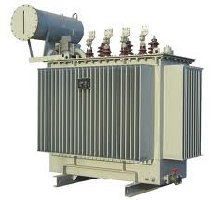
Description of Aqraba Network
Aqraba Electrical Network is provided by Israel electrical company (IEC) through an over head transmission line of 33 kV. The max demand is reached (2MW).
The main supply for Aqraba electrical distribution network in the Za'tara Street.. And the voltage of the existing distribution networks are 33 KV only.IEC supplies electricity to the electrified communities by 33 KV by overhead lines .
Aqraba electrical network consists of 18 (33/0.4 KV) distribution transformers.

Slide 6
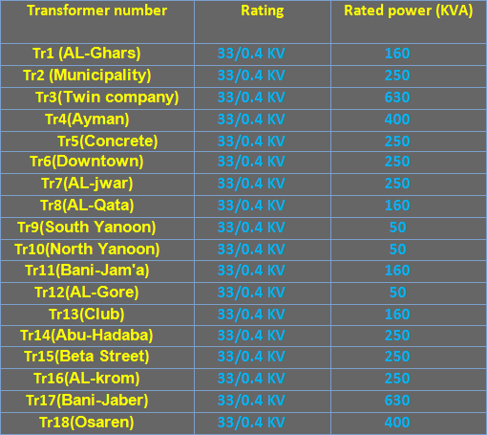
Distribution Transformer for Aqraba Network

Slide 7
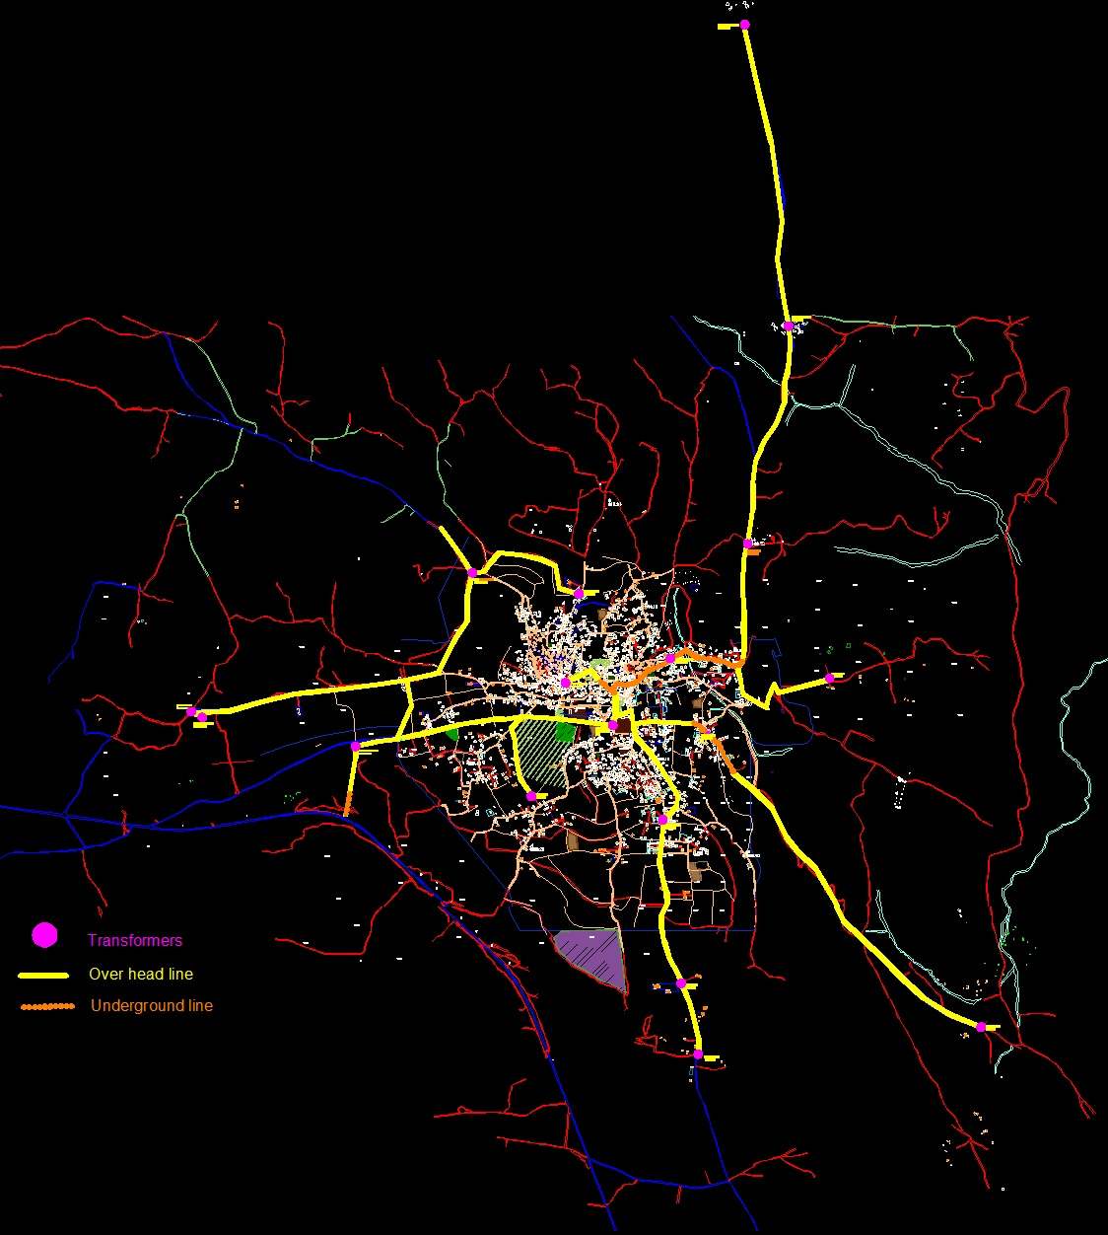
The Length of the Transmission Lines
To determine the length for each transmission line, we use a MAP for Aqraba Village by using AutoCAd software program :

Slide 8
One Line Diagram

Slide 9
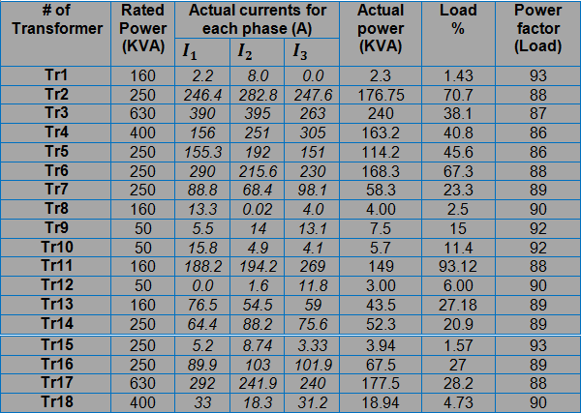
Max. Case Improvement
Transformer loading :

Slide 10

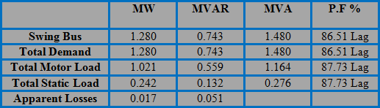
Max. Case Improvement
After making analysis for the original Max. Case, the result is shown below :
Swing Bus Result :
Summary of total generation, loading and demand :

Slide 11
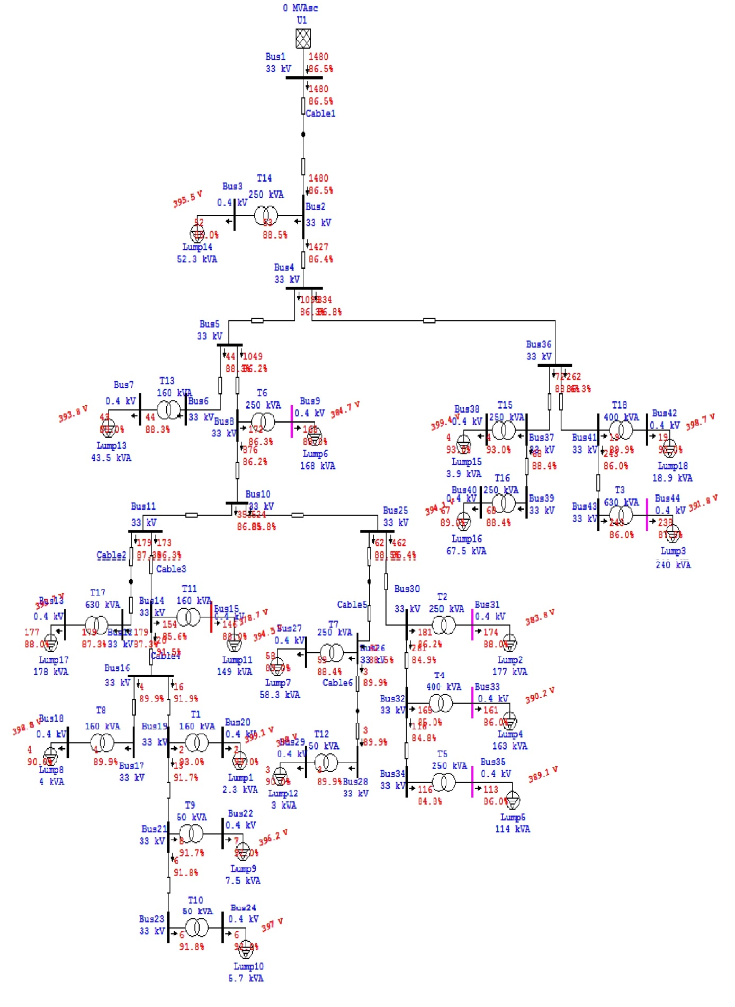

Slide 12
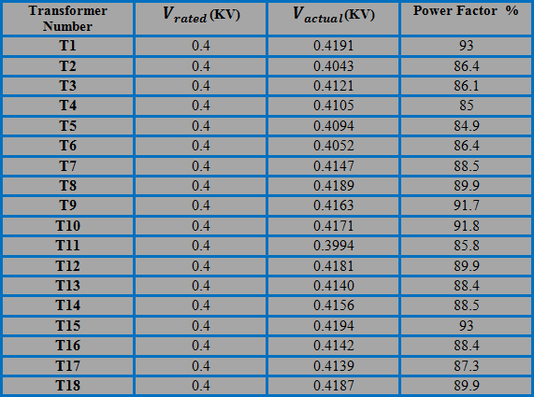
Max. Case Improvement
Increase the swing bus voltage :

Slide 13
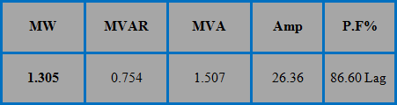
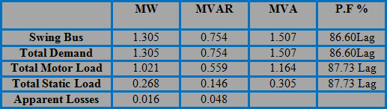
Max. Case Improvement
Swing Bus Result :
Summary of total generation, loading and demand :

Slide 14
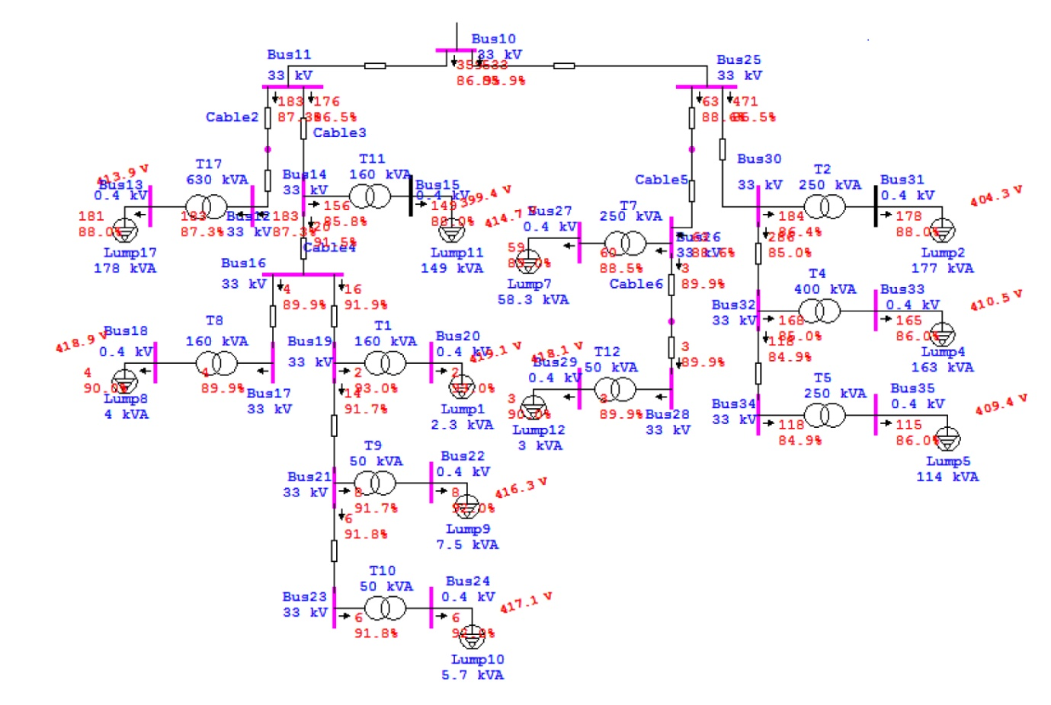

Slide 15
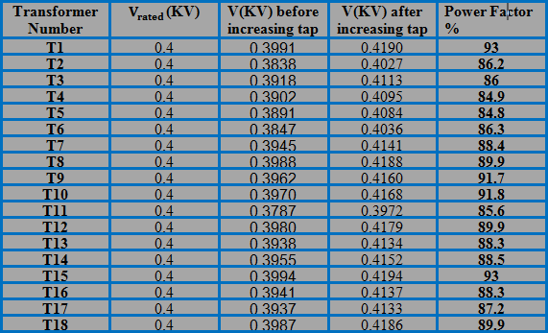
Max. Case Improvement
Increase the tap ratio of the Transformers to 5 % :

Slide 16
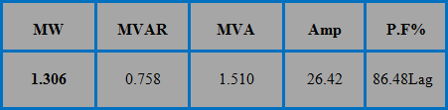
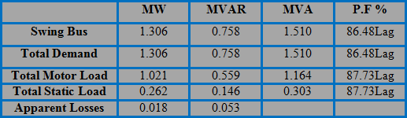
Max. Case Improvement
Swing Bus Result :
Summary of total generation, loading and demand :

Slide 17
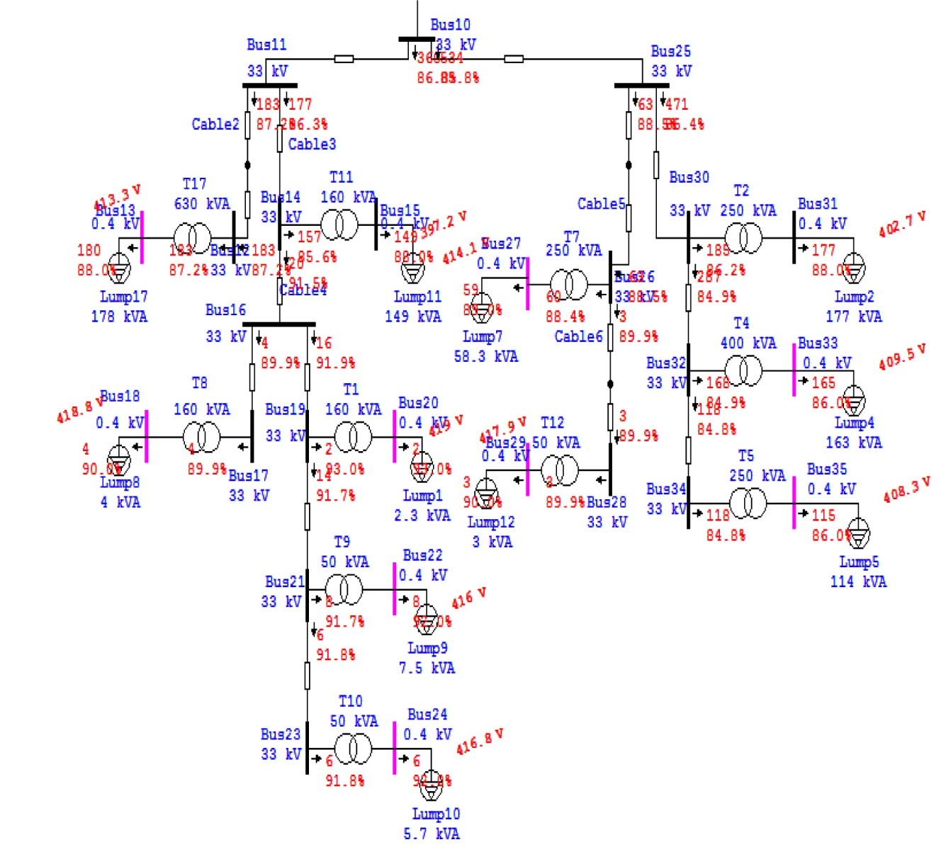

Slide 18
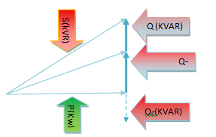
Max. Case Improvement
Power Factor Improvement :
How to improve the Power Factor :
Capacitor Bank:
The important of improvement
power factor is by adding shunt
capacitor banks at the buses at
both transmission and distribution
levels and loads and there are more effective to add them in the low level voltages.

Slide 19
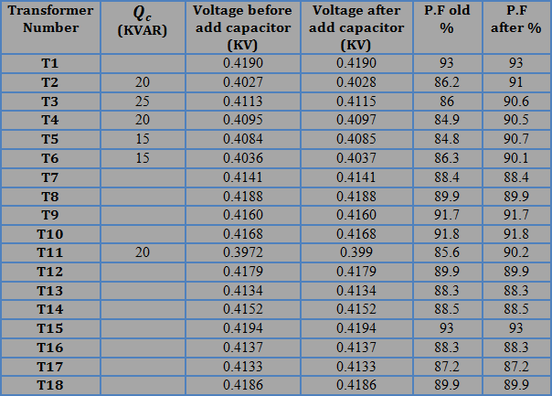
Power Factor Improvement :
The result of load flow after after adding the capacitor banks :

Slide 20
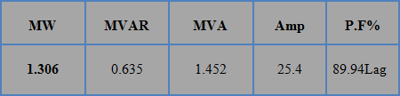
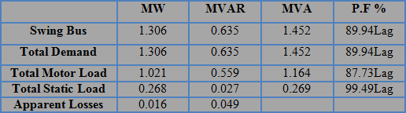
Max. Case Improvement
Swing Bus Result :
Summary of total generation, loading and demand :

Slide 21
Max. Case Improvement
After adding the capacitor banks the losses in the network
decrease and the total current decrease
- The losses before= 0.018 MW, and the swing current = 26.42 A.
- The losses after=0.016 MW, and the swing current = 25.4 A.

Slide 22
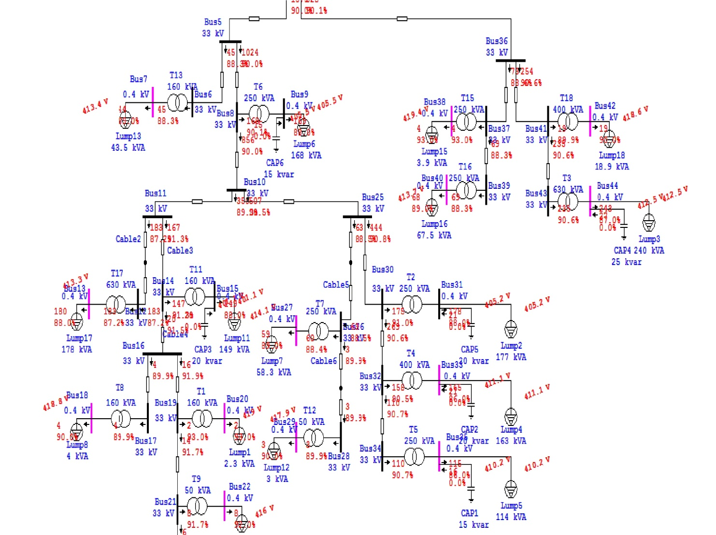

Slide 23
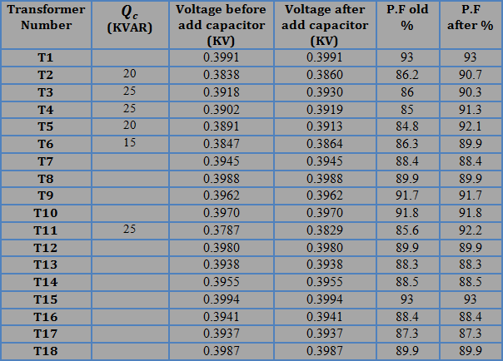
Max. Case Improvement
The voltage level improvement :

Slide 24
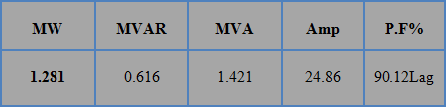
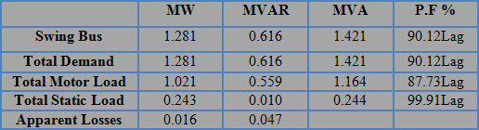
Max. Case Improvement
Swing Bus Result :
Summary of total generation, loading and demand :

Slide 25
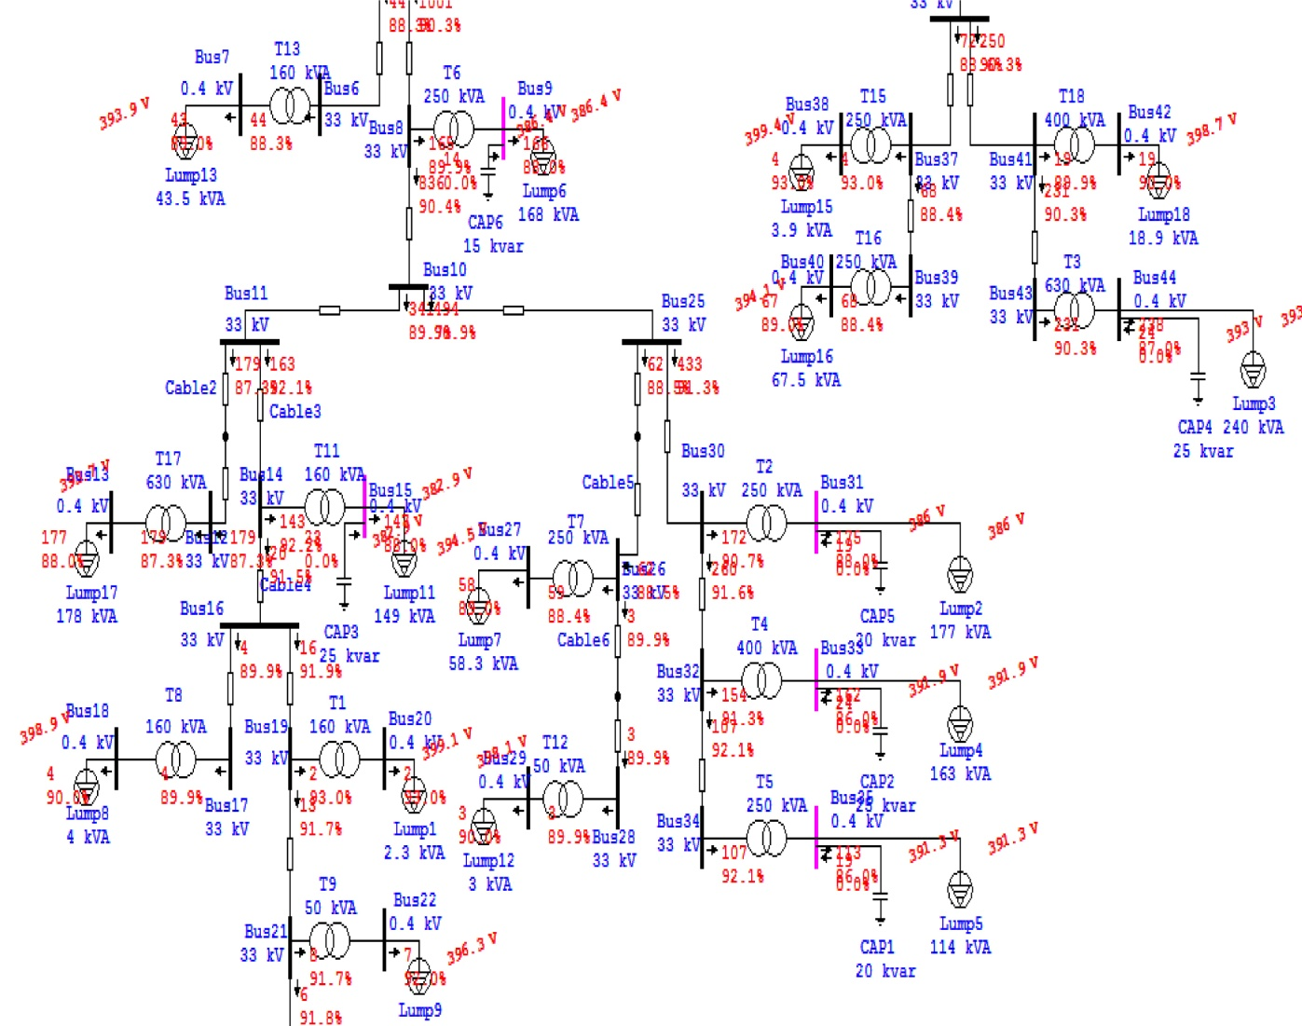

Slide 26
Max. Case Improvement
After adding the capacitor banks the losses in the network
decrease and the total current decrease
- The losses before= 0.018 MW, and the swing current = 26.42 A.
- The losses after=0.016 MW, and the swing current = 24.86 A.

Slide 27
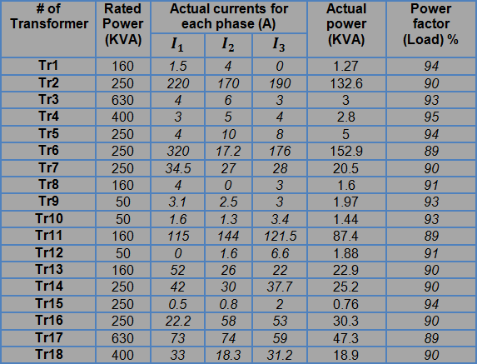
Min. Case Improvement
Transformer loading :

Slide 28

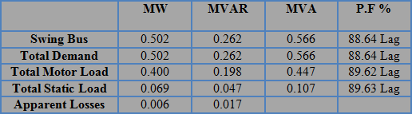
Min. Case Improvement
After making analysis for the original Min. Case, the result is shown below :
Swing Bus Result :
Summary of total generation, loading and demand :

Slide 29
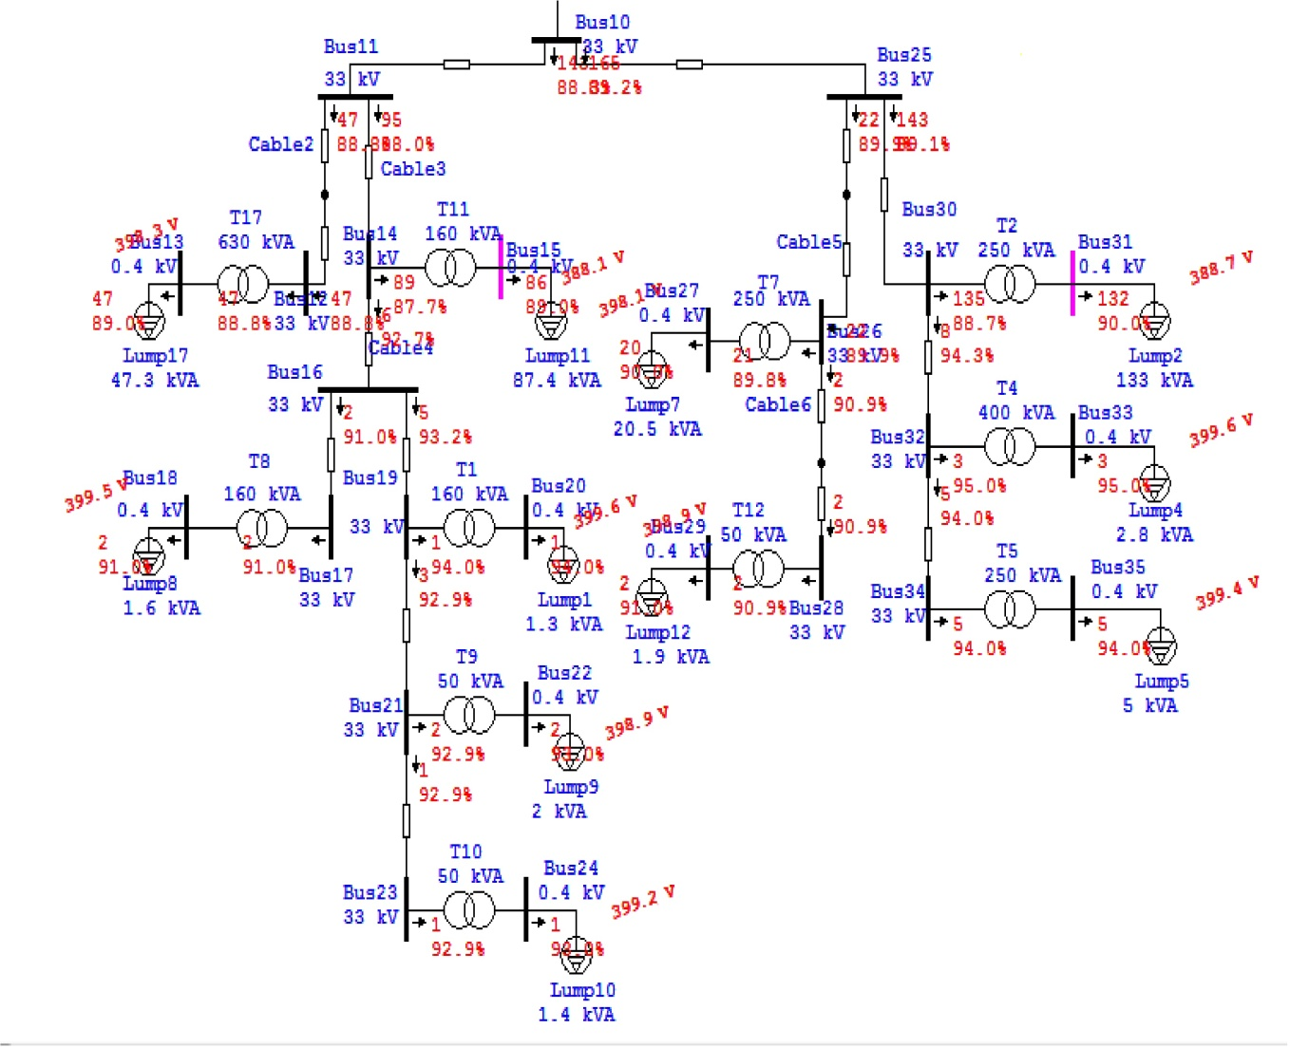

Slide 30
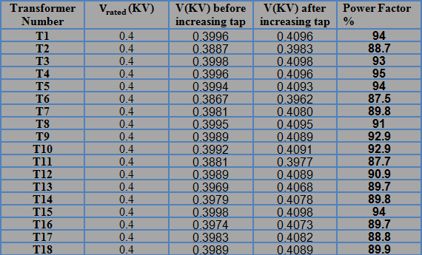
Min. Case Improvement
Increase the tap ratio of the Transformers to 2.5 % :

Slide 31

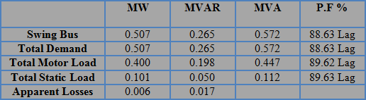
Min. Case Improvement
Swing Bus Result :
Summary of total generation, loading and demand :

Slide 32
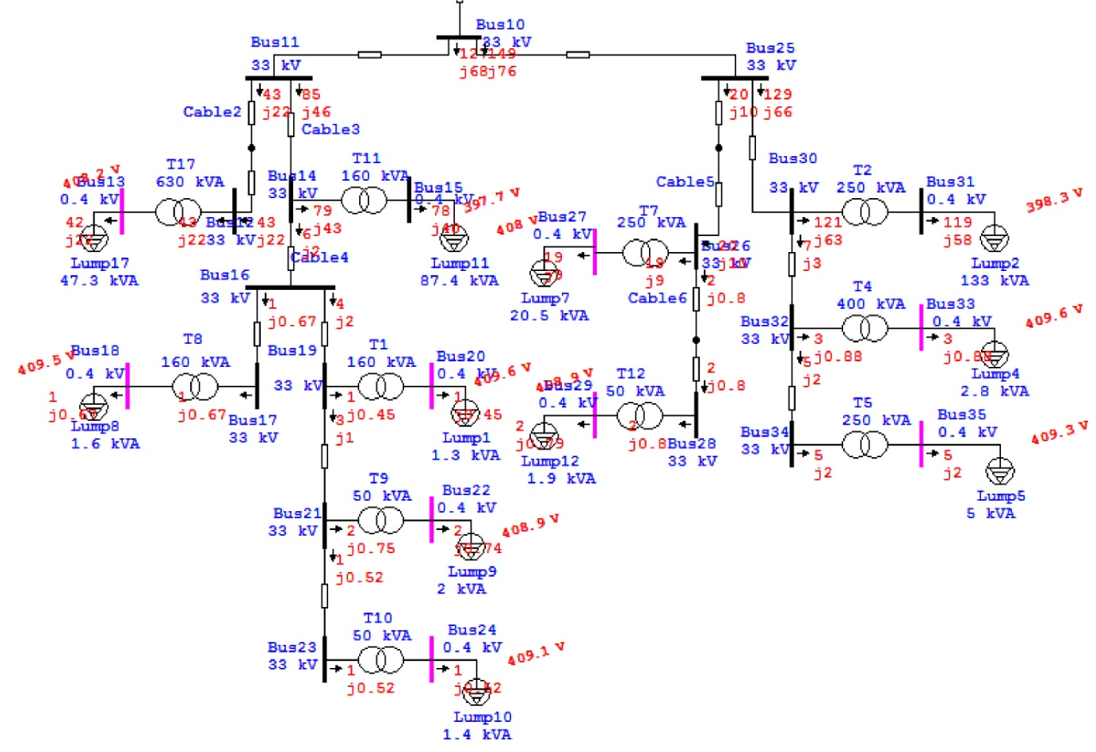

Slide 33
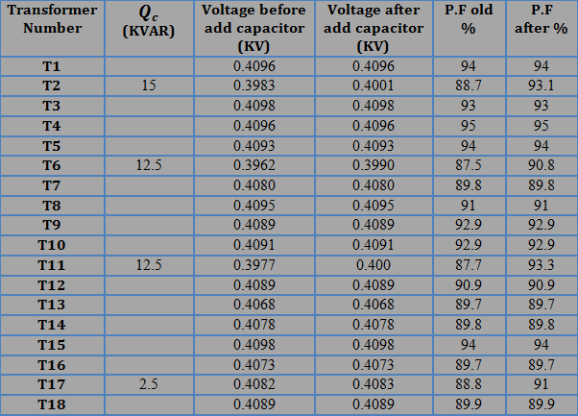
Power Factor Improvement :
The result of load flow after after adding the capacitor banks :

Slide 34

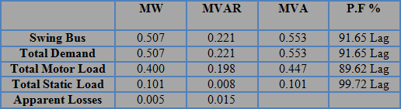
Min. Case Improvement
Swing Bus Result :
Summary of total generation, loading and demand :

Slide 35
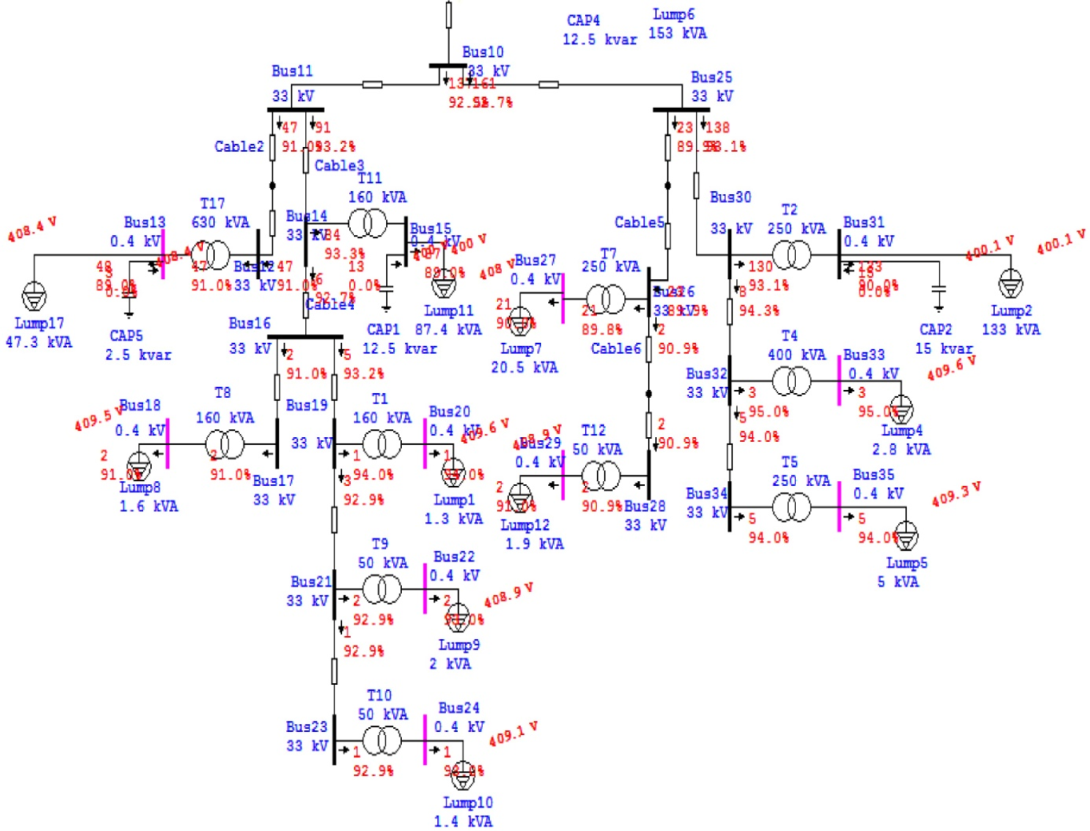

Slide 36
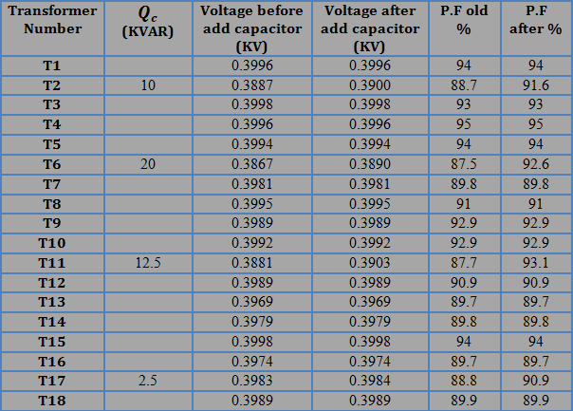
Min. Case Improvement
The voltage level improvement :

Slide 37

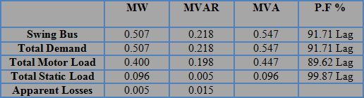
Min. Case Improvement
Swing Bus Result :
Summary of total generation, loading and demand :

Slide 38
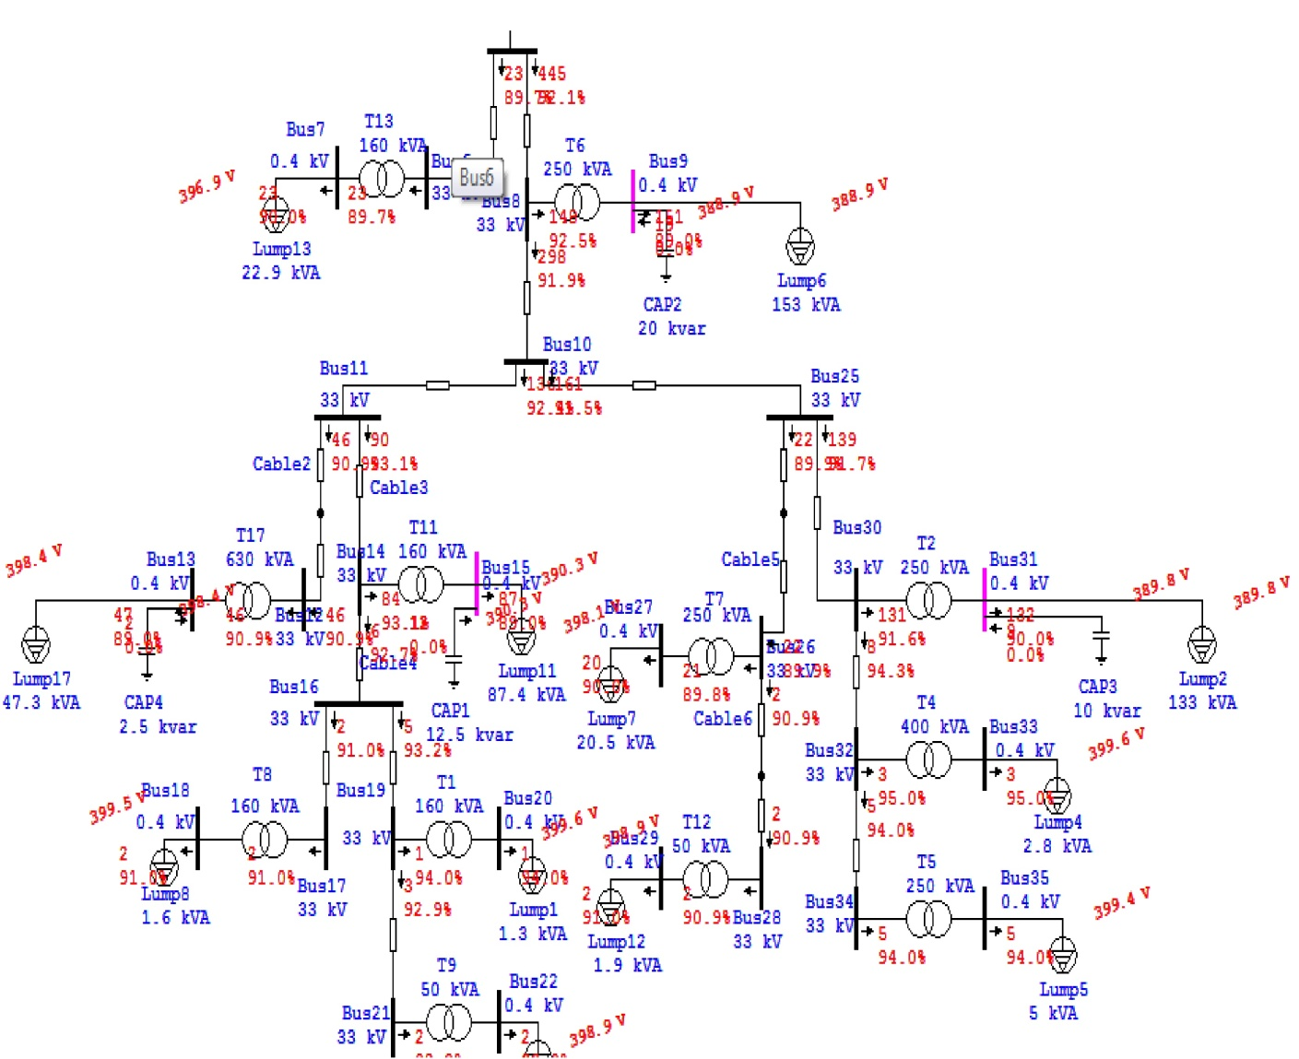

Slide 39
Min. Case Improvement
After adding the capacitor banks the losses in the network
decrease and the total current decrease
- The losses before= 0.006 MW, and the swing current = 9.91 A.
- The losses after=0.005 MW, and the swing current = 9.57A.

Slide 40
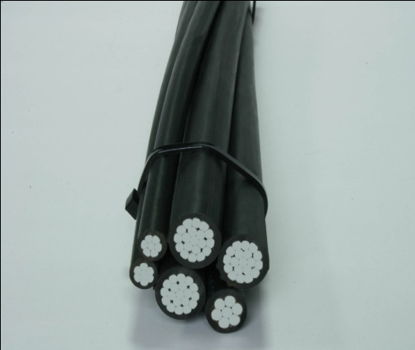
Max. Case Improvement at Low Voltage Side
Low Voltage Side :
Most of the problems of the electrical networks are located in
the low voltage side ( Low Tension Side ) , and the most
important of these problems are : power losses due to the high
current value in this side, and the drop voltage.
In this chapter and in the next chapter the network in low
voltage will be studied.
We measured the load ( Real Power, Current for each phase,
power factor) for each feeder of each transformer in max. and
min. case.

Slide 41
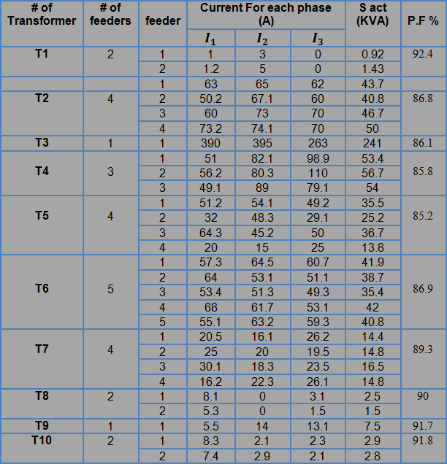
Max. Case Improvement at Low Voltage Side
The load at each feeder for some trasformers :

Slide 42
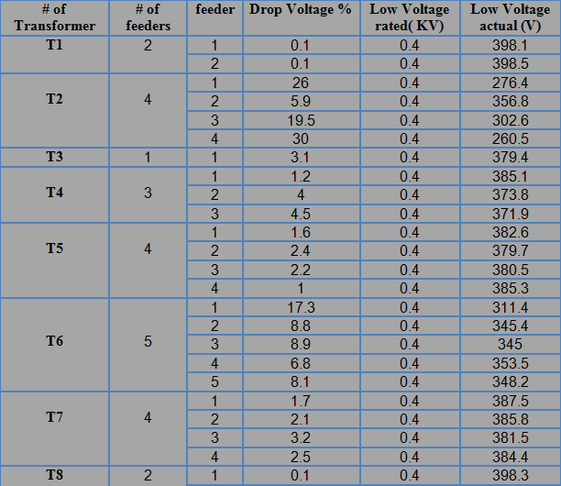
Max. Case Improvement at Low Voltage Side
After making analysis for the original Max. Case, the result is shown below :

Slide 43

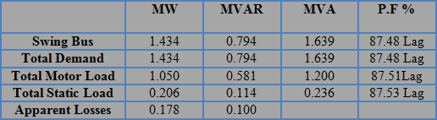
Max. Case Improvement at Low Voltage Side
Swing Bus Result :
Summary of total generation, loading and demand :

Slide 44
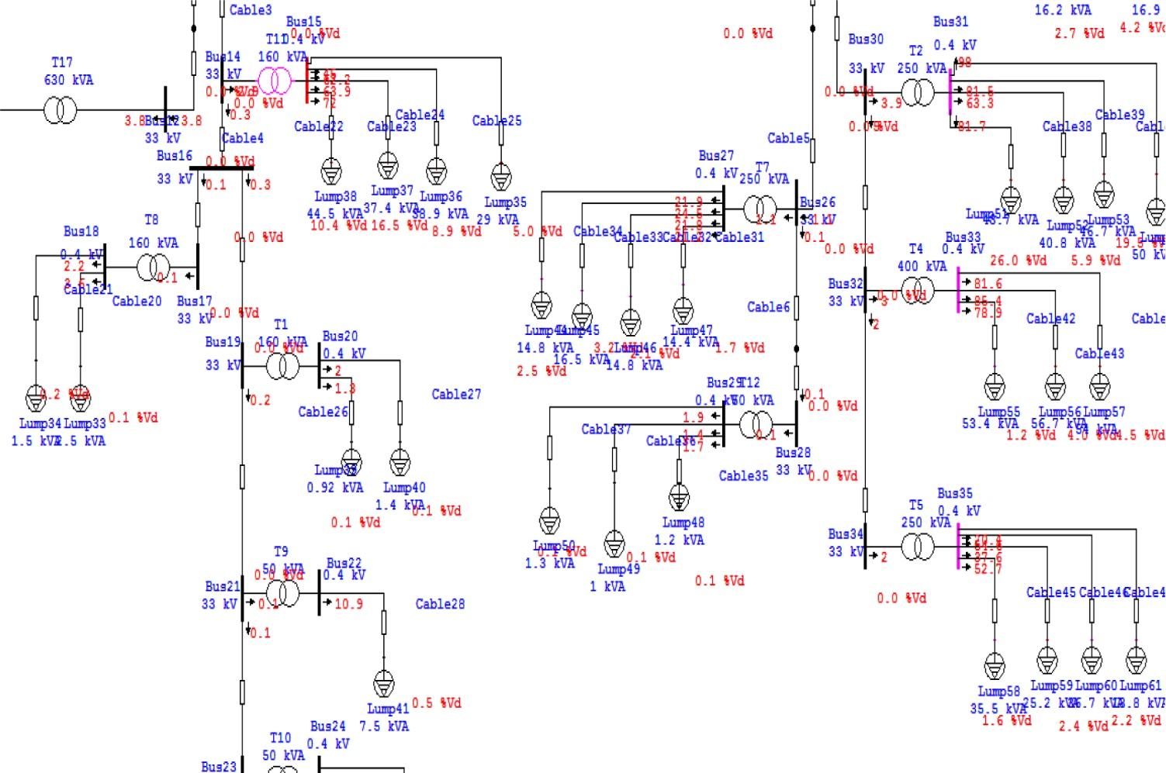

Slide 45
Max. Case Improvement at Low Voltage Side
The main problem in the low level side is the unsymmetrical
loads between phases which cases many problems :
- High neutral current.
- High drop voltage in feeder which cases low voltage in the consumers.
High losses in the network
- The losses before adding the low voltage side = 0.017 MW.
- The losses after adding the low voltage side = 0.178 MW.

Slide 46
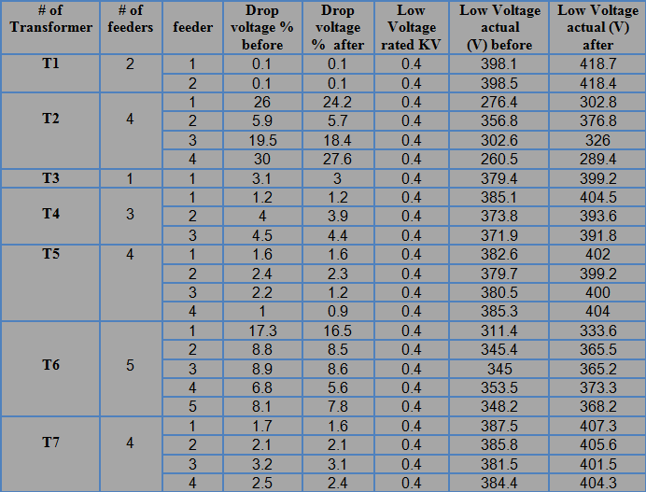
Max. Case Improvement at Low Voltage Side
Increase the tap ratio of the Transformers to 5 % :

Slide 47
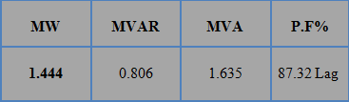
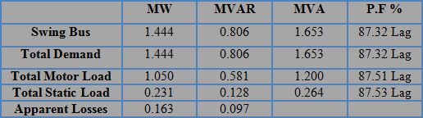
Max. Case Improvement at Low Voltage Side
After making analysis for the original Max. Case, the result is shown below :
Swing Bus Result :
Summary of total generation, loading and demand :

Slide 48
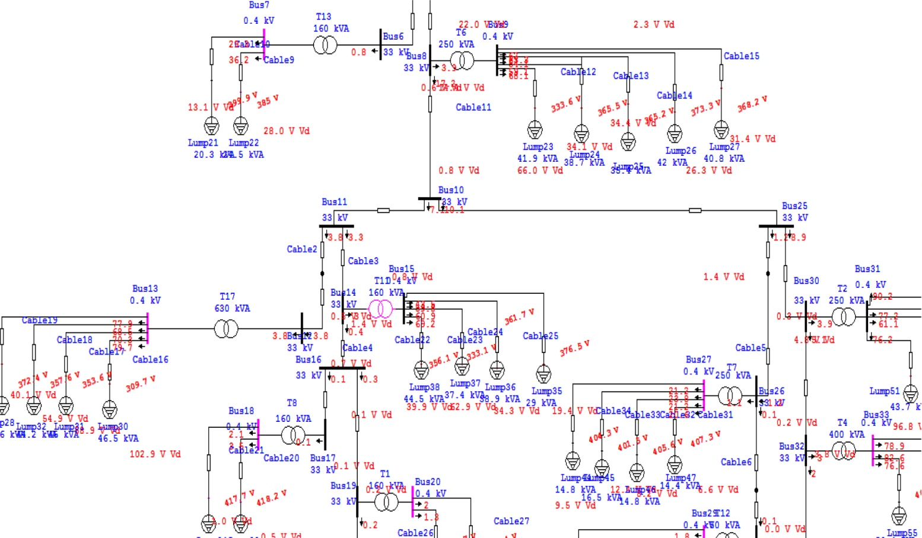
After changing the taps of the transformers the voltage in the consumers increased, also the voltage drop in the feeders decrease and the losses in the network decrease.

Slide 49
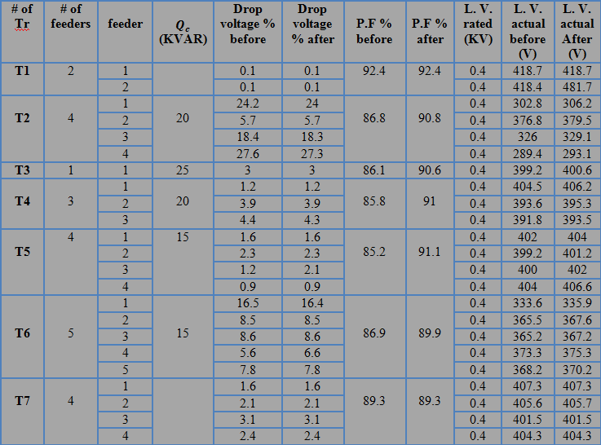
Power Factor Improvement :
The result of load flow after after adding the capacitor banks :

Slide 50
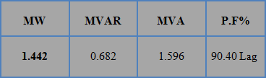
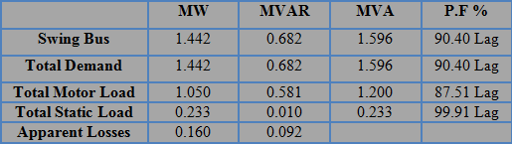
Max. Case Improvement at Low Voltage Side
After making analysis for the original Max. Case, the result is shown below :
Swing Bus Result :
Summary of total generation, loading and demand :

Slide 51
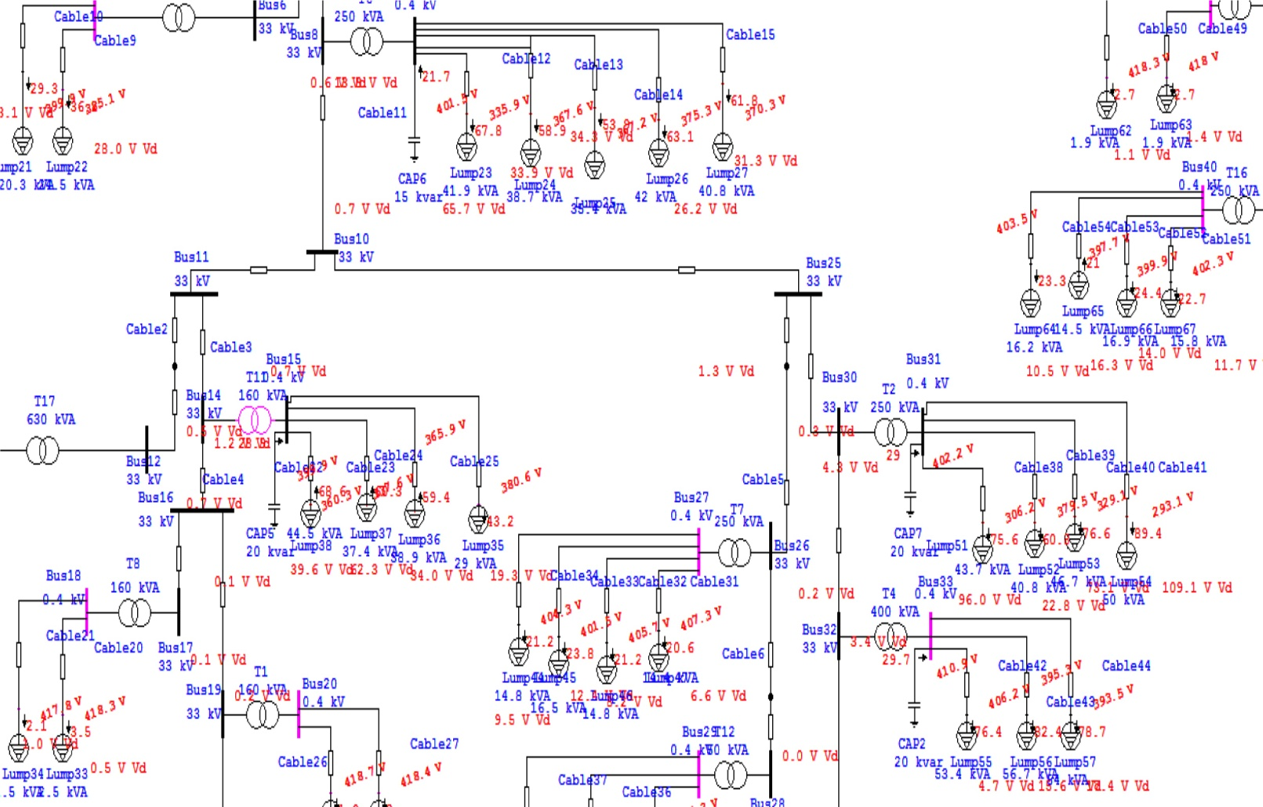
After increasing the tap ratio and adding the capacitor banks the losses in the network decrease :
- The losses before= 0.178 MW.
- The losses after=0.160 MW .

Slide 52
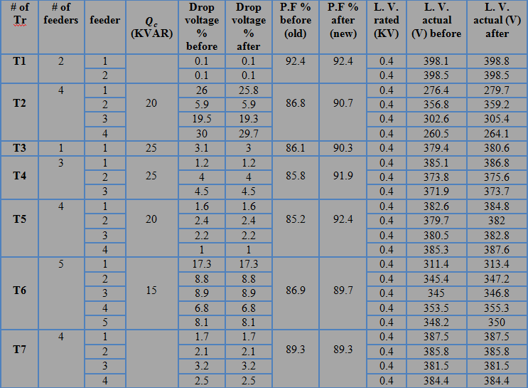
Max. Case Improvement at Low Voltage Side
The voltage level improvement :

Slide 53


Max. Case Improvement at Low Voltage Side
Swing Bus Result :
Summary of total generation, loading and demand :

Slide 54

After adding the capacitor banks the losses in the network decrease :
- The losses in the original case = 0.178 MW.
- The losses after =0.175 MW.
The voltage level in some buses increase.

Slide 55

Min. Case Improvement at Low Voltage Side
The load at each feeder for some trasformers :

Slide 56

Min. Case Improvement at Low Voltage Side
After making analysis for the original Min. Case, the result is shown below :

Slide 57


Min. Case Improvement at Low Voltage Side
Swing Bus Result :
Summary of total generation, loading and demand :

Slide 58

After the analysis : the losses in the network increase more than the losses in the minimum case at the medium voltage:
- The losses before = 0.006 MW .
- The losses after = 0.53 MW .

Slide 59

Min. Case Improvement at Low Voltage Side
Increase the tap ratio of the Transformers to 2.5 % :

Slide 60


Min. Case Improvement at Low Voltage Side
After making analysis for the Network, the result is shown below :
Swing Bus Result :
Summary of total generation, loading and demand :

Slide 61

After changing the taps of the transformers the voltage in the consumers increased, also the voltage drop in the feeders decrease and the losses in the network decrease.

Slide 62

Power Factor Improvement :
The result of load flow after after adding the capacitor banks :

Slide 63


Min. Case Improvement at Low Voltage Side
After making analysis for the Network, the result is shown below :
Swing Bus Result :
Summary of total generation, loading and demand :

Slide 64

After increasing the tap ratio and adding the capacitor banks the losses in the network decrease :
- The losses before= 0.053 MW.
- The losses after=0. 050 MW .

Slide 65

Min. Case Improvement at Low Voltage Side
The voltage level improvement :

Slide 66


Min. Case Improvement at Low Voltage Side
Swing Bus Result :
Summary of total generation, loading and demand :

Slide 67

After adding the capacitor banks the losses in the network decrease :
- The losses in the original case = 0.053 MW.
- The losses after = 0.050 MW.
The voltage level in some buses increase.

Slide 68

The Economical Study
Saving in Penalties:

Slide 69

The Economical Study
Saving in Losses:

Slide 70

The Economical Study
Simple Pay Back Period :

Slide 71


Sag & Tension Problem in the Network
Calculations of Sag (in general ) :
l = Length of span
Wt = total weight per unit length of conductor
T = Tension in the conductor.
W = weight of conductor per unit length
Wi = weight of ice per unit length
Ww = wind force per unit length

Slide 72

Sag & Tension Problem in the Network
The Problem :
The problem lies in the poor and an error in the estimation of the amount of sag when designing and extension for overhead lines in some areas, where the amount of sag was not enough, and in the last winter, a large amount of snow and low degrees of temperature led to a contraction in the tensile strength of the cables, this led to cut in the cable and destruction of some of the towers as shown in the below picture:

Slide 73

Sag & Tension Problem in the Network
The Recommendations for the sag problem :
To avoid the occurrence of the problem that has been raised previously, there is a mathematical relationship whereby estimate and calculate the amount of sag in correct form:
This gives the freedom of cable stretch in the summer and contraction in the winter without affecting on the cable and without leads to a cut in it.

Slide 74

Solar Energy Station Project
Consumption energy Of the Network :
Data about consumption of the network :

Slide 75
Solar Energy Station Project
Calculations of the power for the solar system:
The Energy of the network in year = 5716110 KWH/year.
The Energy of the network in day = The Energy of the network in year / the number of day in year.
The Energy of the network in day = 5716110/365 = 15660.6 KWH/day.
The average energy produced of 1KW solar cells = 5.4KWH/m^2.day.
We use the penetration factor =20%.
Then the total energy of solar system in day = the penetration factor * The Energy of the network in day.
The total energy of solar system in day = 15660.6 * 0.2 = 3132.1 KWH/day.
Then we calculate the power of the solar system, that will work on the design.
The power of the solar system(Ppv in KW) = The total energy of solar system in day/ The average energy produced of 1KW solar cells.
P pv (KW) = 3132.1 () /(5.4KWH/m^2.day) = 580 KW.
Then we will design the pKWH/dayower of solar system = 580KW.

Slide 76

Solar Energy Station Project
How to determine the optimization of Tilt & Azimuth angle :
To determine the Tilt and Azimuth angle, we use a link on the Internet, as shown below . (The link: http://re.jrc.ec.europa.eu/pvgis/apps4/pvest.php?map )

Slide 77

Solar Energy Station Project
The Result that we obtained from the link :
After we entered all necessary data, the results and calculations of this program are shown below :
*The optimization tilt angle =26 degree, and the optimum azimuth angle = -6 degree
E_{d}: Average daily electricity production from the given system (kWh)
E_{m}: Average monthly electricity production from the given system (kWh)
H_{d}: Average daily sum of global irradiation per square meter received by the modules of the given system (kWh/m²)
H_{m}: Average sum of global irradiation per square meter system (kWh/m²)

Slide 78

Solar Energy Station Project
The average power produced by the solar system per month is shown in the below figure

Slide 79

Solar Energy Station Project
The optimal inclination angle & solar irradiation per month :
Optimal inclination angle is: 26 degrees
Annual irradiation deficit due to shadowing (horizontal): 0.4 %

Slide 80


Solar Energy Station Project
The table below and picture shows the optimal inclination angle and irradiation on plane in each month :
H(26): Irradiation on plane at angle: 26deg.
(Wh/m²/day).
I_{opt}: Optimal inclination (deg.).

Slide 81

Solar Energy Station Project
The Design of the solar station system :
The Power of this station = 580kw, and we will use two program to design this station .
The first program is PV system .

Slide 82


Solar Energy Station Project
PV system :

Slide 83

Solar Energy Station Project
The Result :
After entering all necessary numbers and data and identify options, the program give us the results as shown in the below curves and tables :
The below curve show us the System output energy for each month :

Slide 84

Solar Energy Station Project
The design of the solar station by using Aurora program :
By using the Aurora program in this project, we designed the solar system =580KW ,and we distributed it into 10 groups each group equal to 55KW.
Aurora Designer :

Slide 85

Solar Energy Station Project
In this design that we work on it, we try to achieve the optimum design (the module in series to achieve the voltage of the inverter , and the parallel string to achieve the power of the inverter , and the oversize of the inverter that we chosen is between (95%-110%)).
* The number of the module in series =17 module.
* The parallel string =12.
The next figure shown how to enter the series module and parallel string in the Aurora program:

Slide 86


Solar Energy Station Project
The Result from the Aurora Program :
System configuration:
Inverter Specifications:

Slide 87


Solar Energy Station Project
PV Module Data:
Array Sizing Parameters:

Slide 88

Solar Energy Station Project
Voltage and Current Parameter Check:

Slide 89

Solar Energy Station Project
*But when the parallel string is equal to (11), the new results are shown in the below tables ( and this is more acceptable ):

Slide 90


Solar Energy Station Project
The Result :
New System configuration:
New Voltage and Current Parameter Check:

Slide 91

Solar Energy Station Project
Calculations to determine the Rating of the set up Transformer:
In this project we distributed the inverter into 10 inverters and the maximum power for each inverter is equal to 55 KW.
The maximum power for all inverters is equal to 550 KW
The rating of the step up transformer can be calculated by these formulas below

Slide 92
Solar Energy Station Project
Economical study for the Solar system project :
The life span period of the solar system = 20 years.
The price of 1kwh of solar = 0.65 NIC.
The price of transformer = 30000 NIC.
The price of each watt =2.2 $ =7.7 NIC. The price of 1 kw =2200$=7700 NIC.
* The average of 1kw produce 1700 kwh/year.
The investment = Price of the transformer + Price of the solar system (580kw)
The investment = 30000 + (580*7700) = 4496000 NIC.
The average producing of the solar system in year = 1700 * 580 = 986000 kwh
The saving in the year = 986000 kwh * 0.65 NIC = 640900 NIC/ year.
The simple pay back period = investment / saving in year
S.P.B.P = 4496000 / 640900 = 7 YEARS.

Slide 93


Slide 94

Any Question ?

