Slide 1

Municipality Building
Prepared By:
Thaer Abu Haniya
Nidal Nazzal
Supervisor:
Dr. Muhannad Al-haj Hussain

Slide 2
Outline
Site location
Architectural Design
Environmental Design
Structural Design
Mechanical Design
Safety Design
Electrical Design
BOQ

Slide 3
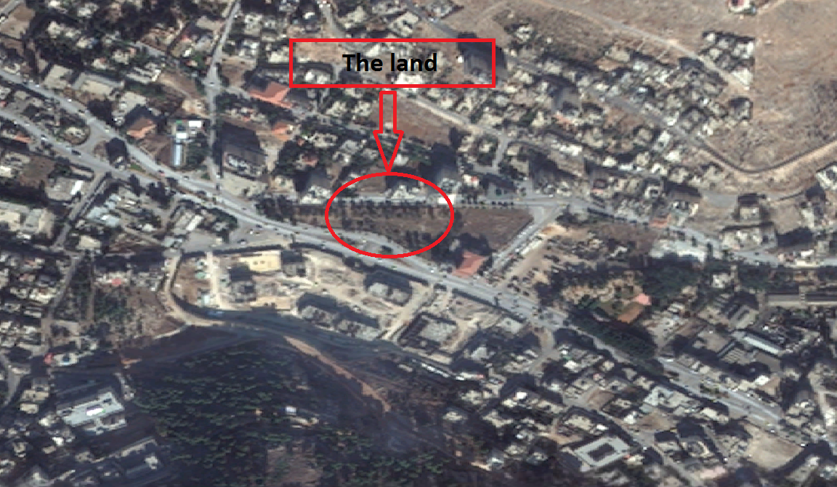
The proposal site is in Nablus city (in front of governorate)

Slide 4
Outline
Site location
Site plan
Architectural Design
Circulation and entrances
Environmental Design
Parking
Structural Design
Plans
Mechanical Design
Safety Design
Elevations
Electrical Design
BOQ

Slide 5
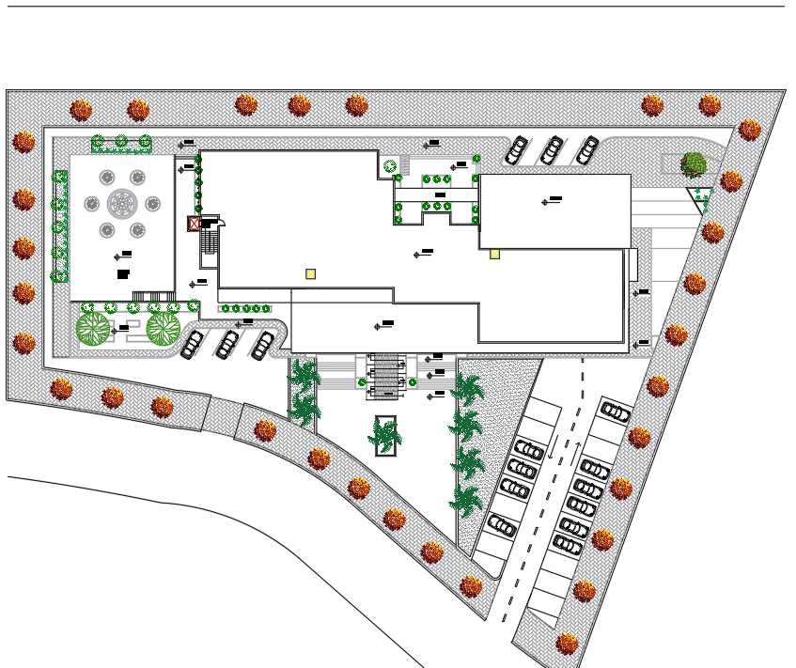
Site plan
Secondary Entrance
Amman street
District street
Governorate
Main Entrance

Slide 6
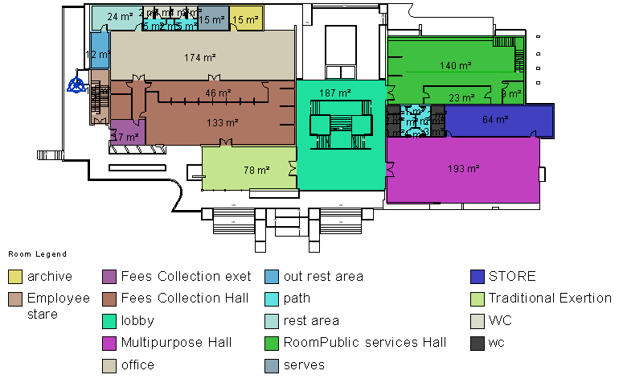
Circulation and Entrances
Ground Floor

Slide 7
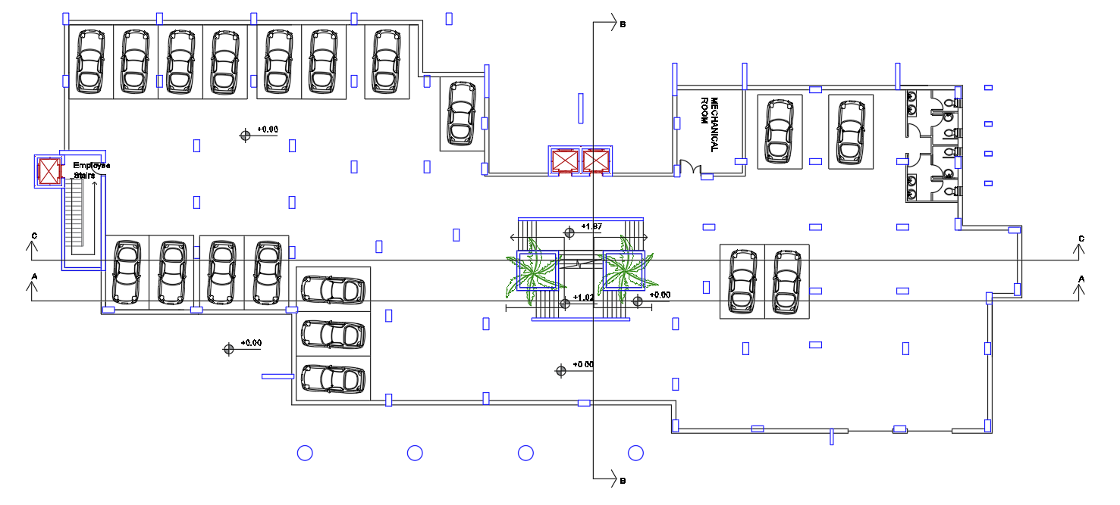
Parking
Area = 1430 m2
19 cars and about 29 cars out door parking

Slide 8
Outline
Site location
Site plan
Architectural Design
Circulation and entrances
Environmental Design
Parking
Structural Design
Plans
Mechanical Design
Safety Design
Elevations
Electrical Design
BOQ

Slide 9
Ground Floor
Area = 1430 m2

Slide 10
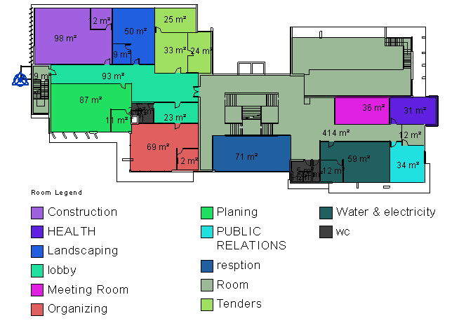
First Floor
Area = 1640 m2

Slide 11
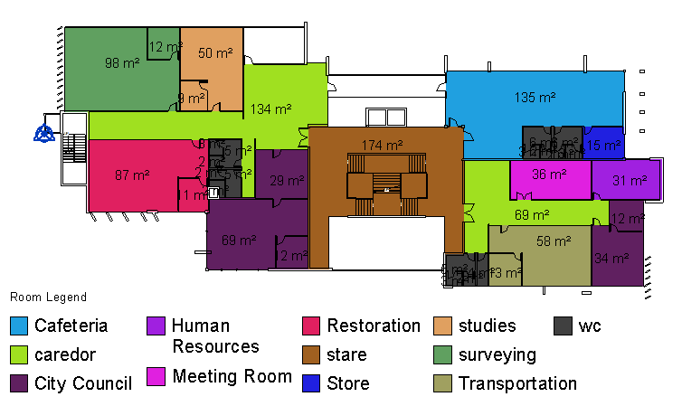
Second Floor
Area = 1640 m2

Slide 12
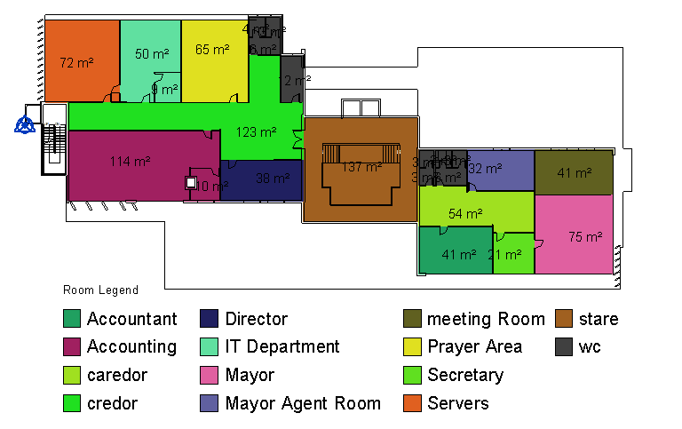
Third Floor
Area = 1040 m2

Slide 13
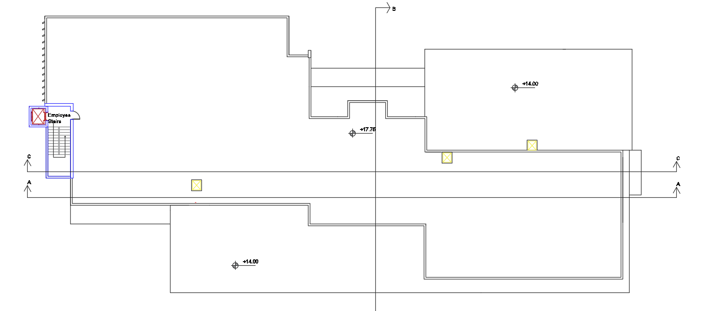
Roof

Slide 14
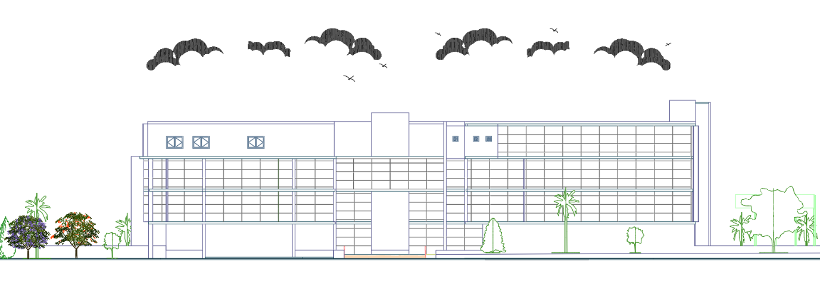
North Elevation

Slide 15
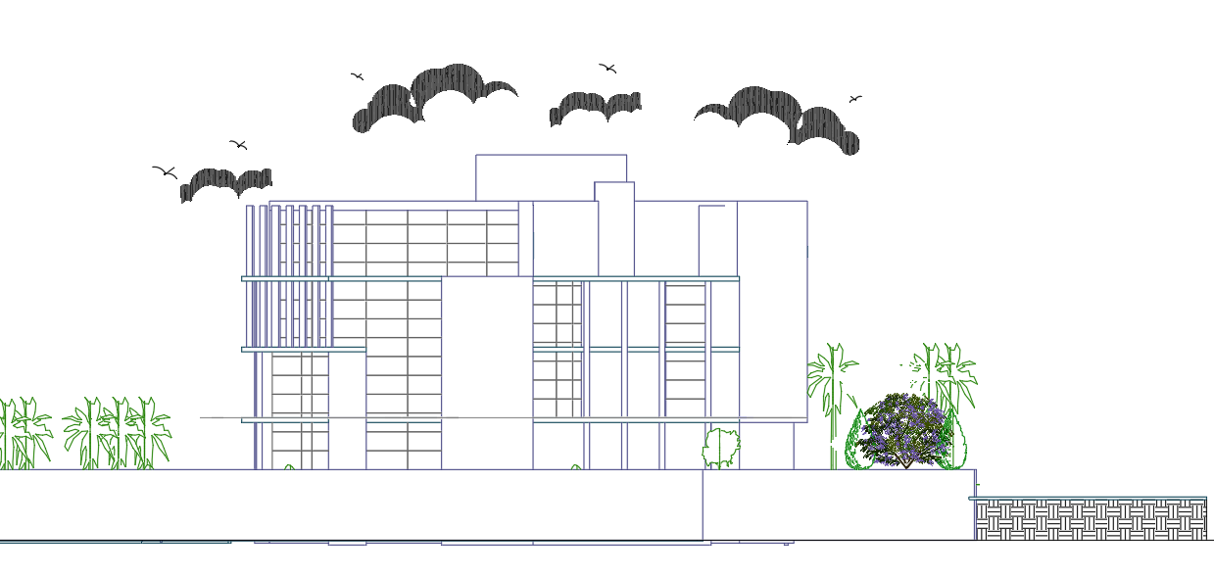
East Elevation

Slide 16
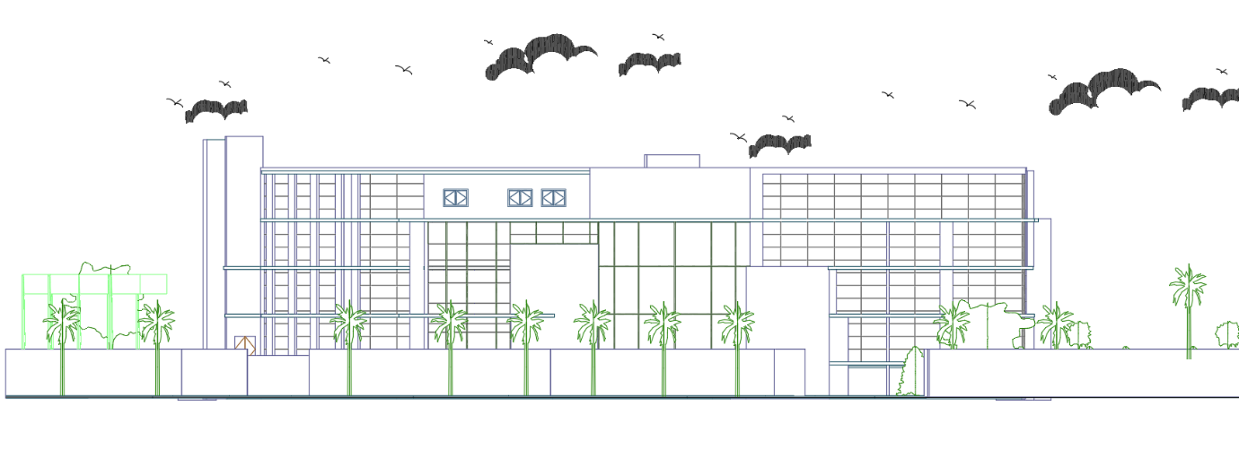
South Elevation

Slide 17
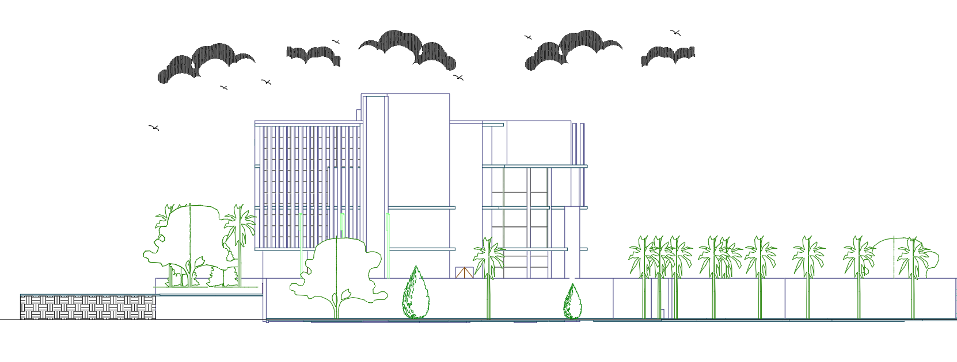
West Elevation

Slide 18
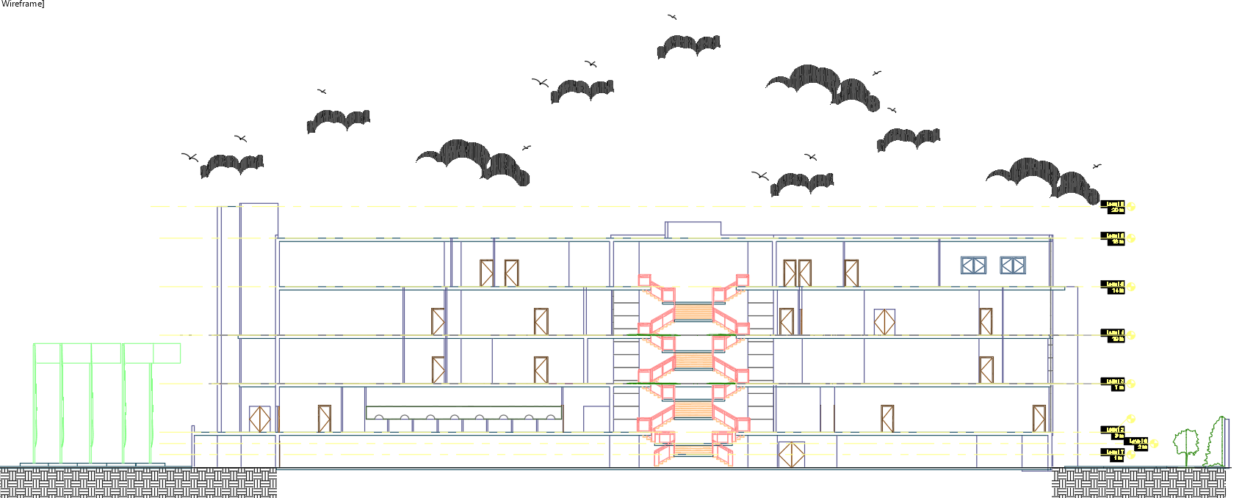
Section A-A

Slide 19
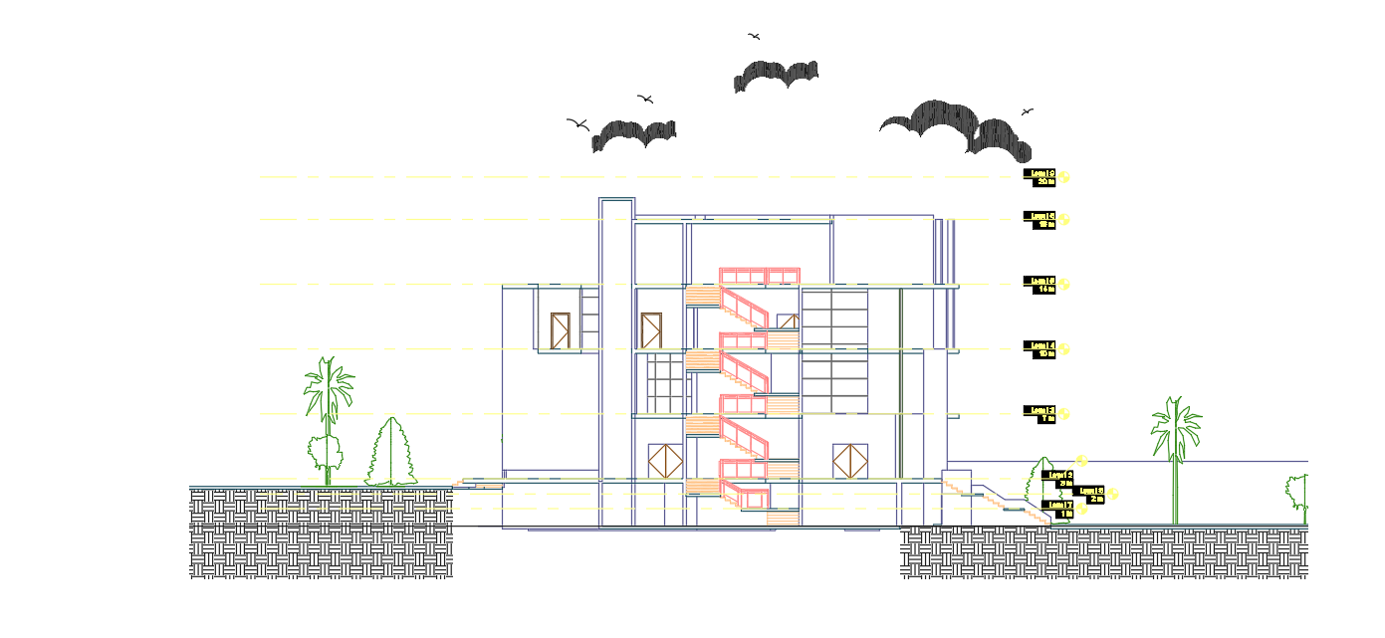
Section B-B

Slide 20
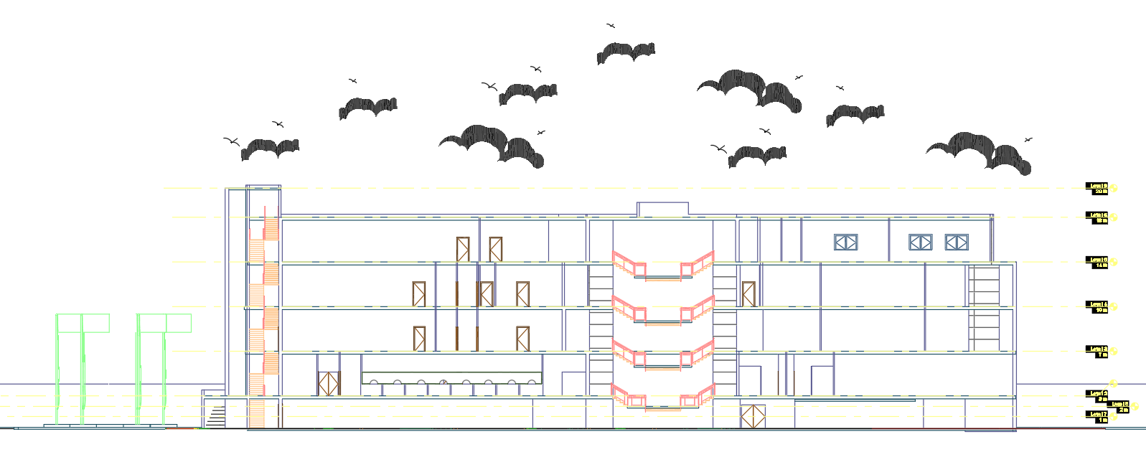
Section C-C

Slide 21
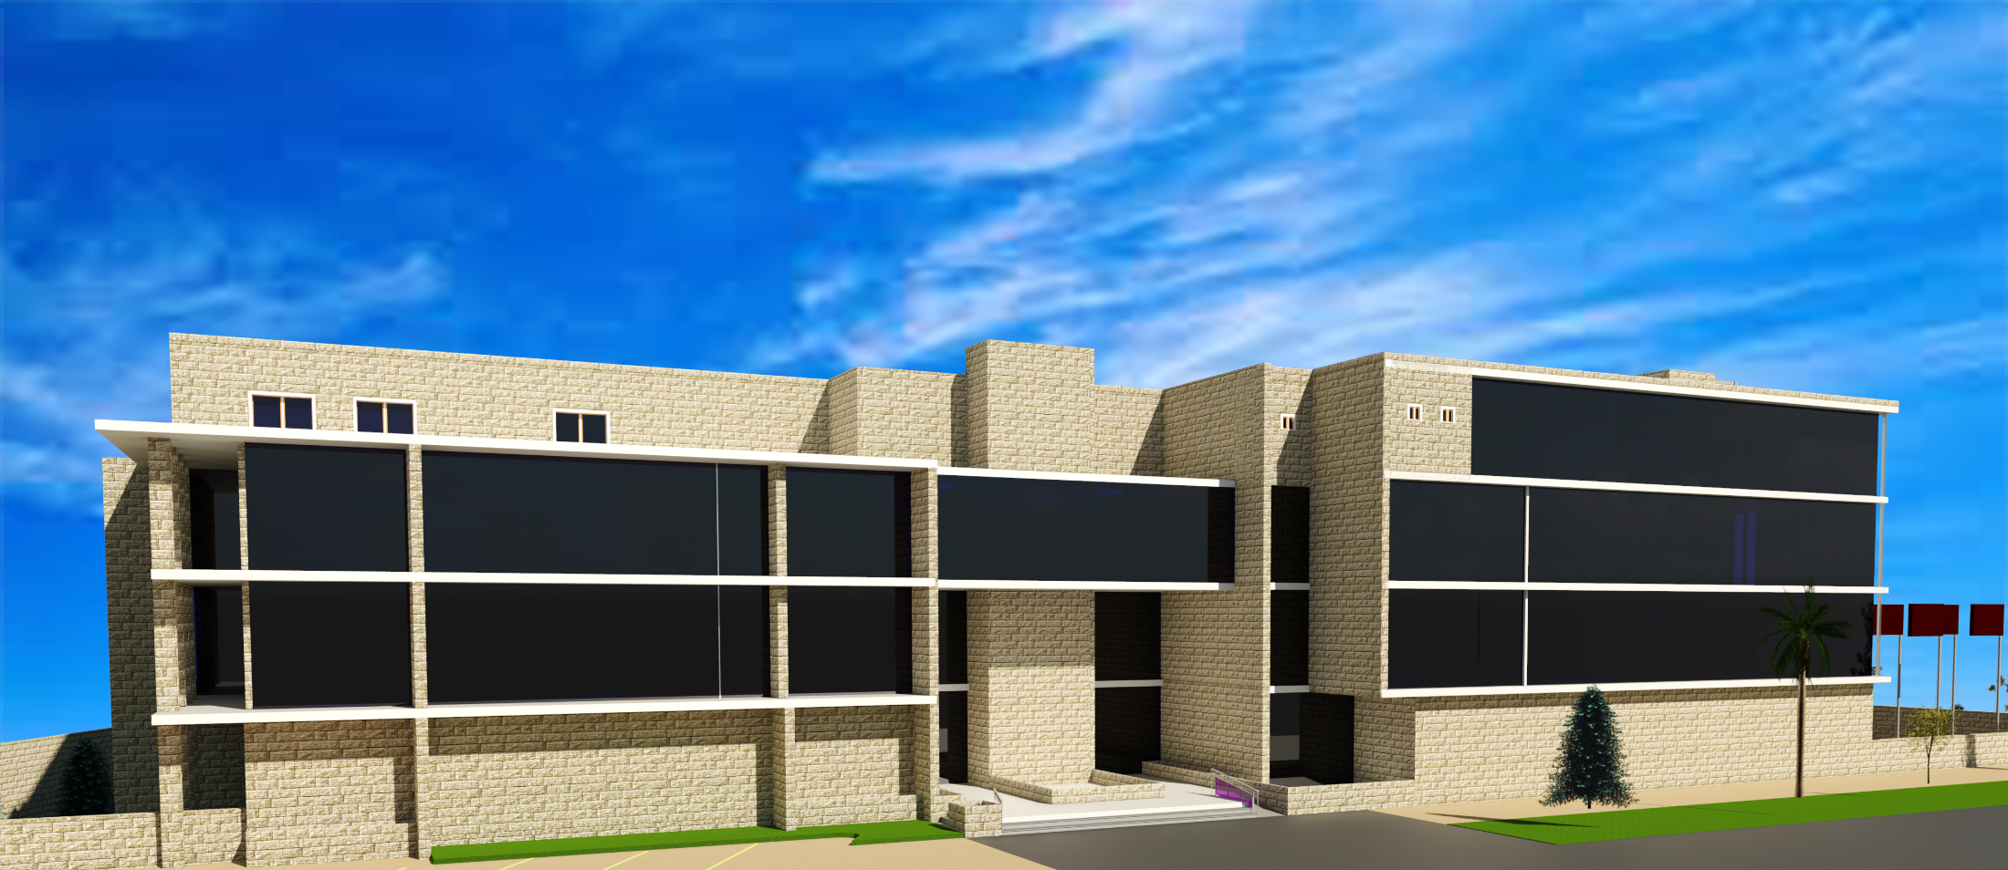
final Design

Slide 22
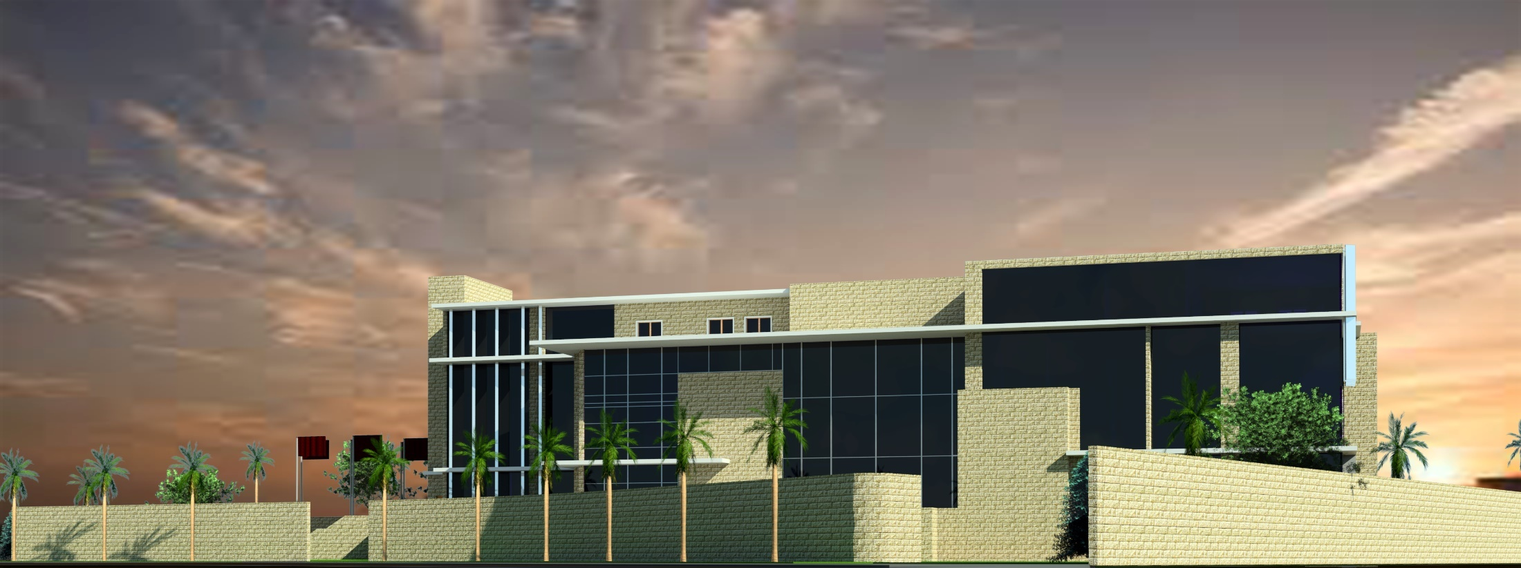

Slide 23
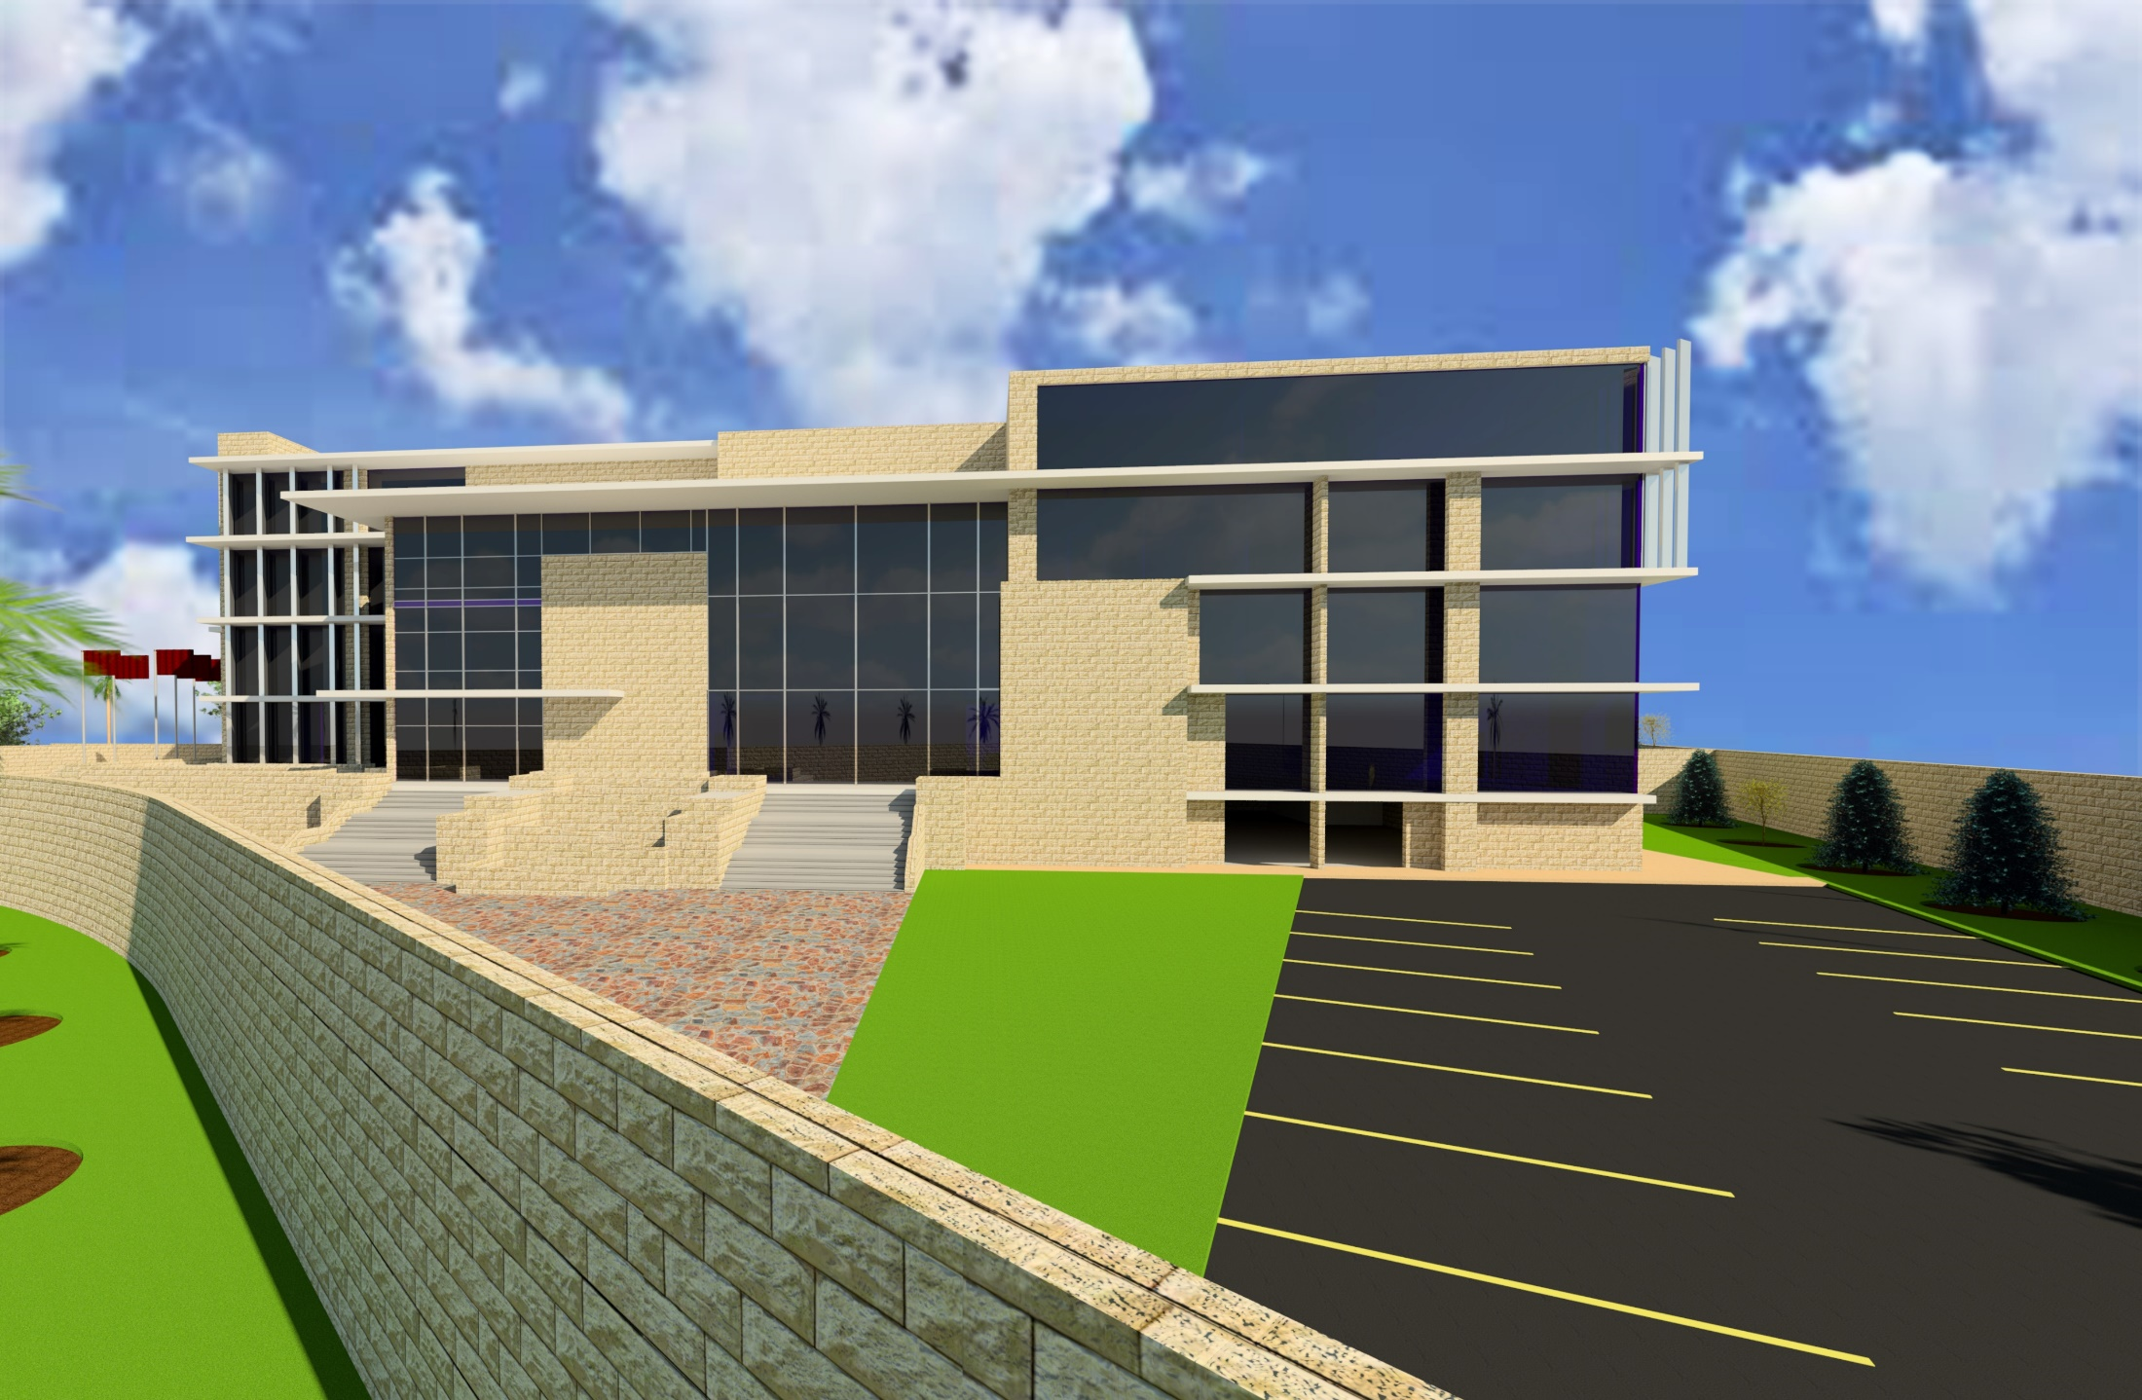

Slide 24
Outline
Site location
Daylight factor
Architectural Design
Environmental Design
Materials and Thermal analysis
Structural Design
Mechanical Design
Acoustical design
Electrical Design
Safety Design
BOQ

Slide 25
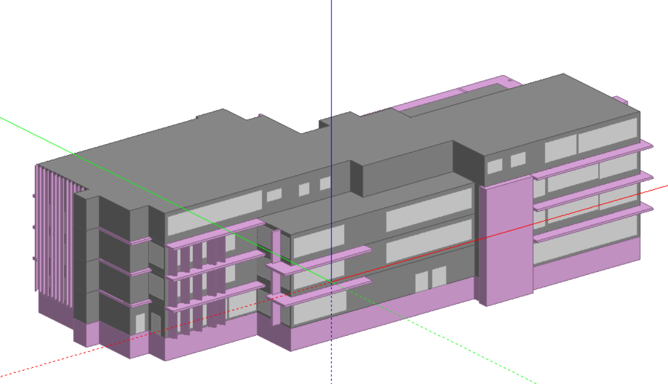
Modeling by Design Builder program

Slide 26
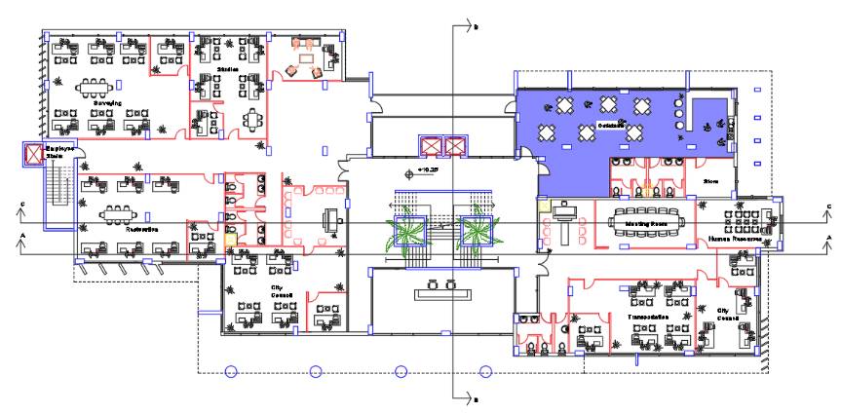
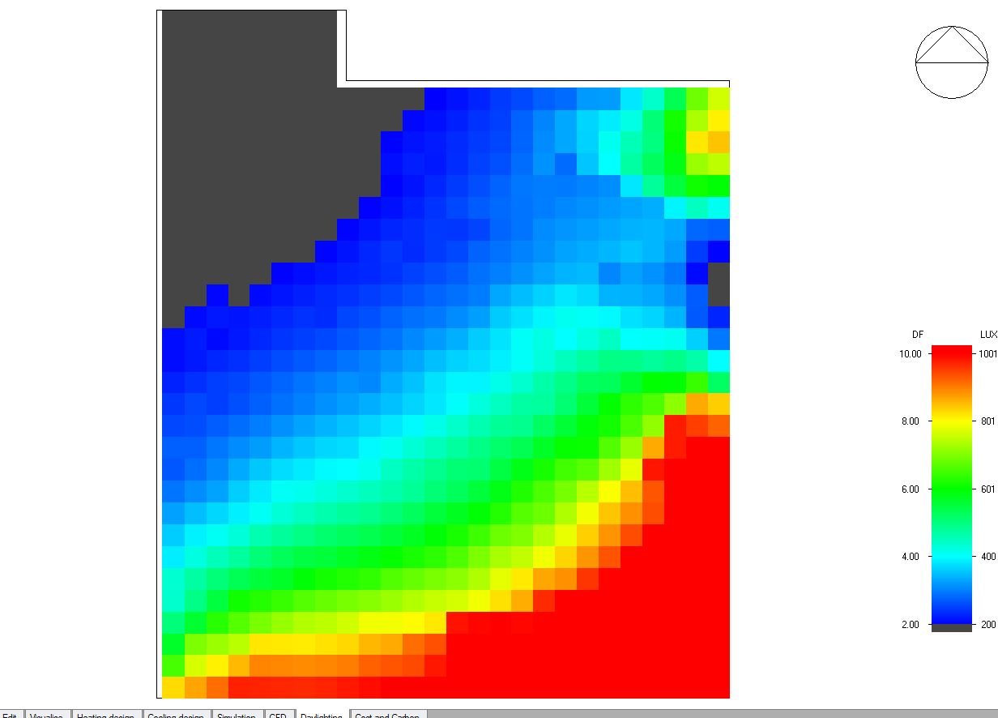
Daylight distribution in Cafeteria

Slide 27
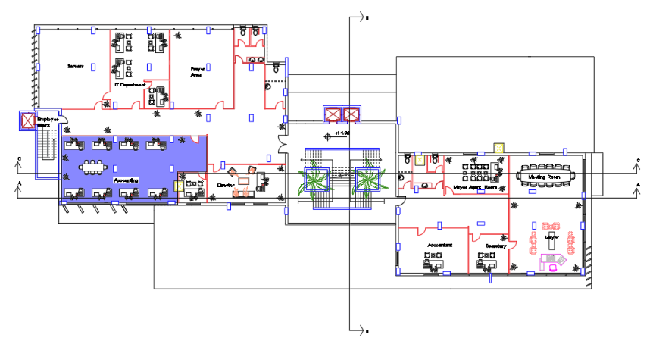
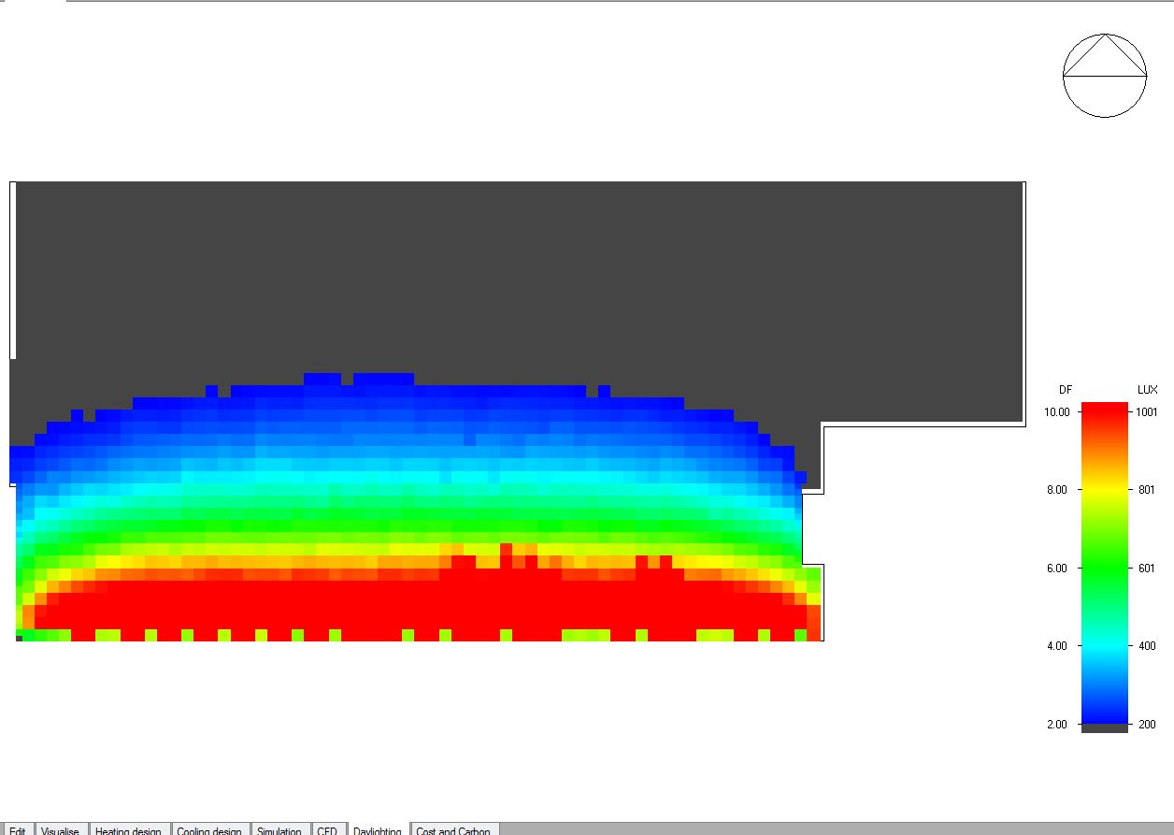
Daylight distribution in accountant

Slide 28
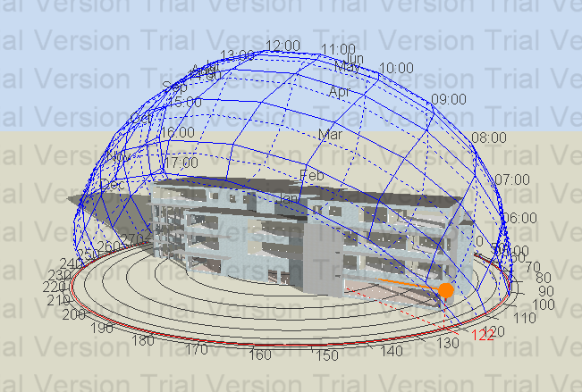
Sun path and shadow for building in summer at 6.00am

Slide 29
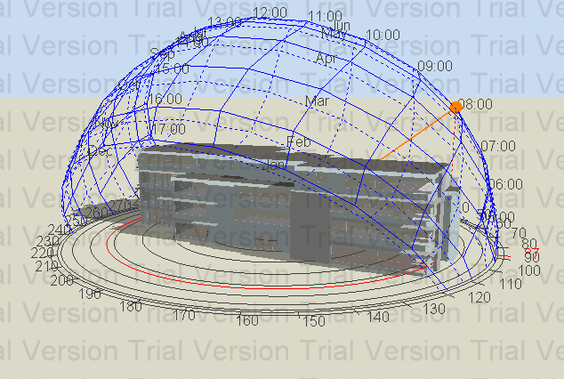
Sun path and shadow for building in winter at 8.00am

Slide 30
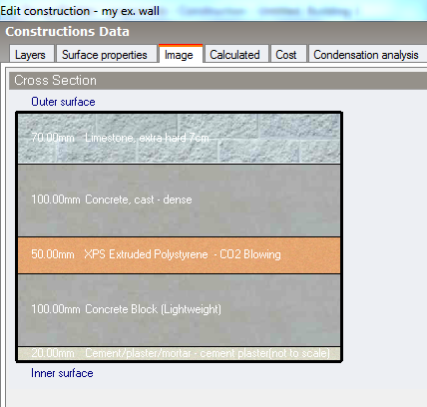
Materials
1- External wall
Cross section in the external wall
U = 0.438 W/m2.k

Slide 31
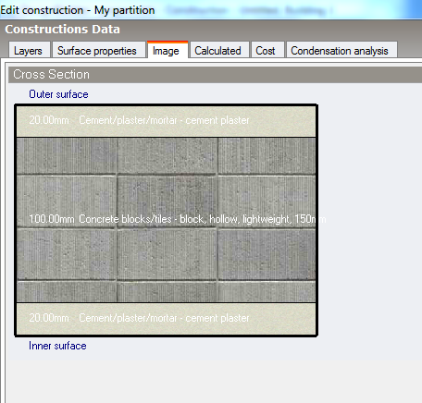
Materials
2- Internal wall
Cross section in the internal wall
U = 1.909 W/m2.k

Slide 32
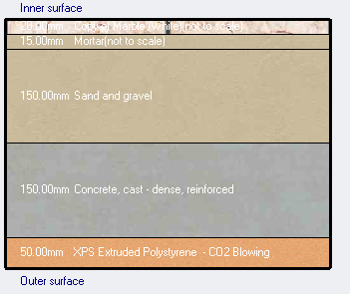
Materials
3- Ground floor
Cross section in the ground floor
U = 0.538 W/m2.k

Slide 33
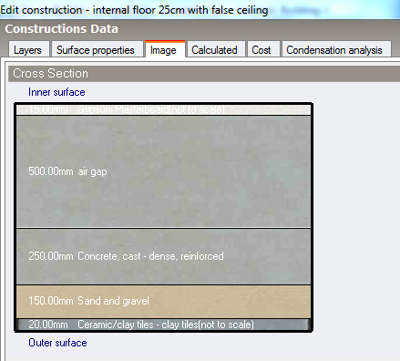
Materials
4- Internal floor
Cross section in the Internal floor
U = 0.449 W/m2.k

Slide 34
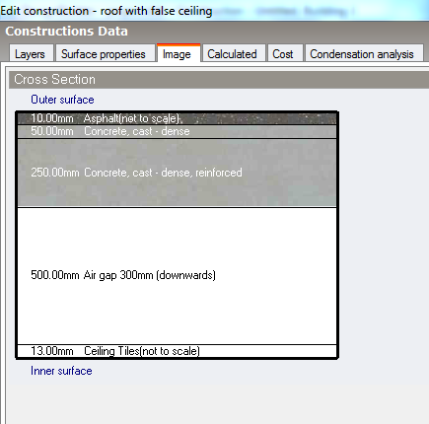
Materials
5- Roof
Cross section in the roof
U = 1.286W/m2.k

Slide 35
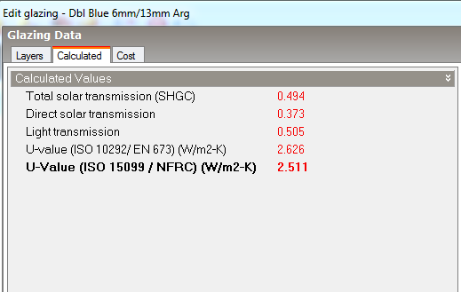
Materials
The windows consist of two layers (double glazing) 6mm with argon gap =13mm
U = 2.511 W/m2.K

Slide 36
Thermal Analysis Results
1-Heating and Cooling loads
 | Heating load | Cooling load
Total | 271.19 (KW) | 298.45 (KW)

Slide 37
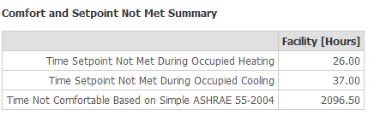
Thermal Analysis Results
2-Total Building energy
The total building energy is 100.74 KWh/m2 < 207KWh/m2
which is acceptable.
3-Thermal comfortable
The number of uncomfortable hours = 2096.50 from 8000 hours
which is acceptable.

Slide 38
Outline
Site location
Architectural Design
Daylight factor
Environmental Design
Thermal analysis and materials
Structural Design
Mechanical Design
Acoustical design
Electrical Design
Safety Design
BOQ

Slide 39
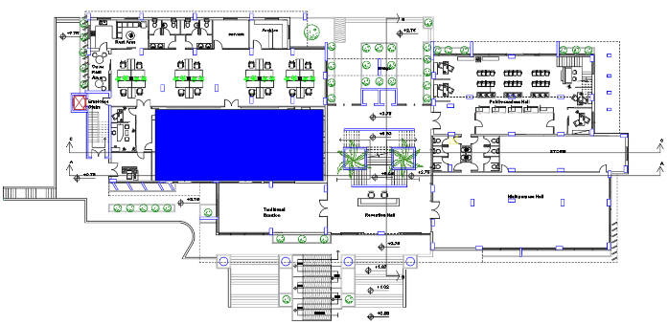
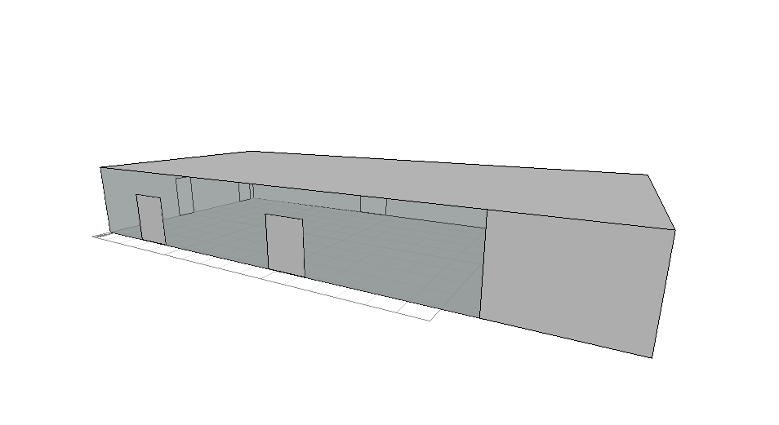
Modeling by Ecotect program
Using Ecotect program for RT60 analysis in the fees collections hall

Slide 40
Reverberation Time (RT60)
The optimum reverberation time for fees collections hall Ranges from 0.6 – 1.4 sec.
Materials used:
Element | Absorption Coefficients
 | 125Hz | 250Hz | 500Hz | 1000Hz | 2000Hz | 4000Hz
Wood floor | 0.15 | 0.11 | 0.1 | 0.07 | 0.06 | 0.07
Plaster for walls | 0.12 | 0.09 | 0.07 | 0.05 | 0.05 | 0.04
Polyurethanene foam reticulated | 0.07 | 0.11 | 0.2 | 0.32 | 0.6 | 0.85

Slide 41
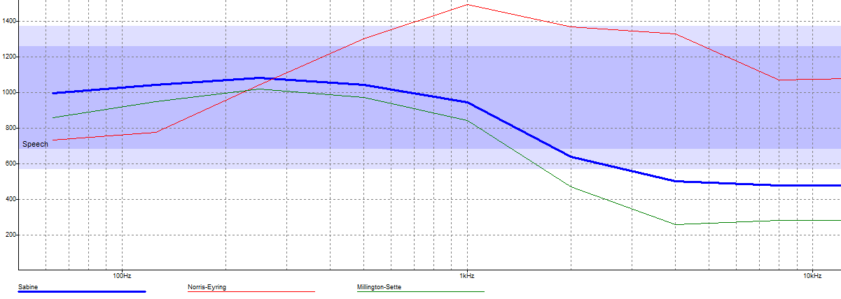
Results
Frequency\Case | Full occupied (60 person) | Half occupied (30 person) | Empty (0 person)
63Hz | 1.00 | 1.03 | 1.05
125Hz | 1.04 | 1.07 | 1.10
250Hz | 1.08 | 1.18 | 1.29
500Hz | 1.04 | 1.12 | 1.21
1kHz | 0.94 | 1.00 | 1.06
2kHz | 0.64 | 0.67 | 0.70
4kHz | 0.50 | 0.51 | 0.52
8kHz | 0.48 | 0.48 | 0.49
16kHz | 0.48 | 0.48 | 0.49

Slide 42
Outline
Site location
Design cods
Architectural Design
Design Data
Environmental Design
Structural Design
Structural Elements
Mechanical Design
Etabs Result
Electrical Design
Detailing
Safety Design
BOQ

Slide 43
Design Codes
The American Concrete Institute code (ACI 318-14).
The seismic design according to UBC-97.
The analysis and design were done using ETABS 2016 programs.

Slide 44
Design Data
1. Concrete compressive strength
F'c =24 MPa for slabs and beams.
F'c = 28 MPa for columns and footings.
2.Yielding strength of steel
The yield strength of steel Fy= 420MPa
3. Bearing capacity of soil
the bearing capacity of soil = 250 KN/m2

Slide 45
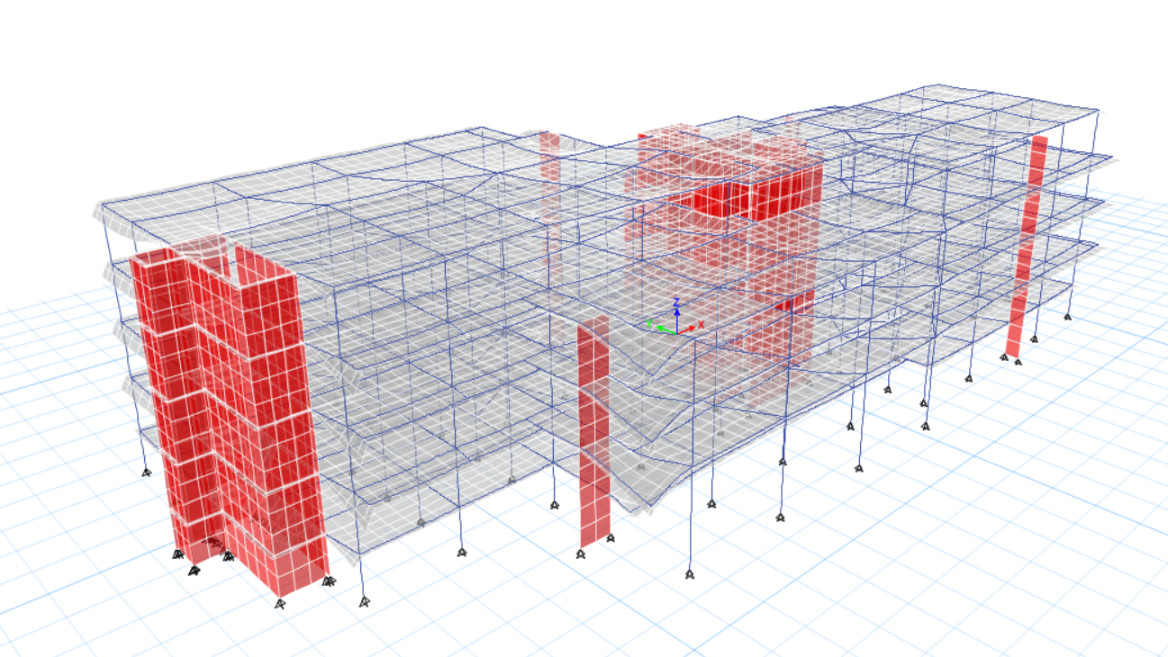
Designed building

Slide 46
Structural Systems
One-way ribbed slab.
Thickness = 25cm

Slide 47
Checks
1-Compatibility check.
2-Deflection check .
3-Equlibriume check.
4-Stress strain check.

Slide 48

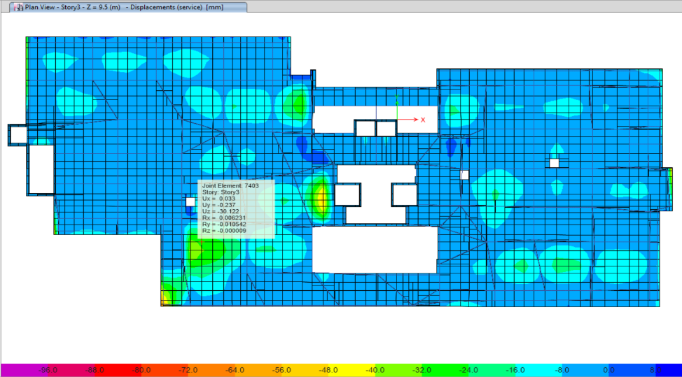
Checks
ETABS 2016
Compatibility check: Deflection check:
Allowable deflection= 7/240=29mm
Max deflection on slab = 30mm

Slide 49
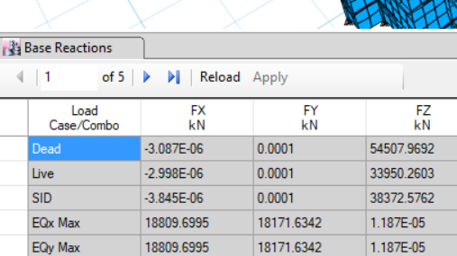
Checks
ETABS 2016
Equilibrium Check
ETABS results Hand results
Fz _{live} (ETABS) = 33950 KN
Area of floors = 7180 m²
So (33950/7180) = 4.7 KN/m²
close to 5 KN/m² its ok

Slide 50
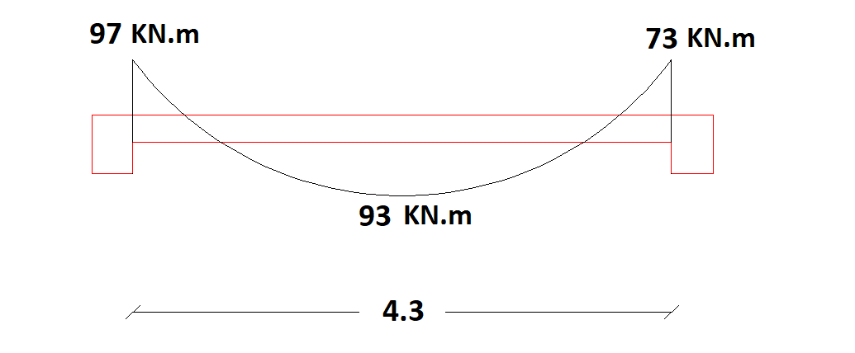
Checks
ETABS 2015
Stress strain check ETABS result
Hand calculation
Wu (span) = 73.15 KN
Mu (span) = 169 KN.m
Mu (ETABS) = 177 KN.m
% of deference = 4.50 %

Slide 51
Seismic Design
The building designed with:
I = 1
Z = 0.2
R = 5.5
Ca = 0.24
Cv = 0.32
Time period:
T = 0.52 sec
T ETABS = 0.862 sec

Slide 52
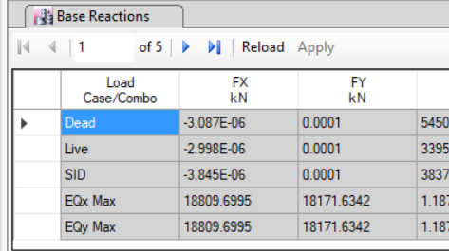
Seismic Design
Base shear check : Base reaction from ETABS
VHand = 18431 KN
VETABS = 18172 KN
% of deference = 1.4 %

Slide 53
Seismic Design
Story drift check:
 | Building
M(mm) | 39.2
Mmax (mm) | 87.5

Slide 54
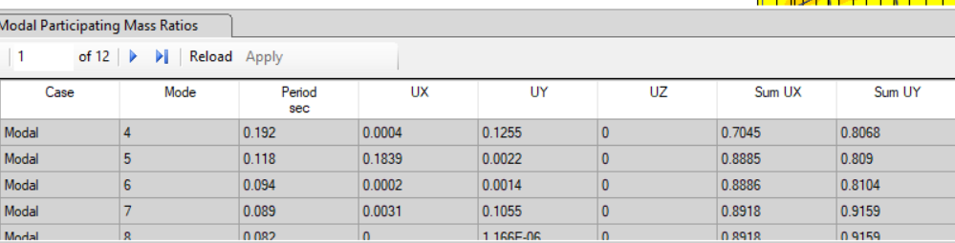
Seismic Design
mass participation ratio check:

Slide 55
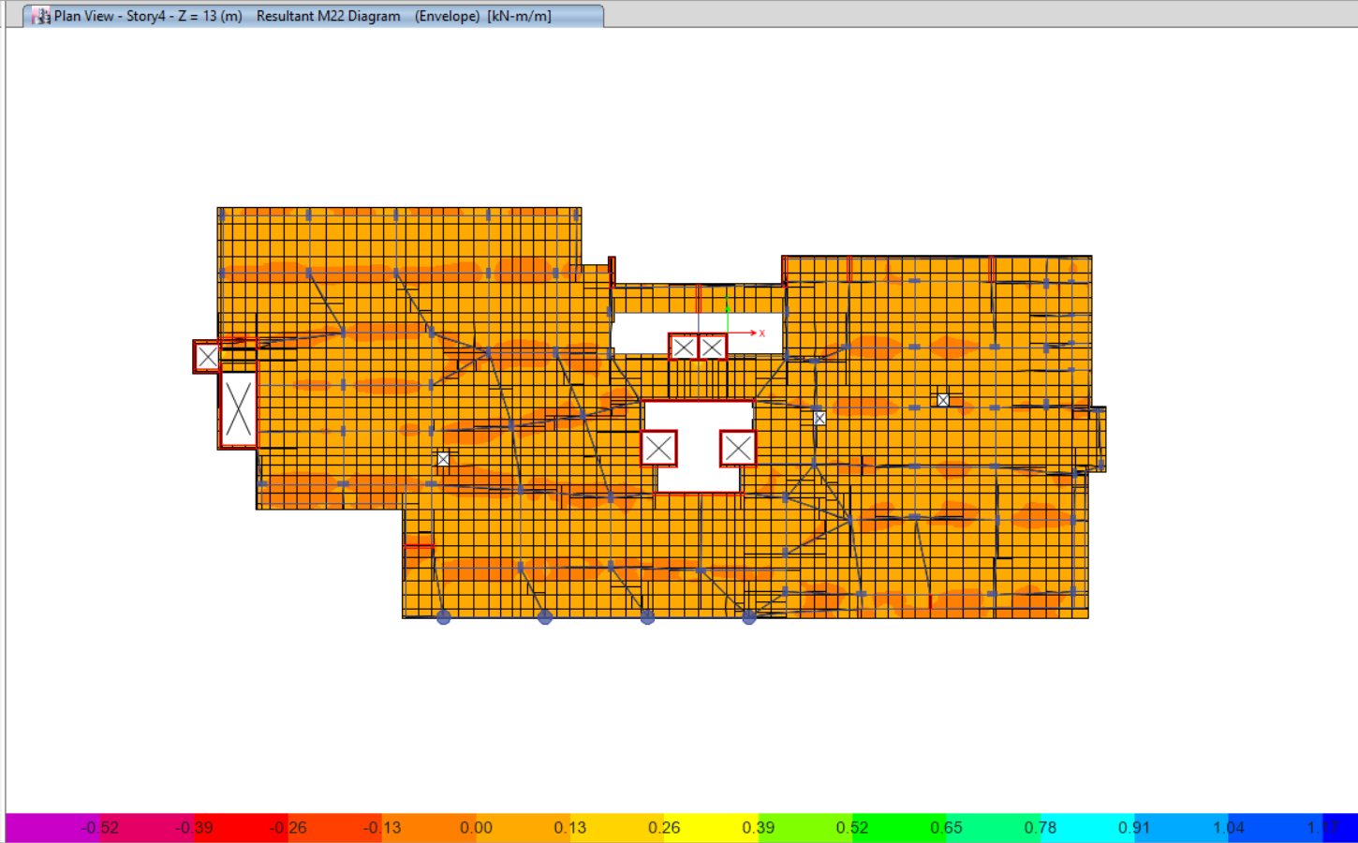
Slab design
From the figure, we need minimum area of steel for positive and negative moment.
As = 124 mm² → 2Ø10 mm
Use Ø10 mm/150 mm stirrups
we will use steel mish with 4 Ø10mm/m in each direction.

Slide 56
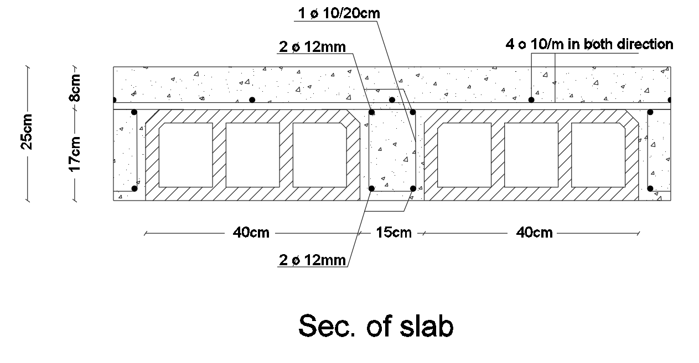
Slab Reinforcement

Slide 57
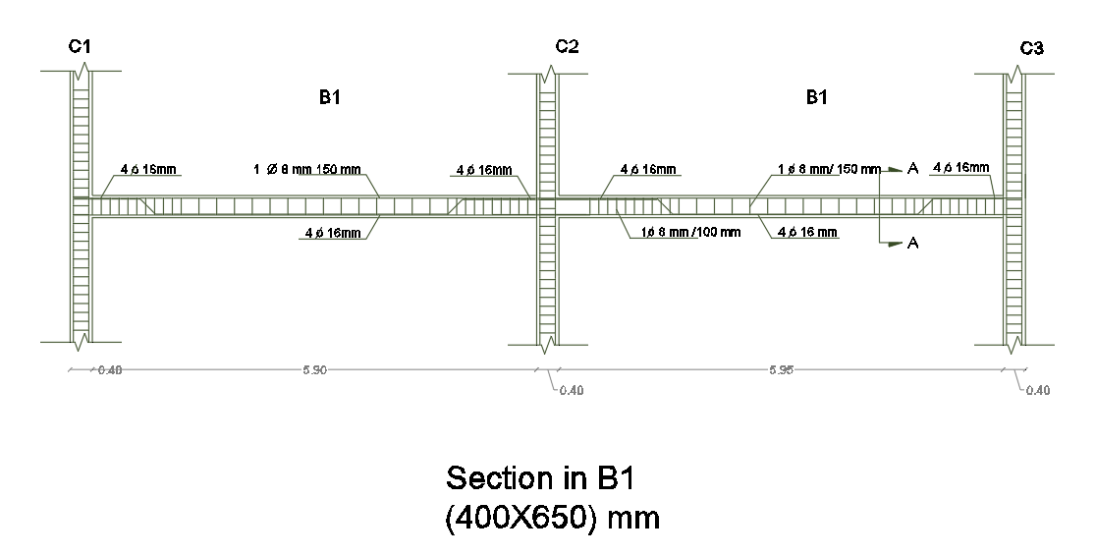
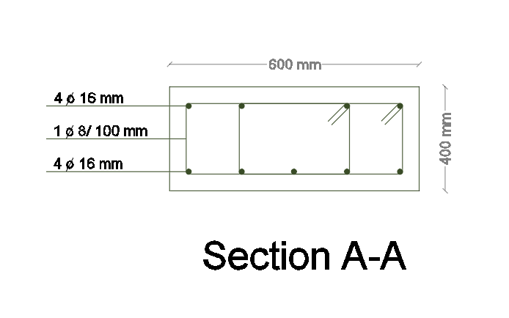
Beams Reinforcement

Slide 58
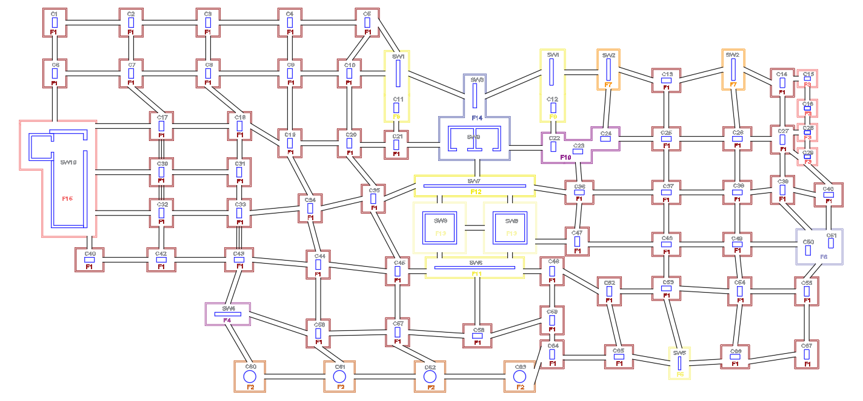
Footing Plane

Slide 59
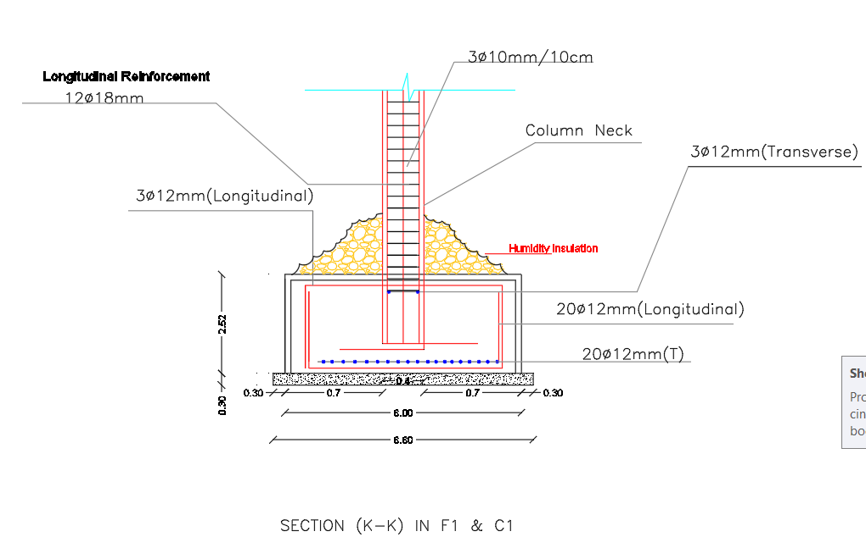
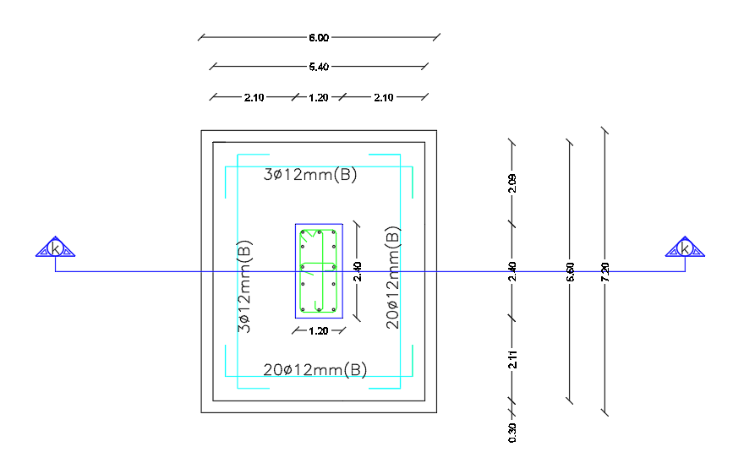
Footing Reinforcement

Slide 60
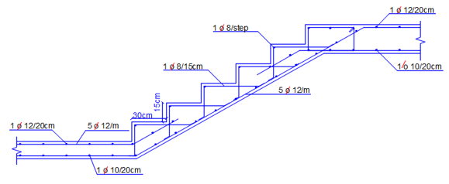
Stairs Reinforcement

Slide 61
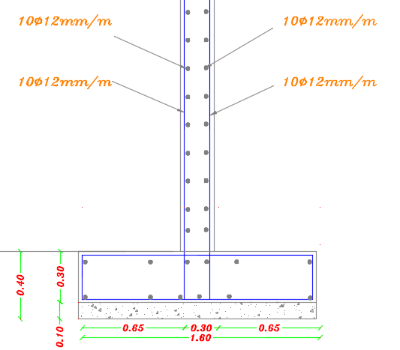
Shear wall Reinforcement

Slide 62
Outline
Site location
Architectural Design
Environmental Design
HVAC
Structural Design
Mechanical Design
Water supply system
Safety Design
Drainage system
Electrical Design
BOQ

Slide 63


VAV system
Ducts distribution in Third floor

Slide 64
VAV system
Ducts diameters
Duct section | V (m³/sec) | ∆P/EL (Pa/m) | D (m) | v (m/sec)
A-B | .2489 | 0.5 | 0.69---(0.5x0.9)m | 5
B-C | 0.22 | 0.5 | 0.5 | 4.5
C-D | 0.18 | 0.5 | 0.4 | 3.8
D-E | 0.15 | 0.5 | 0.35 | 3.7
B-F | 0.18 | 1.66 | 0.4 | 6.7
F-G | 0.15 | 0.1 | 0.35 | 1.9
B-H | 0.15 | 0.2 | 0.35 | 3
H-I | 0.13 | 0.033 | 0.2 | 1.9

Slide 65

Fan coil selection

Slide 66

Chillers selection
For chiller 1&2&3&4 with cooling capacity = 39.3 KW & heating capacity = 38.8 KW

Slide 67
Outline
Site location
Architectural Design
Environmental Design
Structural Design
HVAC System
Mechanical Design
Water supply system
Safety Design
Electrical Design
Drainage system
BOQ

Slide 68

Water supply system :
design of ground floor:
For W.C = 10*5 = 50 F.U
For lavatory = 12*2 = 24 F.U
The total horizontal fixture units = 74 F.U
The total vertical fixture units = (B+GF+F1+F2+F3)
=74+74+(9*2+6*5)* 6 =436 F.U
Branch = 5 F.U

Slide 69

Water installation
vertical : 2.5"
horizontal : 1.5"
branch: 1”

Slide 70
Water supply system :
Assume that there is a 2 day with no water supply from municipality. We use 6 water tanks with 1.5 cube for each one.

Slide 71
Outline
Site location
Architectural Design
Environmental Design
Structural Design
HVAC
Water supply system
Mechanical Design
Drainage system
Electrical Design
Safety Design
BOQ

Slide 72

Drainage system
Stack diameter = 4"
Slope for pipe (horizontal pipe) 4" = 1%
Slope for pipe (horizontal pipe) 2" = 1%
Slope for pipe (horizontal pipe) 6" = 1%

Slide 73
Outline
Site location
Architectural Design
Environmental Design
Structural Design
Mechanical Design
Emergency signs
Safety Design
Electrical Design
BOQ

Slide 74



Emergency Signs

Slide 75
Outline
Site location
Architectural Design
Environmental Design
Structural Design
Mechanical Design
Dialux program analysis
Safety Design
Lighting distribution
Electrical Design
BOQ
Socket distribution

Slide 76

Artificial Lighting
Dialux Program
For meeting room

Slide 77



Artificial Lighting
Dialux Program
Luminaire used
Total illumination, uniformity and glare

Slide 78

Artificial Lighting
Dialux Program
Main office

Slide 79

Distribution of Lighting

Slide 80

Distribution of Sockets

Slide 81
Outline
Site location
Architectural Design
Environmental Design
Structural Design
Mechanical Design
Safety Design
Electrical Design
BOQ

Slide 82
Bill of Quantities
Total cost of project = 9,033,437.50 NIS
Total Cost per m = 1600 NIS
2

Slide 83
Thank you

