Slide 1



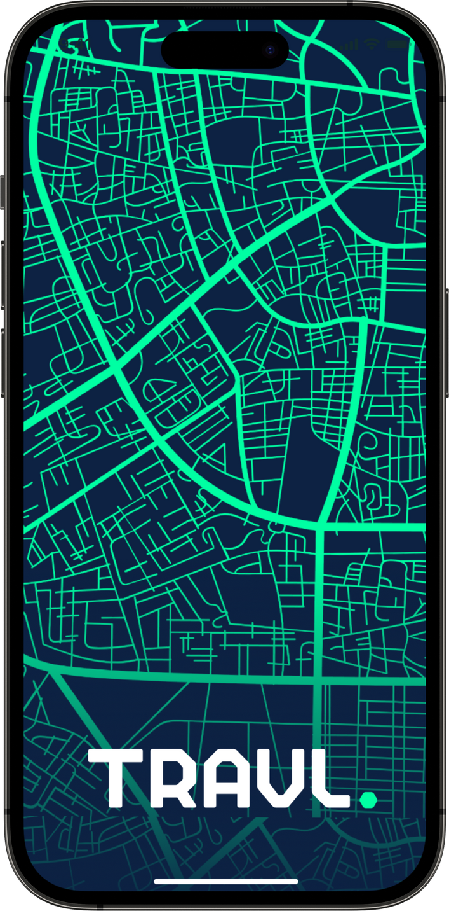

we help
you travl.
TOURPULSE

Slide 2

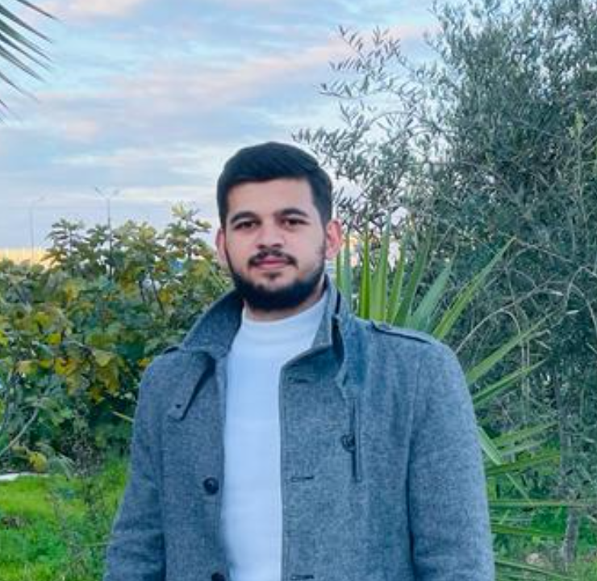


Our Team
Sameh Essa
Ghazal Masri
Motasem Ayyash

Slide 3
Table of content
Introduction
Users
Value Proposition
Architectural Design
Suggested Solution
Recommender System
Approach
Technology Used
Conclusion And Future Work

Slide 4

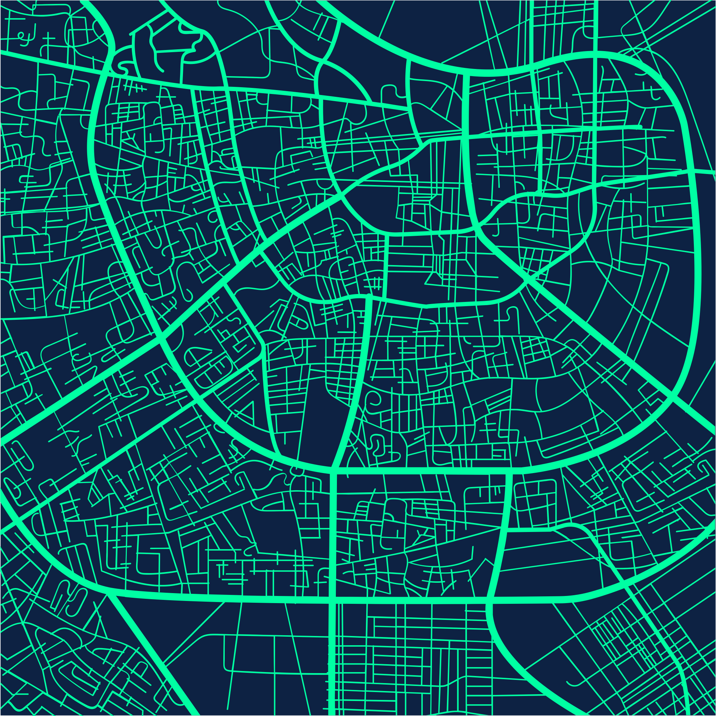
Introduction

Slide 5
The tourism and travel sector is one of the most important active sectors in Palestine, However, this sector faces big problems in availability and marketing, as agencies suffer from weakness in marketing, and people suffer from a limited number of tours available to them.

Slide 6
Value Proposition

Slide 7

Tourpulse is a website for tourism and travel, as it allows Palestinian agencies to market and display their tours in addition to organizing, and managing them, which allows them to reach a larger number of customers and allows users to view all the tours available to them smoothly.

Slide 8
Suggested Solution

Slide 9
Solutions & Features
Problems
•Weak marketing at agencies which makes it difficult for clients to reach many tour picks.
•Weakness in the feedback and reviewing (evaluation) system for agencies and clients.
•Arrangement, organization, and preservation.
A link between agencies and consumers
Evaluation system
A platform for organization and storage

Slide 10
Approach

Slide 11
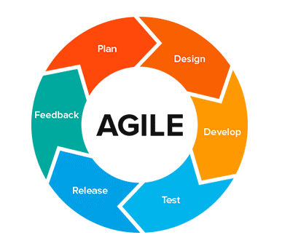
Agile Methodology
dynamic approach that adapts to changes
need to produce prototypes (iterations)
Perfect for teamwork

Slide 12
Users

Slide 13
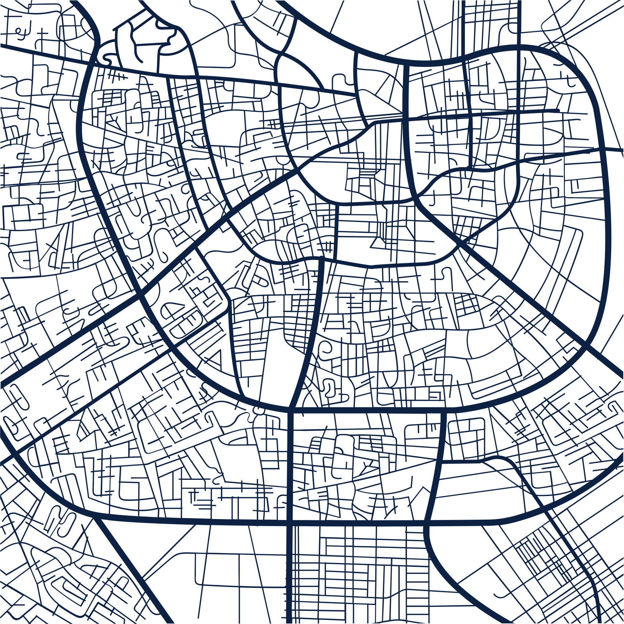
USER
TOUR OPERATOR
SUPER ADMIN/ADMIN
  Sign up/Sign in
  Manage personal profile.
  Update password through email verification.
  Sort, search, and filter tour packages, operators.
  Rate and review tour packages and operators.
  Sign in
  Add new tour packages.
  Delete tour packages.
  Update tour package details.
  Edit profile information.
  Request restoration of deleted tour packages.
  Sign in
  Create tour operator profiles.
  Manage admin profiles (Super Admin exclusive).
  Create and manage tour package categories.
  Manage the lifecycle of tour packages.
  Change status of users and tour operators.
  Publish tourism blogs.
  Update own profile information.
  Search, sort, and filter tour packages and operators.

Slide 14
Architectural Design

Slide 15
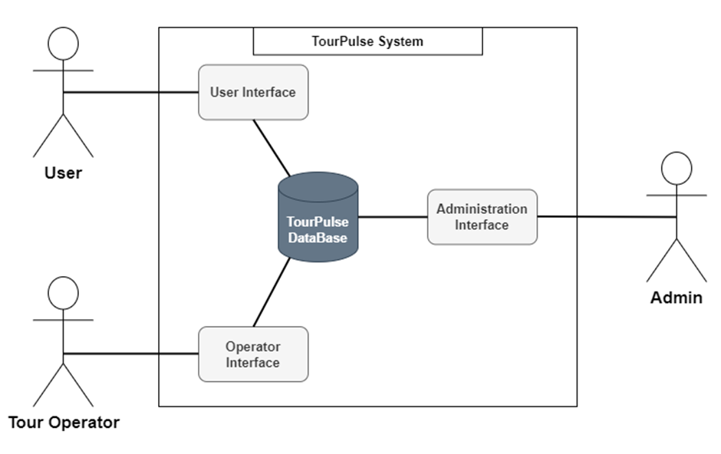
System Environment

Slide 16
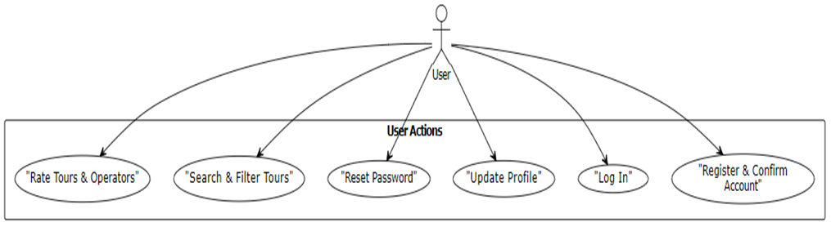
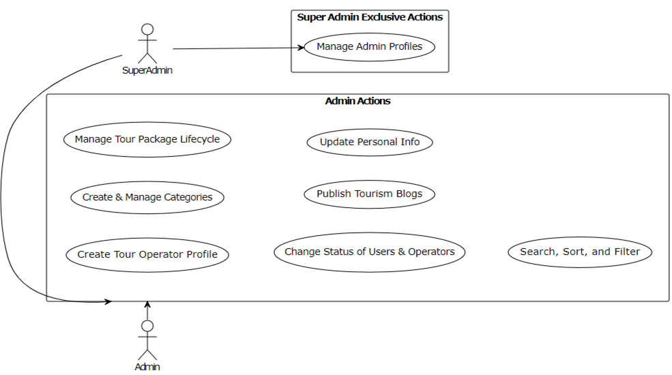
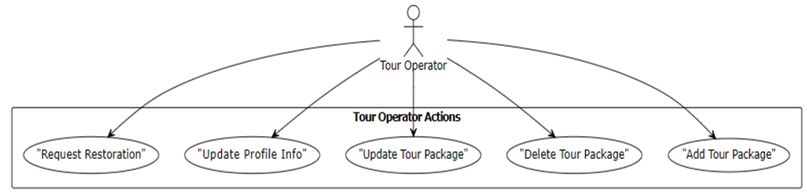
Use Case Diagram

Slide 17
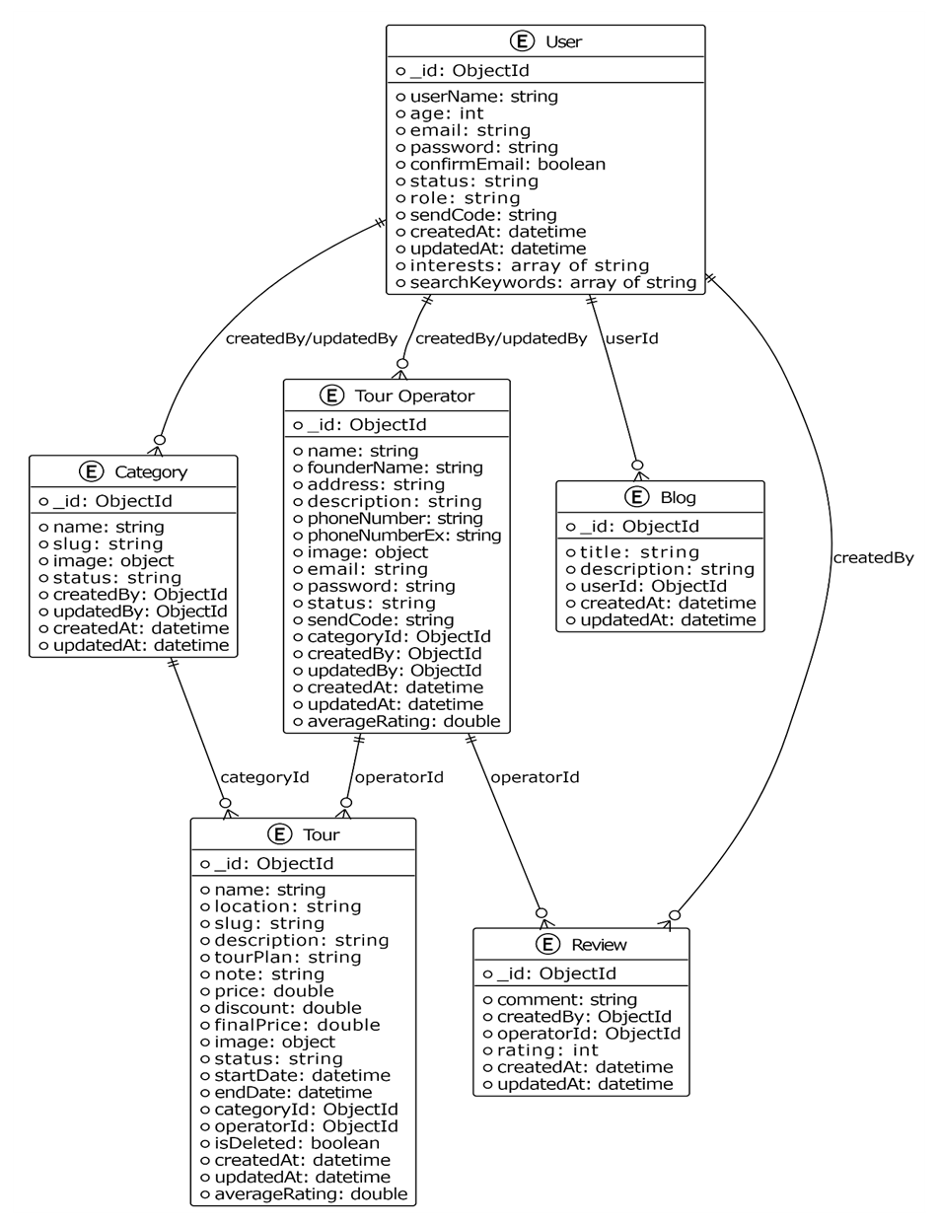
Collection-Relationship Diagram

Slide 18
Recommender System

Slide 19
Hybrid Recommendation System
Content-Based
Collaborative Filtering
Hybrid
Matching Tours to Preferences
User Similarities
Rating Matrix
Combining Both for Better Recommendations

Slide 20
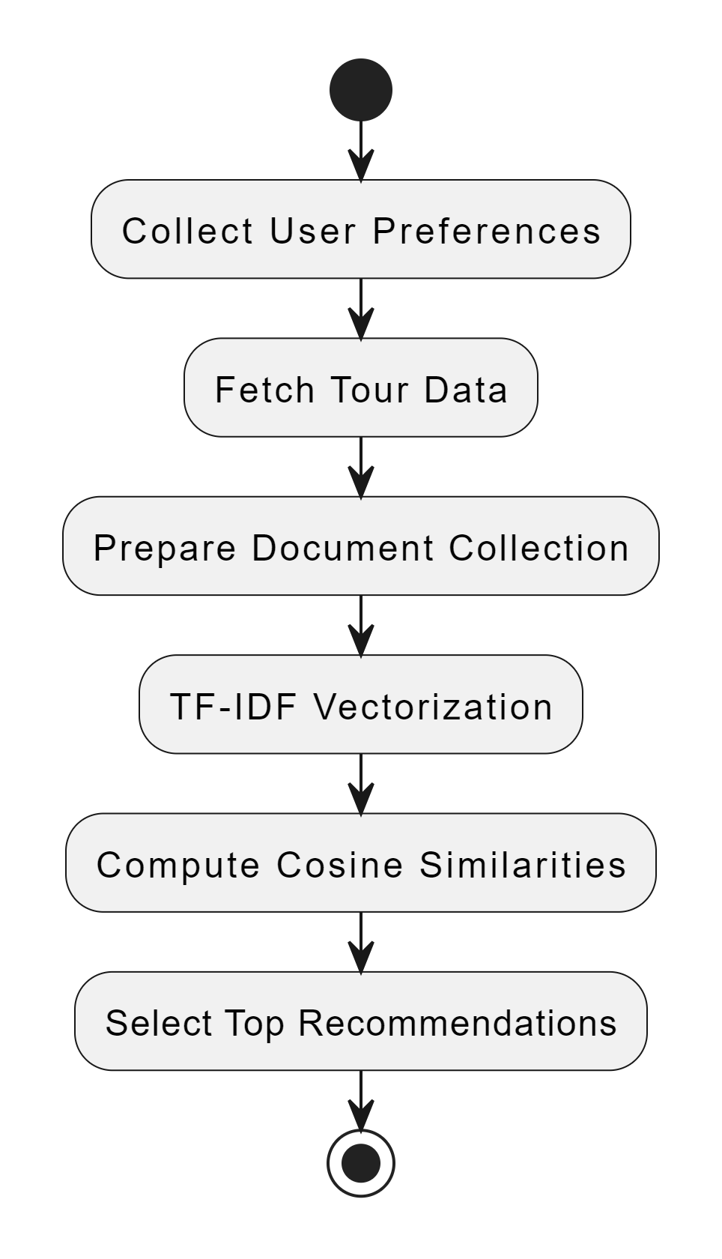
•
Content-Based
content-based filtering by vectorizing user preferences and tour descriptions to compute similarity scores using cosine similarity and generate personalized tour recommendations.
Collect user preferences, including:
Top 3 interests.
Last 5 search keywords.
Combine user preferences into a single comprehensive string.
Fetch tour data for similarity comparison, including:
Tour name.
Tour description.
Tour plan.
Subject the combined user preferences and tour data to TF-IDF vectorization, converting textual information into numerical TF-IDF feature vectors.
Calculate cosine similarity between the user's preference vector and each tour's feature vector to assess similarity.
Sort the tours based on their cosine similarity scores in descending order.
Return the top 10 tours with the highest similarity to the user's preferences for personalized recommendations.

Slide 21
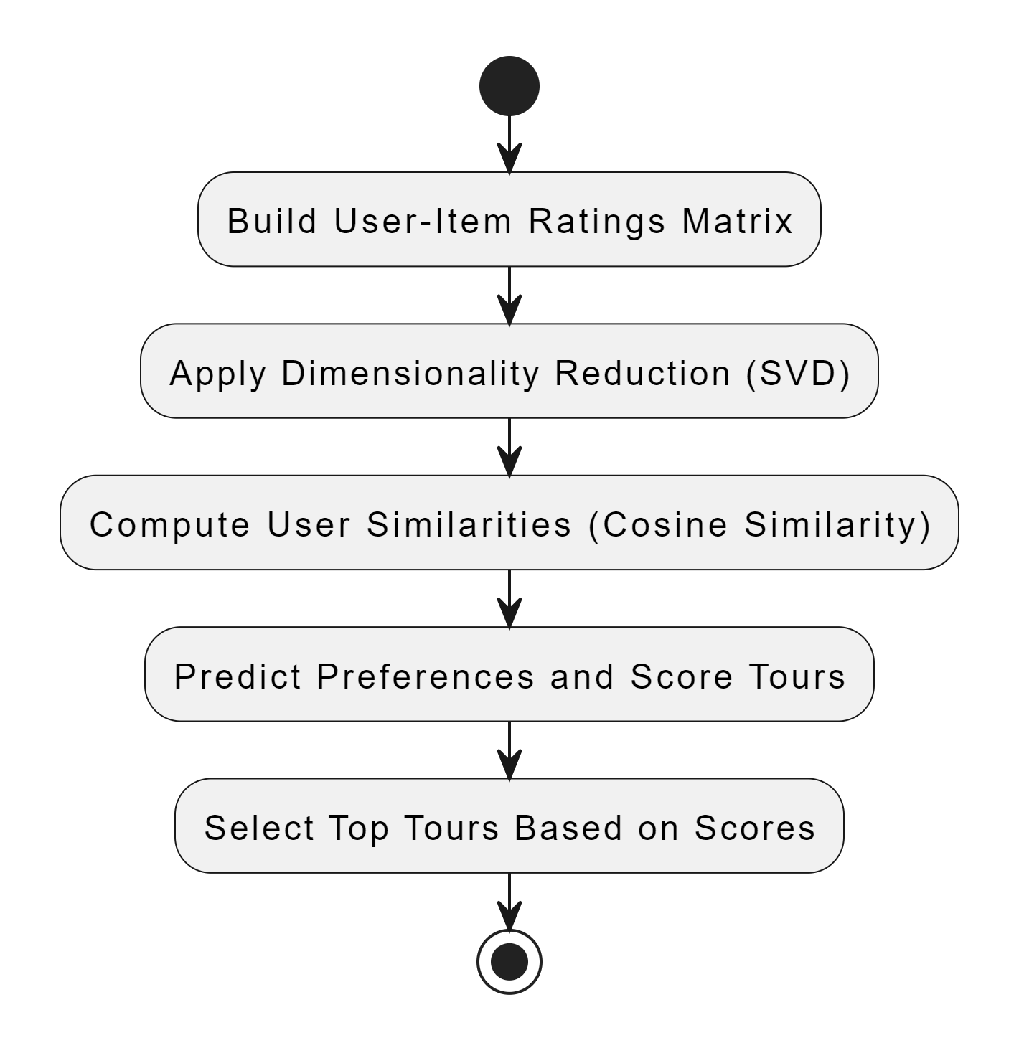
•
Collaborative Filtering
User-Item Ratings Matrix from user reviews, applies dimensionality reduction via SVD, computes user similarities with cosine similarity, and generates personalized tour recommendations based on the preferences of similar users.
Build User-Item Ratings Matrix:
Construct a matrix from user reviews where rows represent users and columns represent tours. Each cell contains the rating a user has given to a tour.
Apply Dimensionality Reduction (SVD):
Use Singular Value Decomposition (SVD) to reduce the dimensionality of the ratings matrix, simplifying the dataset.
Compute User Similarities (Cosine Similarity):
Calculate the cosine similarity between users based on their interactions in the reduced space.
Predict Preferences and Score Tours
Infer the preferences of the target user by aggregating ratings across similar users, generating a score for each tour that reflects its potential relevance to the user.
Select Top Tours Based on Scores
Sort the tours by their scores, Select and return the top tours

Slide 22
•
Hybrid
Why We Used These Algorithms?
TF-IDF: Enhances the content-based filtering by weighting the importance of words in tour descriptions relative to their frequency across all descriptions
Cosine Similarity: Effectively measures the similarity between user preferences and tour descriptions, or between users in collaborative filtering
SVD: Reduces the dimensionality of the user-item ratings matrix, preserving essential patterns while minimizing noise and computational complexity
Cache Node: Reduces computational load and ensures quick access to recommendations.
The hybrid approach seamlessly combines content-based and collaborative filtering to offer personalized tour recommendations, leveraging the strengths of both methods to enhance accuracy and relevance.
To address computational demands, a cache-node is introduced, updating personalized recommendations every 6 hours. This strategy optimizes system performance while ensuring recommendations remain current.

Slide 23
Technology Used

Slide 24









Tools

Slide 25
Conclusion And Future Work

Slide 26
The tourism and travel sector is one of the most important active sectors in Palestine, However, this sector faces big problems in availability and marketing, as agencies suffer from weakness in marketing, and people suffer from a limited number of tours available to them.
Future Work
spreading in Palestine
Add a reservation and payment system
Expanding to other countries & integrating neighboring countries

Slide 27
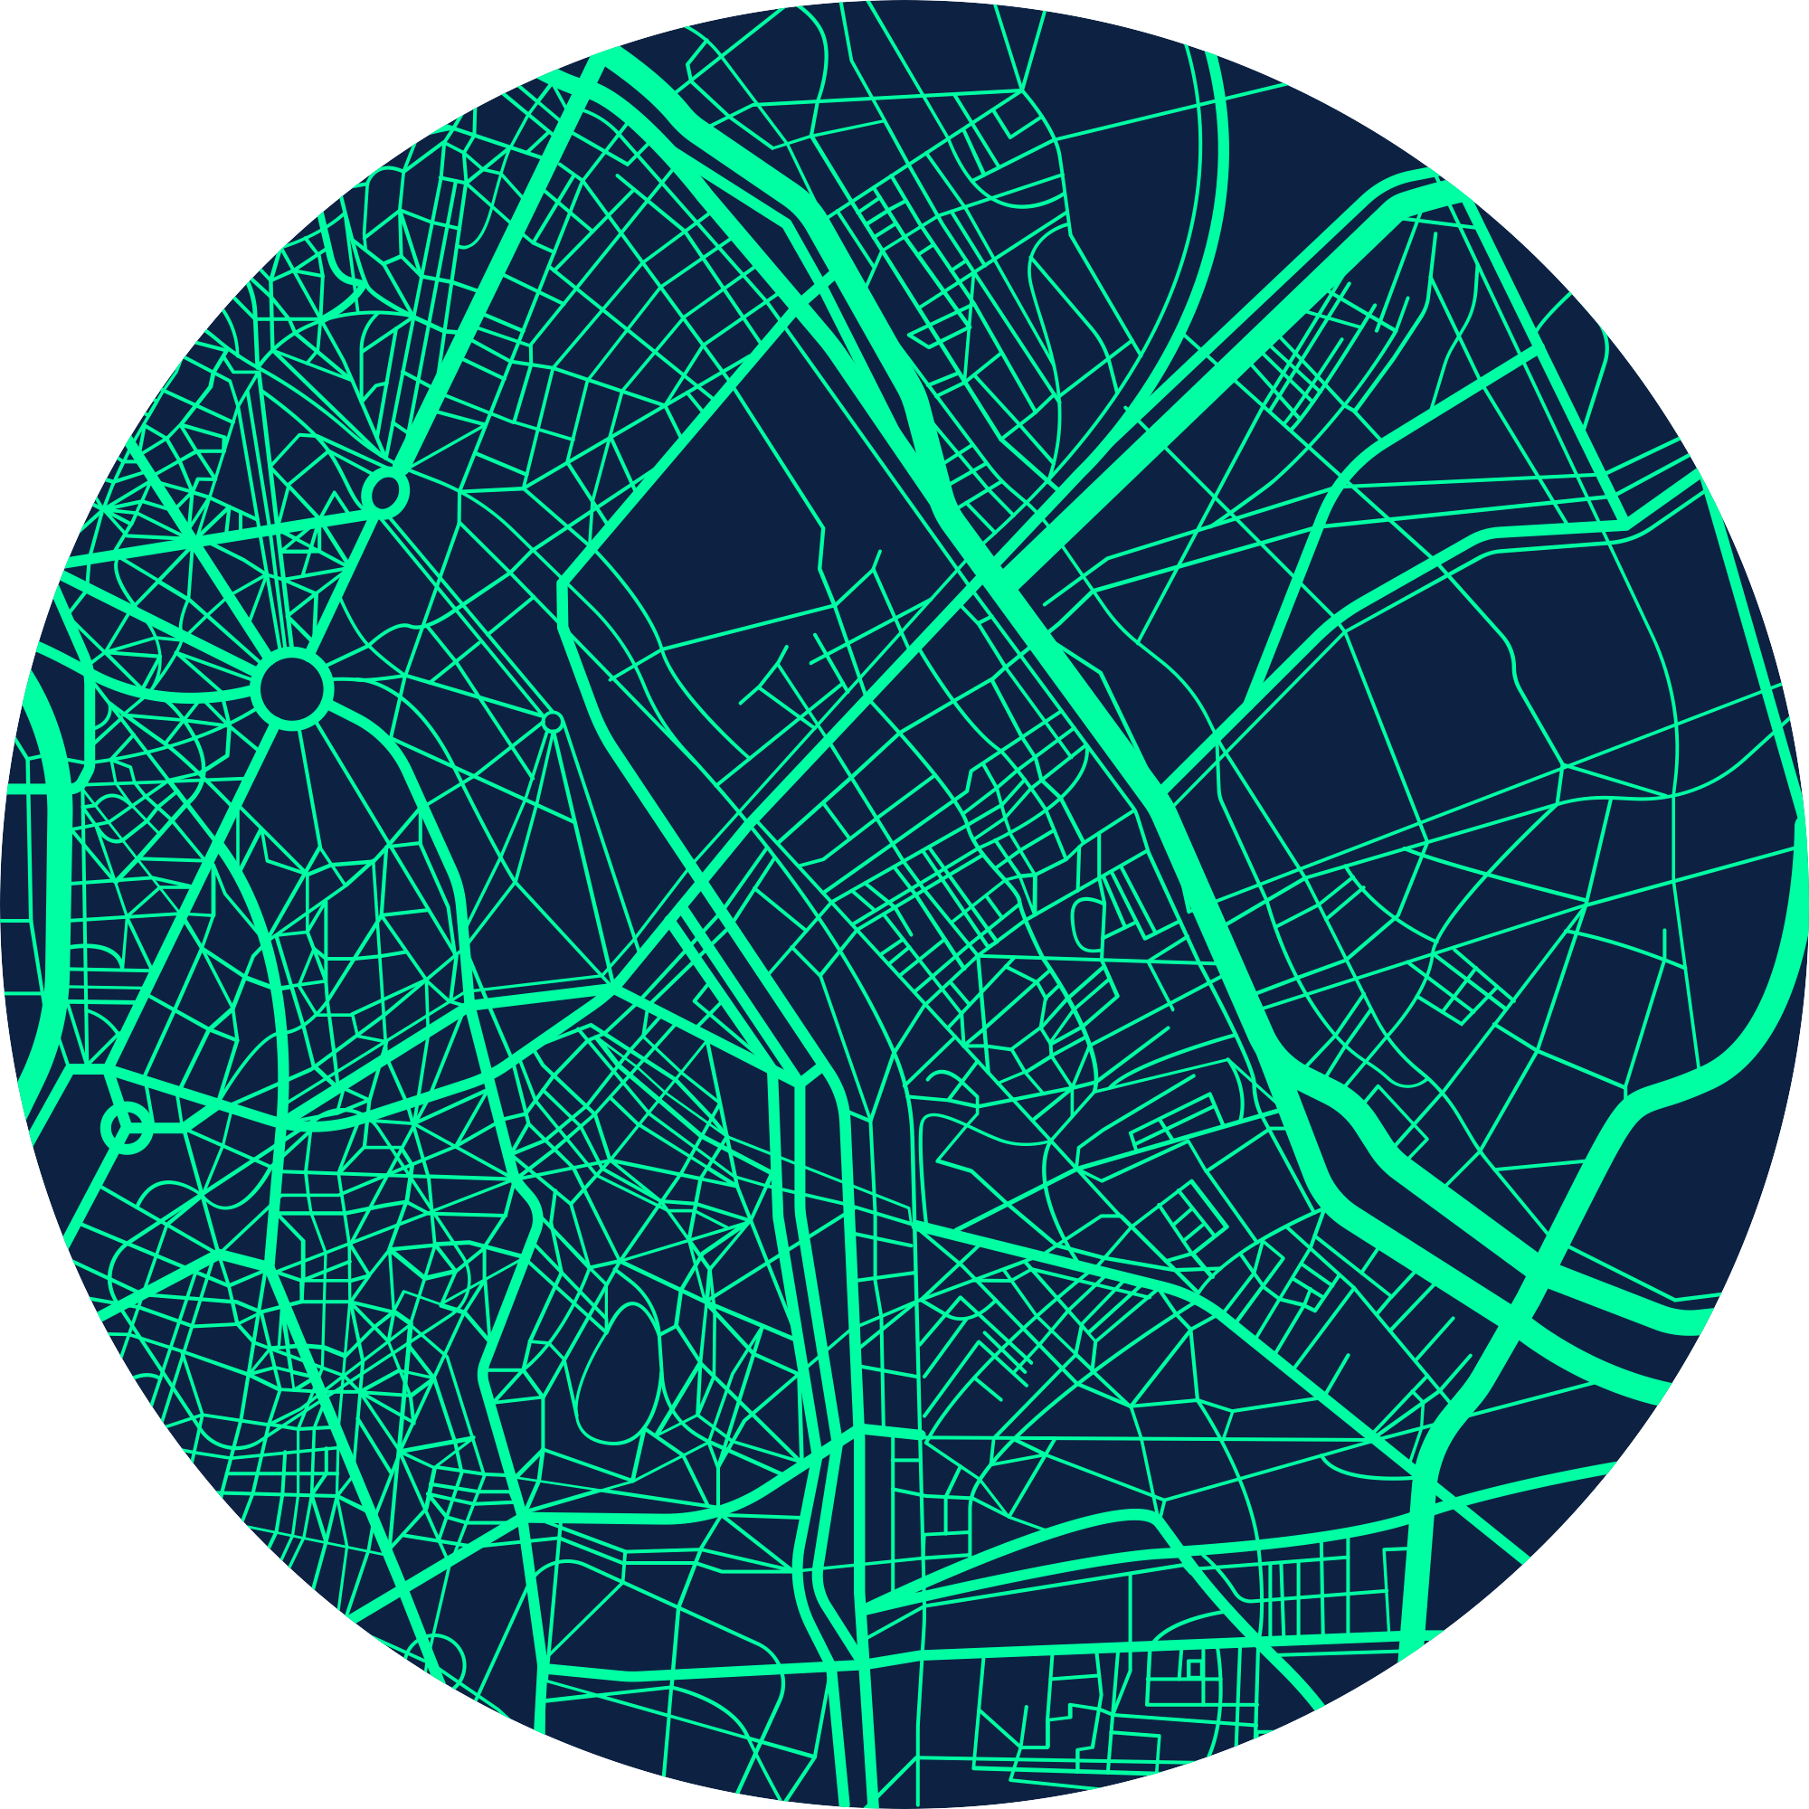
•
THANK YOU

