Slide 1
Graduation Project 2
“Electrospinning device”
Students:
•Ayman Shakhsher
• Malak Shehadeh
Supervisor:
Dr. Bahaa Shaqour

Slide 2
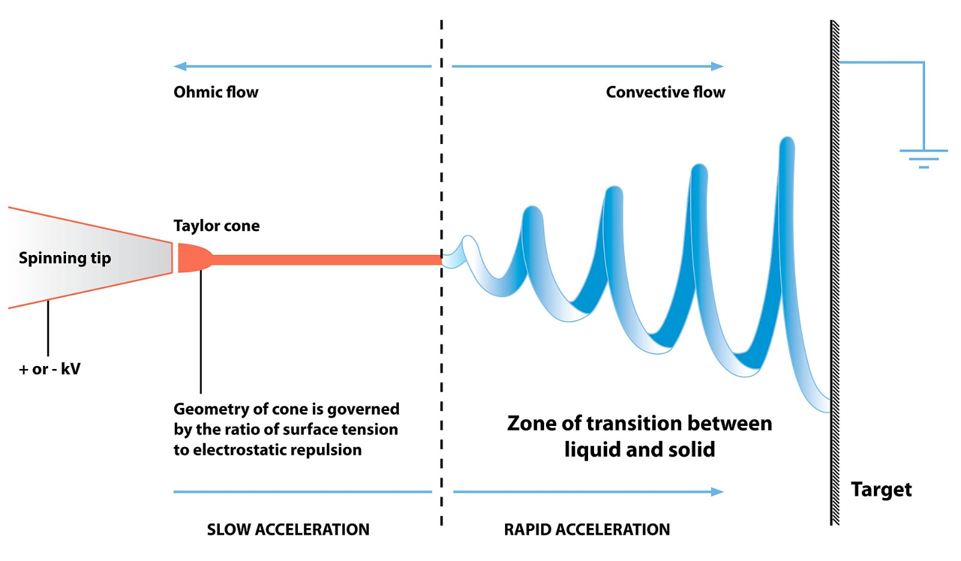
Electrospinning process:

Slide 3
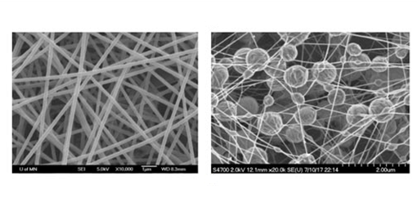
Parameter that affected the structure of nanofiber :
1. Applied voltage. 2. Distance between nozzle-collector.
3. Dispersion flow rate.
Smooth and beaded fiber.

Slide 4
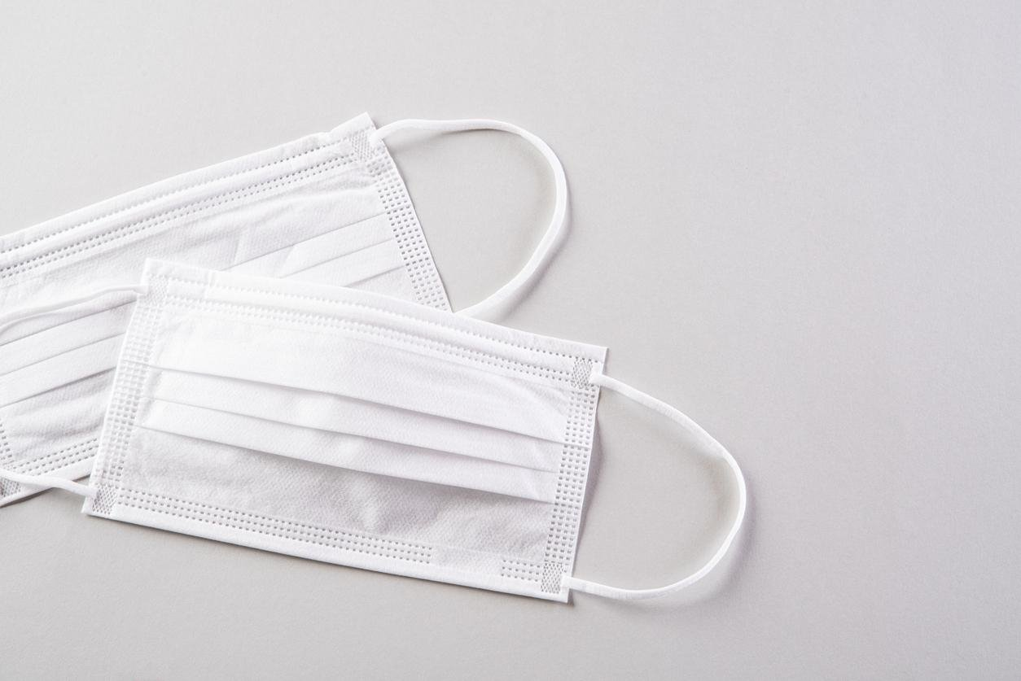
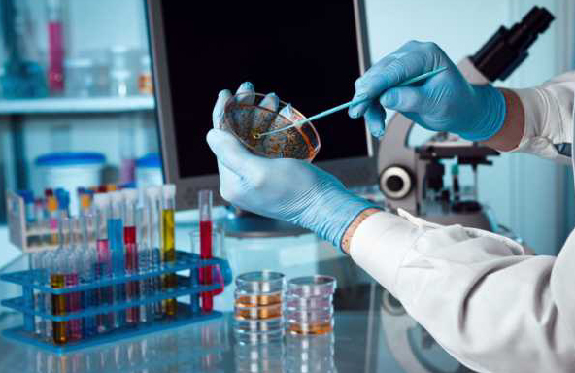
Applications:
Fddgsd Biomedicine | Filtration separation

Slide 5
System performance and safety
High voltage power supply (HVPS)
HVPS is one of the main parts of electrospinning process to produce nanofibers
HVPS consists of AC signal , step up transformers , full wave rectifier circuit with filtration circuit and the measurement of the output voltage circuit
A (HVPS) with Vout up to 8KV has been designed by multisim software as shown in the following figure .

Slide 6
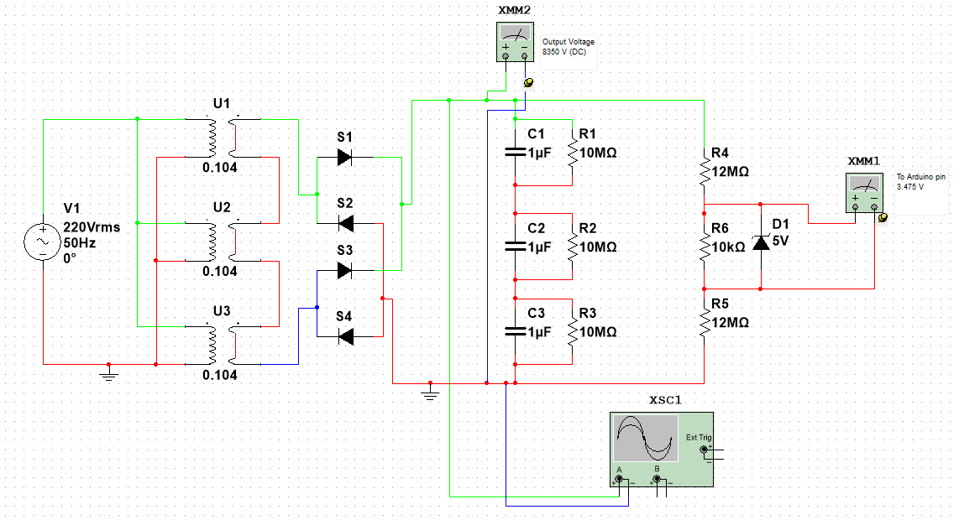

Slide 7
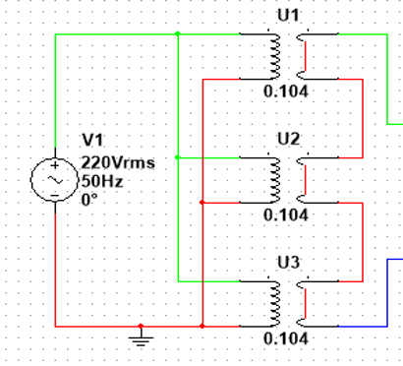
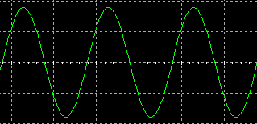
Ac source with step up transformers
Vout up to 9000v peak to peak

Slide 8
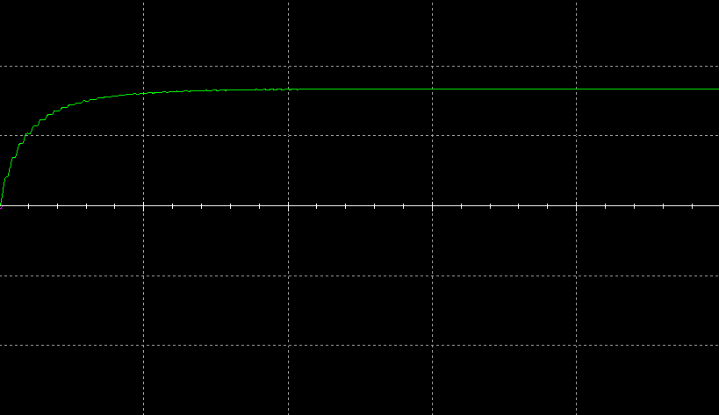
After rectification and filtration the signal

Slide 9
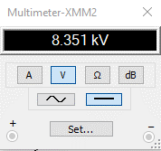
Output voltage

Slide 10
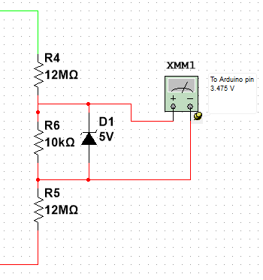
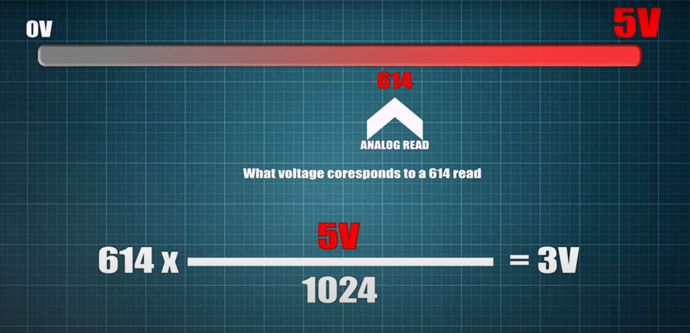
Voltage divider circuit
V_{out} = (5/1023) * ADCreading(pin A0) * 2401
Vout=Vin*(R2/(R1+R2))

Slide 11
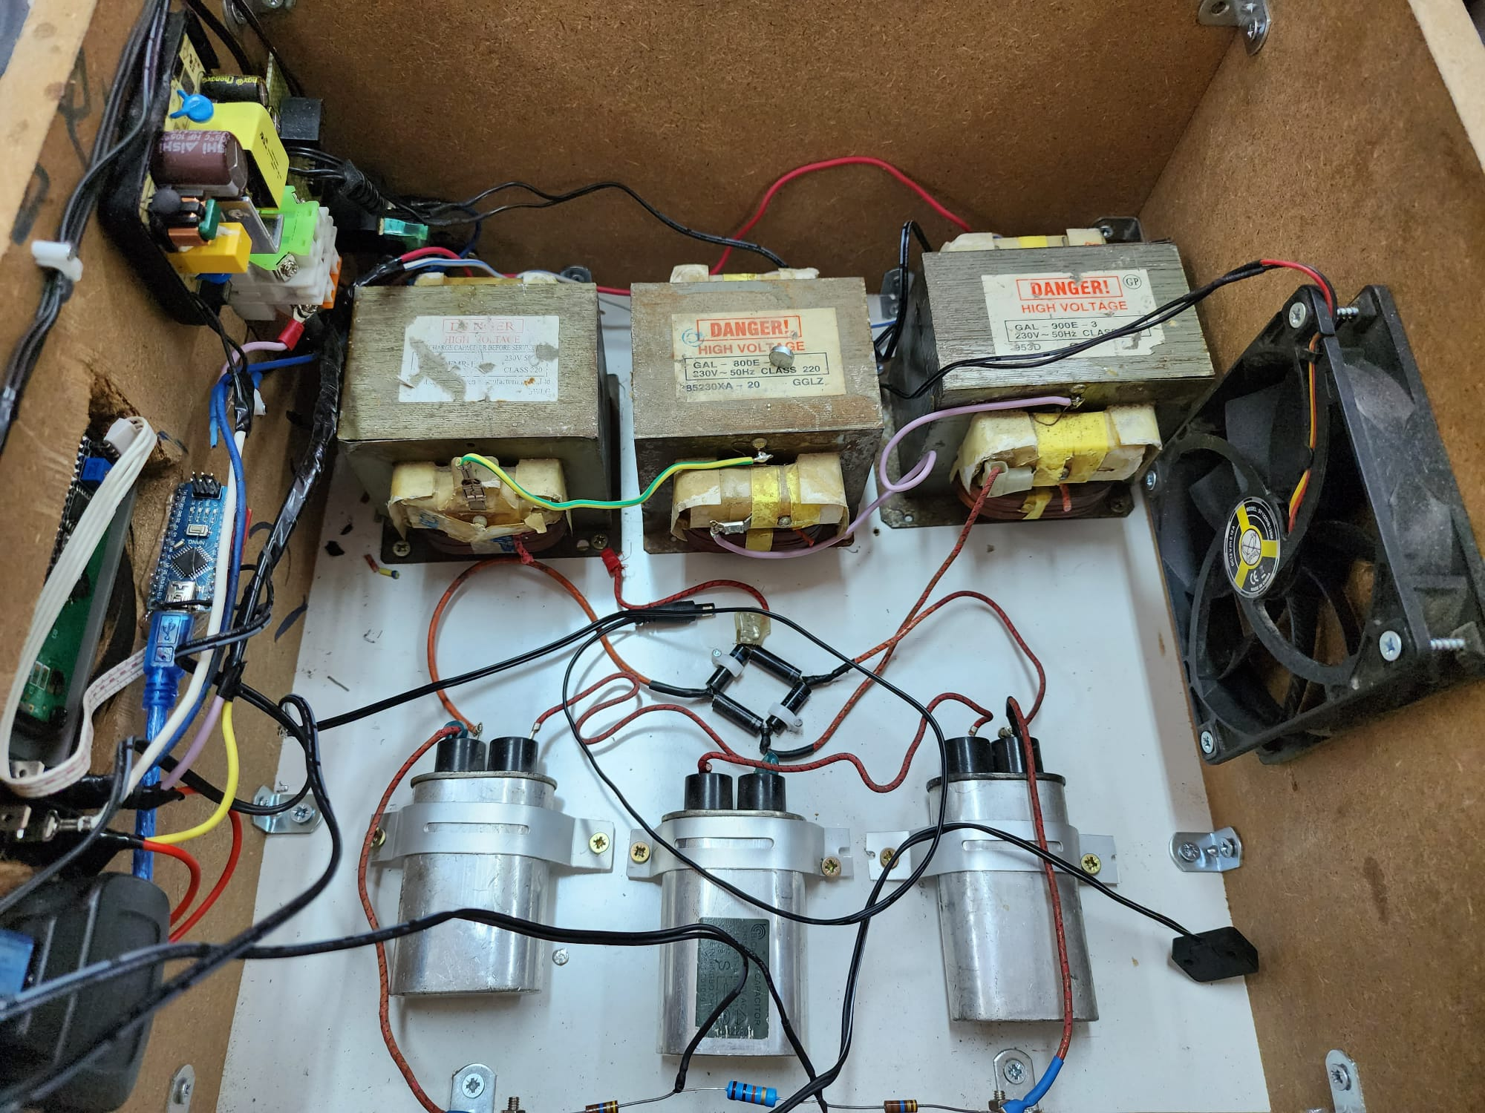
Power supply

Slide 12
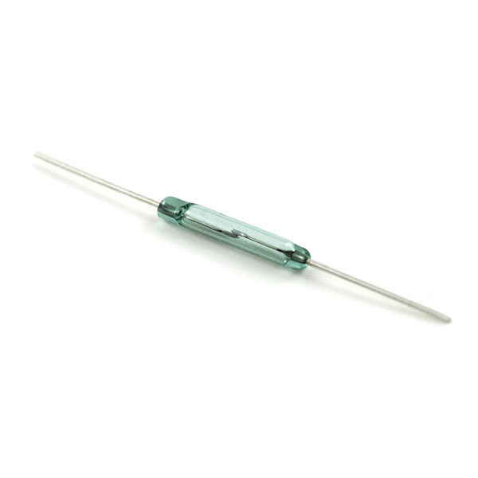
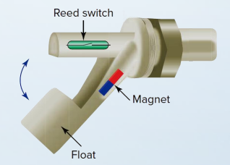
For safety issue
Isolate the HVPS
Magnetic reed switch

Slide 13


For safety and to avoid accidents:
Wear safety gloves.
Wear safety shoes.

Slide 14
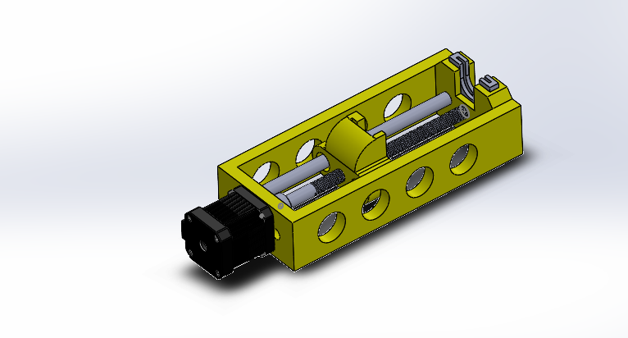
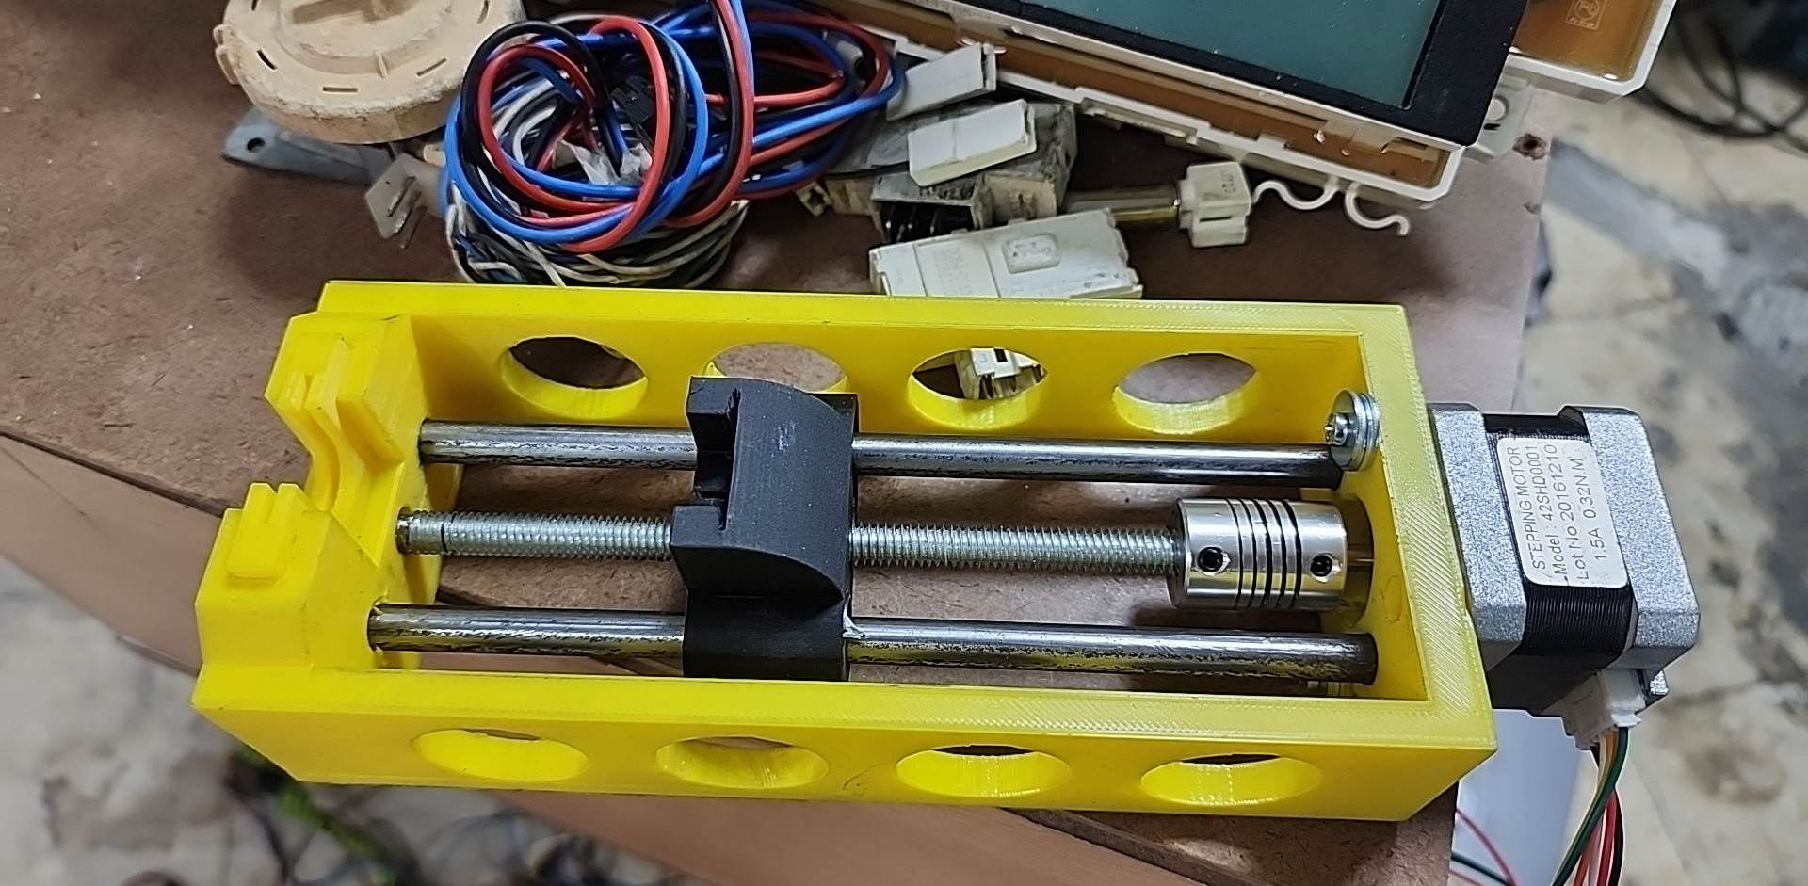
Syringe pump:
1. mechanical part

Slide 15
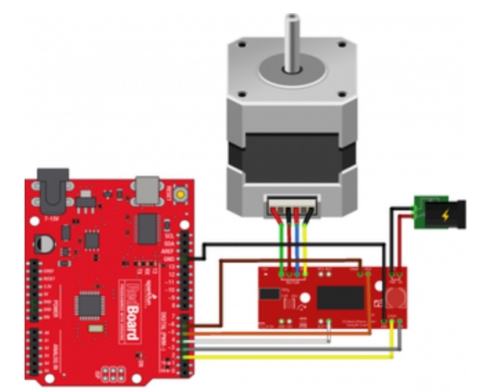
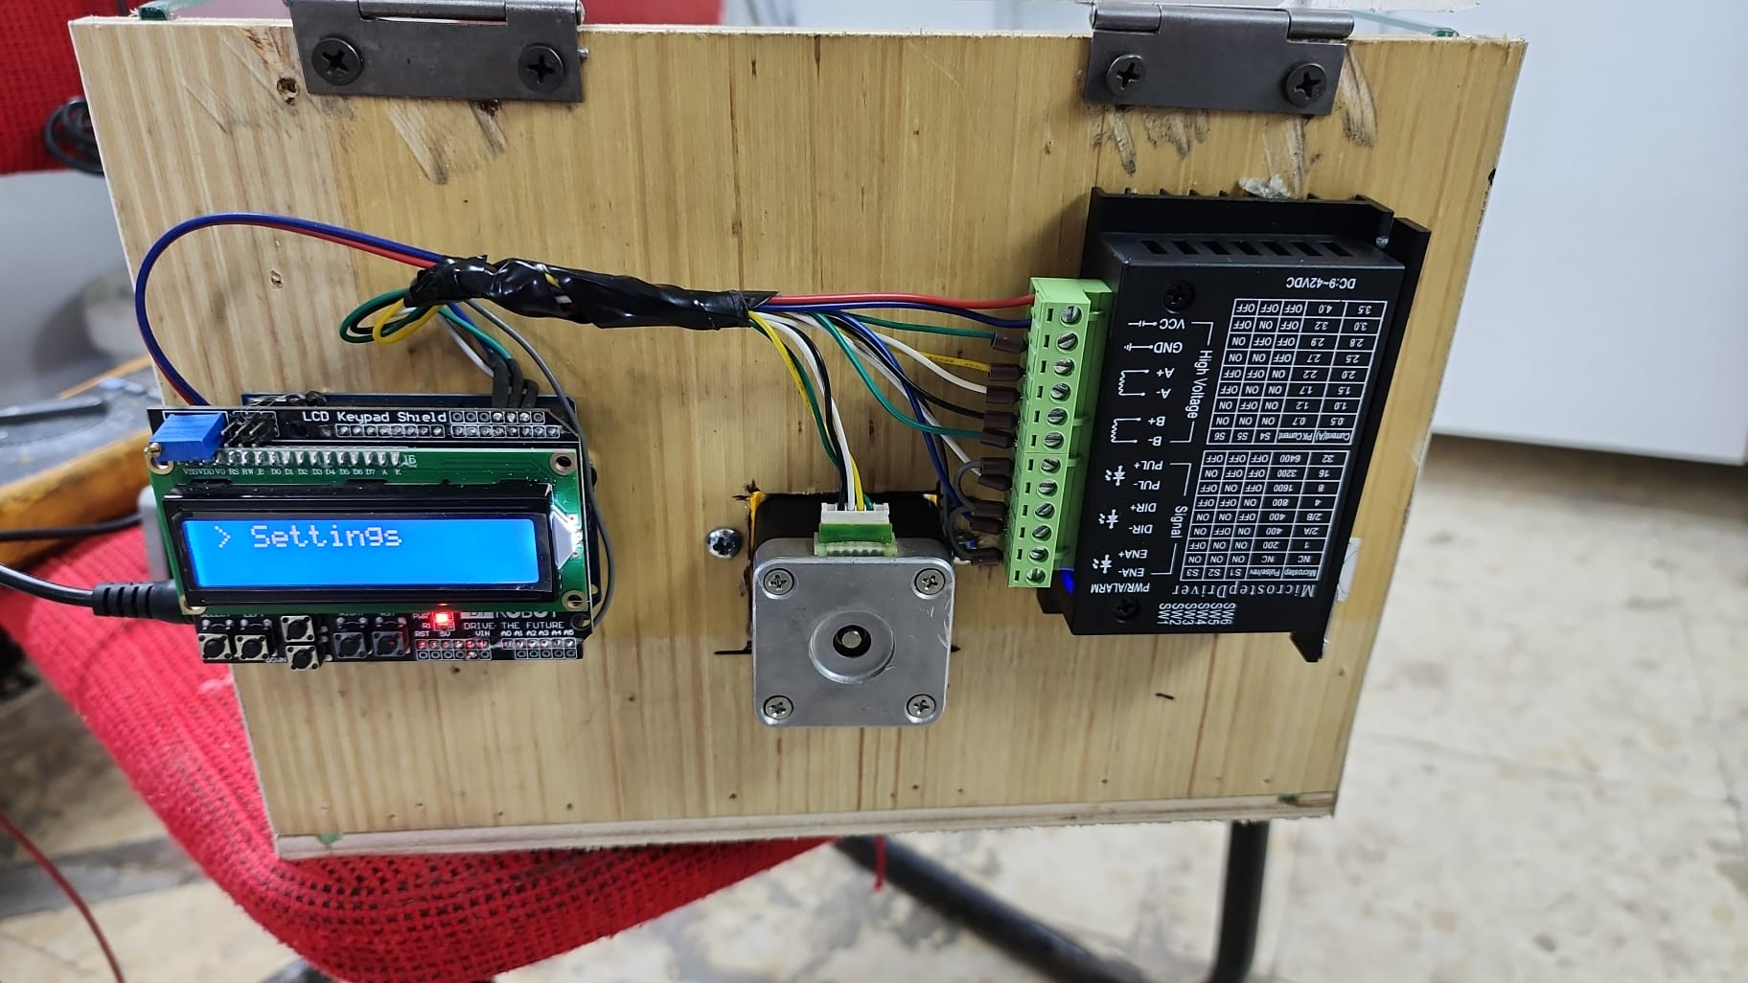
2. electrical part:

Slide 16
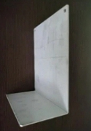
Collector:

Slide 17
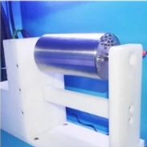
Future Work:
Types of collectors:
Flat collector Rotating drum collector

Slide 18
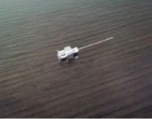
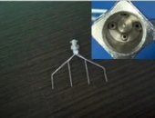
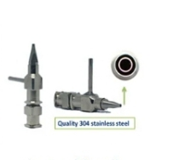
Shapes of the needle :
Single syringe needle. 1 inlet,4outlets needle. Coaxial needle.

Slide 19
Any Questions

