Slide 1
Graduation Project II
Designing of Wastewater collection network of Kafr Ra’I Town
Project Done by:
Abd Al-Khaliq Touqan
Obadah Hamdan
______________________________
Submitted to:
Dr. Anan Jayousi

Slide 2
Project Outline
Revision of Graduation Project I
Introduction to Project II
Objectives of Second Project
Methodology of designing Wastewater Collection Network
Collected data and Calculations
Theory
Design
Problems and Solution
Design Results
Recommendations

Slide 3
Revision of Project I
Water is one of the most important requirements to live, everything on the earth needs water,
Our project is to design a water distribution network (WDN) for village of Kufr Ra’I
Figure 1: Kafr Ra’I Town

Slide 4
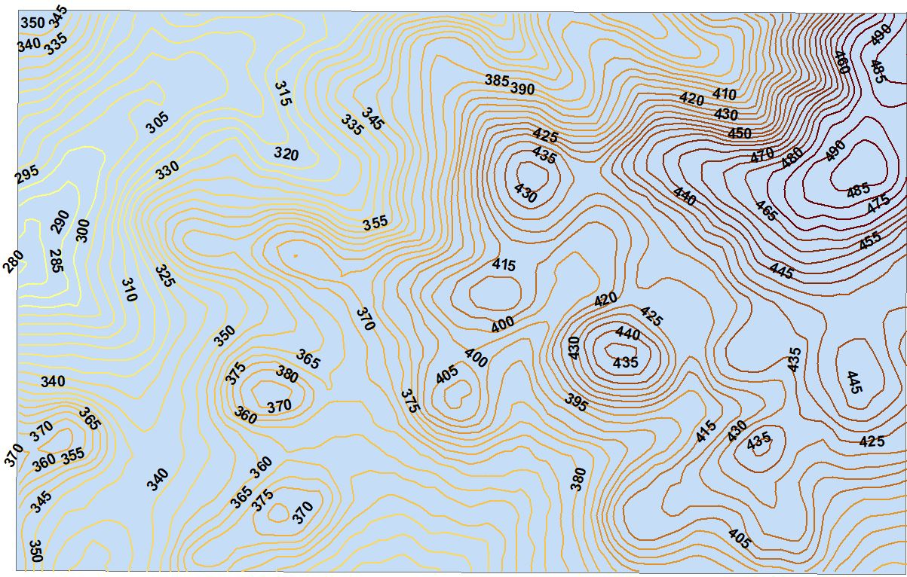
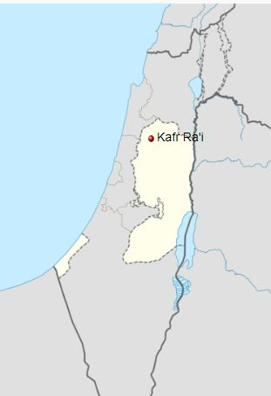
Location and Topography of the studied area
Figure 2: Topography of Kafr Ra’i

Slide 5
Location
The Town is located nearly 22 km Southwest of Jenin city
Northeast to the city of Tul-Karm
Located on and between 4 highlands

Slide 6
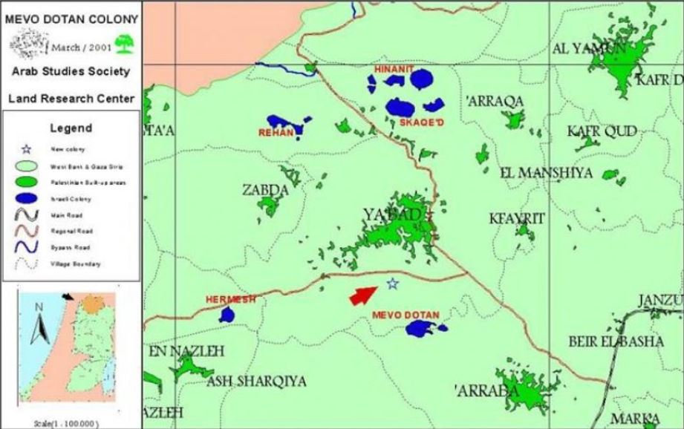
Location
The village is surrounding by the following villages:
Ya’bad and Al-Nazla-Alshaqeyeh from the North
Fahmah and Ajah from the East
Al-Ramah and Bala’a from the South
Sayda and Allar from the West.

Slide 7
Introduction to Project II
We had redesigned WDN in our Project I
Most of the Town contains Cesspits
And the Objective is to design a WWCN

Slide 8
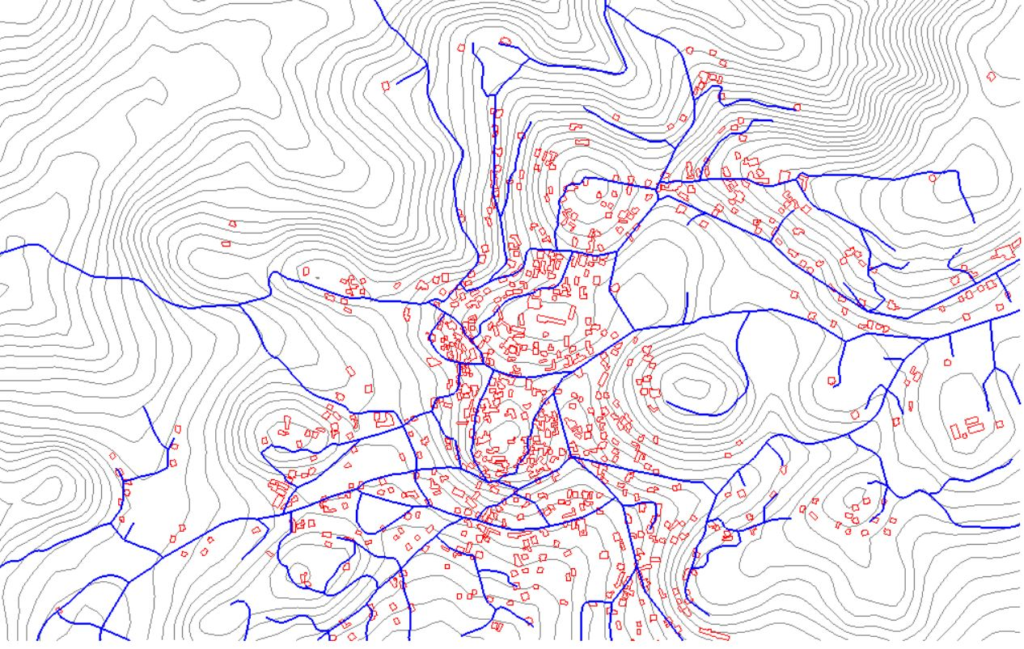
Methodology of designing Wastewater Collection Network
Collecting Useful Informations
Mainly: Contours, Buildings, and Roads maps

Slide 9
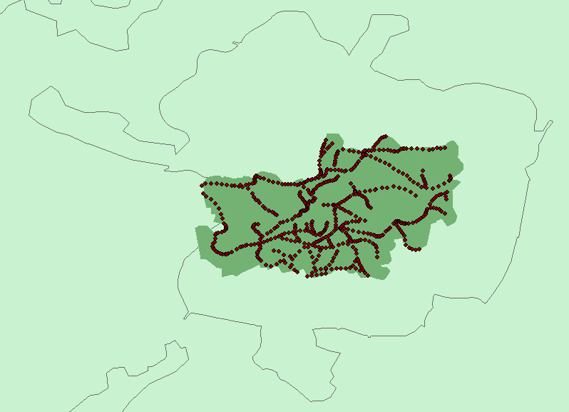
Area = 1,431,850.4586 sm =1,432 Donum
And Density was = 0.0107 C/sm
Figure 4: Design Area

Slide 10
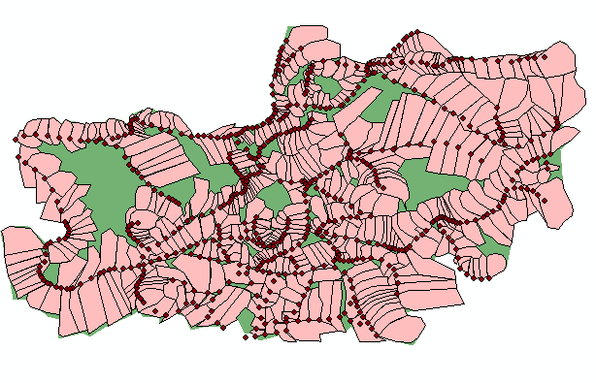
Sewer sheds design
Figure 5: Sewer Sheds

Slide 11
Related Hydraulic Concepts
General procedure for flow rate quantification
Average water consumption
Average wastewater generation
Average infiltration enters manholes
Total WW flow
Max hourly WW
Computing the design value

Slide 12
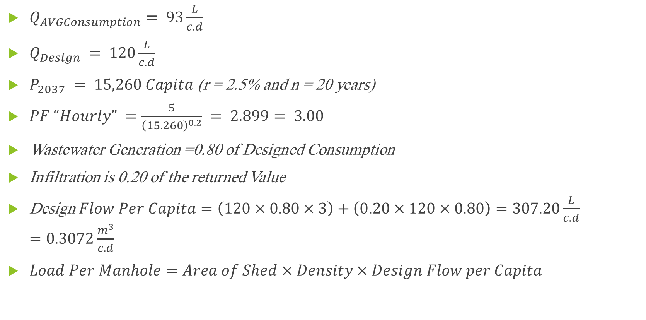
Collected Data and Calculations
$Q_{AVGConsumption}= 93\frac{L}{c.d}$
$Q_{Design} = 120\frac{L}{c.d}$
$P_{2037} = 15,260 Capita$ (r = 2.5% and n = 20 years)
$PF “Hourly” =\frac{5}{{\left(15.260\right)}^{0.2}} = 2.899= 3.00$
Wastewater Generation =0.80 of Designed Consumption
Infiltration is 0.20 of the returned Value
Design$Flow Per Capita=\left(120×0.80×3\right)+\left(0.20×120×0.80\right)=307.20\frac{L}{c.d}=0.3072\frac{m^{3}}{c.d}$
$Load Per Manhole=Area of Shed×Density×Design Flow per Capita$

Slide 13
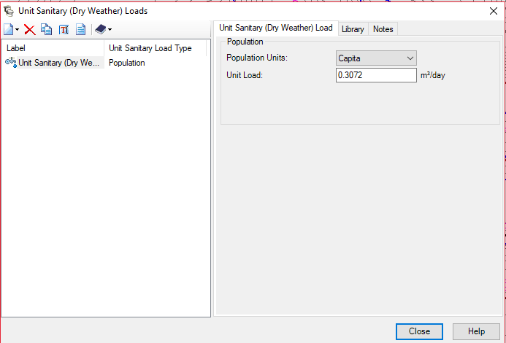
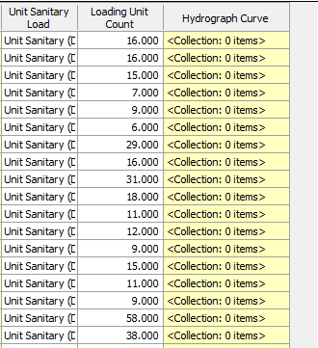
Manhole Loading
Figure 6: Manholes Loading

Slide 14
Theories
Energy Principle
Manning’s Equation “Friction Loss”

Slide 15

The Energy Principle
In hydraulic applications, energy is often represented as energy per units of length.
We used the following energy equation

Slide 16
Hydraulic and Energy Grade Lines
Hydraulic grade line (HGL): Describes the heads of pressures and elevation
Energy grade line (EGL): Describes the heads of pressures, elevation and velocity

Slide 17

Friction Loss Method
We used Manning’s equation for free surface flow
$$Q=\frac{1}{n}K×A×R^{\frac{2}{3}}×S^{\frac{1}{2}}$$

Slide 18
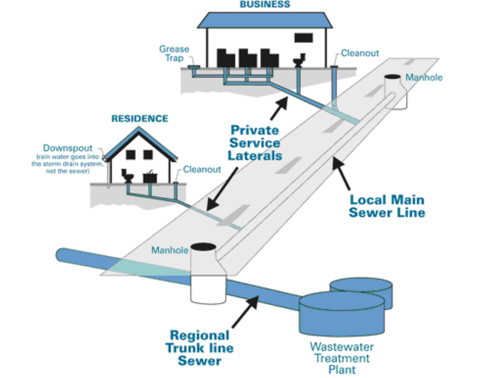
Designing of WWCN

Slide 19
Design Constraints
Velocities (0.60 – 3.00) m/s.
Slopes (1-12) %
Cover depth (1.00-5.00) m

Slide 20
Types of Sewer systems
Sanitary Sewer System
Storm Sewer System
Combined Sewer System

Slide 21
Types of Wastewater Collection systems
Gravity Sewer System
Pressurized Sewer System

Slide 22
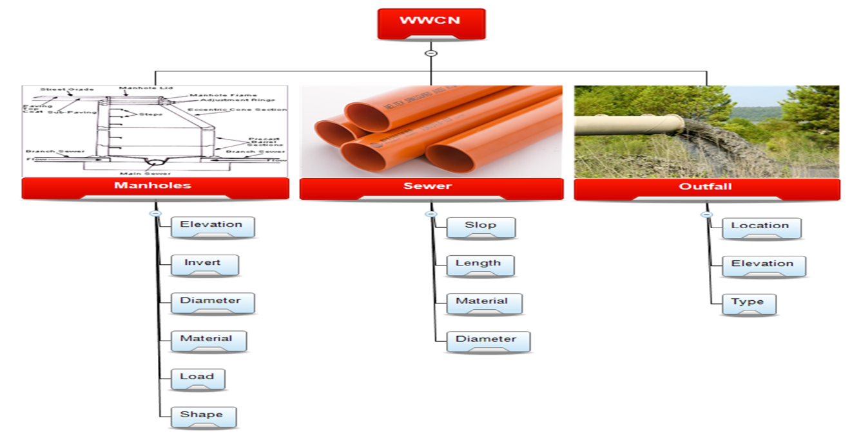
WWCT Components

Slide 23
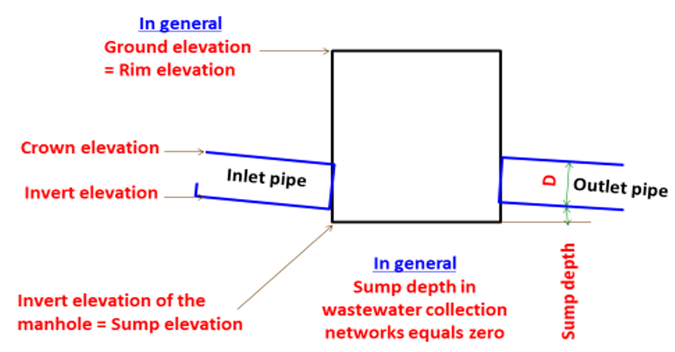
Cross Section of manhole

Slide 24
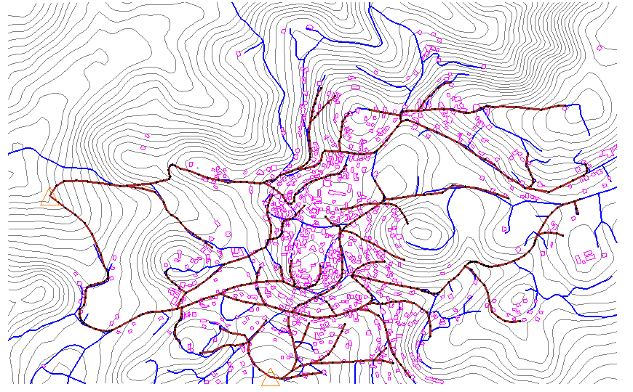
Final Design
Figure 3: WWCN

Slide 25
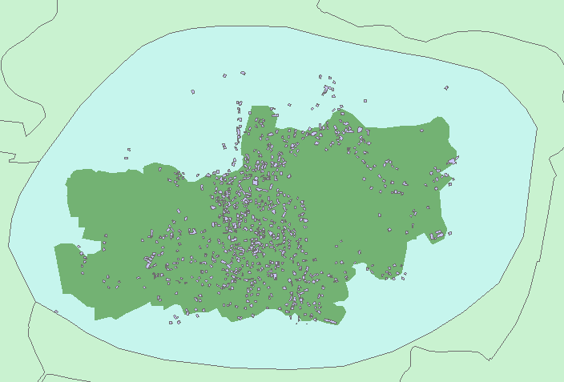
Problems and Solution
Design Area = 3,483,835.2262 sm = 3,484 Donum
Figure 7: Design Area Problem

Slide 26
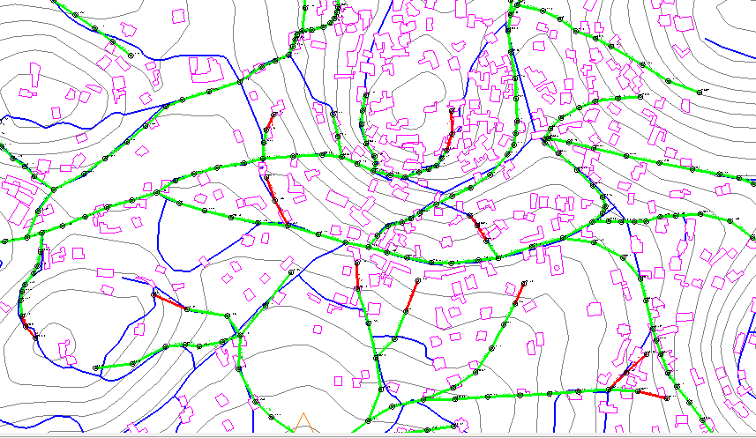
Figure 8: Low Velocities

Slide 27

Design results

Slide 28
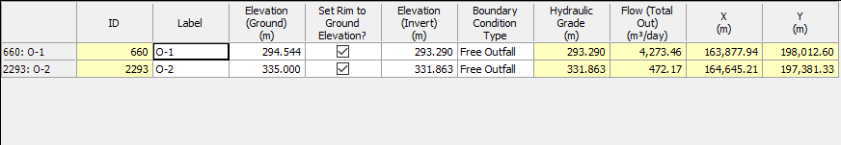
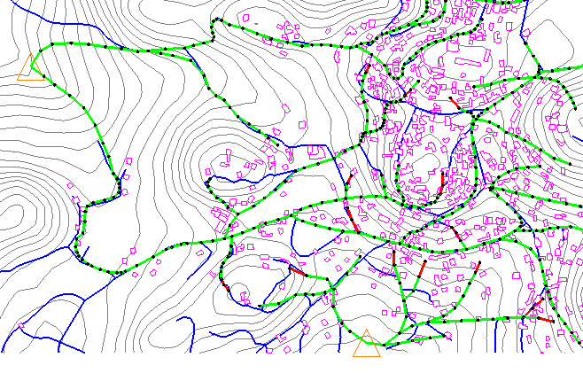
Outfalls
Figure x: Outfalls Flow Values and Locations

Slide 29
Profiles
An Engineering Graph which describes the Slope, Cover, Rim elevation, Invert of Manholes and Conduits and it shows how the drop Manhole “Structure” would look like.

Slide 30
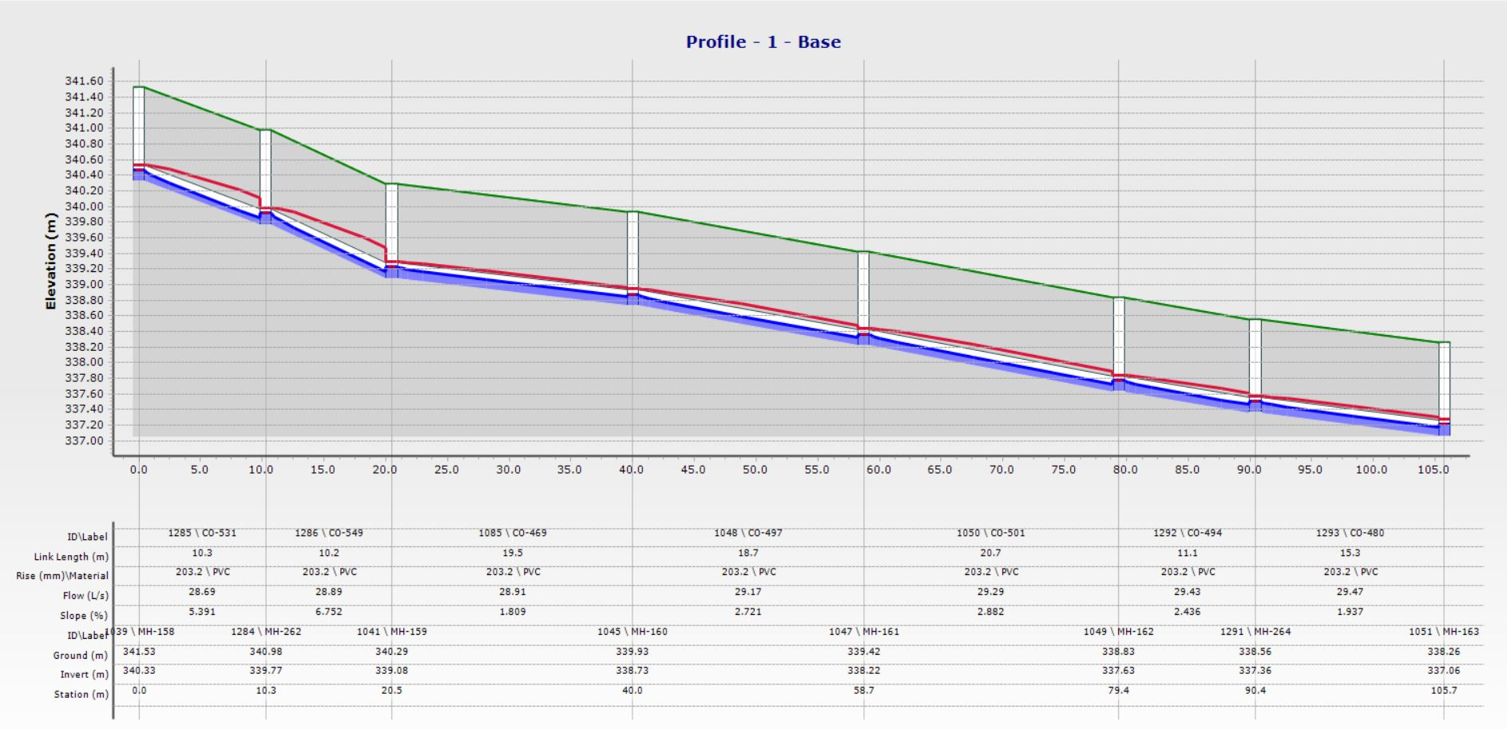
Profile-1

Slide 31
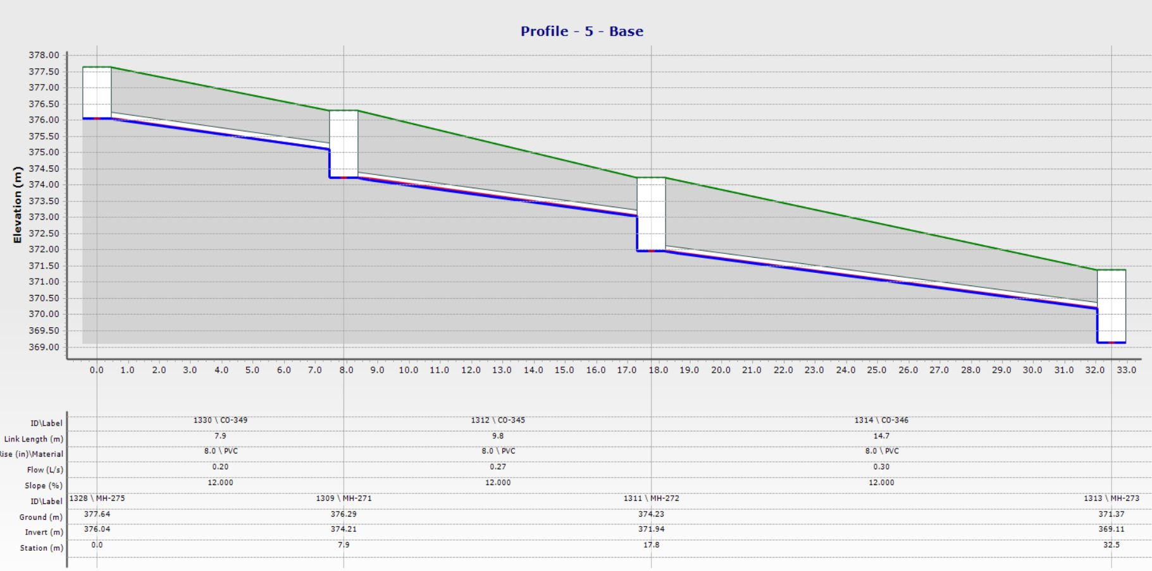
Profile-2

Slide 32
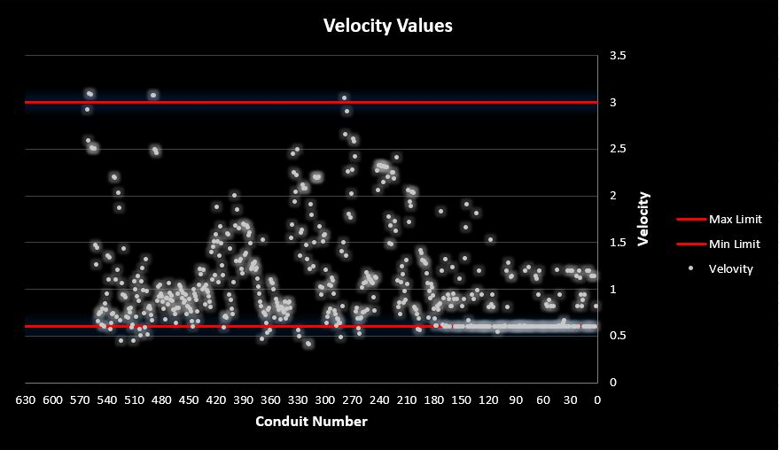
Velocities
Figure 9: Velocities Range

Slide 33
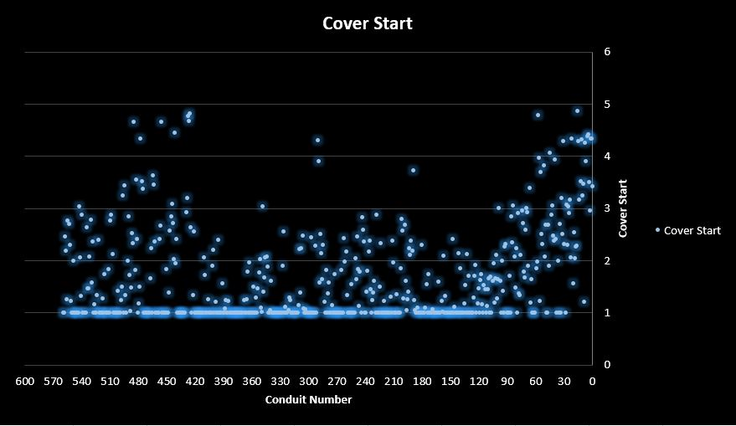
Cover Start Values
Figure 10: Cover Start Range

Slide 34
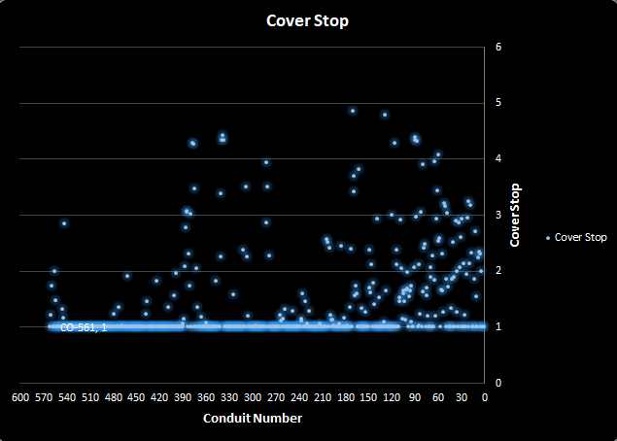
Cover Stop Values
Figure 11: Cover Stop Range

Slide 35
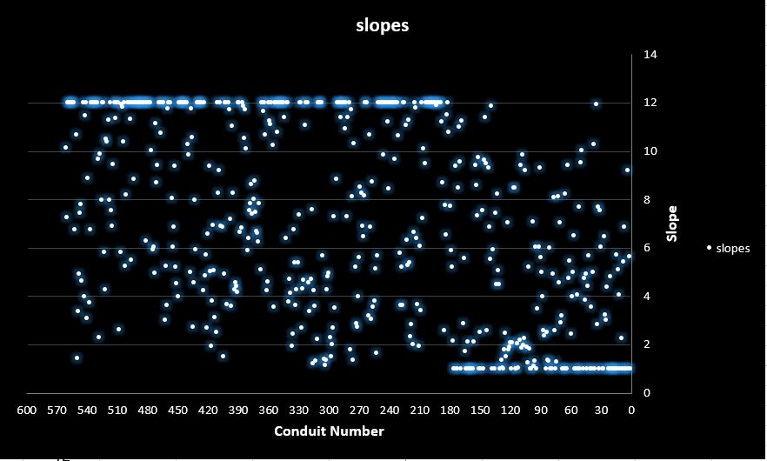
Slope Values
Figure 12: Slope Range

Slide 36

Conclusion and Recommendation

Slide 37
Conclusion
The network ends with two outfalls.
The network includes 561 manholes and 561 conduits.
All conduits have a diameter of 8" and 10".
Slopes of pipes are within a range of (1 - 12%).
Cover depths varies from (1.00 – 4.86 m).
Velocities through conduits varies from (0.41 – 3.09 m/s).

Slide 38
Recommendations
Outfalls
Flushing

