Slide 1
Driving Safely
Graduation Project 2

Slide 2
Supervisor:
Dr. Suleiman Abu Kharmeh
Prepared by :
Raghad Abu Baker
Shaymaa Ashqar

Slide 3
Outlines
o Introduction.
o Features.
o Motivation.
o Hardware Components.
o Overall Design.
o Circuit.
o Software Implementation
o Constraints and Difficulties.
o Future Works.
o Demo.

Slide 4
Introduction
Driving Safely is a system that provides safety inside the car, as it monitors the driver's eyes to reduce the possibility of accidents and detect it when it is occur and provides a system that works when a traffic accident occurs.
To achieve this system we need some hardware components Raspberry pi 3, Arduino Uno R3, Raspberry Camera, Arduino GPS, Sim900A GSM, Piezo sensor, Buzzer 5v, LEDs and car model

Slide 5
Features
Monitors the driver's eye, and when the driver closed his eyes for consecutive seconds, an alarm sounds gradually increasing as the eye closing period increases.
Detecting and sensing the occurrence of the accident

Slide 6
Features
When a traffic accident occurs, a message is sent to the police number and inside this message is a map indicating the location of the accident.
When a traffic accident occurs, the warning sound starts to work also the warning lights become red.

Slide 7
Features
There is also a screen that displays the current location of the car and the location is continuously renewed, in addition to that the screen displays the status of the car.
When the car situation is safe, the safety signal is displayed in LCD and the lights will become green and yellow, and if the car situation is dangerous, the danger signal will be displayed (when an accident occurs) the lights will become red.

Slide 8
Motivation
The application of the principle of monitoring the driver's eye with a camera to know the driver’s status is a qualitative leap to reduce traffic accidents. As there will be the ability to significantly reduce them, especially resulting from the driver’s sleep, in addition to the device’s contribution to detecting accidents faster and easier.
The world now is more interested in this type of the car because in the event of a traffic accident, the site of the accident is sent to the authorities from hospitals, security ,police stations.

Slide 9
Hardware Components
Raspberry pi 3
Camera for raspberry pi 5MP
Arduino Uno R3
Arduino GPS data to google maps GY-NEO6MV2
Sim900A GSM
Piezo Sensor
Buzzer 5v
Leds
Car model
Lithium battery

Slide 10
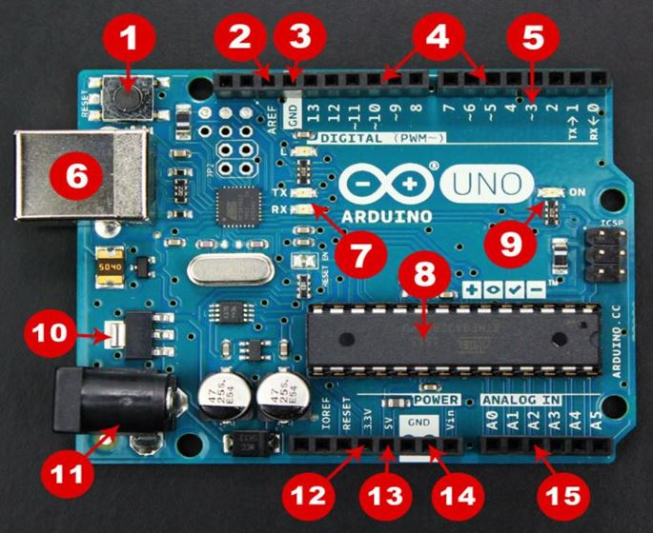
Arduino Uno
We used the Arduino UNO board because it is the most popular board on the Arduino boards. In addition, it is the best board for beginners in the use of electronics and Arduino programming. Most of the Arduino boards contain these components

Slide 11
Once the circuit has been created ,we’ll need to upload the program (sketch) to the Arduino. The sketch is a set of instructions that tells the board what functions it needs to perform.
Arduino sketch has two parts :
. void setup() : Contains things that have to be done once and then don’t happen again-
- void loop() : Contains the instructions that repeated over and over until the board is turned off .

Slide 12
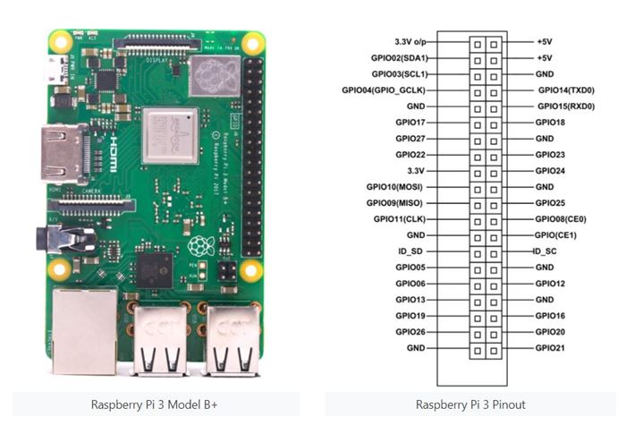
Raspberry pi
RASPBERRY PI platform is most used after ADRUINO. Although overall applications of PI are less it is most preferred when developing advanced applications. Also the RASPBERRY PI is an open source platform where one can get a lot of related information.

Slide 13
Raspberry Pi 3 Technical Specifications
- Broadcom BCM2837 64bit Quad Core Processor.
- 3.3v the Processor operating voltage.
- 5V, 2A power source the Raw voltage input.
- 16 Am Maximum current through each I/O pin.
- 54mA Maximum total current drawn from all I/O pins.
- 16Gbytes SSD memory card for Flash memory.
- 1Gbytes DDR2 the internal RAM.
- 1.2GHz the clock frequency.
- -40ºC to +85ºC Operating Temperature.

Slide 14
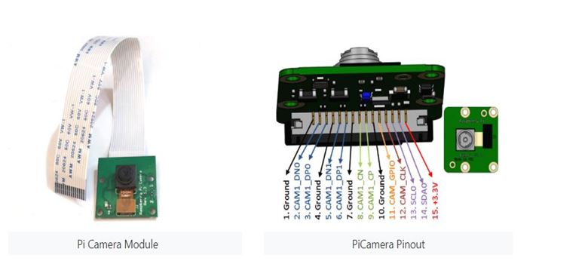
Pi Camera Module – 5MP
The Pi camera module is a portable light weight camera that supports Raspberry Pi. It communicates with Pi using the MIPI camera serial interface protocol. It is normally used in image processing, machine learning or in surveillance projects .
PiCam Features
- 5MP colour camera module without microphone for Raspberry pi
-Supports both Raspberry Pi Model A and Model B
- MIPI Camera serial interface
- Omnivision 5647 Camera Module
- Resolution: 2592 * 1944
-Supports: 1080p, 720p and 480p
- Light weight and portable (3g only)

Slide 15
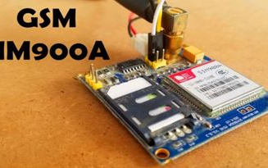
SIM900A GSM
We used it to send SMS messages to mobile phone.
SIM900A GSM Module is the smallest and cheapest module for GPRS/GSM communication .The module offers GPRS/GSM technology for communication with the uses of a mobile sim. It uses a 900 and 1800MHz frequency band and allows users to receive/send mobile calls and SMS

Slide 16
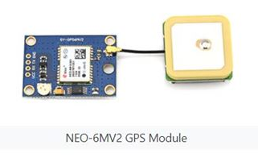
NEO-6MV2 GPS
The NEO-6MV2 is a GPS (Global Positioning System). The module checks its location on earth and provides longitude and latitude of its position.
Features and Electrical Characteristics
Standalone GPS receiver
5Hz the maximum navigation update rate.
-160dBm the sensitivity.
9600bps the default baud rate.
3.6V the supply voltage.
10mA the maximum DC current .
-40ºC TO 85°C operating temperature .
Anti-jamming technology
UART Interface at the output pins
Under 1 second time-to-first-fix for hot and aided starts
Receiver type: 50 Channels - GPS L1 frequency - SBAS .
Time To First fix: For Hot Start <1s, For Warm Start 23s,For Cold Start 32s.
Operation limits: Gravity-4g, Altitude-50000m, Velocity-500m/s.
EEPROM with battery backup

Slide 17
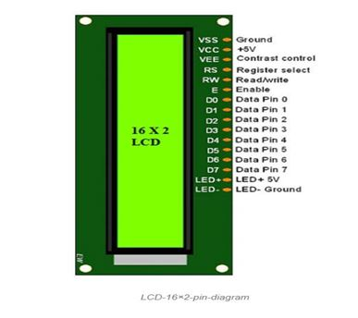
LCD Display 16x2
The term LCD stands for liquid crystal display. It is one kind of electronic display module used in electronics. These displays are mainly preferred for multi-segment light-emitting diodes and seven segments. The benefits of using this module are inexpensive; simply programmable, displaying custom characters ,animations,etc.

Slide 18
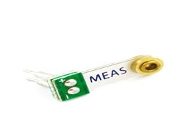
Piezo sensor
The MiniSense 100 is a low cost cantilever-type vibration sensor loaded by a mass to offer high sensitivity at low frequencies. Pins are designed for easy installation and are solderable. Horizontal and vertical mounting options are offered. The active sensor area is shielded for improved RFI/EMI rejection. Rugged, flexible PVDF sensing element withstands high shock overload. Sensor has excellent linearity and dynamic range, and may be used for detecting either continuous vibration or impacts.

Slide 19
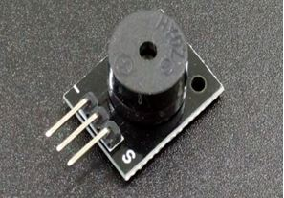
Buzzer 5v
The Buzzer Active 5V Module is an active piezo buzzer module useful for creating sound in a project.

Slide 20

LEDs
We used it in this project as status indicators where the red light indicates a dangerous state and the green , yellow light indicates safety.

Slide 21
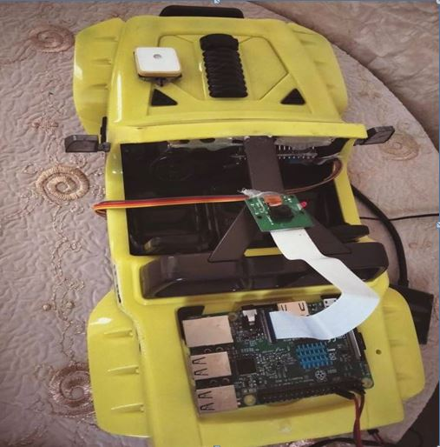
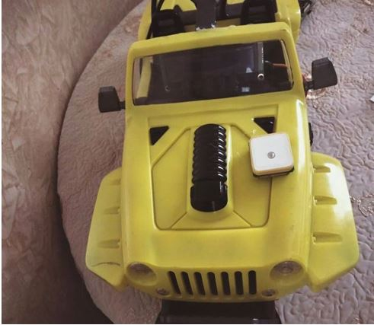
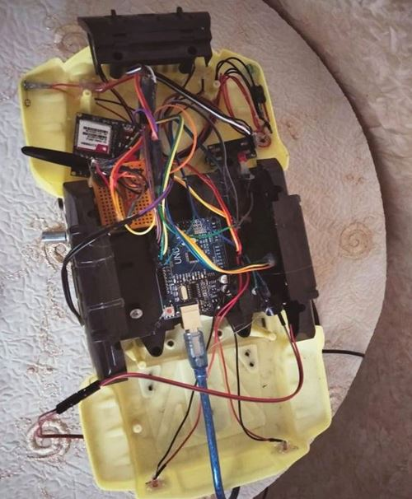
Overall Design

Slide 22
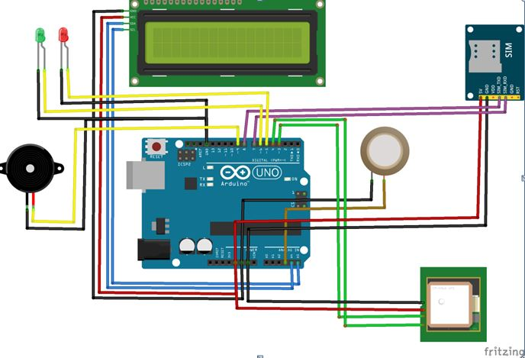
Circuits:-
Arduino circuit

Slide 23
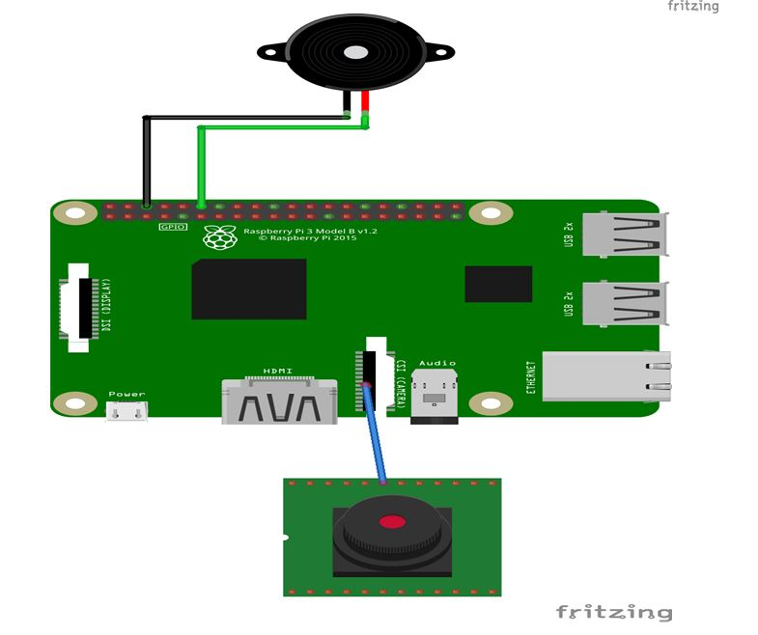
Raspberry pi 3 circuit

Slide 24
Software Implementation
Arduino:
We connected the circuit to the part related to the Arduino and then wrote the code on the Arduino program, after that we downloaded it to the project and followed up the results until we got the required results.

Slide 25
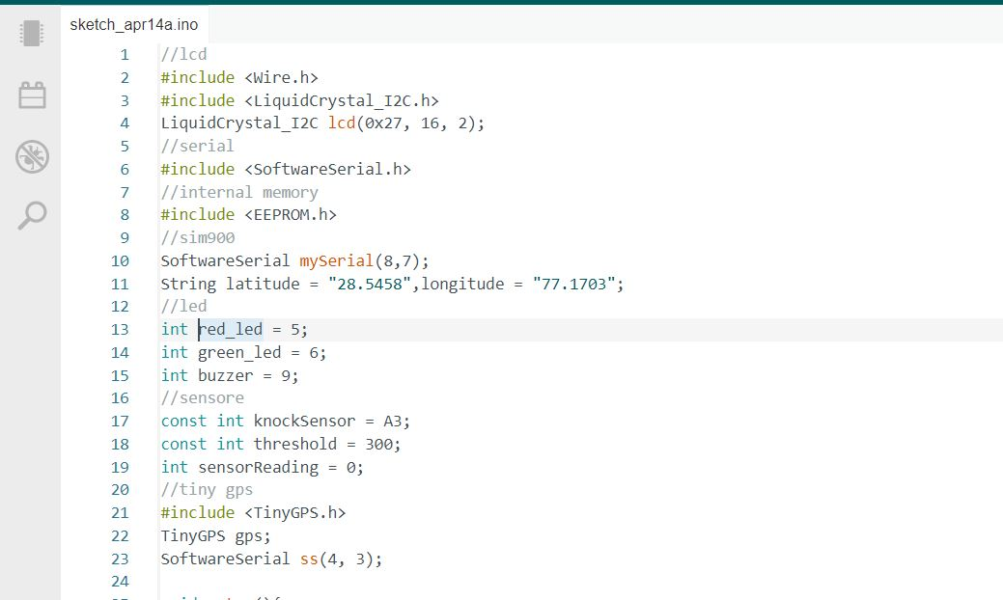

Slide 26
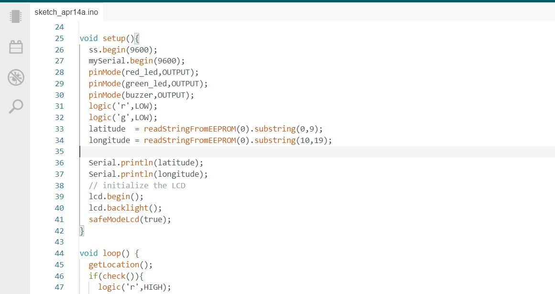

Slide 27
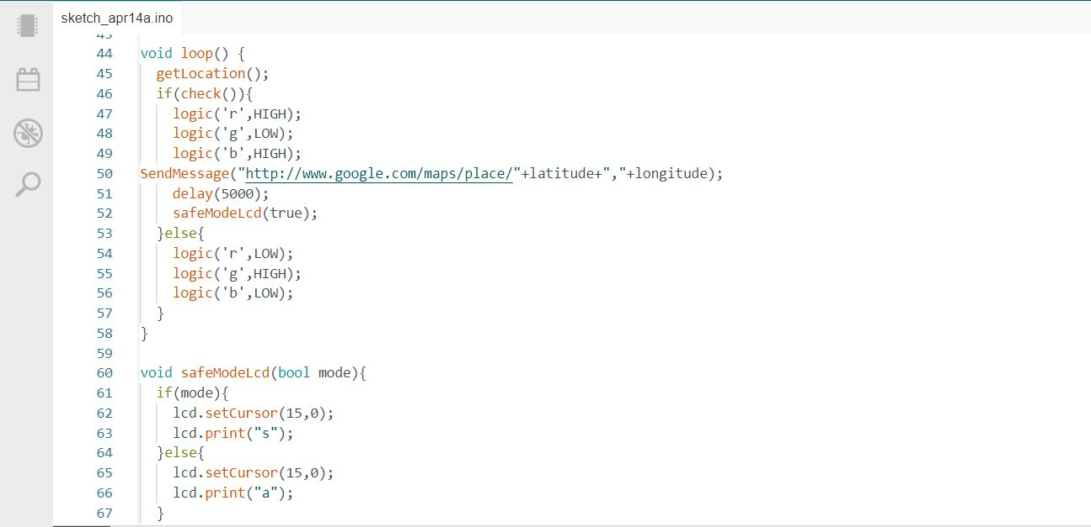

Slide 28
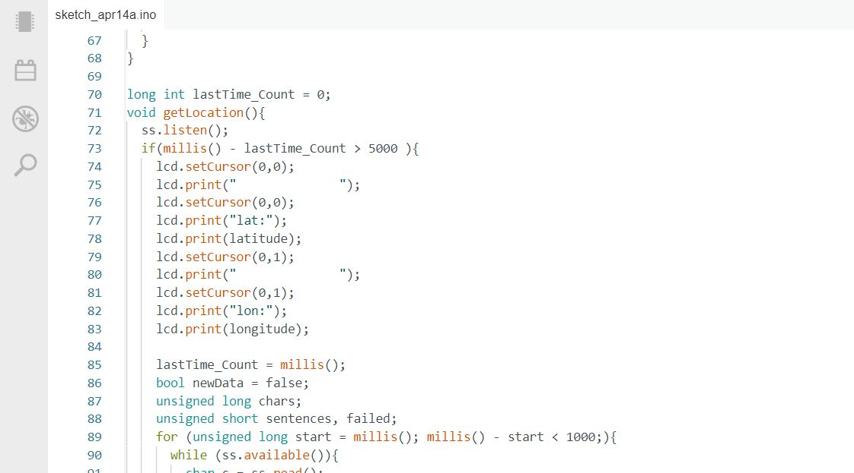

Slide 29
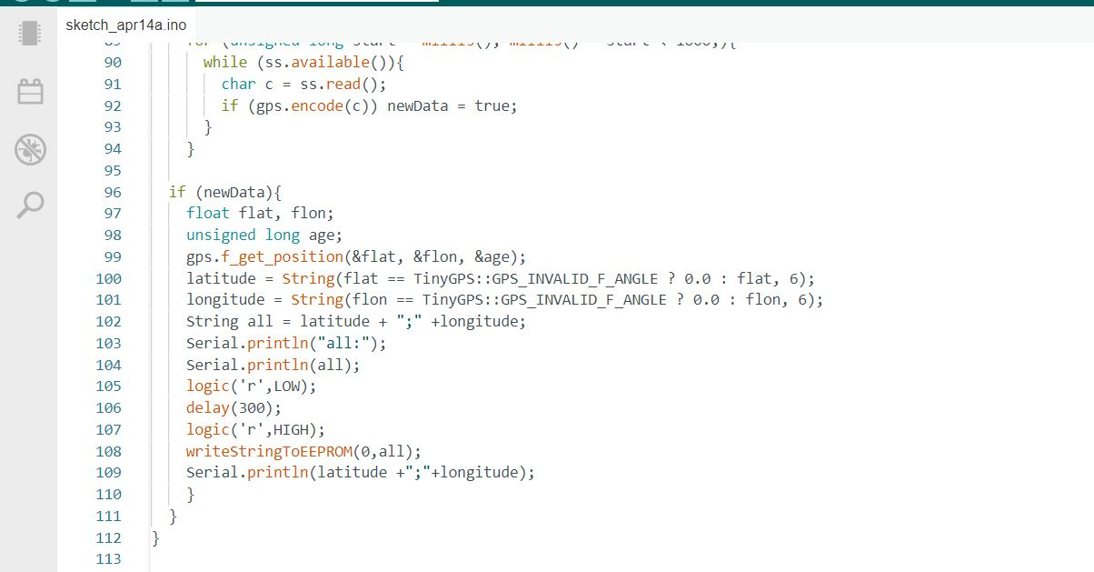

Slide 30
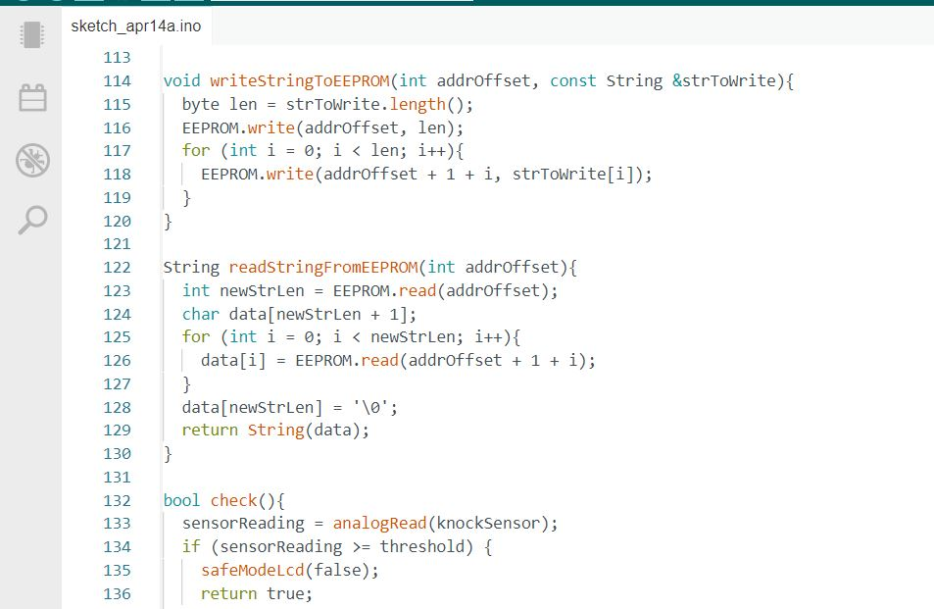

Slide 31
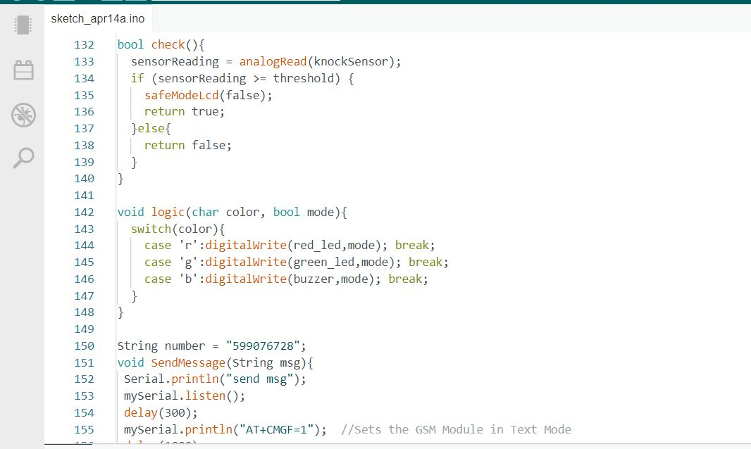

Slide 32
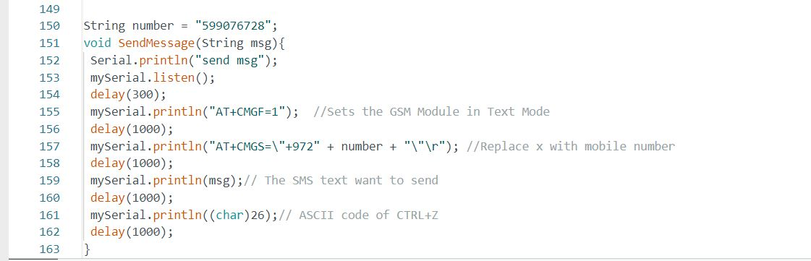

Slide 33
Raspberry Pi :
Then we connected the Raspberry circuit. The Raspberry Pi needs an operating system to work so we used Raspberry Pi OS (Raspbian) is the official supported operating system then we downloaded and installed Raspberry Pi on a PC with an SD Card Reader. Next we put the SD card that we used with our Raspberry Pi into the reader then we opened the Raspberry Pi and chose the required OS from the list shown. We chose the SD card that we want to write to it. Then we clicked "Write" to start writing data to the SD card. Also for running the new operating system we inserted an SD card into the Raspberry Pi and powered it up.

Slide 34
Firstly we track some steps to extract eyes, because the eyes is the part that is interested in it, we start with a discussion on the (x, y)-coordinates associated with facial landmarks and how these can be mapped to specific regions of the face, so we write a bit of code that can be used to extract each of the eye .So we are going to use dlib and OpenCV to detect facial landmarks in an image.

Slide 35
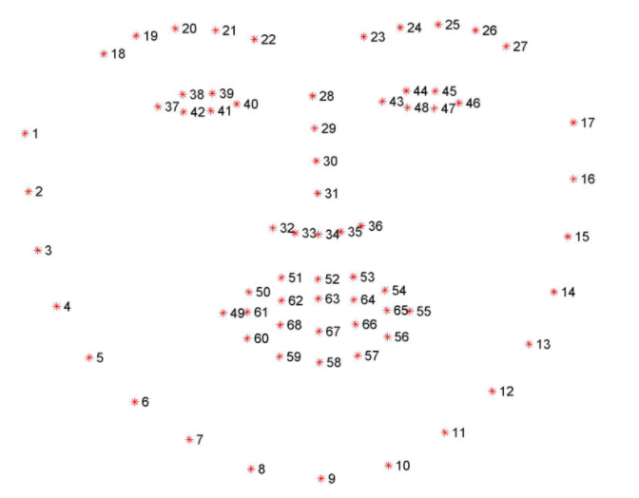
The facial landmark detector implemented inside dlib produces 68 coordinates that map to specific facial structures. These 68 point mappings were obtained by training a shape predictor on the labeled iBUG 300-W dataset.

Slide 36
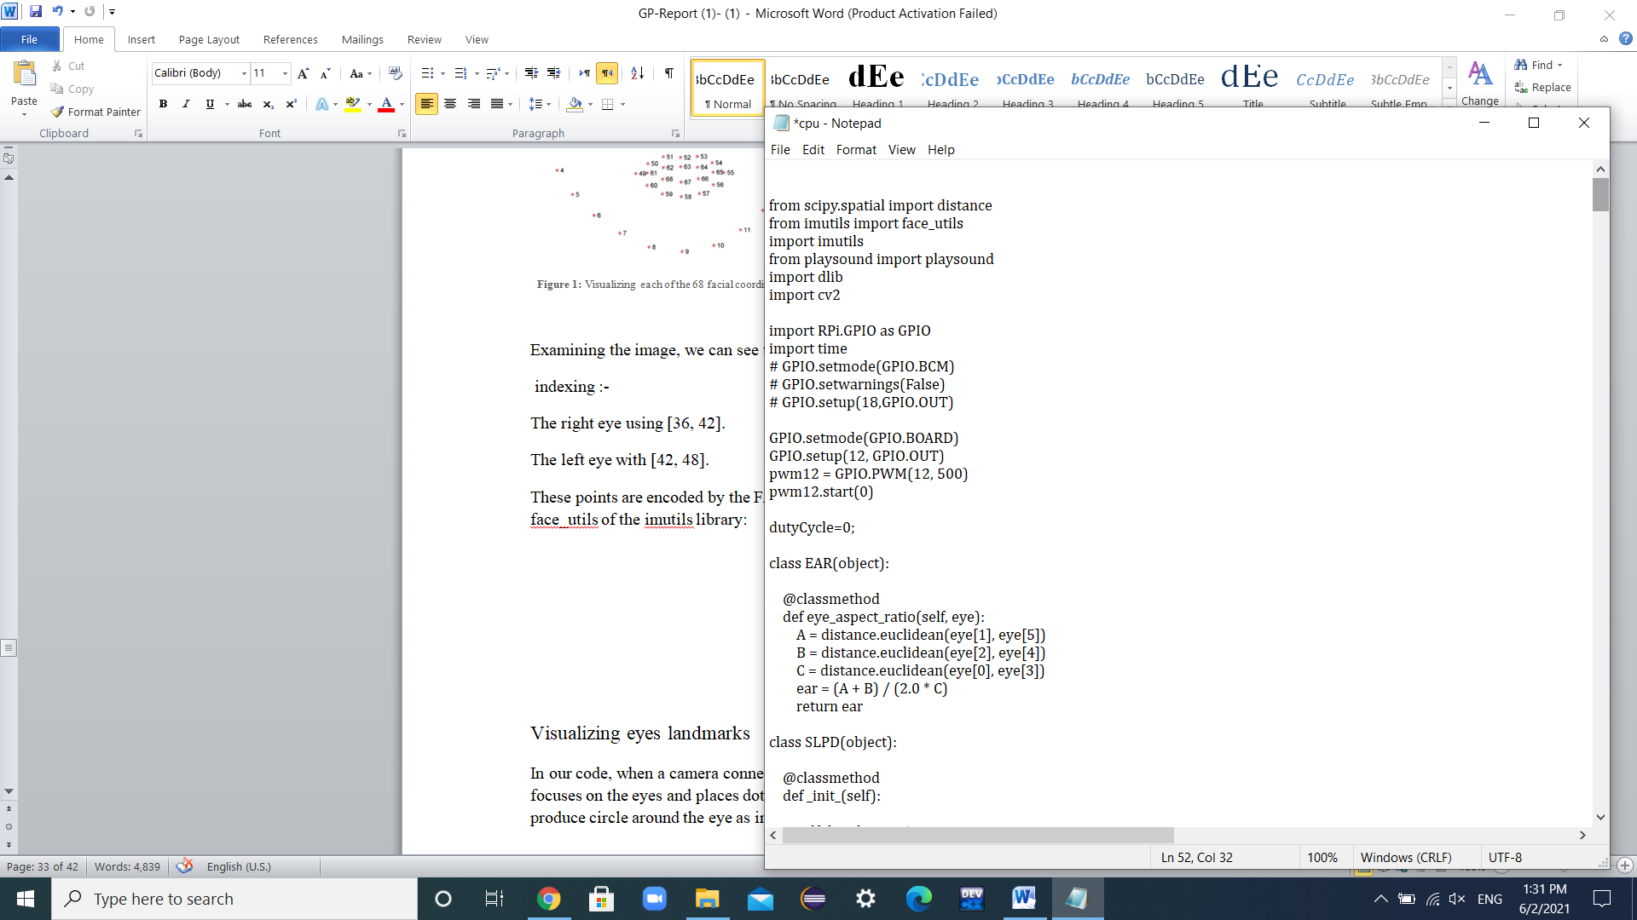
These points are encoded by the FACIAL_LANDMARKS_IDXS dictionary inside face_utils of the imutils library:

Slide 37
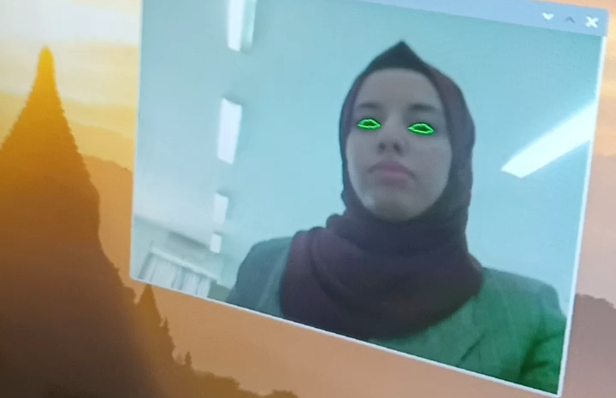
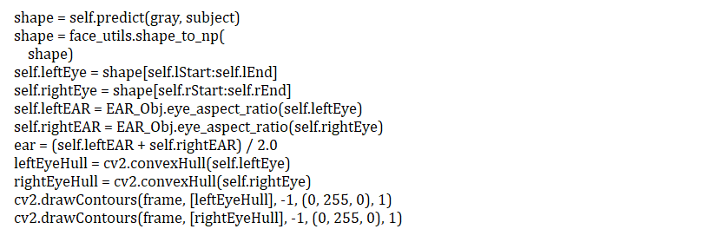
+
In our code, when a camera connected to a Raspberry Pi takes an frames of the face, it focuses on the eyes and places dots around it, and then connects to each other to produce circle around the eye as in image below:

Slide 38
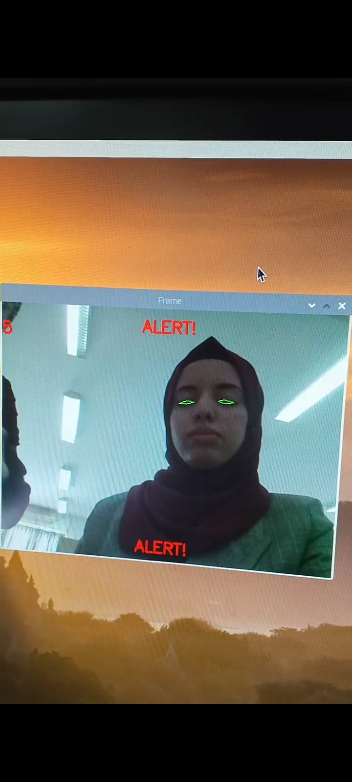
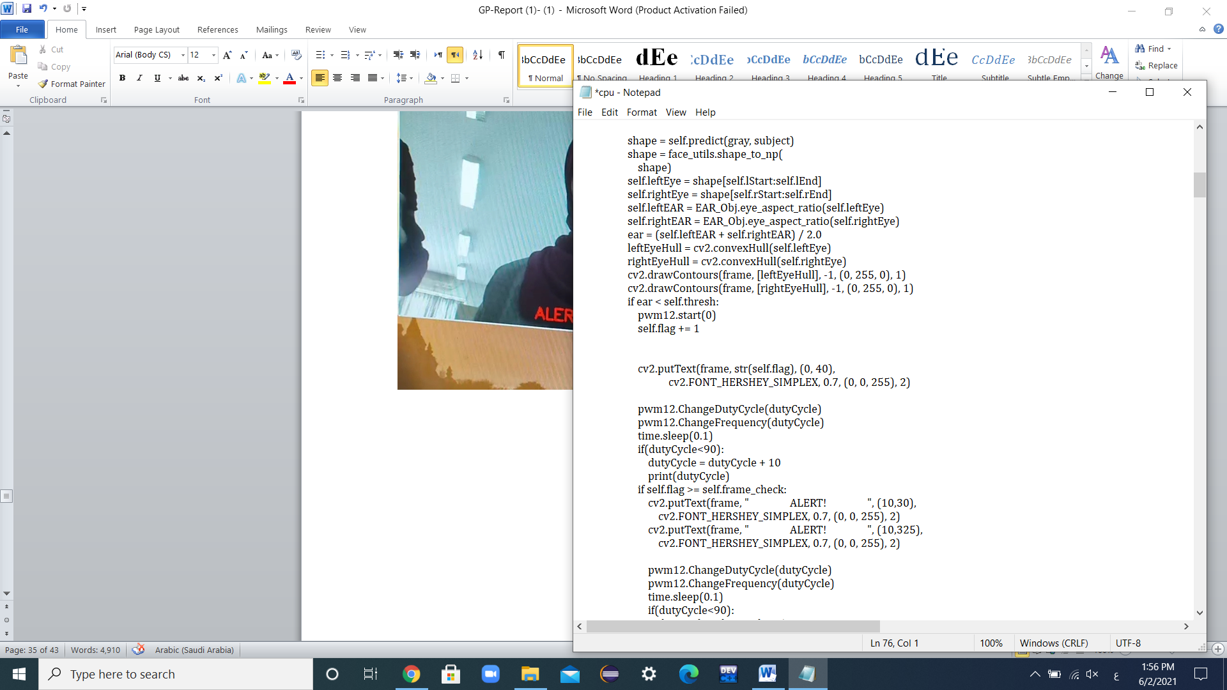
the camera continues to draw the circle around the eye, when the eye is closed for 3 second, it writes on the frame the word “ALERT”, which indicates the presence of danger, as it indicates the number of the frame that it took (5) .

Slide 39
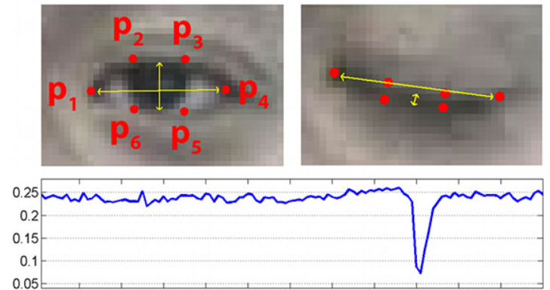
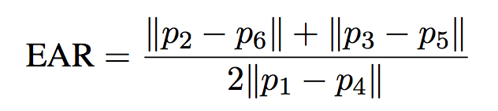
We can apply the Eye Aspect Ratio (EAR) algorithm, for given the eye landmarks associated or connected with an eye.
There is a relation between the width and the height of these coordinates, we can derive an equation that reflects this relation called the eye aspect ratio (EAR):

Slide 40
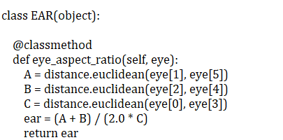
We will be tracking the eye aspect ratio to see if the ration falls but does not increase again, thus implying that the driver/user has closed their eyes.
The value will be relatively constant if the eye is open, but when a blink occurs, it will decrease towards zero, but in the case of sleep, the eye aspect ratio will remain constant at a much smaller value.

Slide 41
Constraints and Difficulties
The system requirements are very complex and diverse that it took a significant amount of time to integrate all components of the system.
Difficulty finding raspberry pi 4 which is more accurate and is faster in taking of face frames from raspberry pi 3. This board was also very expensive.

Slide 42
Constraints and Difficulties
The difficulty in obtaining the appropriate areas for its operation, which depends on GPS and GSM and its connection with satellites.

Slide 43
Future Work
It is possible to add a mobile application for the system to track all important matters while driving, such as the car’s speed and generate an alarm when the car’s speed exceeds a certain limit and send a message to the police.
In addition, the application may provide the ability to change the number to which the warning message is sent.

Slide 44
Demo
Link For Demo : https://drive.google.com/file/d/1tgvBrjvT344gBgckcWsAfQCvUQKWE8ec/view?usp=sharing

Slide 45
Thanks!
Any questions?

