Slide 1
Smart Street Lighting
Supervisor : Jamal Kharrousheh
Prepared by:
Omar Hakawati
Qusai Nazzal
Anas Hakawati

Slide 2
Abstract
On our region (west Bank) of our whole country (Palestine) we can detect that the lights spend many hours specially after midnight without cars on the out-of-towns roads or a few cars on Intermittent times so this is a big consumption of our energy that we can use it usefully on another needed area.
Our project for developing a smart street light system is reviewed. In this project, the street light system, in which lights on when needed and light-off when not needed.
Smart Lighting is lighting that is connected to each other, or the Internet through networking devices. This enables more efficient lighting management using a Central Management System. The network connectivity inbuilt into smart lighting can also provide Internet access for other smart city uses (e.g. smart parking sensors).
Currently, in the whole world, huge electric energy is consumed by the street lamps, which are automatically turn on when it becomes dark and automatically turn off when it becomes bright. This is the huge waste of energy in the whole world and should be changed.

Slide 3
Differences between two systems
Disadvantages of Existing System:
Manual Switching off/on of Street Lights.
More Energy Consumption.
High expense.
More manpower.

Slide 4
Differences between two systems
Advantages of the Proposed System:
Automatic Switching of Street lights.
Maintenance Cost Reduction.
Reduction in CO₂ emission.
Reduction of light pollution.
Wireless Communication.
Energy Saving.
Reduction of manpower.

Slide 5
Standards
The main standards of lamp control are 0-10, DALI1, DALI2 (Digital Addressable Lighting Interface). The important thing is to make sure that the smart lighting controllers are compatible to the lamps’ control system.
Furthermore, some lighting controllers allow for further connectivity. Sensors for special functions can be added to the system, whether for deploying special lighting control characteristics or to mount additional, non-related sensors. Adaptive lighting is such an example. Adaptive lighting requires the ability to dim up the lamps in real time when presence (pedestrians or cars) is detected. This requires (besides controller’s technical ability) adding a motion sensor to the lighting pole, usually connected directly to the lighting controller.
Radio communication (RF)
In the street lighting field, Radio control (RF) manages to overcome most of the limitations of power line communication. Although most smart street lighting systems function in a similar way, there are numerous different methods of exchanging data between connected streetlights and the CMS. These include cellular (2G, 3G) ,Wi-Fi,ADSL and other medium- to long-range solutions.
On our project we used Wi-Fi protocol to feed our module cause of easy availability on towers cover for internet wireless and fast speed.

Slide 6
Standards
HTTP: is the foundation of data communication for the
World Wide Web, where hypertext documents include hyperlinks to other resources that the user
HTML: is the standard mark-up language for creating web pages
and web applications. With Cascading Style Sheets (CSS) and JavaScript, it forms a triad of cornerstone technologies for the World Wide Web.
PHP: is a general-purpose programming language originally designed for web development.

Slide 7
Constraints:
when approaching lamp level street lighting controllers, things may be getting a bit complicated. There are three types of restrictions that you should keep in mind: design, installation and communication.
More often than not, street lamps fulfill more than a functional role. They have become a key asset in creating and maintaining local architectural value. Whether modern, classic or retro, street lighting fixtures need to compliment local architecture, and smart lighting controllers need not to ruin that effort. It’s unlikely that a city architect would accept a modern piece of electronics to be visible on their black wrought iron, expensive, retro fixtures.
Furthermore, as any change to the lighting grid usually involves cumbersome civil works, it’s important for city managers to keep installation cost at a minimum. That’s why lighting engineers have invested in several mounting solutions to ensure smooth lamp upgrade and fast lighting controller installation.
The most important constraint is if there is a problem on the connection caused of bad whether or and technical problems from the network.

Slide 8
Hardware overview
Our project contains hardware and software sections and in this sections of the chapter the hardware section described by listing hardware which the project needs (tools) and their work needed.

Slide 9
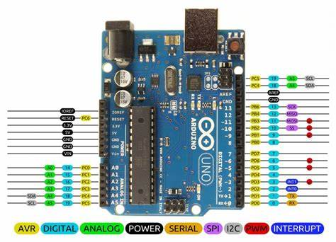
1.Arduino Uno :
via an on-board regulator, or be supplied by USB or another regulated 5V supply.
Summary:
The Arduino Uno is a micro-controller board based on the ATmega328 (data-sheet). It has 14 digital input/output pins (of which 6 can be used as PWM outputs), 6 analog inputs, a 16 MHz ceramic resonator, a USB connection, a power jack, an ICSP header, and a reset button. It contains everything needed to support the micro-controller; simply connect it to a computer with a USB cable or power it with a AC-to-DC adapter or battery to get started. The Uno differs from all preceding boards in that it does not use the FTDI USB-to-serial driver chip. Instead, it features the Atmega16U2 (Atmega8U2 up to version R2) programmed as a USB-to-serial converter.

Slide 10
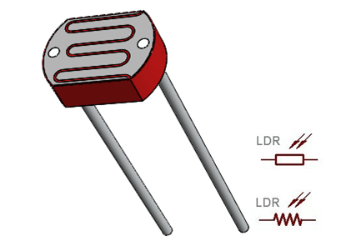
Light Decreasing Resistance (LDR)
A Light Dependent Resistor (LDR) or a photo resistor is a device whose resistivity is a function of the incident.
electromagnetic radiation. Hence, they are light sensitive devices. They are also called as photo conductors, photo conductive cells or simply photocells. They are made up of semiconductor materials having high resistance.
A light dependent resistor works on the principle of photo conductivity. Photo conductivity is an optical phenomenon in which the materials conductivity (Hence resistivity) reduces when light is absorbed by the material.

Slide 11
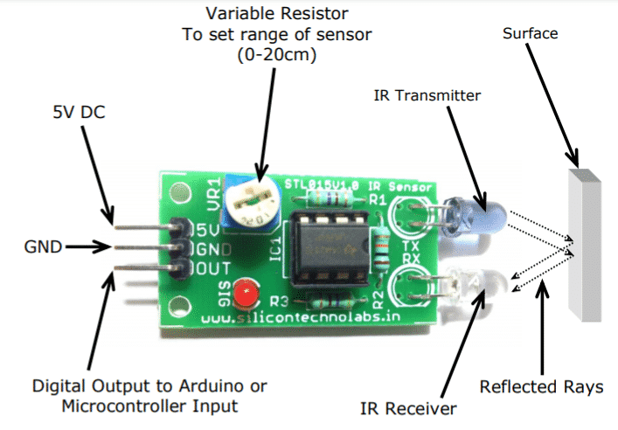
IR Sensor
An infrared sensor is an electronic instrument that is used to sense certain characteristics of its surroundings by either emitting and/or detecting infrared radiation.
It is also capable of measuring heat of an object and detecting motion. Infrared waves are not visible to the human eye. In the electromagnetic
spectrum, infrared radiation is the
region having wavelengths longer than visible light wavelengths, but shorter than microwaves.
The infrared region is approximately demarcated from 0.75 to 1000µm. IR (infrared) sensors detect infrared light. The IR light is
transformed into an electric current, and this is detected by a voltage or amperage detector.

Slide 12
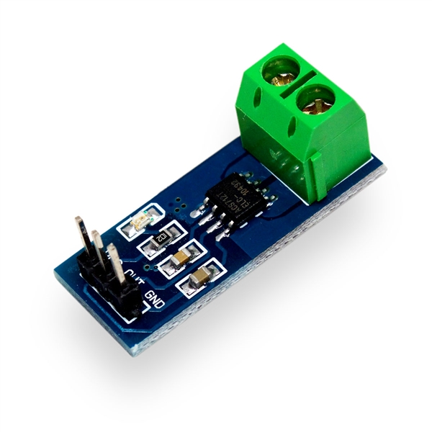
Current Sensor
A current sensor is a device that detects electric current (AC or DC) in a wire,
and generates a signal
proportional to it. The generated signal could be analog voltage or current or
even digital output. It can be then
utilized to display the measured current in an ammeter or can be stored for
further analysis in a data acquisition
system or can be utilized for control purpose.

Slide 13
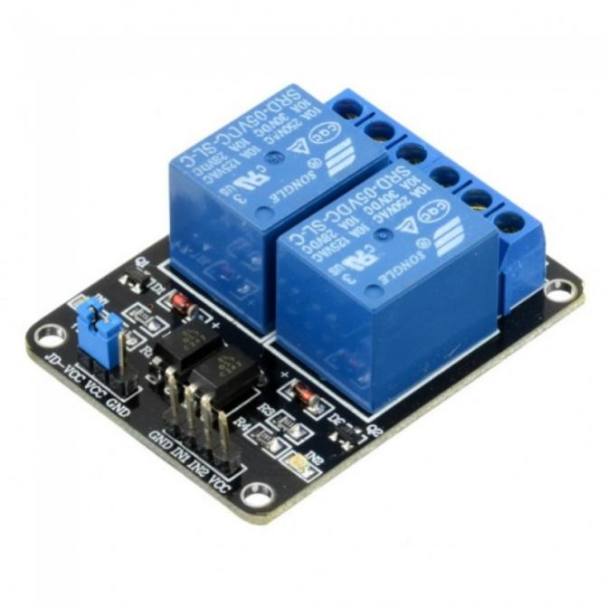
Two Channel Relay
A relay is usually an electromechanical device that is actuated by an electrical current. The current flowing in one circuit causes the opening or closing of another circuit. Relays are like remote control switches and are used in
many applications because of their relative simplicity, long life, and proven high reliability.
The dual-channel relay module is more or less the same as a single-channel relay module, but with some extra features like optical isolation. The dual-channel relay module can be used to switch mains powered loads from the pins of a microcontroller

Slide 14
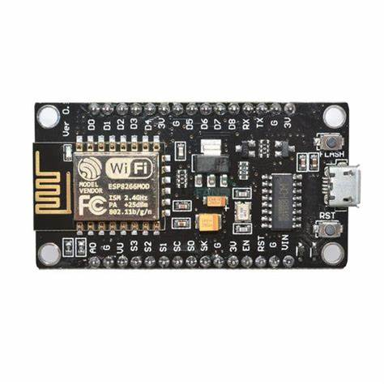
Wi-Fi Module
Most people call ESP8266 as a WIFI module, but it is actually a microcontroller. ESP8266 is the name of the microcontroller developed by Espressif Systems which is a company based out of shanghai. This microcontroller has the ability to perform WIFI related activities hence it is widely used as a WI-FI module.
Our project equipments cannot be connected to internet on its own. So, this chip enables these equipments to connect with internet and make them (IoT) devices. Now, you can easily open your doors for (IoT) Projects with the help of this module. This low cost, small size module could do wonders and is really simple and easy to use.

Slide 15
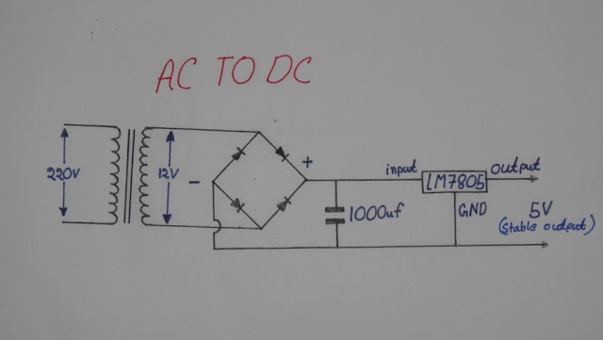
Regulated 5 volt DC source
This In the electrical design need DC source (5V) to feed the micro-controller,Wifi,Module,IR sensor,Current sensor.
The electronic parts of this unit :
➢ Transformer (230/12 v).
➢ Full bridge rectifier.
➢ LM7805 adjustable voltage regulator.

Slide 16
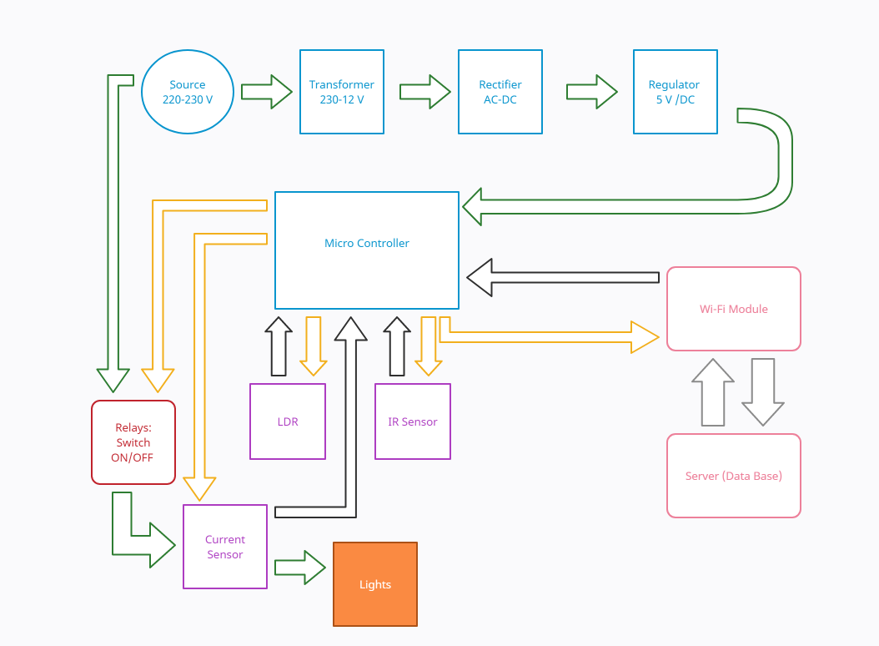
Block Diagram (Flowchart).

Slide 17
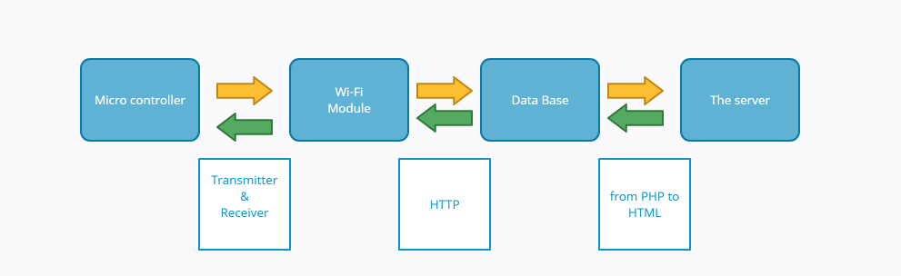
data transfer

Slide 18
Embedded system
An embedded system is a computer system—a combination of a computer processor, computer memory, and input/output peripheral devices—that has a dedicated function within a larger mechanical or electrical system. It is embedded as part of a complete device often including electrical or electronic hardware and mechanical parts. Because an embedded system typically controls physical operations of the machine that it is embedded within, it often has real-time computing constraints. Embedded systems control many devices in common use today. Ninety-eight percent of all microprocessors manufactured are used in embedded systems.Modern embedded systems are often based on microcontrollers (i.e. microprocessors with integrated memory and peripheral interfaces), but ordinary microprocessors (using external chips for memory and peripheral interface circuits) are also common, especially in more complex systems. In either case, the processor(s) used may be types ranging from general purpose to those specialized in a certain class of computations, or even custom designed for the application at hand. A common standard class of dedicated processors is the digital signal processor (DSP).

Slide 19
Embedded system
Since the embedded system is dedicated to specific tasks, design engineers can optimize it to reduce the size and cost of the product and increase the reliability and performance. Some embedded systems are mass-produced, benefitin from economies of scale.
Embedded systems range from portable devices such as digital watches and MP3 players, to large stationary installations like traffic light controllers, programmable logic controllers, and large complex systems like hybrid vehicles, medical imaging systems, and avionics. Complexity varies from low, with a single micro controller chip, to very high with multiple units, peripherals and networks mounted inside a large equipment rack.

Slide 20
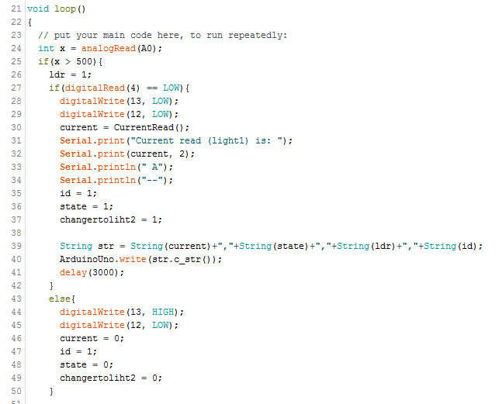
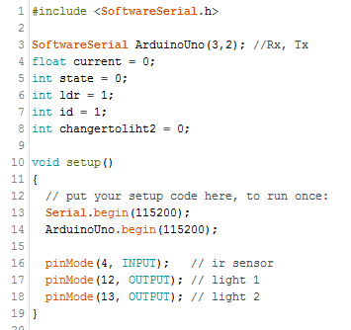
5.1 Code for Arduino:

Slide 21
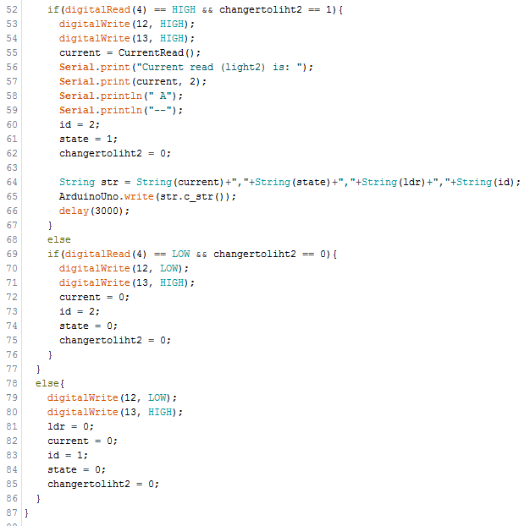

5.1 Code for Arduino:

Slide 22
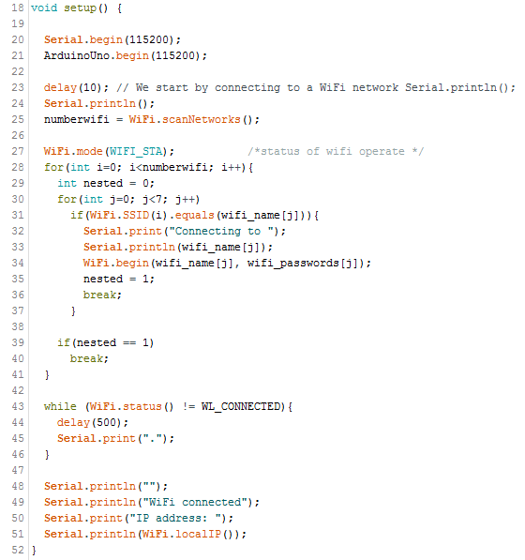
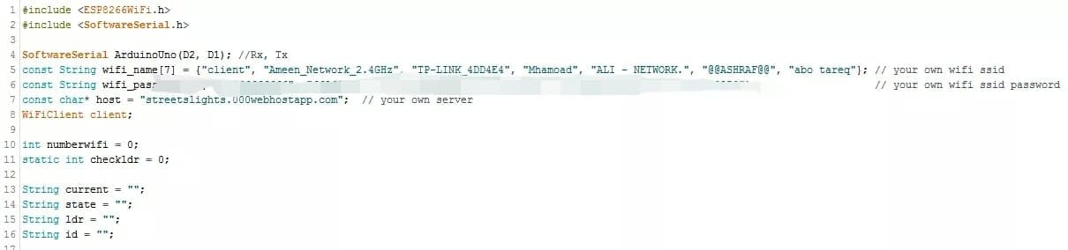
5.2 Code for WiFi Module:

Slide 23
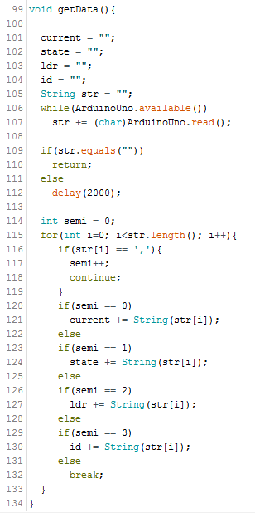
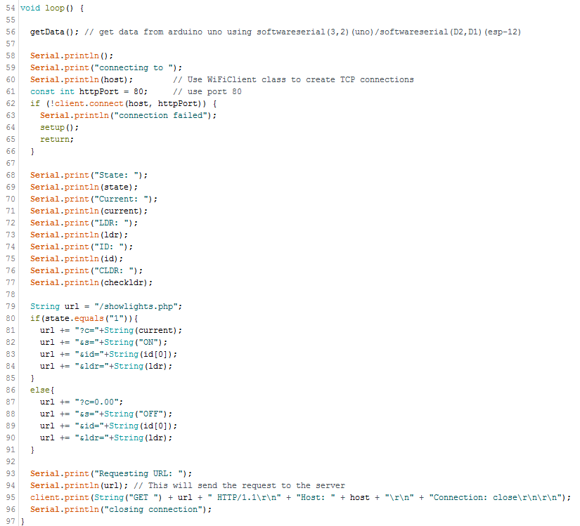
5.2 Code for WiFi Module:

Slide 24
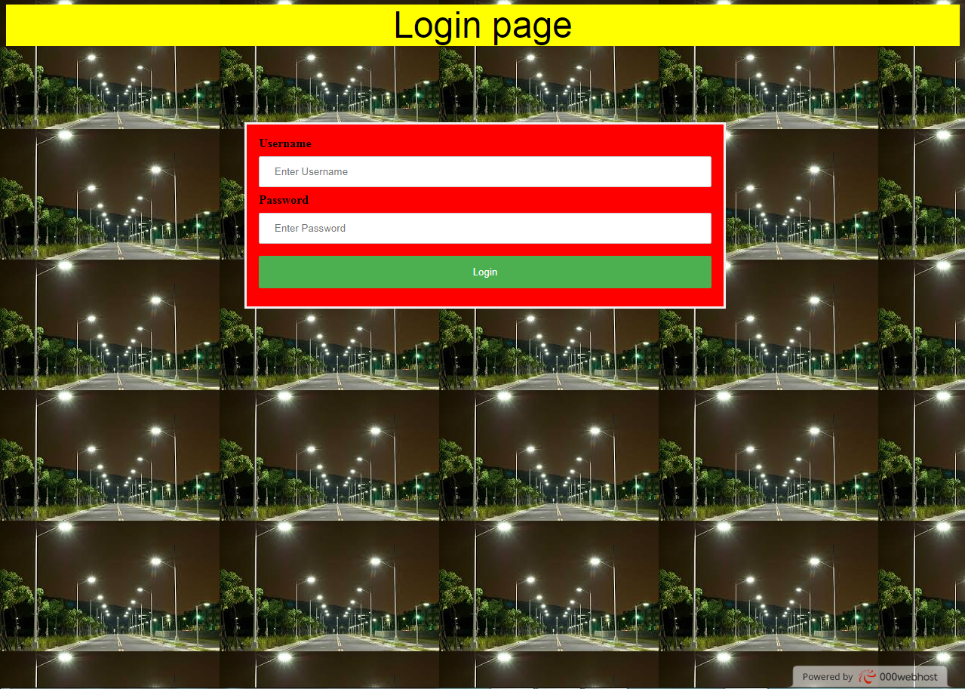
The Server:
This site done using website programming techniques which are two parts:
Front - End: HTML5/CSS3/JS
Back - End: PHP/MYSQ
Local or hosting server to receive results and calculation of lights of the street and save it.
Using the link : https://streetslights.000webhostapp.com
Login Page.

Slide 25
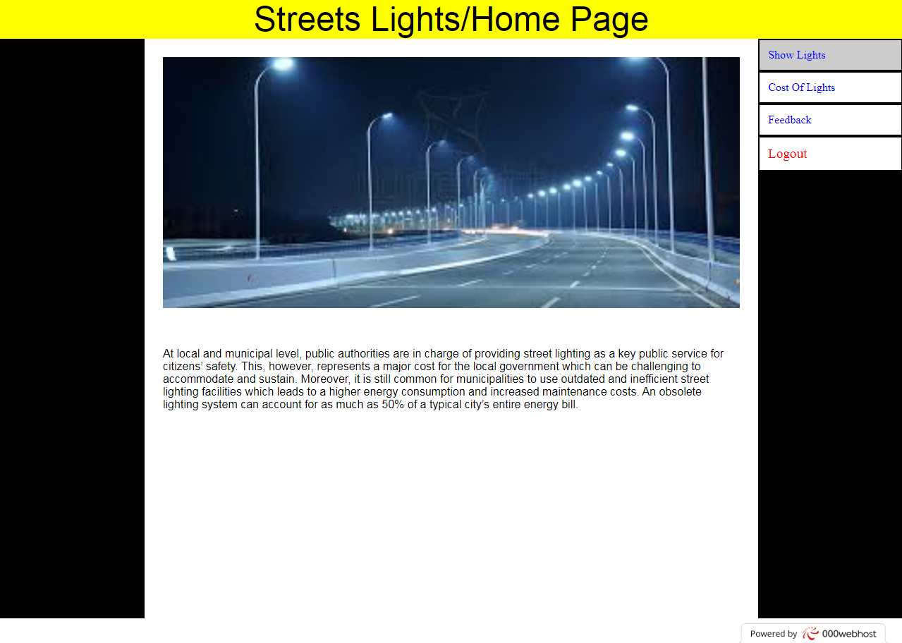
The Server:
After Login with user name and password :
Home page.
On Home page we can see an explain of our project and its advantages.

Slide 26
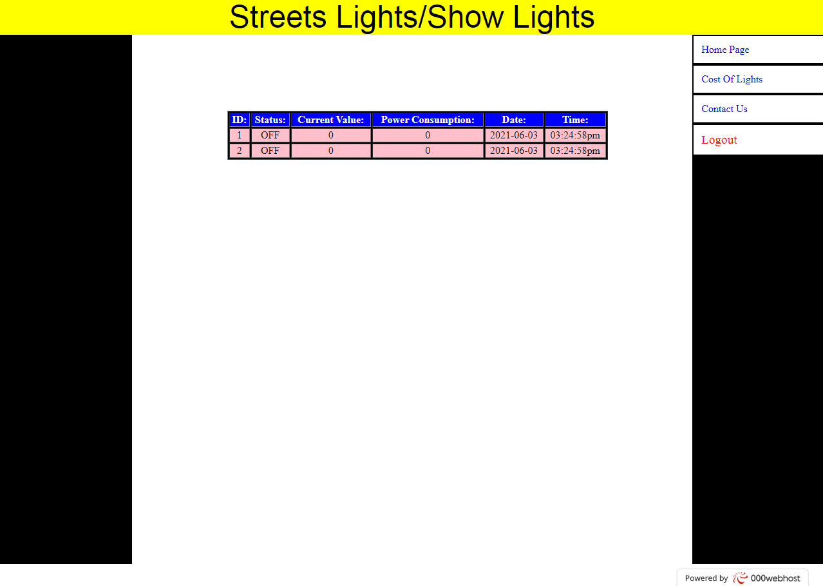
The Server:
Show Lights page :
this page show the state of lights and its current, power, date and time when ON.

Slide 27
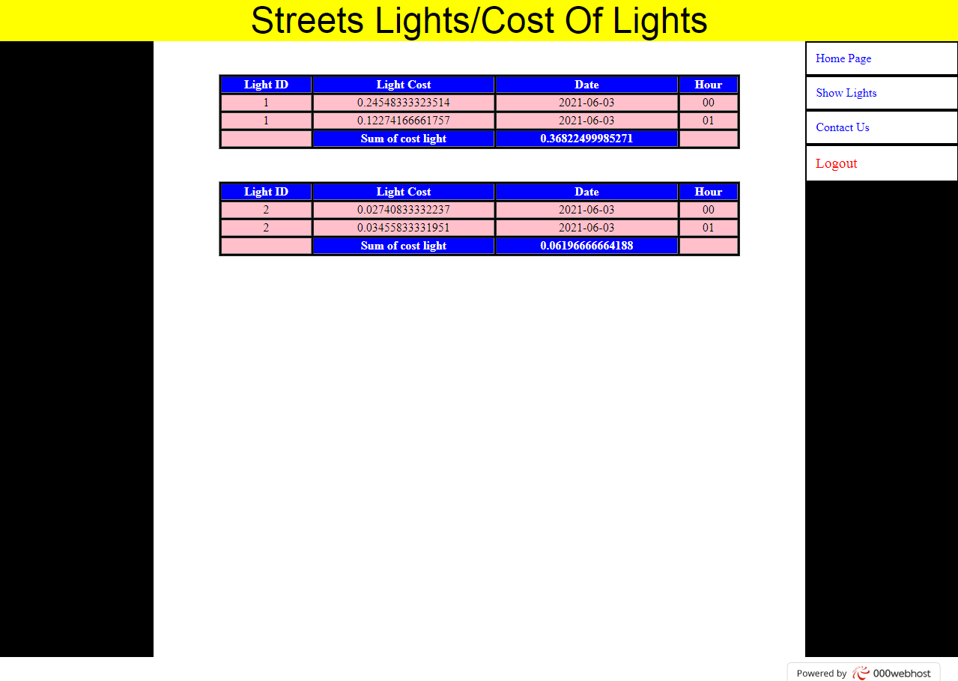
The Server:
Cost of Lights page :
Here we can calculate the power consumption for each light on each hour.

Slide 28
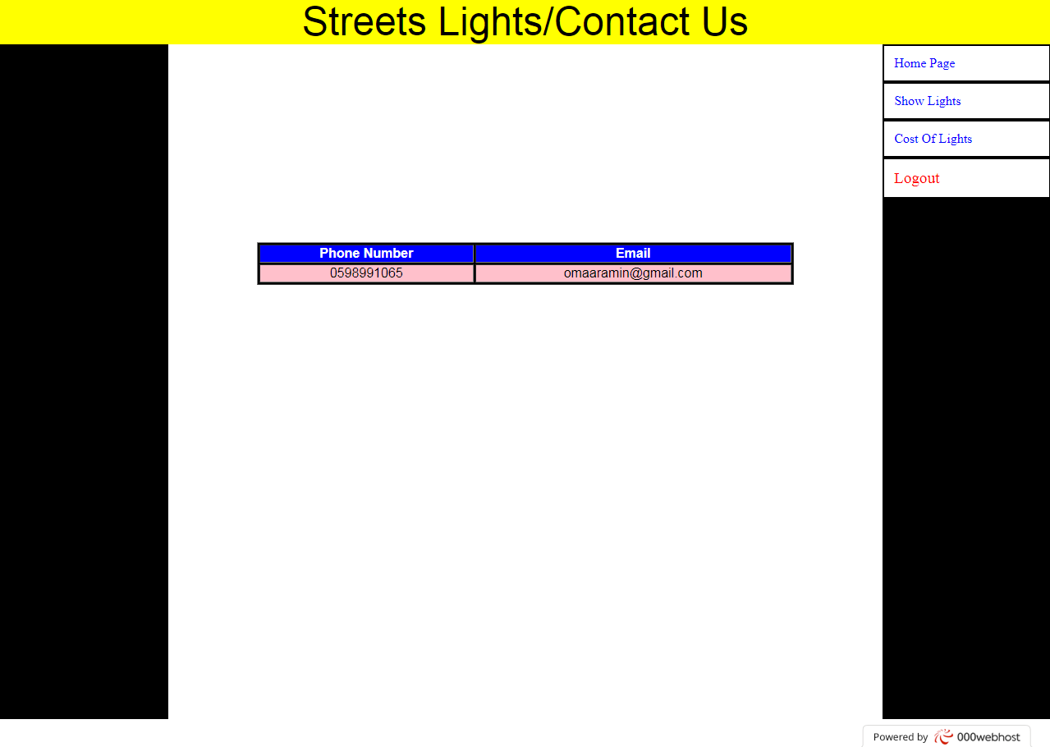
The Server:
Contact Us Page :
*If you have any question about the project or you have to advise us to improve it or whatever you can contact us on email or whats app.
*Later we can add Chairman of the Council email’s and his mobile number.

Slide 29
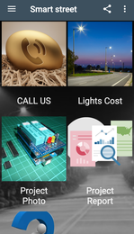
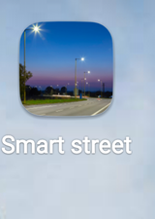
The application

Slide 30
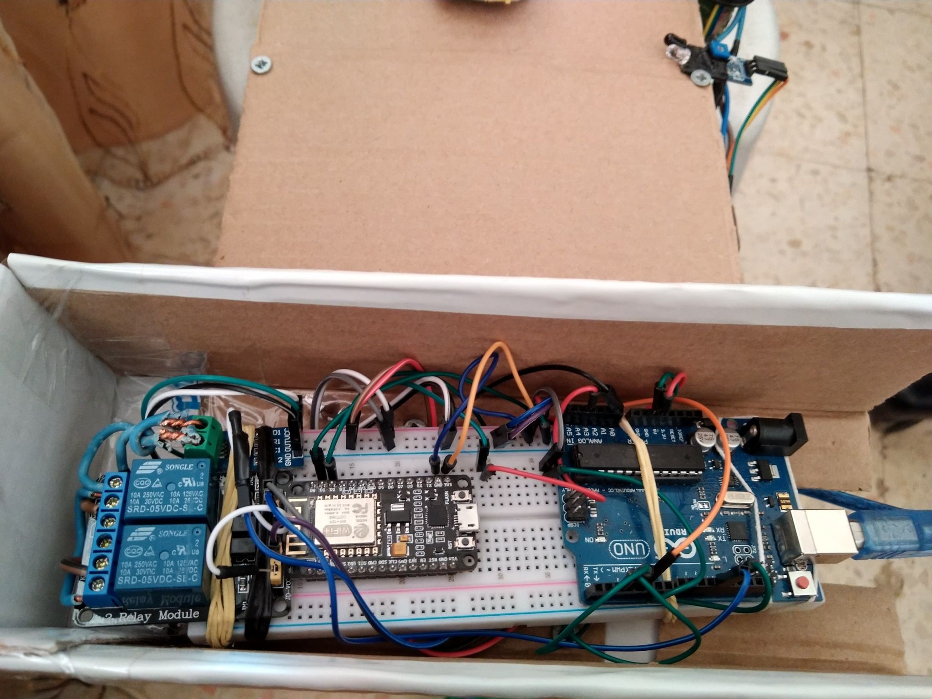
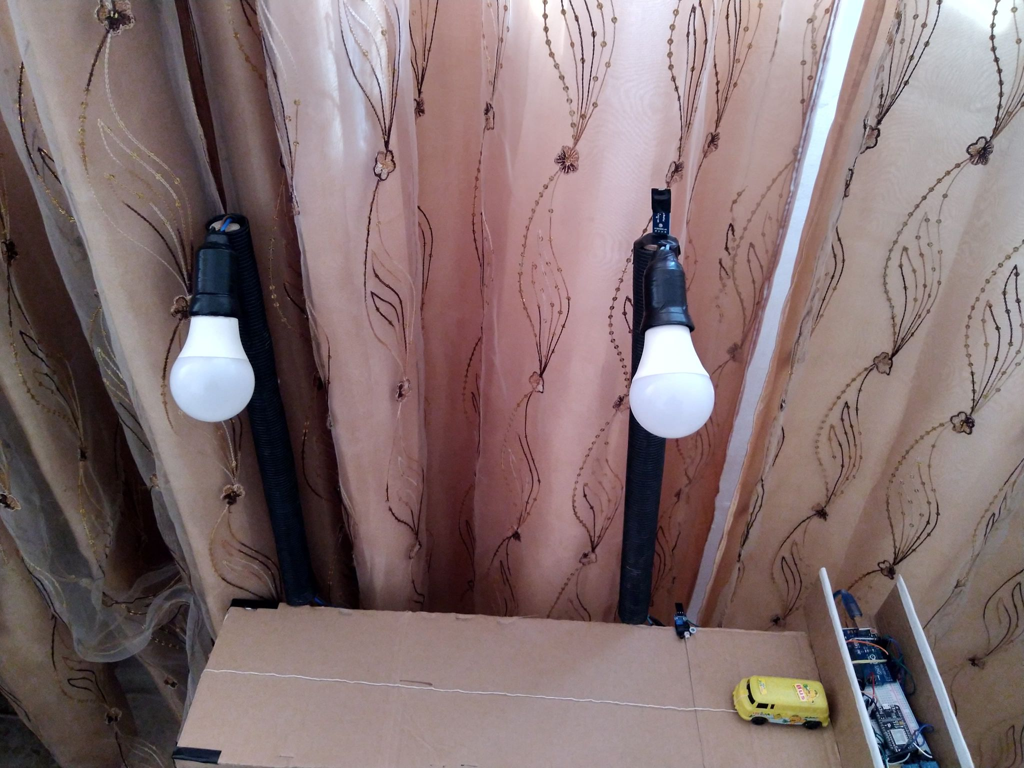
Our Project: at daytime

Slide 31
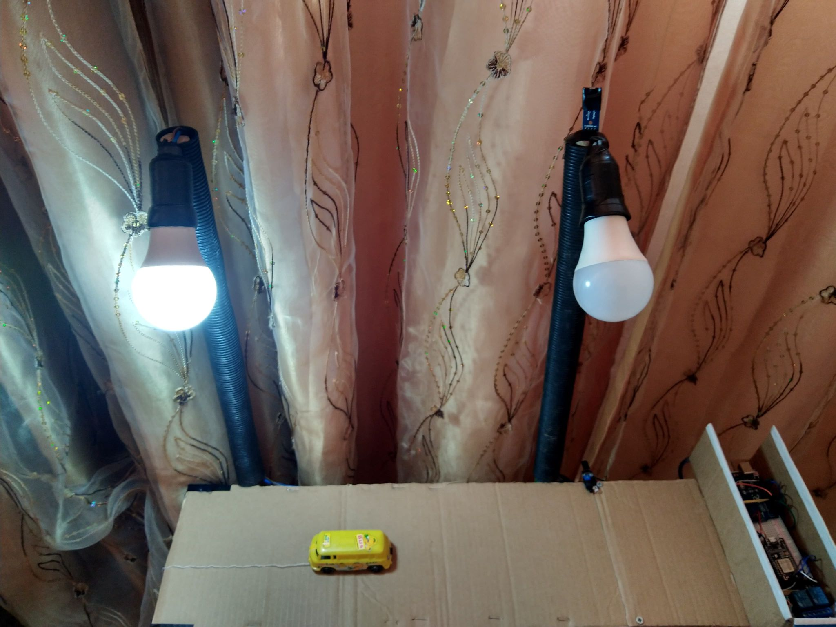
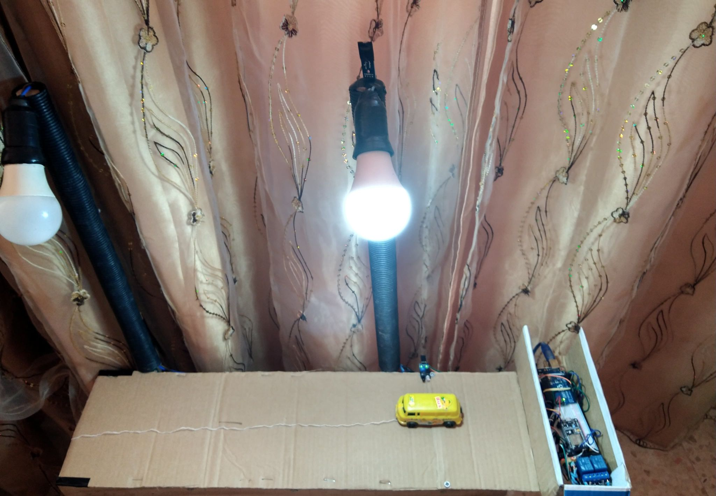
Lights After Sunset and a car is going on

Slide 32

Feasibility study:
This chapter will highlight the economic study for smart light street, as known it is one of the most important factors for a successful project is to be feasible economically to make a competitive between other meters which we already talked about it and be more feasible from others so list of element prices was made as following
economical equations:
Total Cost = $(total fixed ∗ DF) + Total$ running cost.
Pay pack Period = $\frac{Total Fixed}{saving per year}$
NO. | Element | Price($)
1- | Arduino Uno | 15
2- | LDR | 6
3- | IR sensor | 6
4- | current sensor | 5
5- | Relay | 6
6- | WI FI Module | 25
7- | Charger(Transformer, Rectifier and voltage regulator) | 7.5
8- | Bread board | 4
12- | Hosting Server | 8
13- | Total | 81.5

Slide 33
Conclusion:
Our project idea to reduce power consumption using developed technology as we are on 21st century to be smart lights village firstly then we can improve it.
So we firstly connect to our micro controller an LDR sensor to control the turn OFF/On depend on the sun,a motion sensor to detect vehicles or people move under it,Wi-Fi module to connect the system with the server and relays work as ON/OFF switch depend on micro controller commands.
The server will have all data of the street so you can monitor everything moves and detect it from any where just be online and choose one of the server or the application.

Slide 34
References:
www.wikipedia.org
tutorial45.com
www.arduino.cc
InteliLIGHT® - Street Lighting Remote Management

