Slide 1
An-Najah National University
Faculty of Engineering
Civil Engineering Department
Graduation Project
Submitted To:- En. Imad Al-Qasem.
Prepared By: - Omar Mohammed.
Nabeeh Isleem.
Nadeem Al-Jallad.

Slide 2
Overview
  Mecca Mall.
  Under Construction.
  Twelve Story and Roof.

Slide 3
Total Area is 6500 m² .
ACI 318-08 .
LRFD 2005 .

Slide 4
f 'c = 28 Mpa for columns and footing.
f 'c = 24 Mpa for slabs.
Fy = 420 Mpa.
Bearing Capacity Of Soil = 2.5kg/cm².

Slide 5
Story Number | Own weight (kN/m²) | Super imposed (kN/m²) | Live load office (kN/m²) | Live load storage (kN/m²) | Live load corridors (kN/m²)
Roof | 6.8 | 0 | 10
2-8 | 6.8 | 4.1 | 2.5 | 0 | 4
1 | 6.8 | 4.1 | 4 | 0 | 5
GF | 6.8 | 4.1 | 4 | 5.25 | 5
B1 | 6.8 | 4.1 | 0 | 5.25 | 0

Slide 6
Load factors (Combination)
Wu = 1.4DL
Wu = 1.2DL + 1.6LL
Wu = 0.9DL + EL
Wu = 1.2DL + LL + EL

Slide 7
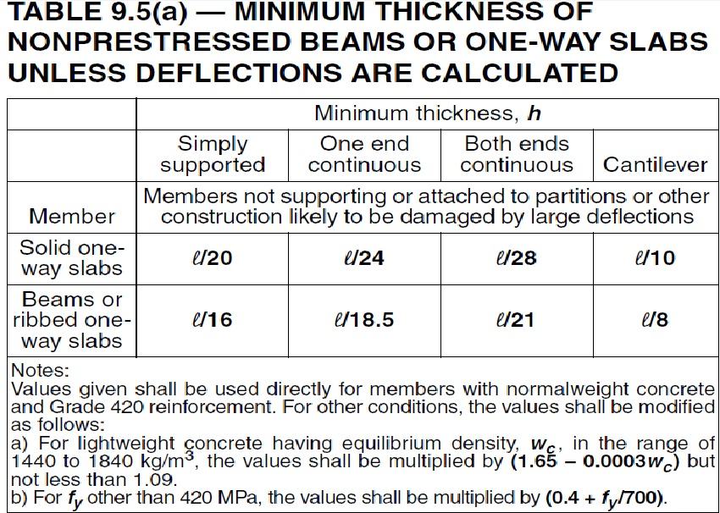
Slabs Thickness
From Architectural plans the cantilever = 3m .
h min = 3000/8 = 375 mm ……. Take the thickness equal to 40cm .

Slide 8
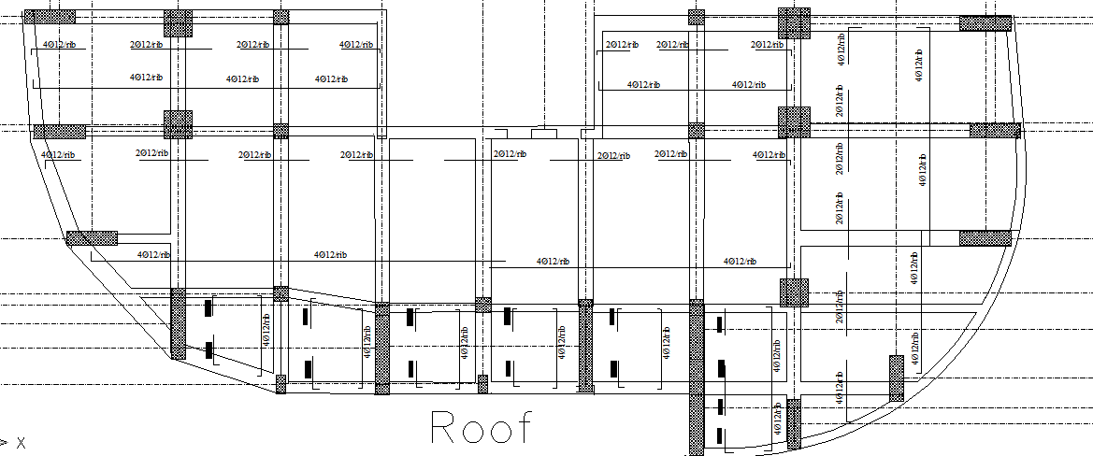
Reinforcing Direction

Slide 9
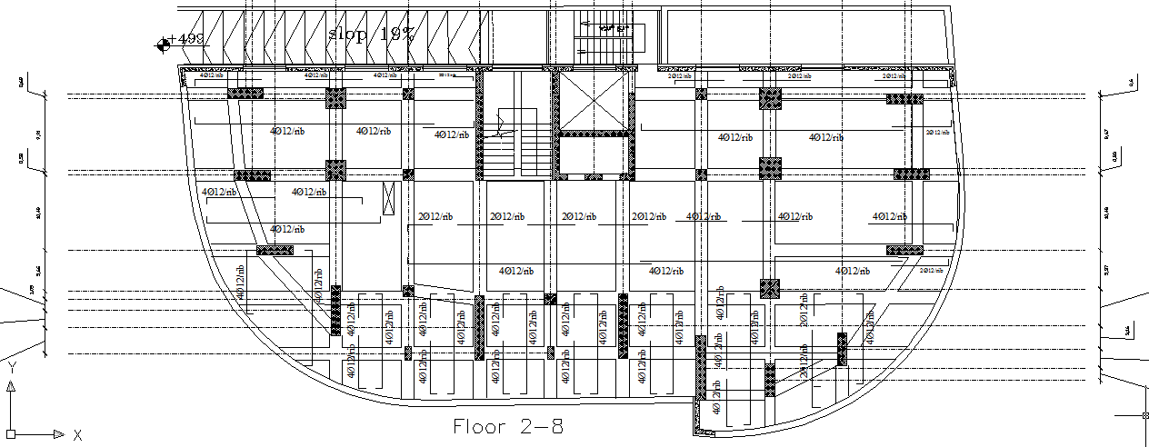

Slide 10
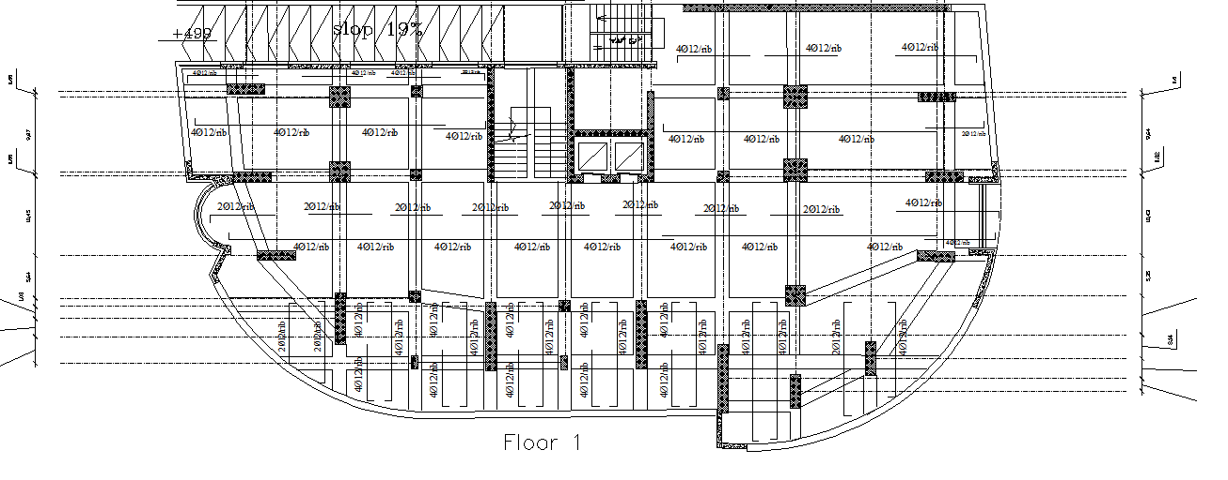

Slide 11
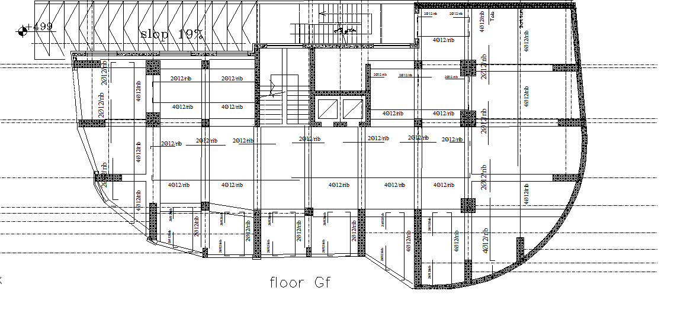

Slide 12
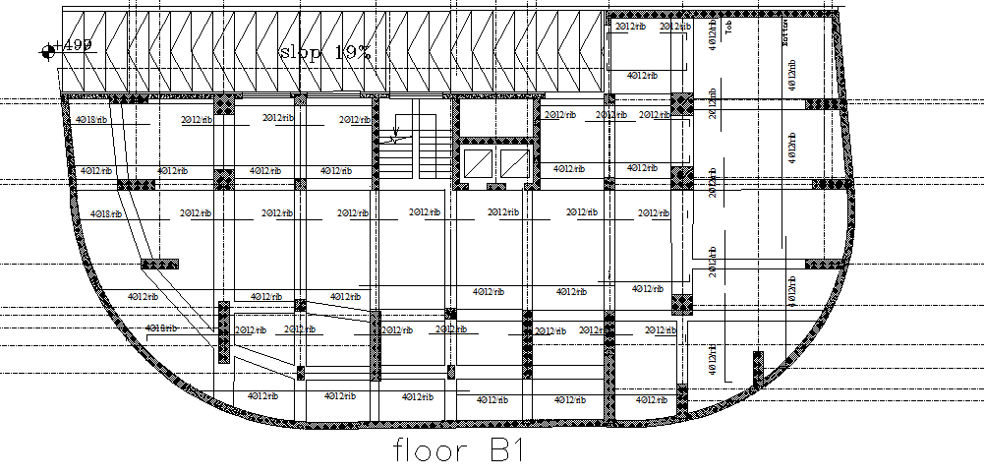

Slide 13
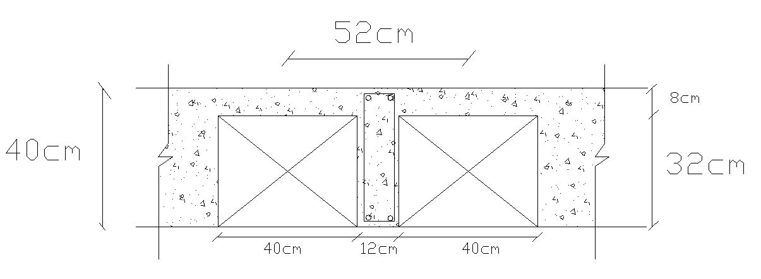
Cross Section in Rib

Slide 14
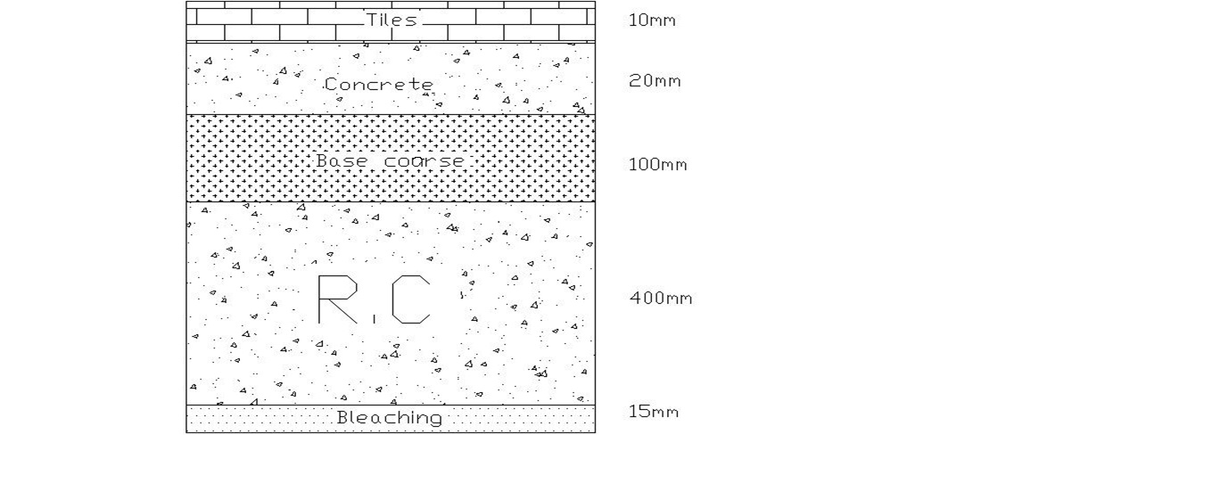
Cross Section in Slab

Slide 15
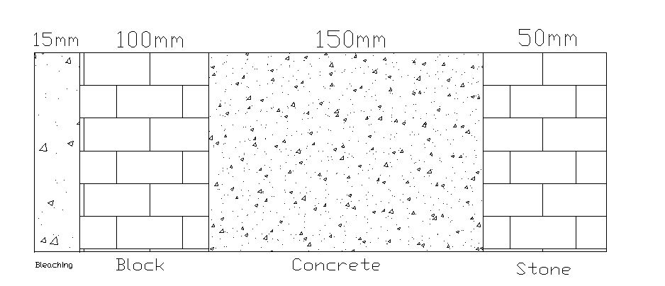
Cross Section in Wall

Slide 16

Check Slabs for Shear
ØVc =0 .75*($\frac{1}{6}$ bd√f 'c) /1000
ØVc = 0.75*120*350*5.3/6000 = 28 Kn
Max shear less than concrete capacity.

Slide 17
Shrinkage Steel
As = 0.0018*b*d
As = 0.0018*1000*60 = 141mm²
Use 3 Ø 8 /m

Slide 18
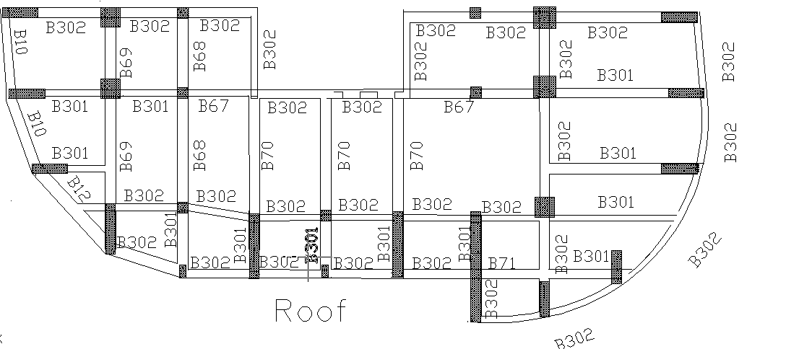
Distribution of Beams

Slide 19
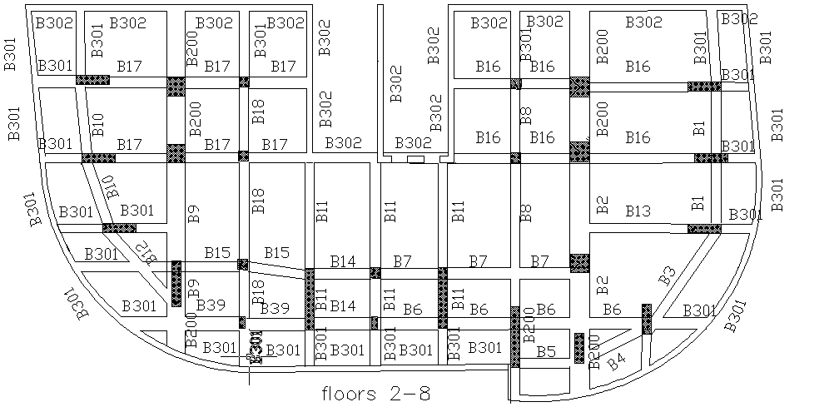

Slide 20
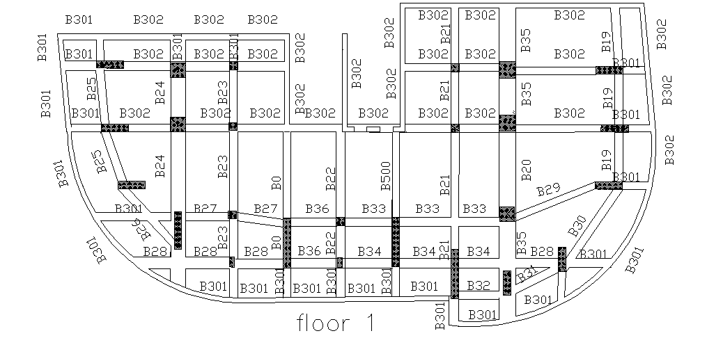

Slide 21
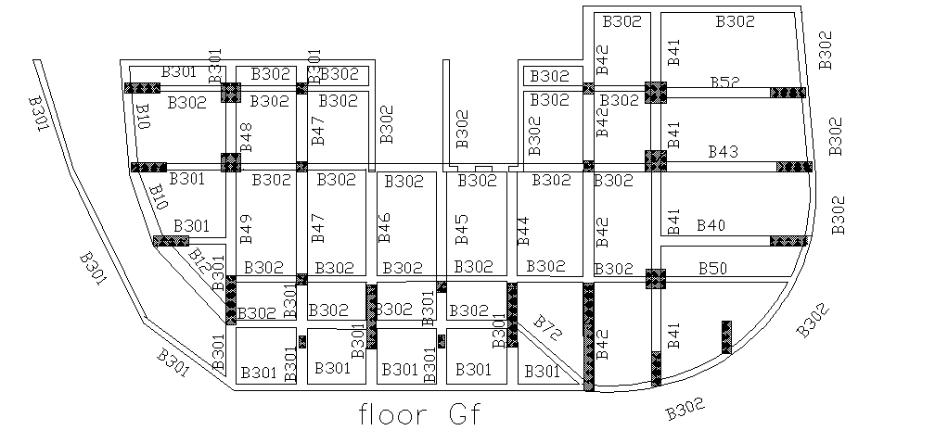

Slide 22
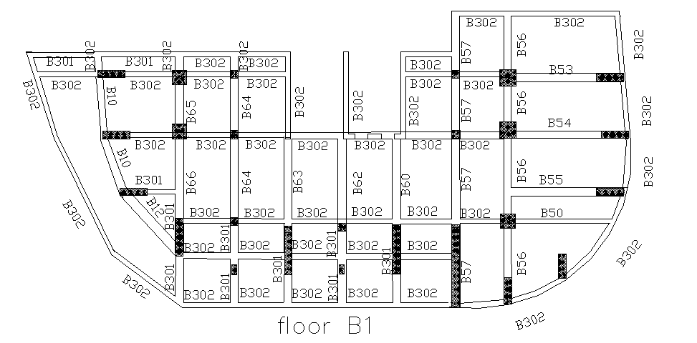

Slide 23
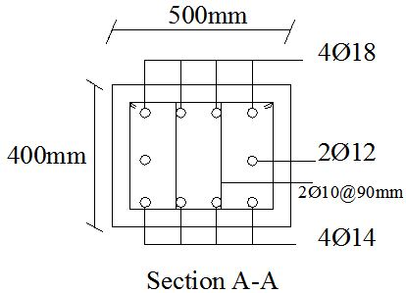
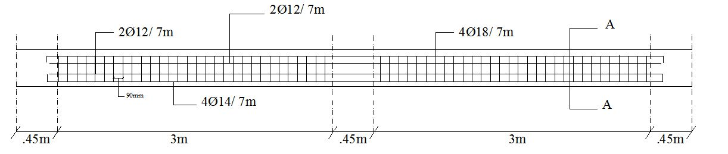
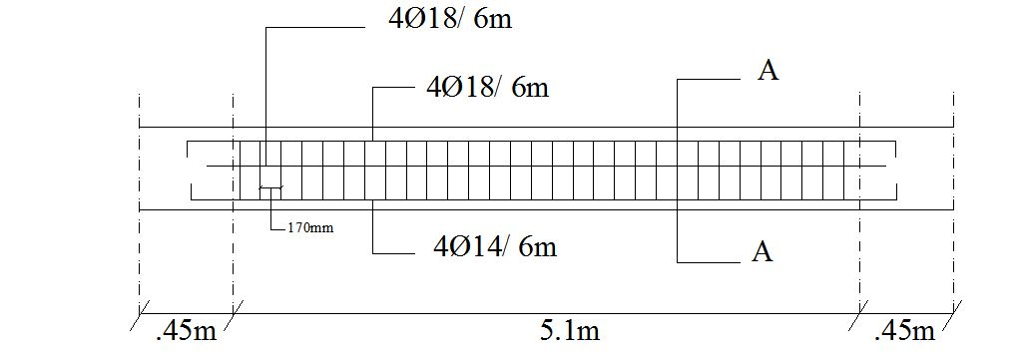
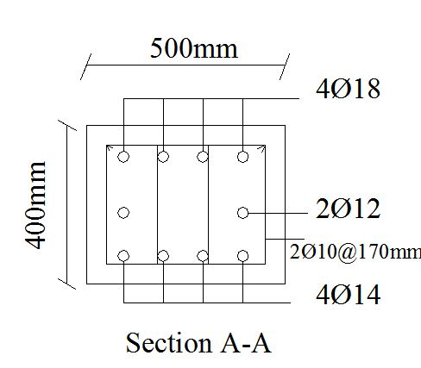

Slide 24
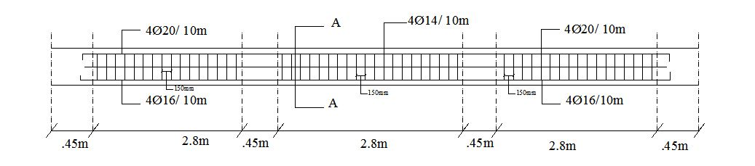
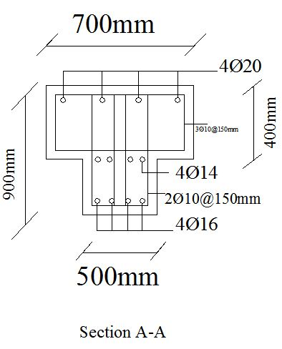
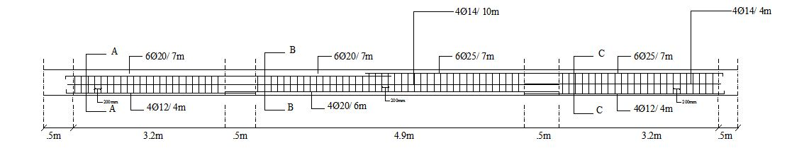
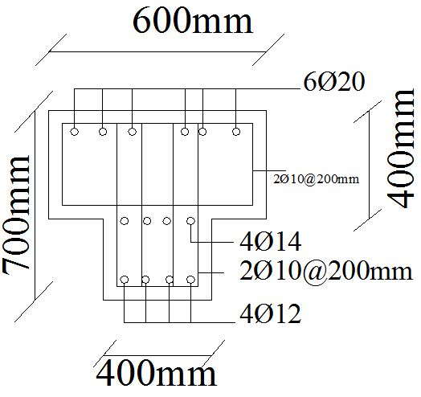

Slide 25
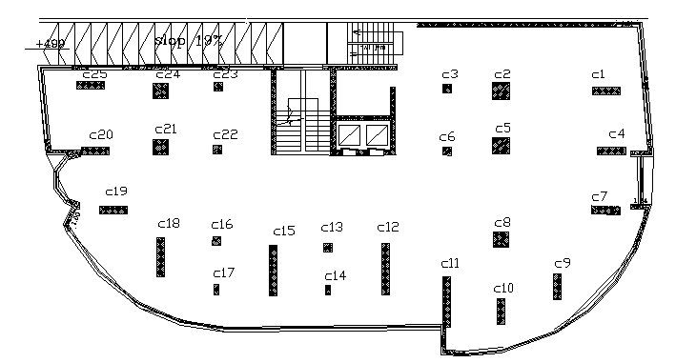
Columns Design

Slide 26
Tied Columns will be used.
Dimensions are selected by architect.
Area of steel is minimum.
According to Buckling Check the columns are short.

Slide 27
Group Number | Dimension (m) | Load (Kn) | Column in the Group
1 | 1.65*0.45 | 5365 | C1, C4, C7, C19, C20,C25
2 | 1.0*1.0 | 6663 | C2,C5,C21,C24
3 | 0.5*0.5 | 3188 | C3,C6,C16,C13,C22,C23
4 | 0.9*0.9 | 7288 | C8
5 | 1.5*0.45 | 4832 | C9,C10
6 | 3.0*0.45 | 8377 | C11,C12, C15
7 | 0.6*0.3 | 2458 | C14,C17
8 | 2.3*0.45 | 8386 | C18
9 | 0.8*0.3 | 567 | C26
10 | 0.7*0.3 | 435 | C27

Slide 28
 | G1 | G2 | G3 | G4 | G5
Ultimate load kN | 5400 | 6700 | 3200 | 7300 | 4900
Dimensions m | 1.65*0.45 | 1.0*1.0 | 0.5*0.5 | 0.9*0.9 | 1.5*0.45
Reinforcement | 30Ø18 | 32Ø20 | 14Ø16 | 26Ø20 | 28Ø18
Stirrups mm | Ø10 | Ø10 | Ø10 | Ø10 | Ø10
Spacing cm | 20 | 20 | 20 | 20 | 20
 | G6 | G7 | G8 | G9 | G10
Ultimate load kN | 8400 | 2500 | 8400 | 600 | 500
Dimensions m | 3.0*0.45 | 0.6*0.3 | 2.3*0.45 | 0.8*0.3 | 0.7*0.3
Reinforcement | 54Ø18 | 10Ø16 | 42Ø18 | 12Ø16 | 12Ø16
Stirrups mm | Ø10 | Ø10 | Ø10 | Ø10 | Ø10
Spacing cm | 20 | 20 | 20 | 20 | 20

Slide 29
Three Dimensional Modeling
1.Compatibility.
2.Equilibrium .
3.Stress – Strain relationship .

Slide 30
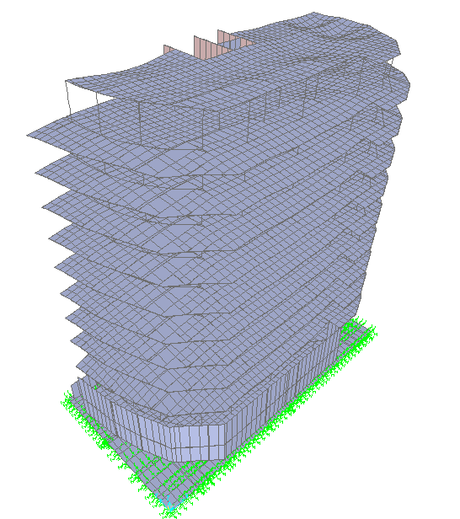
Compatibility.

Slide 31
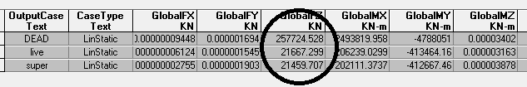
Equilibrium Check

Slide 32
Error | Sap | Hand
2.6 %. | 21667.3 kN | 22244.5 kN | Live
4.3% | 21459.7 kN | 22429.46 kN | Super
3.9 % | 257724.53 | 247644.89 | Dead
Note: all Equilibrium Load check's are OK

Slide 33
Stress – Strain relationship .
Figure (5.14): Bending moment diagram for beam10(1D) kN.m.

Slide 34
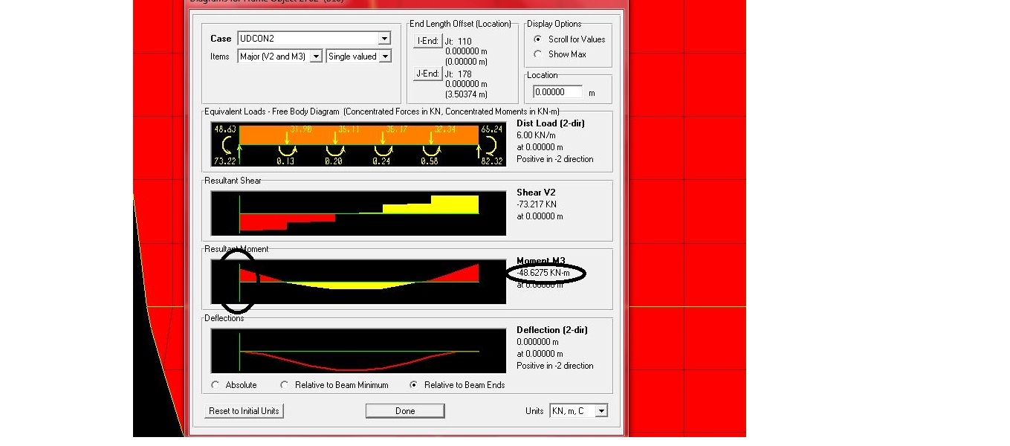
Figure (5.15): Left Bending moment diagram for beam10(3D) kN.m.

Slide 35
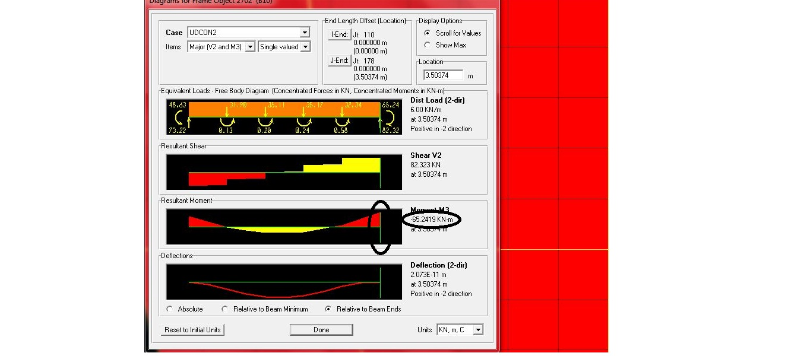
Figure (5.16): Right Bending moment diagram for beam10(3D) kN.m

Slide 36
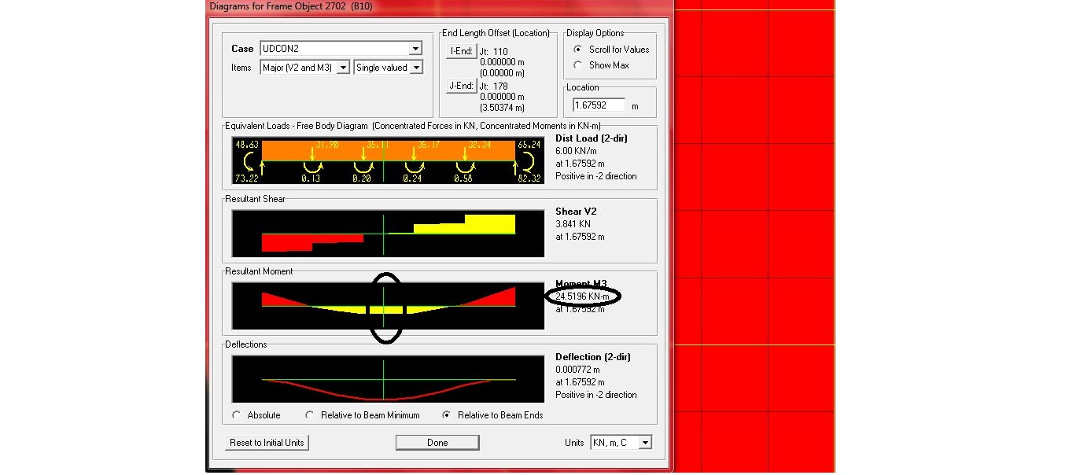
Figure (5.17):Middle Bending moment diagram for beam10(3D) kN.m

Slide 37
Mu⁺ from 3D = (48.2+ 65.3)/2 + 24.5 = 81.3 kN.m
Error = (81.3 – 76.7 ) / 81.3 = 5.0%
Note: all Stress-Strain Relationship check's OK

Slide 38
Footing Design
460> (560*0.5) = 280 m²
Mat Foundation should be used in the Project.

Slide 39
Check Punching Shear:
*Vu=Pu=8400 kN.
*When d equal 1.2
*ϬV_{c}=9392 kN>8400 kN
OK

Slide 40
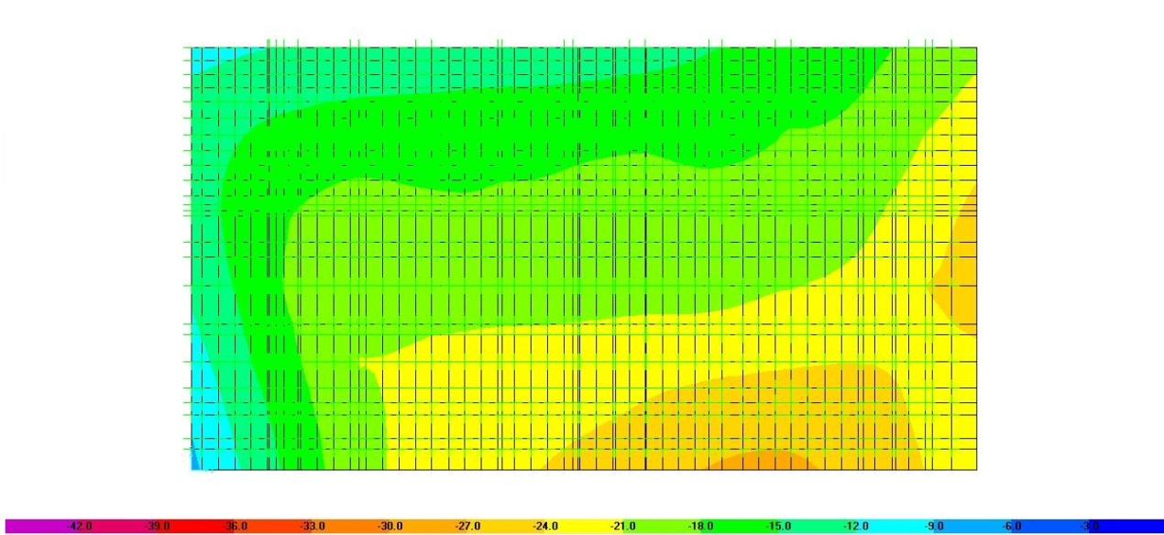
Check for Deflection
Δ = 10mm.is the maximum deflection.
Figure (6.1): Deflection Shape value for footing under surface load(m)

Slide 41
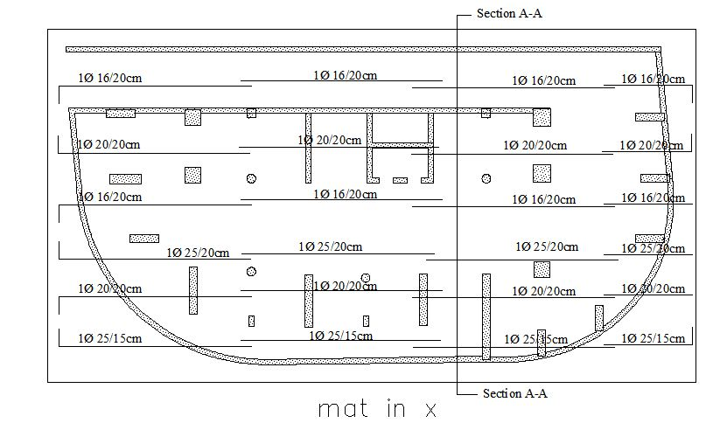
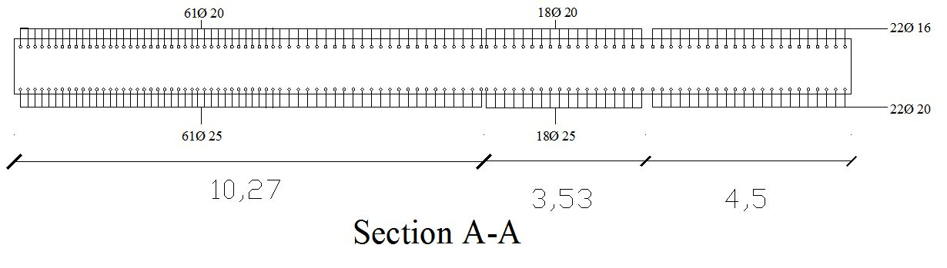

Slide 42
Dynamic Analysis
Earthquake analysis procedure :
Model/Ritz Vectors Analysis.
Equivalent Lateral Load.
Response Spectrum.
Linear Time History.
Response Spectrum had been used to design and analysis .

Slide 43
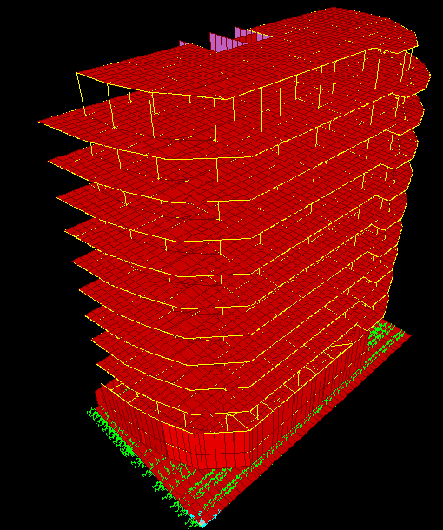

Slide 44
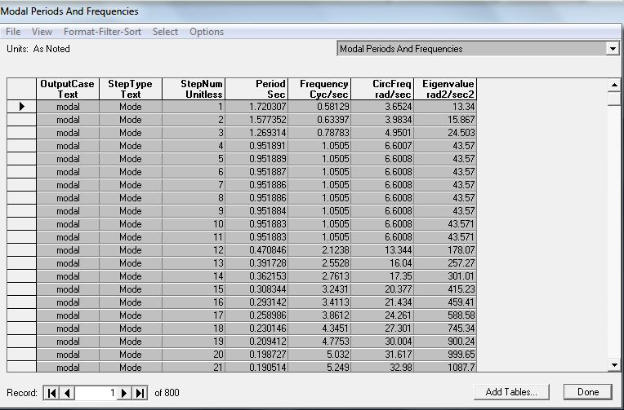
Figure(7.1): Periods and frequencies for modes.
T = 1.72 second.

Slide 45
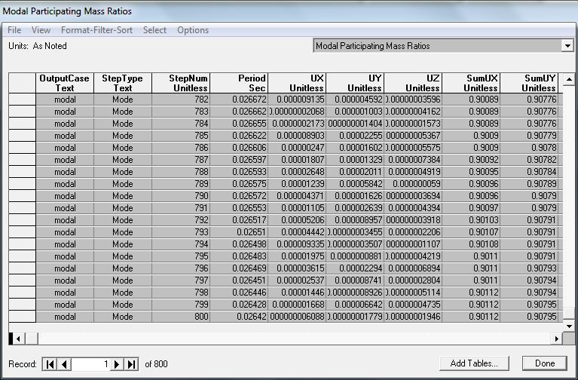
Figure(7.2): Modal Participating Mass Ratios.

Slide 46
Story Number | Displacement x | Displacement y | Displacement z
B2 | 0 | 0 | .6
B1 | .01 | .24 | .43
GF | .1 | .5 | .6
1 | .02 | 2 | 1
2 | .05 | 4 | 1.1
3 | .08 | 6 | 1.2
4 | .1 | 8 | 1.3
5 | .1 | 10 | 1.3
6 | .1 | 12 | 1.35
7 | .1 | 13.7 | 1.35
8 | .07 | 15.4 | 1.32
9 | .05 | 16.8 | 1.3
Roof | .6 | 17 | .82
Displacement in all stories from first mode.

Slide 47
Story Number | Displacement X | Displacement Y | Displacement Z
B2 | 0 | 0 | 3.3
B1 | .5 | .7 | 3
GF | 3.1 | 1.6 | 3.1
1 | 6.5 | 7 | 5.5
2 | 12.9 | 15.4 | 7.4
3 | 20.2 | 25.1 | 8
4 | 27.7 | 35.1 | 8.2
5 | 34.8 | 44.6 | 8.3
6 | 41.1 | 53.2 | 8.2
7 | 47.4 | 60.8 | 8
8 | 52.6 | 67.3 | 7.8
9 | 56.86 | 72.4 | 7.3
Roof | 57.99 | 65.4 | 4.7
Displacement in(mm) in all stories from Response Spectrum Method hitting X direction:

Slide 48
Response Spectrum Method Procedure
Ca
Cv
I
R
Ca = 0.28 and Cv = 0.4 according to UBC code .
I = 1 and R = 3

Slide 49
Thank you for your Attention
Thank you for your Attention
Thank you for your Attention

