Slide 1




REVERSE ENGINEERING
AND AUTOMATED DEFENSE STRATEGIES FOR DETECTING AND PREVENTING RAT MALWARE
PRESENTED BY:
LINDA BSHARAT
lara shahrori
lana khdair

Slide 2






WHAT IS NJRAT?
A Remote Access Trojan (RAT) that emerged in 2013.
Popular on dark web forums due to ease of use and powerful features.
Used for full device control, keylogging, data theft, and delivering payloads.
Relies on Command and Control (C2) servers for executing commands.

Slide 3


WHY IS IT DANGEROUS?
  1
  Easy to use and widely available on the dark web.
  2
  Bypasses traditional antivirus solutions.
  3
Communicates with C2 servers for data exfiltration
  4
  Uses obfuscation techniques to avoid detection.
  5
  Enables remote control over infected devices.

Slide 4

REVERSE ENGINEERING
  Understand malware behavior, extract Indicators of Compromise (IoCs), and develop defense strategies.
Objectives:
  Understand malware behavior (propagation, C2 communication, attack execution).
  Extract IoCs (IPs, domain names, malicious files).
  Develop defense strategies (IDS rules, antivirus updates).

Slide 5


RESEARCH OBJECTIVES
Analyze njRAT samples using reverse engineering (static and dynamic techniques).
Examine persistence techniques used by njRAT (encryption, registry key modifications).
Explore C2 communication and data exfiltration methods.
Develop automated defense mechanisms using Snort and pfSense.
Demonstrate custom rule creation for blocking malicious activity.

Slide 6

RESEARCH METHODOLOGY
Reverse Engineering
Reverse Engineering:
1 .
  Static Analysis: Analyze malware without execution.
  Dynamic Analysis: Observe malware behavior during execution.
2 .
  Use APIs like VirusTotal to gather dynamic behavior reports.
3 .
  Develop custom Snort rules for real-time threat detection.
Static Analysis
Dynamic Analysis
Automated Analysis:
Automated Analysis
Detecting and Preventing
Develop Defense Mechanism & Prevention

Slide 7
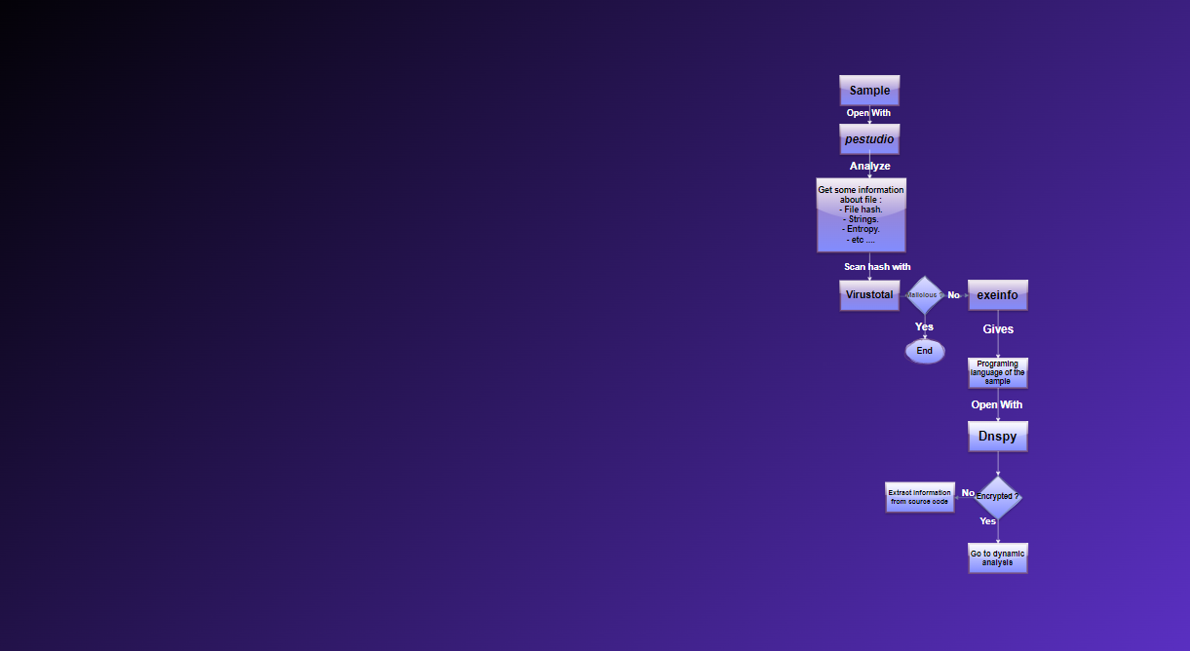


STATIC ANALYSIS
Analyzing executables without execution.
Steps:
Determine file type and architecture.
Generate hash for antivirus database checks.
Extract strings to reveal functionality and IoCs.
Identify obfuscation techniques (packers, cryptors).
  1
  2
  3
  4

Slide 8
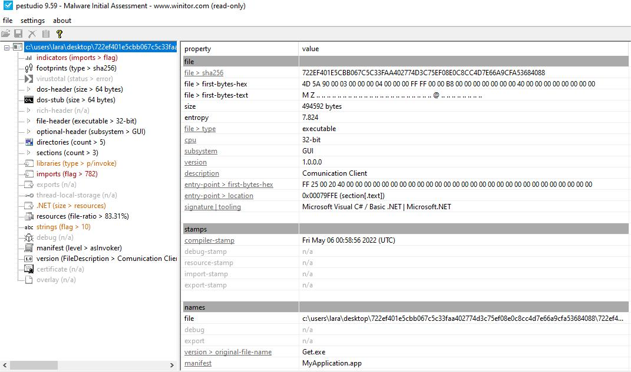



  1
PESTUDIO

Slide 9
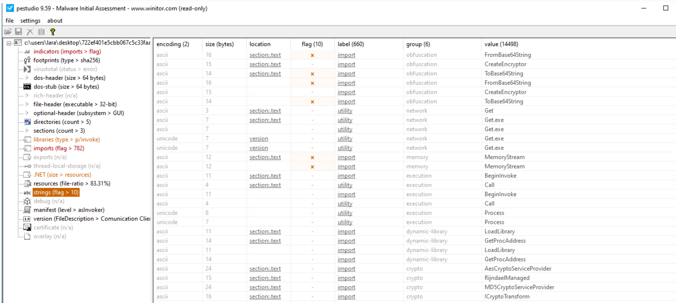
Strings

Slide 10

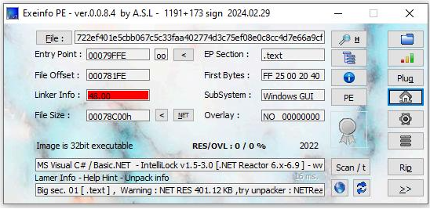
Exeinfo PE tool
  2
  A warning about the difficulty of unpacking the protection using the NETRec tool.

Slide 11
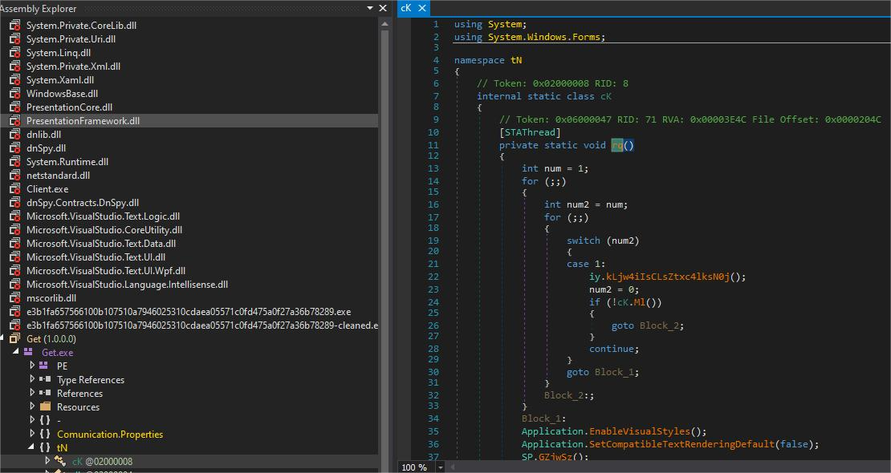
  3
DnSpy tool
  A powerful programming tool for .NET reverse engineering.
  It lets you decompile, inspect, and edit .NET assemblies.
  The malware sample we looked at used code obfuscation techniques which made it hard to analyze manually. As shown in the figure.
Obfuscation function:

Slide 12
STATIC ANALYSIS
Tool Name | Category | Description | Purpose in Research
PEStudio | Static Analysis | A tool for analyzing PE files, extracting metadata, strings, and imports. | Used to analyze the structure of the njRAT malware and identify suspicious indicators.
Exeinfo PE | Static Analysis | A tool for detecting obfuscation and packing in PE files. | Helped identify obfuscation techniques used by njRAT.
DnSpy | Static Analysis | A .NET decompiler and debugger for reverse engineering .NET assemblies. | Used to decompile and analyze the .NET code of njRAT, despite obfuscation.

Slide 13
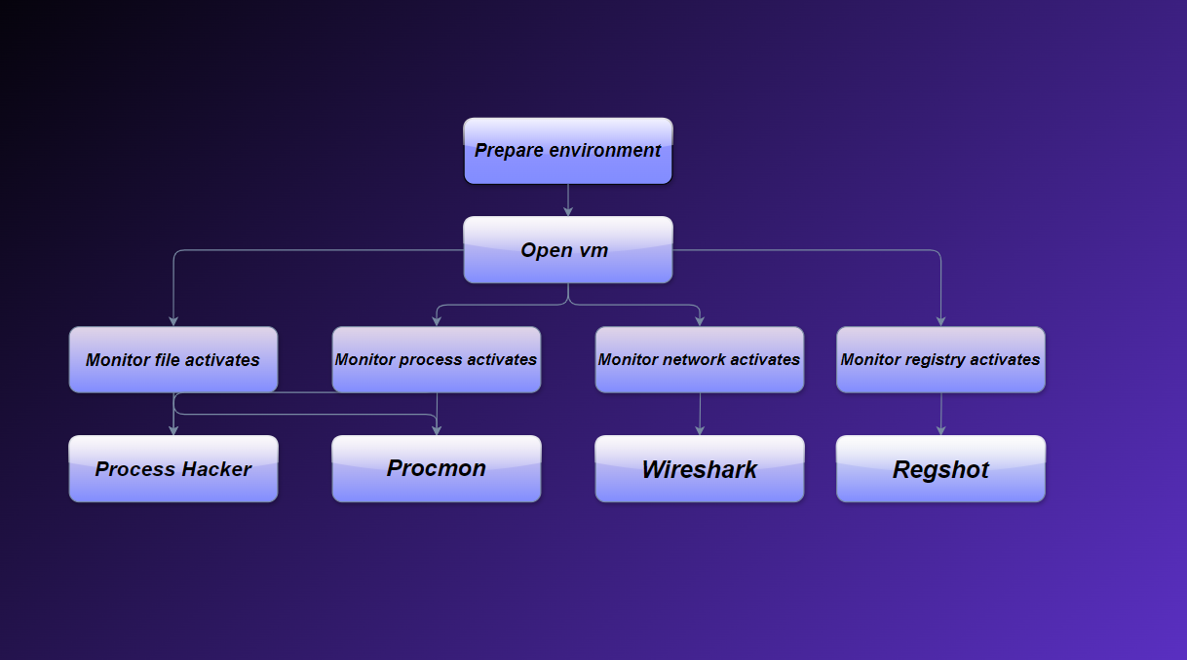
DYNAMIC ANALYSIS
It involves examining malware while running to observe its behavior, and network activity in real-time.

Slide 14
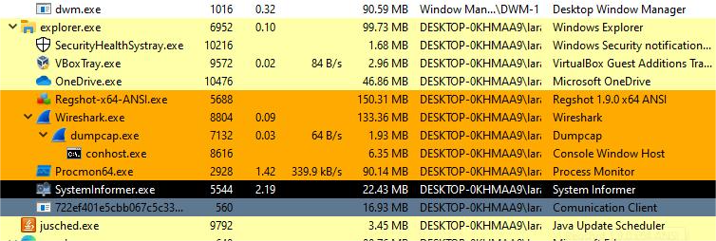
  1
PROCESS HACKER
The process exhibited unusual characteristics, including its obscure, seemingly encrypted name, often a trait of malware attempting to obfuscate its activity.
Monitored suspicious processes :

Slide 15
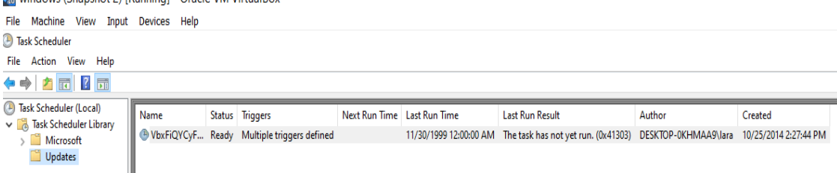
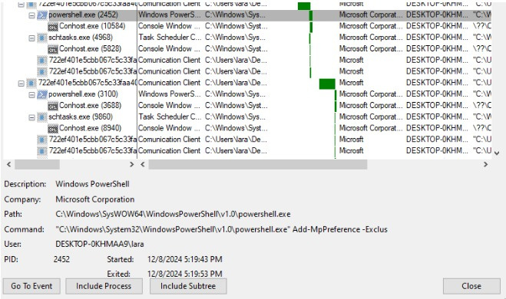
  2
PROCESS MONITOR ( PROCMON )

Slide 16
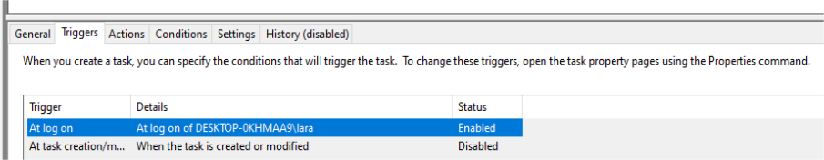
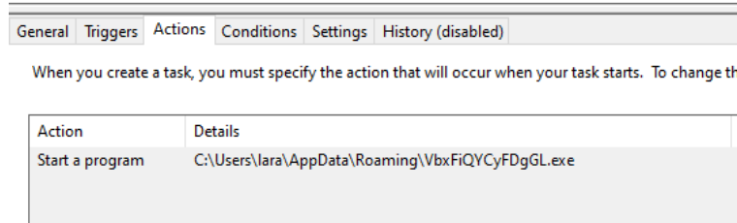
  2
PROCESS MONITOR ( PROCMON )
The task runs under specific conditions, aiding persistence, but disabled triggers may prevent execution in some scenarios.
Action Tab Observation: Malicious software (VbxFiQYCyFDgGL.exe) is set to run via a scheduled task.
Detection: Identified the attacker-added task, revealing persistence mechanism.

Slide 17
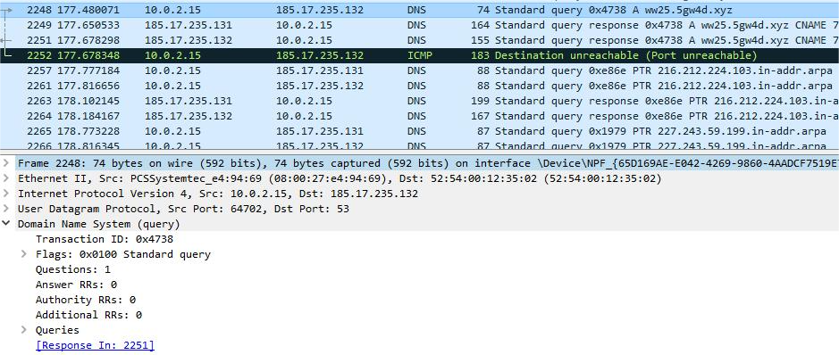
  3
WIRESHARK
WIRESHARK WAS USED TO CAPTURE NETWORK TRAFFIC AND ANALYZE COMMUNICATION BETWEEN THE MALWARE AND ITS COMMAND AND CONTROL (C2) SERVERS.

Slide 18
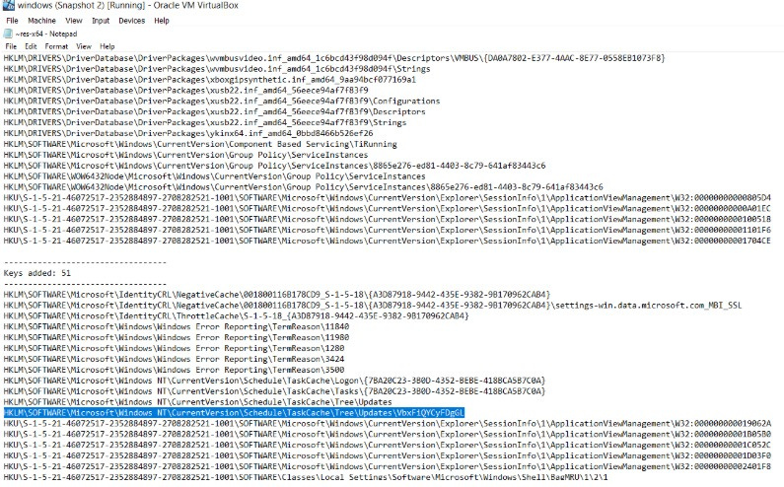
  4
REGSHOT
Regshot was used to monitor changes to the system registry and file system.
The malware added new registry keys under :

Slide 19


DYNAMIC ANALYSIS
Key Findings :
  1
Persistence Mechanisms :
      Created scheduled tasks using schtasks.exe.
      Modified registry keys for startup execution.
  2
Network Activity :
      Outbound connections to C2 servers
      Data exfiltration attempts with encoded information.
Process Activity:
      Suspicious processes with encrypted names.
      Code injection into legitimate processes.
  3

Slide 20
Dynamic Analysis
Tool Name | Category | Description | Purpose in Research
Process Hacker | Dynamic Analysis | A tool for monitoring running processes and system resources. | Captured and analyzed njRAT's C2 communication and data exfiltration attempts.
Process Monitor | Dynamic Analysis | A tool for monitoring file system, registry, and process activity. | Logged system calls and modifications made by njRAT during execution.
Wireshark | Dynamic Analysis | A network protocol analyzer for capturing and analyzing network traffic. | Used to decompile and analyze the .NET code of njRAT, despite obfuscation.
Regshot | Dynamic Analysis | A tool for comparing registry snapshots before and after malware execution. | Tracked registry changes made by njRAT for persistence and evasion.

Slide 21
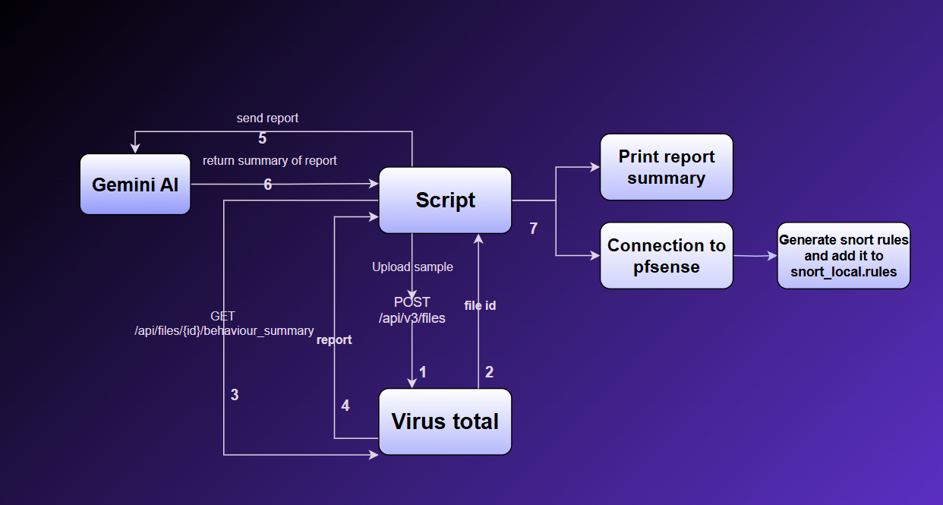
AUTOMATED DEFENSE STRATEGIES FOR DETECTING AND MITIGATING NJRAT MALWARE

Slide 22

AUTOMATED ANALYSIS USING APIS
Collected dynamic behavior reports.
Summarized data from VirusTotal using Gemini API .
  1
Network Connections : HTTP, HTTPs
  2
Registry keys created and modified.
  3
Maliciousness Prediction.
  4
Processes initiated by the file.

Slide 23
AUTOMATED DEFENSE WITH SNORT AND PFSENSE (IDS & IPS)
Deployed as IDS and IPS using snort on pfSense.
Enabled real-time updates and monitoring using python Script
  1
  IP Traffic Data Extraction
    Collected suspicious IPs and ports from VirusTotal and Gemini APIs.
  2
  Snort Rule Generation
    Automatically generated rules using Drop and Alert actions.
  3
  Rule Deployment
    Updated rules, restarted Snort, and checked logs for threat prevention.

Slide 24

KEY FINDINGS AND CONCLUSION
  Static Analysis
  Dynamic Analysis
  Automated Analysis
Snort Integration
Revealed file structure, API calls, and obfuscation techniques.
Identified high entropy and suspicious indicators (e.g., generic file names).
Uncovered persistence mechanisms (scheduled tasks, registry modifications).
Detected C2 communication and data exfiltration attempts.
Provided detailed behavioral data (network connections, DNS lookups).
Identified malicious IPs and domains for C2 communication.
  Successfully blocked malicious traffic in real-time using custom rules.
Impact:
    This approach can be extended to other malware types.
    Enhances network security through automated detection and prevention.

Slide 25

THANK YOU

