Slide 1


Design of OFFICE OF EXCHANGE
“Palestinian Post \ Jericho”
Prepared by:
Khawla Salameh
Noor Barbour
Rema’ Alawneh
Supervisor:
Dr. Riyad Awad

Slide 2
Outlines
Project objective.
Project description.
Preliminary Design of slabs, beams & columns.
Three dimensional structural analysis and design.
Seismic loads analysis.

Slide 3
Project Objective
To design the building of Office of Exchange \ Palestinian Post in Jericho using the primary principles of structures by using one dimensional analysis and three dimensional structural analysis and then design it for seismic loads analysis.

Slide 4
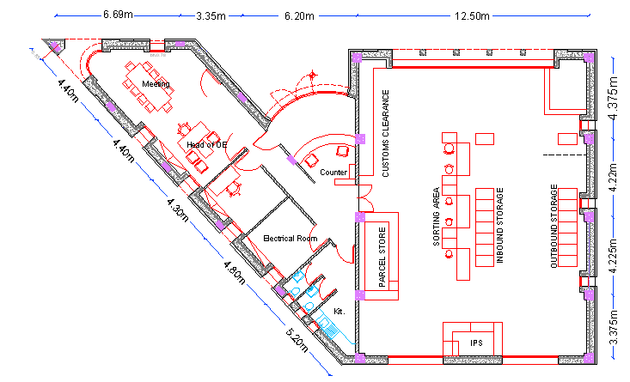
Plan of Ground Floor

Slide 5
Project Description
The building is used for commercial purposes.
The building consists of one floor with an area of 349.7 m²
The floor assumed to be two blocks, block 1is used for Customer Services and block 2 for offices.
The elevation of the floor is 7.05 m in block 1 and 4.45 m in block 2.

Slide 6
Materials
Reinforced concrete:
  Concrete compressive strength f_{c} = 24 MPa for slabs, beams and columns.
  Concrete compressive strength f_{c} = 28 MPa for footings.
  Modulus of elasticity E_{c} = 23 GPa
Steel:
  Yield stress in steel bars and stirrups = 420 MPa

Slide 7
Design Codes
ACI 318-08: American concrete institute provisions for reinforced concrete structure design.
UBC-97: Universal Building Code used for seismic loads calculations.
IBC 2009:International Building Code used for live load determination.
Notes:
The following codes and standards are used in this study:

Slide 8
Preliminary Design of slabs

Slide 9

One way Solid slab: (Block 1)
Thickness = 20 cm
Dead load = 5 KN/m²
Live load = 0.5 KN/m²
Superimposed dead load = 2 KN/m²
Notes:
I will begin with the type of slabs that we used in block 1 , that is one way solid slab
thickness of the slab is determined based on the longest span and it 20cm
Since the slabs are inclined , they are not accessible , so live load is
Dead load is calculated using the thickness of the slab, and it..
Superimposed dead load is assumed to be 2 KN/m2 , we took into consideration the weight of solar pools In it.

Slide 10
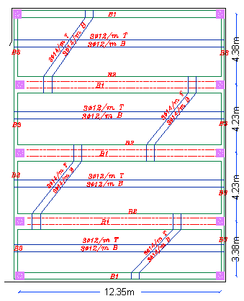
Solid slab reinforcement distribution
Notes:
Using the principles of simple beam , we determine the reinforcement in the solid slab

Slide 11
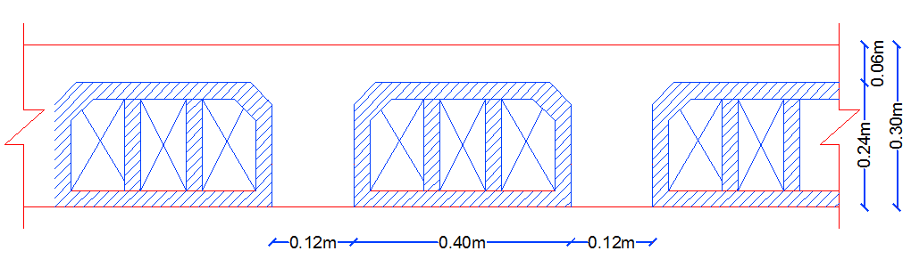
One way ribbed slab:(Block 2)
Thickness = 30 cm
Dead load = 5.1 KN/m²
Live load = 2.5 KN/m²
Superimposed dead load = 4.1 KN/m²

Slide 12
Superimposed dead load details:
Super imposed load = W_{tiles} + W_{mortar} + W_{sand} + W_{plaster} +0.104 (partition)
= (0.03)(27) + (0.03)(23) + (0.1)(20) + (0.02)(23) + 0.104
= 4.1 KN/m²

Slide 13
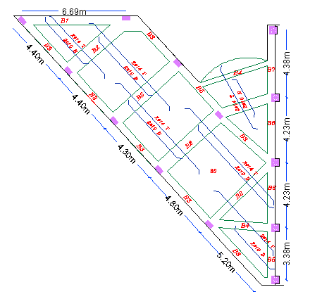
Ribbed slab reinforcement distribution

Slide 14
Preliminary Design of beams

Slide 15
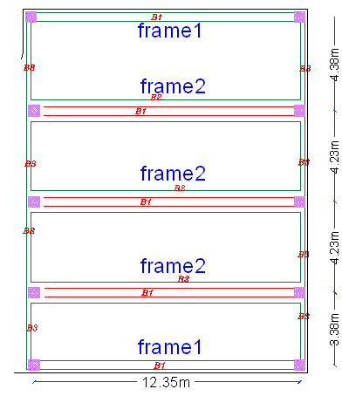
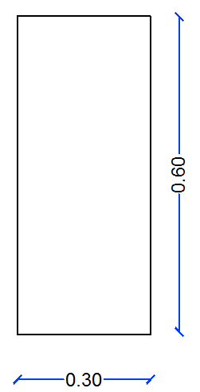
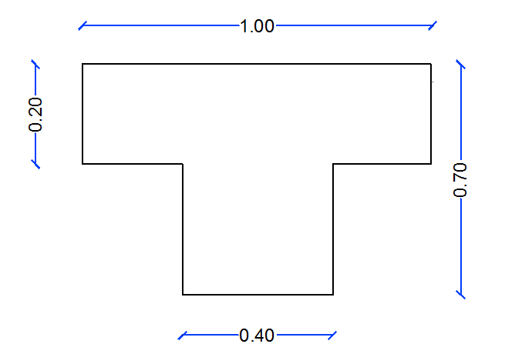
Beam distribution in block 1
B1
B2

Slide 16
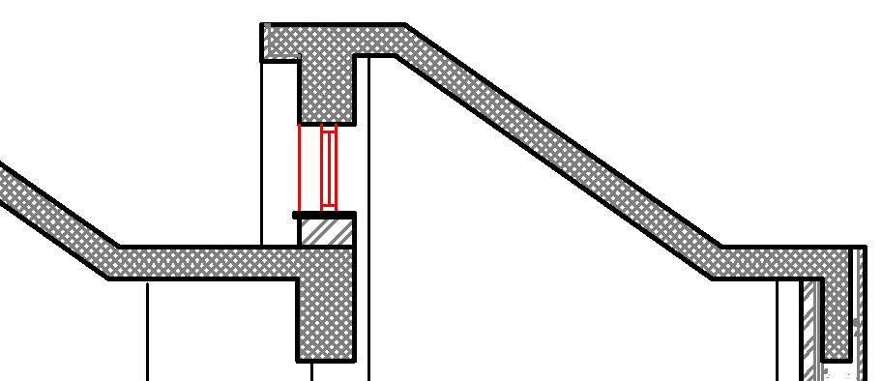
Beams in block 1

Slide 17
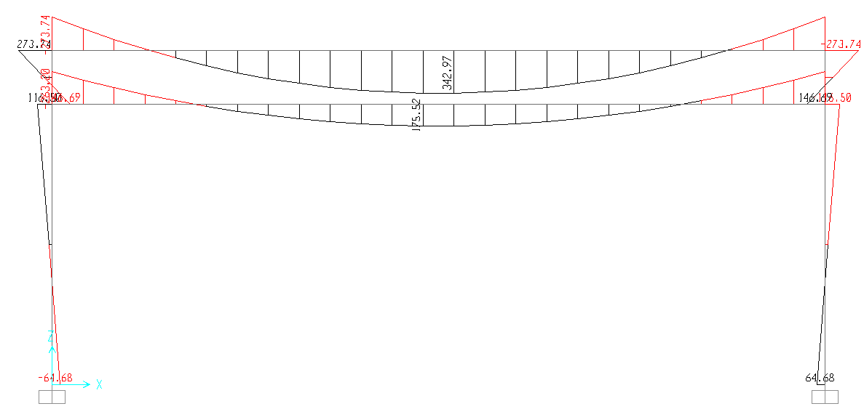
Moment diagram for frame 2

Slide 18
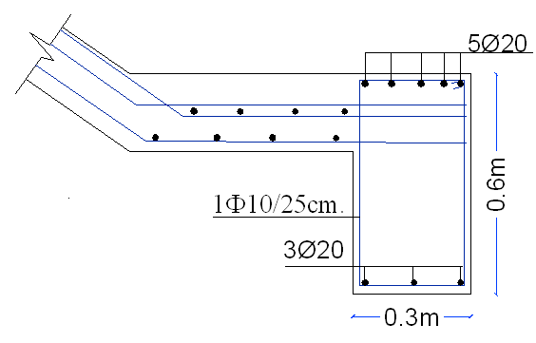
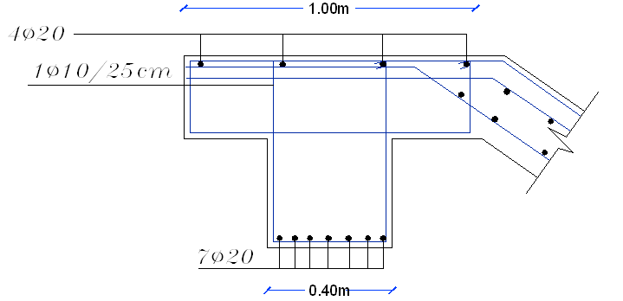
Reinforcement distribution for B1 & B2:
B1
B2

Slide 19
Beams details in block 1

Slide 20
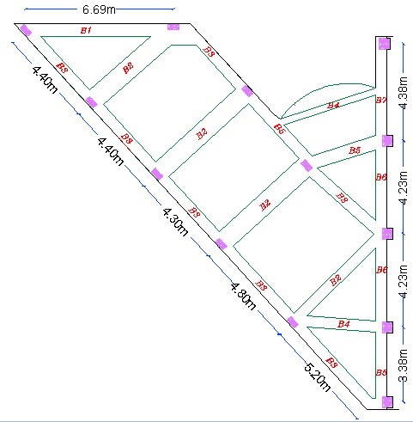
Beams of block 2:
Notes:
We consider the main beams as simple beams , and the secondary beams as continuous beams , and here we have a girder

Slide 21
Beams details in block 2

Slide 22
Preliminary Design of columns

Slide 23
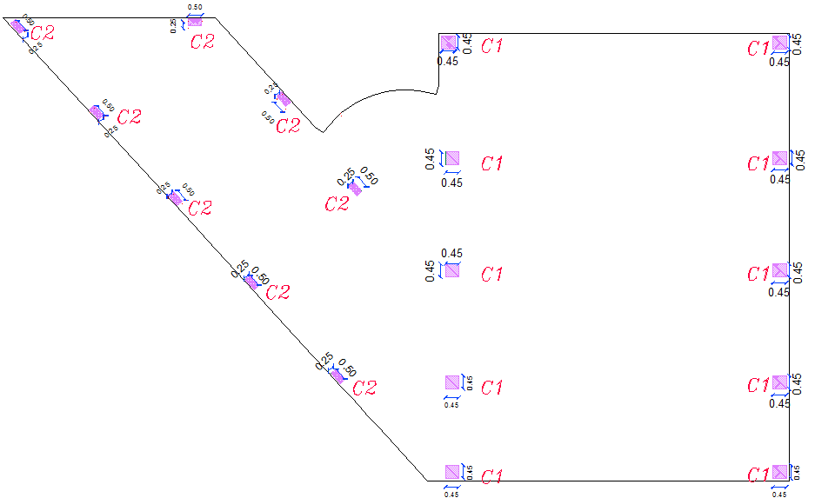
Columns distribution:

Slide 24
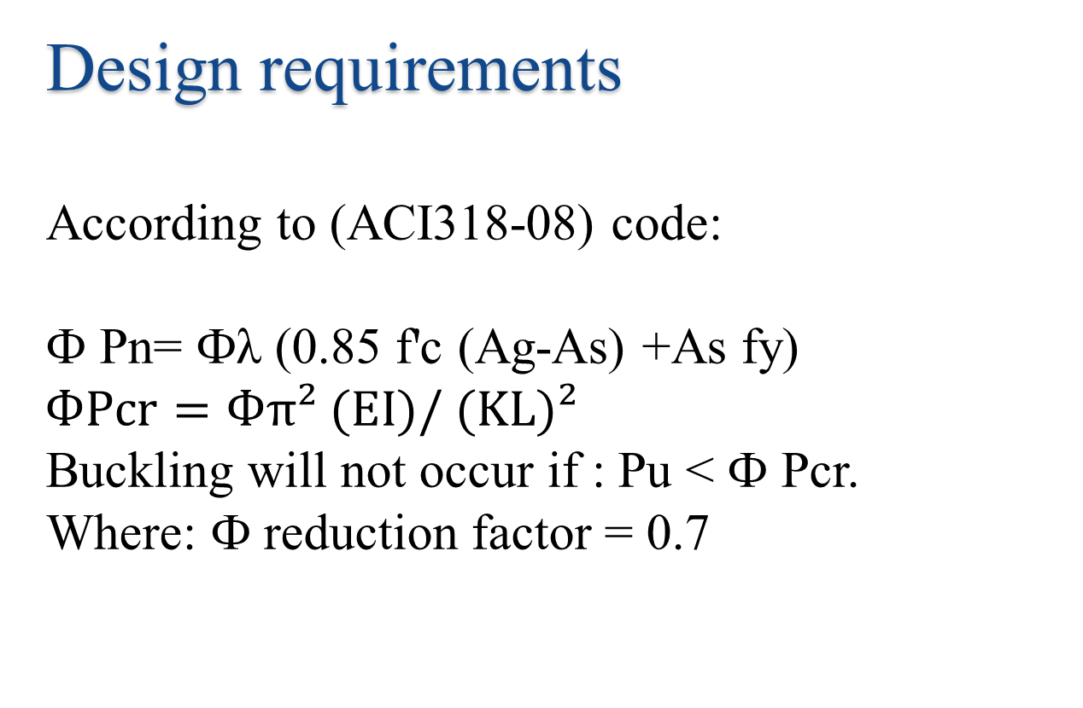
Design requirements
According to (ACI318-08) code:
Ф Pn= Фλ (0.85 f'c (Ag-As) +As fy)
$$ФPcr=Фπ² (EI)/ (KL)²$$
Buckling will not occur if : Pu < Ф Pcr.
Where: Ф reduction factor = 0.7

Slide 25
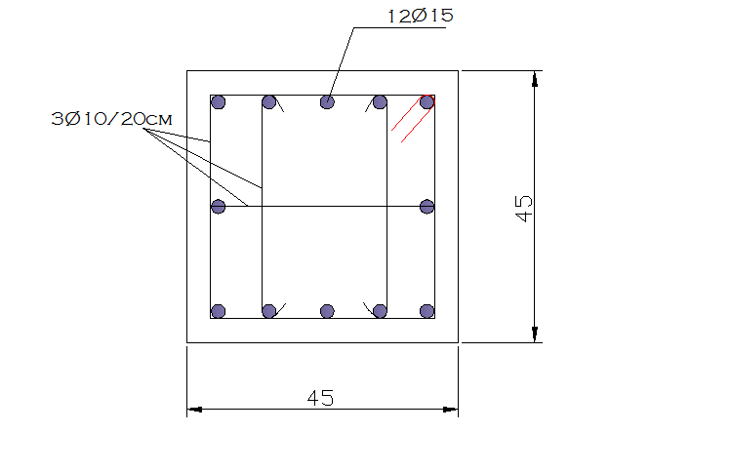
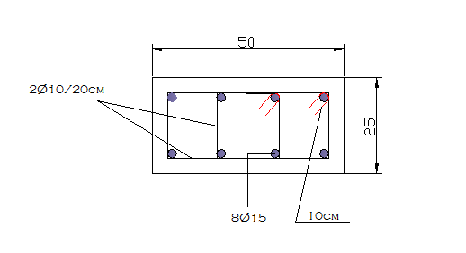
Column 1
Columns details:
Column 2

Slide 26
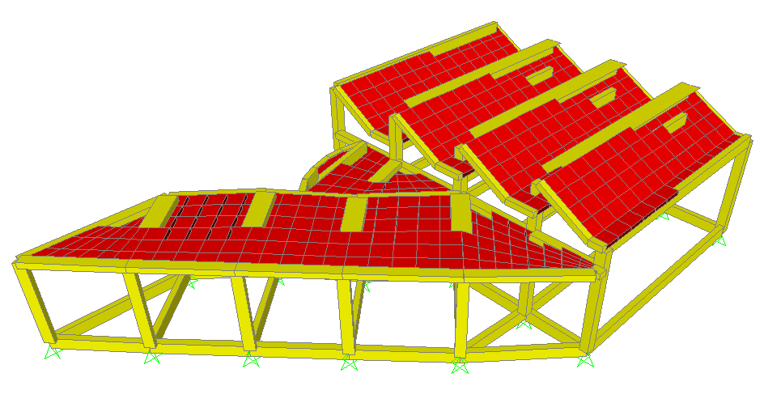
Three Dimensional Structural Analysis and Design

Slide 27
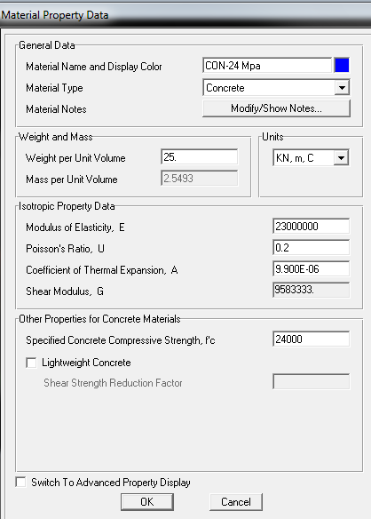
Material Property for concrete

Slide 28
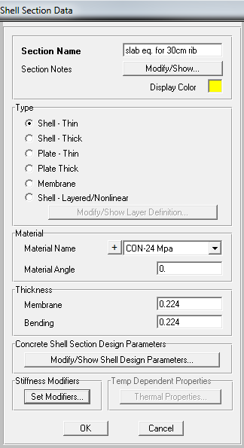
Shell Data
Ribbed slab definition

Slide 29
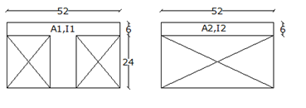
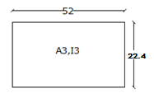
Modification Factors
A₁= (0.06×0.52) + (0.12×0.24) =0.06 m²
A₂= (0.06×0.52) = 0.0312 m²
A₃= (0.224×0.52) = 0.1165 m²
I₁= (0.52×0.06³/12) + (0.06×0.52) × (0.08162) + (0.12×0.24³/12) + (0.12×0.24) × (0.06842) =4.87 e⁻⁴ m⁴
I₂ = (0.52×0.06³/12) = 9.36 e⁻⁴ m⁴
I₃ = (0.52×0.224³/12) = 4.87e⁻⁴ m⁴

Slide 30
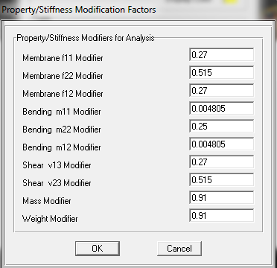
Modifiers equations
Membrane f₁₁modifier =(A₂/A₃) = 0.27
Membrane f₂₂ modifier = (A₁/A₃)=0.515
Membrane f₁₂ modifier = (A₂/A₃) = 0.27
Bending m₁₁ modifier = 0.25×( I₂/ I₃) = 0.004805
Bending m₂₂ modifier = 0.25×( I₁/ I₃) = 0.25
Bending m₁₂ modifier = 0.25×( I₂/ I₃) =0.004805
Shear v₁₃ modifier = (A₂/A₃)= 0.27
Shear v₂₃ modifier = (A₁/A₃)= 0.515
Mass m modifier = (M _{1 way rib} / M _{solid}) = 0.91
Weight w modifier = (9.81×M _{1 way rib}/ 9.81×M _{solid})= 0.91
whe
Modifiers for ribbed slab

Slide 31
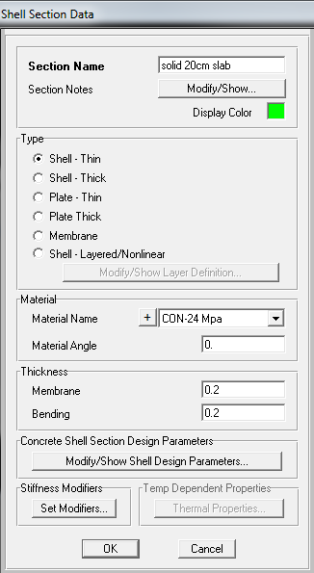
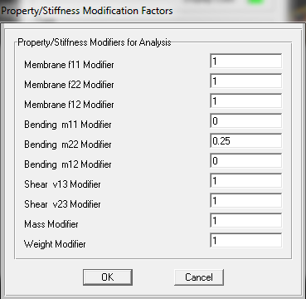
Modifiers
solid slab section data
One way solid slab

Slide 32
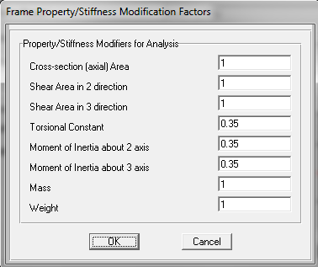
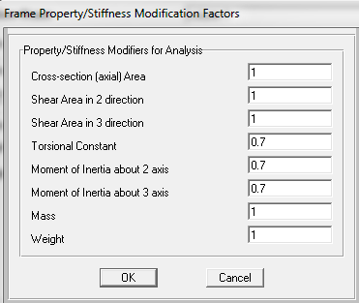
Modifiers
For Beams
For columns

Slide 33
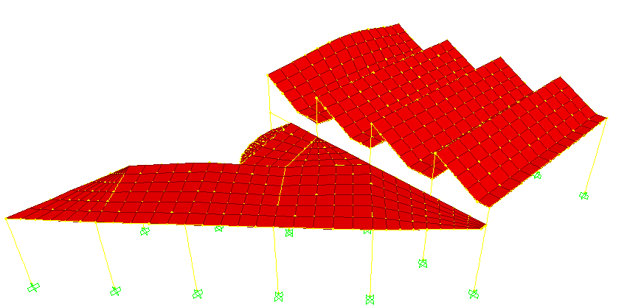
Compatibility Check

Slide 34
Check equilibrium
Dead load results:
Description | Block 1 | Block 2
Slabs | 960 | 645.66
Columns | 206.85 | 112.5
Beams | T-section = 375 Rec. = 500 | 388.665
Total | 2041.85 | 1146.825
Total dead load =3188.675 KN
Total live load= 427.925 KN
Total Superimposed load = 965.18 KN

Slide 35
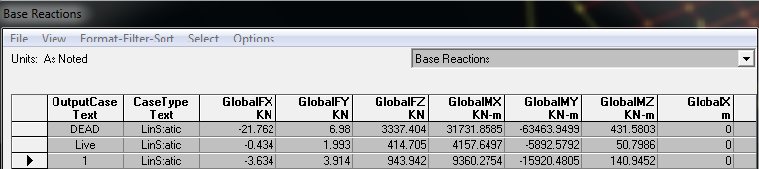
Dead, live and superimposed results from SAP
Error % in dead load = 4.4 % < 5% OK
Error % in live load = 3 % < 5% OK
Error % in superimposed = 2.25% < 5% OK

Slide 36
Slabs Design

Slide 37
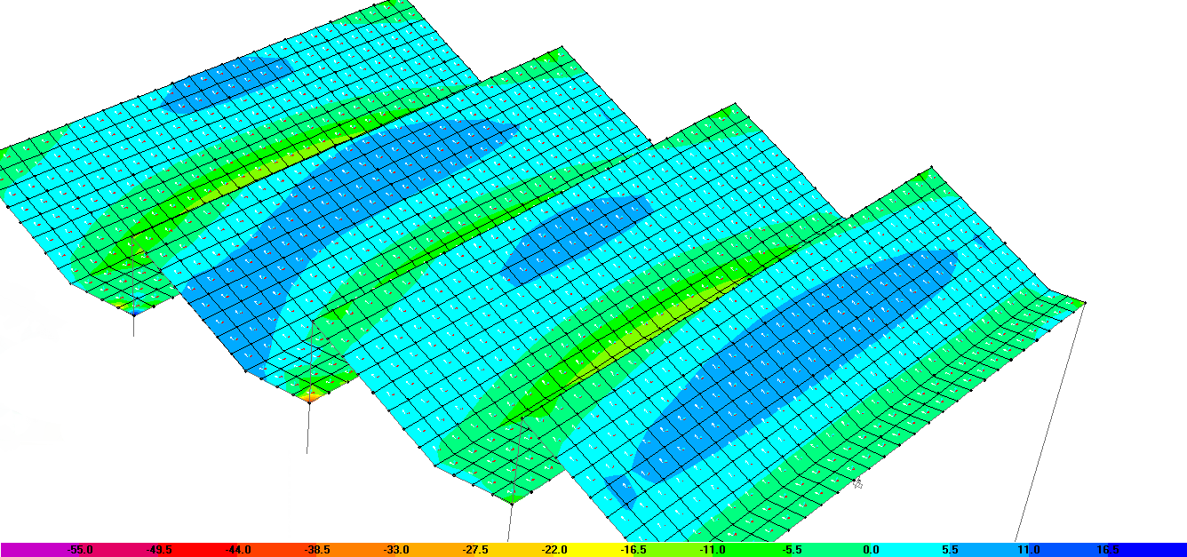
Bending moment for block1 in y-direction

Slide 38
Solid slab reinforcement distribution
Notes:
Using the principles of simple beam , we determine the reinforcement in the solid slab

Slide 39
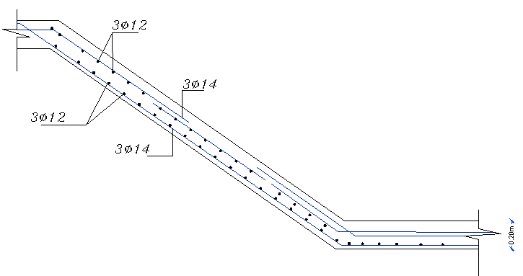
Solid slab reinforcement distribution

Slide 40
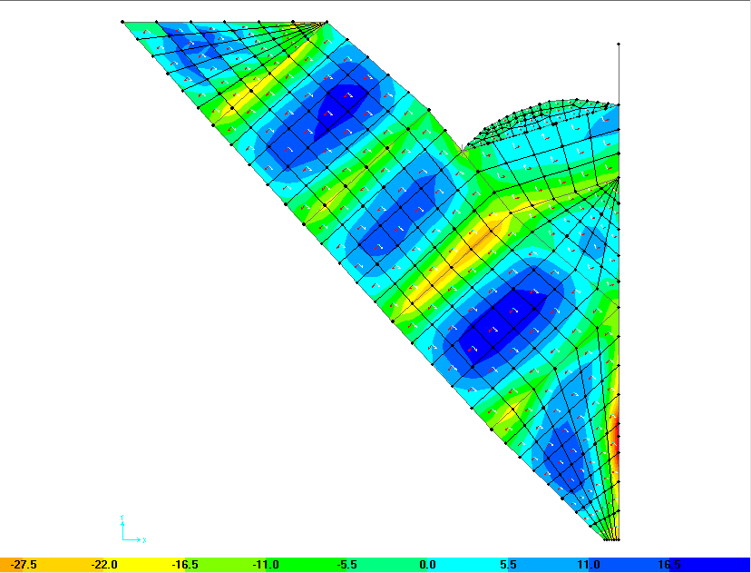
Bending moment for block2 in y-direction

Slide 41
Ribbed slab reinforcement distribution

Slide 42
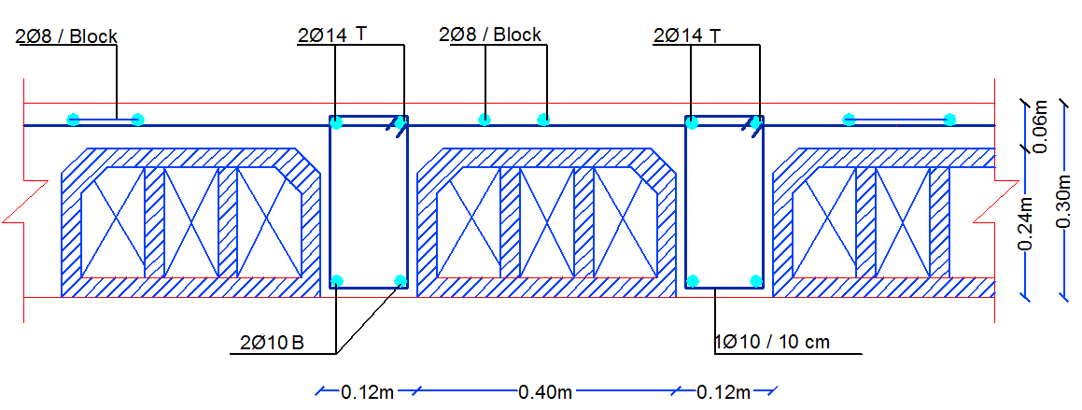
Ribbed slab reinforcement distribution

Slide 43
Beams Design

Slide 44
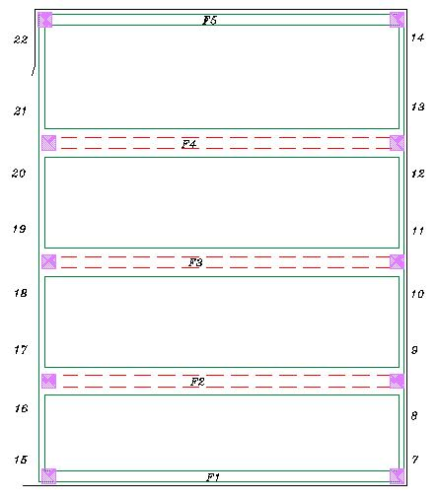
Beams layout in block 1

Slide 45
Reinforcement for all beams in block 1
Beams of Block 1
Frame | Beam |  | station | Area of steel due to moment and torsion
 |  | Dimension of beam (cm) |  | Moment |  |  |  |  |  |  |  | Shear
 |  |  |  | Area of steel(mm²) +ve |  |  |  | Area of steel(cm²) -ve |  |  |  | Av/s (mm²/mm) | # of bars
 |  |  |  | Bottom | As min | As provided | # of bars | Top | As min | As provided | # of bars
1 | 1 |  | Left | 238 | 544.5 | 544.5 | 3Φ16 | 482 | 544.5 | 544.5 | 3Φ16 | 0 | 2Φ10/15
 |  | 30×60 | Middle | 215 | 544.5 | 544.5 | 3Φ16 | 118 | 544.5 | 544.5 | 3Φ16 | 0 | 2Φ10/15
 |  |  | Right | 184 | 544.5 | 544.5 | 3Φ16 | 370 | 544.5 | 544.5 | 3Φ16 | 0 | 2Φ10/15
2 | 1 |  | Left | 227 | 544.5 | 544.5 | 3Φ16 | 459 | 544.5 | 544.5 | 3Φ16 | 0 | 2Φ10/15
 |  | 30×60 | Middle | 153 | 544.5 | 544.5 | 3Φ16 | 153 | 544.5 | 544.5 | 3Φ16 | 0 | 2Φ10/15
 |  |  | Right | 241 | 544.5 | 544.5 | 3Φ16 | 241 | 544.5 | 544.5 | 3Φ16 | 0 | 2Φ10/15
 | 2 | Outside stem = 0.7 Outside flange = 1.0 Flange thickness = 0.2 Stem thickness = 0.4 | Left | 695 | 2178 | 2178 | 7Φ20 | 1080 | 871.2 | 1080 | 4Φ20 | 0.333 | 2Φ10/30
 |  |  | Middle | 853 | 2178 | 2178 | 7Φ20 | 348 | 871.2 | 871.2 | 3Φ20 | 0 | 2Φ10/30
 |  |  | Right | 498 | 2178 | 2178 | 7Φ20 | 853 | 871.2 | 871.2 | 3Φ20 | 0.333 | 2Φ10/30
3 | 1 |  | Left | 343 | 544.5 | 544.5 | 3Φ16 | 540 | 544.5 | 544.5 | 3Φ16 | 0.05 | 2Φ10/15
 |  | 30×60 | Middle | 187 | 544.5 | 544.5 | 3Φ16 | 187 | 544.5 | 544.5 | 3Φ16 | 0.016 | 2Φ10/25
 |  |  | Right | 263 | 544.5 | 544.5 | 3Φ16 | 263 | 544.5 | 544.5 | 3Φ16 | 0 | 2Φ10/15
 | 2 | Outside stem = 0.7 Outside flange = 1.0 Flange thickness = 0.2 Stem thickness = 0.4 | Left | 608 | 2178 | 2178 | 7Φ20 | 940 | 871.2 | 940 | 3Φ20 | 0.333 | 2Φ10/30
 |  |  | Middle | 716 | 2178 | 2178 | 7Φ20 | 304 | 871.2 | 871.2 | 3Φ20 | 0 | 2Φ10/30
 |  |  | Right | 454 | 2178 | 2178 | 7Φ20 | 853 | 871.2 | 871.2 | 3Φ20 | 0.333 | 2Φ10/30

Slide 46
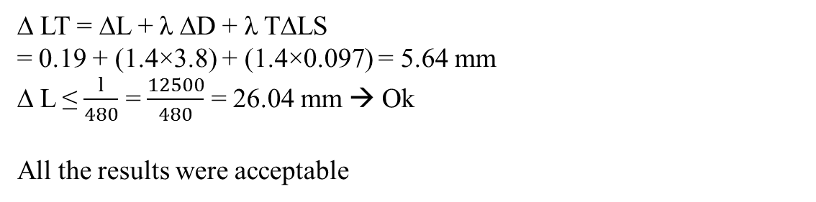
Checking deflection requirements for serviceability in block 1:
The critical beam was taken to check in block 1 (Beam 1 in Frame 2) and the results were as follows:
Deflection type | Deflection value (mm)
∆ Dead | 3.8
∆ Live | 0.19
∆ Sustain load | 0.097
∆ LT = ∆L + λ ∆D + λ T∆LS
= 0.19 + (1.4×3.8) + (1.4×0.097) = 5.64 mm
∆ L ≤ $\frac{l}{480}$ = $\frac{12500}{480}$ = 26.04 mm → Ok
All the results were acceptable

Slide 47
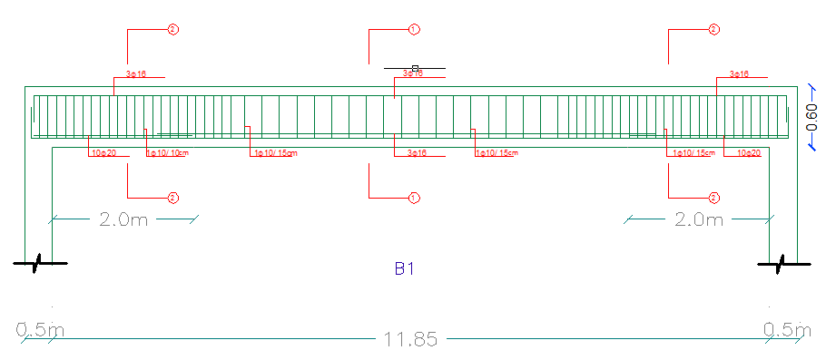
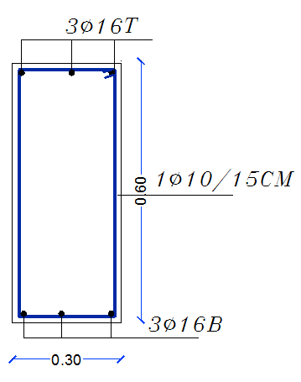
Longitudinal section in Beam 1
Sections in Beam 1

Slide 48
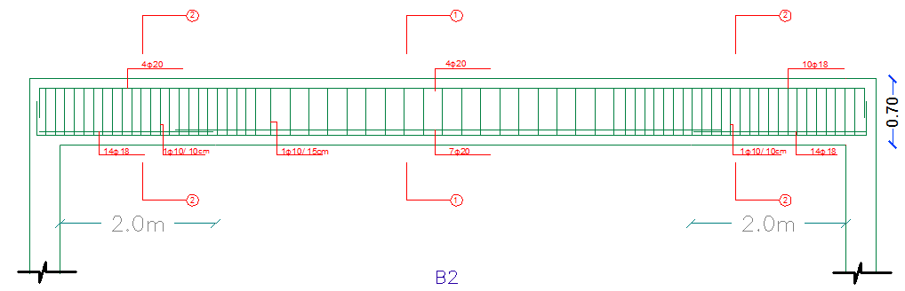
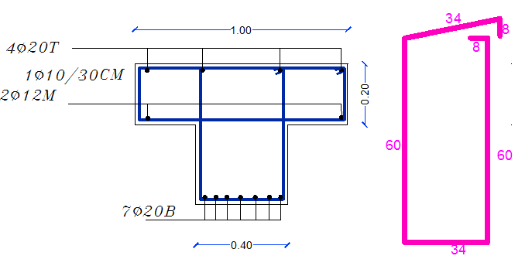
Longitudinal section in Beam 2
Sections in Beam 2

Slide 49
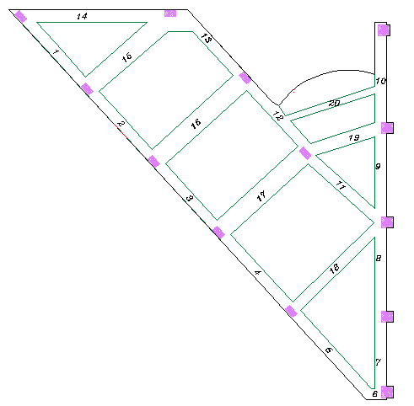
Beams layout in block 2

Slide 50
Reinforcement for all beams in block 2
Beams of Block2
Beam | Dimension of beam (cm) |  | station | Area of steel due to moment and torsion
 |  | span |  | Moment |  |  |  |  |  |  |  | Shear
 |  |  |  | Area of steel(mm²) +ve |  |  |  | Area of steel(mm²) -ve |  |  |  | Av/s (mm²/mm) | # of bars
 |  |  |  | Bottom | As min | As provided | # of bars | Top | As min | As provided | # of bars
1 | 40X30 |  | Left | 109 | 330 | 330 | 2Φ16 | 220 | 330 | 330 | 2Φ16 | 0.101 | 2Φ10/15
 |  | 1 | Middle | 181 | 330 | 330 | 2Φ16 | 63 | 330 | 330 | 2Φ16 | 0.188 | 2Φ10/15
 |  |  | Right | 126 | 330 | 330 | 2Φ16 | 254 | 330 | 330 | 2Φ16 | 0.188 | 2Φ10/15
2 | 40X30 |  | Left | 104 | 330 | 330 | 2Φ16 | 210 | 330 | 330 | 2Φ16 | 0.186 | 2Φ10/10
 |  | 2 | Middle | 146 | 330 | 330 | 2Φ16 | 54 | 330 | 330 | 2Φ16 | 0 | 2Φ10/20
 |  |  | Right | 109 | 330 | 330 | 2Φ16 | 220 | 330 | 330 | 2Φ16 | 0 | 2Φ10/10
3 | 40X30 |  | Left | 103 | 330 | 330 | 2Φ16 | 208 | 330 | 330 | 2Φ16 | 0 | 2Φ10/15
 |  | 3 | Middle | 124 | 330 | 330 | 2Φ16 | 52 | 330 | 330 | 2Φ16 | 0 | 2Φ10/20
 |  |  | Right | 104 | 330 | 330 | 2Φ16 | 209 | 330 | 330 | 2Φ16 | 0 | 2Φ10/15
4 | 40X30 |  | Left | 138 | 330 | 330 | 2Φ16 | 279 | 330 | 330 | 2Φ16 | 0 | 2Φ10/15
 |  | 4 | Middle | 182 | 330 | 330 | 2Φ16 | 69 | 330 | 330 | 2Φ16 | 0 | 2Φ10/25
 |  |  | Right | 127 | 330 | 330 | 2Φ16 | 257 | 330 | 330 | 2Φ16 | 0.186 | 2Φ10/15
5 | 40X30 |  | Left | 184 | 330 | 330 | 2Φ16 | 360 | 330 | 360 | 2Φ16 | 0.19 | 2Φ10/15
 |  | 5 | Middle | 238 | 330 | 330 | 2Φ16 | 92 | 330 | 330 | 2Φ16 | 0.102 | 2Φ10/20
 |  |  | Right | 93 | 330 | 330 | 2Φ16 | 188 | 330 | 330 | 2Φ16 | 0.005 | 2Φ10/15

Slide 51
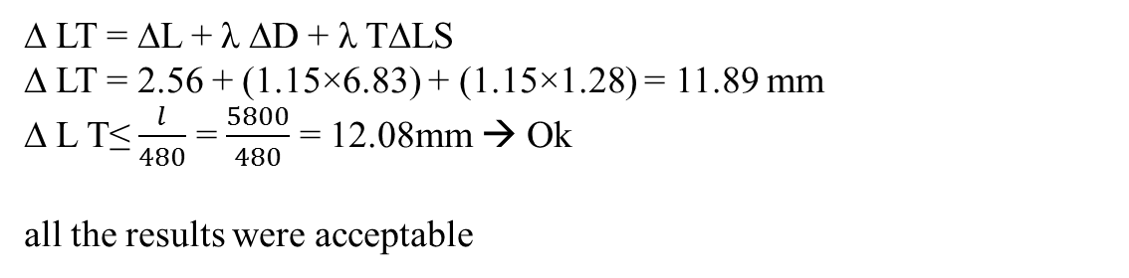
Checking deflection requirements for serviceability in block 2:
The critical beam in block 2 is beam 2 and it was taken to check.
The results were as follows:
Deflection type | Beam (mm)
∆ Dead | 6.83
∆ Live | 2.56
∆ Sustain load | 1.28
∆ LT = ∆L + λ ∆D + λ T∆LS
∆ LT = 2.56 + (1.15×6.83) + (1.15×1.28) = 11.89 mm
∆ L T≤ $\frac{l}{480}$ = $\frac{5800}{480}$ = 12.08mm → Ok
all the results were acceptable

Slide 52
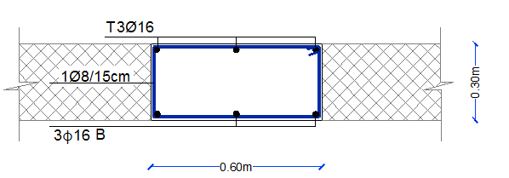
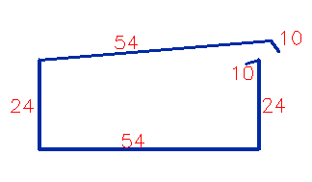
Cross section in beam 1

Slide 53
Columns Design

Slide 54
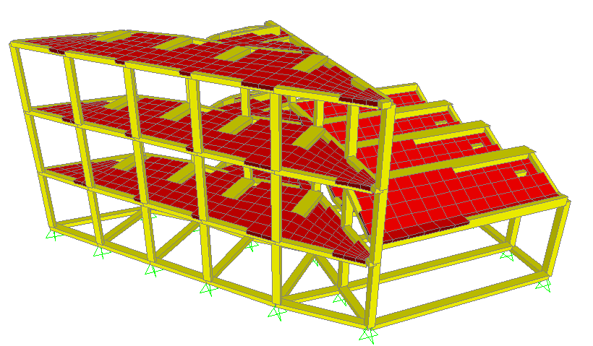
Columns are designed to carry one floor at block 1 and three floors at block 2.

Slide 55

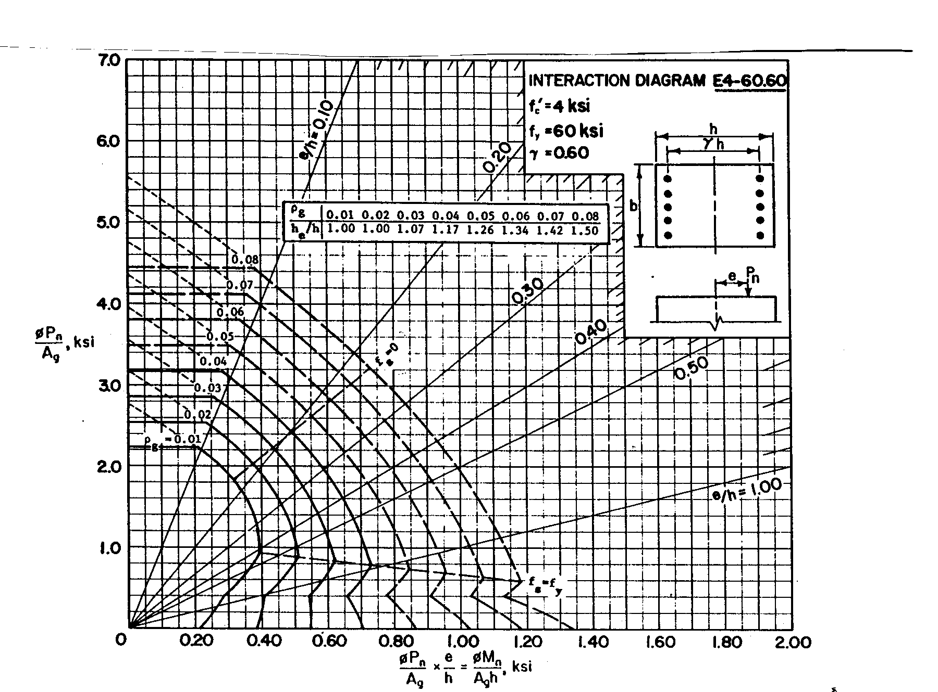
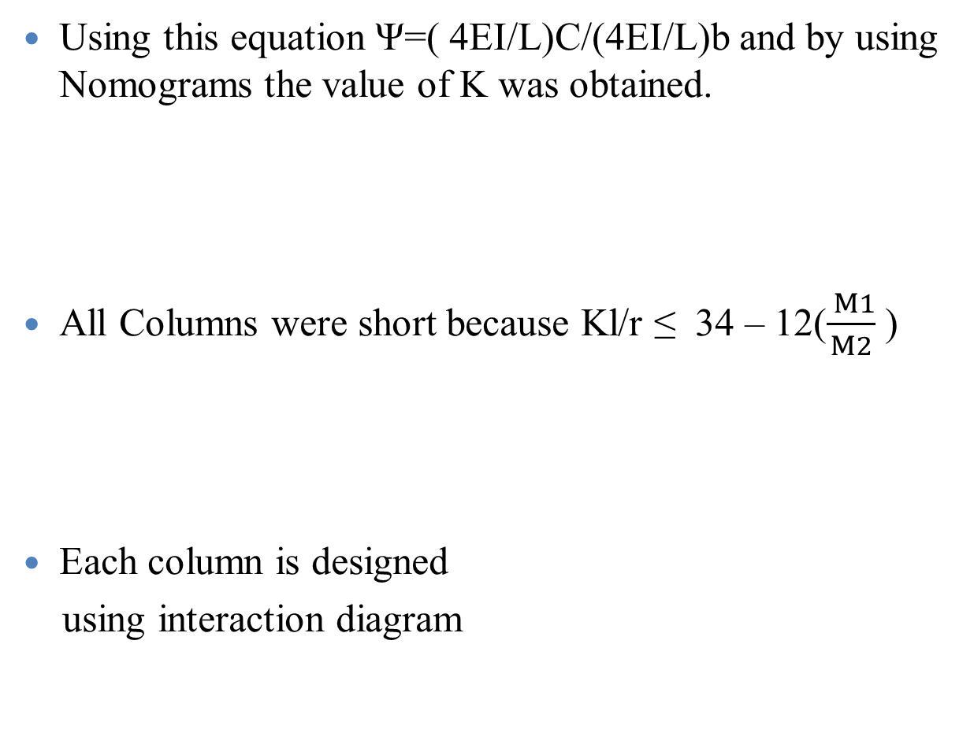
Design Requirements:
Using this equation Ψ=( 4EI/L)C/(4EI/L)b and by using Nomograms the value of K was obtained.
All Columns were short because Kl/r ≤ 34 – 12($\frac{ M1}{M2}$ )
Each column is designed
using interaction diagram

Slide 56
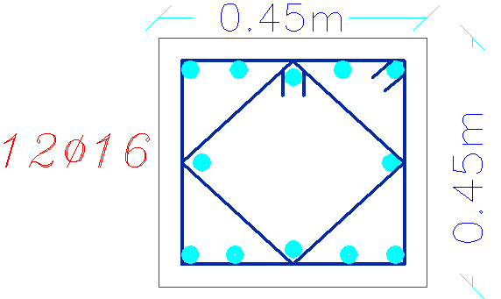
Reinforcement for all columns in block 1
No. of column | Section (cm×cm) | rebar percentage | AS (mm²) | # of bars | Ties
C1 | 45×45 | 1% | 2025 | 10Ø16 | 1Ø10/10cm
C2 | 45×45 | 1.49% | 2066 | 11Ø16 | 1Ø10/10cm
C3 | 45×45 | 1% | 2025 | 10Ø16 | 1Ø10/10cm
C4 | 45×45 | 1.12% | 2343 | 12Ø16 | 1Ø10/10cm
C5 | 45×45 | 1% | 2025 | 10Ø16 | 1Ø10/10cm
C6 | 45×45 | 1% | 2025 | 10Ø16 | 1Ø10/10cm
C7 | 45×45 | 1% | 2025 | 10Ø16 | 1Ø10/10cm
C8 | 45×45 | 1% | 2025 | 10Ø16 | 1Ø10/10cm
C9 | 45×45 | 1% | 2025 | 10Ø16 | 1Ø10/10cm
C10 | 45×45 | 1% | 2025 | 10Ø16 | 1Ø10/10cm
Section in column 1

Slide 57
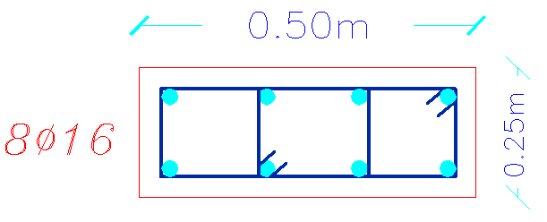
Reinforcement for all columns in block 2
No. of column | Section (cm×cm) | rebar percentage | AS (mm²) | # of bars | Ties
C11 | 25×50 | 1% | 1250 | 6Ø16 | 1Ø10/10cm
C12 | 25×50 | 1.02% | 1274 | 6Ø16 | 1Ø10/10cm
C13 | 25×50 | 1.23% | 1537 | 8Ø16 | 1Ø10/10cm
C14 | 25×50 | 1.12% | 1250 | 6Ø16 | 1Ø10/10cm
C15 | 25×50 | 1% | 1250 | 6Ø16 | 1Ø10/10cm
C16 | 25×50 | 1% | 1250 | 6Ø16 | 1Ø10/10cm
C17 | 25×50 | 1% | 1250 | 6Ø16 | 1Ø10/10cm
C18 | 25×50 | 2.69% | 3369 | 8Ø25 | 1Ø10/10cm
Section in column 2

Slide 58
Footings Design

Slide 59
Design requirements
The selected footings in this project are pile footings since the project is located in Jericho, where the soil is very poor.
Piles is designed to carry one floor at block 1 and three floors at block 2.
Based on the soil type in Jericho , the following assumptions are used:
Ø = 21˚
γ = 17 KN/m²
C = 12

Slide 60
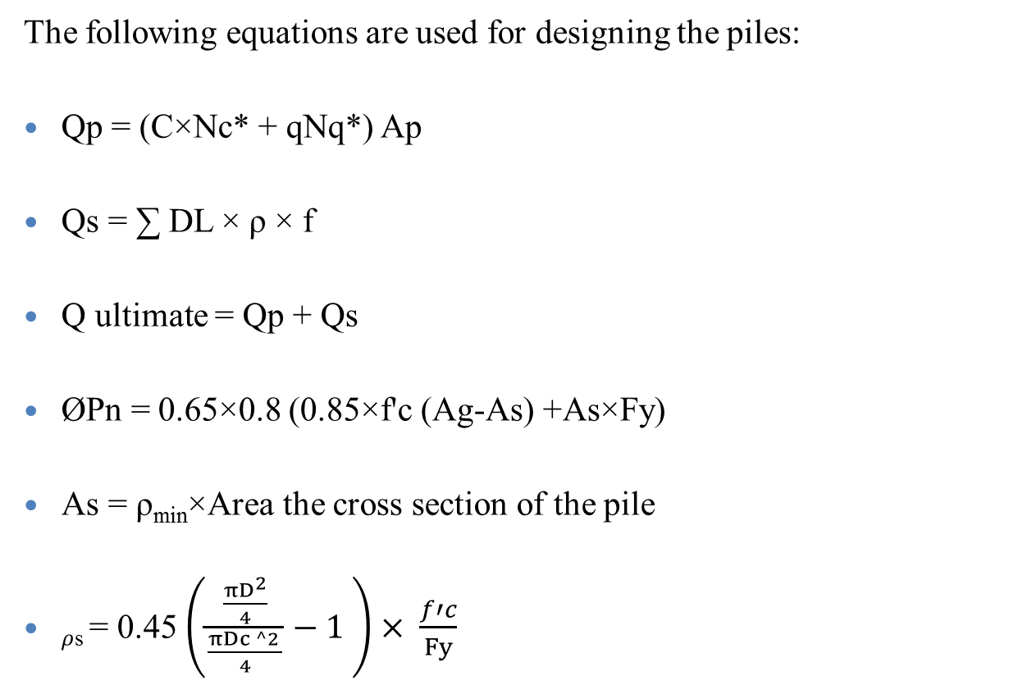
Design requirements
The following equations are used for designing the piles:
Qp = (C×Nc* + qNq*) Ap
Qs = ∑ DL × ρ × f
Q ultimate = Qp + Qs
ØPn = 0.65×0.8 (0.85×f'c (Ag-As) +As×Fy)
As = ρ_{min}×Area the cross section of the pile
$ρ$_{s} = 0.45 $\left(\frac{\frac{πD^{2}}{4}}{\frac{πDc ^2 }{4}}−1 \right)× \frac{f′c}{Fy}$

Slide 61
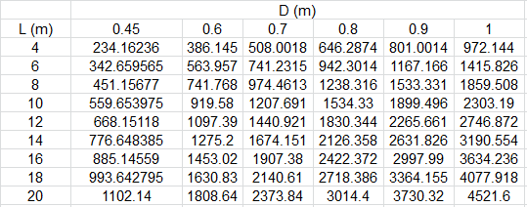
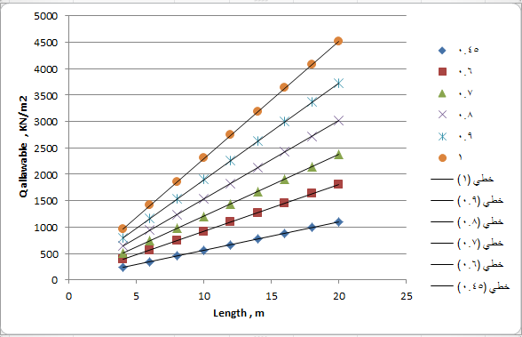
Selection of pile length & diameter
Results of Bearing capacity at different lengths and diameters
Design Chart for selecting piles

Slide 62

Piles Groups and design
Piles grouping and characteristics:
Diameter (m) | Length (m) | No. of piles | Q allowable | Pu | Group No.
0.6 | 4 | 1 | 490 | 400 | 1
0.8 | 6 | 1 | 900 | 700 | 2
0.7 | 6 | 2 | 700 | 1250 | 3
Piles groups design:

Slide 63




Design of the pile cap
Cap reinforcement | Cap depth (m) | Cap Dimensions ( m × m) | Group Number
3Ø20 | 0.6 | 0.9 × 0.9 | Group 1
4Ø20 | 0.6 | 1.1 × 1.1 | Group 2
6Ø20 | 1.2 | 1 × 3.1 | Group 3
Group 1
Group 3

Slide 64


Vertical section in Pile 1 / column 1
Horizontal section in Pile 1 / column 1

Slide 65
Seismic Load analysis

Slide 66

The structure is located in Jericho area which is classified as zone 3 according to Palestine seismic zones, in Palestine seismic zones map

Slide 67
The UBC97 code seismic parameters are as follows:
The seismic zone factor, Z= 0.3 (Table16-I)
The soil is stiff soil profile, so the soil type is S_{D}.(Table16-j)
The importance factor, I= 1.0 (Table16-k).
The ductility factor, R= 5.6 (Table16-n).
The seismic coefficient, Ca=0.36 (Table16- Q).
The seismic coefficient, Cv=0.54 (Table16-R)

Slide 68

Define response spectrum function

Slide 69

Define load cases

Slide 70

Define load case data

Slide 71

Design of Slabs for seismic load
Bending resistance: (Block.1)
M_{u-ve} = 12.5 KN.m
As =360 mm²
Use 3 Ф 14/m
M_{u+ve} = 13.6 KN.m
As =360 mm²
Use 3 Ф 14/m

Slide 72

Design of Slabs for seismic load
Bending resistance: (Block.2)
M_{u-ve} = 30.5 KN.m
As =369 mm²
Use 2 Ф 16
M_{u+ve} = 16.5 KN.m
As = 64.8 mm²
Use 2 Ф 10

Slide 73



Design of Beams for seismic load
Block 2 : (Beam2)
M_{u-ve} = 187.25 KN.m
As = 2088.3 mm²
Use 11Ø16
M_{u+ve} = 117.1 KN.m
As = 1266 mm²
Use 7Ø16
Shear diagram
Use 1 Ф10/10 cm

Slide 74



Design of Beams for seismic load
Block 1 : (Frame2/Beam1)
M_{u-ve} = 72.5 KN.m
As = 554.4 mm²
Use 4Ø16
M_{u+ve} = 26 KN.m
As = 554.4 mm²
Use 3Ø16
Shear diagram
Use 1 Ф10/25 cm

Slide 75

We are glad
to hear
your comments
& questions
about the
presentation
Khawla
Noor
Rema’
☺

