Slide 1



OPTIFORK
Autonomous Warehouse Robot
Ali Turabi | Anas Ismail
Supervisor: Dr. Samer Mayaleh

Slide 2
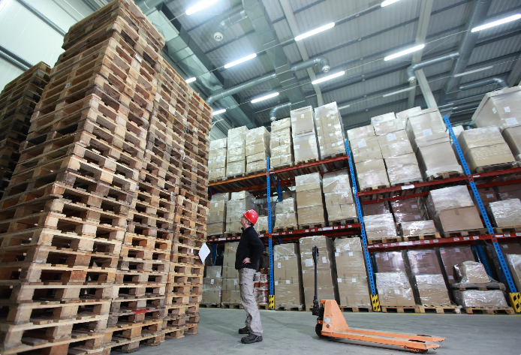
Problem Statement
  Manual warehouse item retrieval is slow and inefficient

Slide 3
Problem Statement
  Manual warehouse item retrieval is slow and inefficient
  High dependence on human labor increases errors and fatigue

Slide 4
Problem Statement
  Manual warehouse item retrieval is slow and inefficient
  High dependence on human labor increases errors and fatigue
  Inventory tracking is often inaccurate

Slide 5
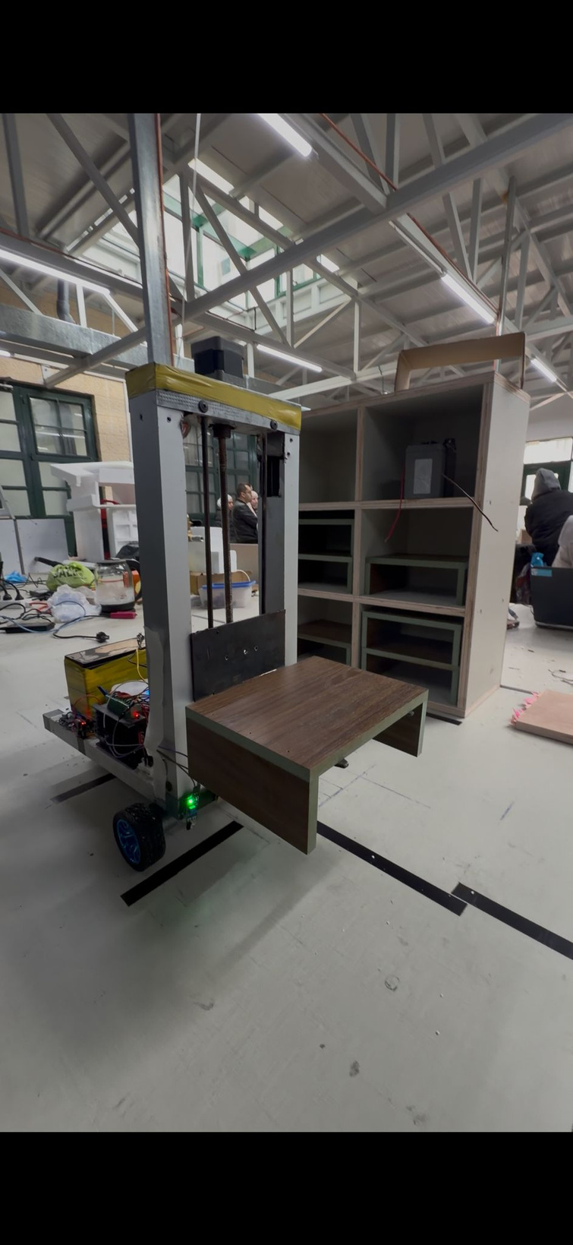
Proposed Solution – OptiFork
  Autonomous mobile warehouse robot.

Slide 6
Proposed Solution – OptiFork
  Autonomous mobile warehouse robot.
  Receives digital requests from a manager.

Slide 7
Proposed Solution – OptiFork
  Autonomous mobile warehouse robot.
  Receives digital requests from a manager.
  Navigates, retrieves items, and returns automatically.

Slide 8
Proposed Solution – OptiFork
  Autonomous mobile warehouse robot.
  Receives digital requests from a manager.
  Navigates, retrieves items, and returns automatically.
  Updates inventory after each operation

Slide 9
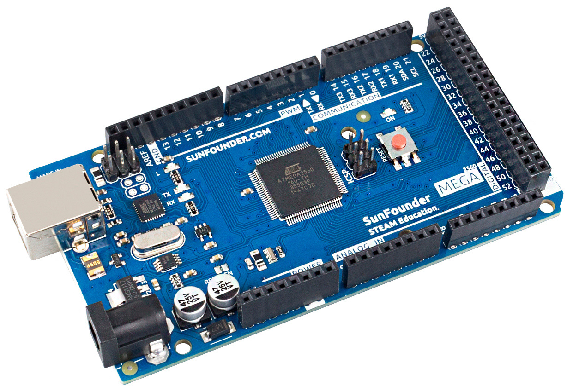
Components
Controllers Selection
Arduino Mega
  Real-time control of motors and sensors
  Large number of I/O pins
  Deterministic timing for control tasks

Slide 10
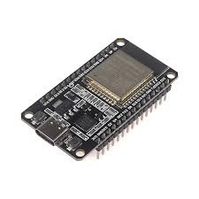
Components
Controllers Selection
ESP32
  WiFi communication
  Web-based user interface
  Inventory and job management

Slide 11
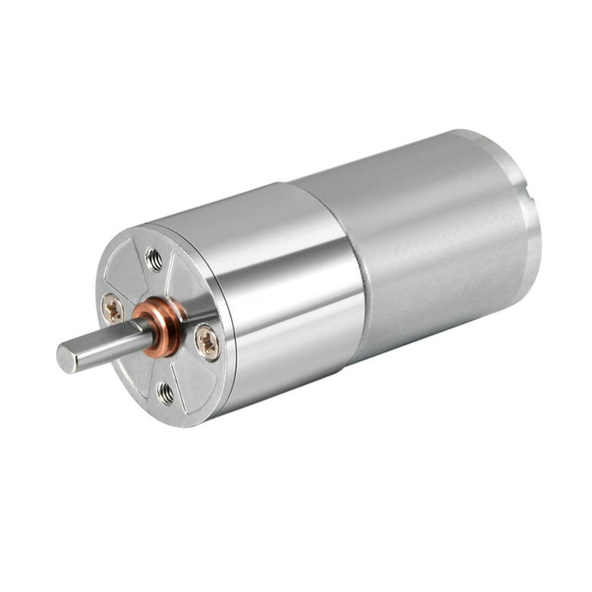
Components
Motors & Mechanical Design
Gearbox DC Motors
  High torque with low current
  Better efficiency than direct DC motors

Slide 12
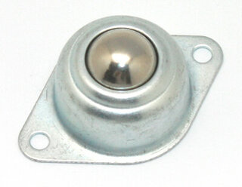
Components
Motors & Mechanical Design
Caster Wheel
  Improves balance and stability
  Enables smooth turning and direction correction

Slide 13
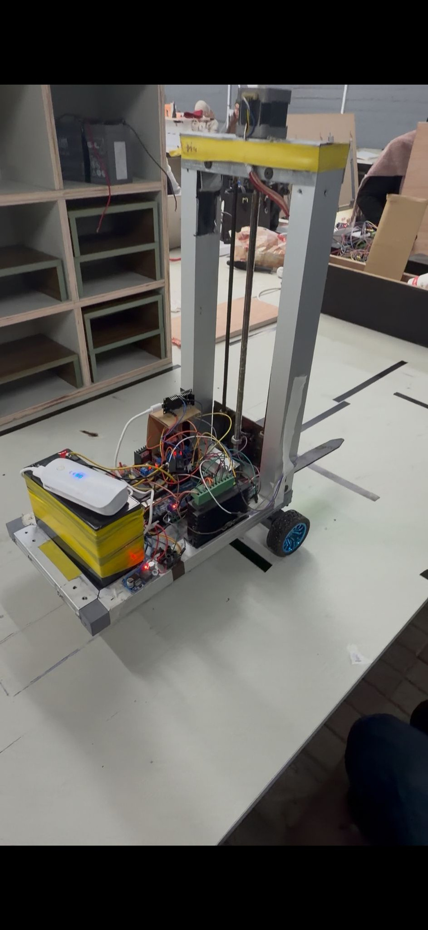
Components
Motors & Mechanical Design
Scaled Dimensions
  Robot dimensions derived from a real forklift using ratios.

Slide 14
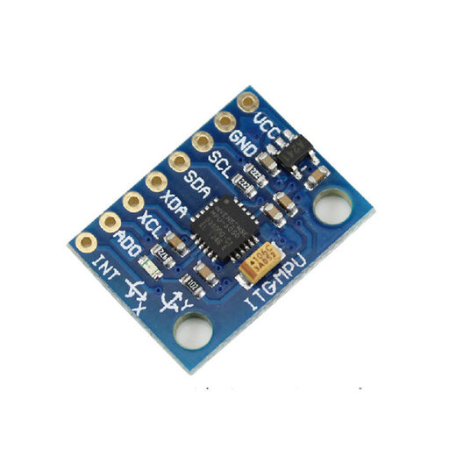
Components
Sensors and Fork Mechanism
MPU6050
  Maintains straight driving
  Enables accurate 90° and 180° rotations

Slide 15
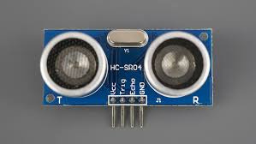
Components
Sensors and Fork Mechanism
Ultrasonic Sensor
  Distance measurement and stopping points

Slide 16
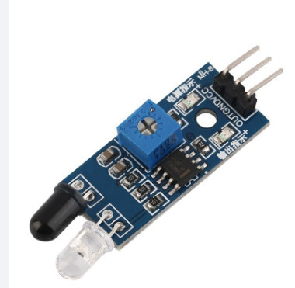
Components
Sensors and Fork Mechanism
IR Sensors
  Shelf and marker detection

Slide 17
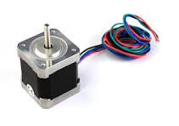
Components
Sensors and Fork Mechanism
Stepper Motor
  Precise fork height control (e.g. 5 cm accuracy)

Slide 18
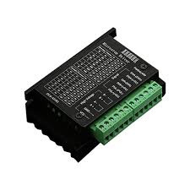
Components
Sensors and Fork Mechanism
TB6600 Driver
  Accurate and reliable step control.

Slide 19
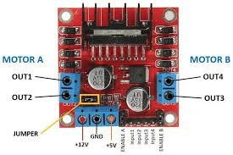
Components
Sensors and Fork Mechanism
H-bridge
  control the DC motors

Slide 20
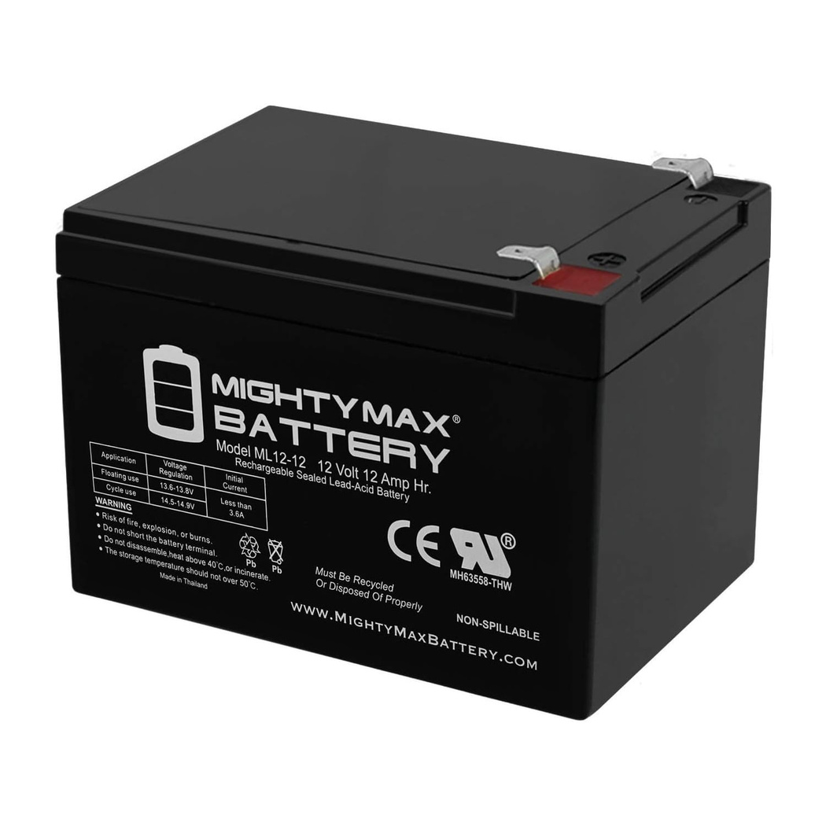
Components
Power Distribution
12V Battery
  Powers motors and main system

Slide 21
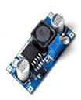
Components
Power Distribution
12V → 5V Converter
  Supplies sensors and MPU
  Prevents Arduino Mega overload
  Improves system stability

Slide 22
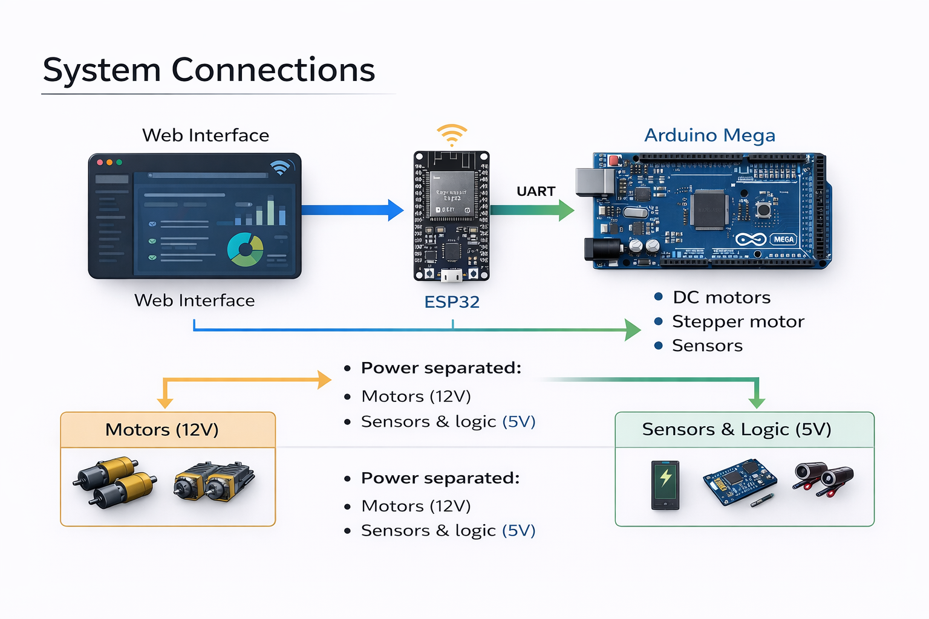
System Connections

Slide 23
Challenges & Solutions
  Robot drift
  Sensor noise
  Fork height accuracy
  Power instability

Slide 24
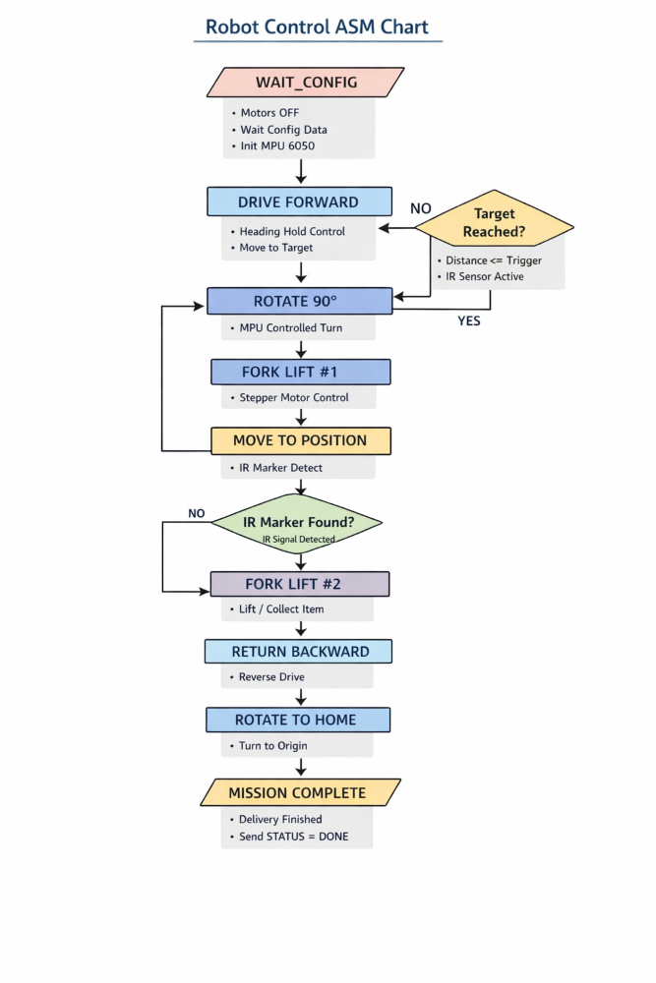
Control Algorithm

Slide 25

Conclusion
  Low-cost autonomous solution
  Flexible and scalable design
  Strong hardware–software integration

Slide 26

Future Work
  AI-based navigation
  LiDAR + SLAM
  Camera vision
  Self-adaptive control
  Multi-robot coordination

Slide 27


