Slide 1
Mechanical Systems for
Al-Basateen Trading Center
Supervisor
Ins.RamezKhaldi
Luay A. Aghbar (10715641)
Husni H. Malysha (10824938)
Mohammad S. Ahmad (10825466)
Yousif F.Abdi (10821885)
May 2013

Slide 2
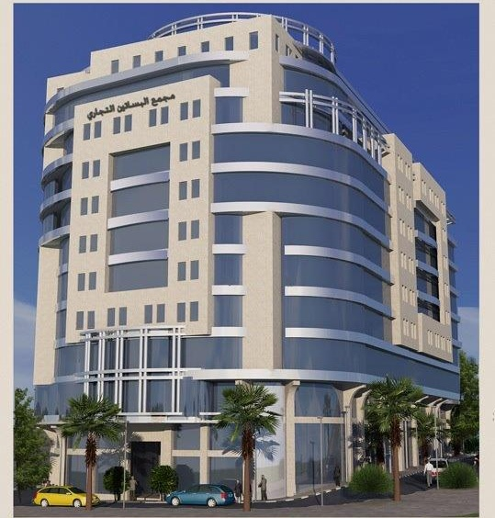

Slide 3
Building Description
Al-Basateen Trading Center located in city downtown , Nablus city. It evaluate 533 meter above of the sea level. The building face sits at the west north orientation where the wind speed greater than 5 m/s.
Al-Basateen Trading Center consists of nine floors; each floor has approximately 1550 m².

Slide 4
Inside and Outside Design condition
Palestine in general divided into six climatology regions. Nablus sit in forth region according to the Palestinian code . The parameters design is shown in table
Parameters | T_{in} | T_{o} | T_{un} | T_{g} | Φ_{in} | Φ_{out} | W_{in} | W_{out}
Winter | 22 | 4.7 | 31 | 9.7 | 30% | 70% | 4.9 | 3.7
Summer | 24 | 30 | 28 | 29 | 60% | 52% | 11.2 | 13.9

Slide 5

Overall heat transfer coefficient, U_{overall}
Overall heat transfer coefficient depends on the construction of the unit.
The Uoverall is given by
U= $\frac{1}{Rtot}$
$Rtot$= Ri+ R+ Ro
R= ∑ $\frac{x}{k}$

Slide 6
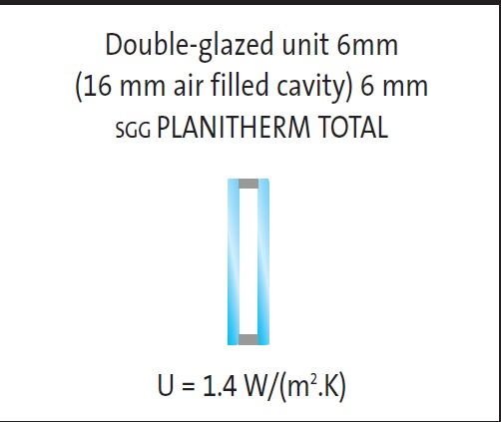
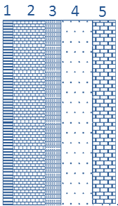
External walls
The external walls consists mainly from glass. There are some areas has a different construction consists of five different materials
 | construction | Thickness X (m) | Thermal conductivity K (w/m.C)
1 | Plaster | 0.03 | 1.2
2 | Cement brick | 0.1 | 0.95
3 | insulation | 0.03 | 0.04
4 | Concrete | 0.10 | 1.75
5 | Stone | 0.07 | 1.7

Slide 7
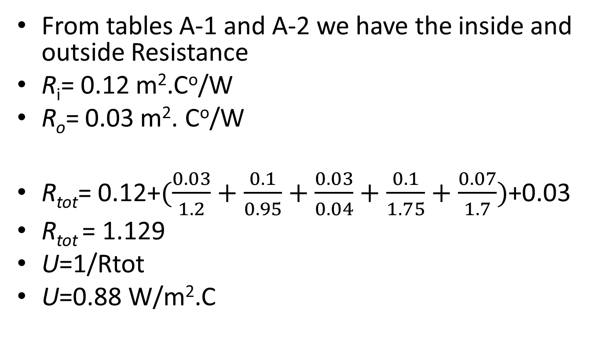
External walls

Slide 8
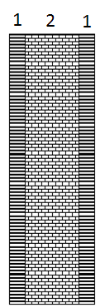
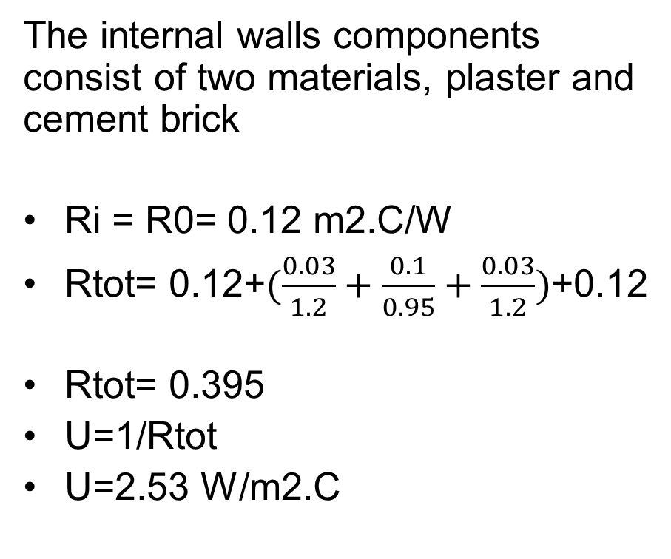
Internal walls
 | Construction | Thickness[m] | Thermal conductivity k[w/m.C)
1 | Plaster | 0.06 | 1.2
2 | Cement brick | 0.1 | 0.95
The internal walls components consist of two materials, plaster and cement brick
Ri= R0= 0.12 m­2.C/W
Rtot= 0.12+$(\frac{0.03}{1.2}+\frac{0.1}{0.95}+\frac{0.03}{1.2})$+0.12
Rtot= 0.395
U=1/Rtot
U=2.53 W/m2.C

Slide 9
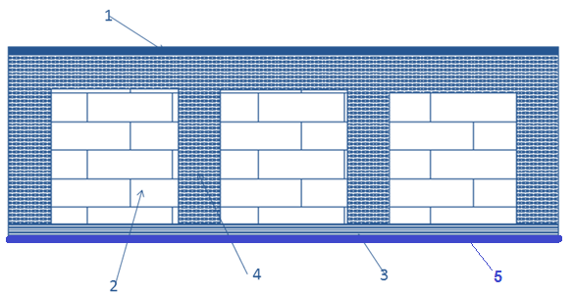
Ceiling
The ceiling wall construction consists of four different materials
Layer Number | Construction | Thickness X(m) | Thermal conductivity K
1 | Asphalt mix | 0.02 | 0.7
4 | Concrete | 0.05 | 1.75
2 | Cement brick | 0.18 | 0.95
3 | Insulation | 0.02 | 0.04
4 | Concrete | 0.06 | 1.75
5 | Plaster | 0.02 | 1.2

Slide 10
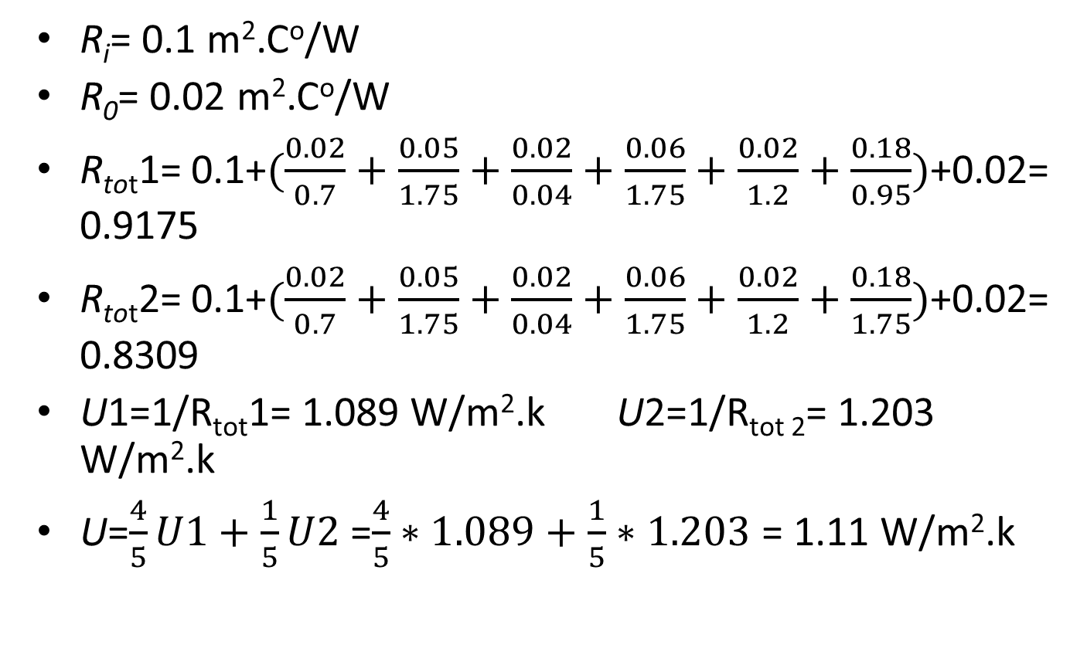
Ceiling
R_{i}= 0.1 m­².Cº/W
R₀= 0.02 m­².Cº/W
R_{tot}1= 0.1+$(\frac{0.02}{0.7}+\frac{0.05}{1.75}+\frac{0.02}{0.04}+\frac{0.06}{1.75}+\frac{0.02}{1.2}+\frac{0.18}{0.95})$+0.02= 0.9175
R_{tot}2= 0.1+$(\frac{0.02}{0.7}+\frac{0.05}{1.75}+\frac{0.02}{0.04}+\frac{0.06}{1.75}+\frac{0.02}{1.2}+\frac{0.18}{1.75})$+0.02= 0.8309
U1=1/R_{tot}1= 1.089 W/m².kU2=1/R_{tot 2}= 1.203 W/m².k
U=$\frac{4}{5}U1+\frac{1}{5}U2$ =$\frac{4}{5}∗1.089+\frac{1}{5}∗1.203$ = 1.11W/m².k

Slide 11
summary of overall heat transfer coefficient for each element
Type | Overall heat transfer coefficient w/m2.K
Outside wall | Glass walls 1.4
 | Construction 0.88
internal wall | 2.53
Ceiling | 1.11
Glass | 6.7
Steel door | 5.8
Wood door | 1.5

Slide 12
HVAC SYSTEM :
Heating load calculation

Slide 13
Heating load sources :
1- Walls
2- Roofs
3- Windows
4- Doors
5- Basement Walls Basement Floors
6- Infiltration Ventilation

Slide 14
Heating load results for each floor:
Floors | Heating Load KW
Second Basment | 0
First Basement | 0
Ground Floor 1 | 82.6
Ground Floor 2 | 67.5
First floor | 69.8
Second floor | 50.8
Third floor | 51.4
Forth floor | 42.8
Fifth Floor | 42.8
Sixth floor | 42.8
Seventh floor | 42.8
Eighth floor | 60.7

Slide 15
Ex. of heating load for 4th floor each room:
4th floor | Heating load(W)
office1 | 2696.8
office2 | 3270.6
office3 | 2867
office4 | 2643
reception | 3472.6
office6 | 2655.2
office7 | 2896.6
office8 | 2344.4
office9 | 2376
office10 | 2796
office11 | 3588.6
office12 | 3606.2
office13 | 3326.8
office14 | 3003.6
service | 1269.2

Slide 16
Cooling load calculation:

Slide 17
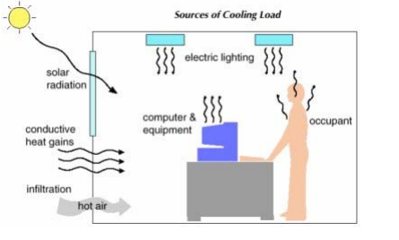
Sources of cooling load

Slide 18
Cooling load factors:
Values of CLTD, LM, K, and CLTDcorr
 | west | east | north | south | Roof
CLTD | 9 | 16 | 6 | 11 | 16
LM | 0 | 0 | 0.5 | -2.2 | 1.1
K | 0.65 | 0.65 | 0.65 | 0.65 | 0.5
(CLTD)corr | 7.95 | 12.5 | 6.325 | 7.82 | 10.65

Slide 19
SHG, SC, CLF, CLTD FOR glass.
 | West | East | North | South
SHG | 675 | 675 | 139 | 189
SC | 0.64 | 0.64 | 0.64 | 0.64
CLF | 0.49 | 0.24 | 0.7 | 0.43
CLTD | 8 | 8 | 8 | 8

Slide 20
CLF values:
 | Cooling load factor (CLF)
Occupants | 0.84 from (A-11)
Lighting | 0.84 from (A-12)
Equipments | 0.87 from (A-17)

Slide 21
Total cooling load:
Floors | Sensible Cooling | Latent Cooling | Total Cooling Load KW
Second Basment | 0 | 0 | 0
First Basment | 0 | 0 | 0
Ground Floor 1 | 105.9 | 15.4 | 121.3
Ground Floor 2 | 94.6 | 13.9 | 108.5
First floor | 87.5 | 16.8 | 104.3
Second floor | 89.2 | 18.1 | 107.3
Third floor | 73.7 | 16.4 | 90.1
Forth floor | 60.2 | 11.2 | 71.4
Fifth Floor | 60.2 | 11.2 | 71.4
Sixth floor | 60.2 | 11.2 | 71.4
Seventh floor | 60.2 | 11.2 | 71.4
Eighth floor | 79.8 | 9.6 | 89.4

Slide 22
Exp. Of cooling load for 4th floor:
4th floor | Total cooling | Total sensible
office1 | 5239.759 | 4825.759
office2 | 3584.397 | 2756.397
office3 | 3002.068 | 2312.068
office4 | 3585.709 | 2895.709
reciption | 10700.02 | 9872.021
office6 | 5452.975 | 4486.975
office7 | 5377.255 | 4549.255
office8 | 7646.64 | 7094.64
office9 | 3718.813 | 3028.813
office10 | 3187.661 | 2497.661
office11 | 3429.819 | 2601.819
office12 | 3389.783 | 2423.783
office13 | 4642.927 | 3538.927
office14 | 6273.137 | 5445.137
service | 2165.445 | 1889.445

Slide 23
VRV system
The design by using the tools of daikin company xpress

Slide 24
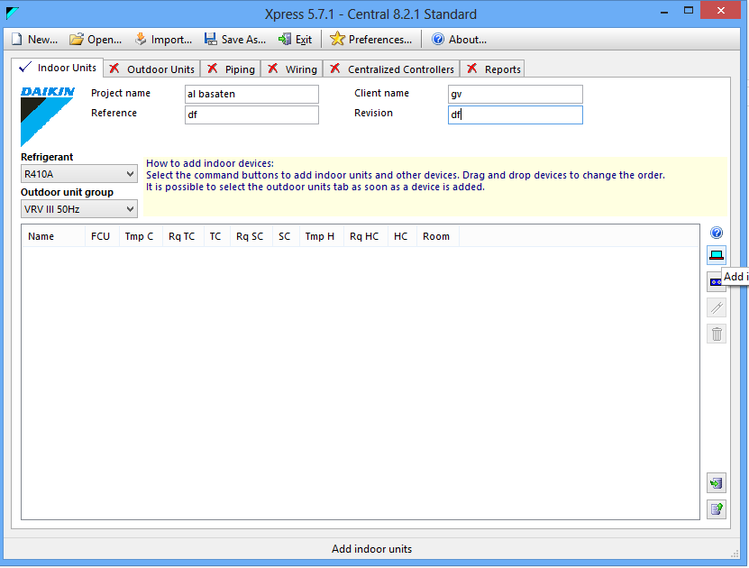

Slide 25
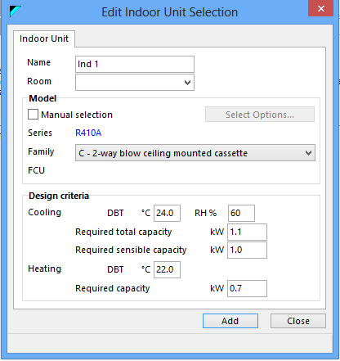

Slide 26
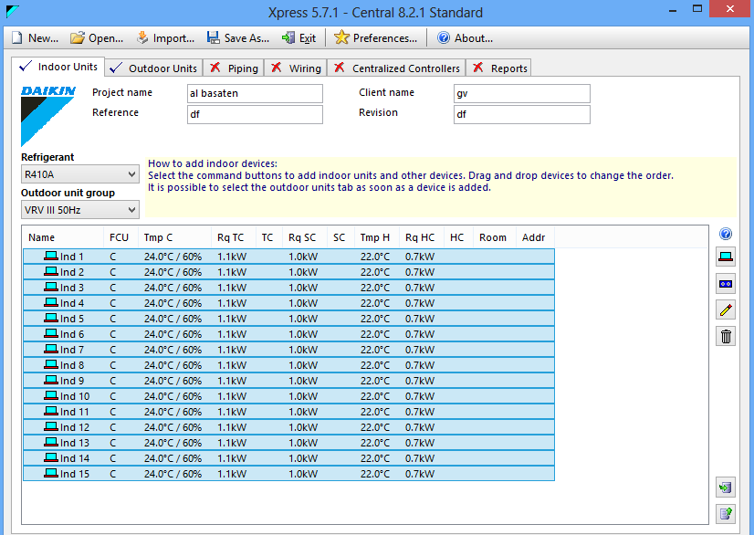

Slide 27
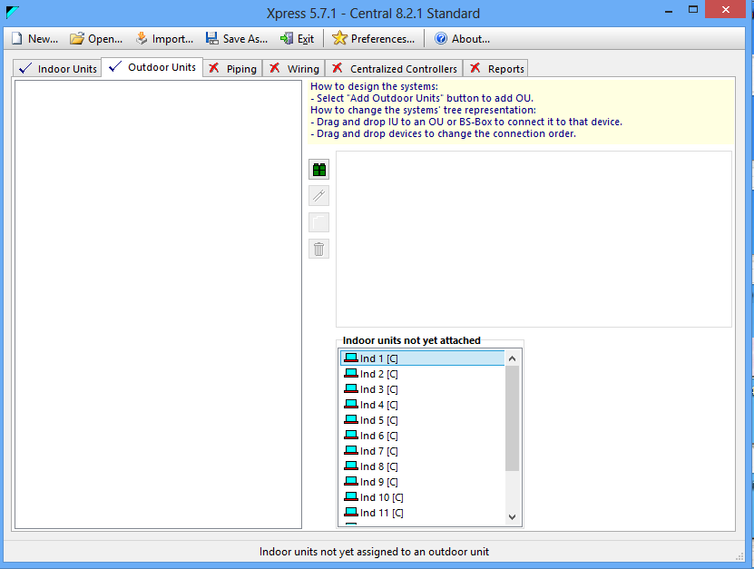

Slide 28
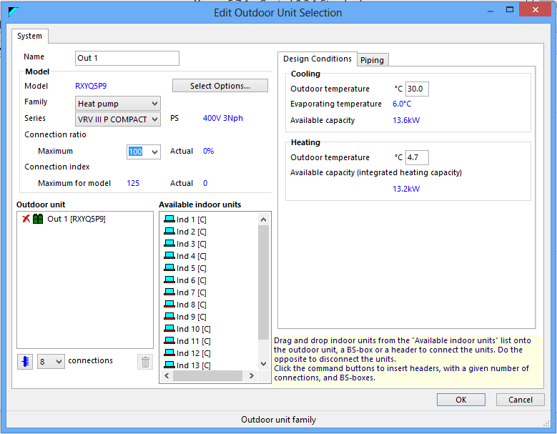

Slide 29
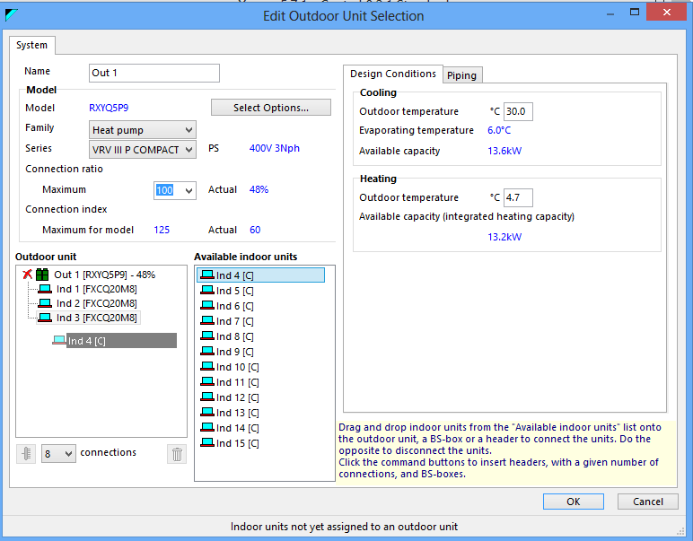

Slide 30
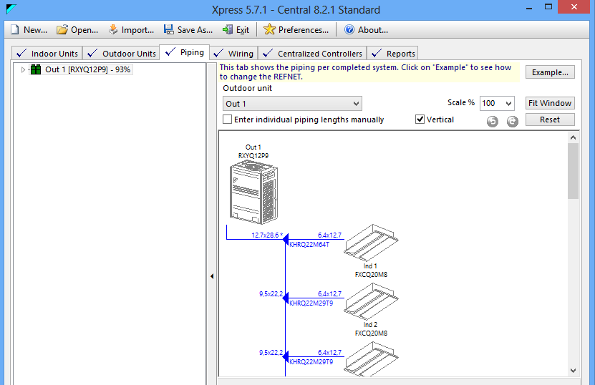

Slide 31
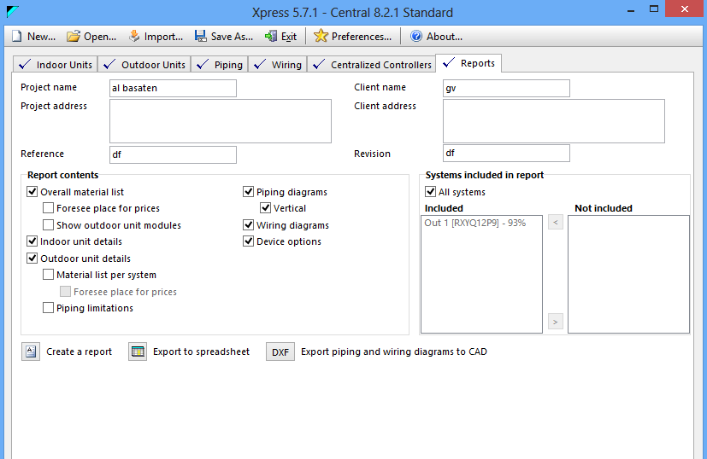

Slide 32
Result from report exp. In 4th floor
1)quantity results
Model | Qty | Description
RXYQ44P8 | 1 | Heat pump VRV III P COMPACT
FXCQ32M8 | 1 | C - 2-way blow ceiling mounted cassette
FXMQ100P7 | 1 | M - Concealed ceiling unit (large)
FXMQ125P7 | 1 | M - Concealed ceiling unit (large)
FXMQ200MA | 1 | M - Concealed ceiling unit (large)
FXMQ40P7 | 5 | M - Concealed ceiling unit (large)
FXMQ50P7 | 2 | M - Concealed ceiling unit (large)
FXMQ63P7 | 1 | M - Concealed ceiling unit (large)
FXMQ80P7 | 3 | M - Concealed ceiling unit (large)
KHRQ22M20T | 1 | REFNET branch piping kit
KHRQ22M29T9 | 2 | REFNET branch piping kit
KHRQ22M64T | 4 | REFNET branch piping kit
KHRQ22M75T | 7 | REFNET branch piping kit
BHFQ22P1517 | 1 | Outdoor unit multi connection piping kit for 3 outdoors

Slide 33
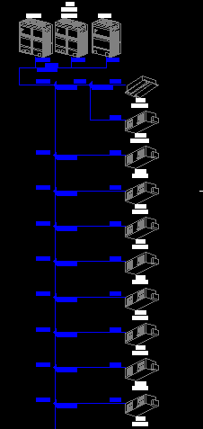
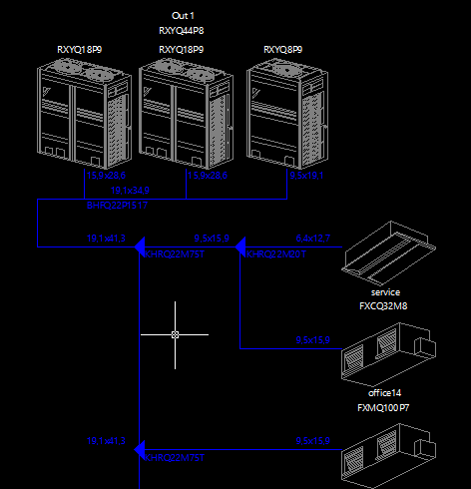

Slide 34
2)Ventilation results
Name | FCU | Airflow
 |  | cfm
service | FXCQ32M8 | 318
office14 | FXMQ100P7 | 1130
office13 | FXMQ63P7 | 689
office12 | FXMQ40P7 | 565
office1 | FXMQ80P7 | 883
office2 | FXMQ40P7 | 565
office11 | FXMQ40P7 | 565
office3 | FXMQ40P7 | 565
office10 | FXMQ40P7 | 565
office4 | FXMQ50P7 | 636
office9 | FXMQ50P7 | 636
reciption | FXMQ200MA | 2048
office6 | FXMQ80P7 | 883
office7 | FXMQ80P7 | 883
office8 | FXMQ125P7 | 1377

Slide 35
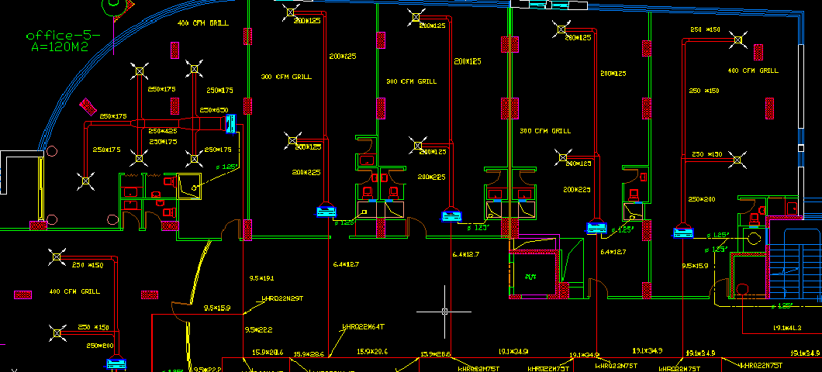

Slide 36
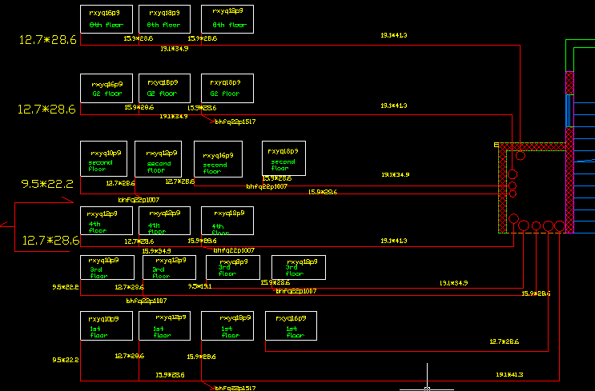

Slide 37
Ventilation system

Slide 38
Fresh air value for each floor
Floors | Vent ( CFM )
Second Basement | 12588
First Basement | 12914
Ground Floor 1 | 3517
Ground Floor 2 | 3221
First floor | 3502
Second floor | 3308
Third floor | 3203
Forth floor | 1980
Fifth Floor | 1980
Sixth floor | 1980
Seventh floor | 1980
Eighth floor | 1980

Slide 39
Exp. Fresh air for each room
4th floor
rooms | L/S | CFM0
office1 | 60 | 132
office2 | 60 | 132
office3 | 50 | 110
office4 | 50 | 110
reciption | 60 | 132
office6 | 70 | 154
office7 | 60 | 132
office8 | 60 | 132
office9 | 50 | 110
office10 | 50 | 110
office11 | 60 | 132
office12 | 70 | 154
office13 | 80 | 176
office14 | 60 | 132
service | 60 | 132

Slide 40
Fans calculation and selections
Fan | CFM | P | M3/hr | Model No
For Basements Fresh air | 25500 | 130Pa | 41434 | HRZS07-710
For Basement Exhaust air | 26650 | 140pa | 43303 | HRZS07-710
For All other floors fresh air | 26650 | 140pa | 43303 | HRZS07-710
For All floors Bathroom Exhaust air | 100 | 40pa | 43303 | R 125 STAHL

Slide 41
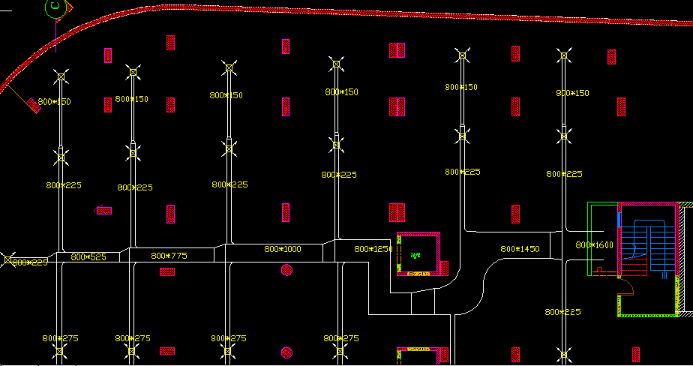
Basement2 floor fresh air

Slide 42
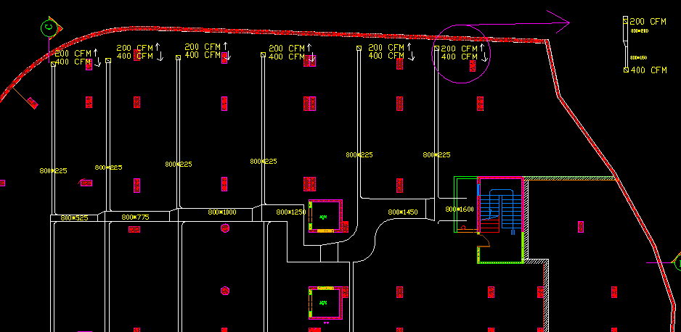
Basement floor exhaust

Slide 43
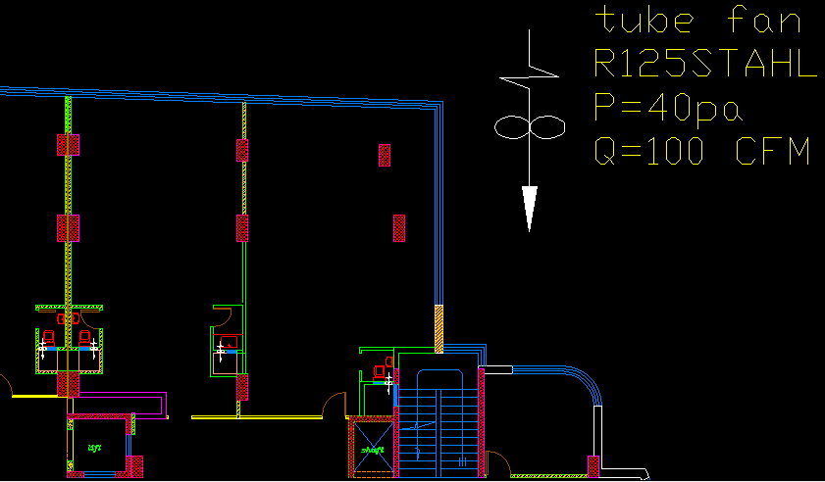
Tube fan for bathroom exhaust

Slide 44
Potable water system

Slide 45
Hot water system: hot water plumping fixture unit in building:
Size of pipe (in) | No. of fixture | Type of fixture
3/8 | 1.5 | Lavatory
1/2 | 2.25 | Service sink

Slide 46
Hot water flow rate and pipe size for the main pipe that entered to each floor:
Floor name | Total F.U | flow rate (L/S) | Pipe Size ( in )
ground floor1 | 15 | 1.105 | 1
ground floor2 | 15 | 1.105 | 1
first floor | 39 | 1.64 | 1.25
second floor | 34.5 | 1.57 | 1.25
third floor | 33.75 | 1.54 | 1.25
fourth floor | 50.25 | 1.85 | 1.25
fifth floor | 50.25 | 1.85 | 1.25
sixth floor | 50.25 | 1.85 | 1.25
seventh floor | 50.25 | 1.85 | 1.25
eighth floor | 50.25 | 1.85 | 1.25
Total fixture unit in the building= 389

Slide 47
Distribution of steel Hot water pipe supply in ground floor:
Name | service sink | lav. | Total F.U | flow rate (L/S) | Pipe Size ( in )
collector 1 | 0 | 4 | 6 | 0.68 | 0.75
collector 2 | 0 | 6 | 9 | 0.86 | 1

Slide 48
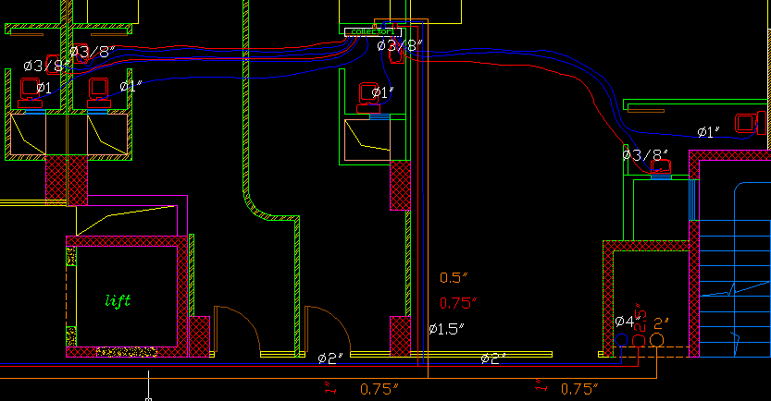

Slide 49
Riser sizing:
Name | Total F.U | flow rate (L/S) | Pipe Size ( in )
Basement2_G1 | 389 | 6.48 | 2.5
G2 | 374 | 6.29 | 2.5
1st | 358.5 | 6.09 | 2.5
2nd | 319.5 | 5.59 | 2.5
3rd | 285 | 5.17 | 2
4th | 251.25 | 4.74 | 2
5th | 201 | 4.11 | 2
6th | 150.75 | 3.45 | 2
7th | 100.5 | 2.74 | 1.5
8th | 50.25 | 1.84 | 1.25

Slide 50
Pump selection:
Name | P ( Kpa )
P residual | 34
Phead | 353
Pfri+fiting | 24
Total Head | 411
P pump= | 411 KP
Q pump= | 6.48 L/s
From wilo company we select circulating pump NL 40/200-5.5

Slide 51
Boiler cylinder circulating pump:
Q= 6.8 L/s (same to the building flow rate pump because it depend on boiler capacity)
P=6.75 m
From WILO we select a circulating pump model number IBL 50/115-0.75/2

Slide 52
Boiler selection:
From IPC code :for office and stories we need 4L/person/day
 | person | Water needed(L/person)
G1 | 179 | 716
G2 | 179 | 716
1st | 194 | 776
2nd | 185 | 740
3rd | 179 | 716
4th | 83 | 332
5th | 83 | 332
6th | 83 | 332
7th | 83 | 332
8th | 83 | 332
Total domestic hot water=5324 L
From PARKER HOT WATER BOILER We select the model T1460 with capacity of 288 KW.

Slide 53
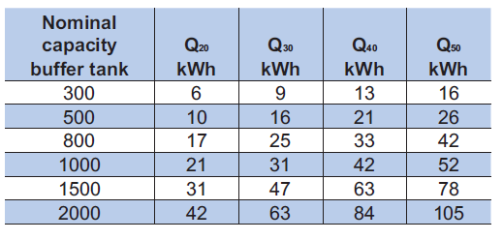
Storage tank (cylinder) selection: the selection is depend on boiler capacity(288KW) this table from catalogue :
A 3 hot water cylinder are selected with capacity of 2000 liters
( 2 *Q50 + 1 * Q40).

Slide 54
Expansion tank selection: depend on boiler capacity and this table from IPC cod
Boiler capacity(KW) | Tank volume(L)
29 | 100
58 | 200
87 | 250
116 | 500
190 | 750
280 | 1000
From aqua system company
we selected a VBV series 1000 liters expansion tank

Slide 55
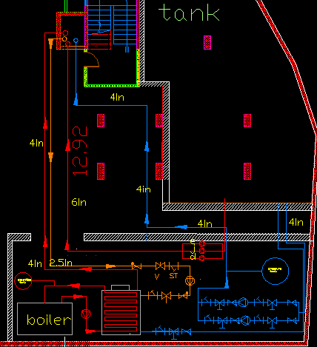
In the mechanical room you can see All of last component
*volume of domestic cold water tank 18 M3/day for 3 day 54 M3
*volume of fire fighting tank for 90 min.=255 m^3
*Total volume of the tank=310 m^3

Slide 56
Potable Water
Cold Water

Slide 57
Plumbing System in Building
There are many type of fixture that used in the building and there size of every pipe in the fixture are establishing from the international standard code
The specification for each fixture in the building is public usage and flush valve.
Size of pipe (in) | No. of fixture | Type of fixture
1/2 , 3/8 | 10 | Water closet ( w .c )
1/2 , 3/8 | 1.5 | Lavatory
1/2 | 2.25 | Service sink

Slide 58
Cold water The Total fixture units in building
 | service sink | lav. | WC | Total F.U
ground floor1 | 0 | 10 | 10 | 115
ground floor2 | 0 | 10 | 11 | 125
first floor | 2 | 23 | 23 | 269
second floor | 2 | 20 | 19 | 224.5
third floor | 1 | 21 | 20 | 233.75
fourth floor | 13 | 14 | 14 | 190.25
fifth floor | 13 | 14 | 14 | 190.25
sixth floor | 13 | 14 | 14 | 190.25
seventh floor | 13 | 14 | 14 | 190.25
eighth floor | 13 | 14 | 14 | 190.25
Total F.U in the building is 1918 F.U.

Slide 59
Cold water Flow rate and pipe size for each floor.
Floor name | Total F.U | flow rate (L/S) | Pipe Size ( in )
ground floor1 | 115 | 4.57 | 2
ground floor2 | 125 | 4.7 | 2
first floor | 264 | 6.42 | 2.5
second floor | 220 | 6.1 | 2.5
third floor | 232 | 6.25 | 2.5
fourth floor | 161 | 5.56 | 2.5
fifth floor | 161 | 5.56 | 2.5
sixth floor | 161 | 5.56 | 2.5
seventh floor | 161 | 5.56 | 2.5
eighth floor | 161 | 5.56 | 2.5

Slide 60
Cold water Flow rate and pipe size Risers
Name | Total F.U | flow rate (L/S) | Pipe Size ( in )
Basement2_G1 | 1918.5 | 19.92 | 4
G2 | 1803.5 | 19.2 | 4
1st | 1678.5 | 16.5 | 4
2nd | 1409.5 | 16.3 | 4
3rd | 1185 | 14.9 | 4
4th | 951.25 | 13.1 | 4
5th | 761 | 11.2 | 3
6th | 570.75 | 9.3 | 3
7th | 380.5 | 8.01 | 3
8th | 190.28 | 5.5 | 2.5

Slide 61
cold water Pump head
Name | P ( Kpa )
P residual | 102
Phead | 353
Pfri+fiting | 24
Total Head | 479
Flow rate and head for cold water pump
P pump= | 480 KP
Q pump= | 19.92 L/s

Slide 62
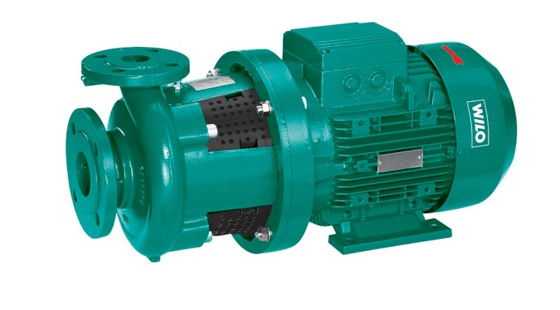
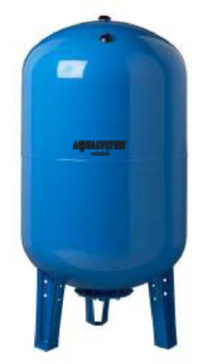
Two WILO BL 50/220 pumps were selected.
A suitable VAV 750 from AQUASYSTEM pressure tank was selected

Slide 63
Drainage System in Building
There are many type of fixture that used in the building and there sizes of every pipe in the fixture are mentioned, they are establishing from the international standard code.
Size of pipe ( in ) | No .of fixture | Type of fixture
4 | 6 | Water closet
2 | 1 | Lavatory
2 | 2 | Service sink
2 | 3 | Floor drain

Slide 64
The design of drainage system applied as follows:
Every stacks contains many fixture are groups and there are many no. of stacks in each floor .
The vent design of the stack pipes equal 4 in until reach the last floor it becomes equal 4 in , so that to obtain a good ventilation to drainage system in the building.
Many manholes were used for collecting the all drainage water

Slide 65
The design of drainage system applied as follows
Every 100m² needs a floor drain in the roofs to collect rain water.
A septic tank was designed ( 2*3*2) to collect waste water in second basement.
A two submerged pumps (WILO TS 50 H 111/11) was selected with 10m3/h flow and 10m head.

Slide 66
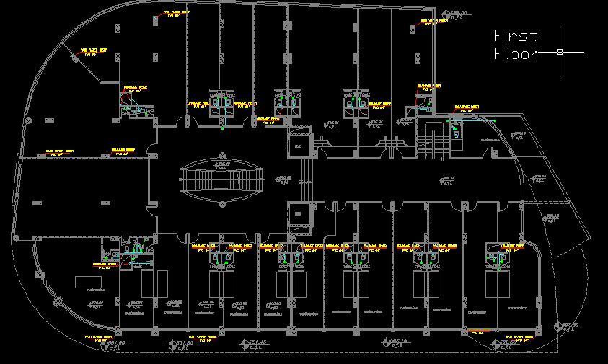

Slide 67
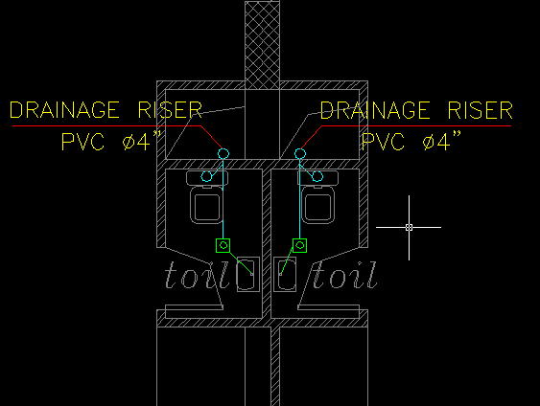

Slide 68
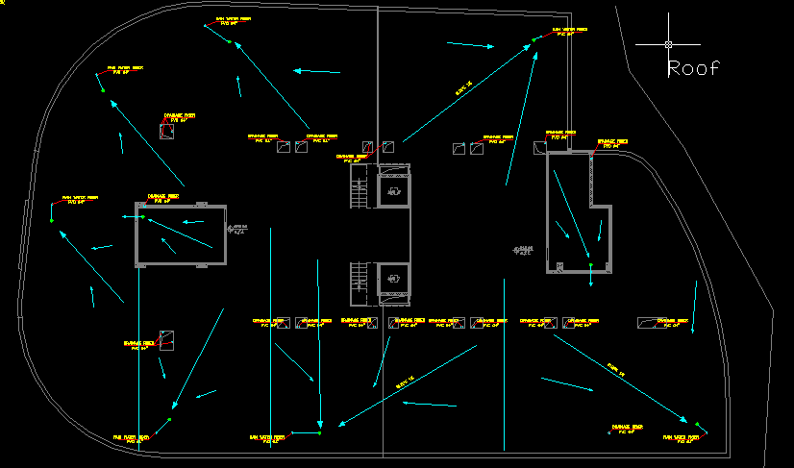

Slide 69
Fire fitting system

Slide 70
Fire Fighting system design
1) Sprinklers
Ex. Sprinklers for basement 1 :
area
no of sprinkllers
type of sprinkllers
Area coverd by spr
MAX dis. Between 2 spr.
radius of sprinkller flow
1200 M2
99
ordinary hazard
12M2
4.6 M
1.95 M

Slide 71
Pipe Sizing for Sprinklers
size | no of SPR.
1 | 2
1 1/4 | 3
1 1/2 | 5
2 | 10
2 1/2 | 20
3 | 40
3 1/2 | 65
4 | 100
5 | 160
6 | 275

Slide 72
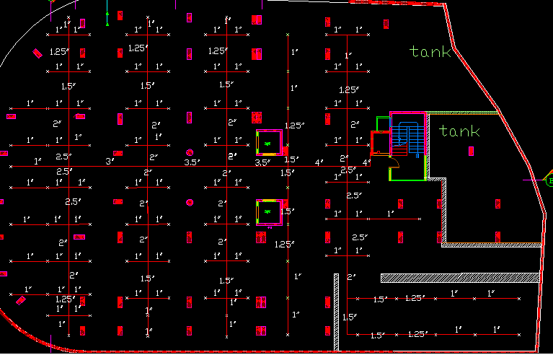

Slide 73
.2) Landing Valves and Cabinets
A) Landing valves flow rate and sizing
unit
landing valve
capinates
riser
pipe(riser_floor)
flow rate
250GPM
100GPM
750GPM
500GPM
size
2.5"
1.5"
4"
4"

Slide 74
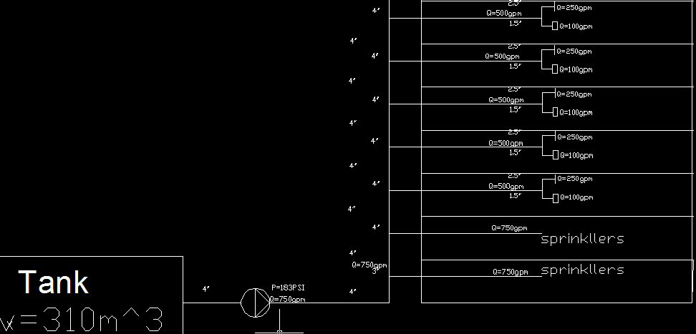
رسمة

Slide 75
Pumps calculation
P residual
P head
P fric+fit
P pump ( PSI )
Flow rate pump
jockey pump
jockey pump
100PSI
51.88PSI
31.12808
183
750GPM
188PSI
8GPM

Slide 76
Pumps Specifications
pump type
Electrical
Jockey
Diseal
P
12.5bar
13 bar
12.5 bar
Q
750GPM
8GPM
750 GPM

Slide 77
Pumps model selections :
pump type
Electrical
Jockey
Diesel
Model
WILO NPG 100-315A
WILO Helix V 1616-1
WILO NPG 100-315A

Slide 78
Tank volume :
Volume = 255 m^3.
Time operation : 90 min .

