Slide 1

StoreMaster
by Deema Hamoudeh & Arees Nobani

Slide 2


The Motiviation
The huge shift from physical stores to online platforms

Slide 3


The problem and our solution
Our solution is StoreMaster which:
  Lack of technical expertise
  High cost
  Difficult to manage the store
  Easily create an Online store
  Efficiently manage the store
  support Accessabliity cases

Slide 4
Methods used
  Flutter
  Nodejs
  MongoDB
  Postman
  Paypal Gateway
  SendGrid

Slide 5
Platform workflow
  Onboarding + login pages
  Store owner role
  Customer role
  Staff role
  Store Employee role
  SuperAdmin role
  Support Accessibility

Slide 6
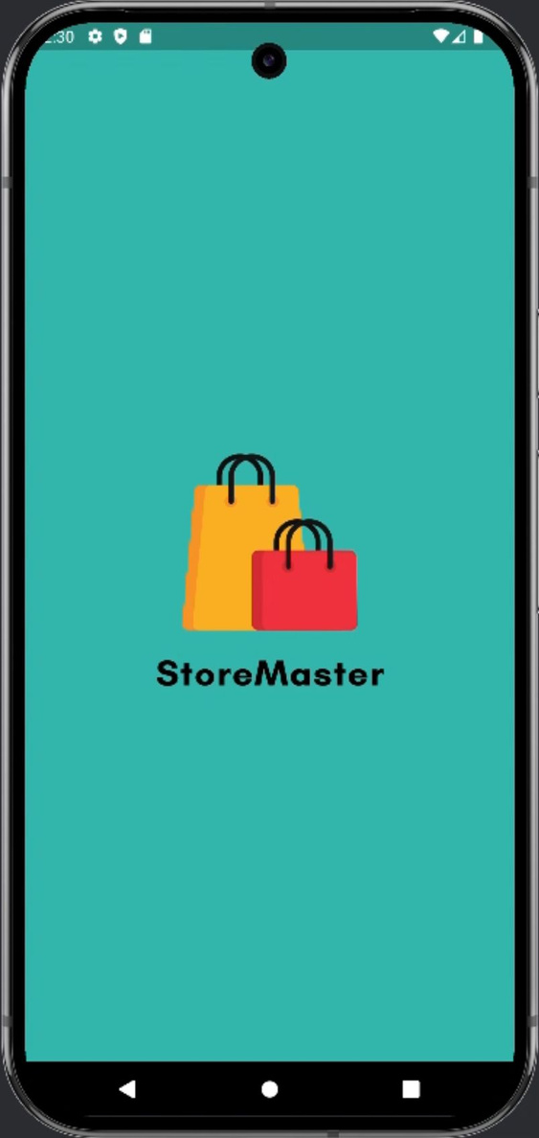
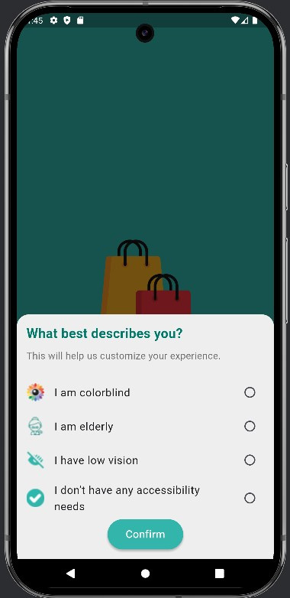
Getting started: initializaion & Accessibility

Slide 7
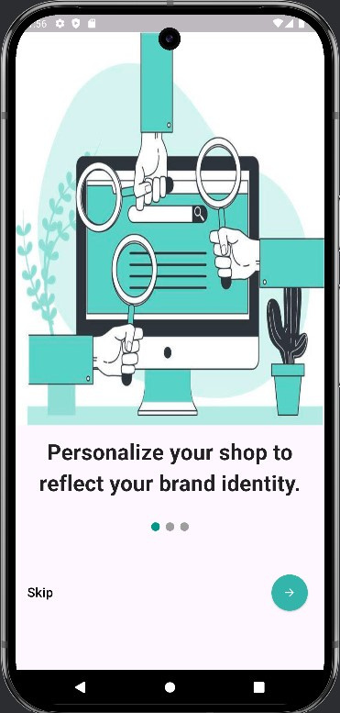
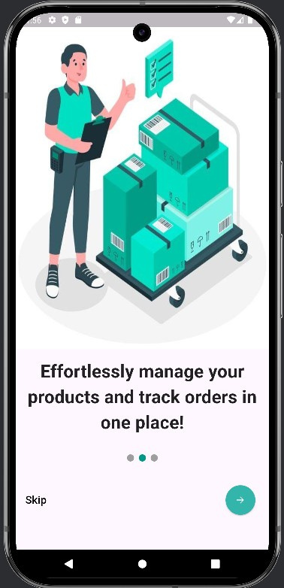
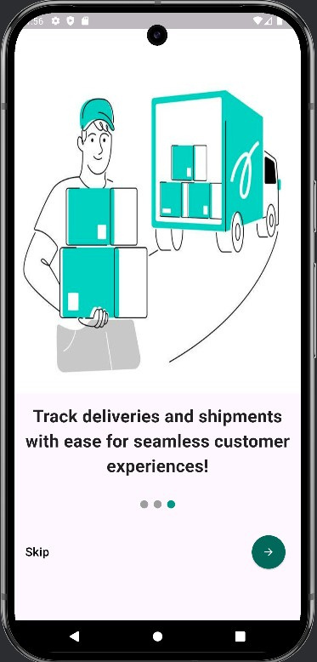
Onboarding screens

Slide 8
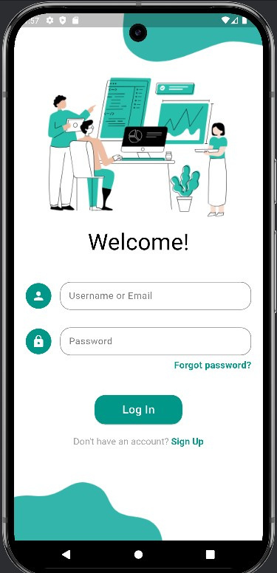
Login screen

Slide 9
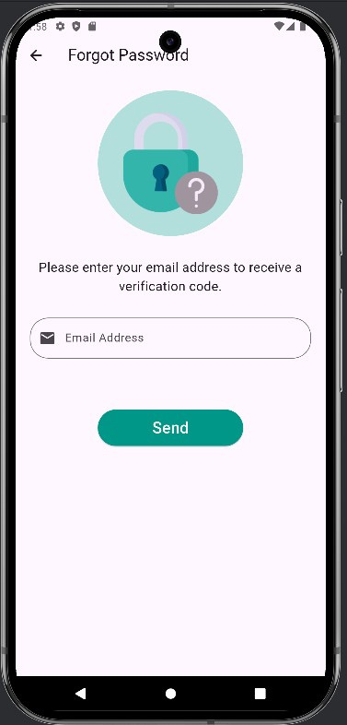
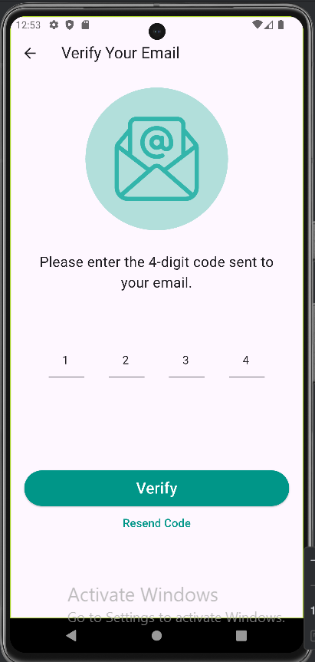
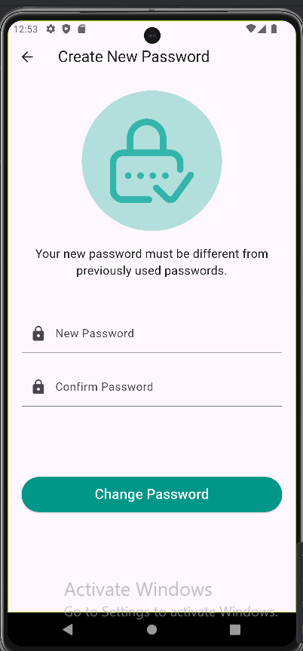
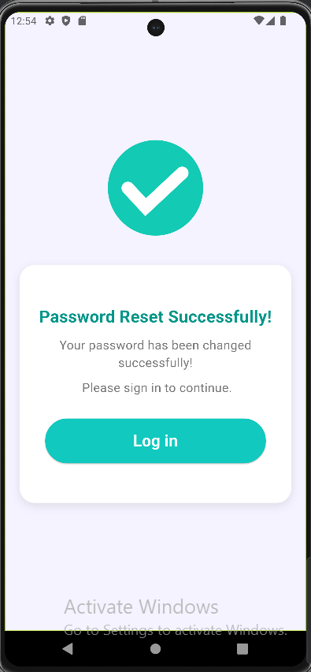
Forget password

Slide 10
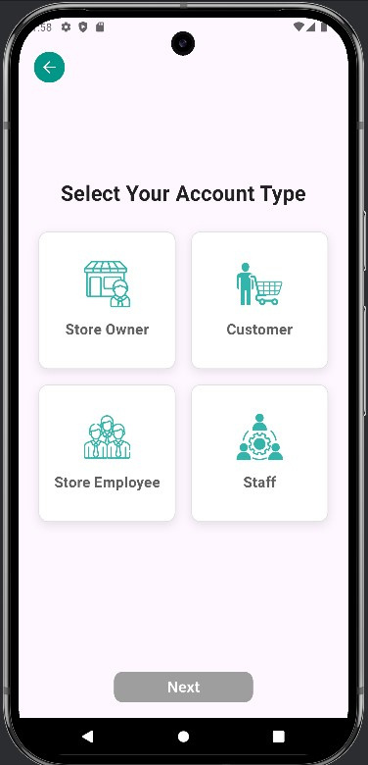
Choosing role

Slide 11
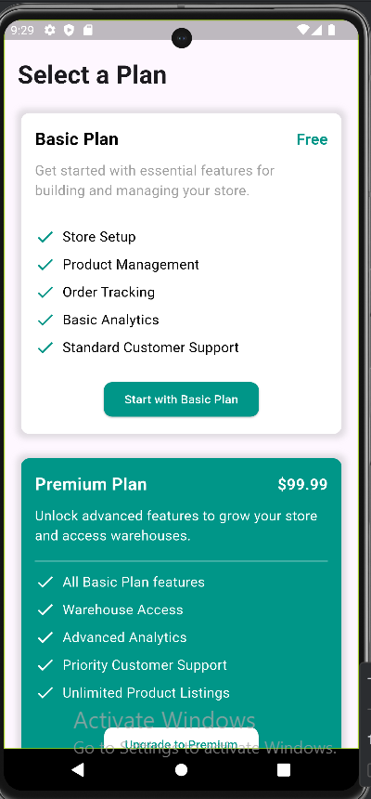
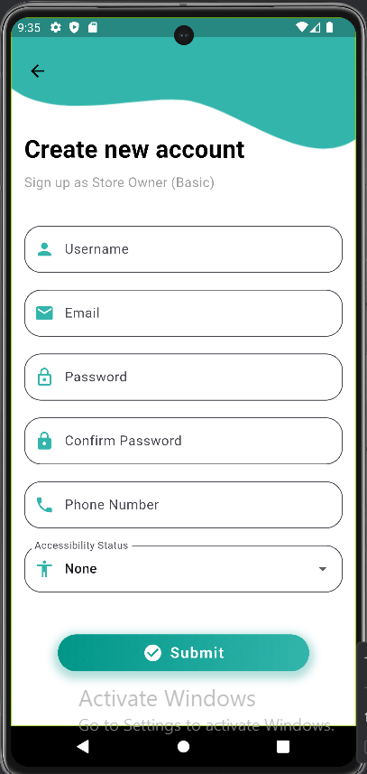
*Store Owner
Basic account
Choosing plan:
Basic , Premium

Slide 12
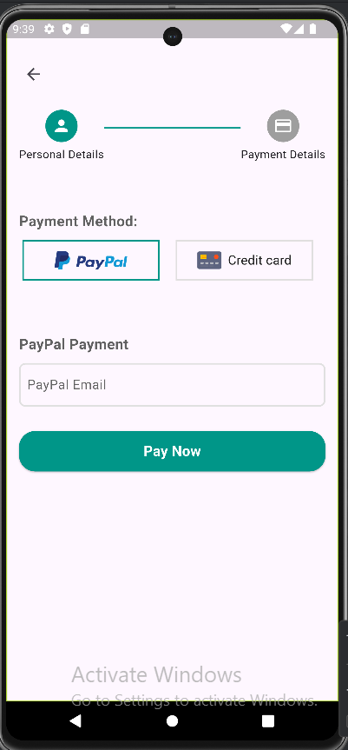
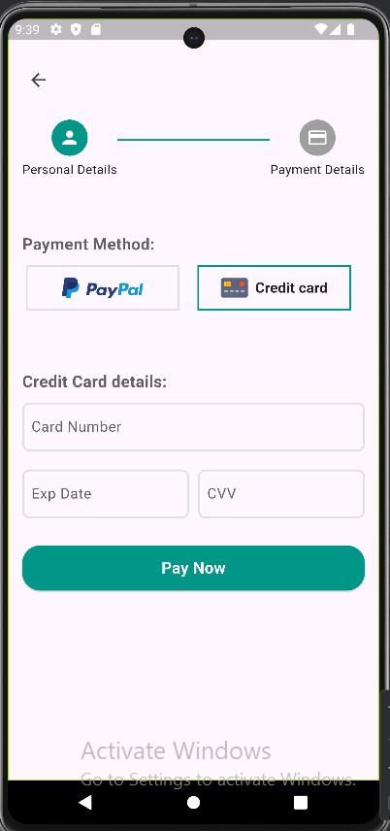
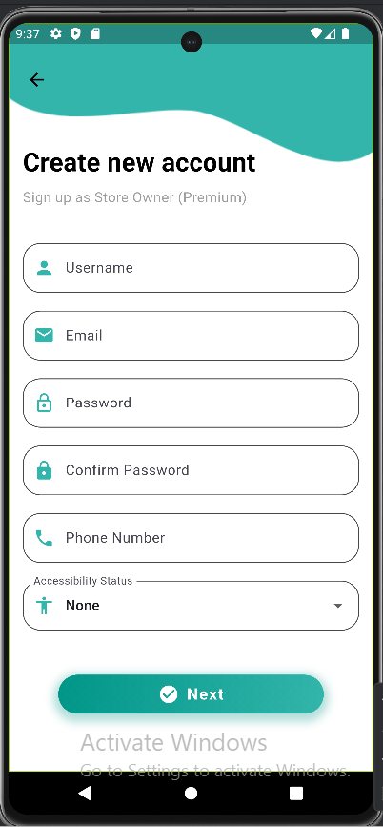
*Store Owner
Premium account

Slide 13
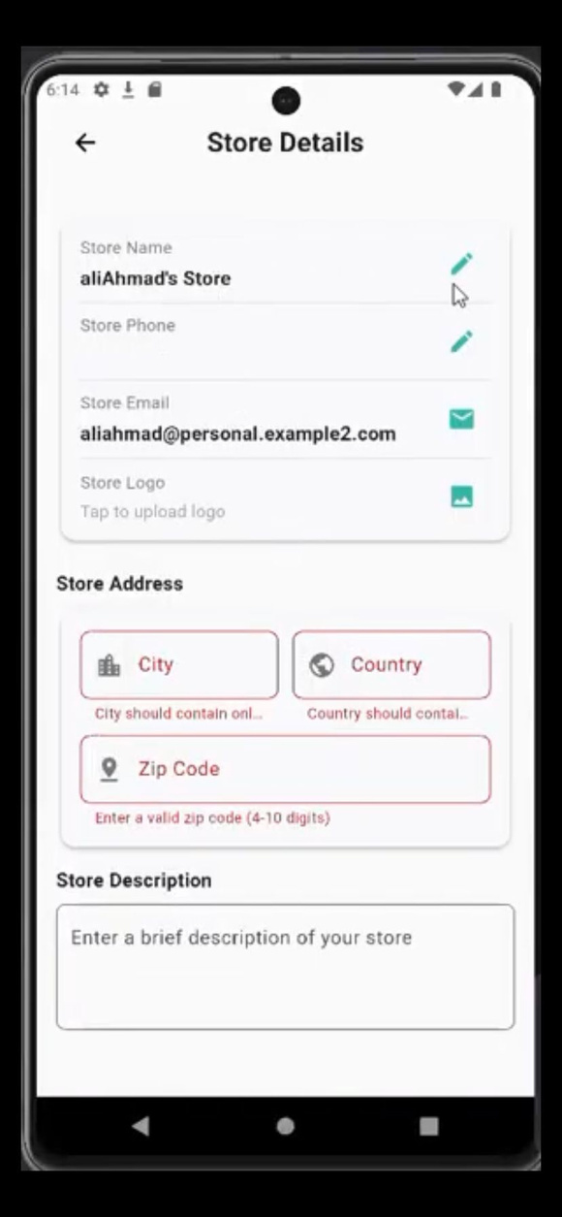
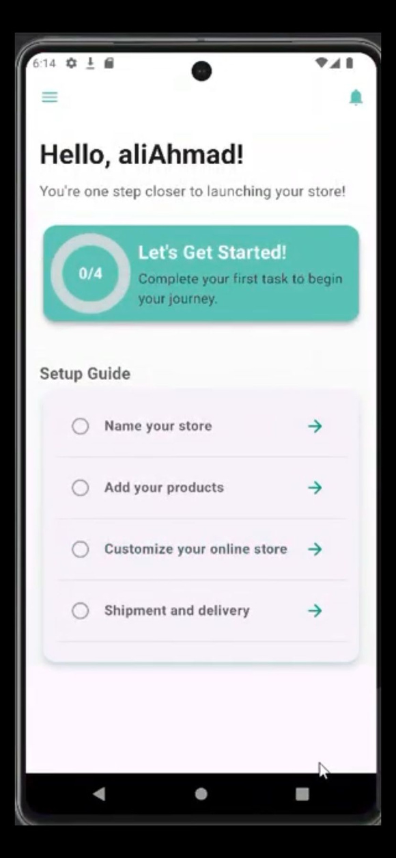
*Store Owner
Store Details
First step:
Name your store

Slide 14
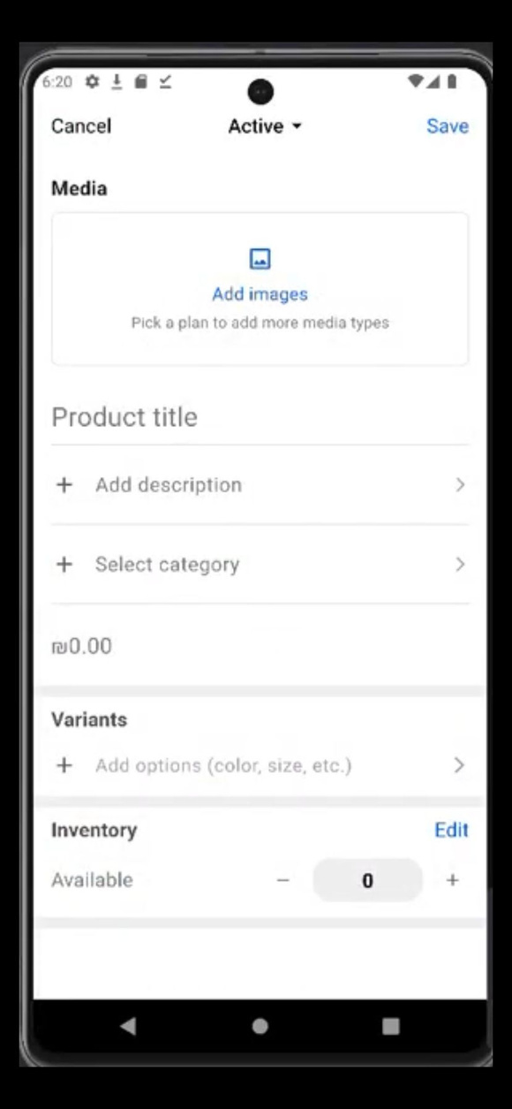
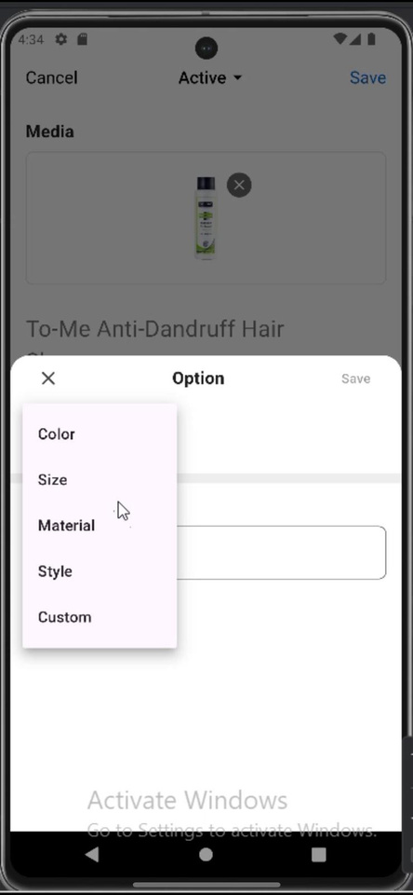
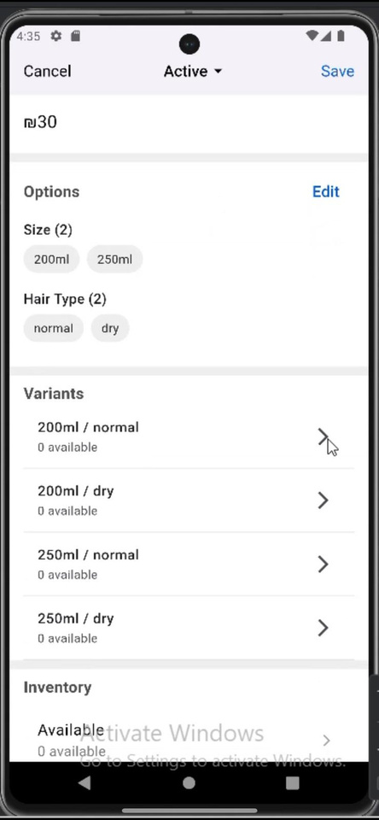
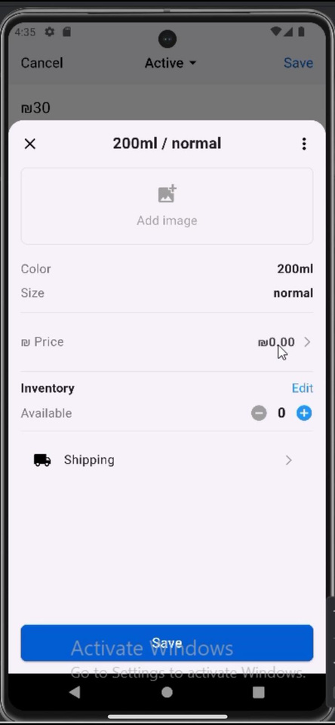
*Store Owner
Second step: Add product

Slide 15
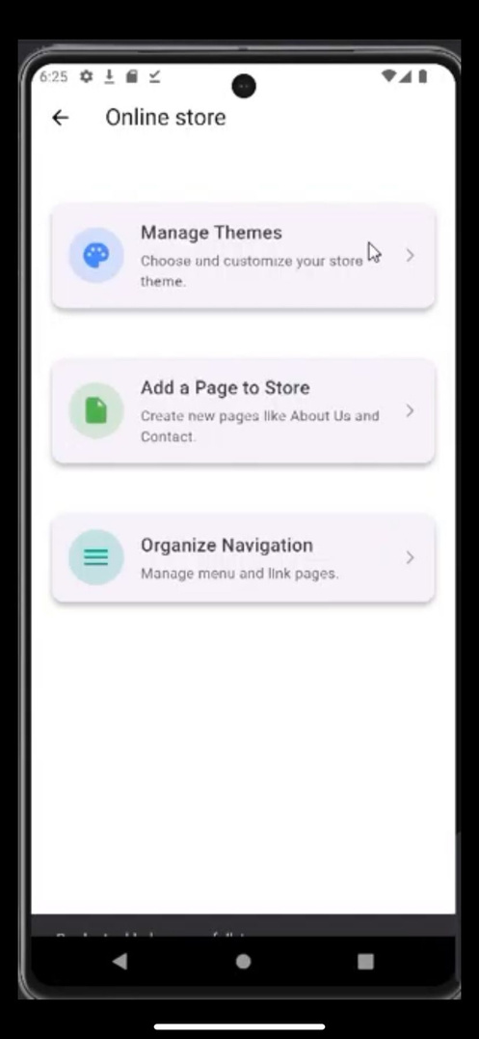
*Store Owner
Third step: Customize your online store
1.manage themes
2.Add Page to store
3.Organize navigation

Slide 16
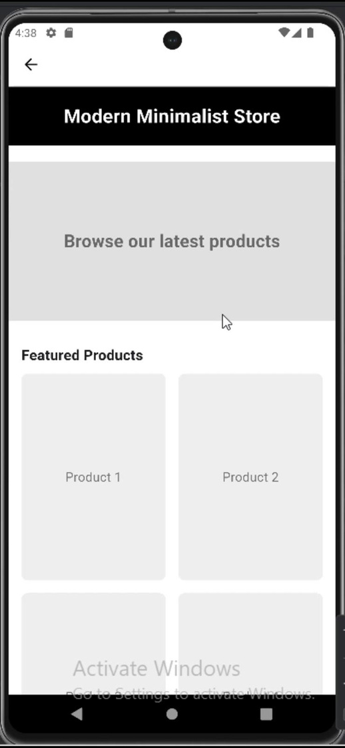
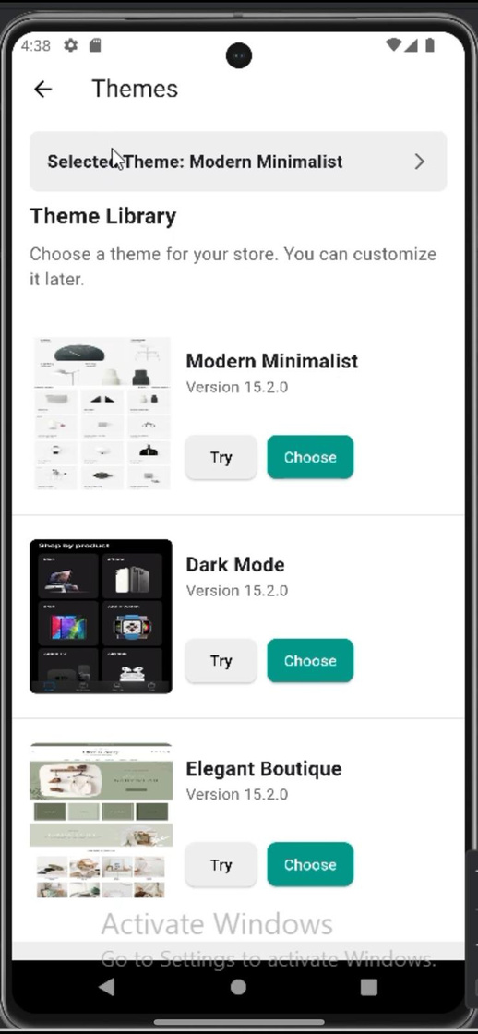
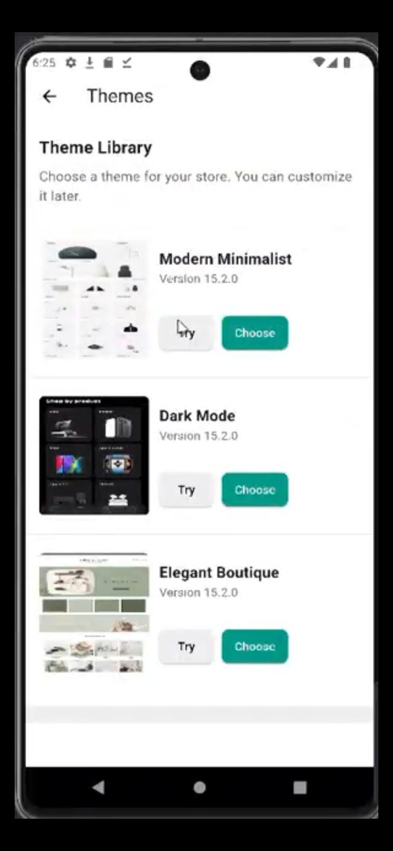
*Store Owner
Third step: Customize your online store
1.manage themes
Try theme
Choose

Slide 17
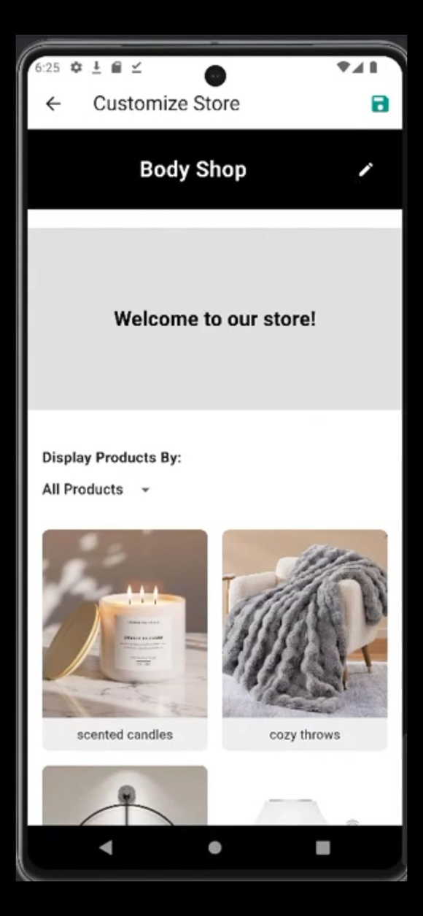
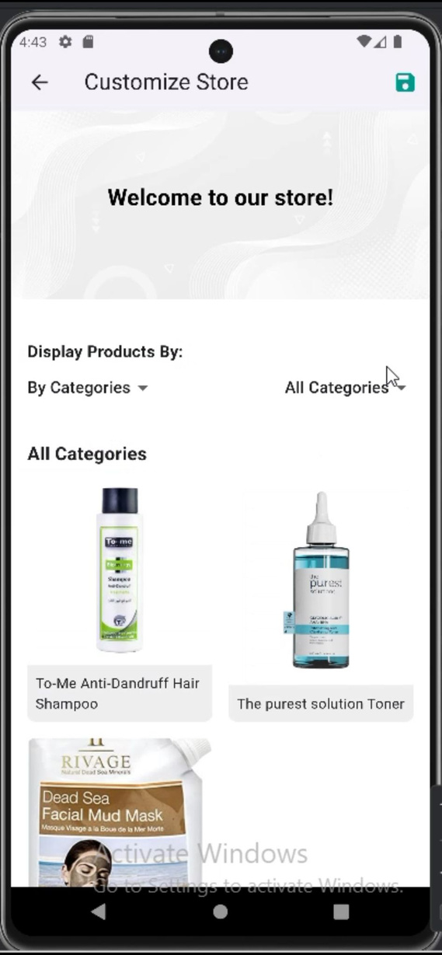
*Store Owner
Third step: Customize your online store
1.manage themes
Customize your theme

Slide 18
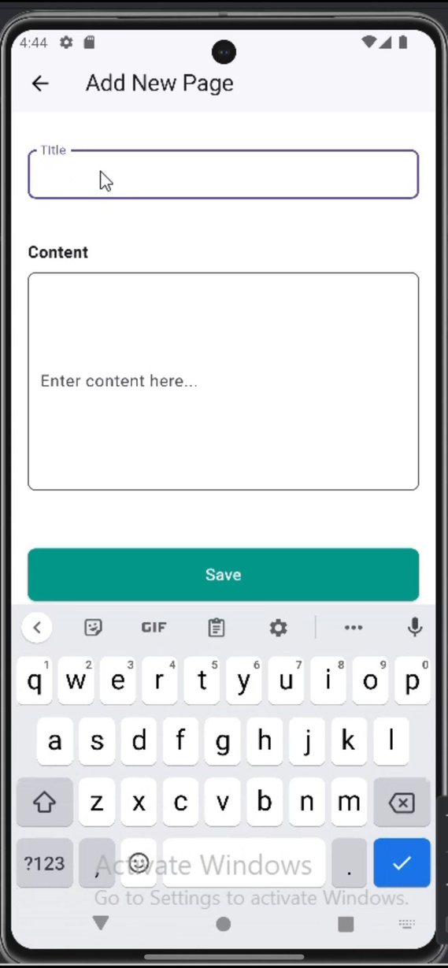
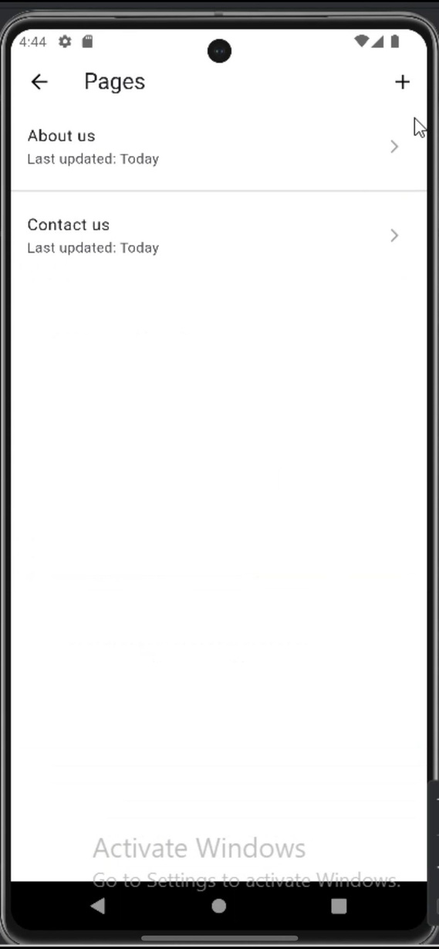
*Store Owner
Third step: Customize your online store
2.Add a page

Slide 19
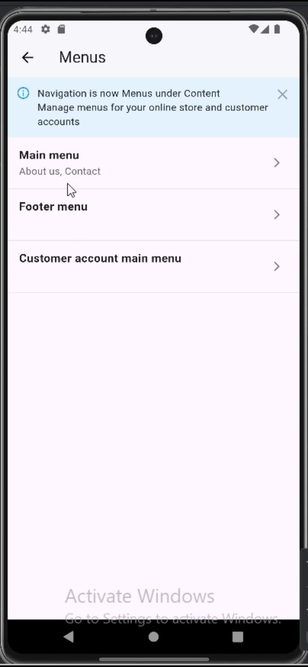
*Store Owner
Third step: Customize your online store
3.Organize navigation

Slide 20
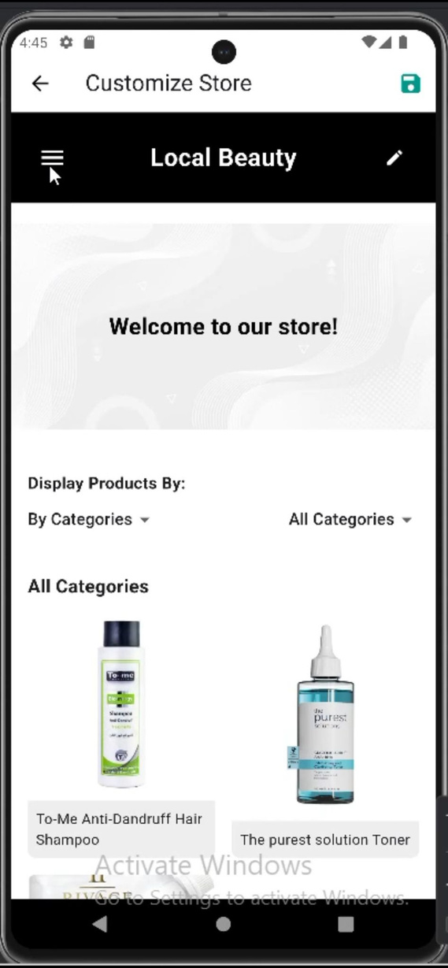
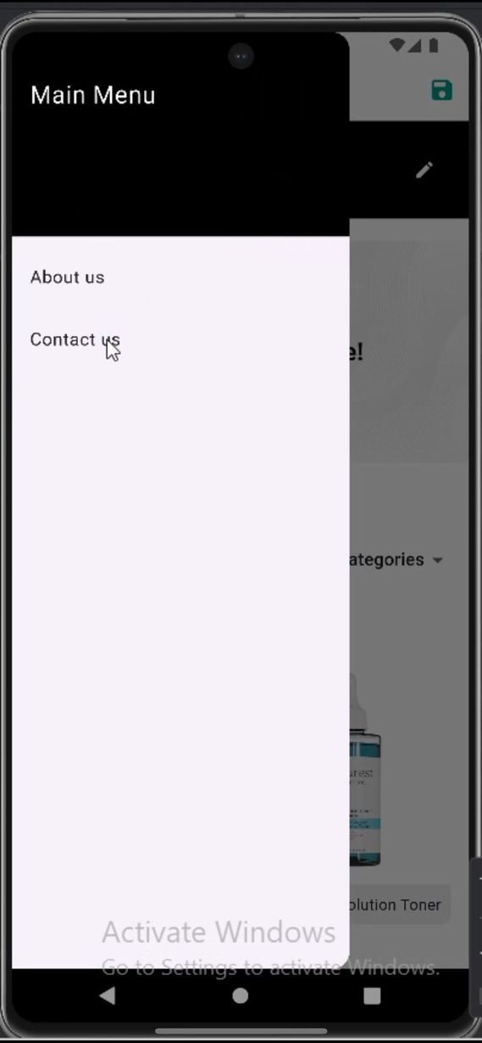
*Store Owner
Third step: Customize your online store

Slide 21
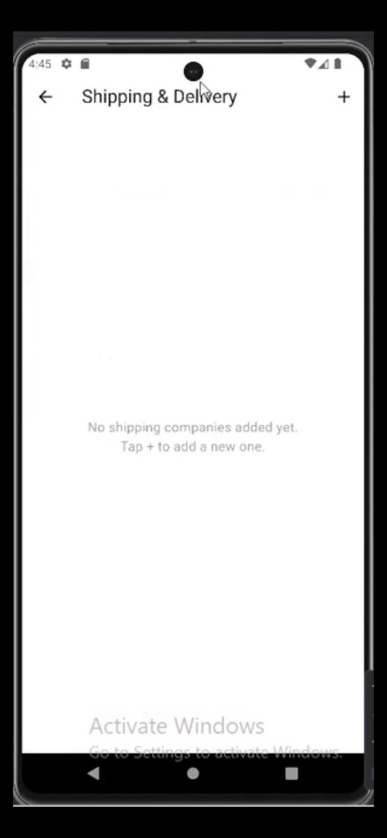
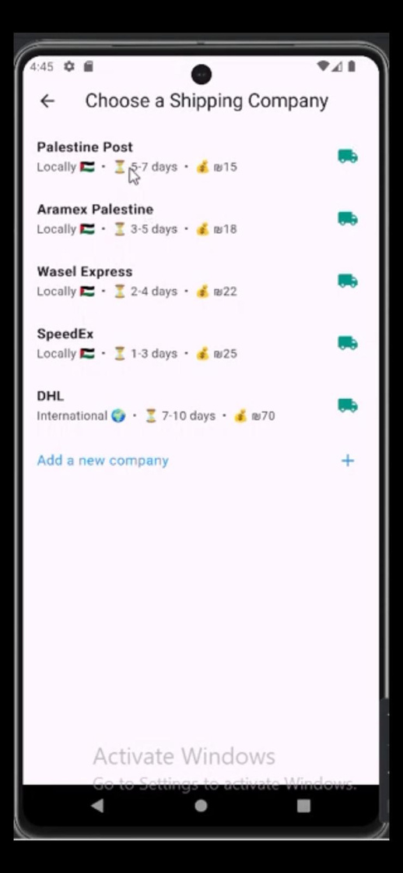
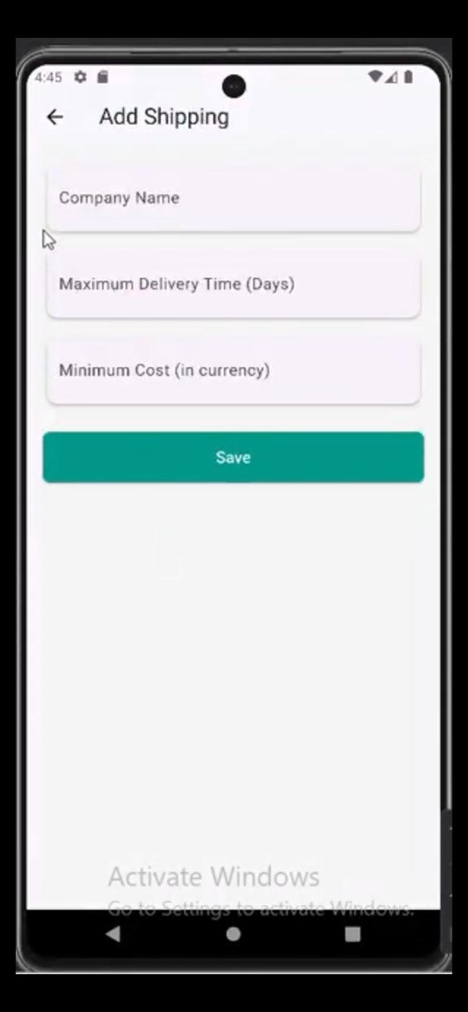
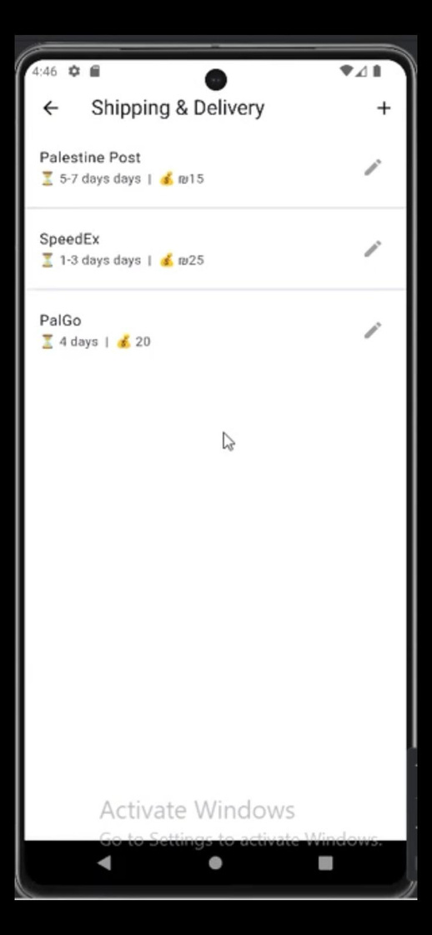
*Store Owner
Fourth step: Shipment and Delivery
(Basic account)

Slide 22
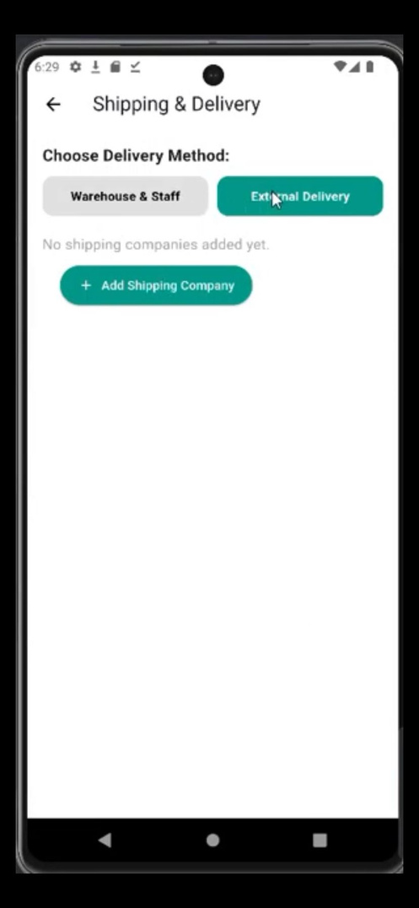
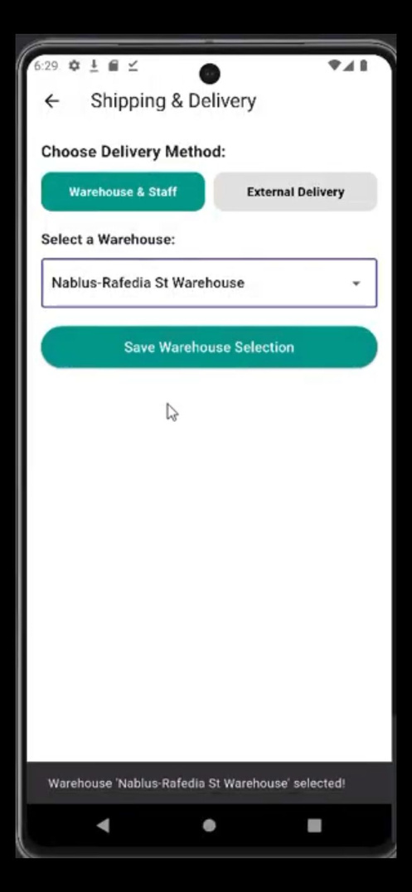
*Store Owner
fourth step: Shipment and Delivery
(Premium account)

Slide 23
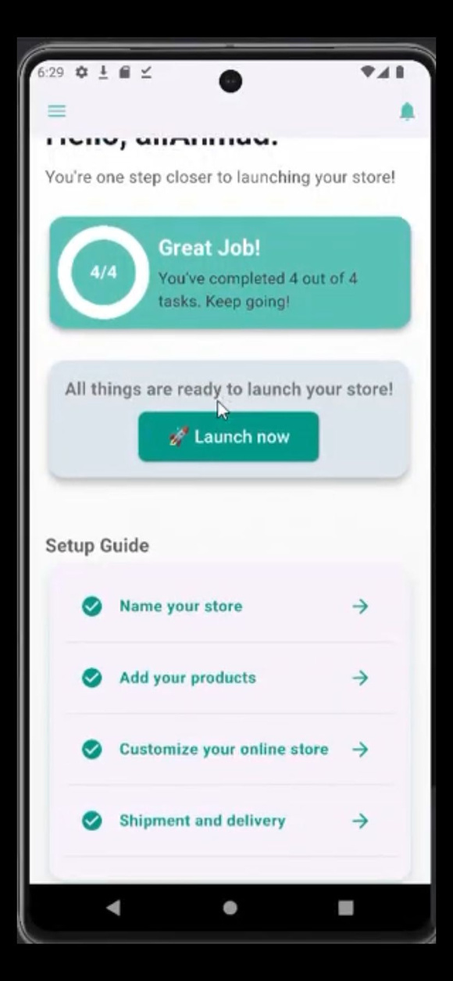
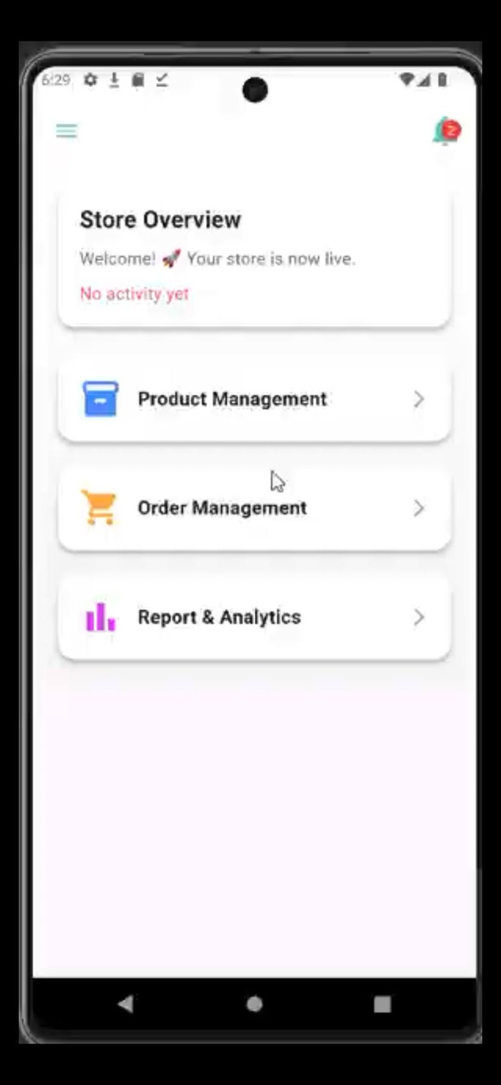
*Store Owner
Finishing all steps, Ready to launch
Post-launch Dashboard

Slide 24
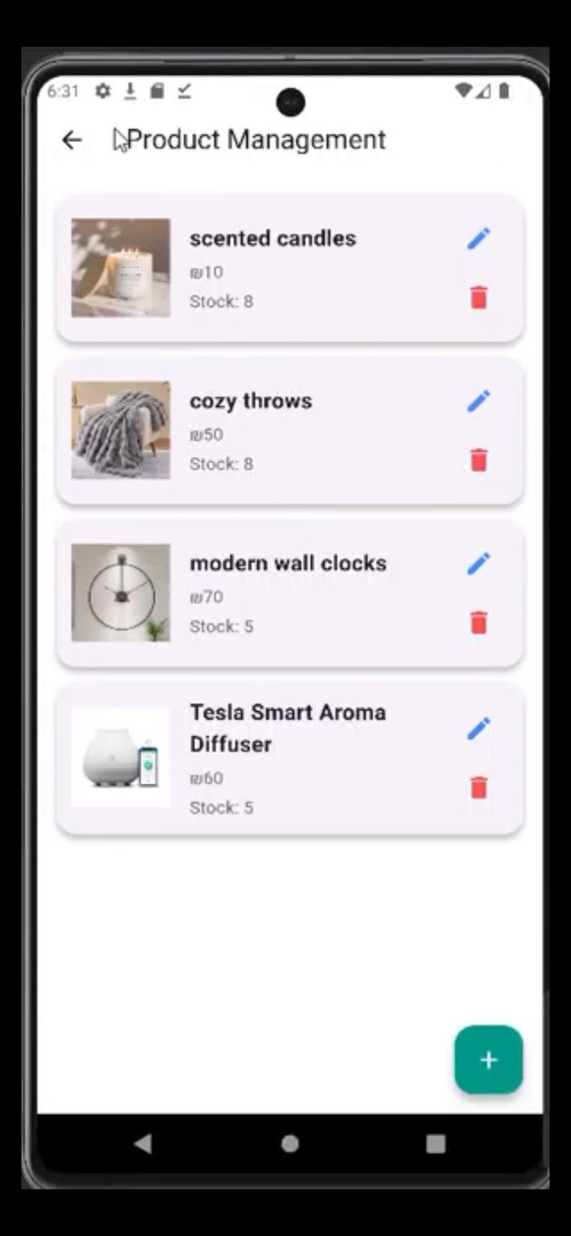
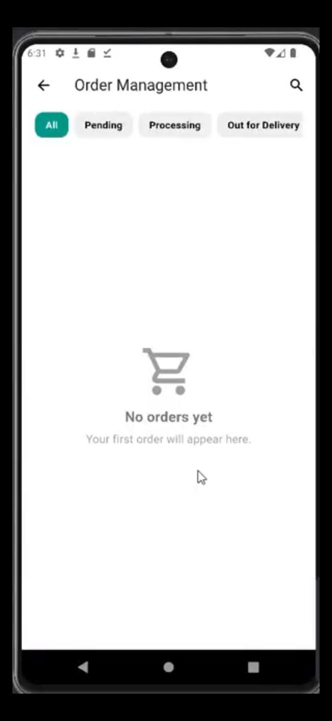
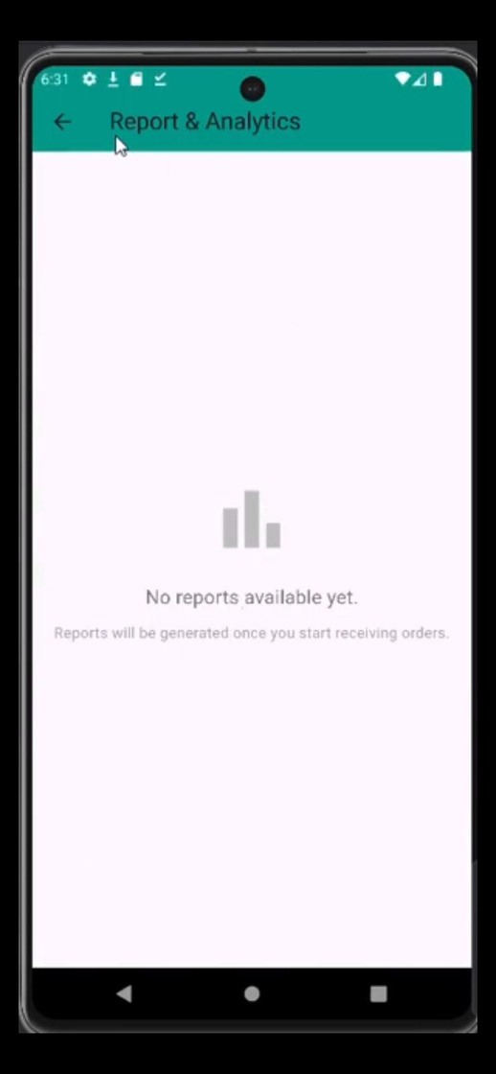
*Store Owner
Product management
Order management
Report & Analytics

Slide 25
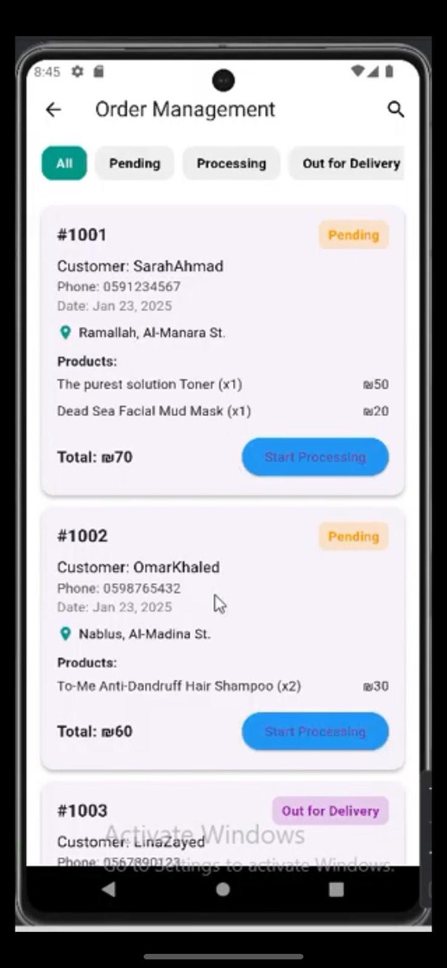
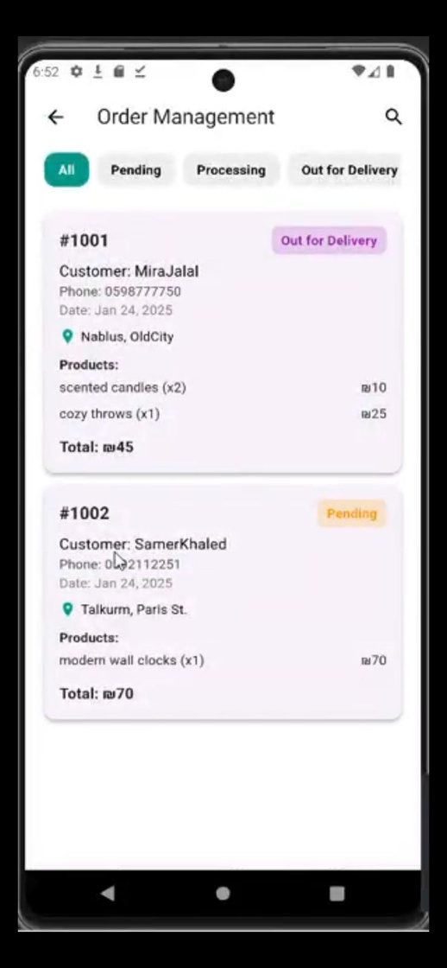
*Store Owner
Order management
(Basic)
Order management
(Premium)

Slide 26
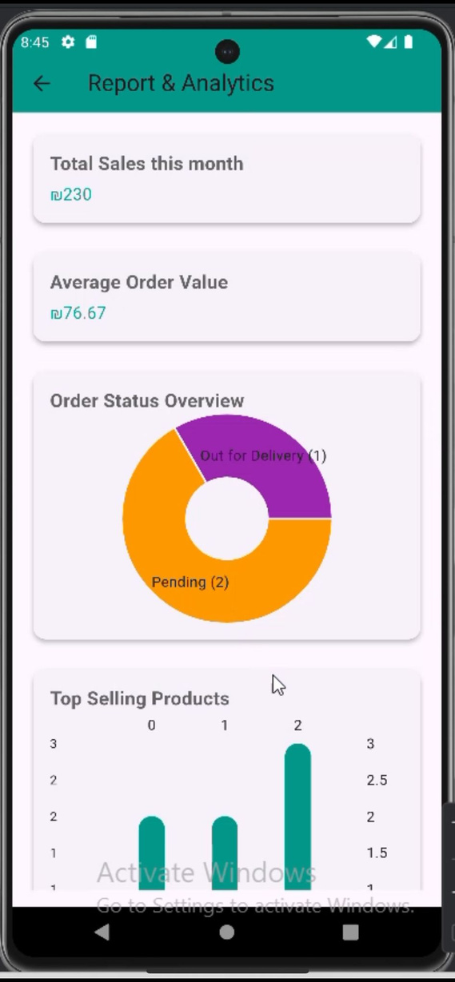
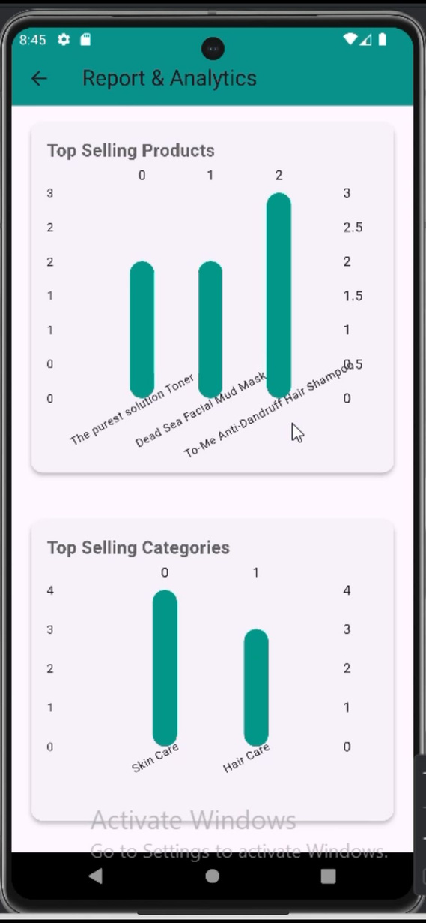
*Store Owner
Report & Analytics

Slide 27
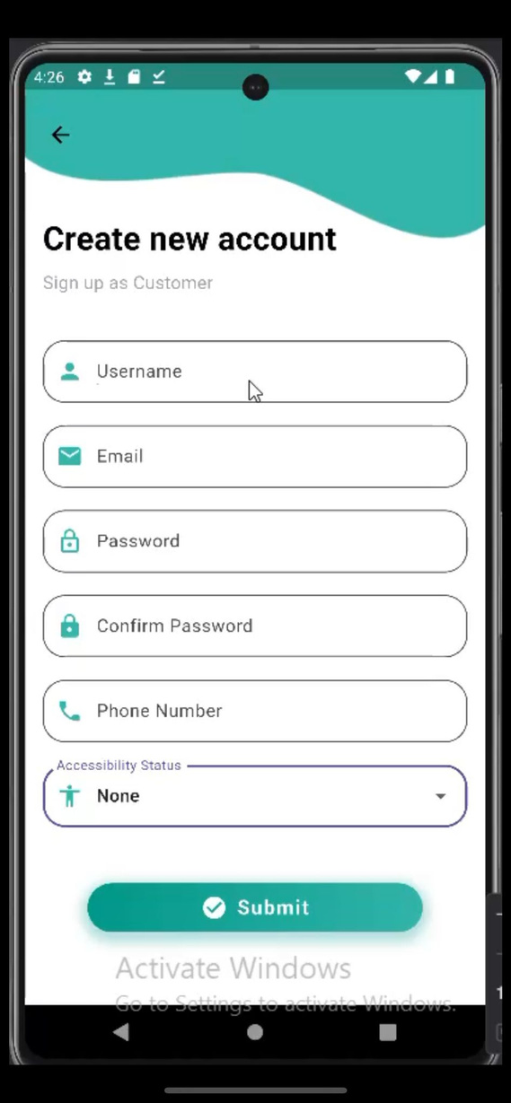
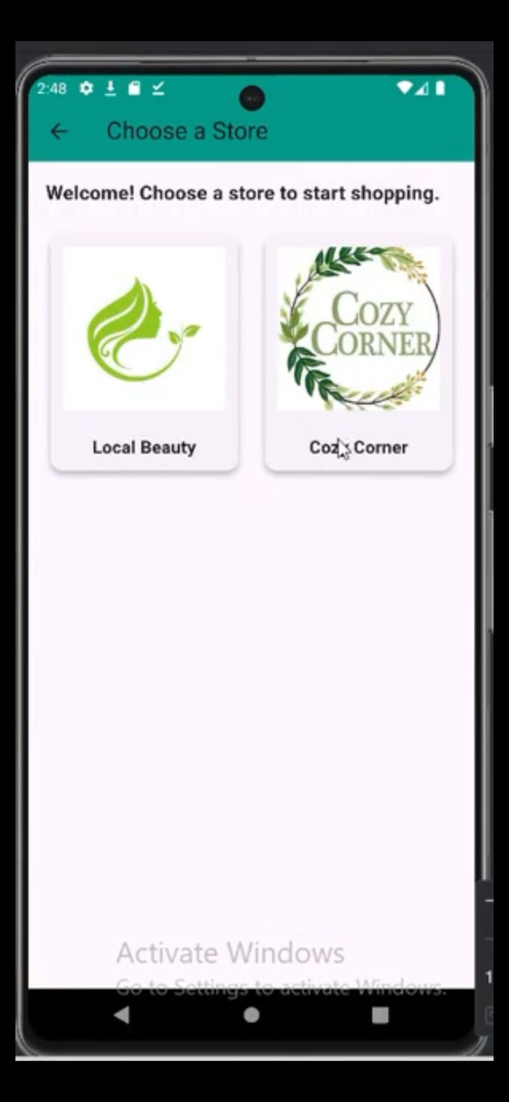

*Customer

Slide 28


*Customer
Add product to card

Slide 29



*Customer
Open card and confirm order

Slide 30


*Customer

Slide 31
*Staff
1.Prepare Orders
2.Delivery Tasks
3.arrange Packages

Slide 32


*Staff

Slide 33


*Staff prepare orders

Slide 34


*Staff delivery tasks

Slide 35


*Staff arrange packages

Slide 36
*Store Employee
1.Order Management
2.Product Management
3. Shipment Tracker
4.Report & Analytics

Slide 37


*Store Employee

Slide 38


*Store Employee

Slide 39



*Store Employee

Slide 40


*Store Employee

Slide 41



Support Store Owner

Slide 42



*Admin

Slide 43


*Admin

Slide 44


*Admin

Slide 45


*Admin

Slide 46


*Admin

Slide 47


*Admin

Slide 48
*Accessibilities
ColorBlind
Low Vision
Elderly

Slide 49




*colorBlind

Slide 50





*Accessibilities
ColorBlind
deuteranomaly
deuteranopia
achromatomaly
protanomaly
achromatopsia

Slide 51



*Accessibilities
ColorBlind
tritanopia
tritanomaly
protanopia

Slide 52


*Accessibilities
Elderly
Low Vision

Slide 53

*Accessibilities

Slide 54
constrains
  System complexity
  Accessibility Challenges
  Integration Challenges

Slide 55
Future Work
  Multi-language Support
  Advanced Voice Control
  Community Features
  International Shipment
  Multiple Store Management
  Advanced and Dynamic Themes
  Integration of AI Features

Slide 56
Thank you

