Slide 1
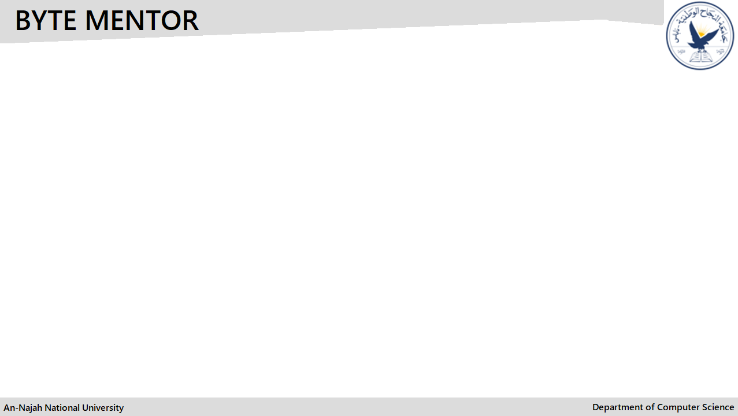

(Connecting IT Students with Companies)
Done By:
Mohamad Abdelhaq
Abdalah Yahya
Supervisor:
Dr. Mai AbuSair
An-Najah National University, Palestine
07.02.2024
1

Slide 2
Outline
What is ByteMentor? & Objectives.
Problem Statement & solution.
Similar platforms & stand out.
Main technologies and tools were used.
Architecture Design & Use case.
Recommendation System.
Features of ByteMentor.
Look to website.
How could ByteMentor be improved?
2

Slide 3
ByteMentor: Connecting IT Students with Companies
ByteMentor: An online platform dedicated to provide relevant training opportunities for students in computer science and information technology.
Project Objectives:
1- Enabling students to explore and apply to various IT fields.
2- Aiding Companies search for skilled interns.
3- Enhanced Guidance Using recommendation systems.
3

Slide 4
Challenges Faced by IT Students and Companies
- Student Problems:
1- Difficulty in Exploring Fields.
2- Scarcity of Training Opportunities.
- Company Problems:
1- Finding Specialized Talents.
2- Application Processing.
- How ByteMentor Addresses These Problems:
1- Personalized Opportunity Matching - Direct student access to training plans and company profiles.
2- Efficient candidate management for companies.
4

Slide 5
Similar Platforms
LinkedIn.
Handshake.
- How Does ByteMentor Stand Out From Other Platforms:
1- ByteMentor exclusively offers IT training, not employment ads.
2- User-Friendly Application Tracking.
3- ByteMentor offers various training plans beyond specific company programs.
5

Slide 6
Utilized technologies
MERN Stack Foundation:
- ReactJS: For a dynamic and responsive user interface.
- NodeJS & ExpressJs: The backend offering a powerful server-side solution.
- MongoDB: Utilizing MongoDB for our database needs.
Python & Flask API:
- which is responsible for handling the recommendation logic.
Supporting Libraries & Tools:
- like react-bootstrap, bcrypt, cors, multer, etc...
6

Slide 7
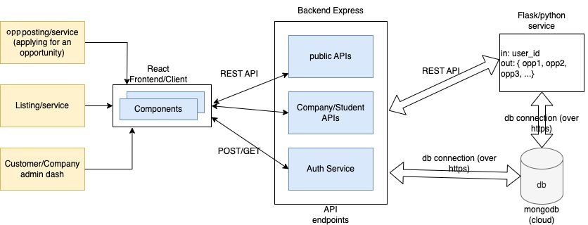
Architecture Design
7

Slide 8
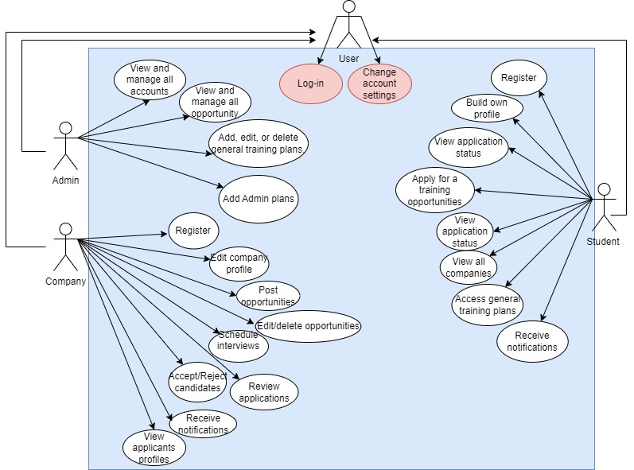
Use Case for ByteMentor
8

Slide 9
ByteMentor Recommendation System
Textual Similarity Match: ByteMentor aligns students with opportunities using cosine similarity, considering bios, skills, and preferred fields.
Flask API: Python's Flask powers our recommendation engine, matching students' profiles with opportunity fields and descriptions.
MongoDB Sync: Profiles and opportunities stay current with MongoDB's real-time sync, tailored to skills and fields.
UI Recommendations: ByteMentor interface presents tailored suggestions, directly drawn from students' bios, skills, and fields of interest.
9

Slide 10
First of all the flask API will get the (bio, preferredField, skills) from students collection -after converting the skills to string (because it was list)- we append all of bio ,preferredField and skills in one long string called “user_text”, so on , we do the same thing to opportunities collection (description, field) and we append it in a string called ” opportunity_text”.
Then we will vectorize both user_text and opportunity_text
Using method vectorizer.
10

Slide 11
For example lets say that the user_text will be:
“Frontend”
And the opportunity_text will be:
“Frontend SCSS”
So the vector will look like this :
11

Slide 12
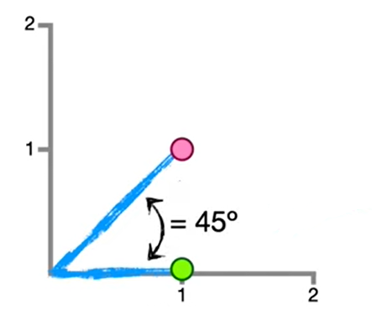
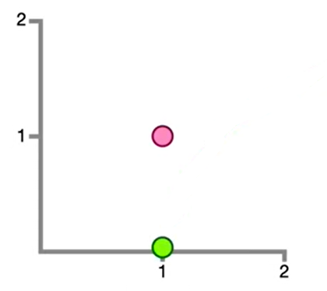
Frontend | SCSS
1 | 1
1 | 0
Frontdend, SCSS →
Frontdend →
SCSS
SCSS
Frontend
Frontend
12

Slide 13
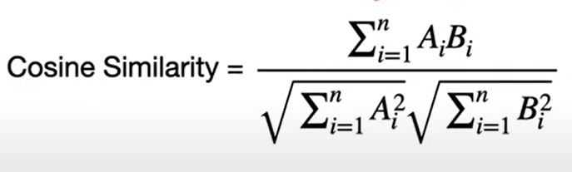
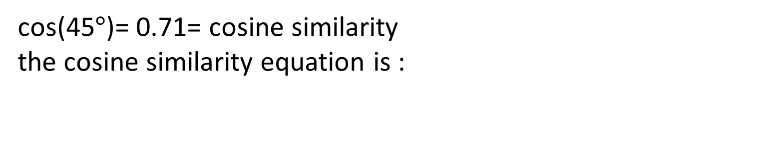
cos(45$°$)= 0.71= cosine similarity
the cosine similarity equation is :
13

Slide 14
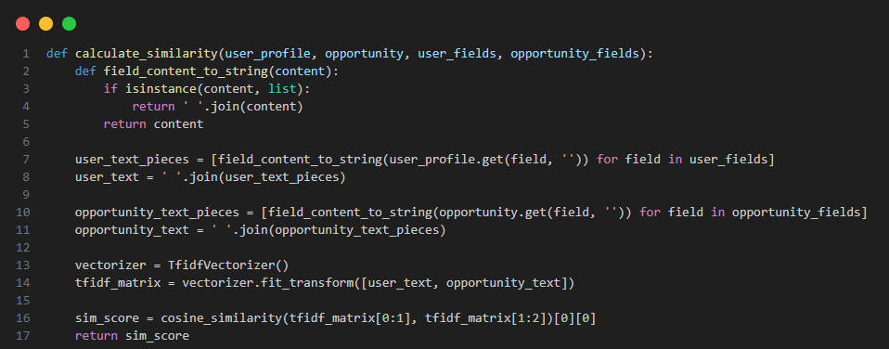
This code is a part (from our code) demonstrates this cosine similarity calculation process:
14

Slide 15
Enhanced Technical Features in ByteMentor
1- Password Recovery: Secure and user-friendly password reset functionality.
2- Notification System: Real-time alerts and updates keeping users informed.
3- Theme Customization: Dark and light modes to suit user preferences.
4- Multilingual Support: The platform caters to both Arabic and English.
5- Responsive Design: Optimized for all screen sizes, ensuring a seamless experience on any device.
15

Slide 16
Look to Website : )
16

Slide 17
How could ByteMentor be improved?
1- Mobile Application Development.
2- Upgrade communication between users.
3- AI Advancements.
17

Slide 18
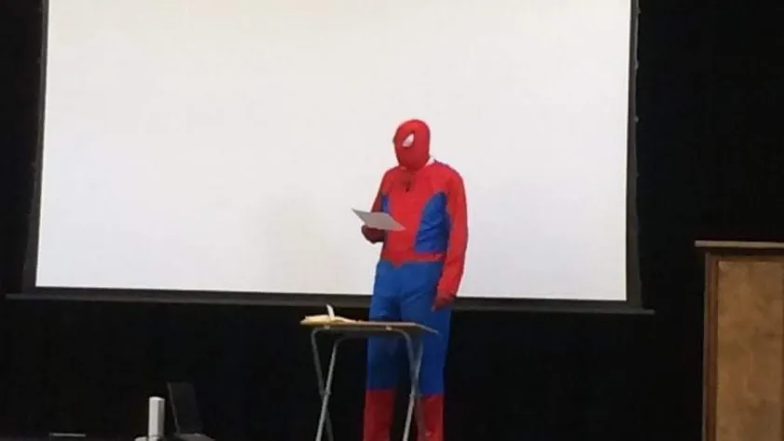
Thank you for your attention, Any questions?

