Slide 1


SOLAR PANEL CLEANING ROBOT

Slide 2

CONTENT
01
INTRODUCTION
02
OVERVIEW & PROBLEM STATEMENT
03
OUR SOLUTIONS
04
TRADITIONAL VS OUR SYSTEM
05
CHALLENGES
06
MECHANISM&CONTROLLER

Slide 3
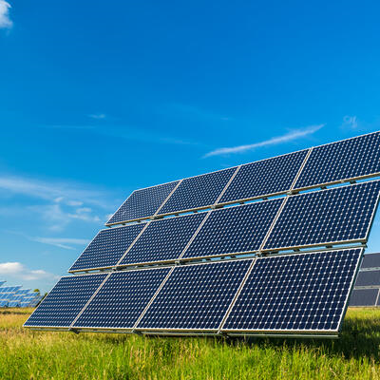

INTRODUCTION
In a world increasingly focused on sustainable energy solutions, solar panels have emerged as a groundbreaking technology that holds immense promise.

Slide 4

OVERVIEW & PROBLEM STATEMENT
Solar panels are designed to convert sunlight into electricity, making them a vital component of our clean energy future. However, a significant challenge arises as they accumulate dirt, dust, and debris over time. This soiling has a detrimental impact on their efficiency, reducing the amount of electricity they can generate. Understanding the extent of this problem and finding effective solutions is crucial for maximizing the performance and economic viability of solar energy systems
30%
Efficiency lost

Slide 5
OUR SOLUTION
The Solar Panel Cleaning Robot. In response to the ongoing challenge of soiling-induced efficiency losses in solar energy systems, our cutting-edge robot is engineered to deliver efficient and autonomous cleaning, ensuring solar panels consistently operate at peak performance. With its versatile adaptability, and cost-effectiveness,

Slide 6




TRADITIONAL VS OUR ROBOT
COSE EFFECTIVNESS
CONSISTENCY
SAFETY
Reduced labor and maintenance costs make our solution cost-effective, with a quick return on investment.
Robots provide consistent cleaning, reducing the likelihood of missed spots or uneven cleaning that can occur with manual labor.
Robots eliminate the need for workers to access rooftops or climb on solar panel structures, reducing the risk of accidents and injuries.

Slide 7
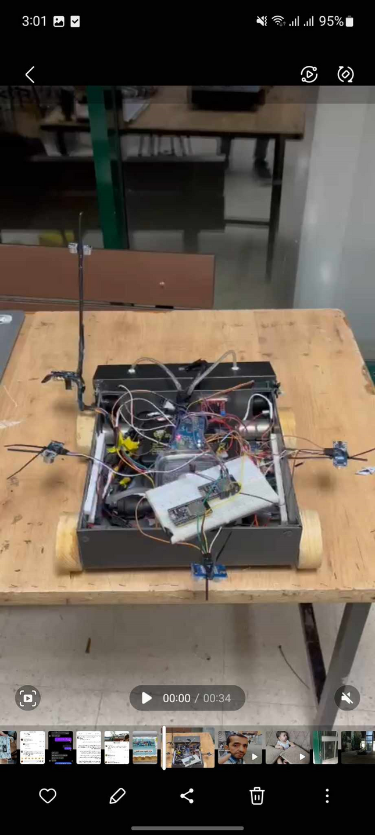
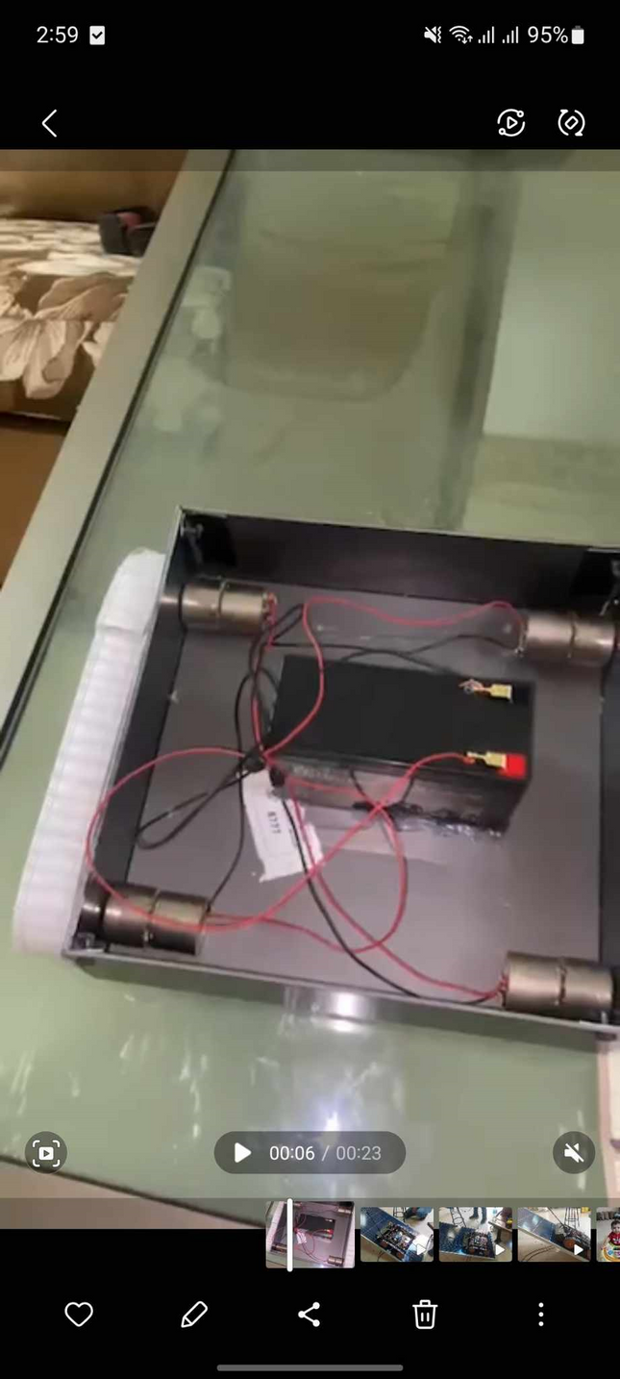
CHALLENGES
1-walking on an angle:
version one : wheels.
version two :Belt.

Slide 8
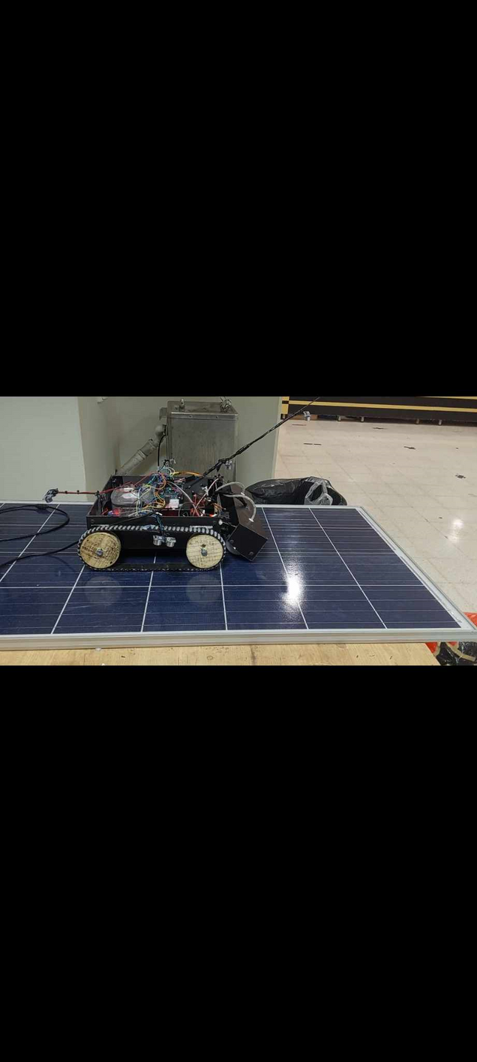
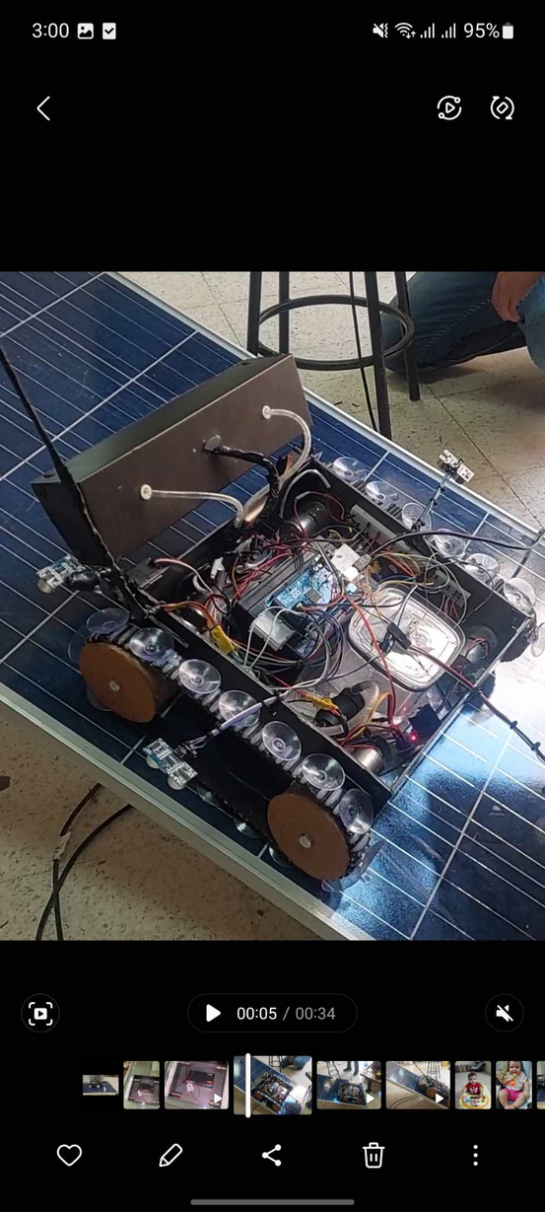
CHALLENGES
1-walking on an angle:
version three : belt with silicon.
version four :Belt and suction cups.

Slide 9

CHALLENGES CONT.
1-Water supply:
A water tank inside the robot.
A remote system to pump water.

Slide 10
FUTURE WORK
1-Add a solar panel to our robot.
2-Add a navigation system to our robot.
3-Add image processing.

Slide 11
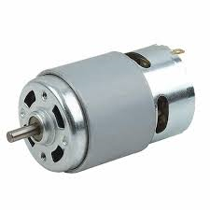
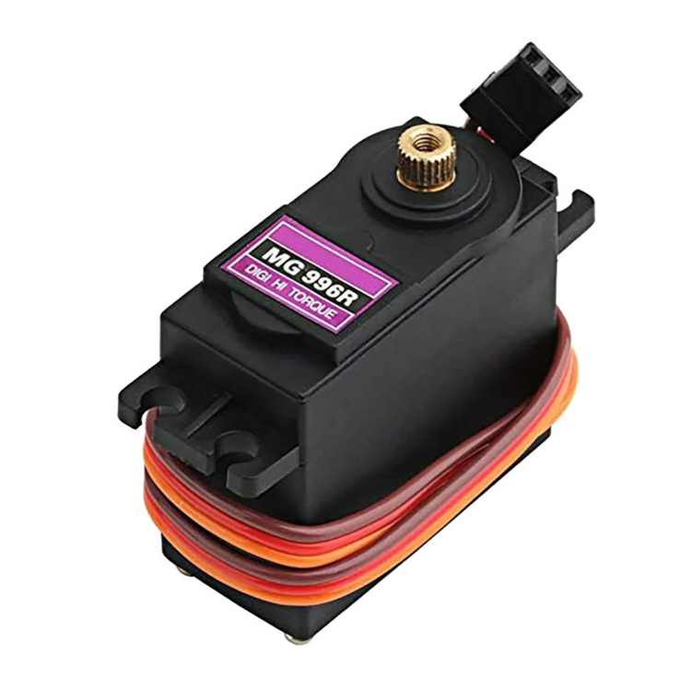
MECHANISM
DC motors for movement.
servo motors to control the brush

Slide 12
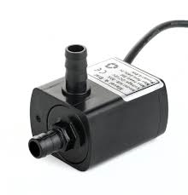
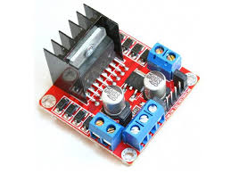
MECHANISM
Water pump
H-bridge to control the DC motors and the brush

Slide 13
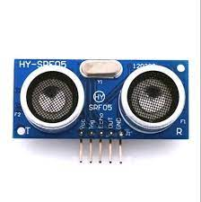
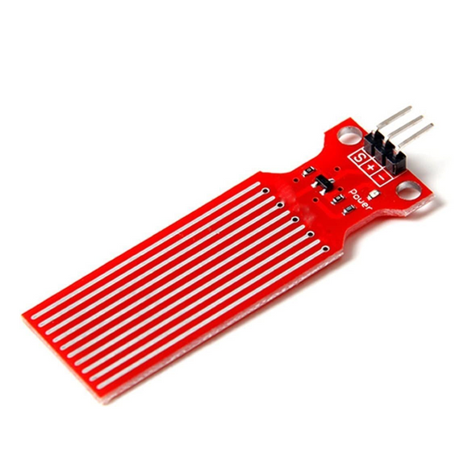
MECHANISM
ultrasonic sensors
Water level sensor

Slide 14
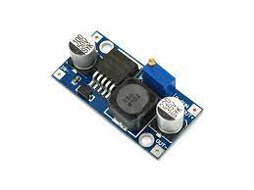
MECHANISM
DC to DC buck converter

Slide 15
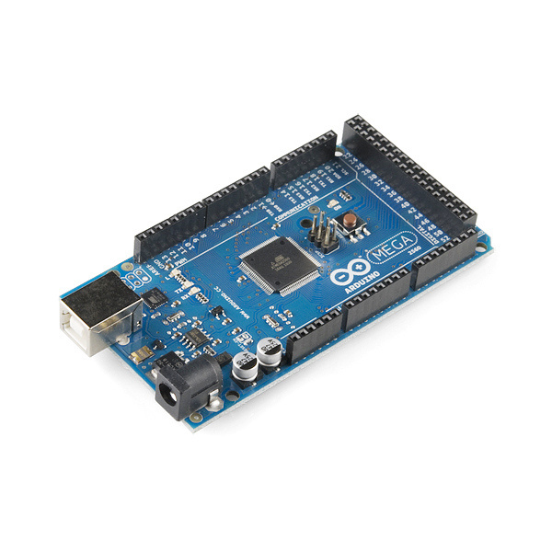
CONTROLLERS:
Arduino Mega

Slide 16
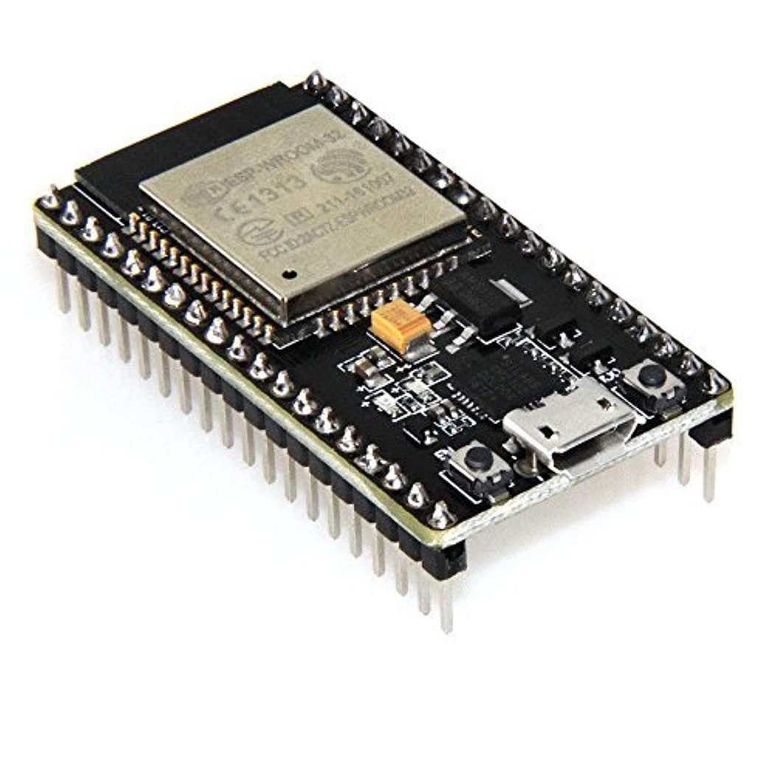
CONTROLLERS:
ESP 32

Slide 17

THANK'S FOR WATCHING

