Slide 1

Graduation Project 2 :
AN-NAJAH NATIONAL UNIVERSITY FACULTY OF ENGINEERING
“Extrusion Process Using Finite Element Analyses”
Students: Othman Kittani
Rafeq Abd Alhafez
Mohammad Irshaid Hamza Mashaqi
Supervisor:Dr. Iyad Assaf February- 2025

Slide 2
INTRODUCTION

Slide 3

Extrusion is a metal-forming process used to shape materials through a die.
Importance:
Used in industries such as construction automotive, aerospace, and medical manufacturing.
Enhances material properties, reduces waste, and increases production efficiency.
Study Objective:
Investigate hot direct extrusion using Finite Element Analysis (FEA).
Compare AA6061 Aluminum, Ti-6Al-4V Titanium, and AZ31 Magnesium alloys.

Slide 4
SCOPE OF THE PROJECT

Slide 5




Key Focus Areas:
Material Behavior: AA6061 Aluminum, Ti-6Al-4V Titanium, and AZ31 Magnesium.
Deformation Mechanics: Stress, strain, and temperature distribution.
Optimization Strategies: Die geometry, friction reduction, and energy efficiency.

Slide 6
STEPS OF WORKING IN ABAQUS

Slide 7

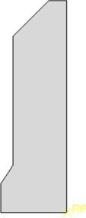
part:
Create the geometry of the model axisymmetric.
Define key features like die and billet for extrusion.

Slide 8
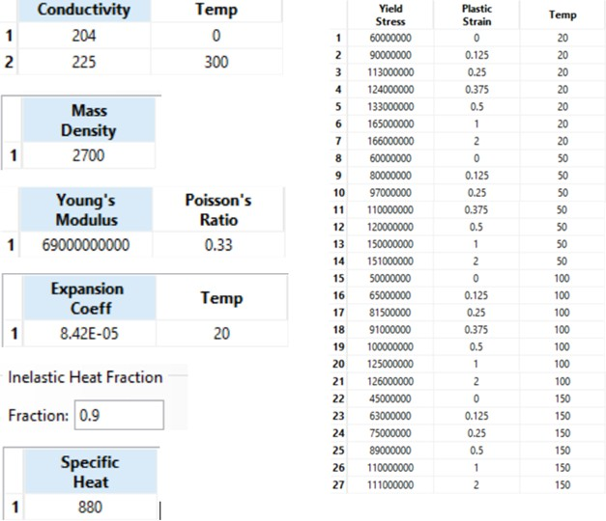
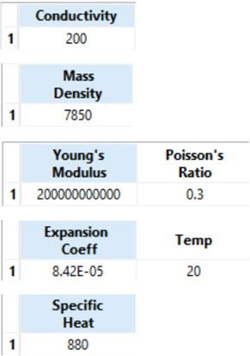
Property:
Aluminum
steel

Slide 9
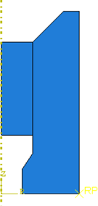
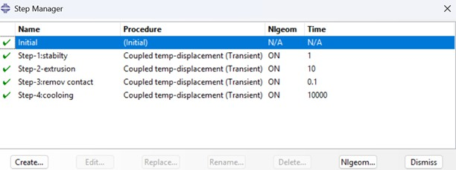
Step:
Assembly:

Slide 10
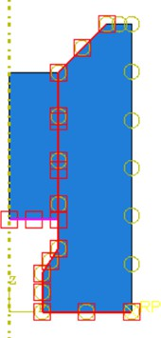
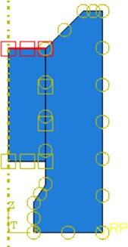
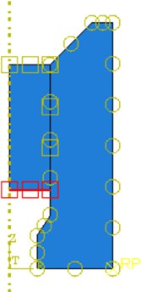
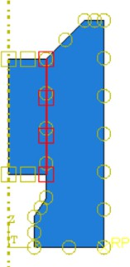
Interaction:

Slide 11
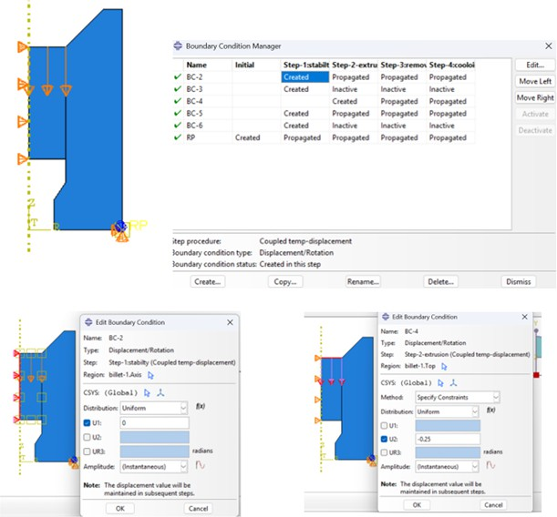
Load :

Slide 12
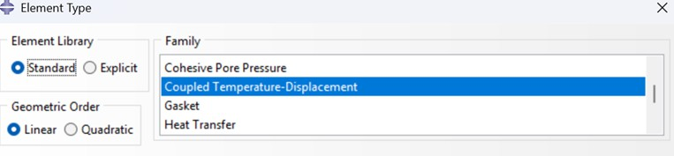
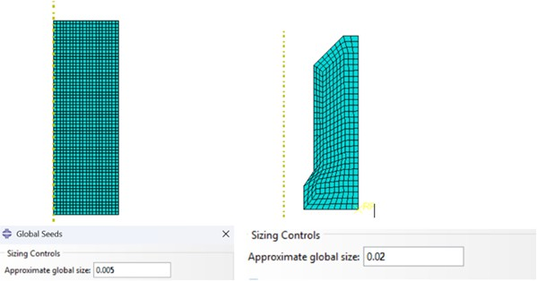
Mesh:

Slide 13
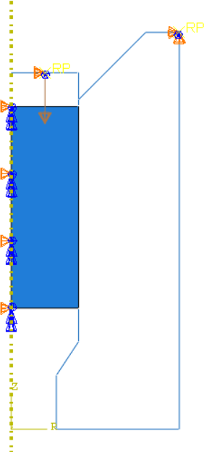
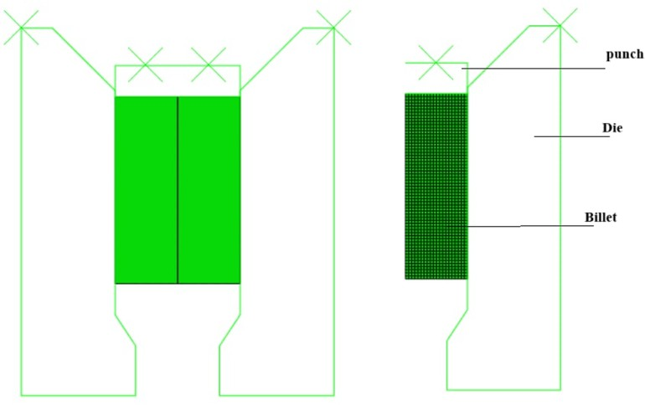
The model with rigid punch:

Slide 14
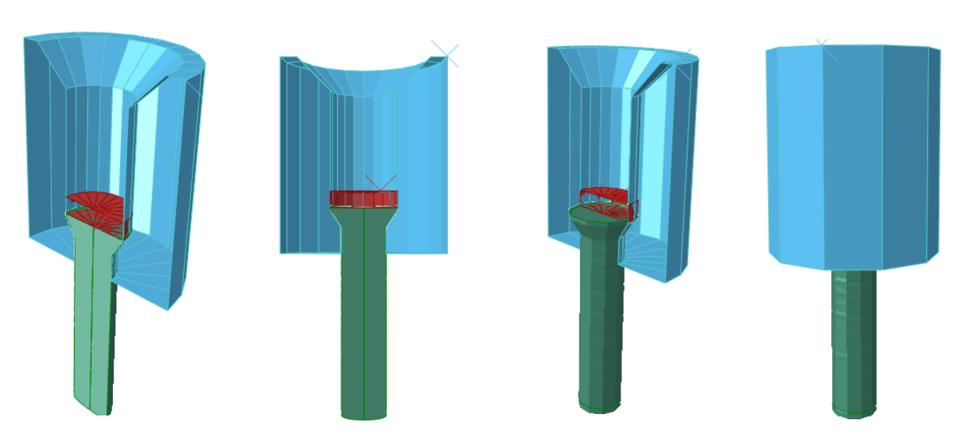
3D Model:

Slide 15
EXTRUSION DIE GEOMETRY G PROCESS PARAMETERS

Slide 16
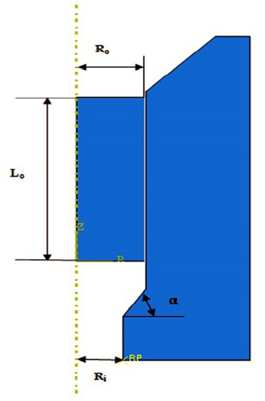

Die Angle (α) Friction Coefficient die profile radius die depth

Slide 17
MATERIALS USED IN THE
STUDY

Slide 18
AA6061 Aluminum Alloy
Ti-6Al-4V Titanium Alloy
AZ31 Magnesium Alloy

Slide 19
ANALYSIS OF EXTRUSION FORCE

Slide 20
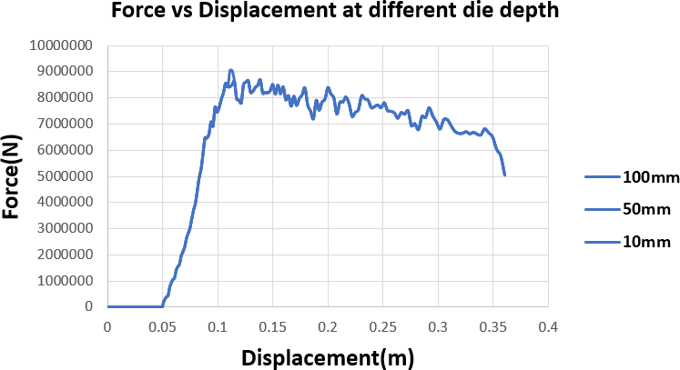
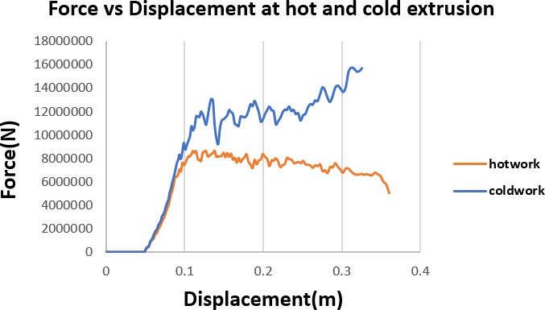
📌 Key Findings:
Die Depth: Had no significant effect on required force.
Cold vs. Hot Extrusion: Cold extrusion requires twice the force of hot extrusion.

Slide 21
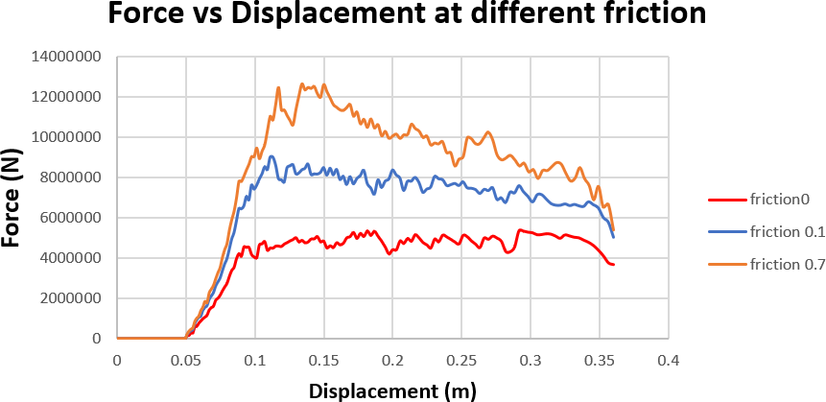
Friction Coefficient: Higher friction = Higher required force.

Slide 22
MATERIAL COMPARISON AA6061 VS. AZ31

Slide 23
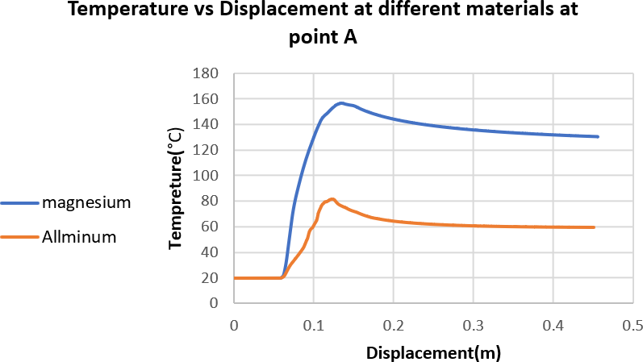


D
C B
A

Slide 24
·AZ31 magnesium exhibits higher temperatures (≈180°C at 0.5 m displacement) than AA6061 aluminum (≈160°C) due to its lower thermal conductivity and higher internal friction.
·Magnesium may require active cooling, while aluminum benefits from inherent heat dissipation.

Slide 25
EFFECT OF COEFFICIENT OF FRICTION ON NODAL TEMPERATURE DISTRIBUTION

Slide 26
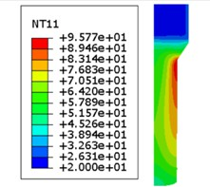
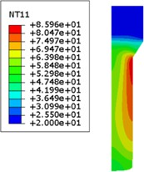
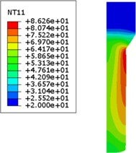
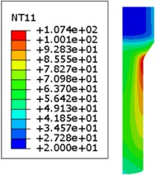
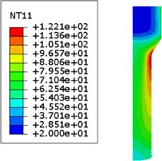
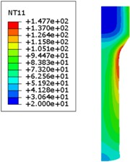
µ=0.001
µ=0
µ=0.025
µ=0.05
µ=0.075
µ=0.1

Slide 27
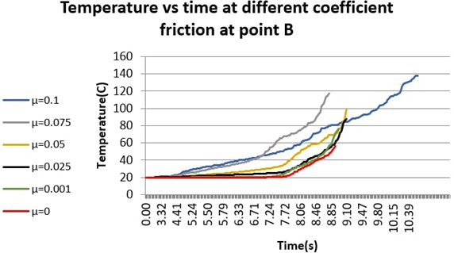

Slide 28
EFFECT OF DIE ANGLE ON HOMOGENEITY OF AA6061

Slide 29
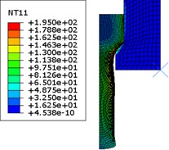
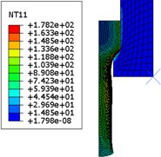
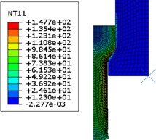
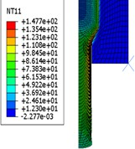
α =50
α =45
α =55
α =60

Slide 30
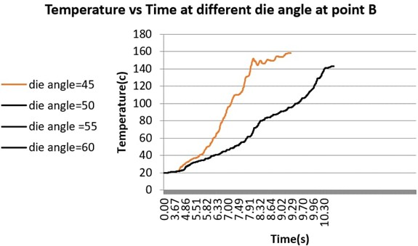

Slide 31
EFFECT OF DIE ANGLE ON EXTRUSION CONTACT PRESSURE

Slide 32
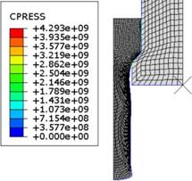
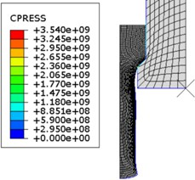
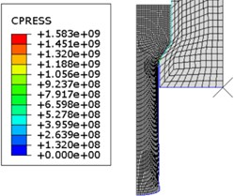
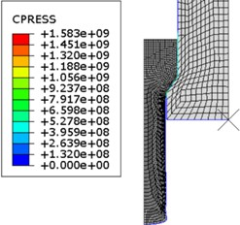
α =50
α =45
α =55
α =60

Slide 33
EFFECT OF DIE PROFILE RADIUS ON CONTACT PRESSURE

Slide 34
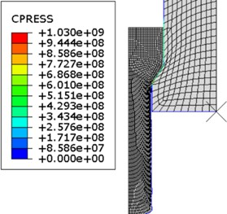
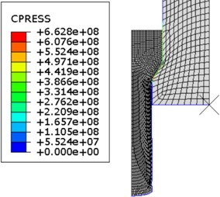
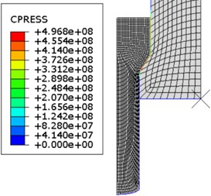
R =12 mm
R =10 mm
R =18 mm

Slide 35
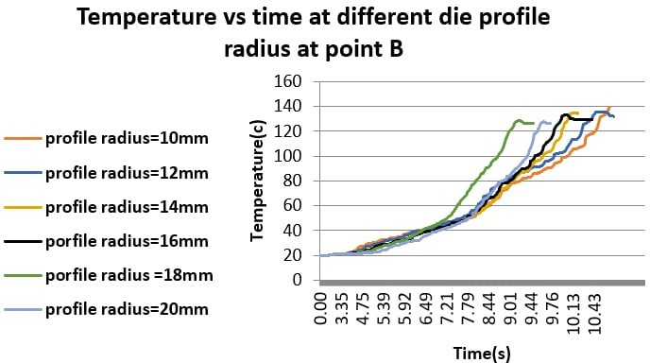

Slide 36
EFFECT OF STRAIN RATE ON TITANIUM ALLOY EXTRUSION

Slide 37
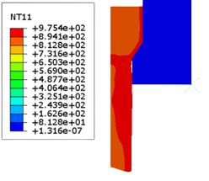
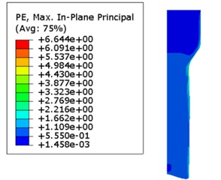
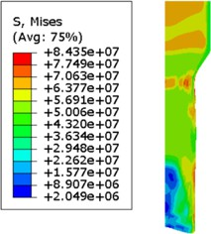
Without strain rate:

Slide 38
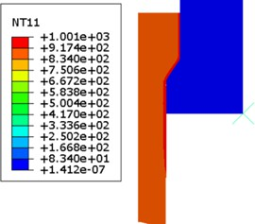
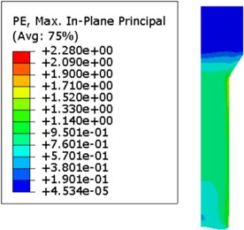
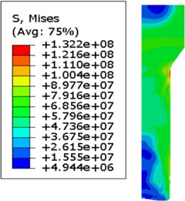
At strain rate =7:

Slide 39
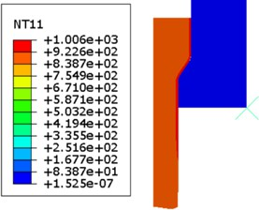
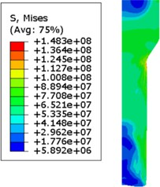
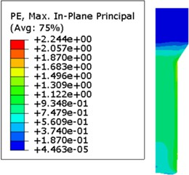
At strain rate =9:

Slide 40
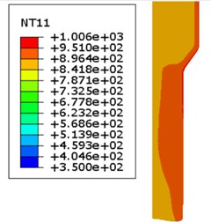


At strain rate =15:

Slide 41

D
C
B
A

Slide 42


D
C
B
A

Slide 43
THANK
YOU
FOR ATTENTION

