Slide 1




Ownly

Slide 2


What is Ownly?
Ownly is an intelligent real estate platform that brings together buyers, property owners, real estate experts, and administrators in one integrated system. The platform simplifies property management, property discovery, expert consultation, appointment scheduling, and AI-powered property evaluation to help users make informed real estate decisions.

Slide 3


Who Uses Ownly?
Buyers
  Search, compare, and save properties.
  Request expert consultations.
  Schedule appointments and use AI evaluation tools.
Property Owners
  Publish and manage property listings.
  Monitor property performance and bookings.
1
2
Real Estate Experts
  Provide professional consultation services.
  Manage appointments and communicate with clients.
Administrators
  Manage users, properties, experts, advertisements, and platform content.
3
4

Slide 4



Our Goals
  Create a secure, responsive, and scalable platform.
  Facilitate appointment scheduling between users and owners.
  Simplify property buying, selling, and management.
  Help buyers find suitable properties quickly and efficiently.
  Enable property owners to manage their listings easily.
  Provide expert consultation services.
  Integrate AI for property evaluation and analysis.

Slide 5
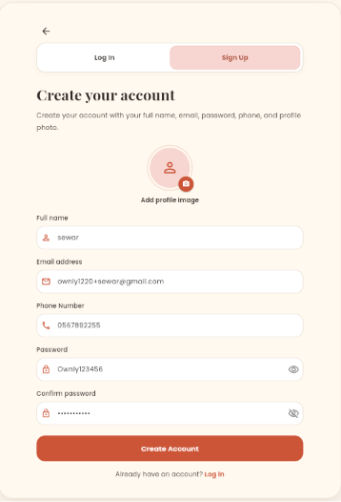
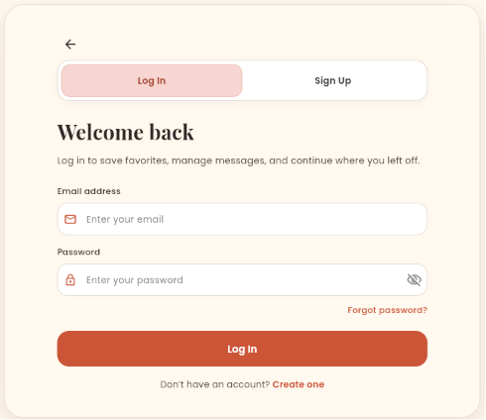
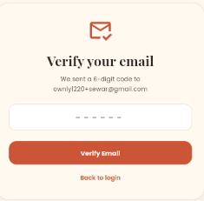
Login & signup

Slide 6
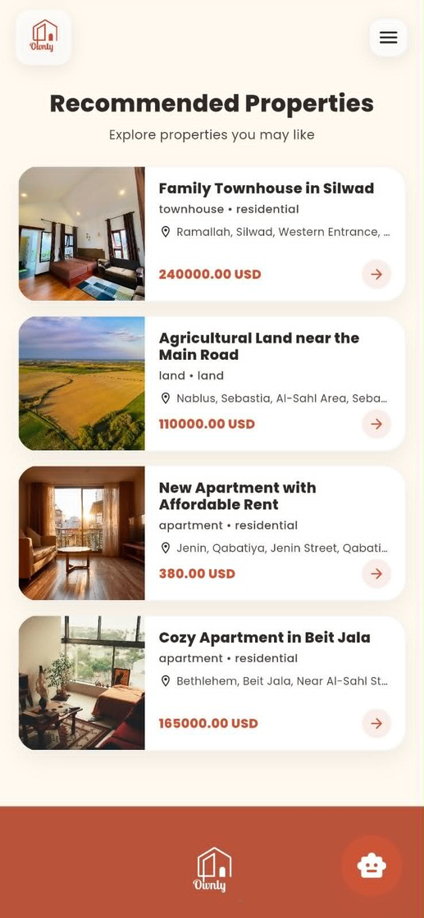
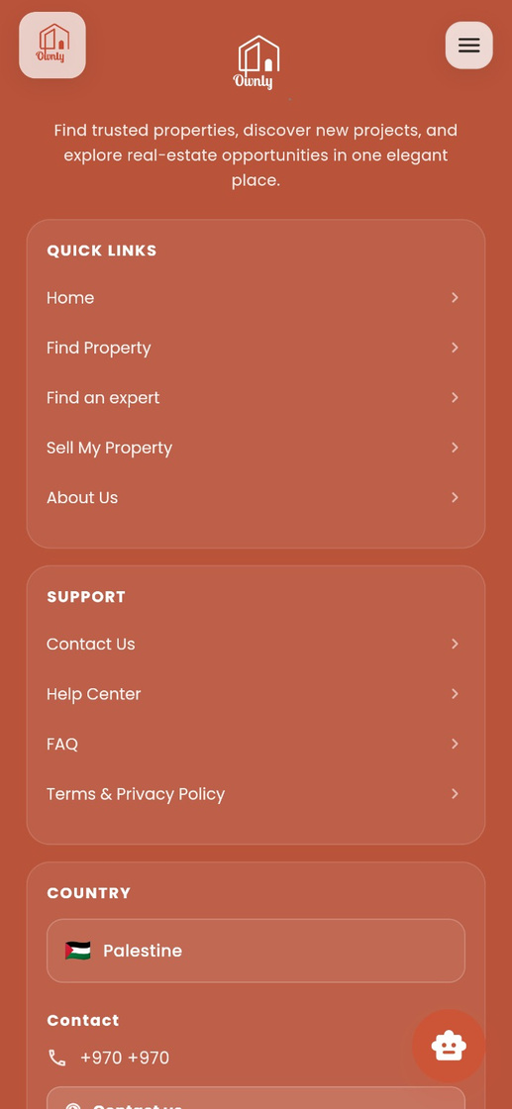
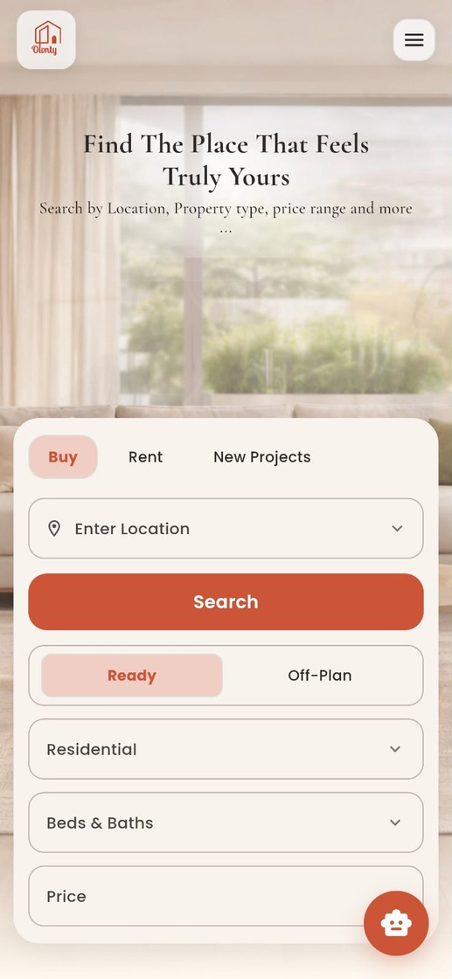
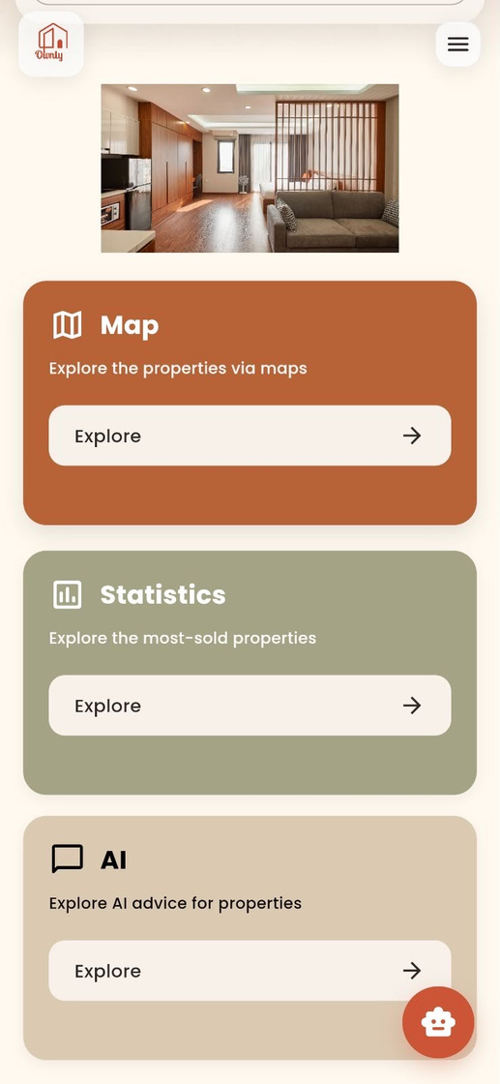
Home Page

Slide 7
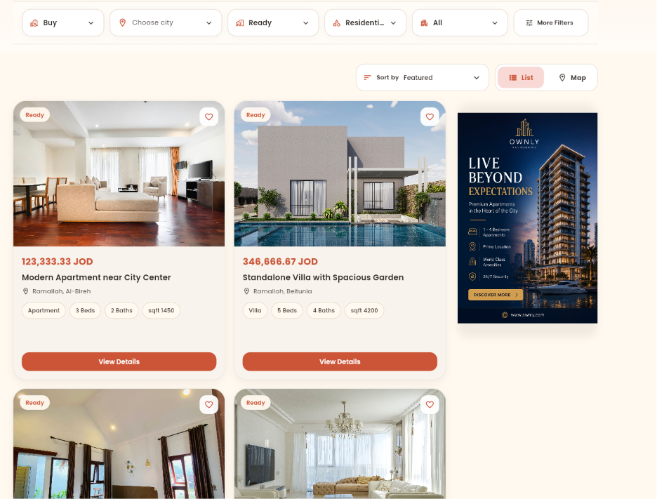
Search and Filtering

Slide 8
Home Page

Slide 9
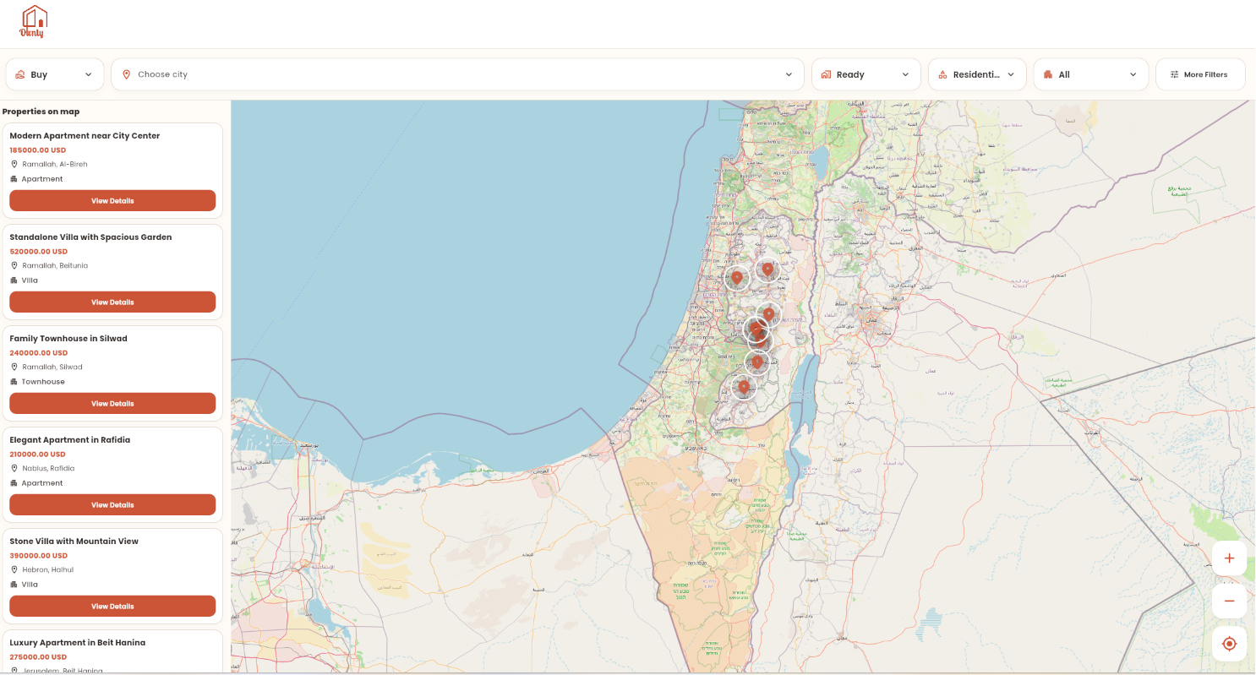
Map-Based Property Search

Slide 10
Home Page

Slide 11
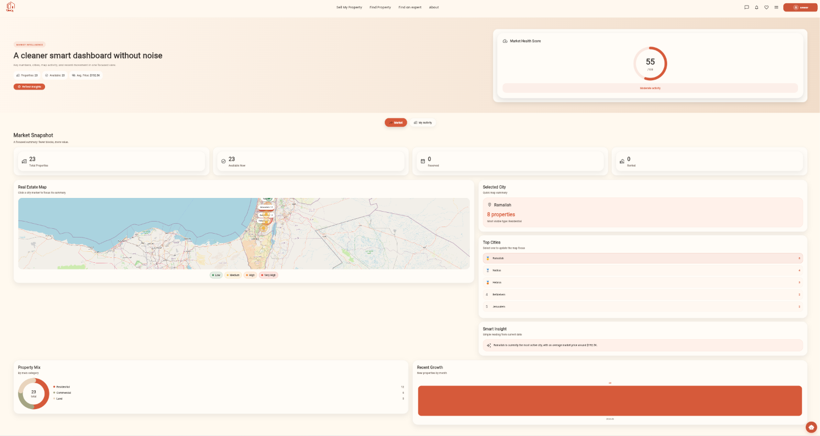
Market Insights Dashboard

Slide 12
Home Page

Slide 13
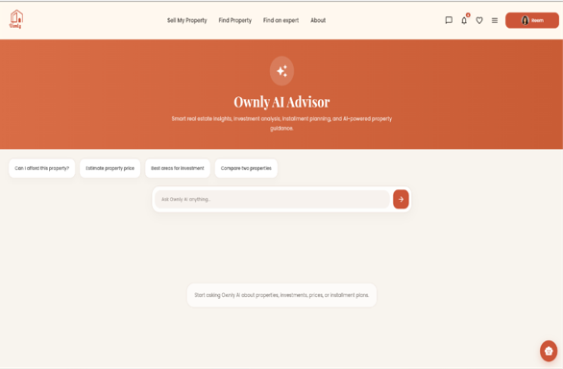


AI-Powered Services
AI-Advisor

Slide 14
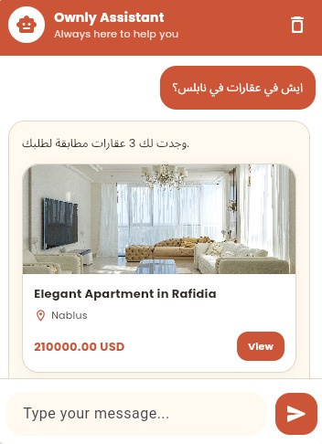
AI-Powered Services
AI-chatpot

Slide 15
Search and Filtering

Slide 16
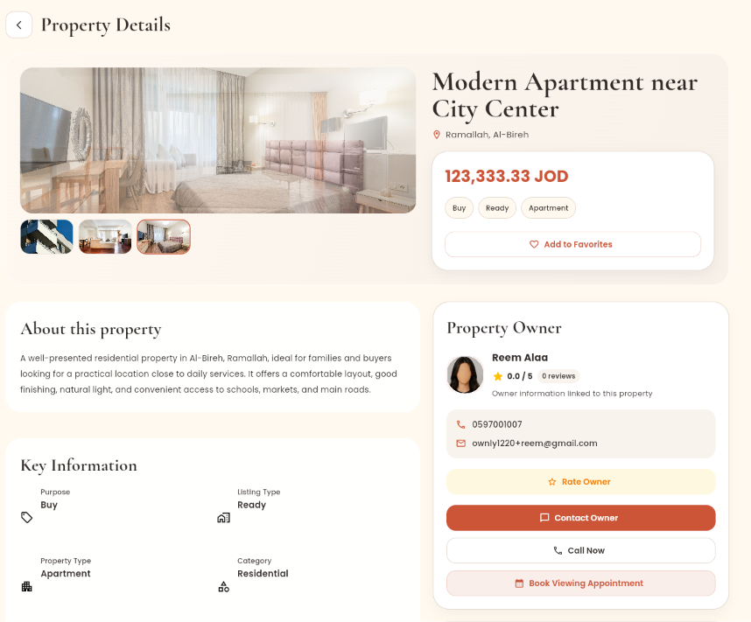
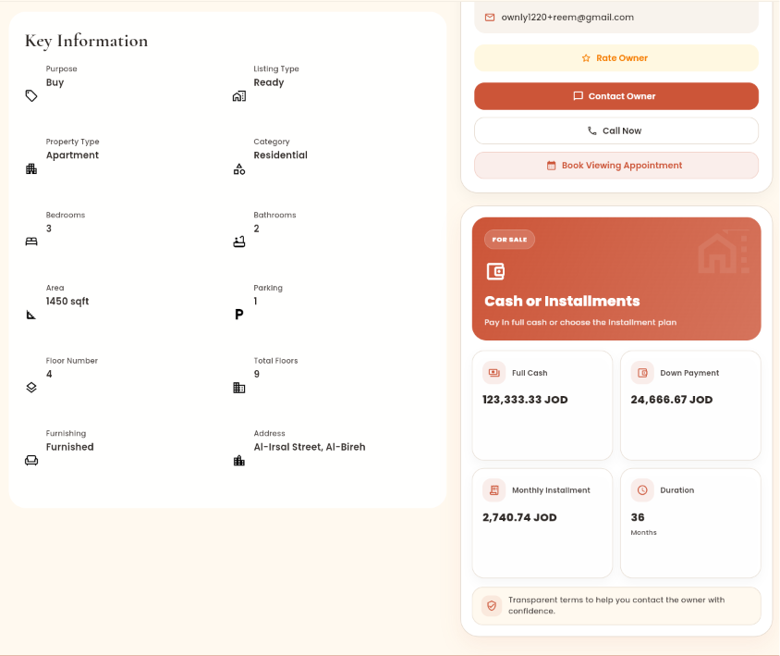
Property Details

Slide 17
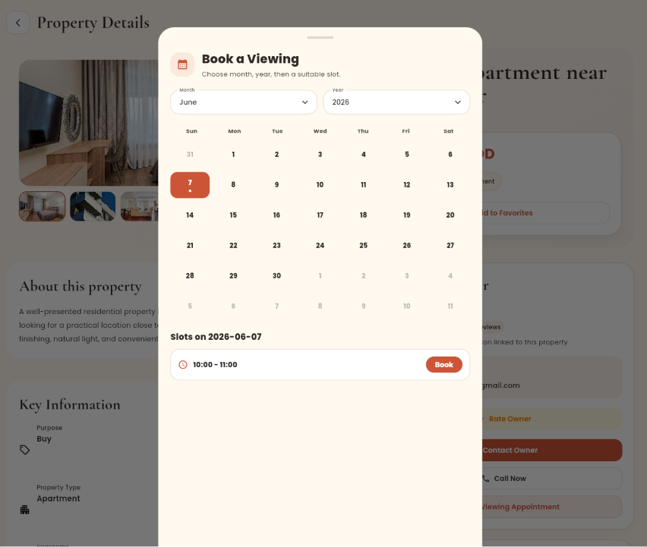
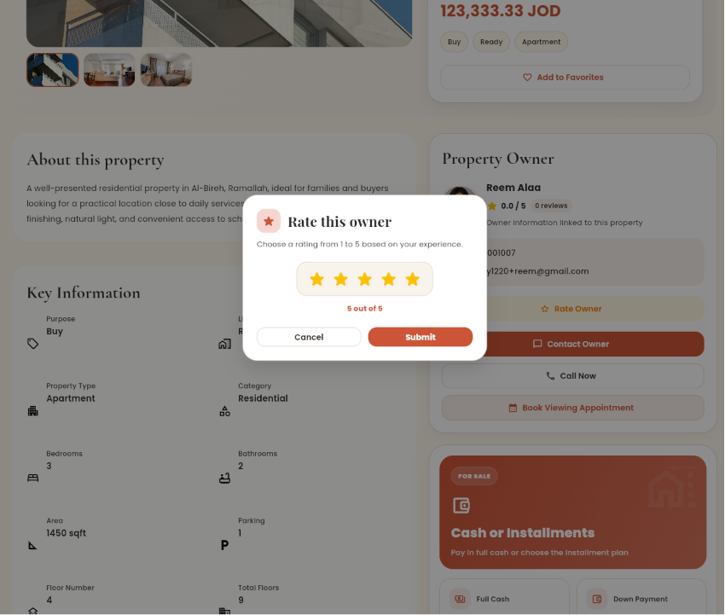
Property Details

Slide 18
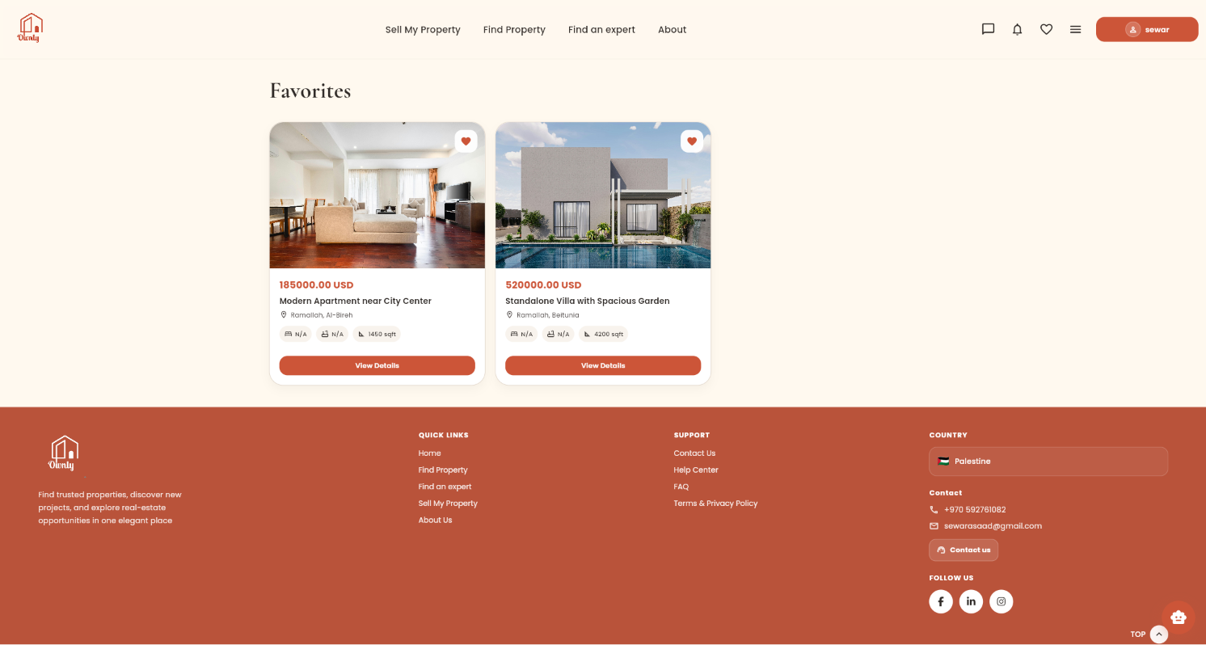
Favourites

Slide 19
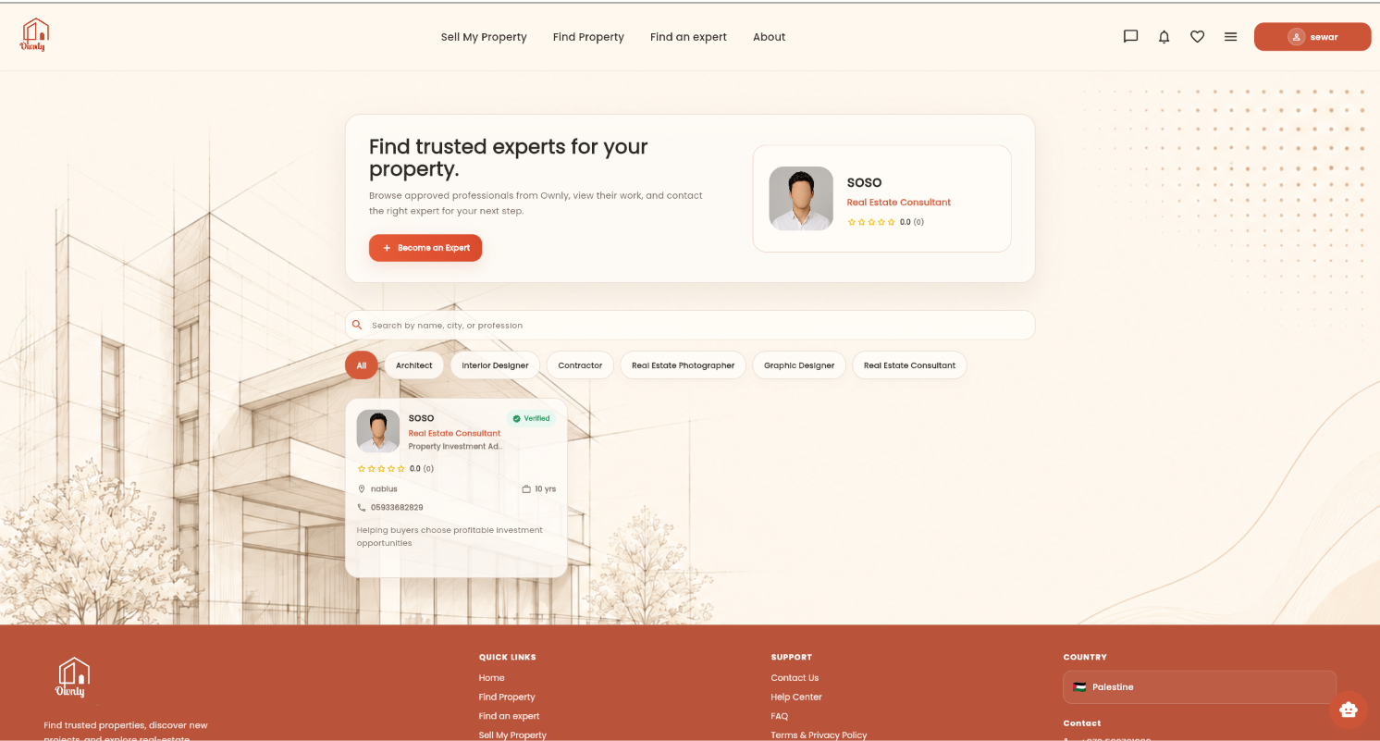
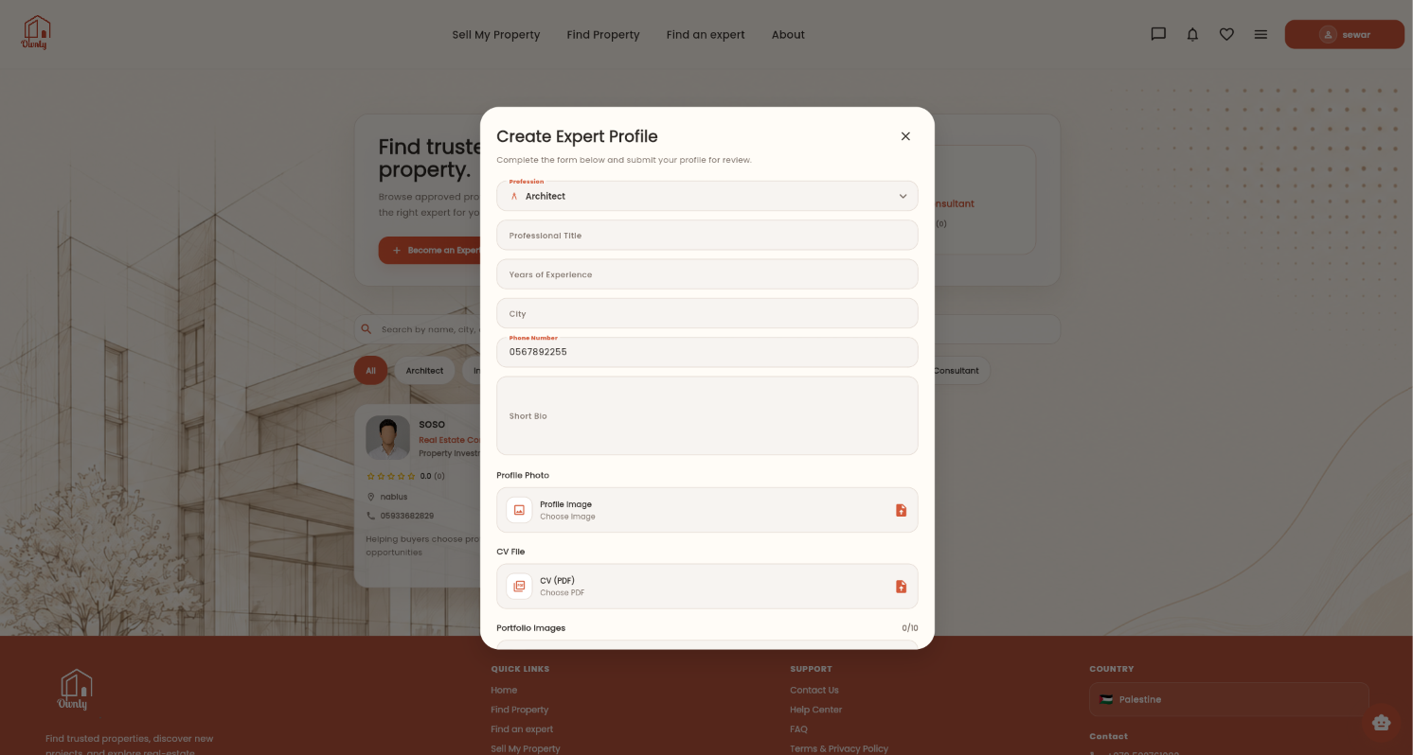
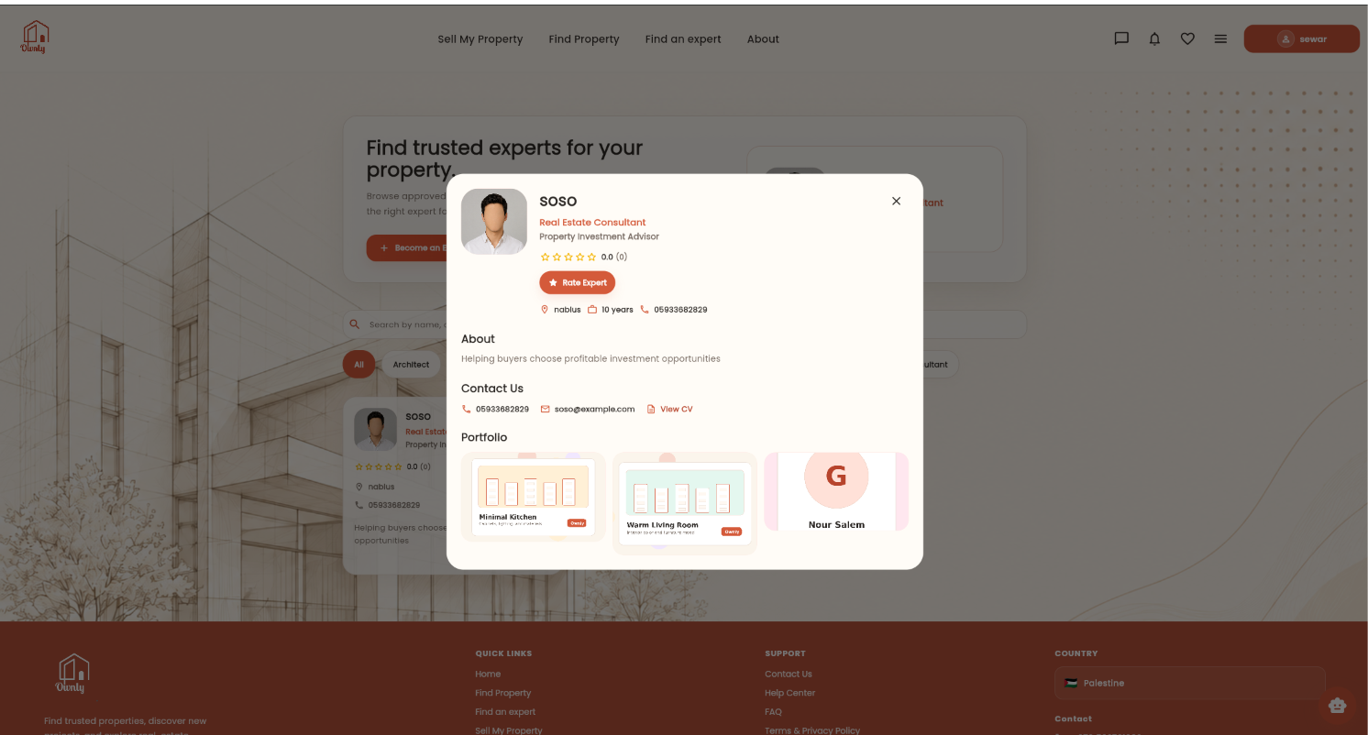
Expert Consultation

Slide 20
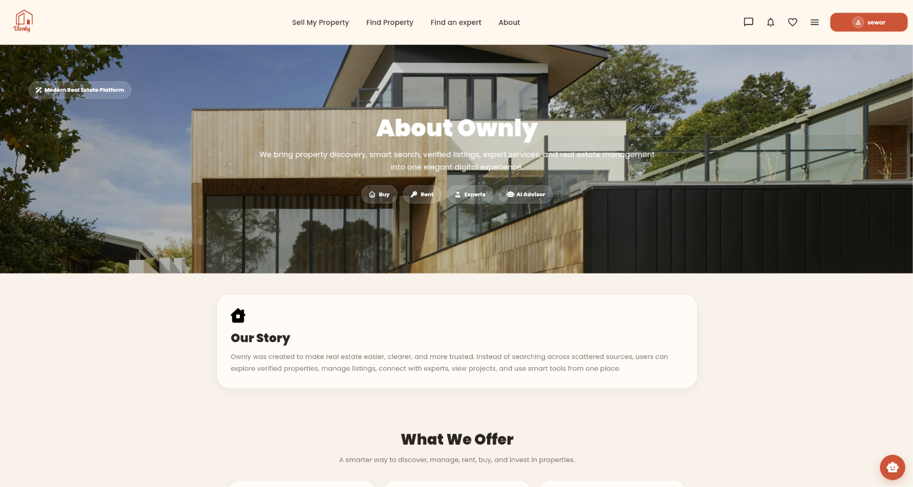
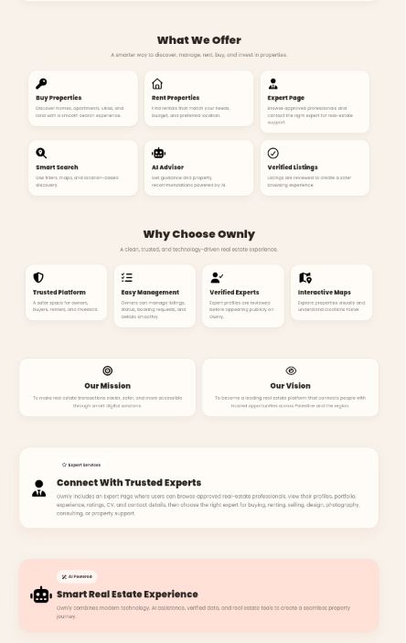
About Page

Slide 21
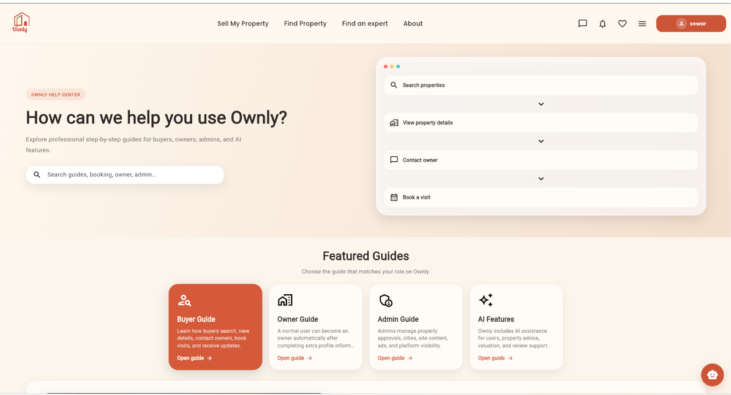
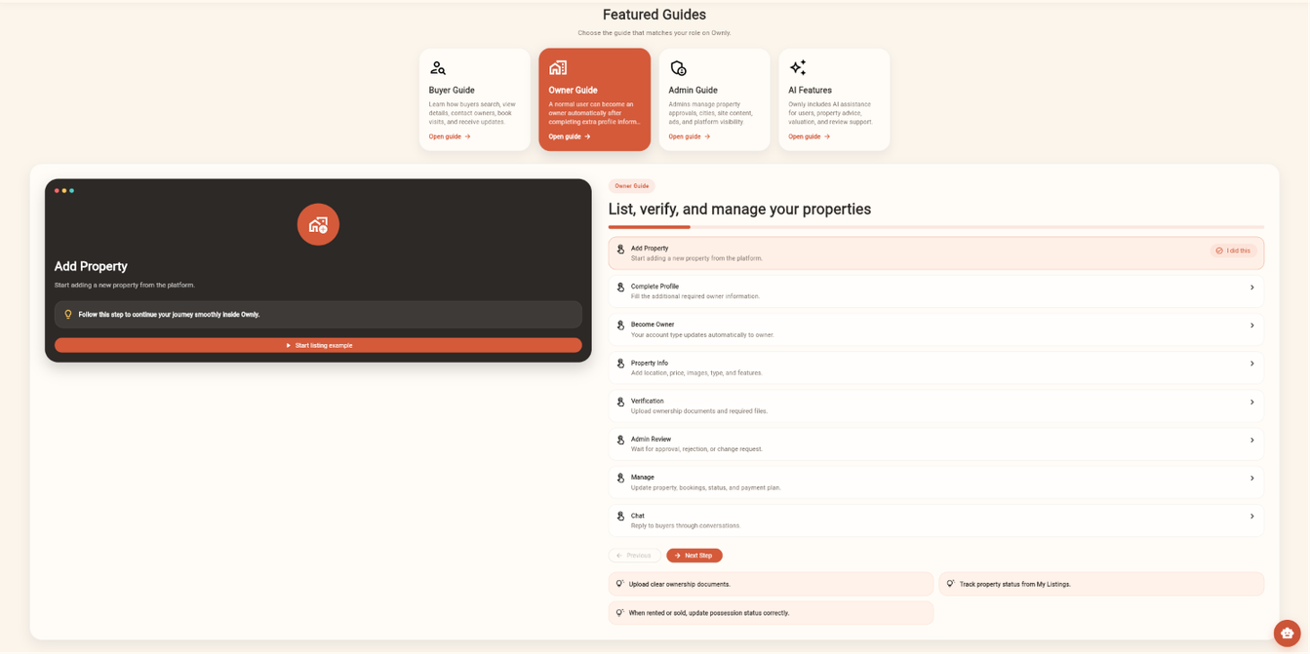
Guides

Slide 22
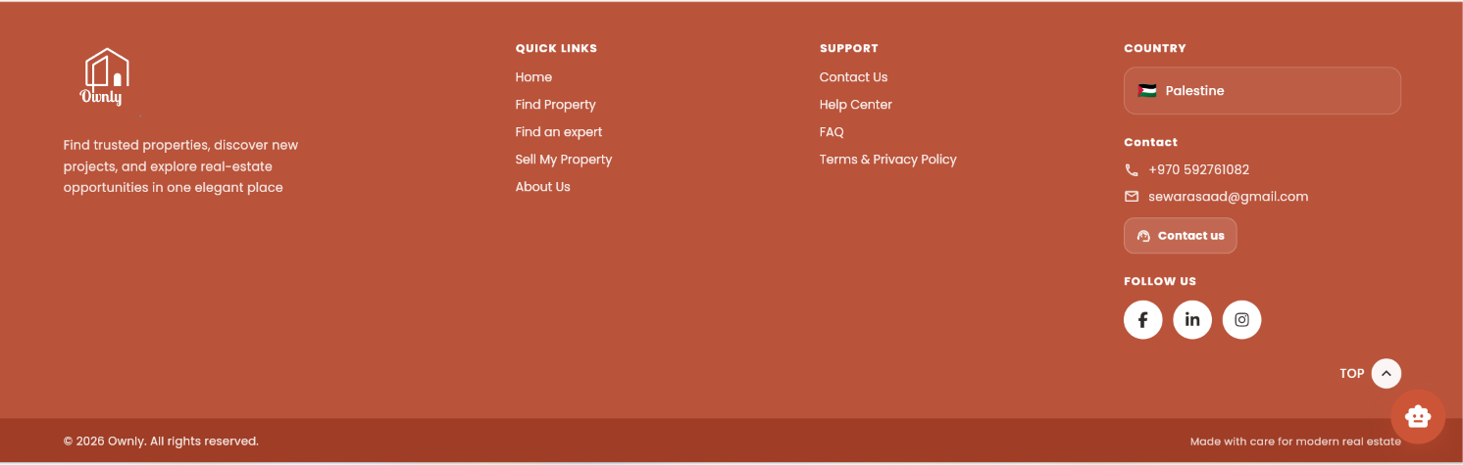
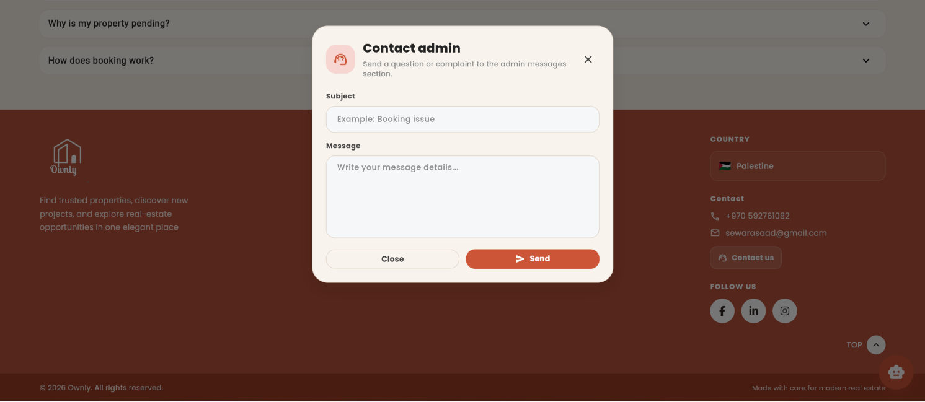
Contact Support

Slide 23
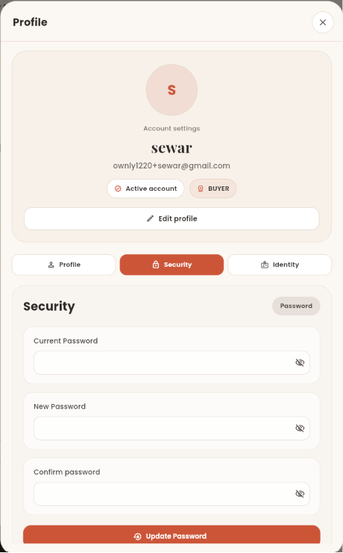
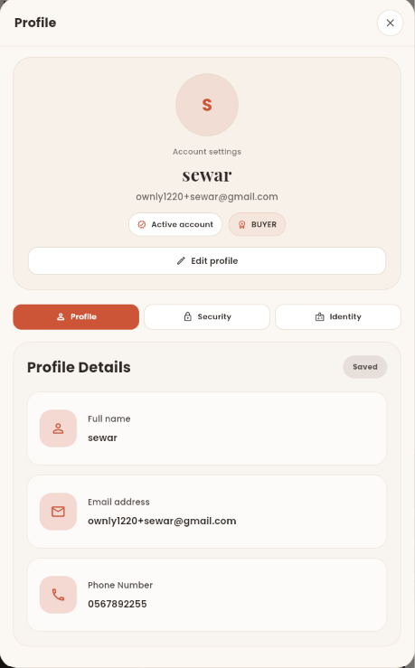
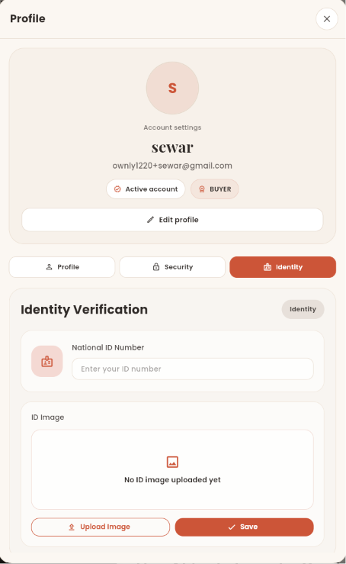
Profile Management

Slide 24
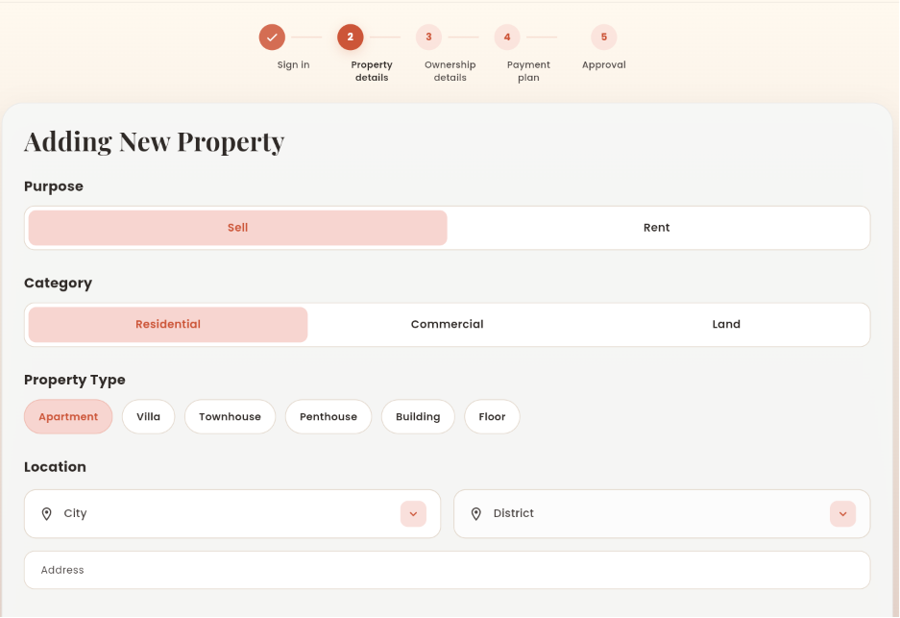
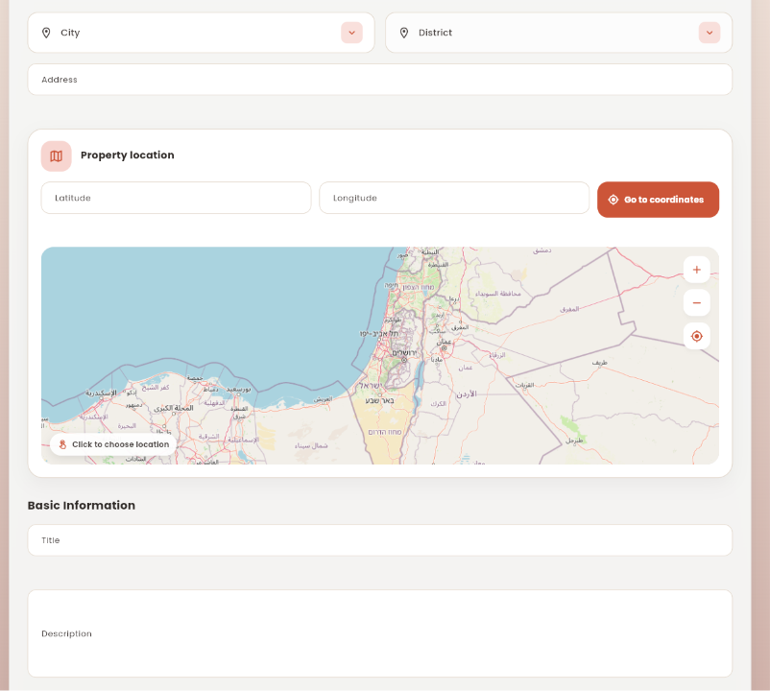
Property Listing Creation & Ownership Verification

Slide 25
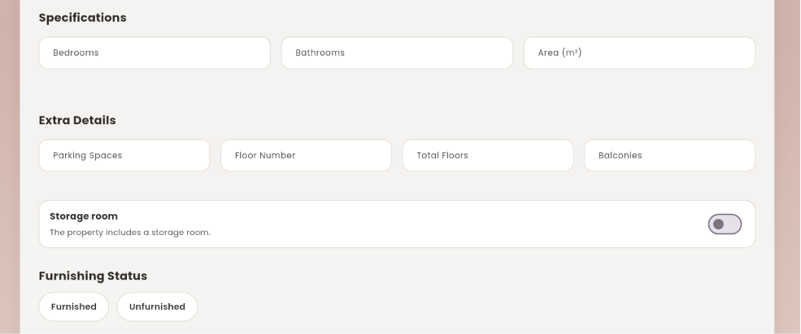
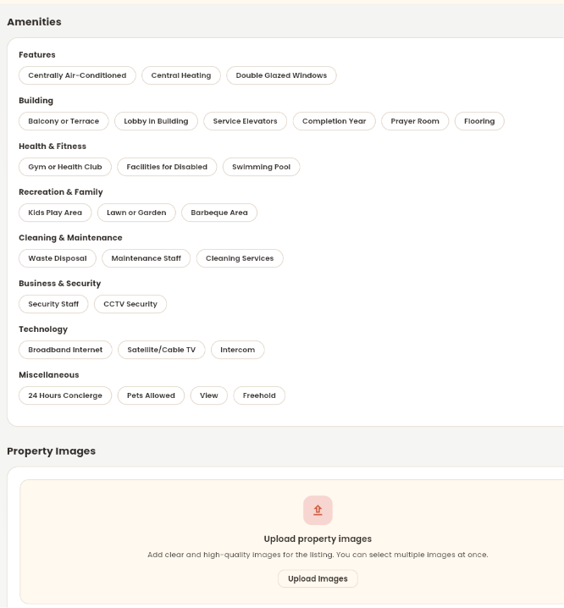
Property Listing Creation & Ownership Verification

Slide 26
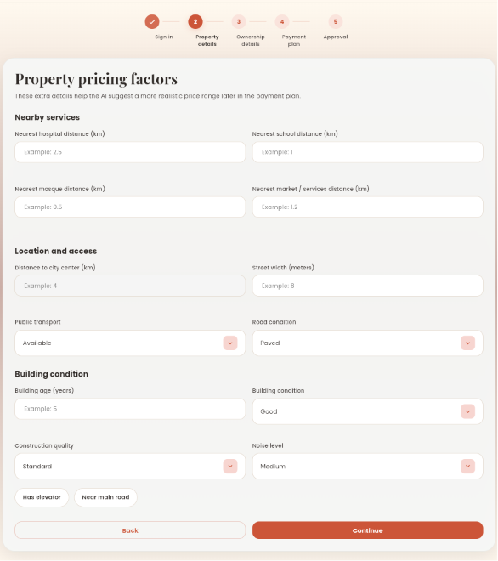
Property Listing Creation & Ownership Verification

Slide 27
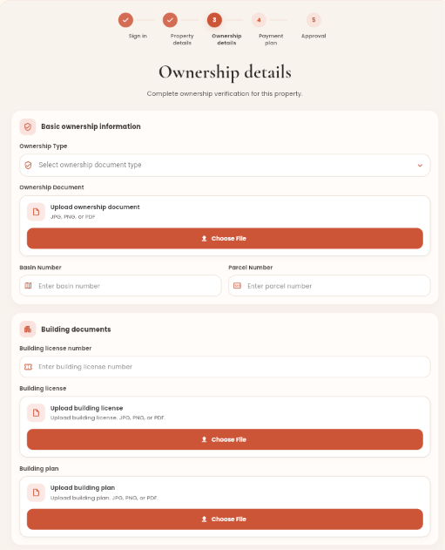
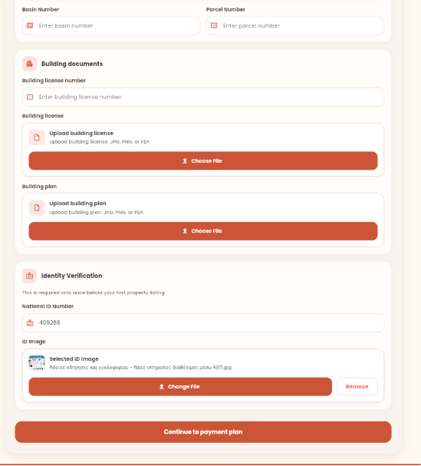
Property Listing Creation & Ownership Verification

Slide 28
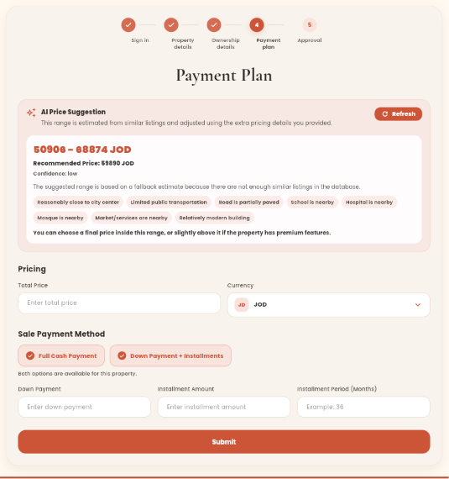
Property Listing Creation & Ownership Verification

Slide 29
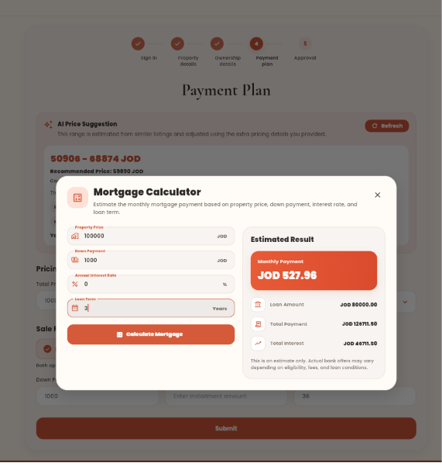
Property Listing Creation & Ownership Verification

Slide 30
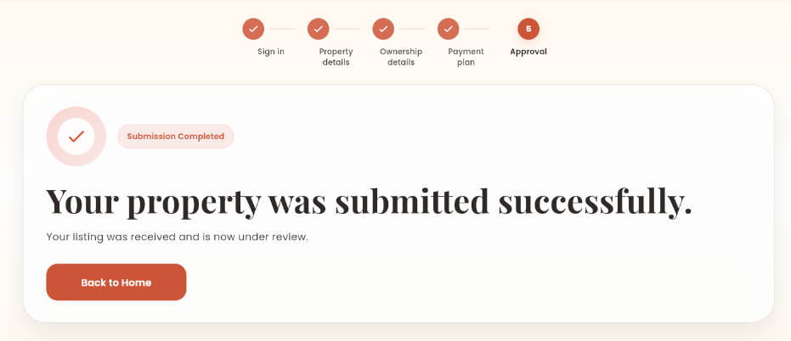
Property Listing Creation & Ownership Verification

Slide 31
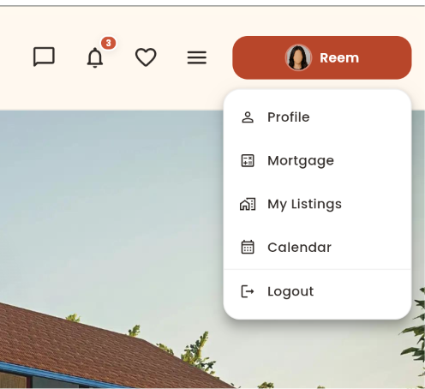
Property Owner Module

Slide 32
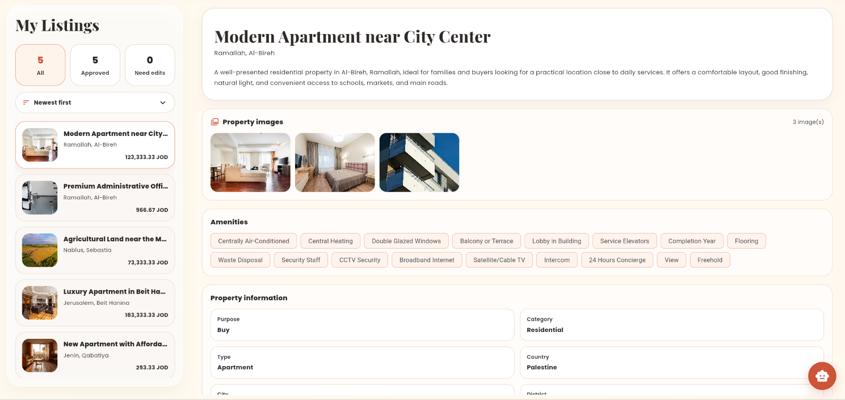
Property Owner Module
My Listings

Slide 33
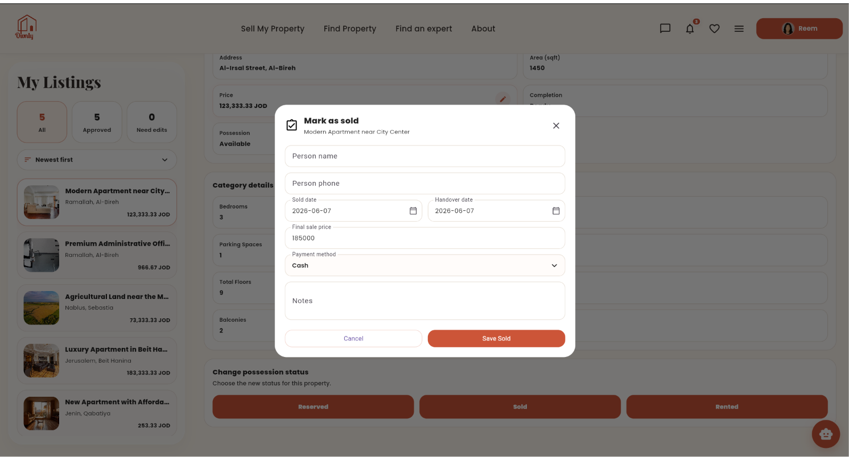
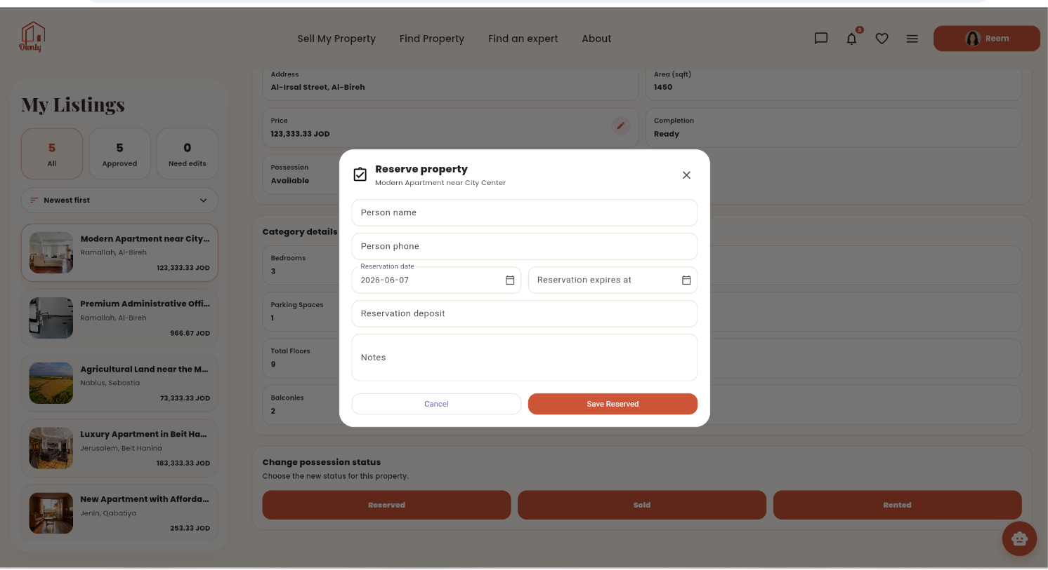
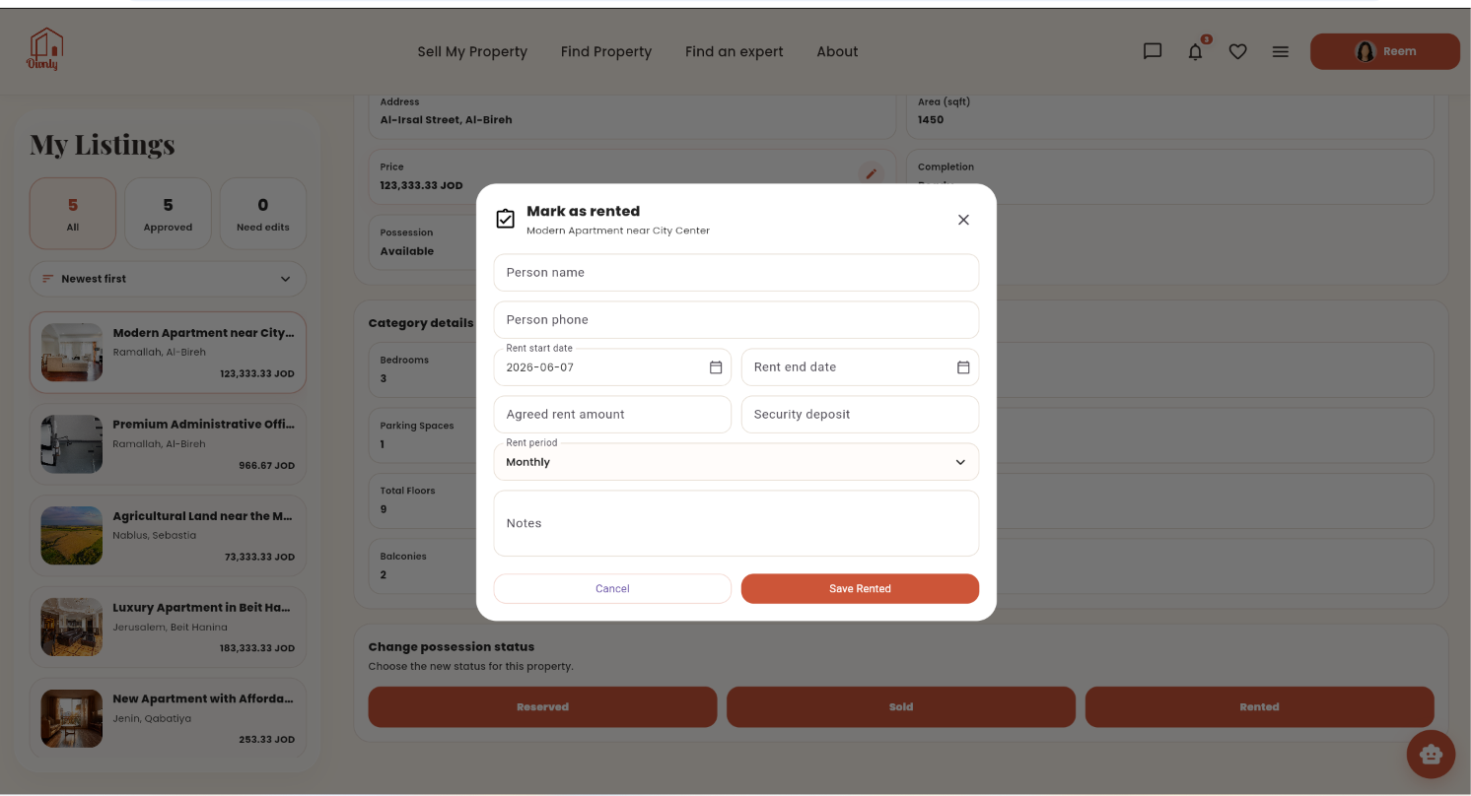
Property Owner Module
My Listings

Slide 34
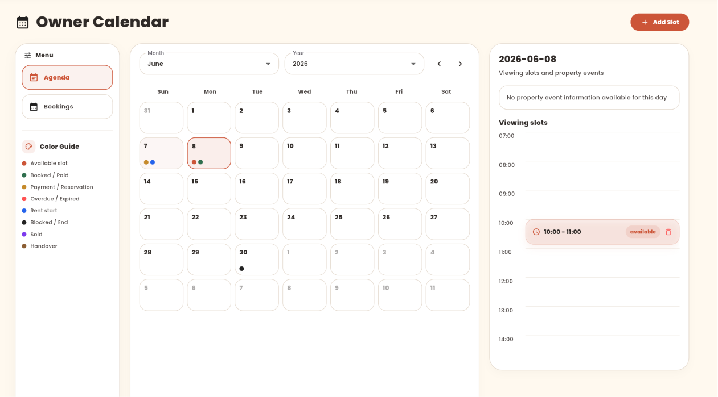
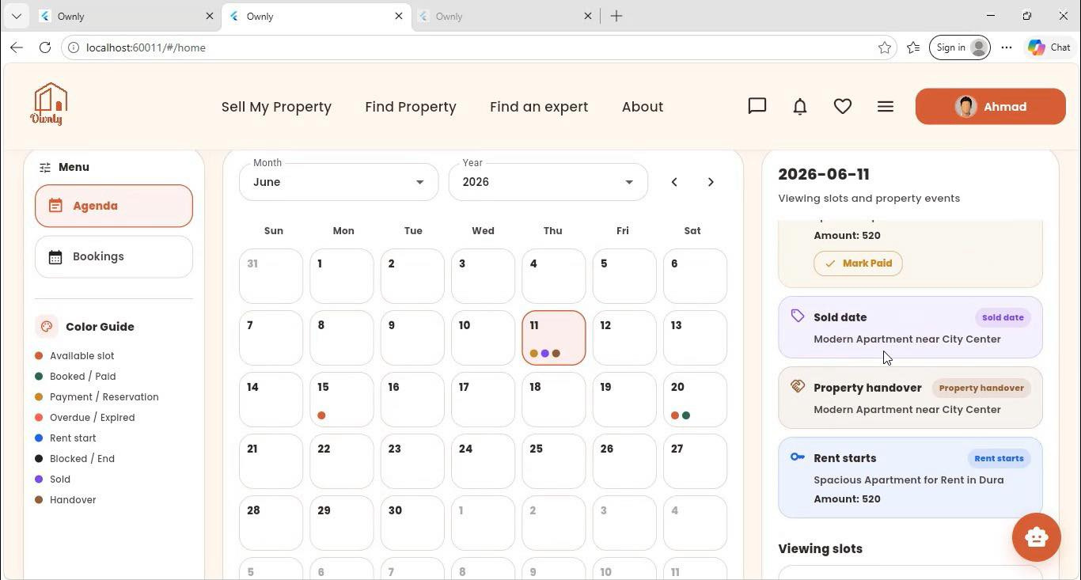
Property Owner Module
Owner Calendar

Slide 35
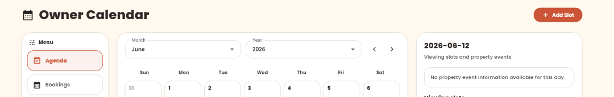
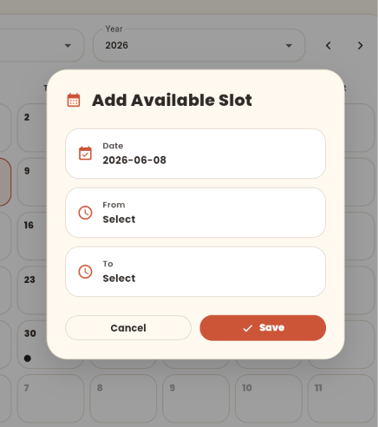
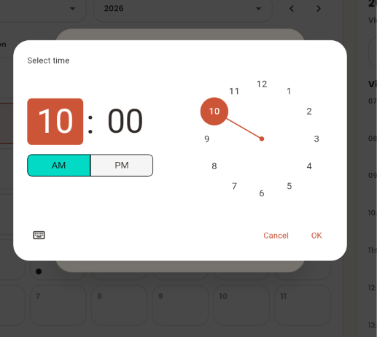
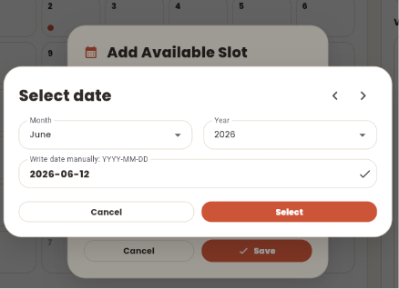
Property Owner Module
Owner Calendar

Slide 36

Property Owner Module
Owner Calendar

Slide 37

Admin Dashboard
Main

Slide 38

Admin Dashboard
Properties Management

Slide 39


Admin Dashboard
User Management

Slide 40

Admin Dashboard
Expert Applications

Slide 41

Admin Dashboard
Advertisement Management

Slide 42

Admin Dashboard
Messages Management

Slide 43

Admin Dashboard
Broadcast Management

Slide 44

Admin Dashboard
Site Content Management

Slide 45

Admin Dashboard
Site Content Management

Slide 46



General Settings

Slide 47


General Settings

Slide 48


Challenges
  Integrating AI-powered property evaluation.
  Building a responsive interface for different devices.
  Ensuring secure communication between all system components.

Slide 49
Future Work
  3D Property Tours
  Smarter AI Features
  Market Expansion

Slide 50



Thank you
Presented by
Sewar & Maha
14 June 2026

