Slide 1

Analysis and redesign of Selit Al- Daher water distribution network
Dr . Mohammad Almasri prepared by :- Ehab Abu Diak
Sutlan Qadri

Slide 2
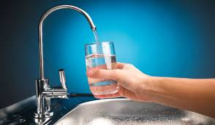
The Importance of water
Water is an essential substance for all human beings , animals and plants . So it is important to have water with good quality in a good and efficient way. And to check if this happening in Selit Al-Daher is our task.

Slide 3
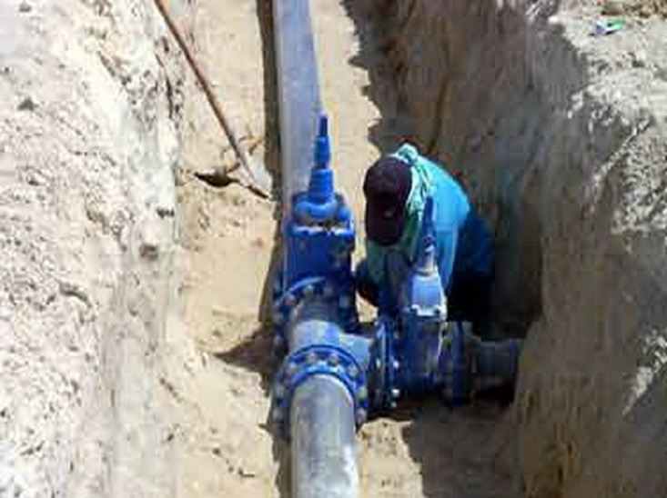
Delivering water needs to be in a good ,efficient way through distributing networks, that this network must save energy, money, water and the quality of the delivered water

Slide 4
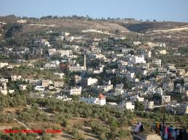
In this project we are studying the WDN of Selit Aldaher to modify or redesign the (WDN) to meet the requirements for the next 30 years if needed.

Slide 5

The first objective was studying the water condition on the town by meeting engineers working with the local governorate and asking people living in that area about the water delivered to them.

Slide 6
The second objective was studying the hydrulic condition for the existing WDN using programs like (WaterCAD) to find results as the amount of water demand, supply, losses and head loss

Slide 7
SELECTION OF STUDY AREA
PROBLEM DETERMINATION
DATA COLLECTION
ANALYSIS OF WATER RESOURCES
DEVELOPMENT OF WND MODEL
HYDRULIC ANALYSIS
HYDRULIC ANALYSIS

Slide 8
The study area
Seilt Aldaher town lies about 20 km to the south of Jenin city in the north of the west bank, it has a population of 7500 capita. It has large farming areas and about 6 large animal farms , so there is a high water demand

Slide 9
Problem determination
We found that the (WDN) in this town need to have more loops to deliver water in more than one direction, and it needs to redesign some of its branches to meet the recommended pressure, velocity and energy consumption.

Slide 10

Data Collection
We started by collecting data from hard copy reports, GIS shapefiles, meetings with engineers working with the local governorates and asking people living in that area about the water delivered to them

Slide 11
Analysis of water rosources

