Slide 1

An-Najah National University
Faculty Of Engineering
Department Of Civil Engineering
Graduation Project 2
Construction Project Management
Delay In Construction Project
“ Al-Mghayer School Project”
Supervised by:
Instructor: Sami Khalefeh
Prepared By:
Anan Abujaber
Muath Waked
Mohammed Jaradat
Baha Al- A’araj

Slide 2
Delay is a major problem that faces the construction projects. Therefore, this research will identify the delay, its causes, and effects.
Introduction
Delay is time over run either beyond completion date specified in a contract, or beyond date that the parties agreed upon for delivery of a project.

Slide 3
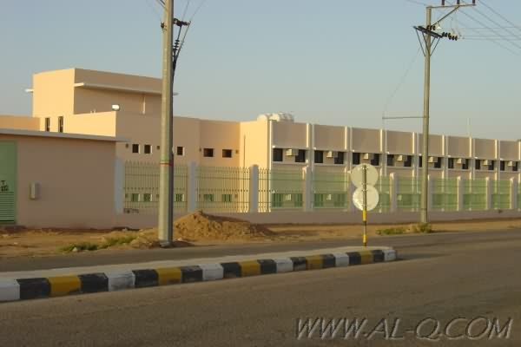
This study will take Al-Mghayer school project as a real case study
This project was planned to start on 21/8/2011 and to finish on 18/2/2012.
In actual, the project was
delayed for more than 40 days ,So this study will seek for the reasons behind the delay in this project.

Slide 4

To enrich this Research, four previous case studies were reviewed and analyzed. These studies are:-
1. Delays in construction projects “The case of Jordan”.
2. Delay mitigation in the Malaysian construction industry.
3. Causes of delay in the planning and design phases for construction projects.
4. Avoiding and minimizing construction delay claim disputes in relational contracting.

Slide 5

Methodology
This study will take Al-Mghayer school project as a real case study to
analyze it and then to extract the main causes which lead to delay in the delivery of the project on time.
Re-visit the specifications and the quantities of the Al-Mghayer school.
The methods are used for data collection are:-
Interviews:
Documentary analysis:
Focus Group:

Slide 6
Data Analysis
Using the previous mentioned tools of the methodology (analysis of daily report, interviews, focus group and by making an ideal time schedule for the project ; analyze for the project as month by month was executed as the following:
Analysis for August (8)…………………..:
Analysis for September (9)……………..:
Analysis for October (10)……………….:
Analysis for November (11)…………….:
Analysis for December (12)…………….:
Analysis for January (1)………………….:
Analysis for February (2)………………..:
Analysis for March (3)……………………:

Slide 7
Analysis of August (8):
Table (4-1): Comparison between the ideal and the actual schedules of August
Ideal schedule (primavera)
Activity |  | Must start | Must finish |  | duration |  | resources
Mobilization |  | 21/8/2011 | 22/8/2011 |  | 2 |  | 2 labors
Excavation |  | 23/8/2011 | 27/82//2011 |  | 4 |  | 3 labors 1 excavator
Footing |  | 28/8/2011 | Nc |  | 4 |  | 7 labors
Actual(daily reports)
Activity | Must start |  |  | Must finish | duration | resources
Mobilization | 21/8/2012 |  |  | Nc | 5 | 2 labors
Code of the symbols:
(*): Working days in this month/total duration (Nc): not completed in this month , (Pr): started in previous month
Activities that must be done (as scheduled)
Activities was already done(actual)
there was no work in the days (27, 28/8/2011) without giving any details
See appendix (A)
29-8-2011 there was an official letter (obstacale on the road
See appendix (B)

Slide 8
Results and Discussion
After applying the tools that were mentioned in methodology, and
making the analysis ;the following main causes are extracted:-
Reasons related to Recourses.
2. Access road to the project.
3. Poor planning.

Slide 9
4. The actual works are not identical with the ideal schedule .
5. poor- Supervision.
6. Crashing was not taken as a solution to mitigate the delay.
7. Inadequate Coordination in the work between the different parties in the site.

Slide 10
Conclusion and Recommendation
1- Resources :
The productivity rate:
Lack of credibility by filling the data:
lack in the resources :
2- site submission :
3- Clear time estimate must be made :

Slide 11
Conclusion and Recommendation
4- Good supervision ensure to be on schedule:
5- Crash:
6- Coordination between the engineers leads to consistency in the work:

Slide 12
Conclusion and Recommendation
7-More site meetings with all parties of the projects
8-All needed information and details must be clear and enough in the Daily reports:
9-Specifications and instructions of the supervising must be seriously applied

Slide 13
Thanks
For Your Attention

