Slide 1

An- Najah National University
Rehabilitation of Nablus Electrical Network by adding a new connection point
Submitted To :
Dr. Maher Khammash
Prepared By :
Ahmad Hatem Abd-Albaqi
&
Ali Namrouti
2015-2016

Slide 2
Introduction
Our project is to study the performance of Nablus Network and to add a new connection point in the eastern region of the city of Nablus at the village of " Huwwara " with maximum capacity up to 20 MW.
Analyzing and make a load flow study using ETAP software and trying to achieve the optimum performance for “Eastern Region” Network .
Taking into consideration that there are 6 connection points in the electrical network of the city of Nablus.

Slide 3
Objectives
Collecting data for the new connection point including all parameters and their specifications ( location, transmission lines , switchgear , load ).
Designing the one line diagram in ETAP program for new condition by adding the new supply bus .
Improving the voltage level and reducing the losses and correcting of power factor in the network .
Making the system more protected by increasing reliability and stability .
Analyzing the network under maximum load condition using load flow analyses.
To get economical benefit when improving the performance of network.

Slide 4
Why new connection point ?
The main problem which faces Eastern Region Network is that the power supplied by IEC الشركة القطرية الاسرائيلية ) ) is not enough for the demand in the city, especially in the summer season . And because the old connection point has a capacity up to 20 MW which is not sufficient for the network demand because the old connection point supplies more than one region, such as the industrial area and “Al-Bathan” .
To solve this problem , we add a new connection point with IEC in the eastern region of the city of Nablus in the village of " Huwwara " through an over head transmission line of 33 kV. The max demand is reached approximately to (20 MW) to cover the total demand .

Slide 5
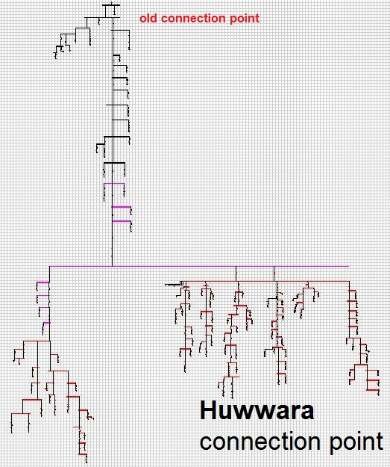
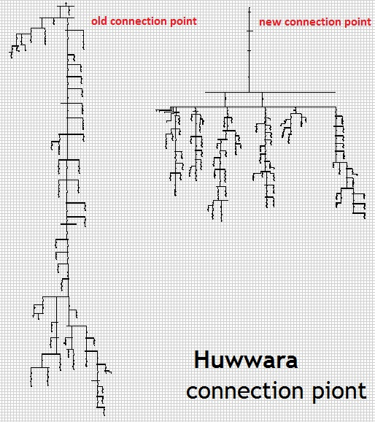
Eastern Region Network
Before & After

Slide 6
Methodology
Collecting data for new C.P and elements
Plotting one line diagram for new network
Changing the voltage level to 11 kV instead of 6.6 Kv
Improve p.f to avoid penalties
Making Economical study for our project
Analyzing the network under max. load case

Slide 7
Plotting one-line diagram using ETAP software for new Network
We make a load flow study and analysis Network using ETAP software .
Components of the network :
Two sources (33 kV) .
( 280 ) bus in this network .
( 107 ) loads( residential, industrial, commercial).
Substation with ( 2 ) power transformer .
( 108 ) Distribution transformers .

Slide 8
Changing the Voltage Level from 6.6 to 11 kV
In this case, each 6.6 kV low voltage side will be exchanged by 11 kV. The same transformers are used because the transformers which are available have two windings on the low voltage side of 6.6 kV and 11 kV.
Distribution transformers of 11/0.4 and 6.6/0.4 kV will not be changed too . So, no new transformers are needed .
After raising the voltage to 11 kV , the voltage drop was decreased and a slight improvement to the power factor was observed .

Slide 9
The results of load flow in original case
Operating Voltage(kV) | Rated Voltage(kV) | Bus
34.000 | 34 | Bus 1
33.043 | 33 | Bus 20
31.503 | 33 | Bus 65
31.016 | 33 | Bus 99
10.355 | 11 | Bus 110
10.302 | 11 | Bus 133
10.280 | 11 | Bus 200
10.087 | 11 | Bus 269
0.365 | 0.4 | Bus 122
0.362 | 0.4 | Bus 182
0.356 | 0.4 | Bus 227

Slide 10
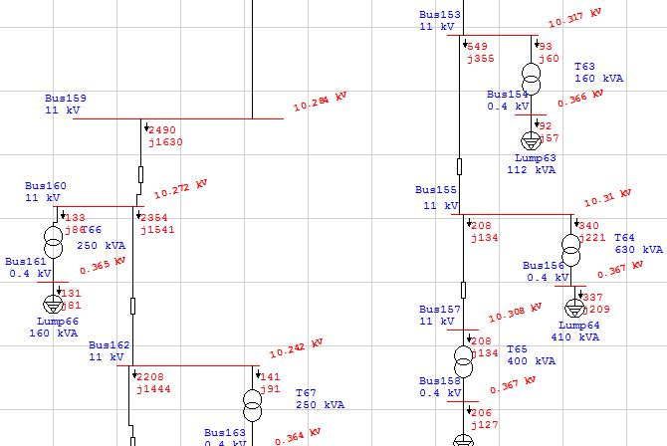
Some of under voltage buses :

Slide 11
Summary of results in original case
%PF | MVA | MVar | MW
82.24 lag | 41.864 | 23.815 | 34.430 | Source (swing bus)
- | - | 5.876 | 2.700 | Apparent losses
From the above results , there are many problems in the network .The P.F of the swing bus = 82.24 Lagging , which causes high penalties and losses . So, we try to increase the power factor of the busses and the voltage of the buses which is not included in the acceptable range .
Therefore ,we note that when we change the Voltage Level from 6.6 to 11 kV the losses for network decrease from 8.9% to 7.8% .

Slide 12
Maximum load case
The voltage should be within this range :
1.05 V nominal < V < 1.1 V nominal
In first stage of the analysis of the network we have to take the maximum load in daily load curve ,then applied it on ETAB .
We started the study of this case after we applied the data needed Like load factor and other data.

Slide 13
Load factor
We have the average value of loads by using the load factor of each load which we got from the real data of network and real daily load curves from SCADA system
The average demand load factor in our network is 75% that means the average load to the maximum load ratio is 75% which considered as a very good operating load factor .

Slide 14
Our goal is to improve the voltages within the range by using the following steps :
Tab changing in the transformers.
Adding capacitors to produce reactive power.
Changing and replacing transformer.
Add another connection point .
The tap changer of the secondary side of the 2 power transformers (33-11 kV) is raised to 10% , and tap change in all distribution transformers by 5% .

Slide 15
Summary of results in maximum load case
%PF | MVA | MVar | MW
83.25 lag | 42.320 | 23.446 | 35.232 | Source (swing bus)
- | - | 5.242 | 2.415 | Apparent losses
The losses in the network decrease . The losses before were = 2.700 MW, but the losses after become =2.415 MW .
For more improvement we add capacitor banks at the low voltage level and this is a temporary solution but we need a major solution to cover the total demand in the city. So , we choose to add a new connection point .

Slide 16
Add a new connection point
Comparing the voltages before and after adding the new connection point.
Voltage with two connection point (kV) | Voltage with one connection point (kV) | Bus
34.000 | 34.000 | Bus 1
33.649 | 33.043 | Bus 20
33.134 | 31.503 | Bus 65
32.666 | 31.016 | Bus 99
11.024 | 10.355 | Bus 110
10.973 | 10.302 | Bus 133
10.952 | 10.280 | Bus 200
10.806 | 10.087 | Bus 269
0.390 | 0.365 | Bus 122
0.387 | 0.362 | Bus 182
0.383 | 0.356 | Bus 227

Slide 17
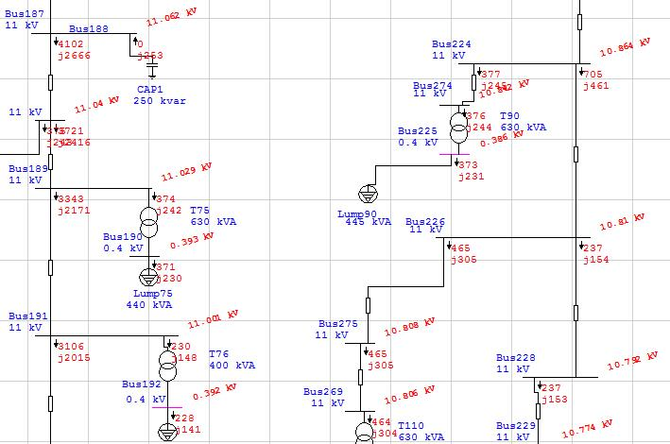
Some of under voltage buses :

Slide 18
Summary of results for new network
%PF | MVA | MVar | MW
83.39 lag | 40.288 | 22.237 | 33.595 | Source (swing bus)
- | - | 4.097 | 1.168 | Apparent losses
We note that when adding a new connection point the losses for network decrease from 8.9% to 3.4% .
The P.F of the swing bus = 83.39 lag , which is low and causes a lot of penalties on both the company and consumers. So, we have to try to increase the power factor of the busses .

Slide 19
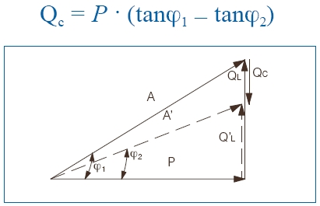
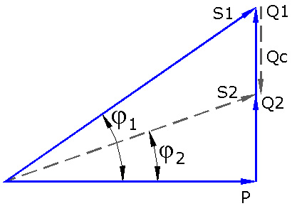
Power Factor Improvement
It is important to keep the P.F above 0.92 on the distribution transformer so as to minimize the electrical losses and do not paying penalties.
How to improve the P.F ??

Slide 20
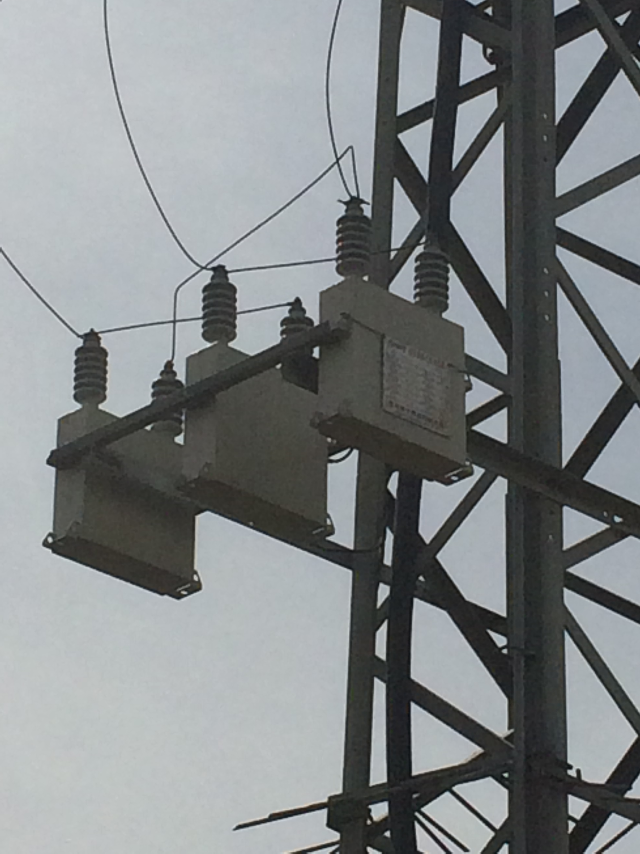
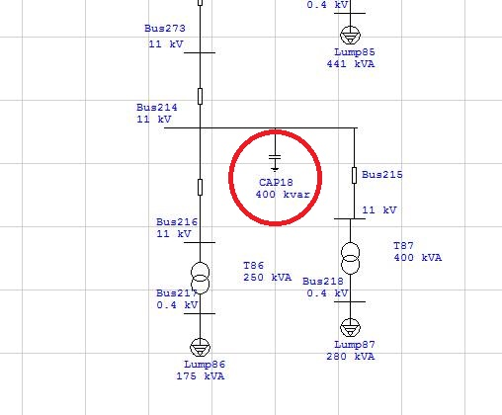
We added shunt capacitor banks at the buses at both transmission and distribution levels and loads with value : ( 300 , 400 , 1000 ) kVAR .

Slide 21
Summary of results after improvement the network
%PF | MVA | MVar | MW
92.09 lag | 36.514 | 14.233 | 33.626 | Source (swing bus)
- | - | 3.606 | 1.010 | Apparent losses
After adding the capacitor banks the losses in the network decrease to 1.010 MW
The P.F = 92.09% which it was achieved , since a P.F was lower than that , it would lead to penalties on both the “NEDCO” and consumers .

Slide 22
Elements Of The Network
1- Sources :
Eastern Region are fed from 2 connection point by Israel Electrical Company (IEC), at 33KV.
2- Transformers :
Power Transformers :
This network consists of (2) power transformer (33/11) KV with ratings 10 MVA .
Distribution transformers :
41 distribution transformers (33/0.4)KV
67 distribution transformers (11/0.4)KV
Number of Transformers | Transformer Ratings (KVA)
2 | 2000
1 | 1600
3 | 1000
43 | 630
34 | 400
16 | 250
8 | 160
1 | 100
108 | Total

Slide 23
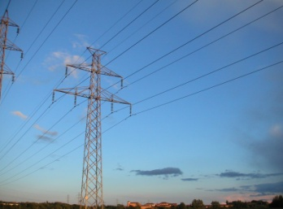
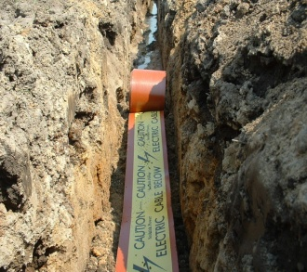
Elements Of The Network
3- Transmission Line & cable :
Over Head Line:
The conductors used in the network are ACSR (Aluminum Conductor Steel Reinforced)
Under Ground Cable :
The underground cable used in the network are XLPE Cu .
4- Switch gear :
switchgears in substations are located on both the high and low voltage sides of large power transformers .
Selection depends on : Voltage level ,Number of lines ,Location of substation , Possibility of expansion

Slide 24
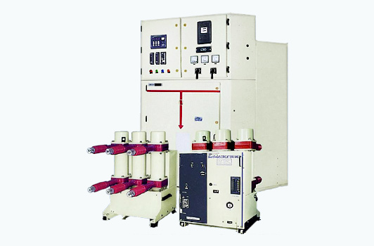
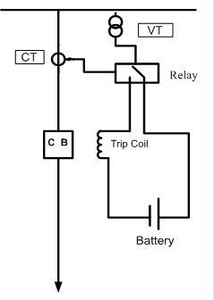
Elements Of The Network
Switchgear contain of :
A. Circuit Breaker :
How to choose CB :
I _{C.B} >= Ksafty * I max load .
V_{C.B} >= V system.
I breaking capacity >= 1.2 * I _{S.C}
The Specifications of the Circuit Breaker that
we have used are as follows:
Ur = 36 kV, Up = 170 kV , Ud = 70kV ; 1 min
Ir = 1250 A , Ik = 25 kA ; tk = 1sec , Ip = 62.5 kA

Slide 25
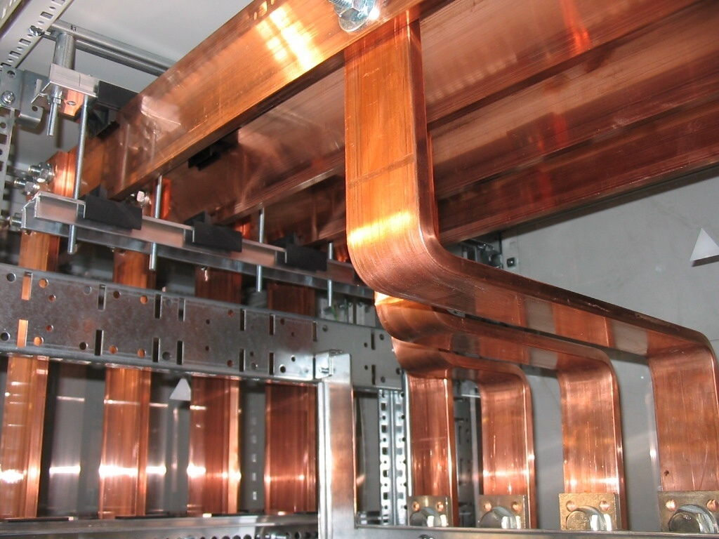
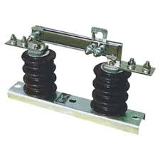
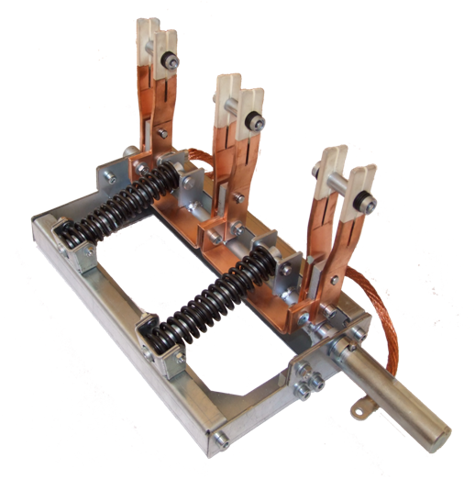
Elements Of The Network
B. Bus-Bar :
The Bus-Bar modules are either with single phase or three phase enclosure. Three phase enclosures are compact and have lesser eddy current losses.
C. Isolator Switch :
Isolating Switches are normally switched only when No Load .
D. Earth Switch :
Earth switch is used to discharge the voltage on the circuit to the earth for safety , earth switch is mounted on the frame of the isolaters

Slide 26
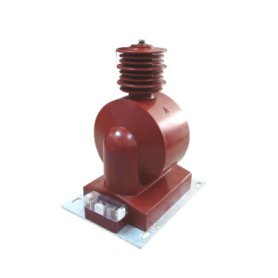
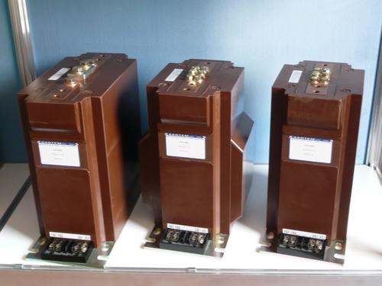
Elements Of The Network
5 - Measurement in the medium voltage :
Current Transformers
Potential Transformers
6 - Supervisory Control & Data Acquisition (SCADA) :
SCADA is a system for remote monitoring and control that operates with coded signals over communication channels.

Slide 27
Economical Study
In this project it is important to study the economical calculation to find if our work is suitable or not .
Saving in penalties :
P.F before imp. = 0.83
P.F after imp. = 0.92
Pav = L.F * Pmax
= 0.75 * 33.626 = 25.21 MW
Total energy per year = Pav * 8760= 220839.6 MWH.
Total cost per year = Total energy * cost (NIS/KWH) = 132503760 NIS/year.
Saving in penalties of P.F = 115278.27 NIS/year.
Saving in losses :
Saving in losses = cost of losses before – cost of losses after
= 1064340 – 398142
= 666198 NIS/year.
Power Factor | P.F Penalties
P.F ≥ 0.92 | No Penalties.
0.92 > P.F ≥ 0.8 | 1% of total bill for each one under 0.92
0.8 > P.F ≥ 0.7 | 1.25% of total bill for each one under 0.92
P.F < 0.7 | 1.5% of total bill for each one under 0.92

Slide 28
Economical Study
Simple Pay Back Period :
Total fixed capacitor banks using = 7.3 MVAR.
Cost of fixed capacitor = 18000 NIS / MVAR .
Total cost of capacitor banks = 7.3 * 18000 = 131400 NIS.
The cost of under ground cable XLPE (1*240 mm²) = 100 NIS / 1 meter
Total cost = 100 * 8000 = 800000 NIS .
The cost of Infrastructure (such as: excavations, power source, accessories) = 100 NIS/1meter
Total cost = 100 * 8000 = 800000 NIS .
The cost of ( Links , wages of workers , equipment , Towers , installation cost and maintenance ) = 300000 NIS
The cost of ( Internal equipment, construction, measurement device , SCADA system ) = 500000 NIS .
Total capital cost = 131400 + 800000 + 800000 + 300000 + 500000 = 2531400 NIS
Total saving = saving in losses + saving in penalties
= 666198 + 115278.27 = 781476.27 NIS
S.P.B.P = Investment / Saving = 2531400 / 781476.27 = 3.23 years

Slide 29
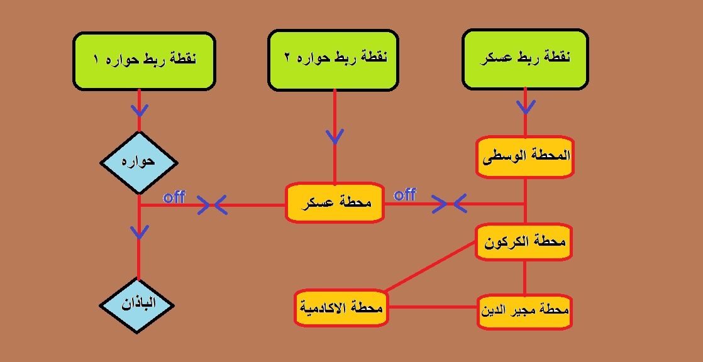
How our new connection point will affect on Nablus network ?
Rehabilitation of the Nablus electrical network
Rehabilitation of the Nablus electrical network

Slide 30
Conclusions
After the analysis and adding a new connection point , drop voltage was decreased , apparent losses was reduced too .
When adding a new connection point the losses for network decrease
from 8.9% to 3.4% .
The power factor was improved to over 92% which will reduce any penalties paid to "IEC" on both "NEDCO" Company and consumers as will, and this is duo to adding a new connection point .
The network at full load need to 34 MW , but the availability of current two connection point is 40 MW . So, now we in the save side .
The time needed to recover the cost for the project is about 3 year . And the new network will be feed the new growth of load for the period from now to 2025 , depending on the annual increase of the loads to cover the demand in the city.

Slide 31
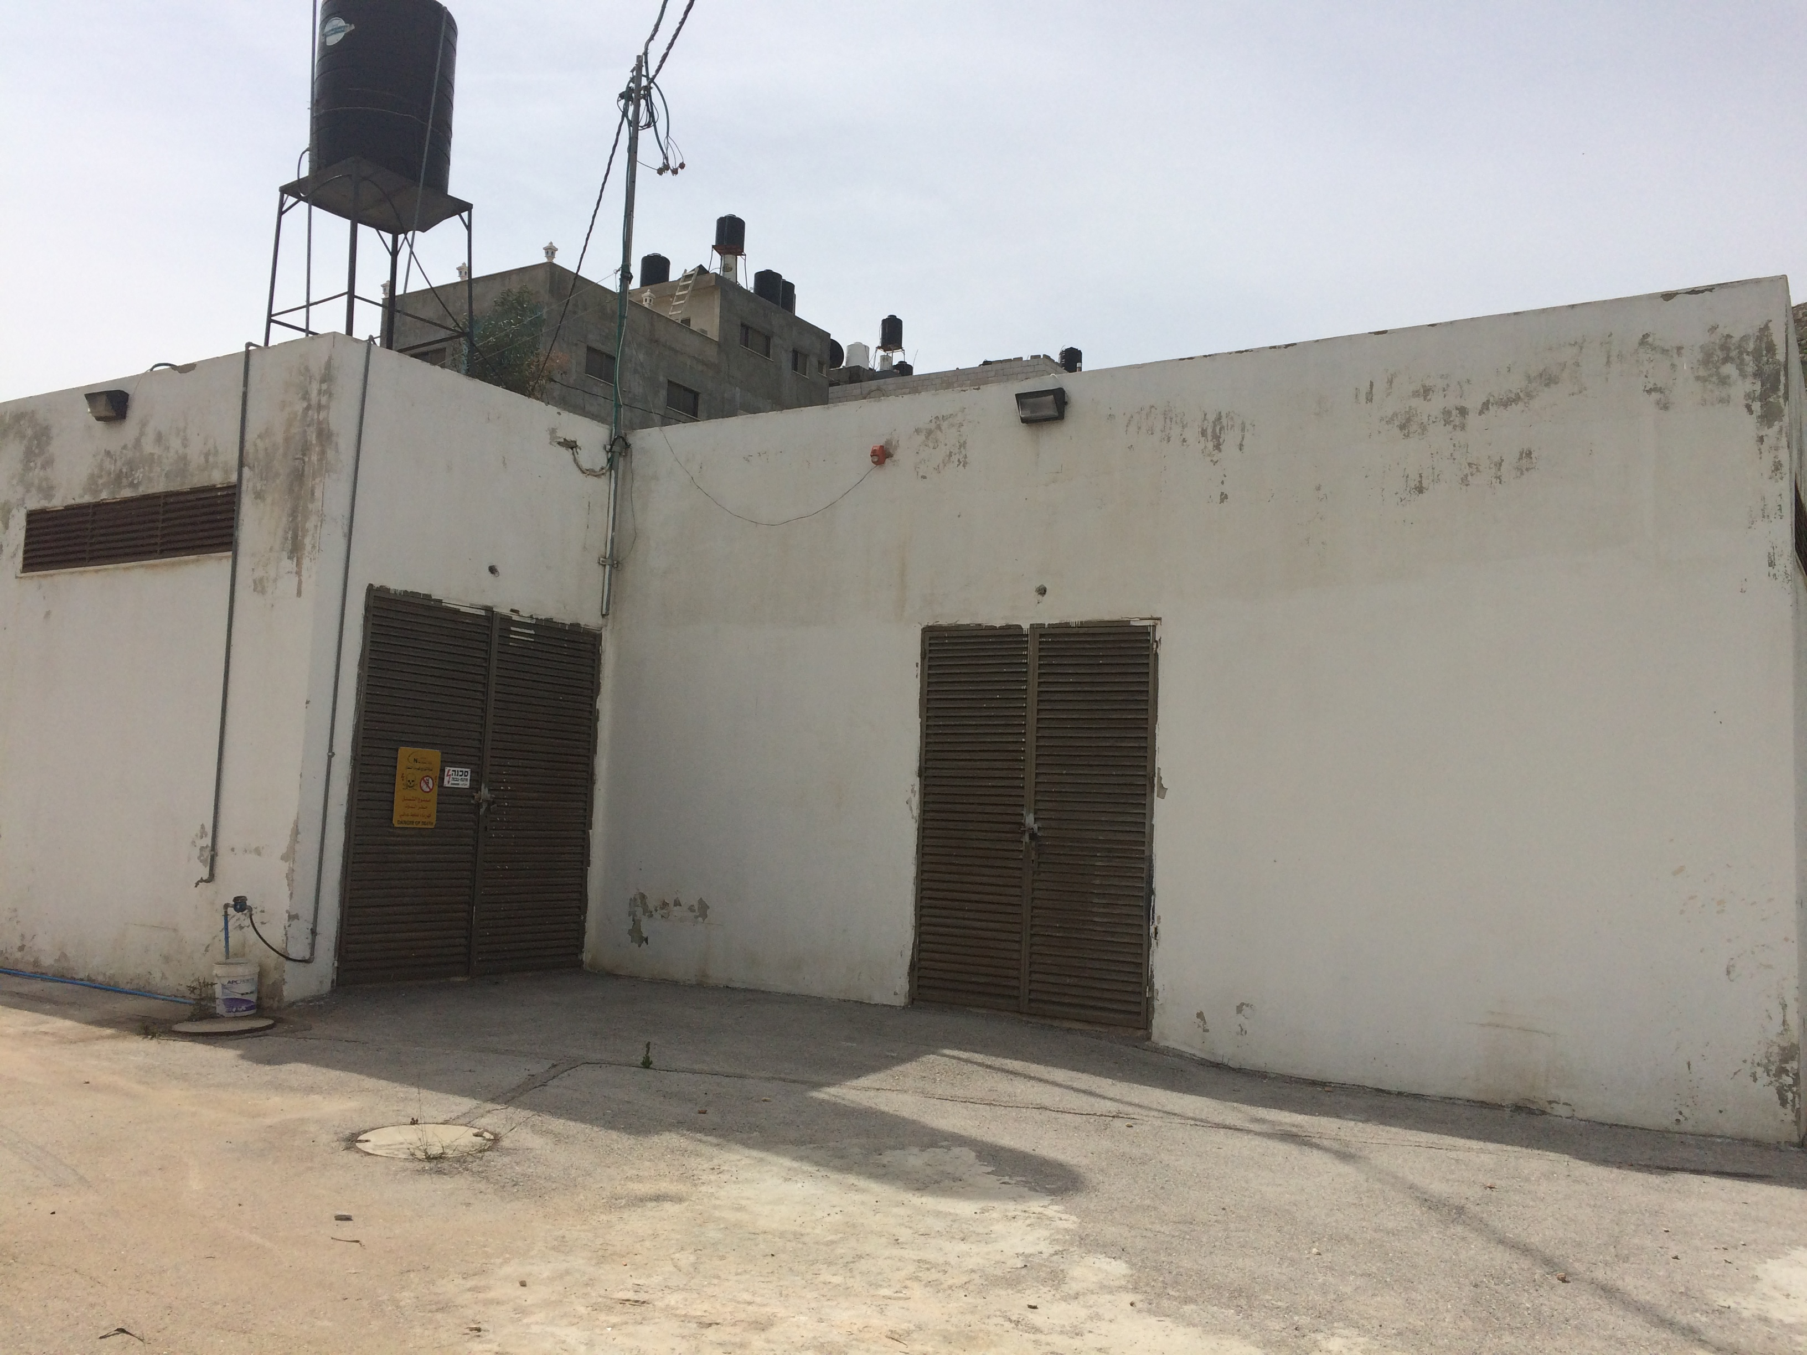
Huwwara connection point
Rehabilitation of the Nablus electrical network

Slide 32
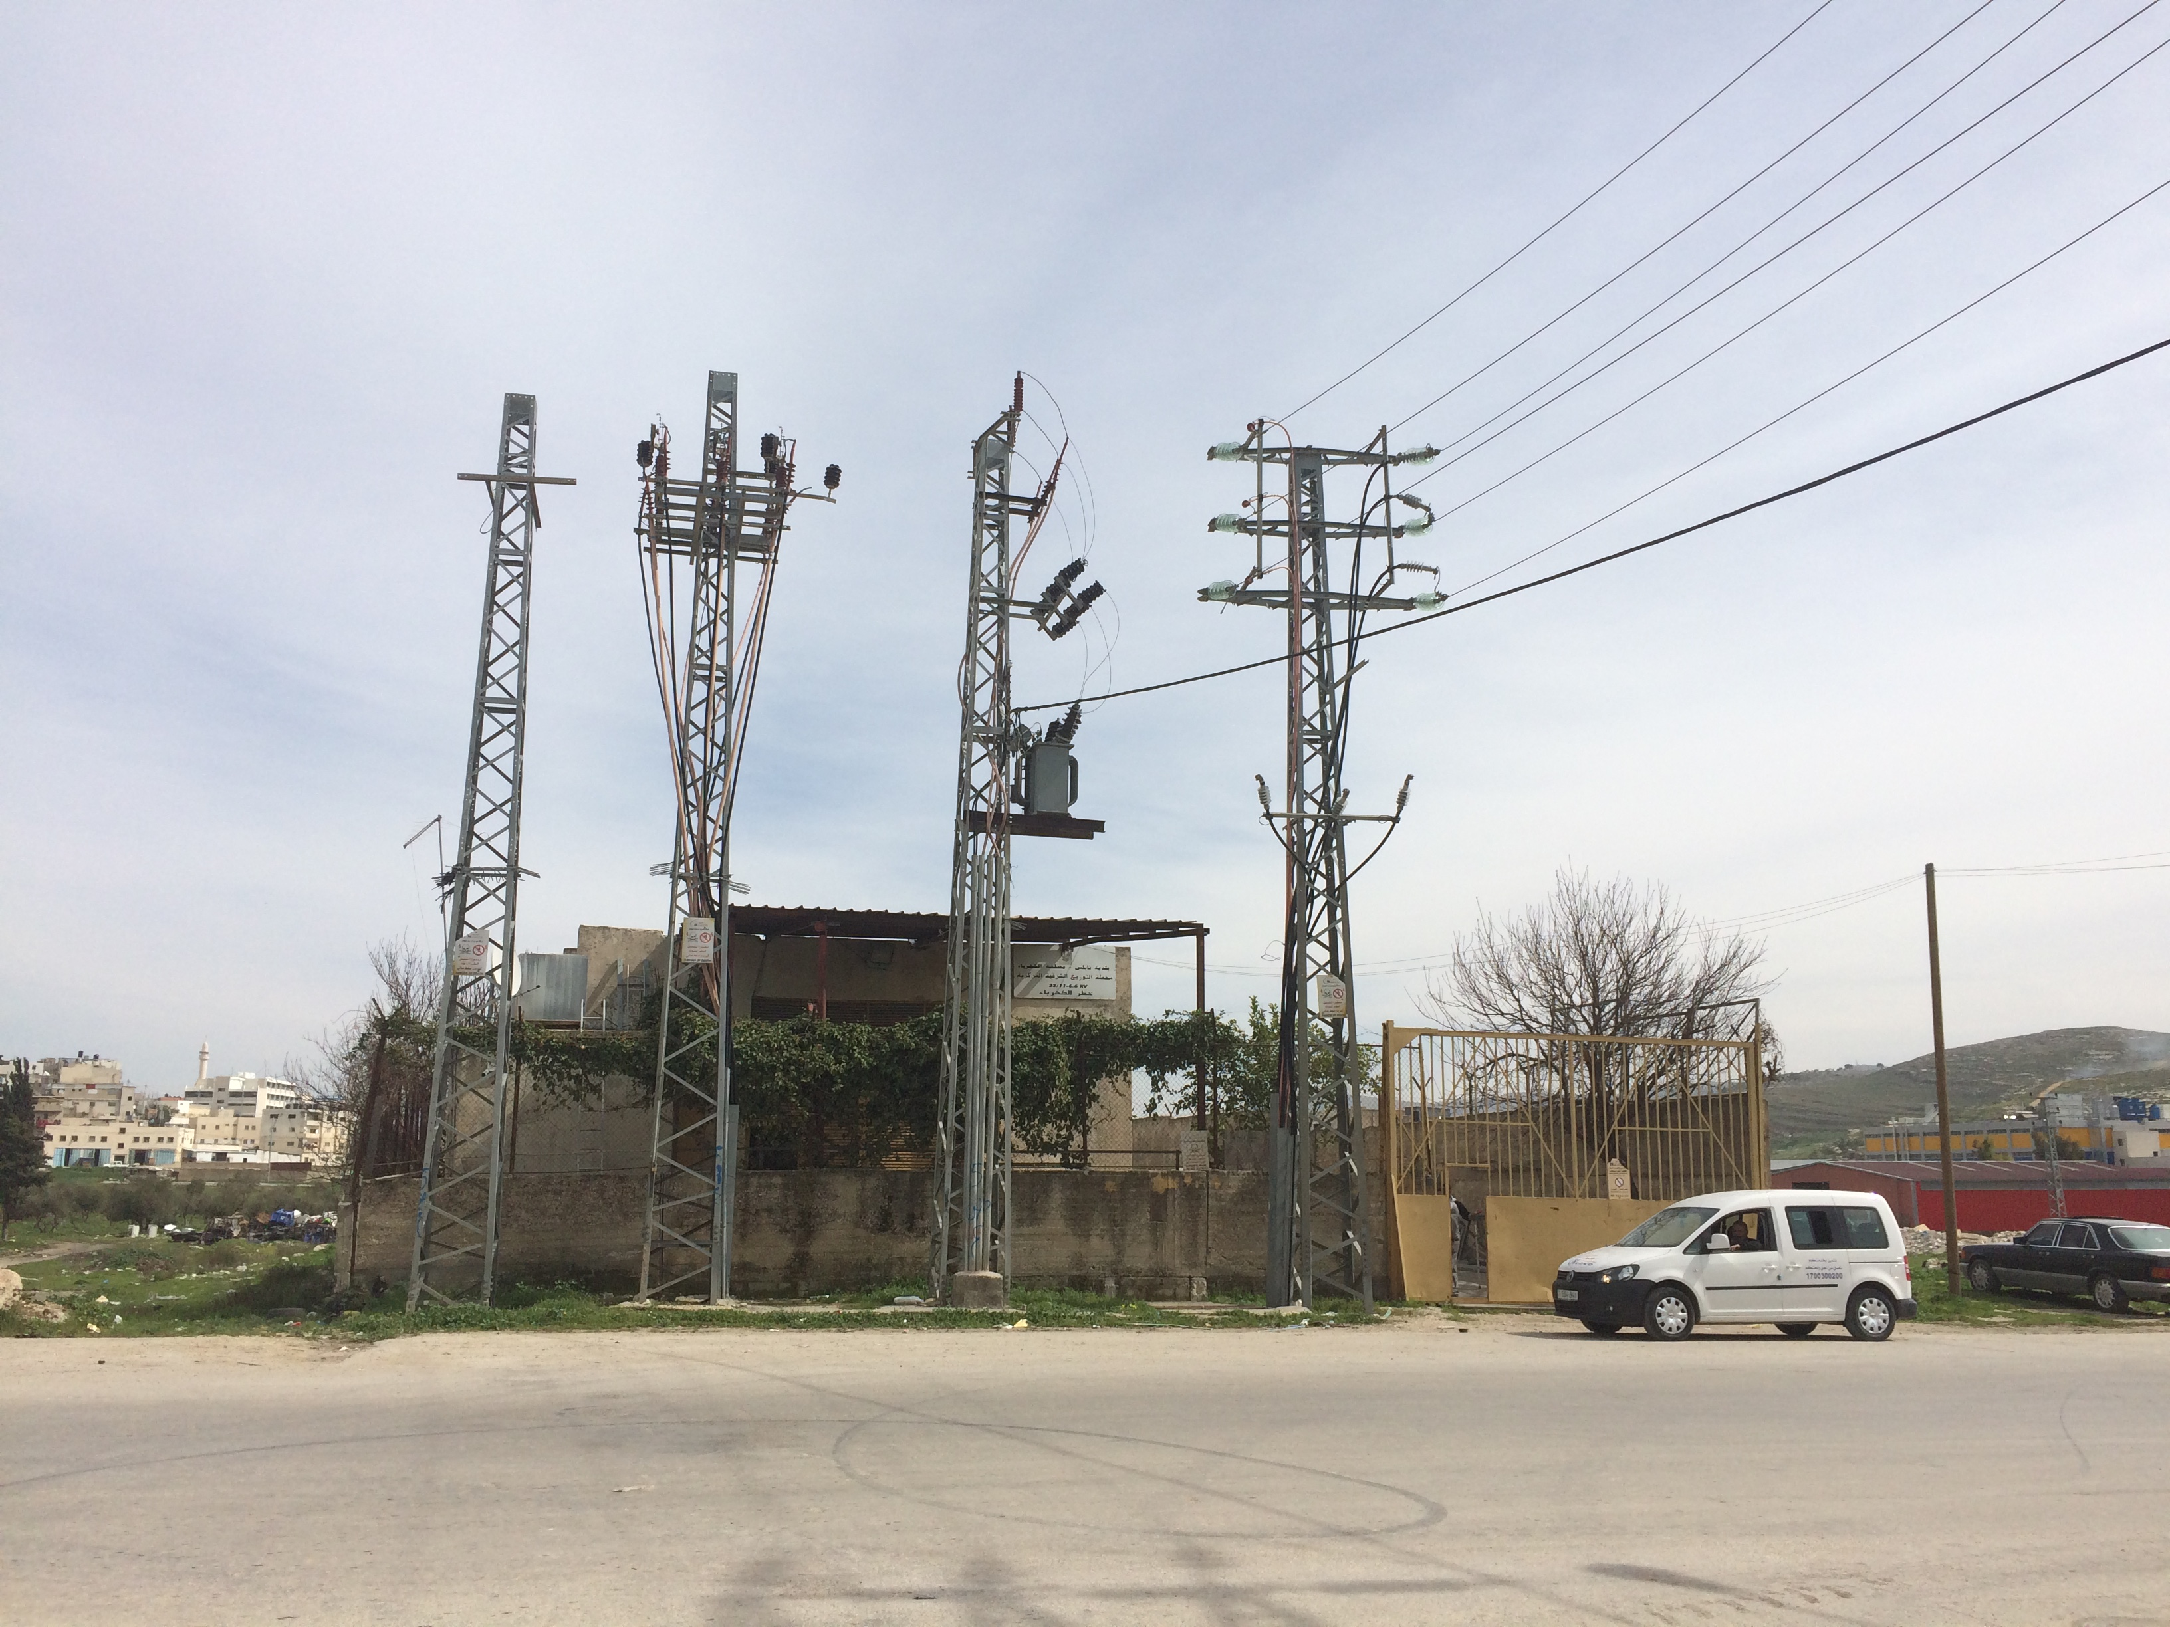
Askar substation
Rehabilitation of the Nablus electrical network

Slide 33
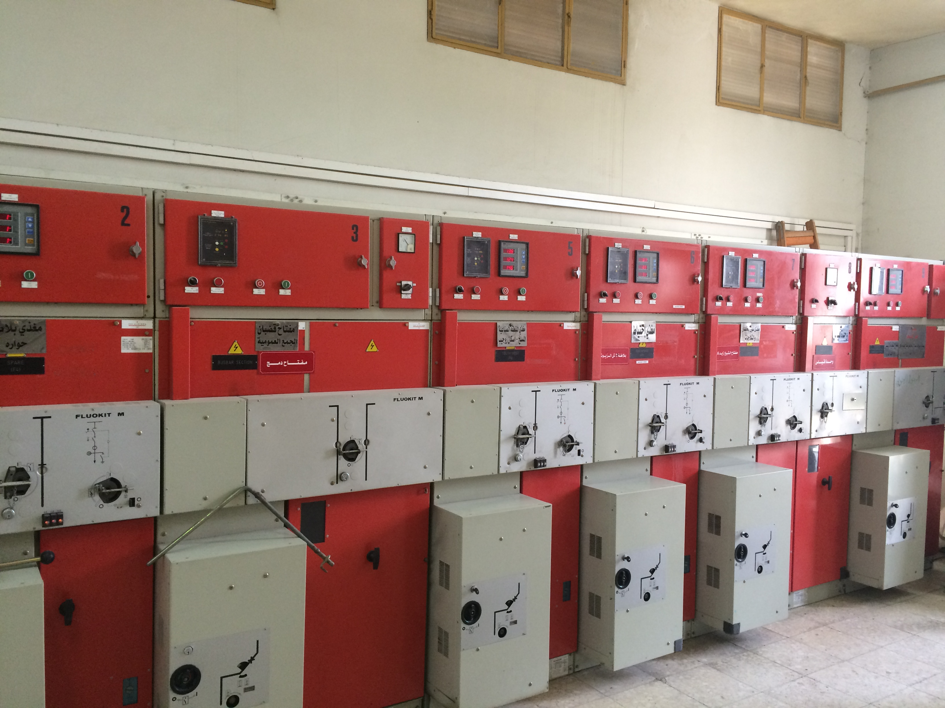
Switchgear in Askar substation
Rehabilitation of the Nablus electrical network

Slide 34
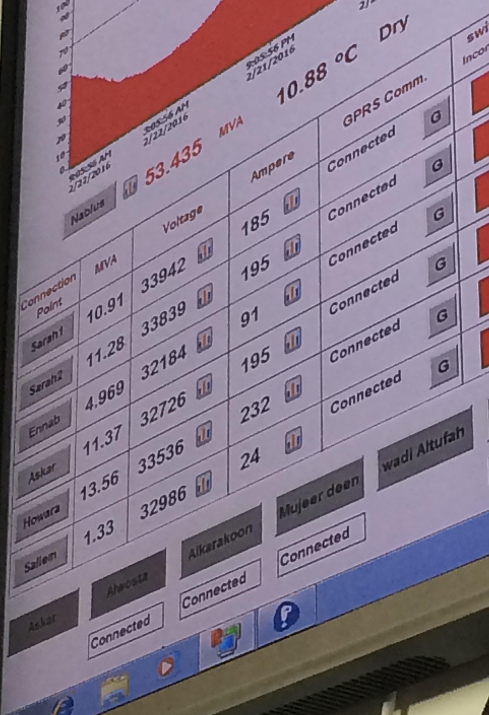
SCADA system
Rehabilitation of the Nablus electrical network

Slide 35
Recommendation
Finally , we hope from NEDCO with which we have contributed in gathering information and data about our project to take into consideration our calculation and improvement of the electrical network seriously . we also hope to see our project in Huwwara to be truly applied on the ground of reality .
THANK YOU FOR YOUR ATTENTION

Slide 36


