Slide 1
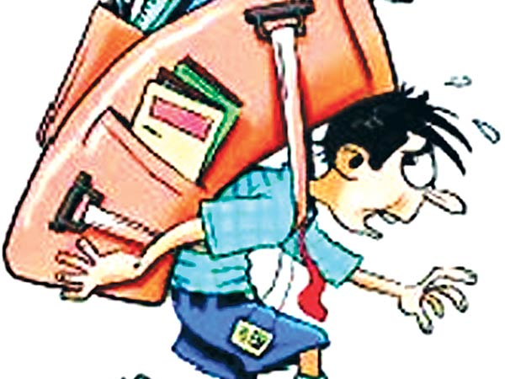
Ergonomic Assessment Of Design Features Of School Bags
Group Members
Alaa Alawneh
Dana Jaber
Saja Mlitat
Wesal Salameh
Supervised By
Dr. Yahya Saleh

Slide 2


Introduction
General Background
Problem Definition
Objectives
Literature Review
International Studies
Regional Studies

Slide 3
Methodology
Study Design
Inclusion Criteria
exclusion Criteria
Questionnaire
Limitations of study

Slide 4
Results & calculations
The Project sample
General Descriptive Results
Minitab Analysis & Results
Conclusion & Recommendation

Slide 5

Introduction

Slide 6

General Background
It was and still is of great concern the relation between back pain and school bags.
In this study, we are also concentrating on the issue of children health through their developmental years in regards of holding school bags on their backs and causing what is called (backpack syndrome).

Slide 7

There is particular concern for the junior students in secondary schools, as the spine is at a critical stage of development in children between 12 – 14 years of age.
This is also the stage at which the bag weight to body weight ratio is likely to be high as some students are still quite small but carry loads similar to larger and older children.

Slide 8
Problem Definition
Back packs are used by the school-age students to carry school books, supplies, other articles, and equipment. Students often carry between ( 3-5 kg) on their backs to and from school and between classes .
In order to better understand abnormalities or health problems related to spine in children we need to be aware of some basic spinal anatomy.

Slide 9
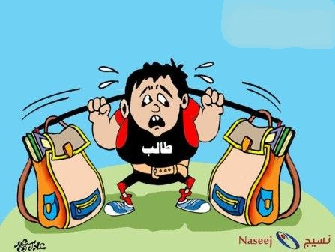
The back is an intricate structure of bones, muscles, and other tissues that form the posterior part of the trunk from the neck to the pelvis; the spine which is the most important support of the back has three major components.

Slide 10
The spinal column (i.e., bones and discs).
Neural elements (i.e., the spinal cord and nerve roots).
Supporting structures (e.g., muscles and ligaments).
When we stand, the weight of our body must be transmitted through the spinal column to the hips and ultimately to the lower limbs. Yet most of our body weight lies anterior to the spinal column.

Slide 12
    Backpack syndrome
characteristics of backpack syndrome:
Poor posture.
Headache, fatigue, or both.
Low back pain that may become chronic.
Discomfort, pain, or both in the shoulder and neck.
Muscle spasms of neck and shoulders.
Pressure sores or blisters of the back or shoulders from straps or inappropriately packed objects.

Slide 13
    Healthy Concerns
Adverse Effects
May cause long-term health problems resulting from neck, shoulder and back pain, as well as fatigue.
Poor posture and pain resulting from leaning forward with neck thrust forward.
Shoulder and arm strain from dragging back pack.
Strain and stress on one side of the body curved by using only one shoulder strap.

Slide 14

Schoolbag risk factors
Risk factors for adverse effects on the spine include:
A schoolbag that weighs more than 10 per cent of the child’s weight.
Holding the bag in one hand by its straps.
Carrying the bag over one shoulder.
An incorrectly packed backpack.
An incorrectly fitted backpack

Slide 15
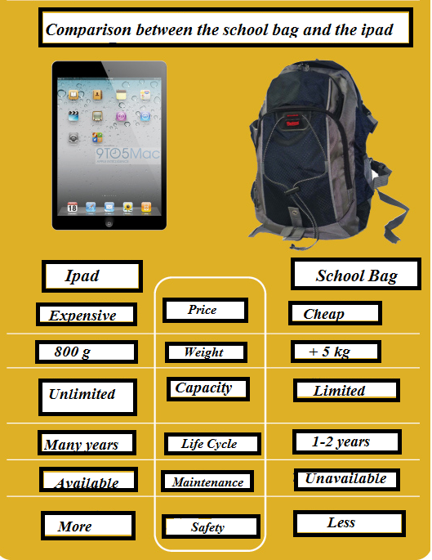

Slide 16
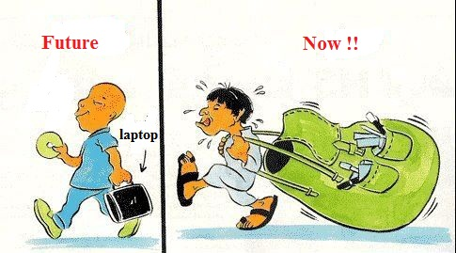

Slide 17
Design and Portage of Backpack
While examining the school bags design, we should have a look at three components :
The back of the bag should be firm and padded to prevent and adequately reduce the pressure on the child’s back, and the level of the back should be adjusted to the child back.
The straps should be padded and adjustable.
The handles should be smooth and comfortable for handling without any rough edges or sharp angles.

Slide 18
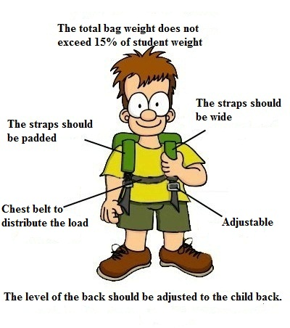

Slide 19

Significance of Study
We can clearly notice the growing weight of school bags and its effects on health of the children that has become a matter of serious concern for every parent, schools, and authorities.
We find it of equal importance too to determine children’s opinion on their individual daily school bag load. Up to my knowledge, no study in Palestine has evaluated the influence of backpack on student’s backs before, we also found that we have a huge number of school students, for these reasons we were encouraged to perform this study.

Slide 20
Statistical information from the ministry of higher education:
Basic education / compulsory: student starts entering the first grade primary from the age of 5 years and 6 months. And which will last for a period of ten years; until the end of the tenth grade (compulsory).
Distribution of basic school students by sex and class in all the supervisory authorities:
Class level | 1 | 2 | 3 | 4 | 5 | 6 | 7 | 8 | 9 | 10 | Sum
Males | 55860 | 52216 | 51140 | 51893 | 51762 | 48038 | 46954 | 44547 | 42934 | 40954 | 486298
Females | 52611 | 49433 | 47737 | 50478 | 49625 | 46748 | 46399 | 45621 | 45782 | 46568 | 481002
Sum | 108471 | 101649 | 98877 | 102371 | 101387 | 94786 | 93353 | 90168 | 88716 | 87522 | 967300

Slide 21
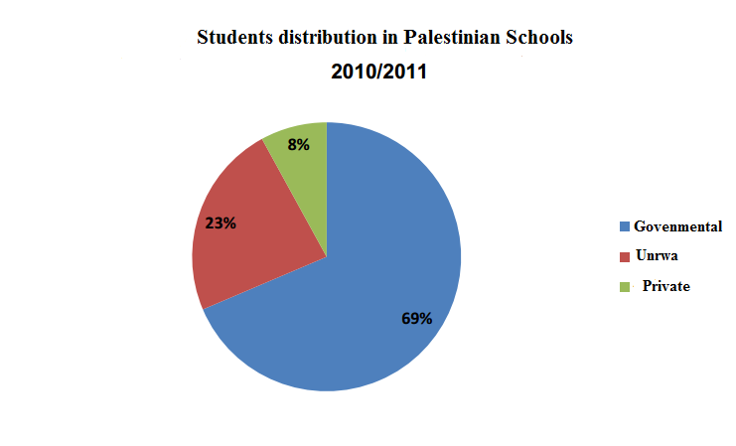
Distribution of basic school students by Supervising Authority

Slide 22

  Objectives
Main Objectives
Assessing the effect of design features of school bags on health of students.
Specific objectives
To identify the methods of carrying school backpacks.
To measure mean backpack weight and backpack weight to student's weight ratio.
To do some calculations of the bags features.
To give some tips about the most appropriate way of bag handling.

Slide 23
Literature review

Slide 24
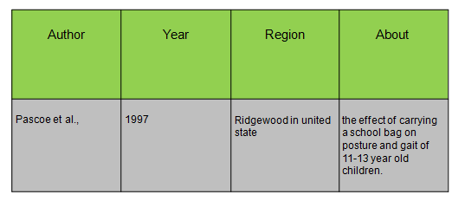
International study

Slide 25
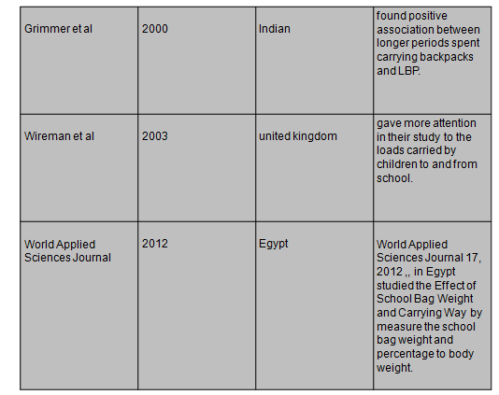

Slide 26
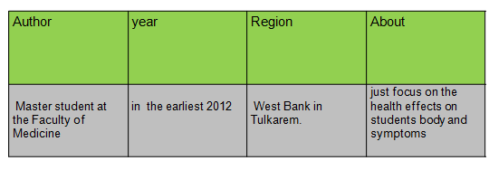
Regional Study

Slide 27
Methodology

Slide 28

Steps of conducted study
Collect the ideas.
Determine the aims.
Translate our view through questionnaire.
Coordination with ministry of education in Nablus to visit schools in formal way.

Slide 29
Data collection
Data collection was accomplished through two steps.
First Step:
Measuring the height of each student.
Measuring the body weight of each student and their school bag(empty and full).
Second Step:
Each student was interviewed to answer the questionnaire.(This method was only used for grades first to sixth).
In secondary schools(seventh to tenth grades) completed the questionnaire themselves .

Slide 30

Inclusion Criteria
First to tenth grade students in participating schools conditioned to be (6-15) years old.
Male and female students.
Generally healthy students

Slide 31
Exclusion Criteria
The researcher excluded Students:
Who are not carrying or unable to carry school bag.
Who have disabilities and health problems.
Who are unable to provide data sufficiently.
Above fifteen or below six years old.

Slide 32
Questionnaire
A structural questionnaire that contains close-ended questions contained two sections:
The first section
contains personal details including age, gender, stages, method of travelling to schools, weight of students, weight of school bags, full and empty, and height of student).
The second section
contains data related to:
Properties of the School bag.
The method of carrying school bag.
What are side effects? Health questions.
What the best way to solve the problem of healthy bags?

Slide 33
Limitations of Study
The difficulty of choosing students because of the midterm exam.
The teachers were on strike.
Some selected schools don’t have the classes that the study needs

Slide 34
Results and Calculations

Slide 35
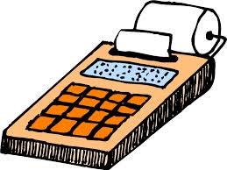
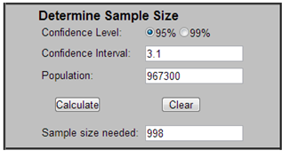
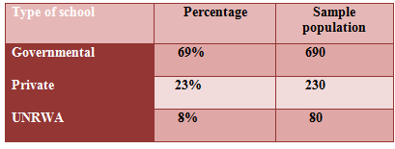
The Project Sample
So we decided to calculate the sample population which can cover our study by using a standard model from the internet as this figure shown:
Then we divided this” 1000 “student sample on the school types in order to the percentage of each from the total as this table shown

Slide 36
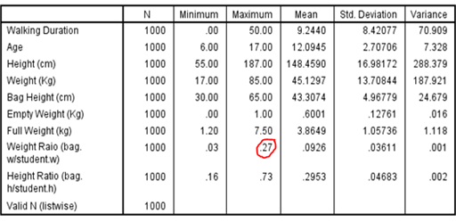
General Descriptive Results for the whole sample
As we see from this table we have a maximum weight ratio of 0.27 >>> 0.1!! higher than the standard .

Slide 37

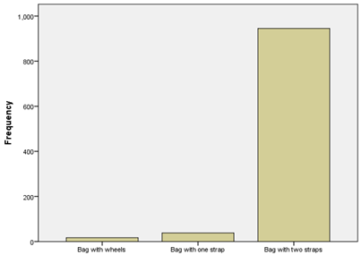
Frequencies
The most important results of the frequencies that student answered with an end answers are concluded here through bar charts and tables :

Slide 38
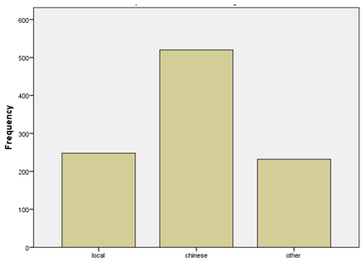
Place Of Bags Manufacturing

Slide 39

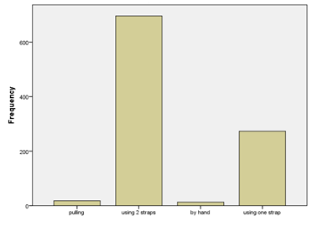
Main way of schoolbag backing

Slide 40
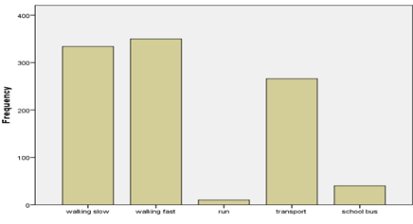
School Arriving Way

Slide 41
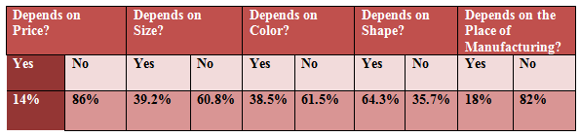
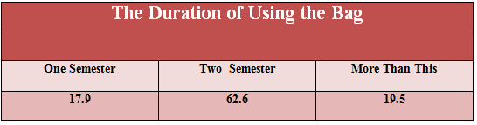
Bag Selection Criterion

Slide 42
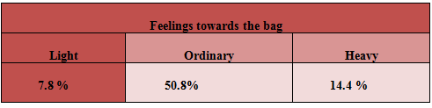
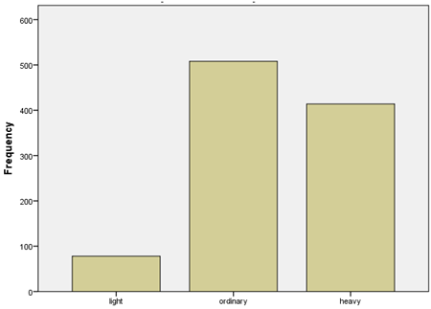
Feelings towards the bag

Slide 43
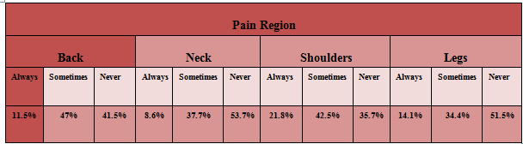
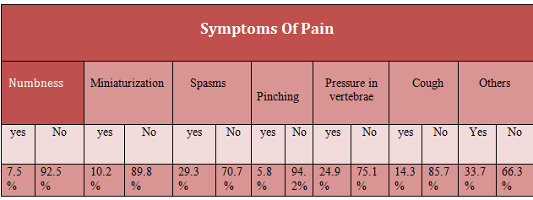
Body Pain Distribution

Slide 44
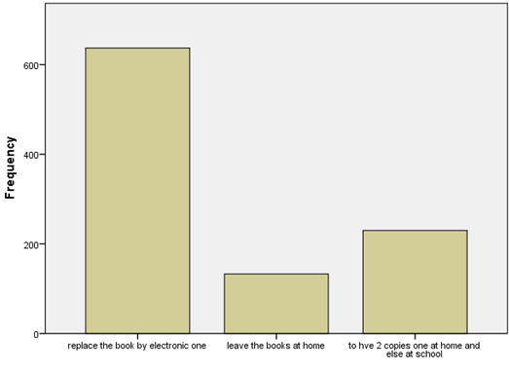
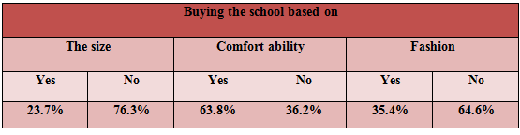
Solutions Proposed By Students

Slide 45
Minitab Analysis
Using Minitab, Two sample –t test
Student’s weight ratio was inserted in two column based on gender factor.
H0: µ= .1 and H1: µ > .1 and α=.05 .
Reject H0 if the P-value is < .05.
if we reject H0, we can conclude that there is a significant difference between genders.

Slide 46
Normality test
During analysis, the null hypothesis H0: normal
the alternative hypothesis H1: not normal .
P- value > 0.05 we accept H0 → normally distributed.
P- value <0 .05 we rejectH0 → not normally distributed.
Non parametric method → Wilcoxon signed-rank test.
(Test assumption is symmetric continuous distribution).

Slide 47

Normality test output

Slide 48
Normal probability plot of males in the governmental schools level (1).

Slide 49
Normal probability plot of females in the governmental schools level (1).

Slide 50
Normal probability plot of males in the private schools level (1).

Slide 51
Normal probability plot of males in UNRWA schools level (1).

Slide 52
Normal probability plot of females in UNRWA schools level (1).

Slide 53
Normal probability plot of males in the governmental schools level (2).

Slide 54
Normal probability plot of males in UNRWA schools level (2).

Slide 55
Normal probability plot of females in UNRWA schools level (2).

Slide 56
Normal probability plot of females in the private schools level (3).

Slide 57
Normal probability plot of males in UNRWA schools level (3).

Slide 58
Normal probability plot of females in the private schools level (1).

Slide 59
Normal probability plot of females in the governmental schools level (2).

Slide 60
Normal probability plot of males in the private schools level (2).

Slide 61
Normal probability plot of females in the private schools level (2).

Slide 62
Normal probability plot of males in the governmental schools level (3).

Slide 63
Normal probability plot of females in the governmental schools level (3).

Slide 64
Normal probability plot of males in the private schools level (3).

Slide 65
Normal probability plot of females in UNRWA schools level (3).

Slide 66
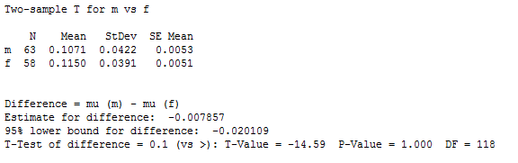
Two –sample t test and CI for males vs. females weight ratio
Tow sample t-test results for males and females weight ratio in the governmental schools level (1).

Slide 67
Conclusion

Slide 68
Heavy school bags are generating a serious problem.
There is an increase in the proportion of the weight of the bag on the weight of the student from the 10% standard ratio, This variance shows clearly in the … stage
About the students feeling during carrying schoolbags
7.8% of students feel the bag is light weight
50.8% feel it ordinary
14.4% feel it heavy weight
So it is a critical problem which should be taken into consideration

Slide 69
Recommendation

Slide 70
Heavy school bags may negatively affect the health of students in many life stages therefore we but many recommended in order to keep their health
1-Recommendations for students and their partners
Choose it right
Choose a backpack with padded shoulder straps.
Choose a backpack with a waist belt.
Choose a backpack which has the appropriate size.

Slide 71
Carry and lift it right
student should use both shoulders.
Adjust the shoulder straps
The bag should lift using both hand and held closest to the body
Pack it right
should only pack with a needed book and other needed items.
choose a notebooks and files with Lightweight as possible
Be sure that the items pack in a way that they closest to the child’s back-

Slide 72
2-Recommendations for schools
Increase the awareness about this issue and corporate with parents effort.
Make a lockers for each student in the class.
Coordinate with the Ministry of Education about the number and types of books
3-recommendations for parents
Should always direct their children to the correct way of carry the bag
Ensure that their children pack only necessary books and items
May always ask their children if they feel any fatigue or back pain
see doctor if there is any Complaints

Slide 73


