Slide 1

Telecommunications Engineering Department
Graduation Project (2)
Applying Real Time Intelligent Transportation System Based On Raspberry Pi/GPS/3G Technologies
Prepared by:
Sondos Tahan
Al’a Nabeel Dweikat
Imtithal Rihan
Supervisor:
Dr. Saed Tarapiah

Slide 2



Outline:
Objectives and Motivation.
System Main components.
Project Description.
Candidate Application.
Feasibility Study.
Results and SWOT Analysis .
Conclusion and Recommendations.

Slide 3
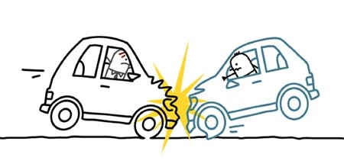

Objectives:
Decreasing Traffic Accidents.
Reducing Time Needs to Access Traffic Accident Place.
Saving Lives.
Raising Awareness About The Importance of Adhering to Traffic Laws.

Slide 4
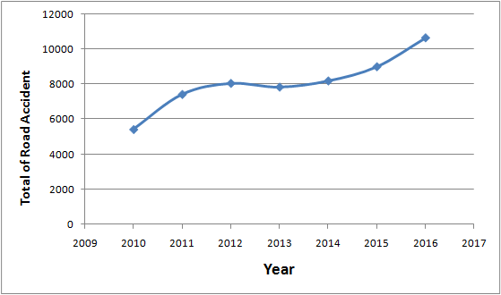
Motivation:
Traffic Accident Increases.
*Transportation and Communication Statistics in the Palestinian Territory: Annual Report2016.

Slide 5
Increasing Casualties:
*Transportation and Communication Statistics in the Palestinian Territory: Annual Report2016.

Slide 6
Recent Accident Statistics:
Traffic accidents in Palestine are a deadly war. Traffic accidents are becoming increasingly dangerous; the number of casualties and deaths in our country as a result of road traffic accidents has been on the rise from one year to the next, reaching 2016 as follows.
*Transportation and Communication Statistics in the Palestinian Territory: Annual Report2016.

Slide 7
System Main components:
GPS
Sensors (shocked and vibration)
RPI camera
3G Mobile Network
3G Gateway
Web Application
Microcontroller
AP
Server
Data Collection Side
Data Gateway Side
Data Analysis Side

Slide 8
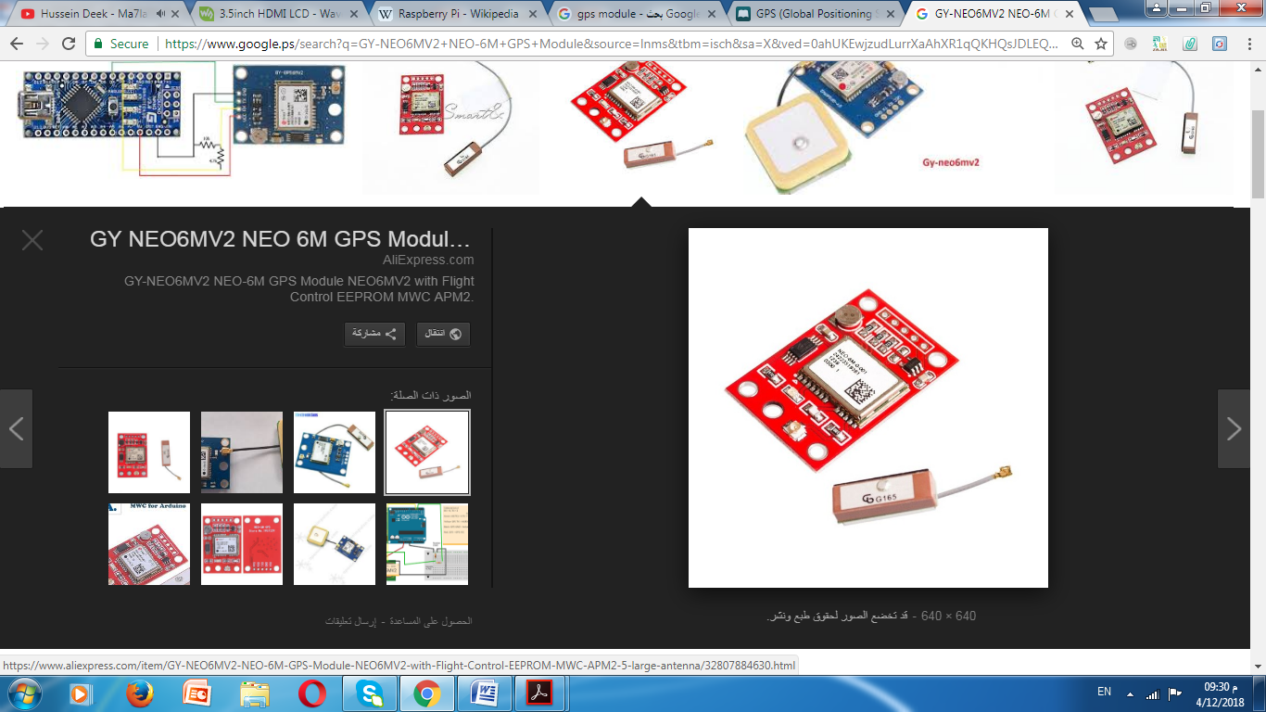
Sensors (shocked and vibration)
RPI camera
3G Mobile Network
3G Gateway
Web Application
GPS
Microcontroller
AP
Server
Data Collection Side
Data Gateway Side
Data Analysis Side
Longitude
Latitude
Time Stamp
Speed = Distance / Time

Slide 9
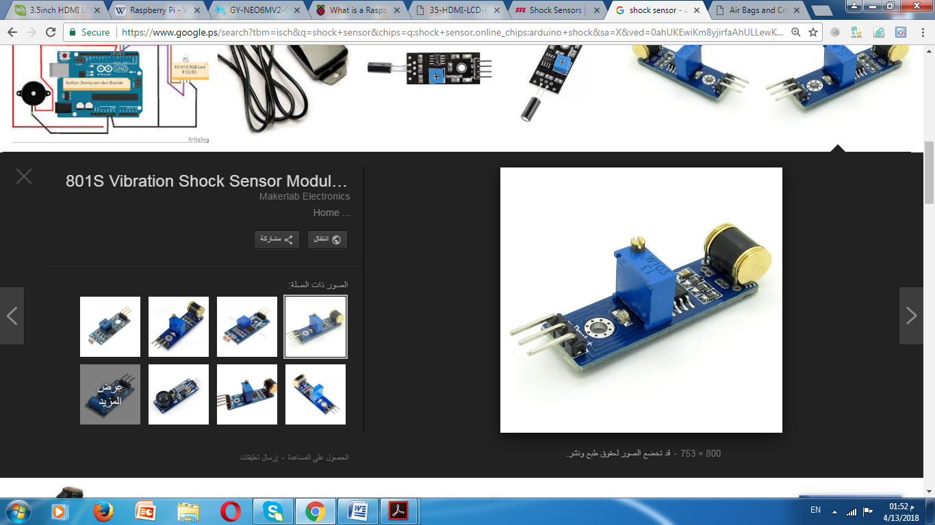
Sensors (shocked and vibration)
RPI camera
3G Mobile Network
3G Gateway
Web Application
GPS
Microcontroller
AP
Server
Data Collection Side
Data Gateway Side
Data Analysis Side
The Idea Of a Shock Sensor: If Somebody Hits, Jostles or Otherwise Moves Your Car, The Sensor Sends a Signal To The Brain Indicating The Intensity Of The Motion.

Slide 10
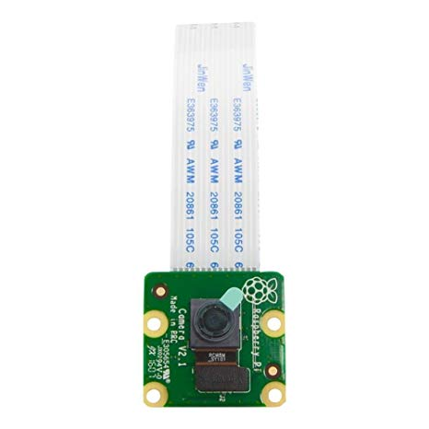
Sensors (shocked and vibration)
RPI camera
3G Mobile Network
3G Gateway
Web Application
GPS
Microcontroller
AP
Server
Data Collection Side
Data Gateway Side
Data Analysis Side
The camera used to take a picture of the accident.

Slide 11
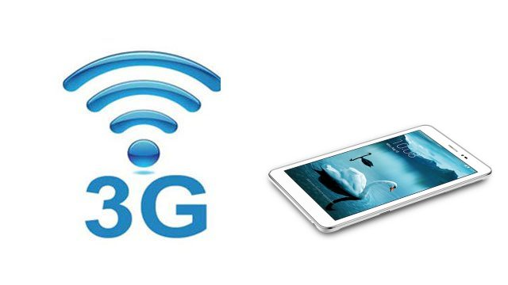
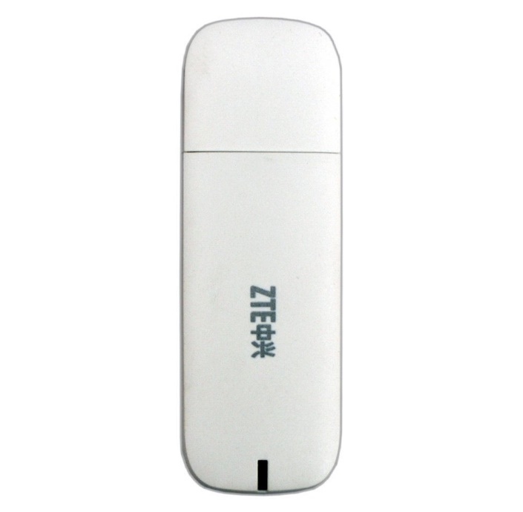
Sensors (shocked and vibration)
RPI camera
3G Gateway
Web Application
GPS
3G Mobile Network
Microcontroller
AP
Server
Data Collection Side
Data Gateway Side
Data Analysis Side
Connect RPI to The AP
Data Transmission

Slide 12
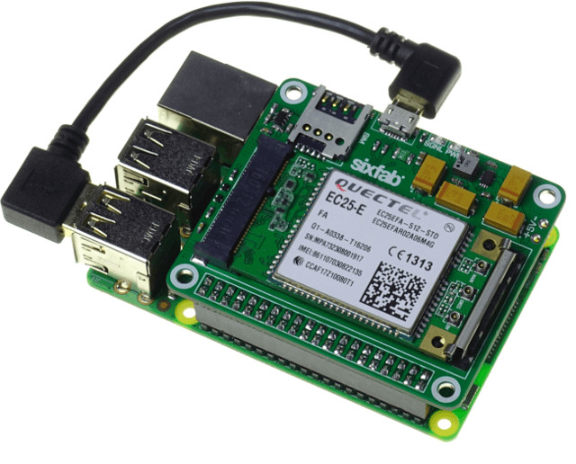
Sensors (shocked and vibration)
RPI camera
3G Gateway
Web Application
GPS
3G Mobile Network
Microcontroller
AP
Server
Data Collection Side
Data Gateway Side
Data Analysis Side
Link Between Microcontrollers And Web Page.

Slide 13

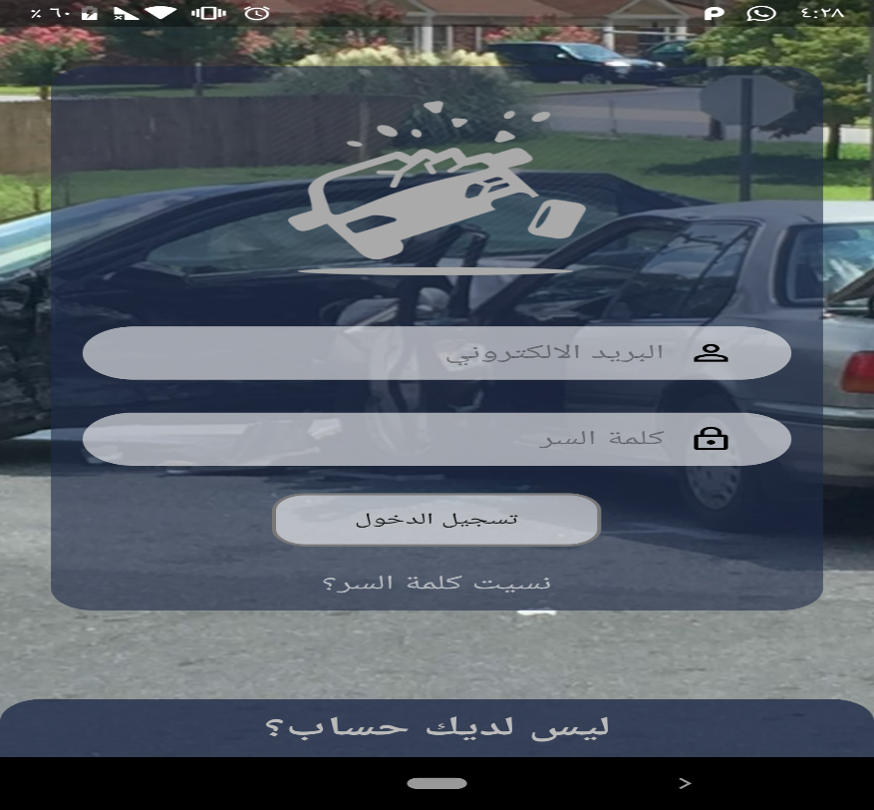
Sensors (shocked and vibration)
RPI camera
3G Mobile Network
3G Gateway
Web Application
GPS
Microcontroller
AP
Server
Data Collection Side
Data Gateway Side
Data Analysis Side

Slide 14



Web-Site:
Based On Html Languages.
PHP Java Script And MySQL for Database.
Programming languages: HTML to design external shape & PHP, Java script for Database
Contents :
accident information like accident time and location , speed.
Get accident location from Google Map .

Slide 15
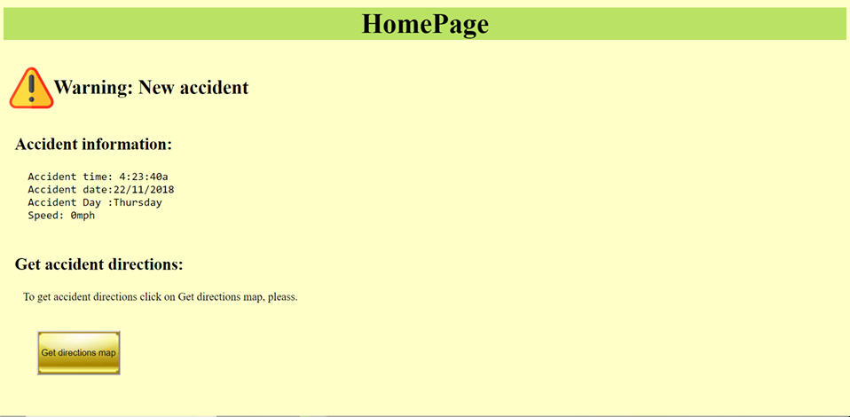
Web Page Design:

Slide 16
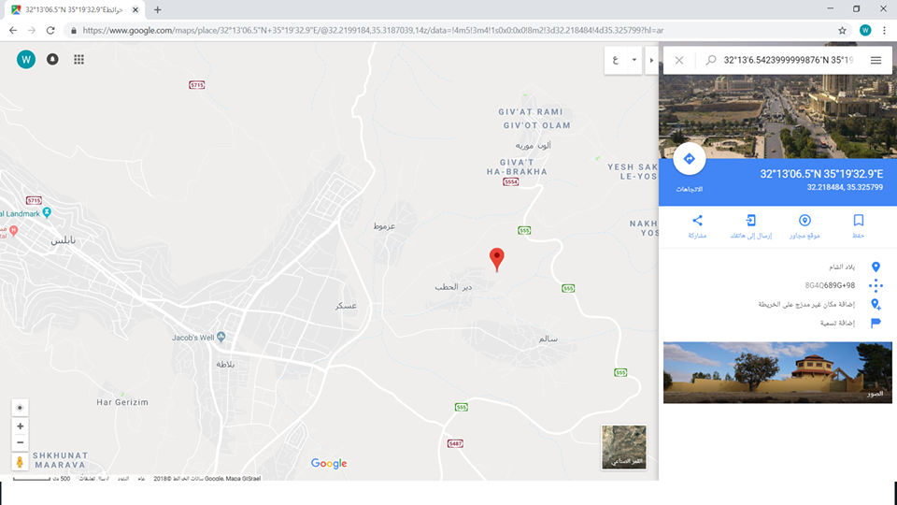
Accident Location from Google Map:

Slide 17
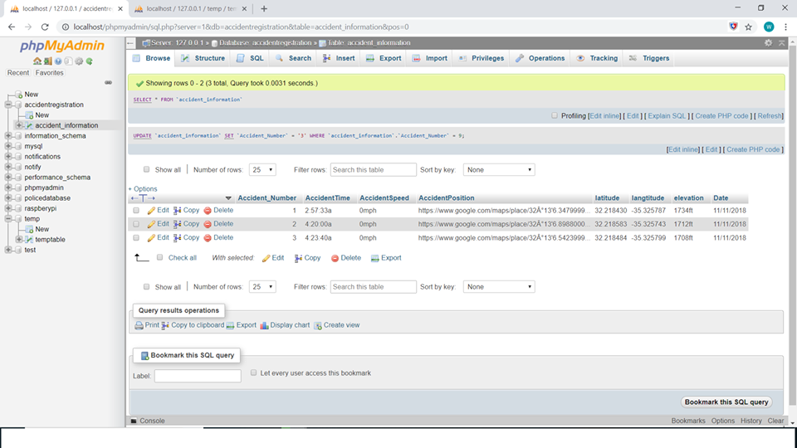
Database :

Slide 18
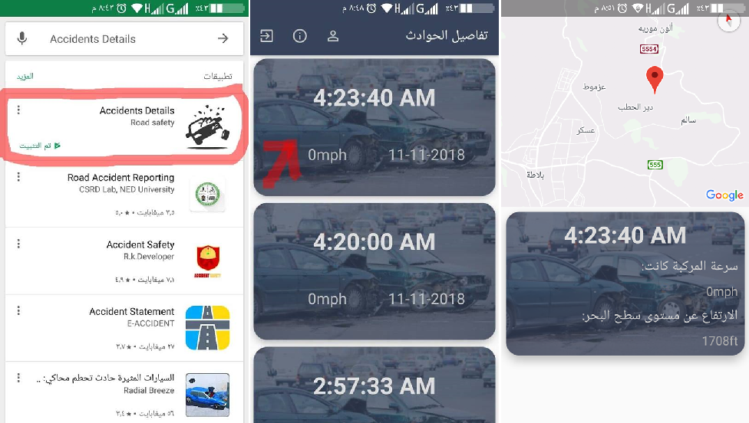
Android Application:
In order to use this application for anyone, they need to have their own account, by registering, where they are aware of the incidents and information about them.

Slide 19
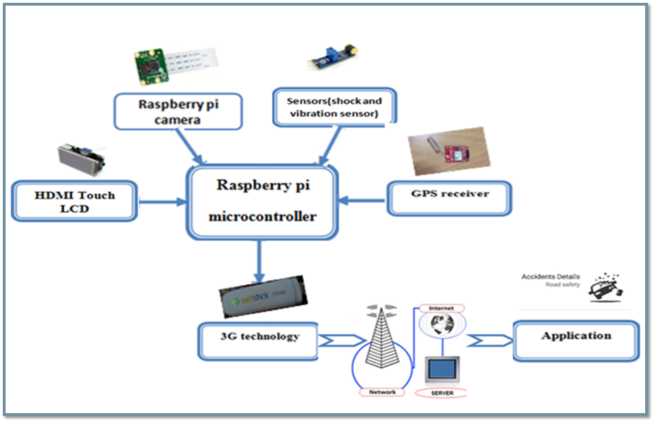
Project Description:

Slide 20
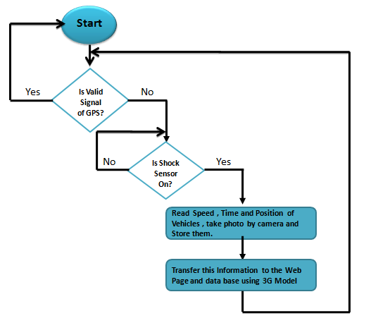
System Flow Chart:
Vehicles Accident Side:

Slide 21
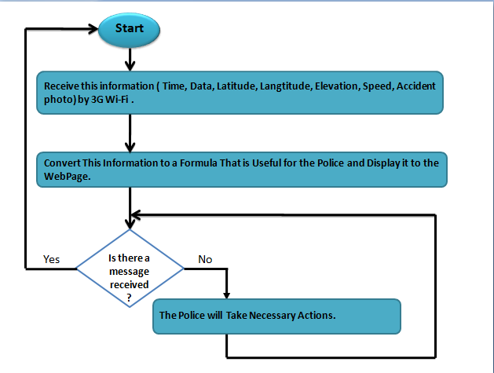
Police Center Side:

Slide 22
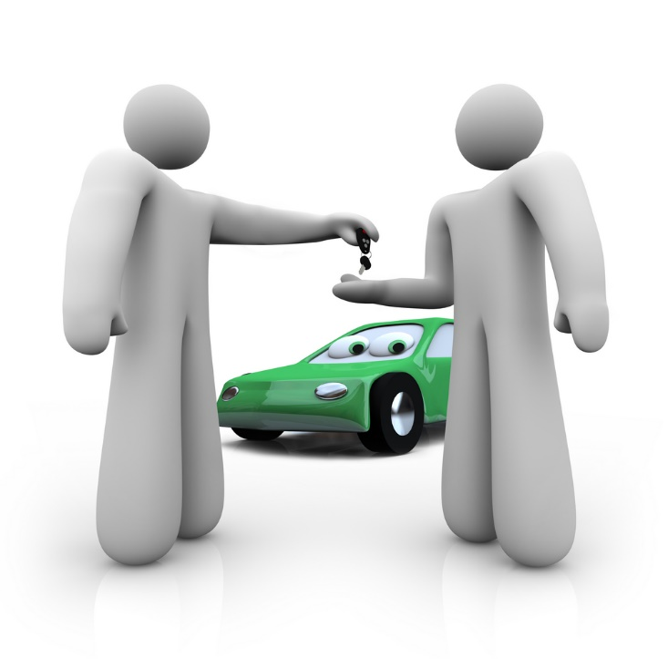
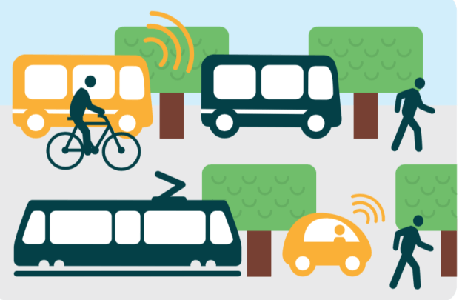
Candidate Application:
The Model is Designed to Be Implemented in:
Public Transportation.

Slide 23
Feasibility Study:
We Will Study and Analyze The Economical Part of Our Project. These Prices are According To The Local Market.
Raspberry Pi3 Model B:25 USD.
GY-NEO6MV2 NEO-6M GPS Module:16 USD.
LCD HDMI :20 USD.
Raspberry Pi3 Camera Module:50 USD
ZTE mf190 3g:40 USD
Vibration and shocked Sensor Module :20 USD
Total Budget :121 USD.

Slide 24
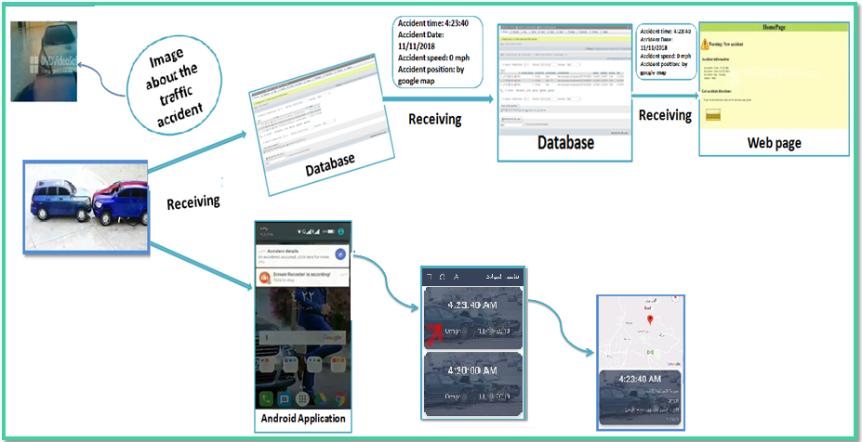
Results and SWOT Analysis:

Slide 25
SWOT Analysis:
1.Uses New and Smart Technologies
2.Low cost.
3. Saving Time and Effort.
4.Acceptable from Police.
1.Not all people connected to 3G .
1.Filming The Traffic Accident By Sending Airplane In The Air When It Happened
2.Give The Driver Financial Penalty When The Vehicle Exceeds A Red Traffic Light.
1. Many available similar application.
S
W
O
T
Strength
Weaknesses
opportunities
Threats

Slide 26
Conclusion And Recommendations:
protecting souls needs both government and drivers corporation responsibility. Much efforts and money will achieve a very good level of road safety.
Our goals are to design a low-cost GPS based wireless controlling model, to implement the system using GPS technology and raspberry pi which are special due to its low cost and availability in the local market.
The proposed model hope to be able to achieve what is meant for, reducing traffic jam, decreasing the number of resulting casualties. All these in favor of human road safety.

Slide 27
Conclusion And Recommendations cont. :
The project help us in developing our programming skills, analyzing and solving problems, and to work under pressure with the team.
In the future, we hope to develop the project by replacing the database with another developed one like elastic search which can store a huge amount of information that can be easily reached. Moreover, sending extra information about serious injuries caused by accident.

Slide 28
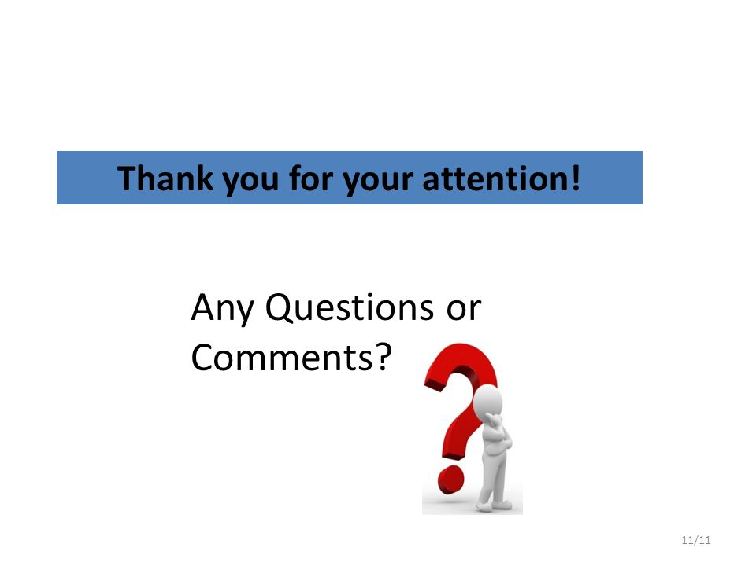

Slide 29
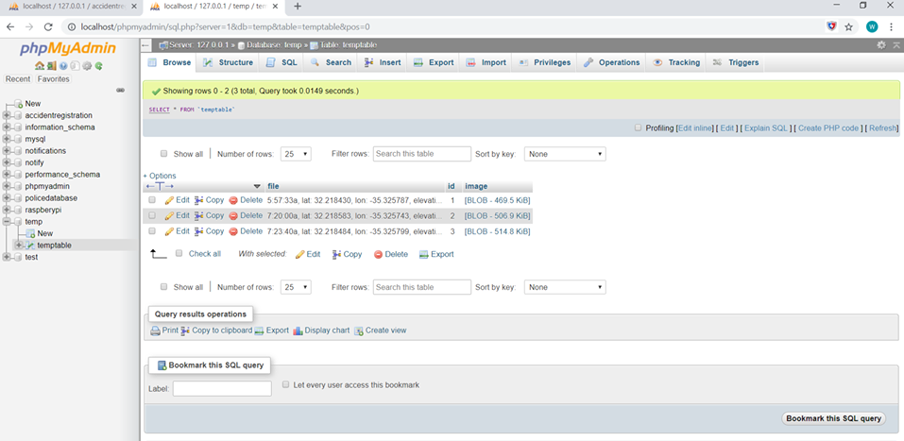

Slide 30
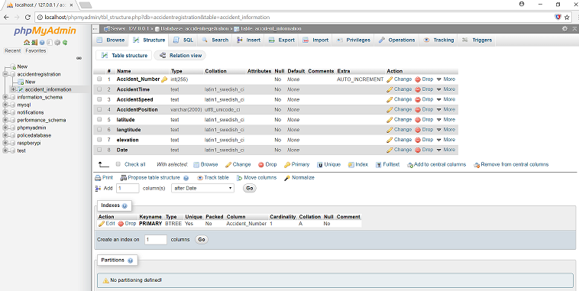

Slide 31
