Slide 1
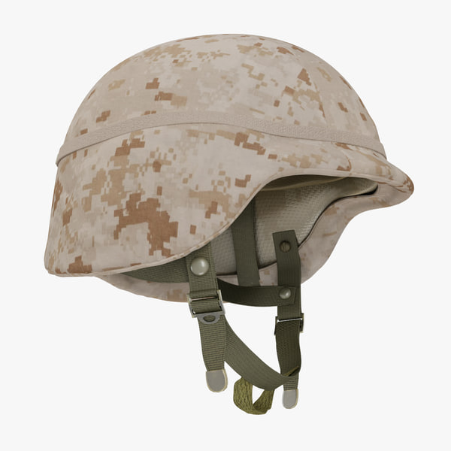
Military Helmet Design
Done by :Ayed Hamad ,Izzat Omran and Meera Mustafa
Supervised by : Dr.Iyad Assaf

Slide 2
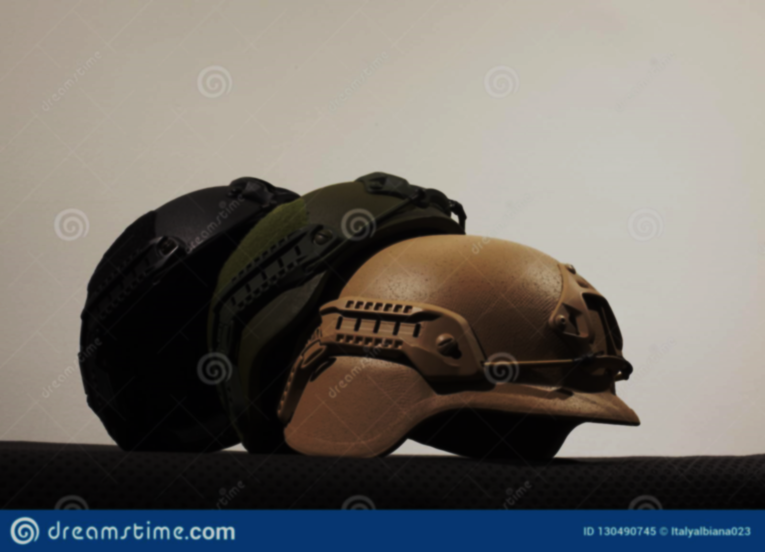
01
Material selection
03
05
Theoretical
Introduction
ABAQUS/CAE
Conclusion
02
04

Slide 3
Introduction
History of military helmets
Composite materials
Kevlar 129
Helmets evolves with the evolution of firearms and the newer the helmets the lighter and more protective they are.
Definition, advantages, Fiber reinforced composites, Aramid Fibers.
Kevlar types, comparison between Kevlar 29 and 129.
Manufacturing
Hashin damage
Preheating oven, thermoforming, and trimming.
Explanation of the symbols and the meanings.

Slide 4

Introduction
Composite materials
History of military helmets
Hashin damage
Kevlar 129
Manufacturing

Slide 5
The development and diversity of weapons drew attention to the military protective helmet, to reduce serious injuries and to protect the soldier's head from fragmentation and the ballistic impact caused by these weapons, and to prevent bullet penetration. There was a need to develop the old helmet and reduce its heavy weight and high cost. Moreover, the use of available materials to achieve this purpose.
Hashin damage
Composite materials
History of military helmets
Kevlar 129
Manufacturing

Slide 6
'Composite material' is defined as a combination of (usually) two different materials, each with its own mechanical and chemical properties, that work together after being judiciously embedded, either physically or chemically, to produce a new material with unique properties that are better than the sum of those of the constituent components.
Fiber-reinforced composites (FRC) are the most common composites employed in today's technological applications. The major objectives to be met while creating these materials are great strength and stiffness while keeping the weight to a minimum.
Composite materials
Kevlar 129
History of military helmets
Hashin damage
Manufacturing
Aramid fiber is organic fiber which is defined as a manufactured fiber in which fiber forming substance is a long chain synthetic polyamide. Fibers such as Kevlar, Nomex, Technora, and Twaron will be included in the Aramid family.

Slide 7
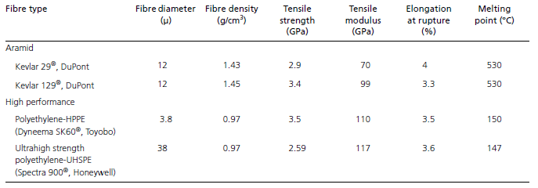
Kevlar Types
Kevlar29 VS Kevlar 129
Composite materials
Kevlar 129
History of military helmets
Hashin damage
Kevlar 29
Kevlar 49
Kevlar 100
Kevlar 119
Kevlar 129
Kevlar 149
Manufacturing

Slide 8
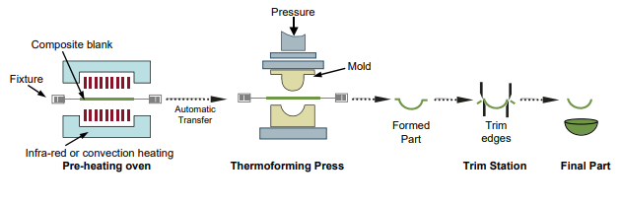
Composite materials
Kevlar 129
History of military helmets
Hashin damage
Manufacturing

Slide 9
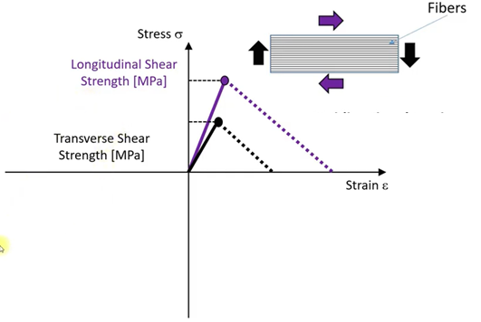
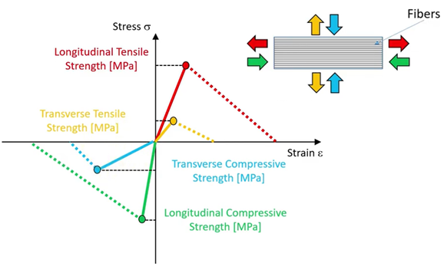
Tensile strength
Shear strength
Composite materials
Kevlar 129
History of military helmets
Hashin damage
Manufacturing

Slide 10
ABAQUS/CAE
1
Bullet shape comparison
5
Helmet Full Model
2
Angle comparison
4
Layers comparison
3
Material comparison

Slide 11
ABAQUS/CAE
Layers comparison
Angle comparison
Material comparison
Bullet shape selection

Slide 12
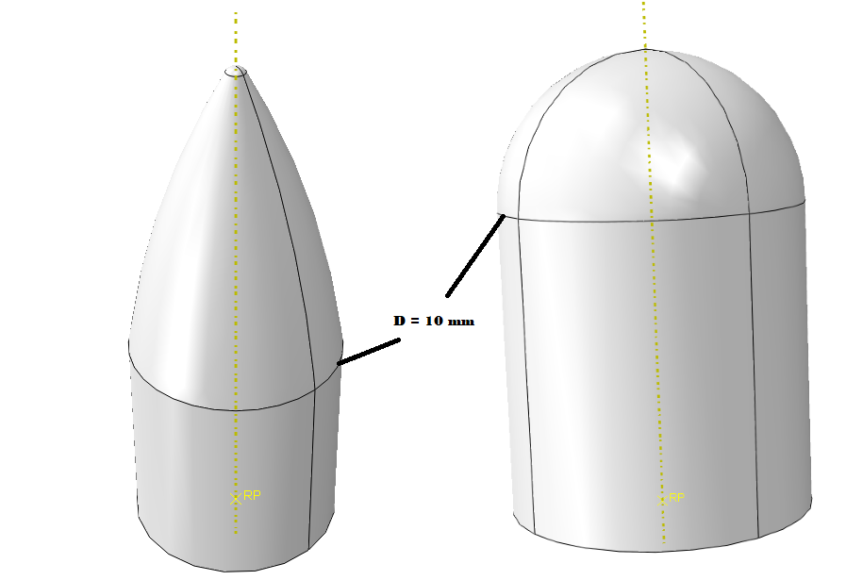
Conical shape
Hemispherical shape
Angle comparison
Material comparison
Layers comparison
Bullet shape selection
Bullet shape | Kinetic energy before (J) | Kinetic energy after (J) | Energy absorbed by the plate (J)
Hemispherical | 3200 | 2886.4 | 313.6
Coincal | 3200 | 3002.9 | 197.1

Slide 13
Material comparison
Angle comparison
Layers comparison
Bullet shape selection
Angles | Kinetic energy before (J) | Kinetic energy after (J) | Energy absorbed by the plate (J)
90/0 | 3200 | 2879.6 | 320.4
0/90 | 3200 | 2880.2 | 319.8
90/45 | 3200 | 2846.5 | 353.5
45/-45 | 3200 | 2833.3 | 366.7
0/45 | 3200 | 2861.2 | 338.8
45/0 | 3200 | 2869.4 | 330.6
45/90 | 3200 | 2851.35 | 348.6

Slide 14
Angle comparison
Layers comparison
Material comparison
Bullet shape selection
Material | Kinetic energy before (J) | Kinetic energy after (J) | Energy absorbed by the plate (J)
Glass fiber reinforced polymer | 3200 | 2732.5 | 467.5
Carbon fiber reinforced polymer | 3200 | 2768.4 | 431.6
E glass epoxy | 3200 | 2412.8 | 787.2
kevlar 129 | 3200 | 1860.7 | 1339.3
Carbon fiber toray T800 | 3200 | 2472.5 | 727.5

Slide 15
Layers comparison
Angle comparison
Material comparison
Bullet shape selection
the more layers added the less ballistic velocity outcome and noticed that the positive ballistic velocity means that the projectile has fully penetrated the target plate, while the negative represents partial penetration and rebounding. It can be observed that for the case of 4.5mm, its ballistic velocity is -325.4m/s. It means that the most kinetic energy of the projectile has been absorbed by the target; negative ballistic velocity means that rebounding has emerged.

Slide 16
Helmet Full Model
Modeling on the ABAQUS
1
Modeling the parts, Material definition and assembly, Boundary conditions and meshing and finally the model results.
Effect of impact angle on helmet thickness
2
Different models were carried out to investigate the effect of the impact contact angle.
Theoretical
3
The results of the theoretical calculation and comparison with the analytical results.
Conclusion
4
The summary of the study and the results.

Slide 17
Modeling on the ABAQUS
Material definition and model assembly
Boundary conditions parts meshing
Model Results
Modeling the parts

Slide 18
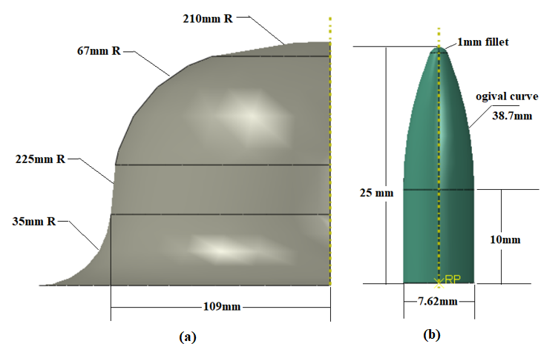
Half helmet dimensions
rigid bullet dimensions
Material comparison
Material definition and model assembly
Modeling the parts
Model Results

Slide 19
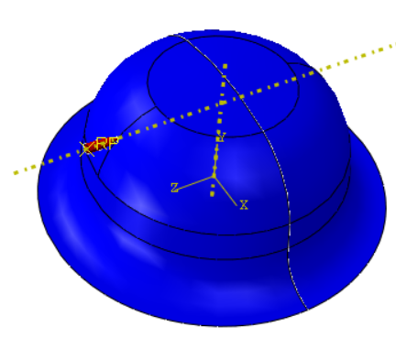
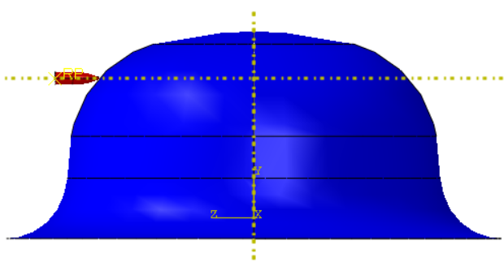
The material of the military helmet was made of Kevlar 129 since it absorbs more energy than other composite materials. The helmet consists of different plies with different direction. As indicated in the investigation chapter, the best orientation of plies angle was selected as (45/-45).
A reference point (RP) was assigned to the rigid bullet.
Layers comparison
Material definition and model assembly
Boundary conditions parts meshing
Modeling the parts

Slide 20
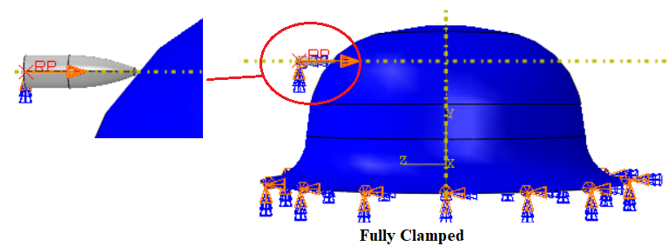
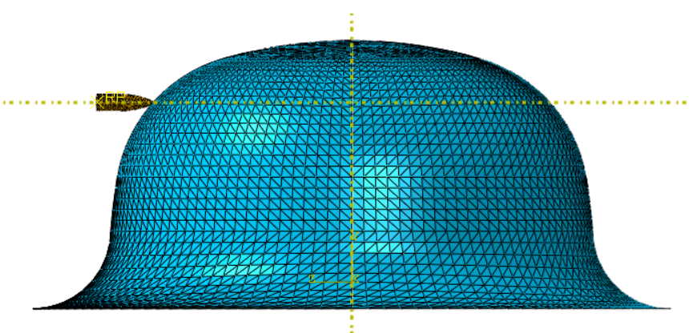
the bottom surface of the helmet was fully clamped as shown in figure (6.4). Also, the bullet was not allowed to move in all direction except in z-direction (where the bullet will move 800m/s)
Material definition and model assembly
Model Results
Boundary conditions parts meshing
Modeling the parts
the element type for the helmet was S3R (shell element, three nodes, reduce integration). In addition, the rigid bullet was meshed using R3D3 (rigid element, three dimensions, three node)

Slide 21
the more layers added the less ballistic velocity outcome and noticed that the positive ballistic velocity means that the projectile has fully penetrated the Helmet, while the negative represents partial penetration and rebounding. It can be observed that for the case of 10mm, the bullet rebounded at time 0.075ms and returned back
Material definition and model assembly
Boundary conditions parts meshing
Modeling the parts
Model Results

Slide 22
Effect of impact angle on helmet thickness
At the angle 60°
At the angle 45°
At the angle 90°
At the angle 30°
At the angle 0°

Slide 23
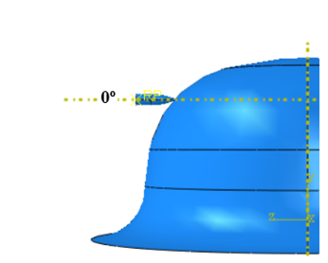
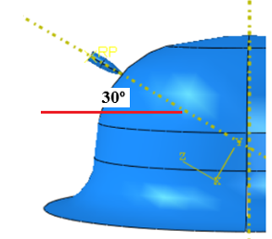
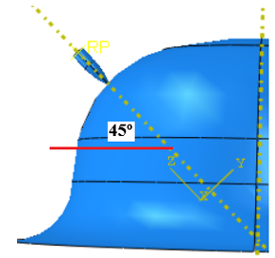
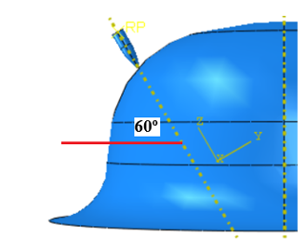
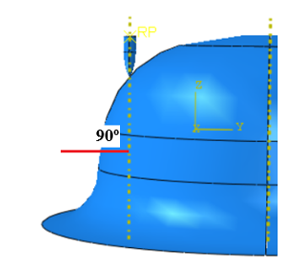
At the angle 0°
At the angle 30°
At the angle 45°
At the angle 60°
At the angle 90°
the helmet thickness needed
To stop the bullet is 10 mm
the helmet thickness needed
To stop the bullet is 8.25 mm
the helmet thickness needed
To stop the bullet is
8 mm
the helmet thickness needed
To stop the bullet is 8.75 mm
the helmet thickness needed
To stop the bullet is 10.25 mm

Slide 24



Theoretical
$V_{i}=\frac{πβ\sqrt{ρ_{t}σ_{e}}D^{2}T}{4G}\left[1+\sqrt{1+\frac{8G}{πβ^{2}ρ_{t}D^{2}T}}\right]$
Initial velocity
for the projectile
The cone angle
Kevlar 129 density
The projectile diameter
The projectile mass
Which is kept unknown.
The angle of the nose of bullet = 112.3°
Which equals 1230Kg/m^3
Which equals 7.6mm
Which is 10 g
Which equals 3.1415
Equals 2sin (θ/2)=1.66
Which varied between
1 mm and 15 mm
Which equals 3620MPa
Pi symbol
Constant beta
Yield strength of Kevlar 129
The helmet thickness

Slide 25
Theoretical results
2mm
4mm
6mm
1mm
289.89 m/s
3mm
431.34 m/s
5mm
549.12 m/s
7mm
197.71 m/s
364.98 m/s
492.17 m/s
603.17 m/s
9mm
11mm
13mm
8mm
704.88 m/s
10mm
800.42 m/s
12mm
891.51 m/s
14mm
654.95 m/s
753.29 m/s
846.44 m/s
935.73 m/s

Slide 26
Theoretical VS ABAQUS/CAE

Slide 27
Conclusion
The hazardous
bullet shape
The best layers
Layup angles
The best composite
Material for the helmet
Theoretical
Effect of impact
Angle
The most hazardous bullet shape was the conical shape.
The best angles were
(45/-45)
Which absorbs more energy than the other angles.
Kevlar 129 is the best of 5 materials were tested in Abaqus/cae
After comparing the theoretical and analytical results for velocity 800 m/s there was a good agreement
After comparing the results of different impact angles the most hazardous impact angle was 90°

Slide 28
1
Thank Y u

