Slide 1
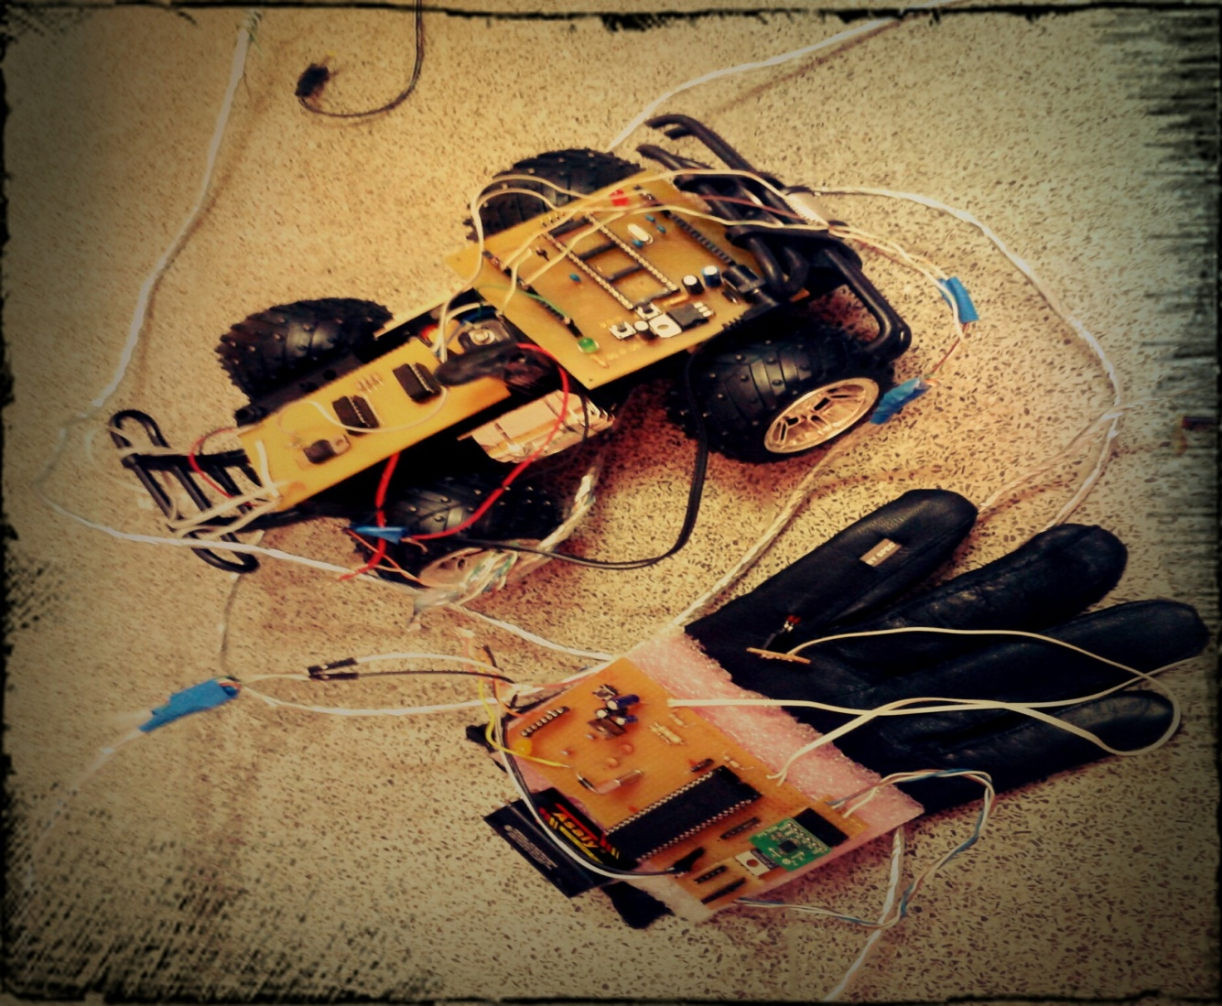
Gesture Controlled Car
(GCC)
By: Ashwaq Alkailany
Reema Abubaker
Supervised by:
Dr. Luia Malhis

Slide 2
Introduction
Introduction
Goal
Outline
Hardware
How Gesture Controlled Car Work?
Problems and solutions
Future work and conclusion

Slide 3

Introduction
Gesture Control Car (GCC)is a microcontroller project that control the car motion by hand glove.

Slide 4
Introduction(Contd…)
Most of controllers of existing remote cars require users to interface with joysticks and push buttons. Comparing to these conventional controllers, we built a wireless gesture controller which enables cars to mock hand motion in all dimensions.

Slide 5
GOAL
The goal of this project is to capture simple hand gestures from the Glove and use that input to wirelessly control car.
Controlled variables include speed, steering, forward/reverse and stop.

Slide 6
SYSTEM COMPONENTS
The Gesture Controlled car consists of four main components:
1. Glove
2. Microcontroller
3. X-Bee
4. car

Slide 7
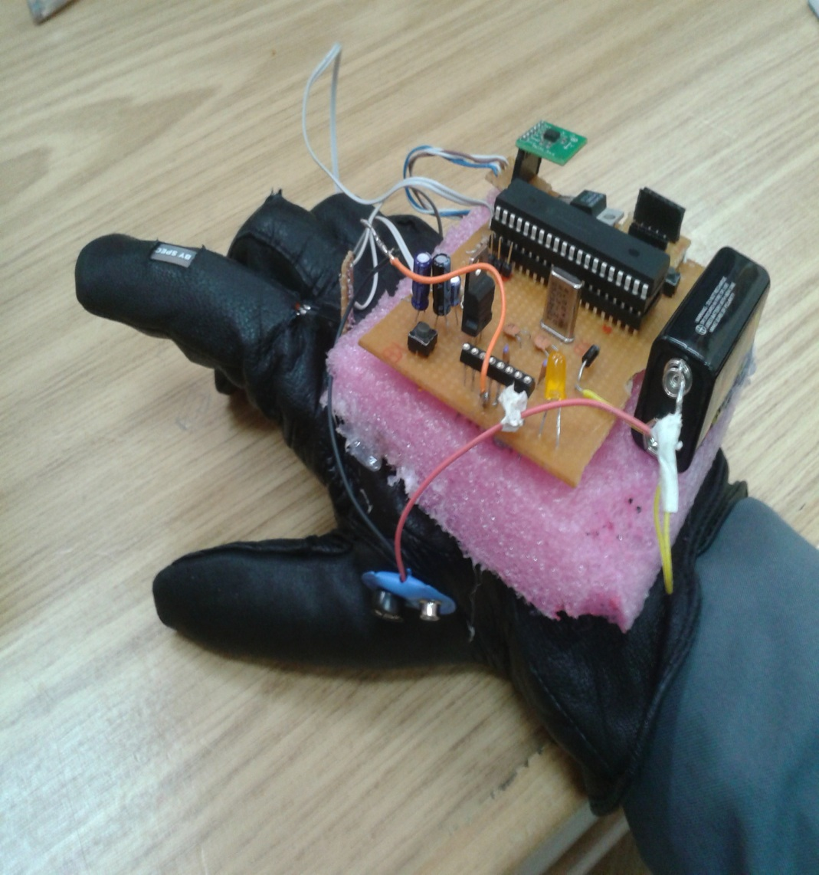
Glove component
1- Microcontroller
2- X-Bee
3- Flex sensor
4- Accelerometer
5- voltage regulator
Notes:
The glove we use is a normal leather glove with flex sensors attached to each finger. As we move the fingers of the hand with the glove on, the movement causes the flex sensors to bend ,and accelerometer control the direction of movement left ,right , backward ,forward thus producing a signal which causes the virtual hand to move.

Slide 8
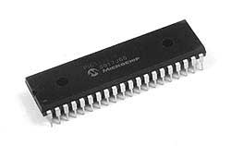
Microcontroller
The microcontroller :is a small computer on a single integrated circuit containing a processor core, memory, and programmable input/output peripherals..

Slide 9
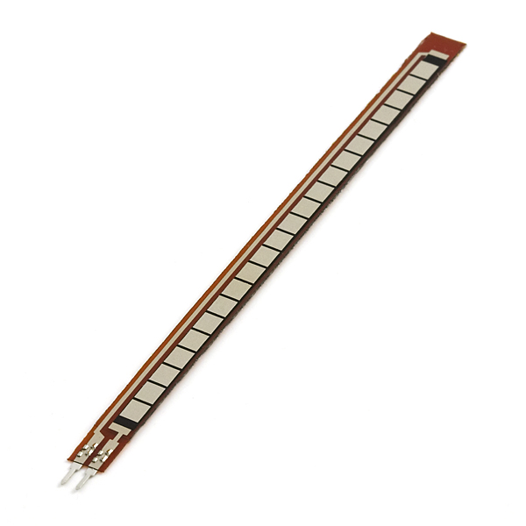
Hardware
Flex sensors : are sensors that change in resistance depending on the amount of bend on the sensor.

Slide 10
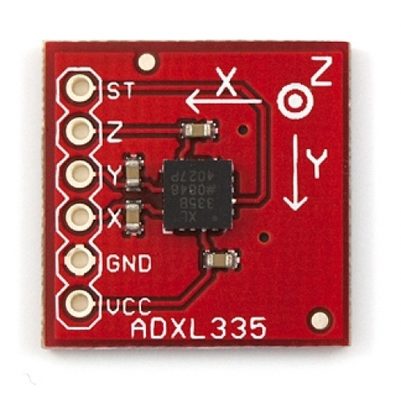
Hardware
Accelerometers: The accelerometer can detect the three-dimensional orientation of the hand . In our project we use ADXL335 is a triple axis accelerometer with extremely low noise and power consumption .

Slide 11
Hardware
Microcontroller : The processor that is used in our project is microcontroller Pic18F4620

Slide 12
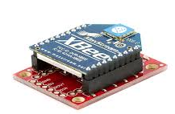
XBee Series 1 Module
These modules allow a very reliable and simple communication between microcontrollers, computers, systems, really anything with a serial port! Point to point and multi-point networks are supported.

Slide 13
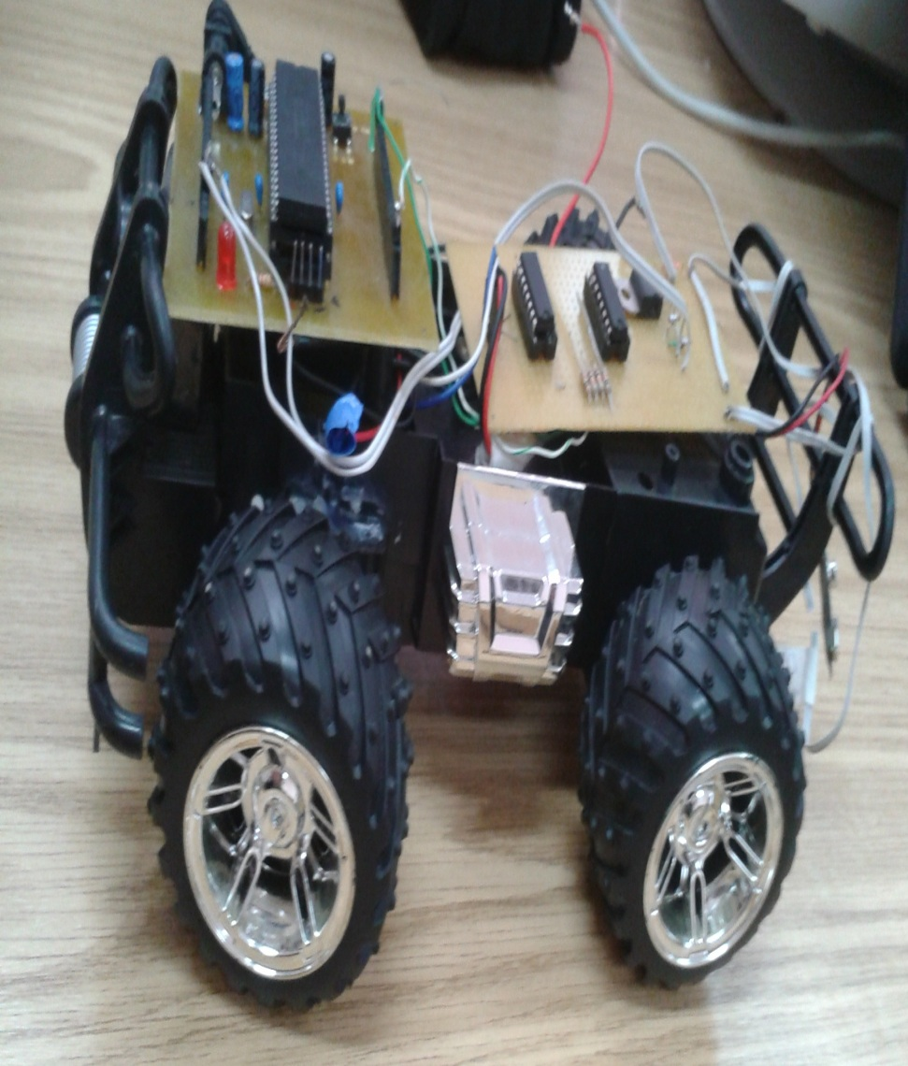
Car Component
1- Microcontroller
2- X-Bee
3- DC motor
4- uln2003a and l293d
5- resistors

Slide 14
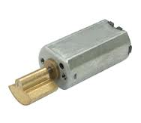
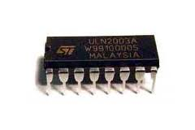
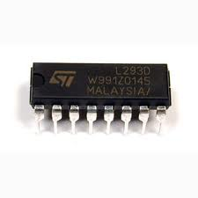
DC motor – ULN2003-L293D

Slide 15
How GCC Work?
Transmitter side(Glove):
When substrate flex sensor is bent the sensor produces a resistance output relative to the bend radius.
The accelerometer measures the tilt of the user’s hand in the 3D XYZ plane.

Slide 16
How GCC Work?
The microcontroller, MCU takes measurements from accelerometer to calculate the current tilt position of the hand and collects the values of two flex sensors to detect the bending of each finger. These sensors are directly connected to the microcontroller which is programmed so that it can process these sensors values and pass it to second part of the system.

Slide 17
Reading accelerometer value
Reading flex1
Reading flex2
Do two ranges to move motor left or right . Also range for reference
Divide the values into five ranges to control speed
Glove flow chart
Reading will be transmitted in the encoded form through X-Bee

Slide 18
How GCC Work?
Receiver side(Car):
The wireless car reads the signals sent by the gesture controller from the wireless modules and send it to MCU.
MCU runs motors depending on data received to determine the movement, speed and directions.

Slide 19


Car flow chart
Received the encoded data
Run motors depending on data received to determine the movement , speed and direction
Appropriate PWM will be fed to the L293d motor driver

Slide 20
Acceler-
ometer
Flex 1
Flex 2
Whole system
Glove MCU
Pic 18f4620
Data transmitting
(X-Bee)
Car MCU
pic18f4620
Motor 1
Motor 2
PWM out put is fed to L293d motor driver

Slide 21
Problems and CONSTRAINTS:
1- accelerometer problem :
the accelerometer destroyed and gave unstable values .
We searched for the reason and we found that we fed it by more than 3.3 volt “completely damaged ”.

Slide 22
Solution
Using voltage regulator fed 3.3 volt.

Slide 23
Problems and CONSTRAINTS:
Sensitivity for Flex sensor :
Its conductive material affected with usage and with the time there will notable variations of the output voltage range .

Slide 24
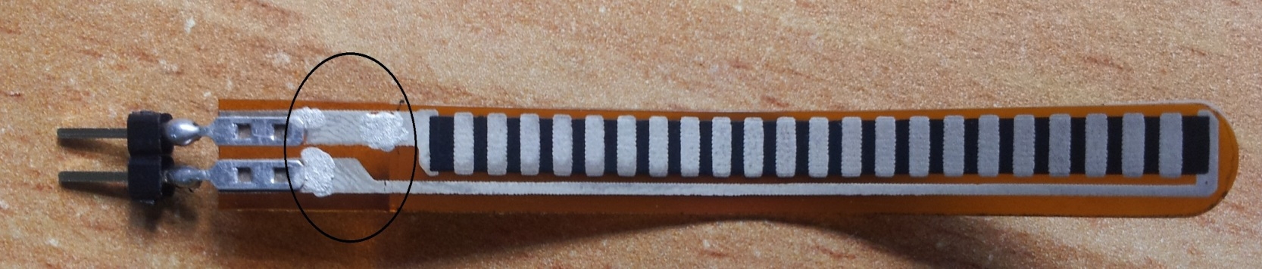
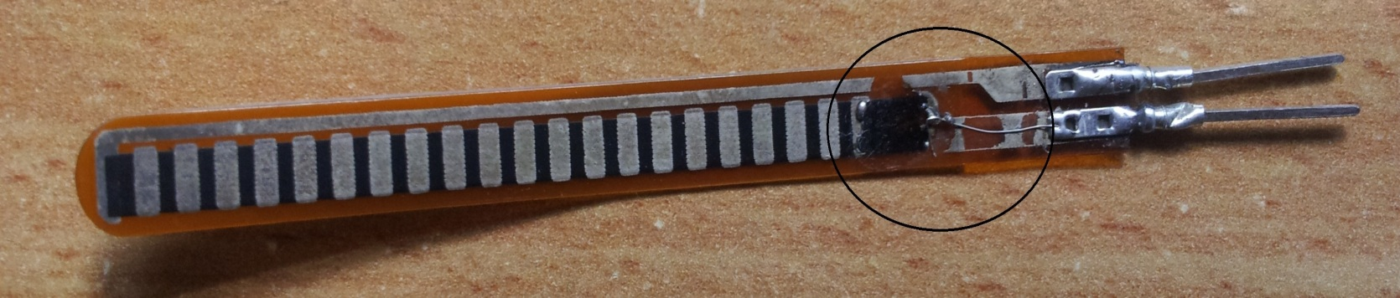
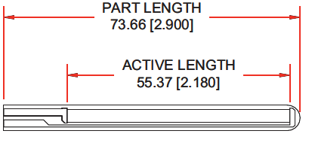

Slide 25
Future work
- we will work to improve our idea "gesture controlling" to control any devices by any part of body not just by hand.
- Also we will use our project to become helpful for people with special needs.
- Games field.

Slide 26
Conclusion
- All difficulties can be overcome by using Accelerometer and Gyroscope sensor.
- Expensive !!!!!

Slide 27


