Slide 1
Exams System Website
Prepared by:
Samah Rabay’ah & Maha Rabay’ah
Supervisor:
Eng. Asmaa Afeefi

Slide 2


Slide 3
Website that used to provide exams and homework (paper or online).
Enter questions for one time and then use it to prepare exams.
Basically used by teachers and students.
This Is The Exams System !!

Slide 4
Outline
Objectives
Tools
Search algorithm
Features
Constraints
Future work

Slide 5
Objectives
Facilitate the process of preparing exams by teachers.
Save time and effort.
Make the teaching process as orderly as possible.
Develop their strategy for putting the exams.

Slide 6
Tools
PhpStorm
XAMPP
Laravel composer
MVC architectural pattern using Laravel framework.
TCPdf library

Slide 7

Data Mining
Extract usable data from a larger set of any row data !

Slide 8
Search Algorithm
Keeping the high power words
Convert to a vector space
Removing common words from query

Slide 9

Search Algorithm (cont.)
Query and keywords vectors:
$Qv=(q1,q2,q3,……qn)$ query vector
$Kv=(k1,k2,k3,……kn)$ keywords vector
cosine similarity
$sim\left(Q,K\right)= \frac{\sum_{i=1}^{n}{(qi∗ki})}{\sqrt{\sum_{i=1}^{n}{(qi)²}}∗\sqrt{\sum_{i=1}^{n}{(ki)²}}}$

Slide 10
Features
Register and Login
Add Materials
Add Questions
Paper Exam
Online Exam

Slide 11
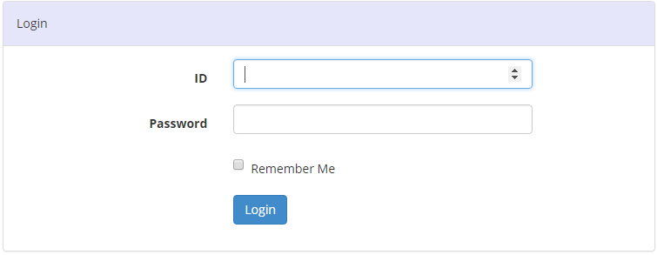
Login

Slide 12

Teacher Home Page

Slide 13
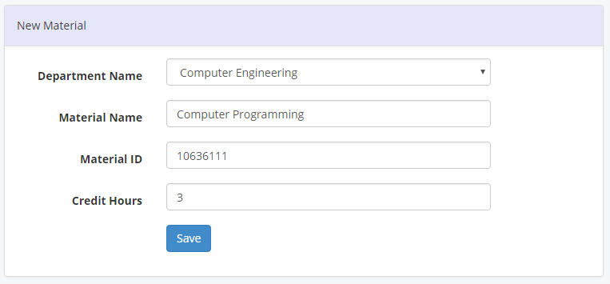
Add Materials

Slide 14
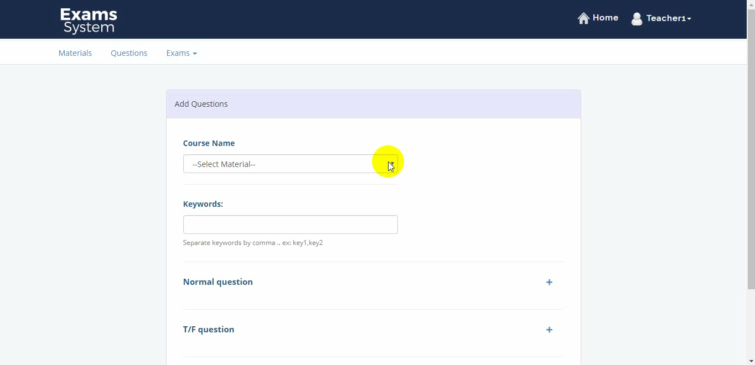
Add Questions

Slide 15
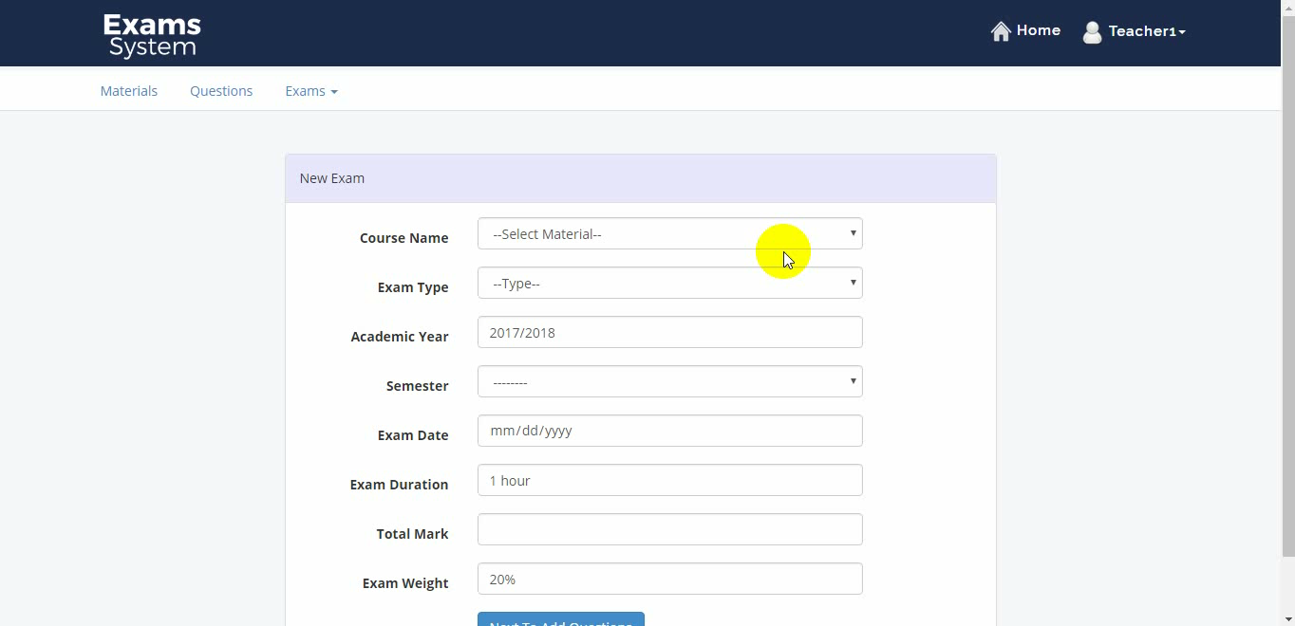
Prepare Paper Exam

Slide 16
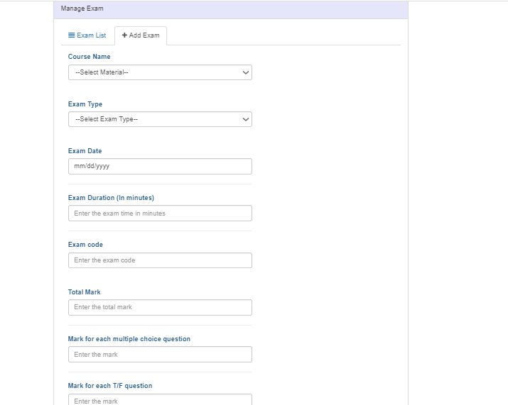
Prepare Online Exam

Slide 17
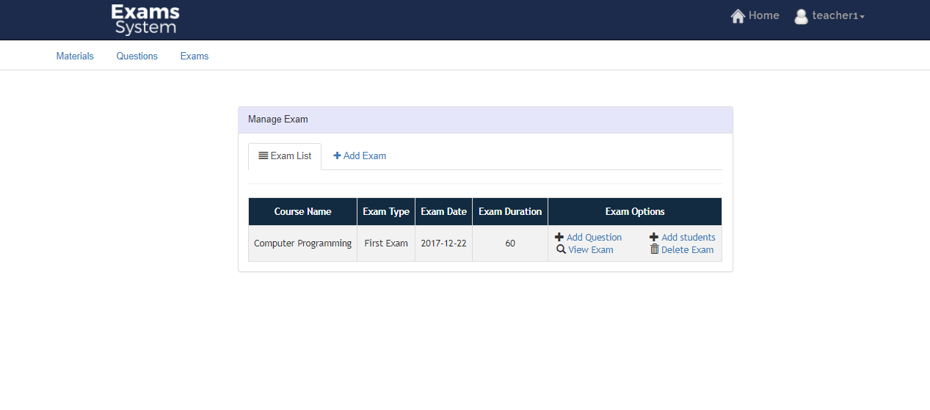
Manage the exam

Slide 18
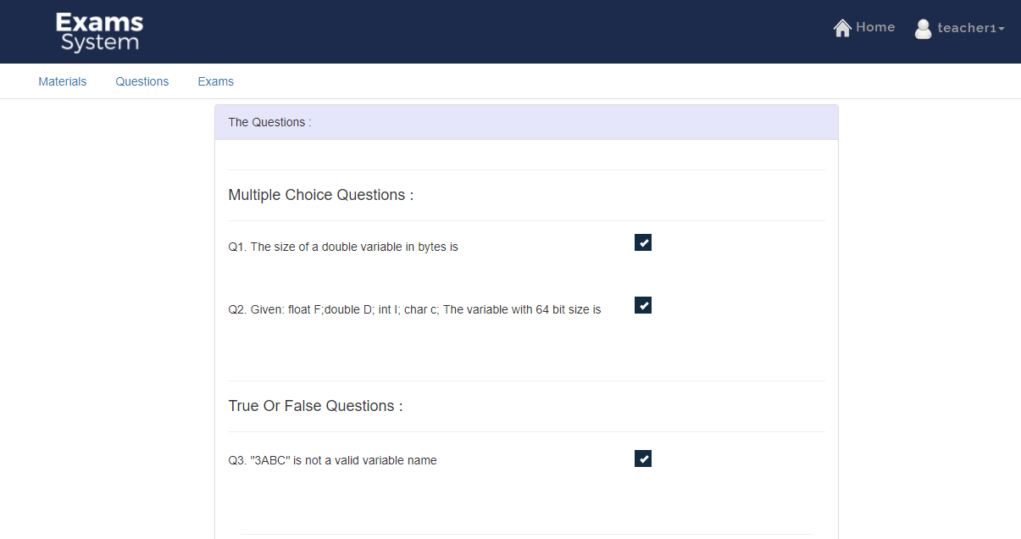
Select the questions you want

Slide 19
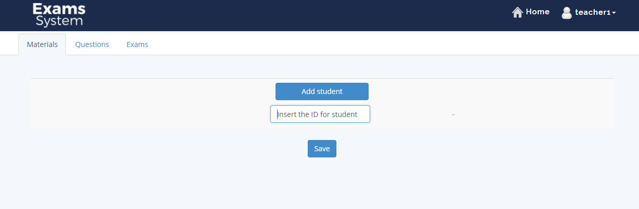
Adding students

Slide 20
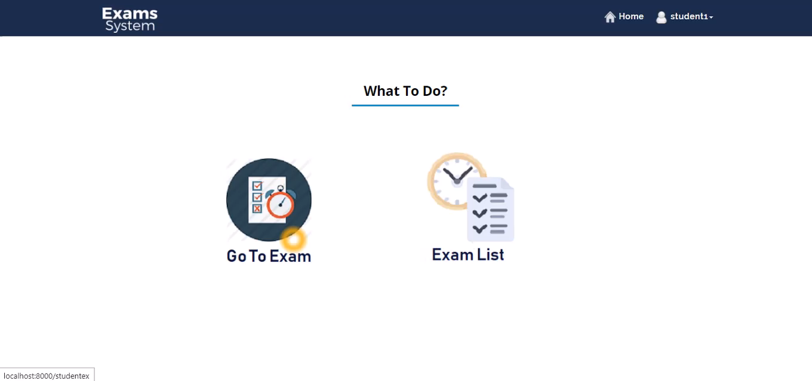
Student side

Slide 21
Constraints
Background knowledge
Real data constraint
Finding the suitable algorithm

Slide 22
Future work
Add as plugin to An-Najah website (Zajel).
Add pictures and tables
Show percentages of questions
More smart algorithm for exam page

Slide 23


