Slide 1

HIER
ME
PREPARED BY: MOHAMMAD ADWAN
HAMZAH FATTOUH
SUPERVISED BY: SUFYAN SAMARA

Slide 2
OUTLINE
• INTRODUCTION
• Motivation
• Project Details
• Future Work
• Constraints

Slide 3

01.
INTRODUCTION

Slide 4

INTRODUCTION
HIRE ME IS A WEBSITE AND MOBILE APPLICATION TO MAKE IT EASY TO FIND A JOB WITH LITTLE EFFORT. IT IS PROVIDED WITH: FILTRING JOB TO FIND BEST ONE DEPANDING ON PROFILE INFORMATION, SENDING A NOTIFICATION THROUGH THE EMAIL FOR ALL REGISTERED USERS, FILTEREING CV FOR COMAPNYS TO FIND BESTONE FOR SEEKERS ,ADD JOB BY COMPANY ,TRACKING JOB FROM APPLAING CV TO ACCSEPT OR REJECT AFTER INTREVIEW ,GENERATER CV DEPEND ON PROFILE INFORMAITON.

Slide 5

02.
MOTIVATION
WE AIM TO DEVELOP A PLATFORM THAT NOT ONLY MAKES THE JOB SEARCH PROCESS EASIER BUT ALSO IMPROVES MATCHING ACCURACY BY COMBINING STATE-OF-THE-ART TECHNOLOGY, USER-FRIENDLY DESIGN, AND USER-CENTRIC FEATURES. THIS ENSURES THAT THE APPROPRIATE TALENT IS MATCHED WITH THE RIGHT OPPORTUNITY. WE ARE DEDICATED TO BRINGING THE IDEA THAT SEEKING A JOB SHOULD BE A SIMPLE AND EMPOWERING EXPERIENCE TO MILLIONS OF INDIVIDUALS ACROSS THE GLOBE. THIS INITIATIVE IS MOTIVATED BY THIS BELIEF.

Slide 6







TECHNOLOGIES AND FRAMEWORKS

Slide 7

1
WEBSITE

Slide 8
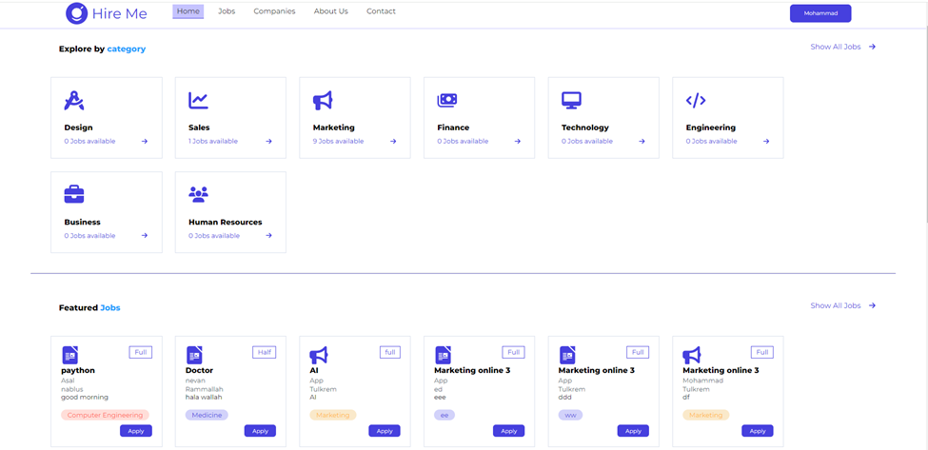
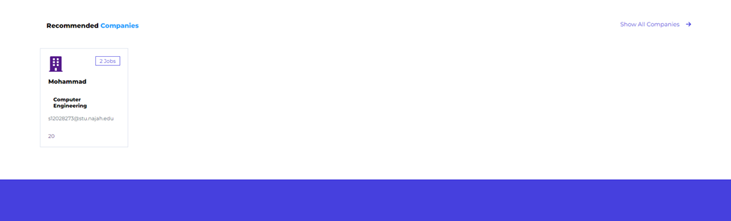
HOME
PAGE

Slide 9
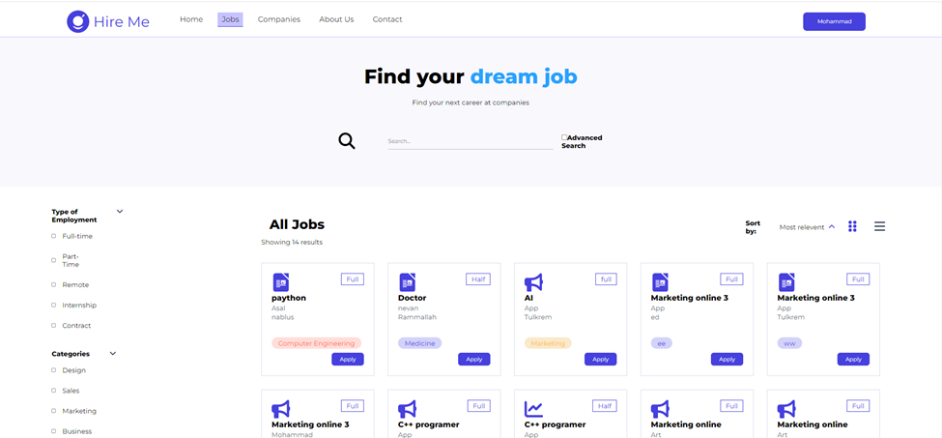
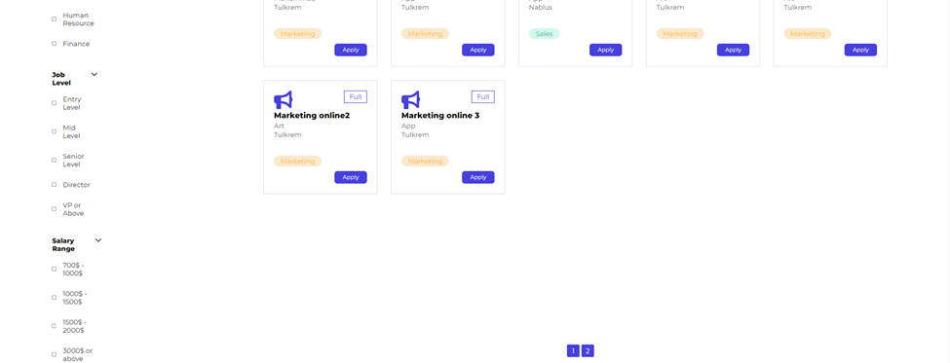
JOBS PAGE

Slide 10


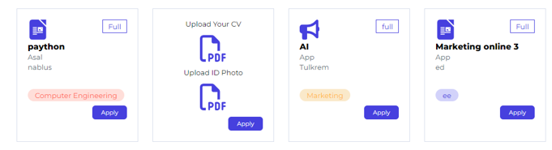
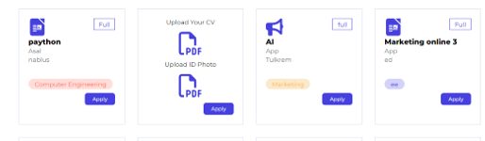
Advance searching
Demand in Skills and Experiences
Applying to job by upload Cv And ID photo for more security

Slide 11
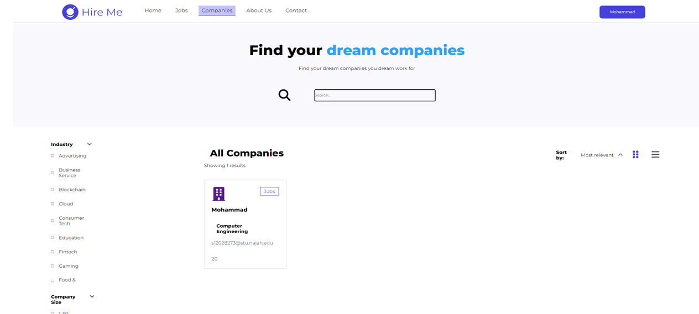
Comopanys Page

Slide 12
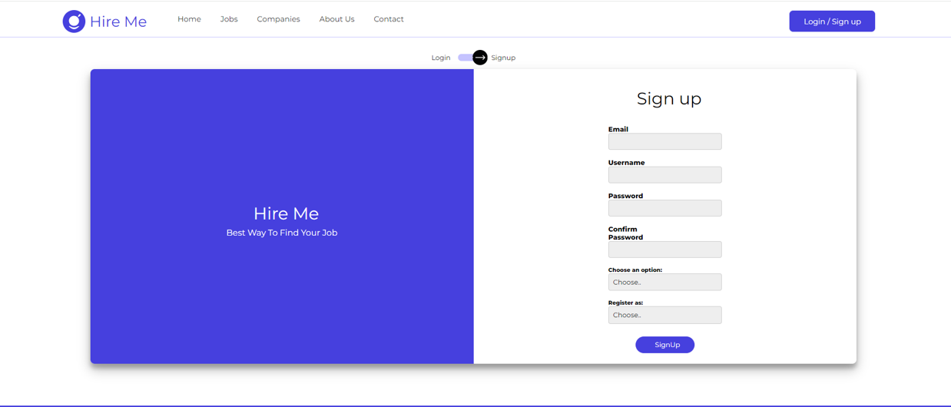
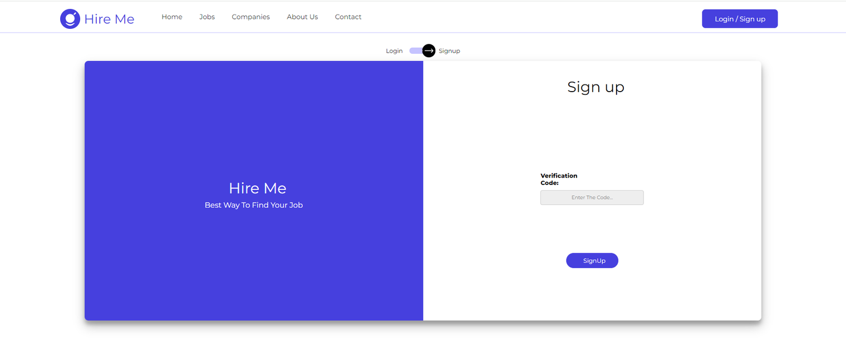
Sign Up Using some
information for Company
and user
Verification by add
the code received
in email

Slide 13
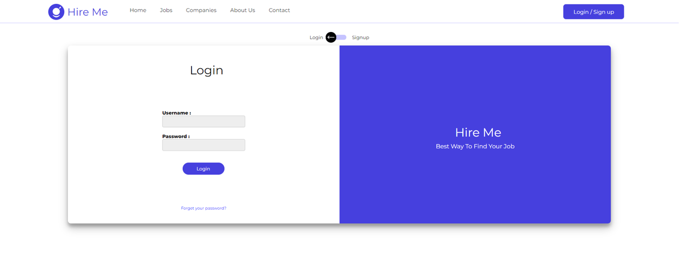
Login Page

Slide 14
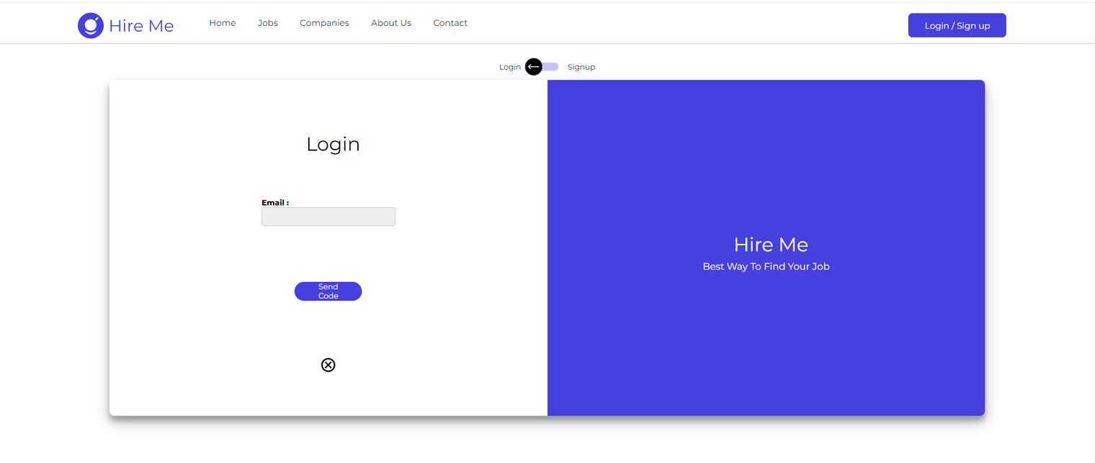
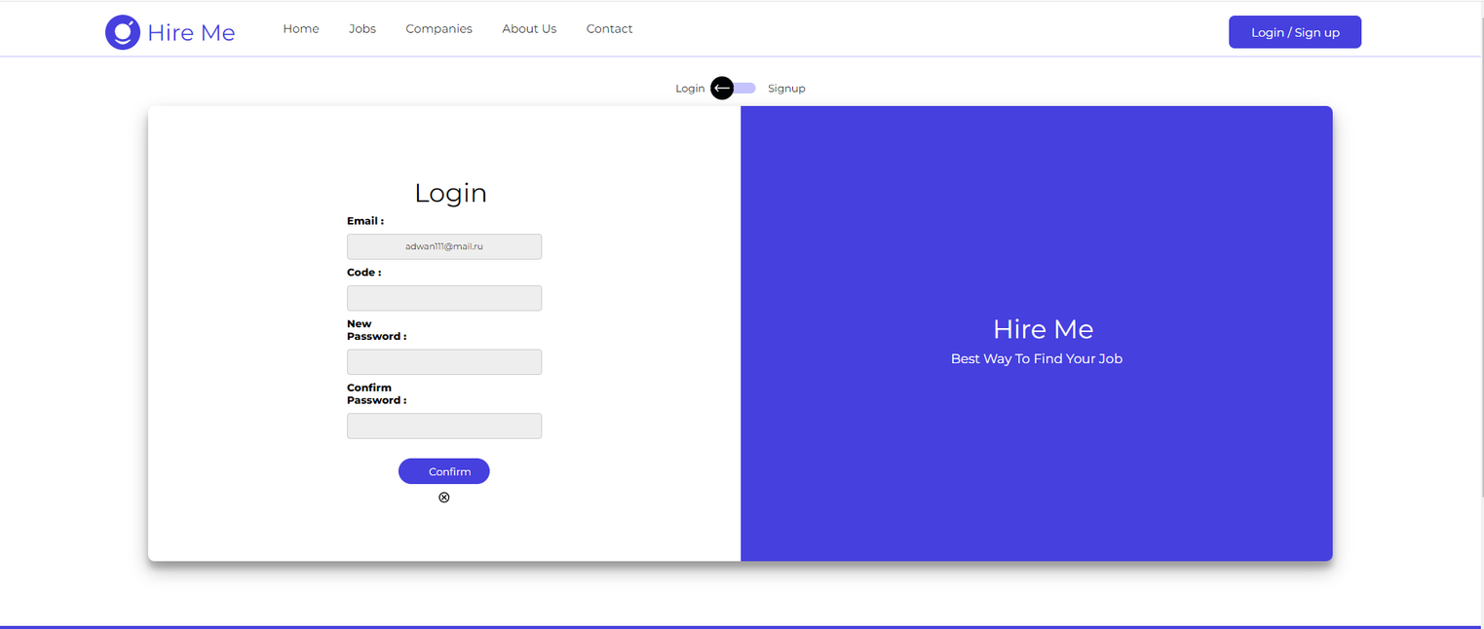
Forget Pass
Return it by email
The code send to email
and then can add it
and change pass

Slide 15
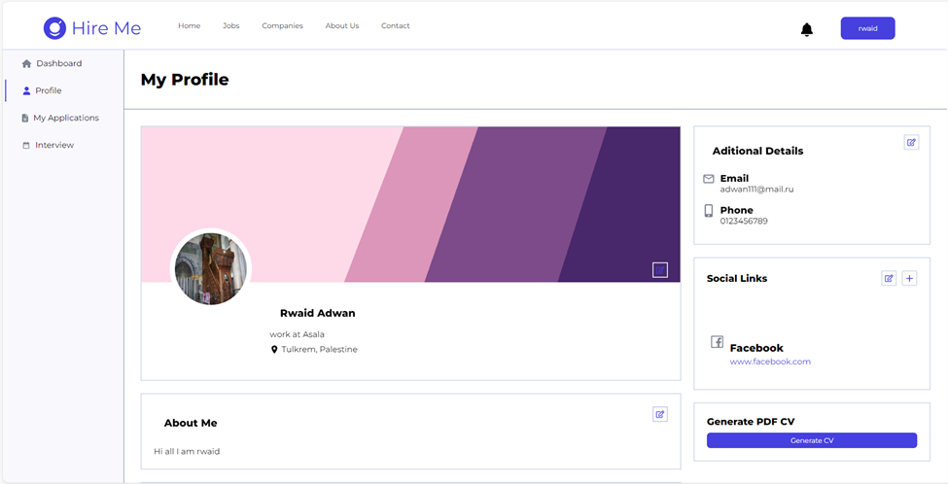
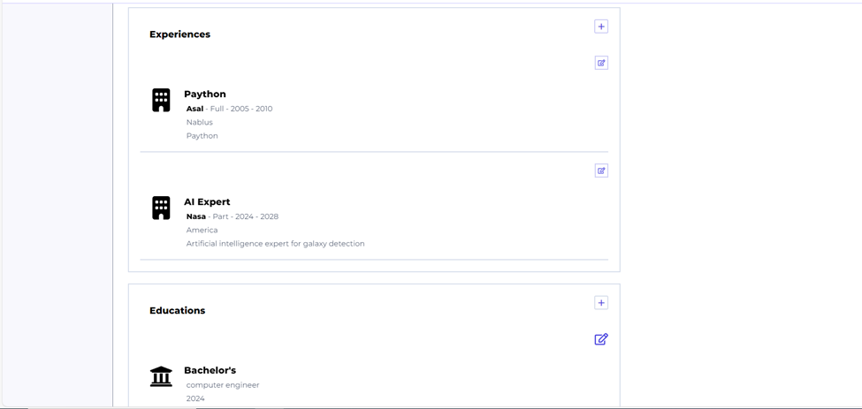
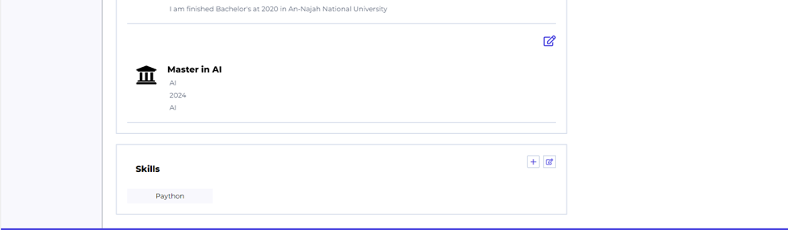
User Profile
1-Informaition about user
2-Experinses
3-Education
4-Skills
5-social media
6-email,phone number,lang
7-generate cv from this information

Slide 16
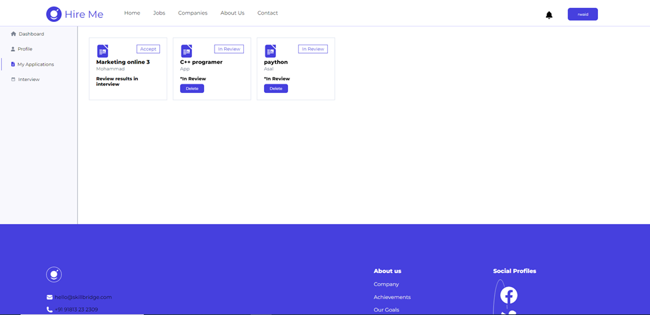
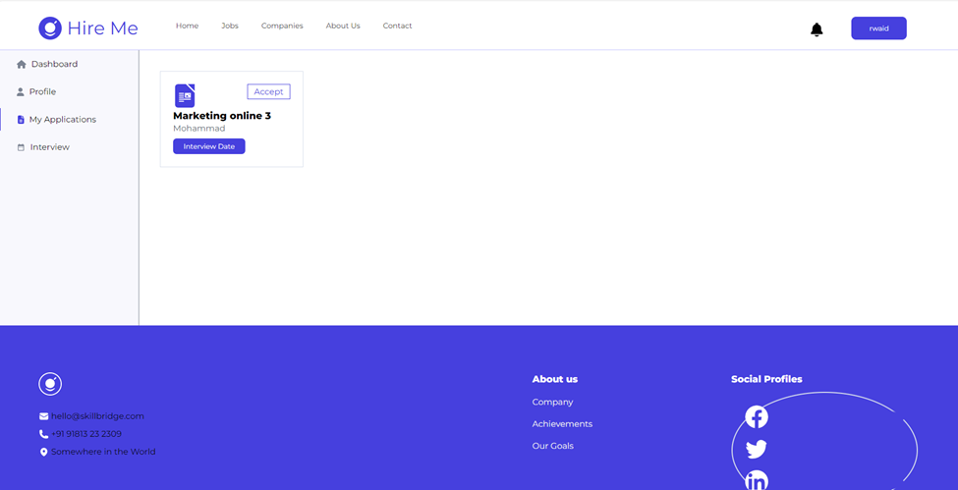
All application of user and can see stats of it (in review ,or booking meeting or results of interview’s)
Interview booking date
after accept CVs

Slide 17
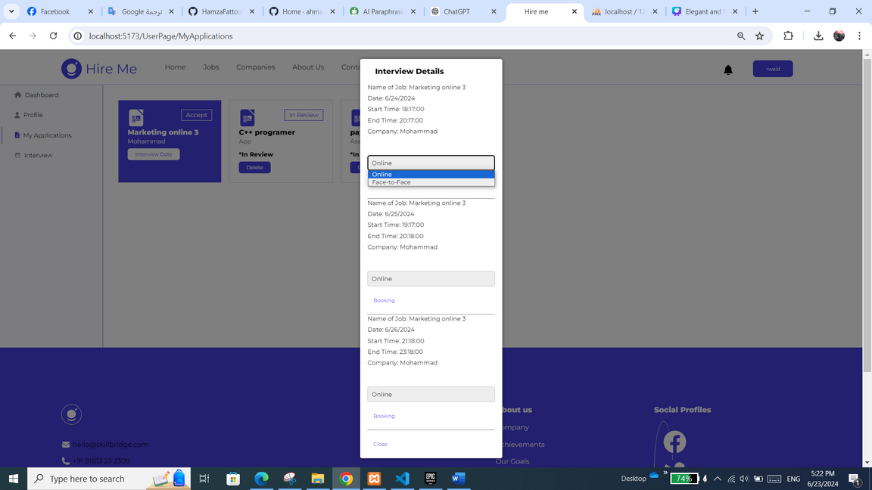
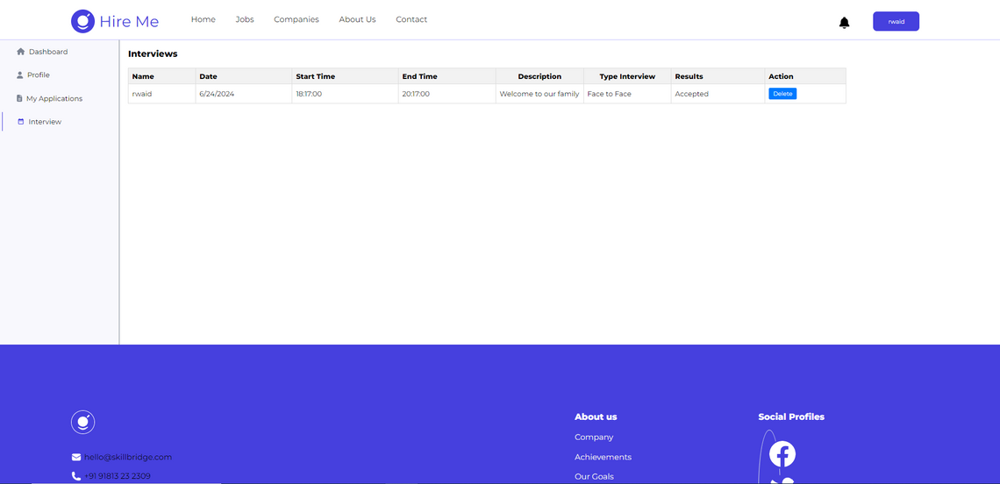
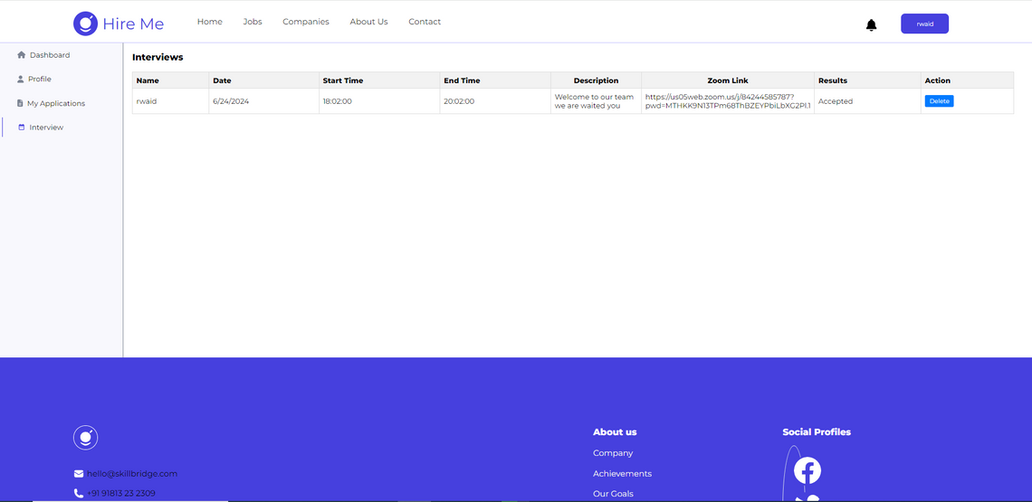
All date by Company to do interview
and can chooses if meet online
or face to face
Stats after interview’s
(accepted or reject or in interviews)
and appear link if online meet

Slide 18
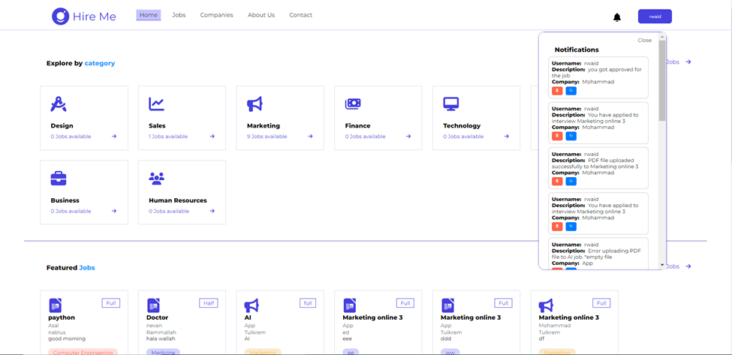
Notification get notification for applying job and stats of review and if cv accepts or reject

Slide 19
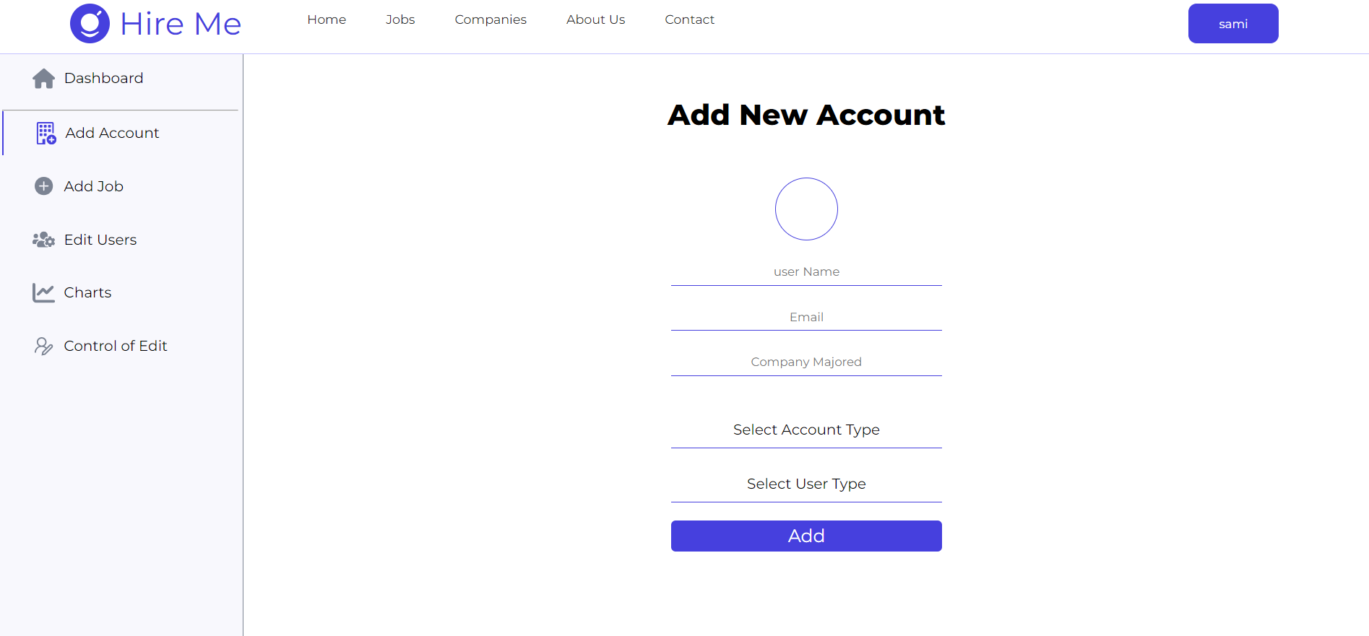
Add new Account by Admin

Slide 20
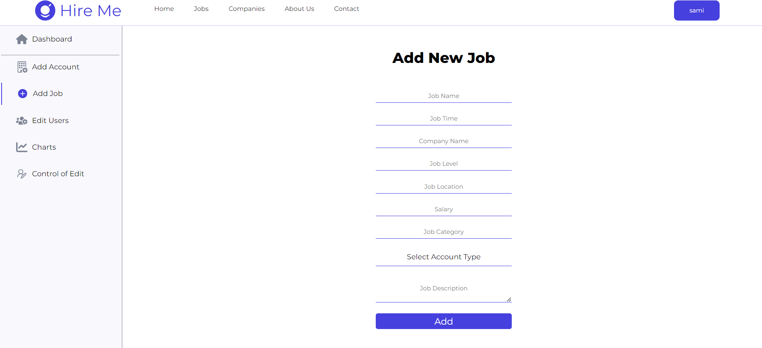
Add new job by admin And if Paid or not

Slide 21
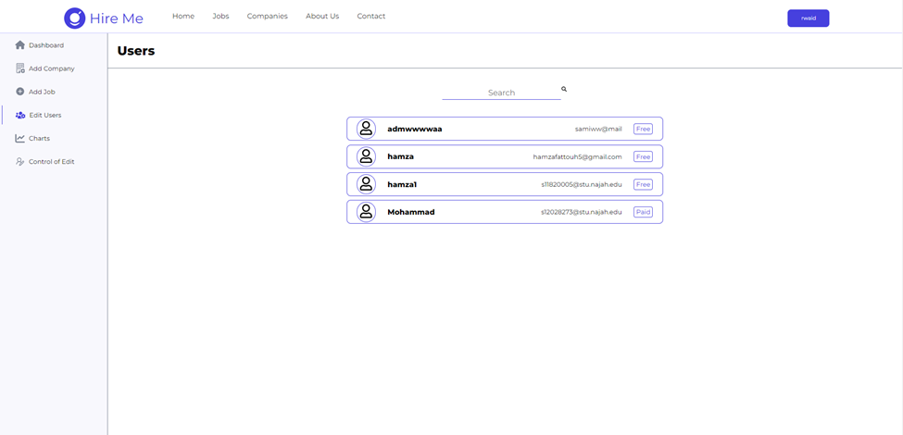
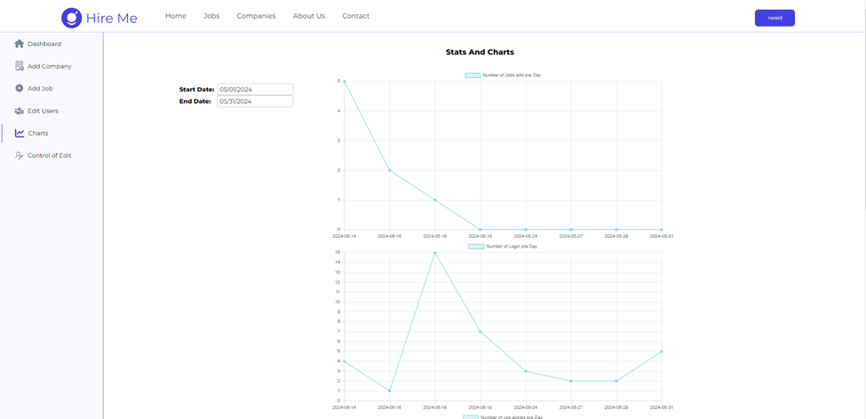
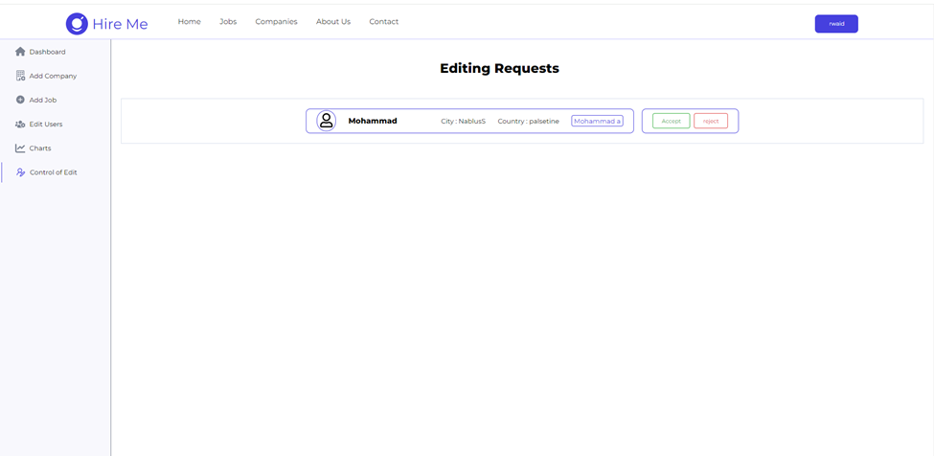
·Some chart about number of login and job add and number of apply to job
See user And join there profile
Accepts editing some sensitive information as name of Company
and location as City and Country

Slide 22
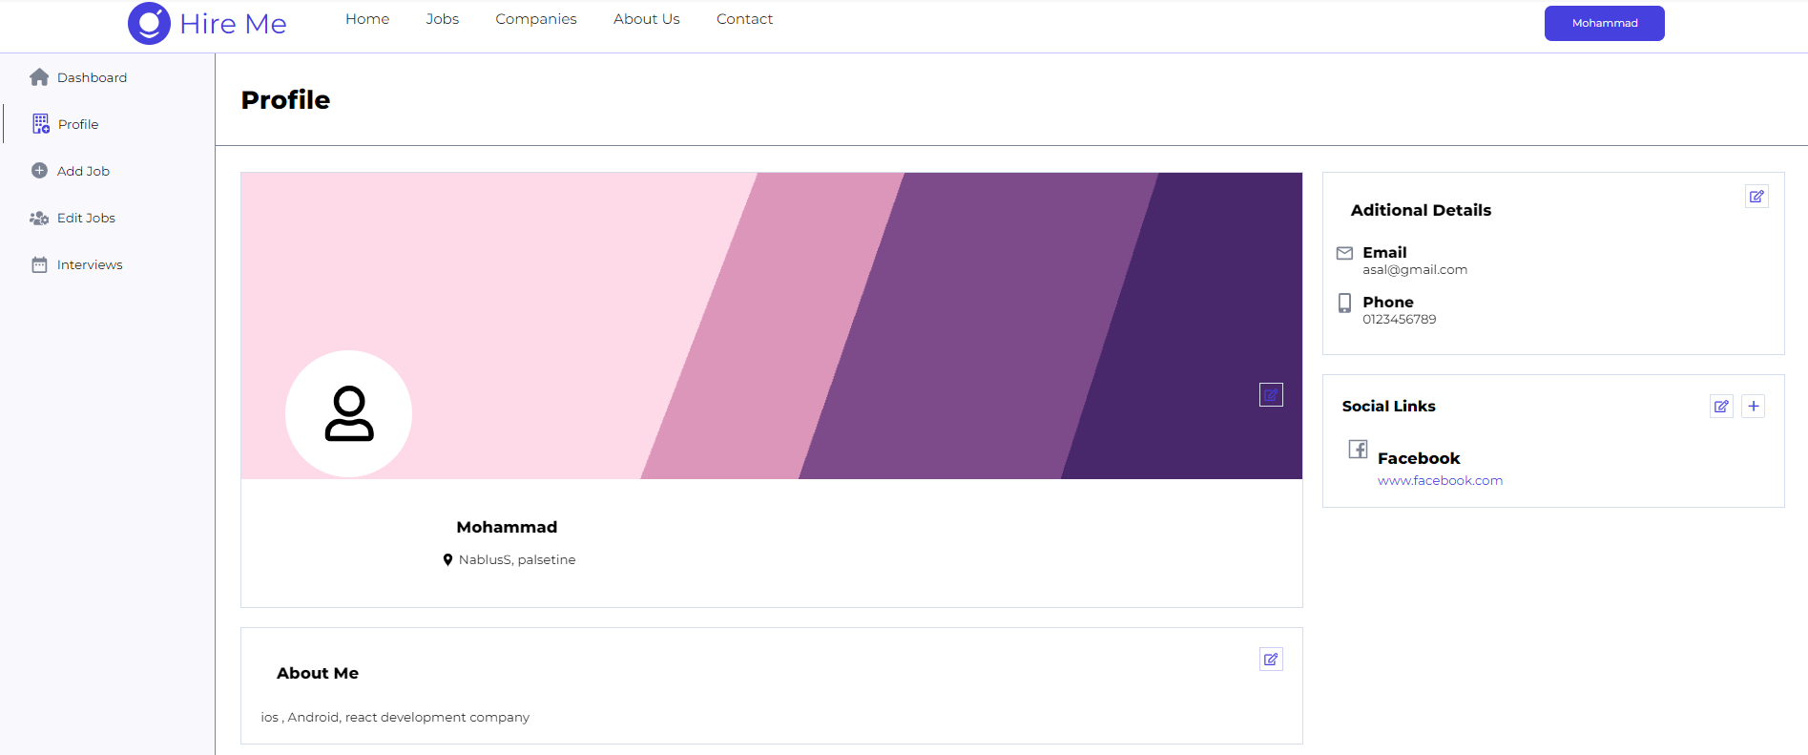
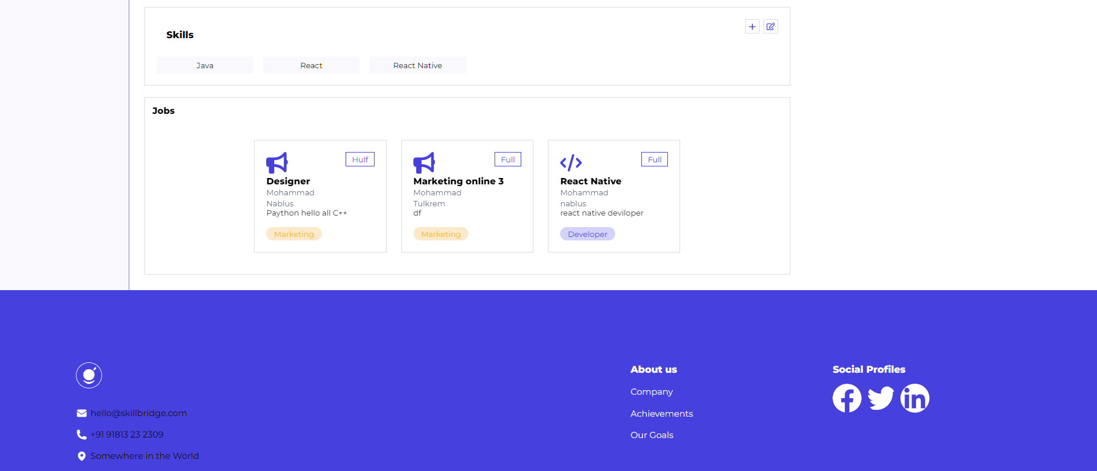
Company Profile see some information And own Jobs

Slide 23
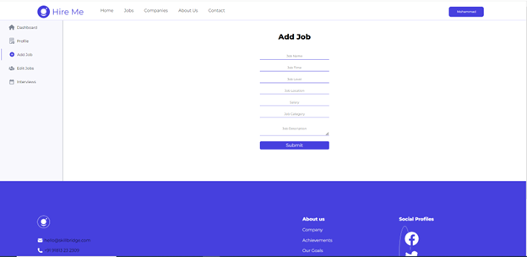
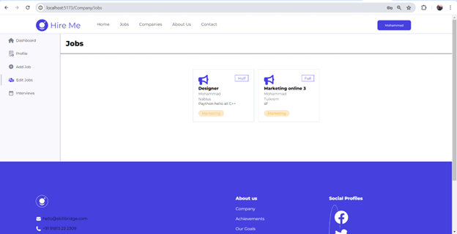
Company add Job
See all company jobs and edit them

Slide 24
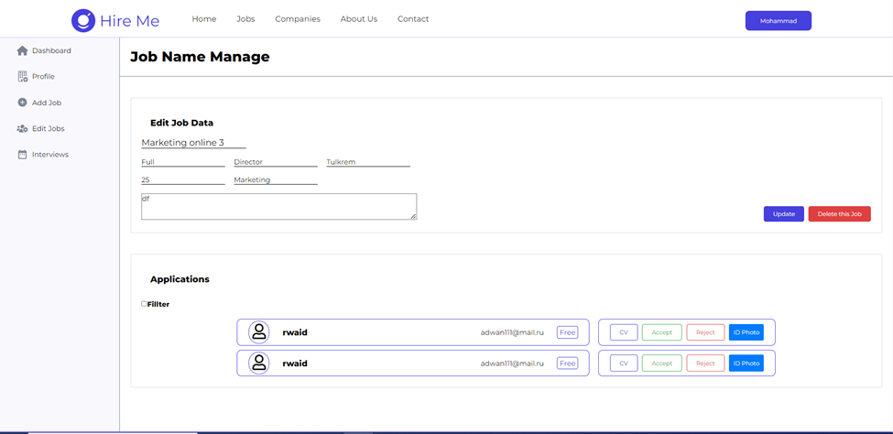
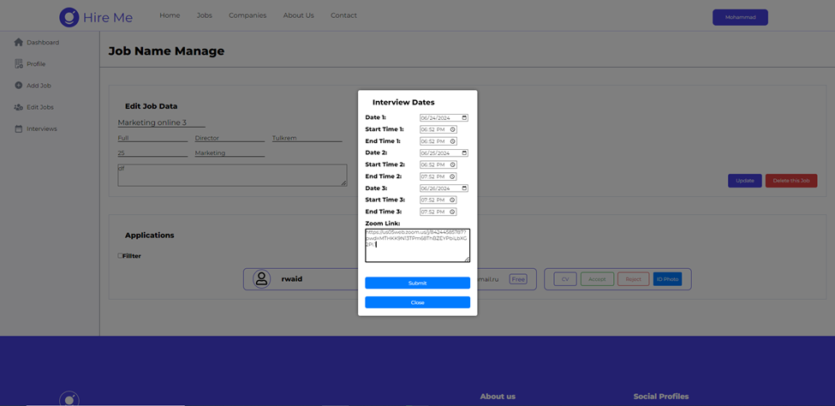
Edit jobs and see all apply of users
that fillters depends on location
, experiences and skills
Chosen times and date
for interviewing users
and send zoom link
for interviewing

Slide 25
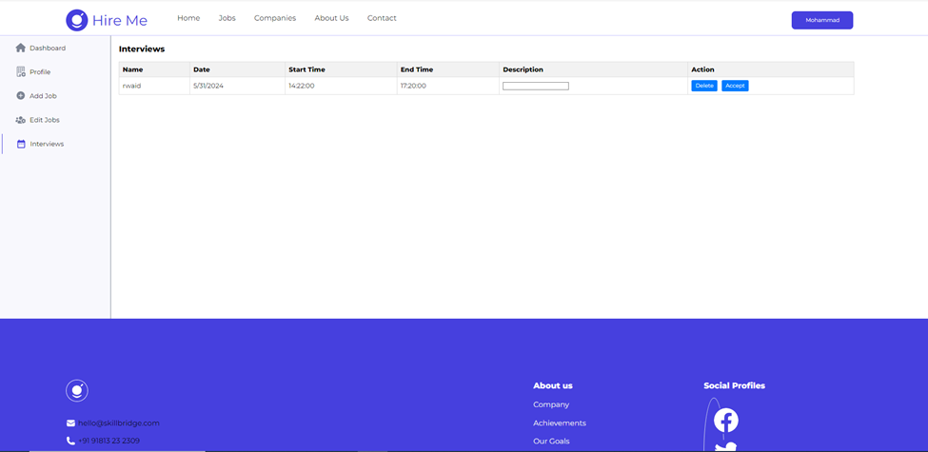
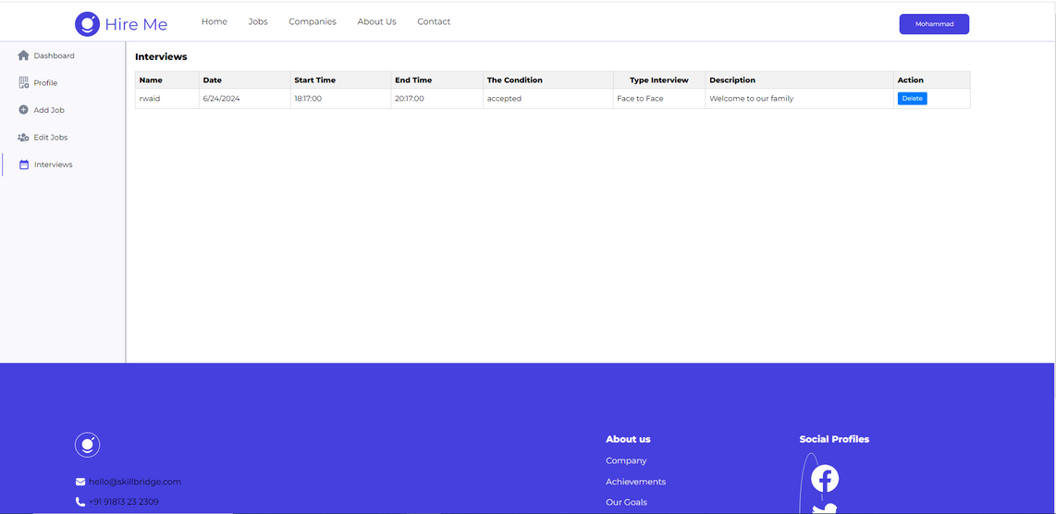
Accepts or reject users after interviews and add reason in description and type of meeting after accept

Slide 26

2
MOBILE
APPLICATION

Slide 27
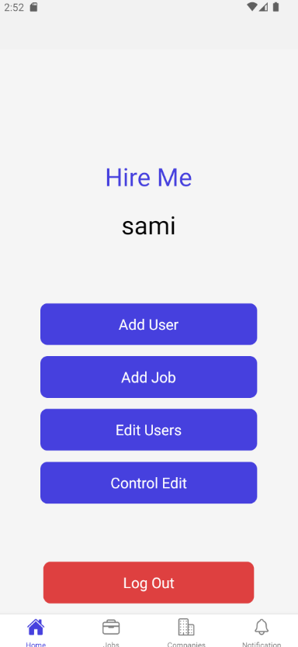
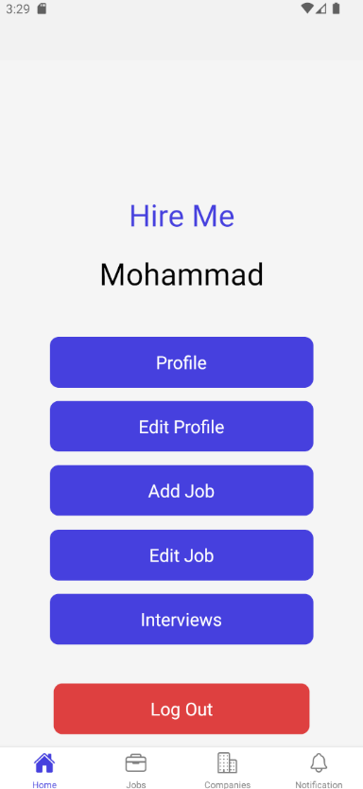
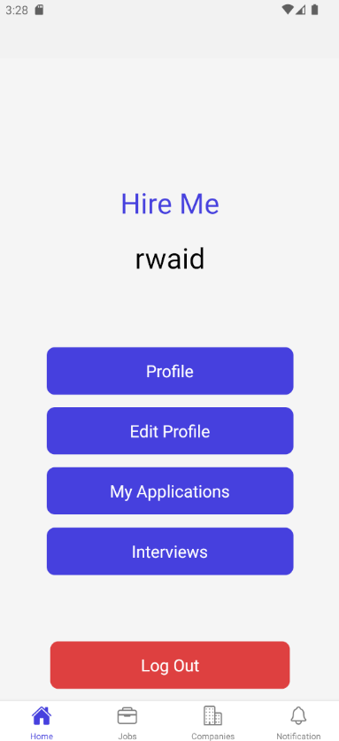
HOME
PAGE
Admin
Company
User

Slide 28
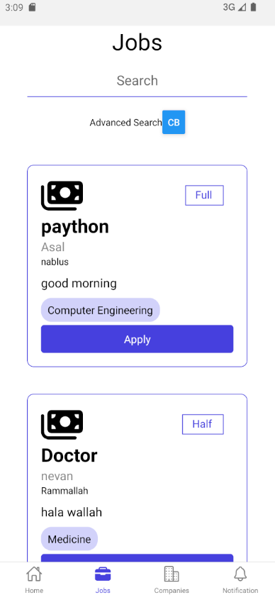
JOBS PAGE

Slide 29
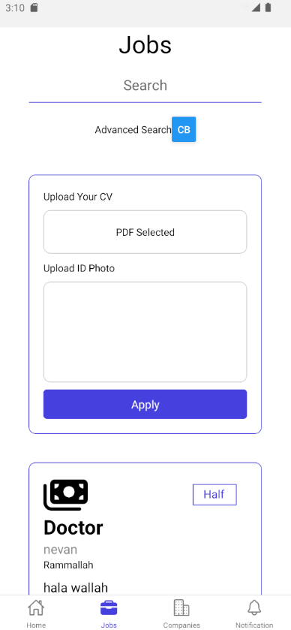
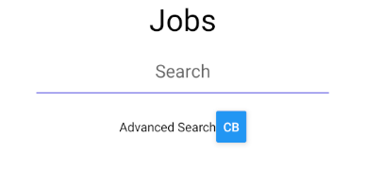
Applying to job by upload Cv And ID photo for more security
Advance searching
Demand in Skills and Experiences

Slide 30
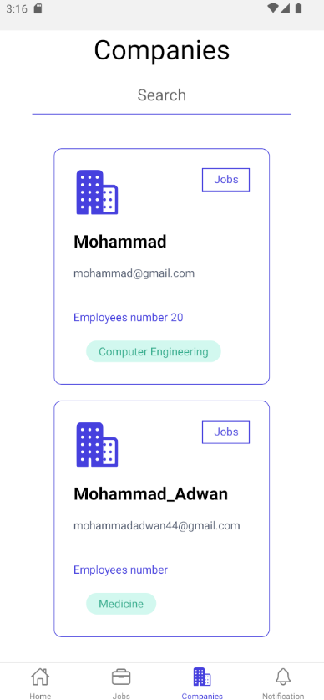
COMPANIES
PAGE

Slide 31
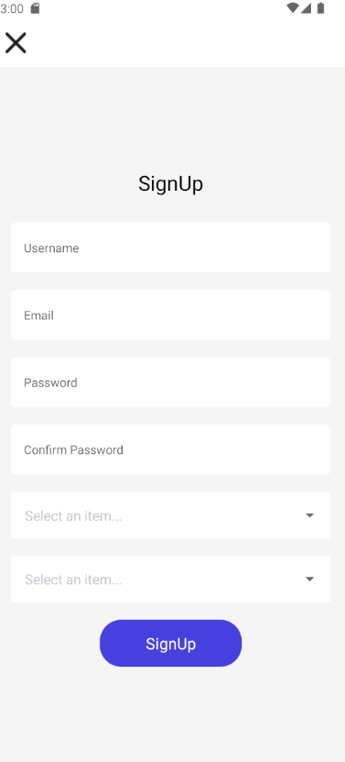
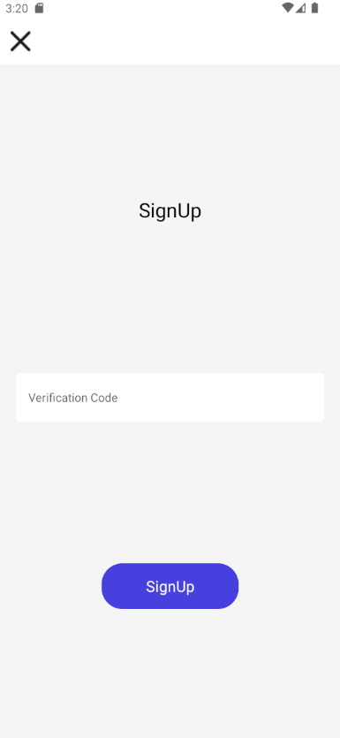
Sign Up Using some information
for Company and user
Verification by add the code
received in email

Slide 32
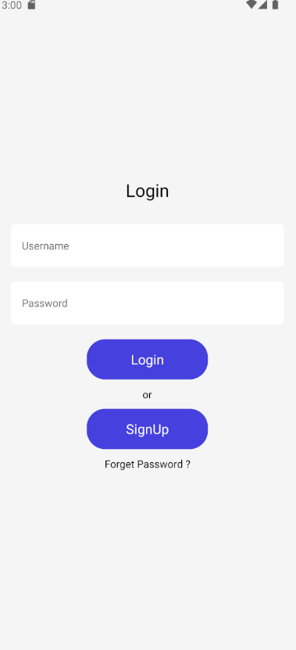
LOGIN
PAGE

Slide 33
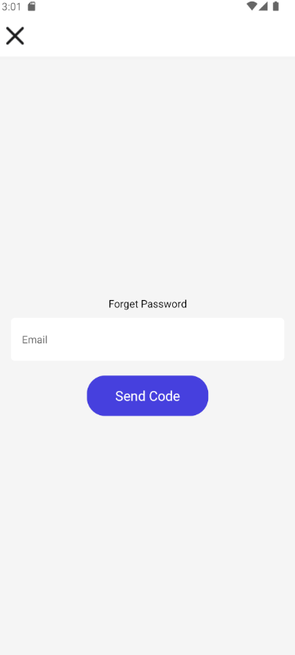
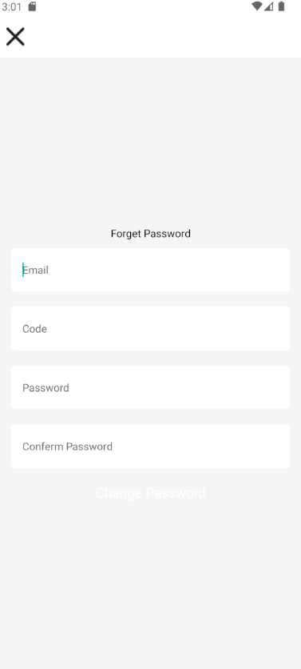
Forget Pass Return it by email
The code send to email and then can add it and change pass

Slide 34
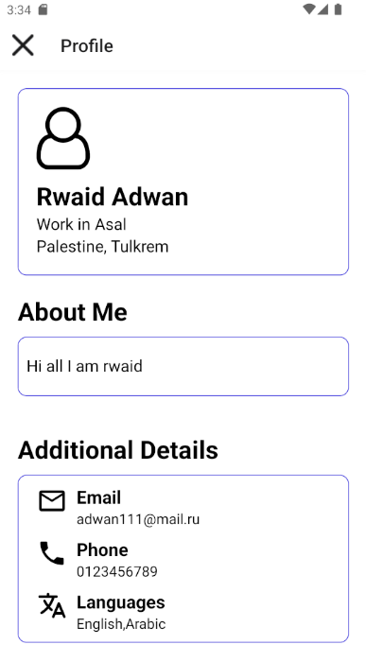
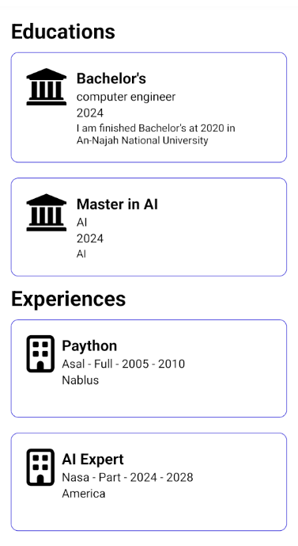
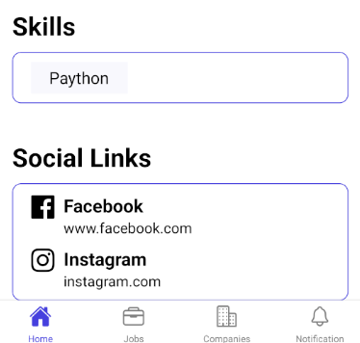
User Profile
1-Informaition about user
2-Experinses
3-Education
4-Skills
5-social media
6-email,phone number,lang

Slide 35
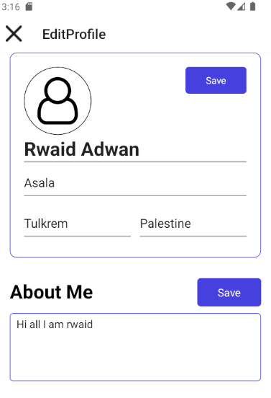




User Edit Profile

Slide 36


All application of user and can see stats of it (in review ,or booking meeting or results of interview’s)
Interview booking date
after accept CVs

Slide 37



All date by Company to do interview
and can chooses if meet online
or face to face
Stats after interview’s
(accepted or reject or in interviews)
and appear link if online meet

Slide 38

Notification get notification for applying job and stats of review and if cv accepts or reject

Slide 39


Add new job by admin
Add new User by admin

Slide 40


Accepts editing some sensitive information as name of Company and location as City and Country
See user And join there profile

Slide 41


Company Profile see some information

Slide 42




Company Edit Profile

Slide 43


Company add Job
See all company jobs and edit them

Slide 44



Edit jobs and see all apply of users
that fillters depends on location, experiences and skills
Chosen times and date for interviewing users and send zoom link for interviewing

Slide 45

Accepts or reject users after interviews and add reason in description and type of meeting after accept

Slide 46
SECURITY
JWT TOKEN: WE USED THIS LIBRARY TO SECURE LOGIN TO THE WEBSITE OR APPLICATION AND VERIFY THE IDENTITY OF USERS.
BCRYPT: A library that encrypts users' passwords to store them in the data base.
React Protected Routs: A feature in the React-Router-Dom library to verify user permissions before entering specific pages on the site.

Slide 47

4. FUTURE WORK
1-
SUPPORT SEVERAL LANGUAGES
2-
Adding more Advance Filtering CVs And Jobsusing Artificial intelligence.
3-
Allow chatting Between user and Company.
4-
CVs video submission.

Slide 48

5. CONSTRAINTS
1-
LIMITING TIME
2-
Learning New Technologies and Frameworks

Slide 49


THANK YOU!

