Slide 1
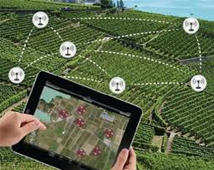
studying the performance of wireless network using cooja simulator- agriculture monitoring based
Prepared by:
Razan Hamadni
Rahma Sawalha
Islam Zamel
Supervisor:
Dr. Saed Tarapiah

Slide 2
Outline:
Introduction.
The used technology.
Standards/codes.
WSN in agriculture.
Software components and programming language.
Feasibility study.
Result analysis and simulation.
Challenges.
Future work

Slide 3
introduction
in this project we hope to design a monitoring system for the agriculture sector using WSN simulated by cooja, in order to increase the quantity and improve the quality of the crop yields in the agricultural field by supporting the decision making of crop producers through analysis of the collected data.

Slide 4
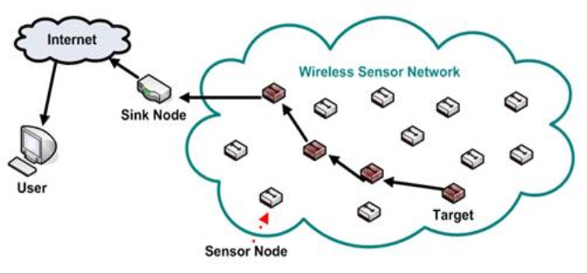
the used technology : WSN
Wireless sensor networks consist of many sensor nodes which can transmit data to each other. This network can be used to monitor various conditions and send back the information to the central controller.

Slide 5
standards /codes
The standards we use in the project: 6LoWPAN 802.15.4 standard :
A) Small packet size _128 byte .
B) Uses 64-bit MAC addresses.
C) It has a data rate between 20 kbps to 250 kbps.
D)It has a transmission range 10m to 30 m

Slide 6
Advantages of WSN
1. Network setups can be carried out without fixed infrastructure.
2. Suitable for the non-reachable places.
3. Flexible.
4. Implementation pricing is cheap.
However, there is some disadvantages:
1. Less secure.
2. Lower speed.
3. More complicated to configure.
4. Easily troubled by surroundings .

Slide 7
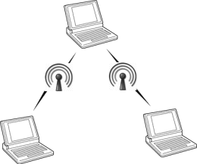
Why did we implement WSN into ad-hoc category?

Slide 8
WSN IN AGRICULTURE
Agricultural environment monitoring has become an important field of control and protection, providing real-time system and control communication with the physical world. An intelligent and smart WSN system can collect and process large amount of data from the beginning of the monitoring and manage air quality, soil conditions, to weather situation.

Slide 9
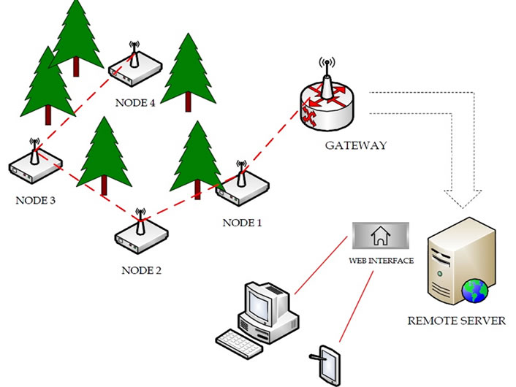
The system model

Slide 10
Feasibility study
The total cost for each Sensors used varies from 4-20$, low enough to introduce in any agricultural application, where we highlight the possibility of developing a sensor network for use in large areas.

Slide 11
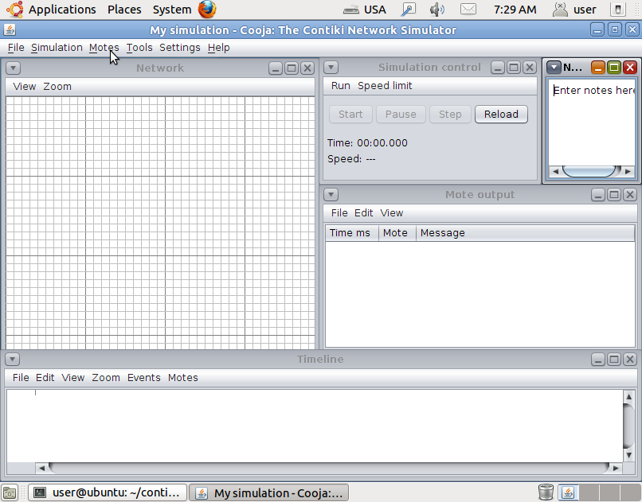
software components and programming language
Contiki and Cooja
Contiki is an open source, highly portable, multi-tasking operating system developed for use in memory-efficient networked embedded systems and wireless sensor networks. It is designed for the microcontroller which only has small amount of memory. a typical Contiki configuration is just 2 kilobytes of RAM and 40 kilobytes of ROM.
it was chosen as the operating system for the sensor nodes which used C language as the programming language.

Slide 12
It has many advantages compared with other sensor network operating systems. It includes an embedded simulation tool: COOJA, which can compile and simulate the application software conveniently and fast.
Also, Power consumption is one of the most important factors in wireless sensor network research, but most simulators do not provide support for visualizing the power consumption of an entire sensor network

Slide 13
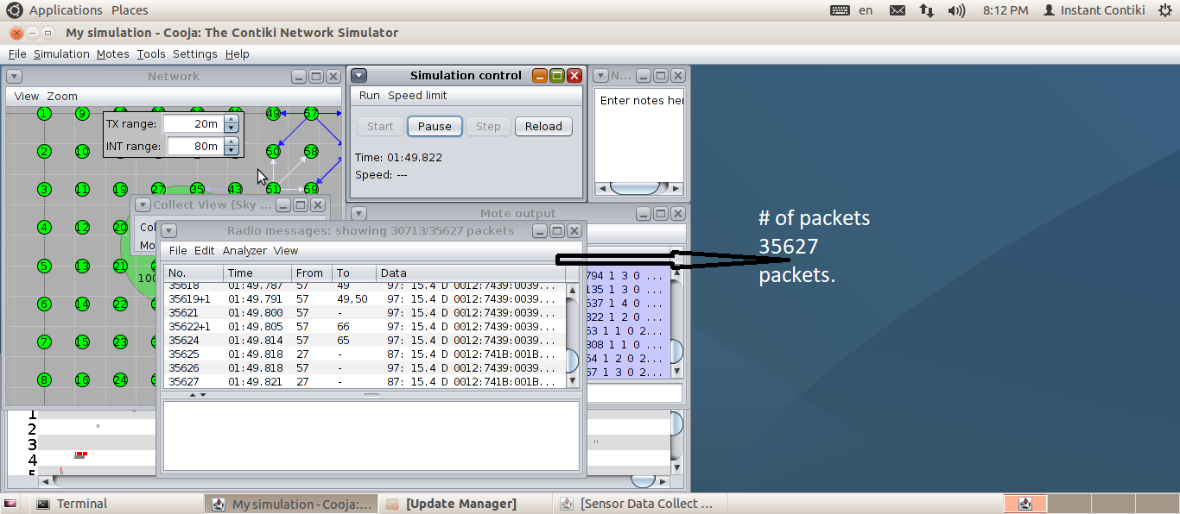
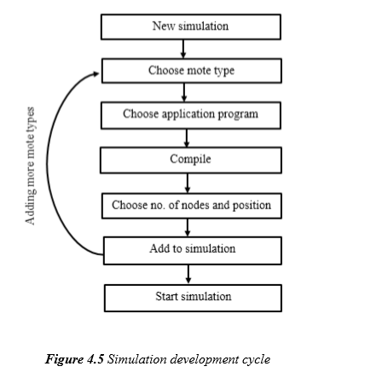
On going work

Slide 14
Result Analysis and simulation.
Simulation setting.
Number of node used | 71 (70 sender) 1 sink
Type of routing | Ipv6
Standard used | 6lowPan IEEE 802.15.4
Scenario area | 88mx88m
Type of transport protocol | UDP
Distance between nodes | 11 m
Transmission range and interface range | 20m, 80 m
Transmission ratio and receiver ratio | 100%, 100 %

Slide 15
Data collected.
Data | Type of data | Size of data in bits
Water quality monitoring | Double | 64
soil constituent | Double | 64
soil humidity | Double | 64
Light | Boolean | 2
Wind speed | Float | 32
Scientific disease and pets monitoring | Boolean | 2
Water irrigation | Boolean | 2
Fire | Boolean | 2
Total |  | 232 bit /29byte

Slide 16
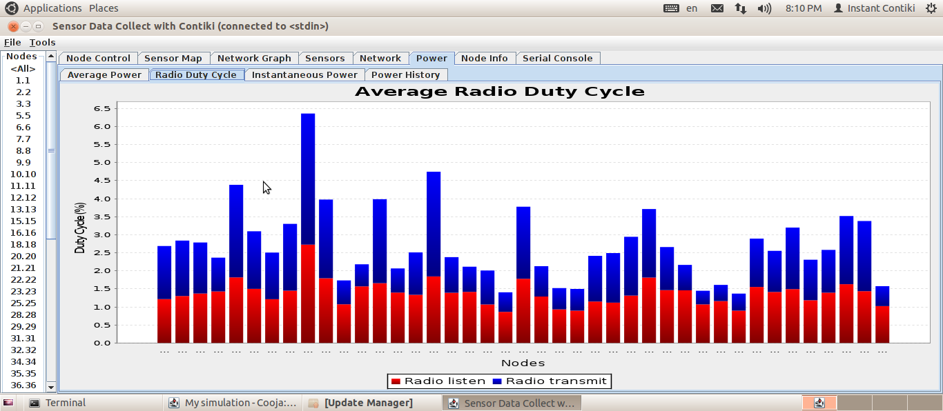
Simulation results.

Slide 17
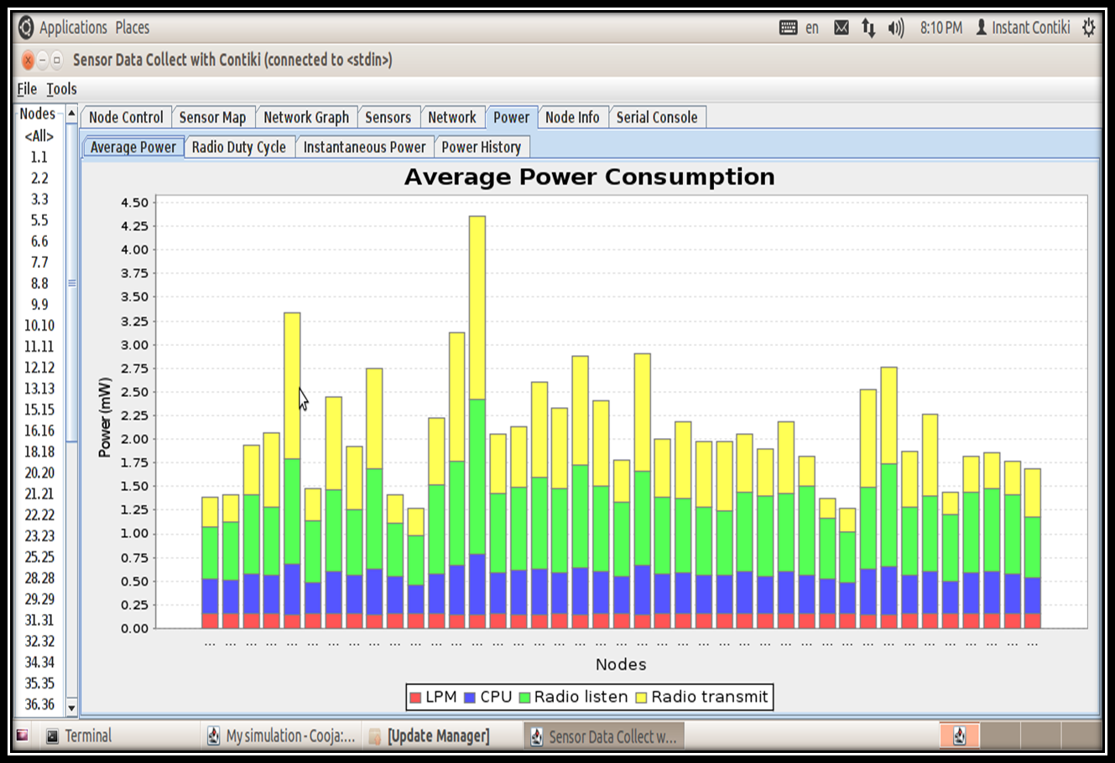
Average power consumption.

Slide 18
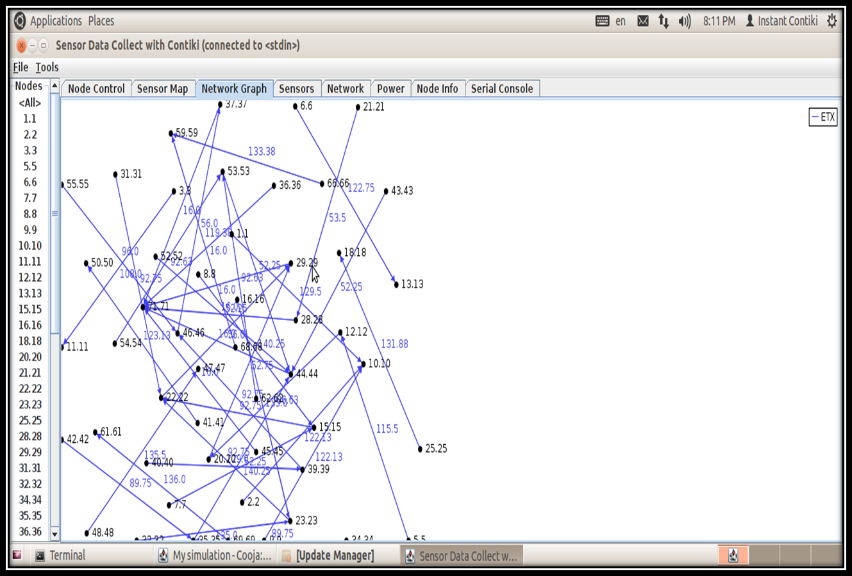
Network graph.

Slide 19
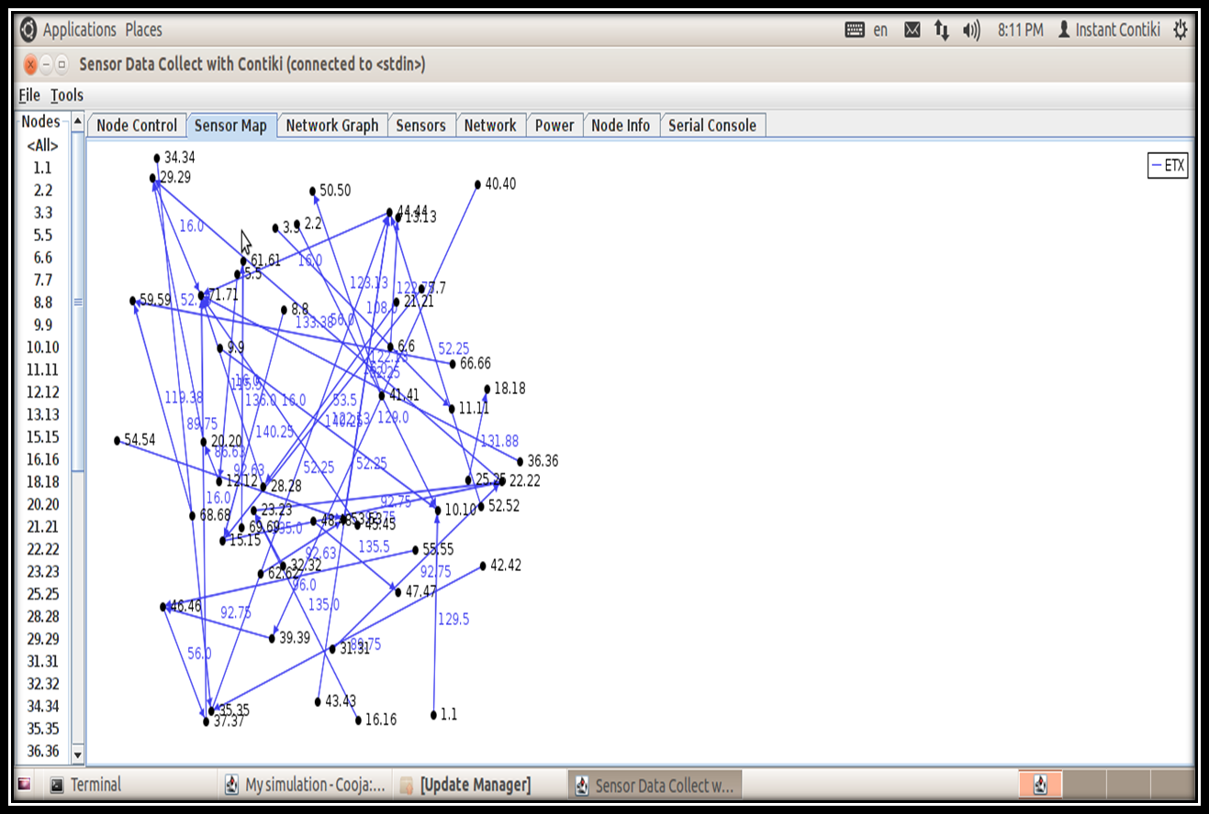
Sensor map.

Slide 20
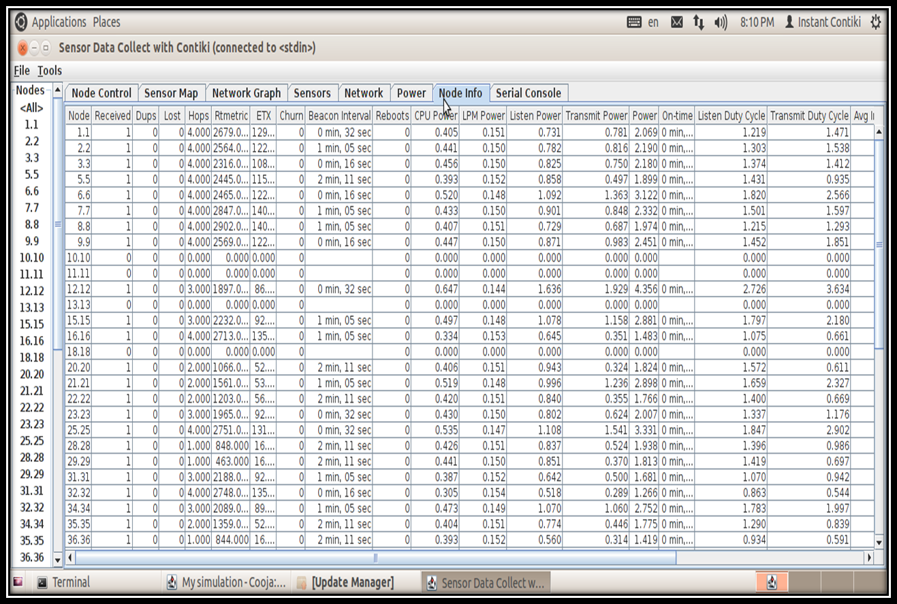
node information.

Slide 21
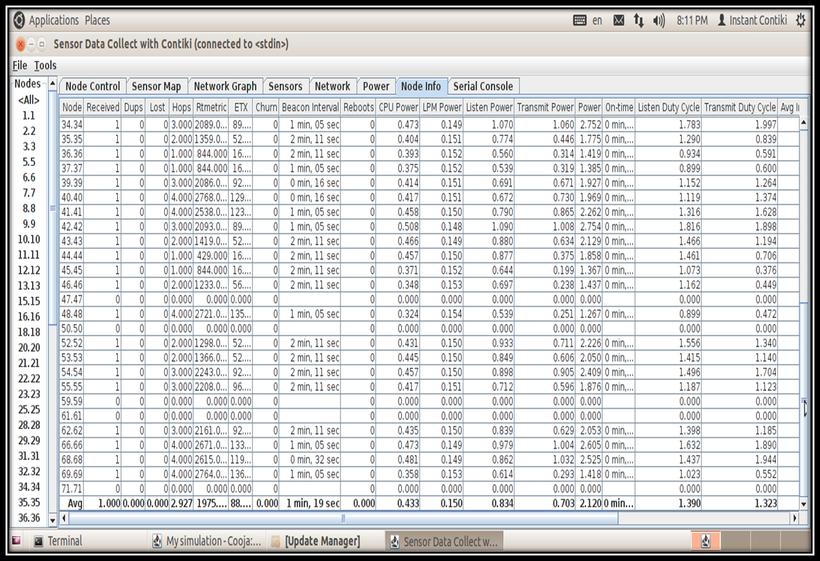
node information.

Slide 22
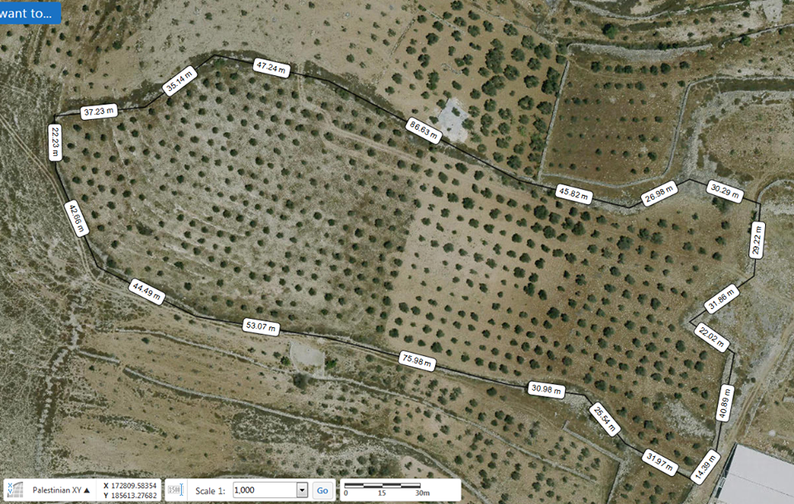
Challenges:
The lack of learning resources.
Higher number of nodes and greater level of details would degrade the performance and will slow down the simulator.
The problem of finding prober tree distribution
Overcome: the problem was solved with collaboration with municipal of Asira Al-shamalia.

Slide 23
FUTURE WORK :
Mobility will be introduced to nodes.
perform several kinds of attack to the network such as Distributed Denial of Service (DDoS) attack, The Sybil attack, A node imitation attack, An application level attack to check the quality of service.

Slide 24
THANKS FOR YOUR LISTENING
ANY QUESTIONS?

