Slide 1

An-Najah National University
College of Engineering and Information Technology
Management Information Systems

Slide 2

Enterprise Resource Planning For Maslamani Company
September 5, 2021 - December 15 ,2021
Supervised by
Dr.Ahmad Shraide & Dr.Maher Arafat
Prepared By:
Reem Ishtayeh & Aseel Salhab
Ala'a Malamani & Eba'a Maher

Slide 3

Table of Contents
Introduction
Current state
Reporting
Comparison of Odoo and Israa Shamel
Modules
Problem
Feasibility study
Solution

Slide 4










Introduction
Al-Maslamani company.
Founded in Nablus in 1952.
It exports products and imports confectionery and dairy products such as wafers, Activia yogurt, and chocolates for the local market.
It employs approximately 20 employees.
Our project aims to implement Enterprise Resource Planning For Maslamani Company.
Introduction

Slide 5
Current state
Current state
Information system
Centralizing
Accounting system (Shamel)

Slide 6

Problem
Integration problem
Inventory problem.
Editing invoice problem.
Reorder.
Sales process.
Marketing problem.
Problem

Slide 7

Solution
By using Odoo
Odoo is an ERP system and a cloud-based website builder that
lets you create sites and manage online operations.
Why using Odoo?
Odoo is open source, cover all the needs of different business sectors.
Odoo is the best integration tool and management program.
The Odoo program is ease of use, and employee trainee and customer (end user) can simply understand and deal with it.
Odoo has agents all over the world, they are receive our requests and inquiries and help solve problems .
Solution

Slide 8

Compare between
Odoo and Israa Shamel
 | Odoo | Shamel
Usability |  | 
Multi-functional |  | 
Multi user |  | 
Maintainability |  | 
compatibility |  | 
Extendibility |  | 
Odoo Vs Shamel

Slide 9
Compare between
Odoo and Israa Shamel
Modules | Odoo | Shamel
Accounting |  | 
Purchase |  | 
Sale |  | 
Inventory |  | 
Website |  | 
BUDGET | $ 1680 | $ 7768
Odoo Vs Shamel

Slide 10

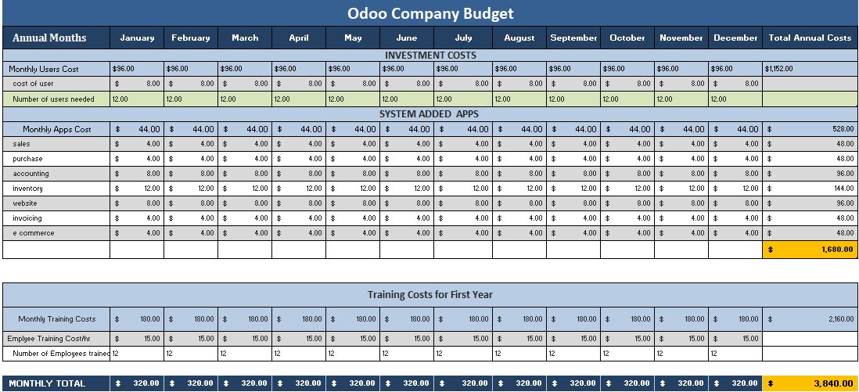
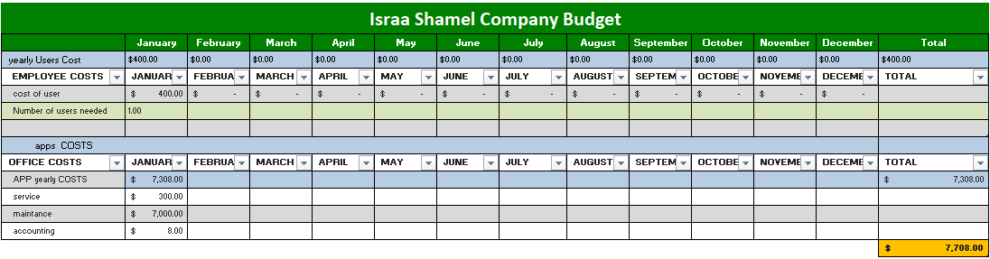
Feasibility study
Feasibility study

Slide 11
Modules
PURCHASE
INVETORY
SALES
WEBSITE
ACCOUTING
EMPLOYEE
CONTACTS
Modules

Slide 12
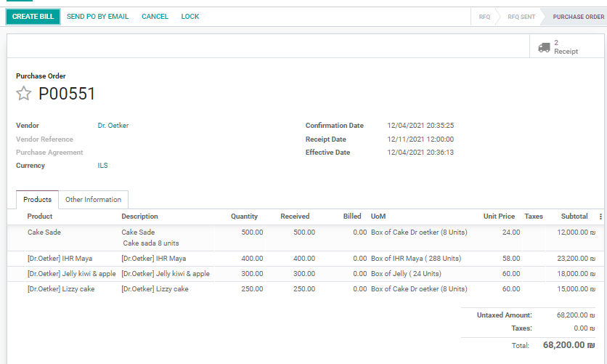
Modules
Purchase
Modules

Slide 13
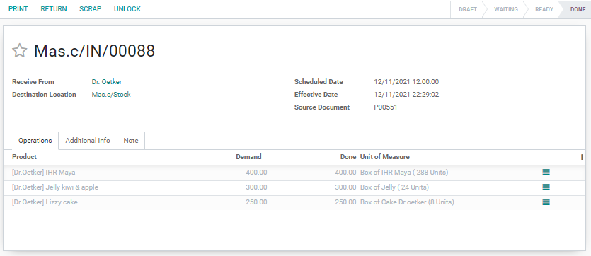
Modules
Purchase
Inventory
Receipt
Modules

Slide 14
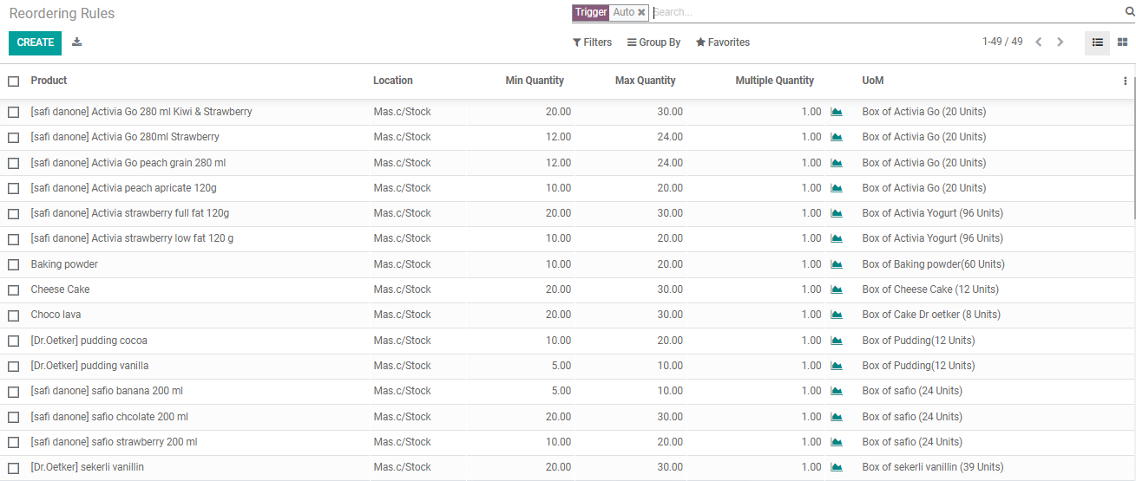
Modules
Purchase
Inventory
Reordering Rules
Modules

Slide 15
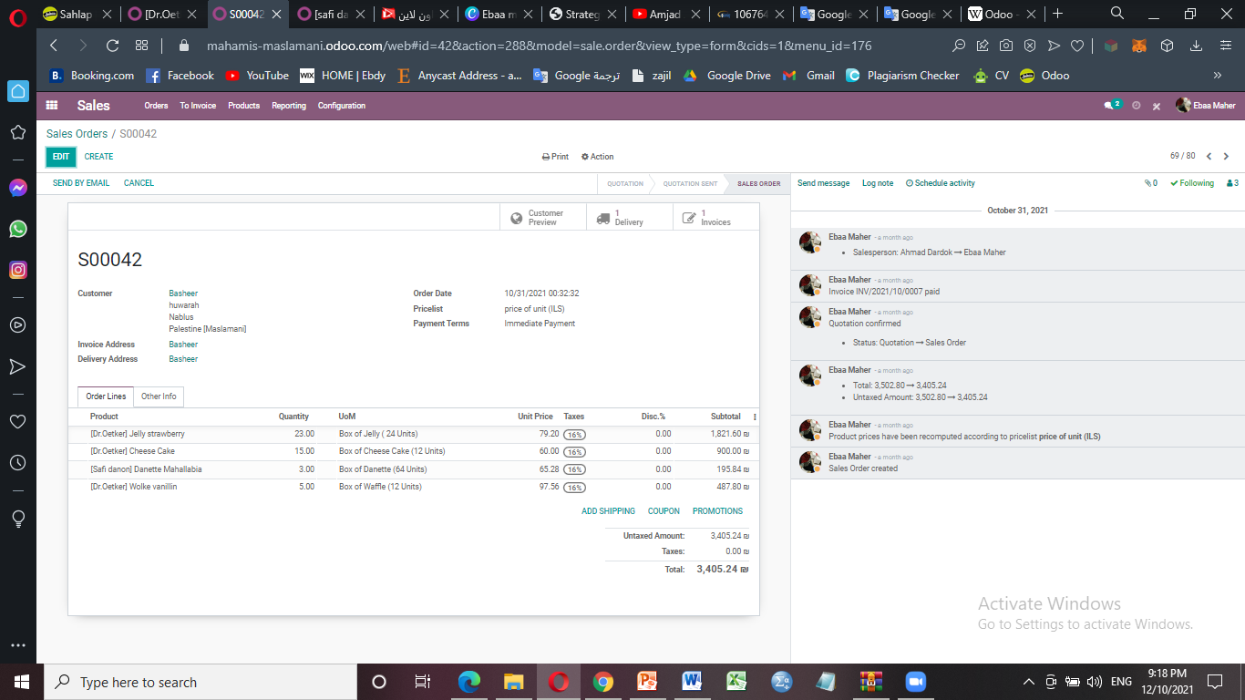
Modules
Purchase
Inventory
Sale
Modules

Slide 16
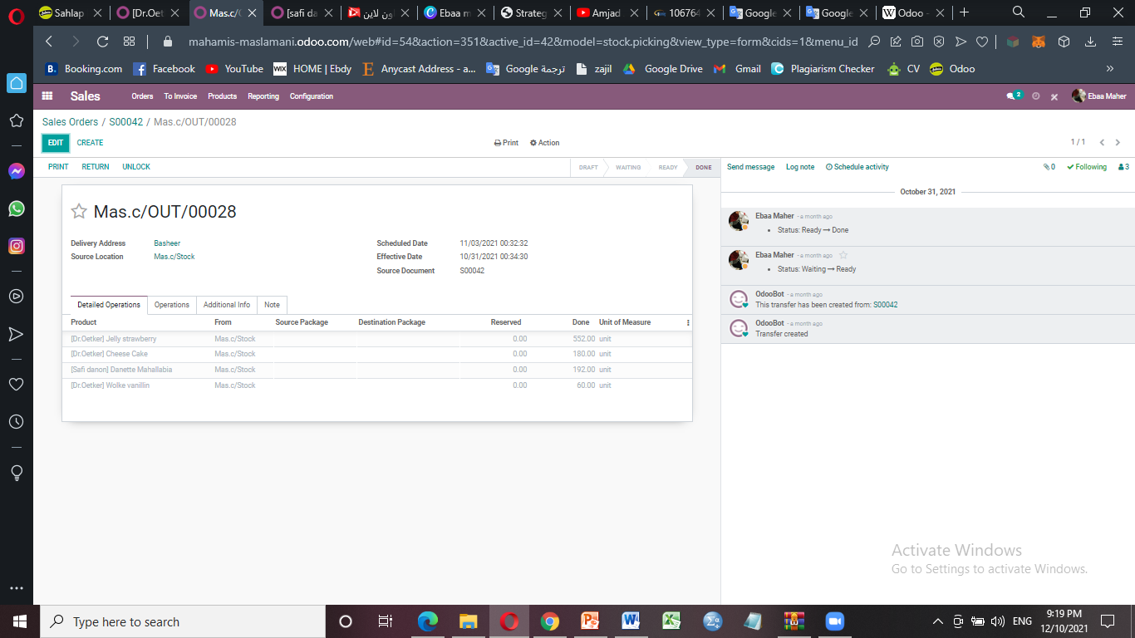
Modules
Purchase
Inventory
Sale
Delivery
Modules

Slide 17
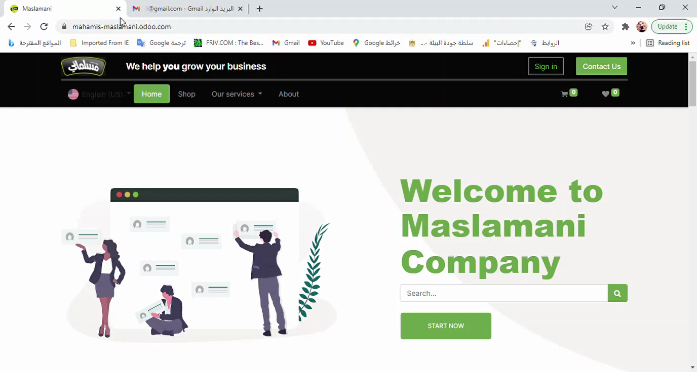
Modules
Purchase
Inventory
Sale
Website
Modules

Slide 18
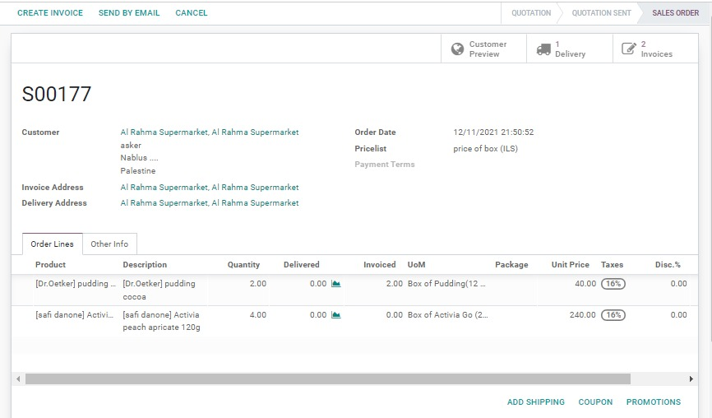
Modules
Purchase
Inventory
Sale
Website
Modules

Slide 19
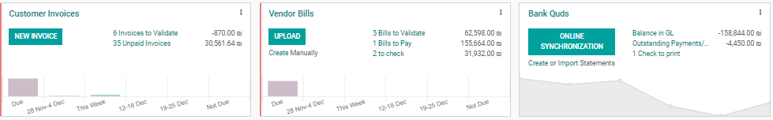
Modules
Purchase
Inventory
Sale
Website
Accounting
Modules

Slide 20
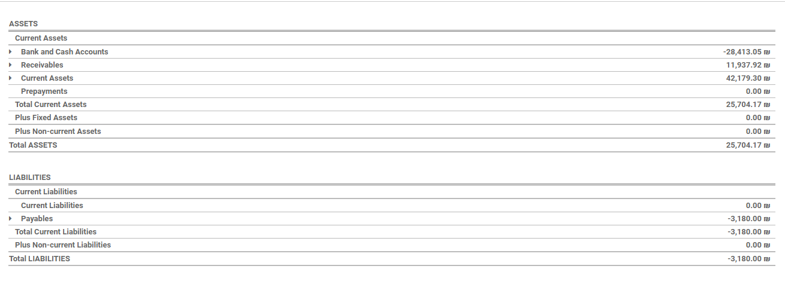
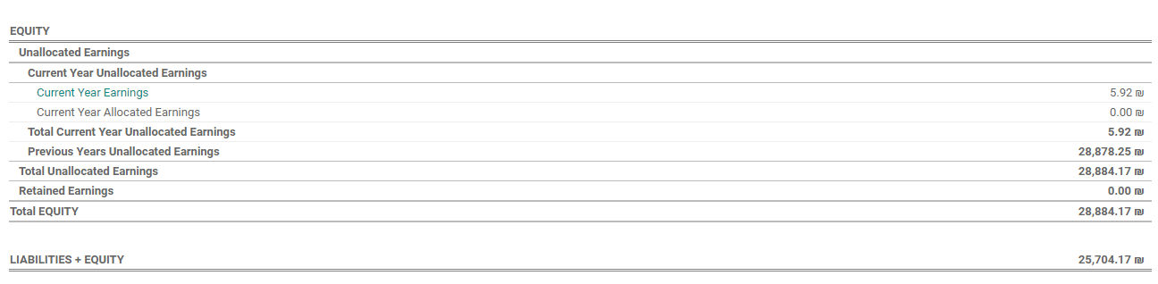
Modules
Purchase
Inventory
Sale
Website
Accounting
Balance sheet
Modules

Slide 21
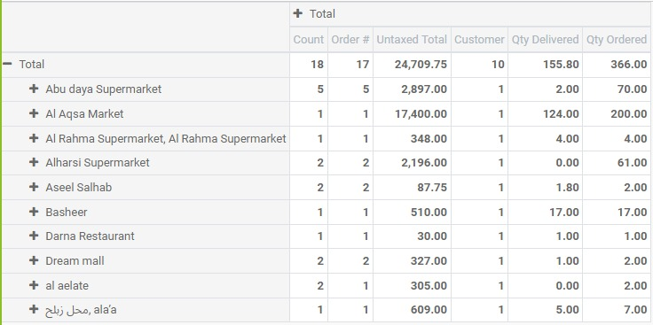
Reporting
Type of reporting :
Routine reports
Reporting

Slide 22
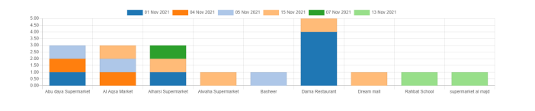
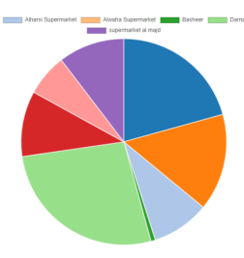
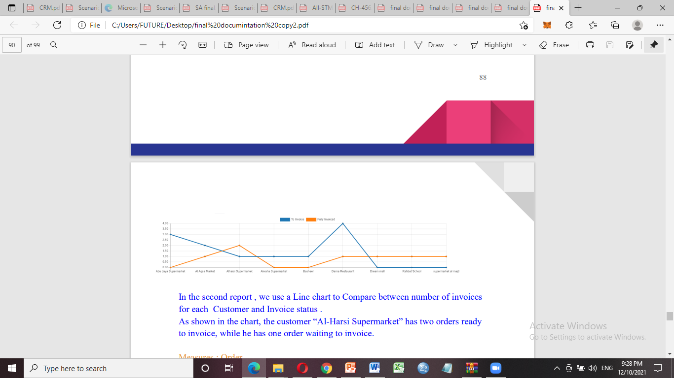
Reports
Ad hoc reports
Bar chart show the date of day and who is ordered on this date .
Pie chart Compares between total selling product to the customer and the name of the customers.
Reporting
Line chart Compares between number of invoices for each Customer and Invoice status (to invoice , fully invoice).

Slide 23
1. Develop the Expert system for buying and selling operations.
2. Data mining to classification and expected potential customer.
3. Search engine optimization .
Future development

Slide 24


Slide 25

Thank you for attention
Any Question?

