Slide 1
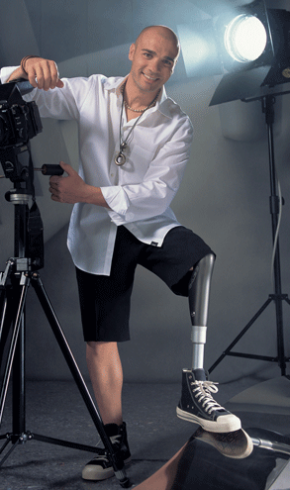
Prosthetic limbs

Slide 2

The main object is to design a prosthetic limb and develop it to give motion that simulate the exact natural human motion

Slide 3
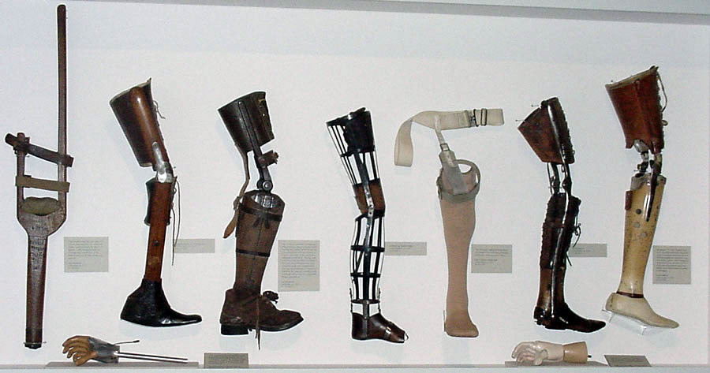
Introduction

Slide 4
Prosthetic limbs used to help those people who lose their lower limbs by many reasons (wars , diseases as diabetes and landmines ) to live their life as we are.
There are two cases of amputee (BK) below knee (turn action of the femur bone) or (AK) above knee(turn action of the tibia bone), we handle the case of the above knee amputation.
    In the previous semester we discus the idea of the prosthetic limbs and then we designed it.
    here we can see how did we execute it

Slide 5
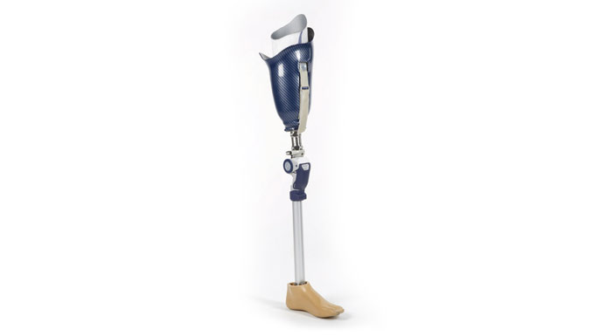
Main component

Slide 6
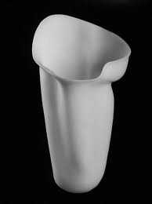
Socket
    It’s the interface between the patient and the prosthetic.
    A very important part it must be stable, comfortable and if not the patient will not want to wear it.
    It can be made from several materials but the best one which we chosed is the fiber glass since it is lightweight, extremely strong and non toxic

Slide 7
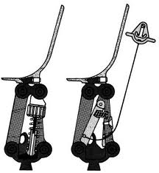
Four bar mechanism
    It will act as the knee joint in the human leg. To connect between the femur and the tibia.

Slide 8
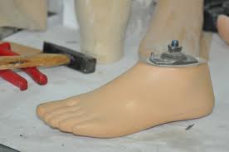
Foot
    There is a variety of foots available to use:
    Articulated feet with moving joints and non-articulated feet that does not have moving joints

Slide 9
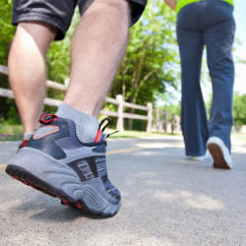
Human gait

Slide 10
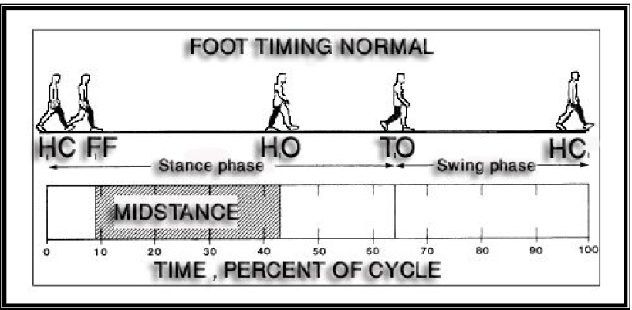
The gait cycle can most simply be described by its division into a stance phase which is defined by initial heel contact to toe-off and a swing phase from toe-off to similar to heel contact

Slide 11
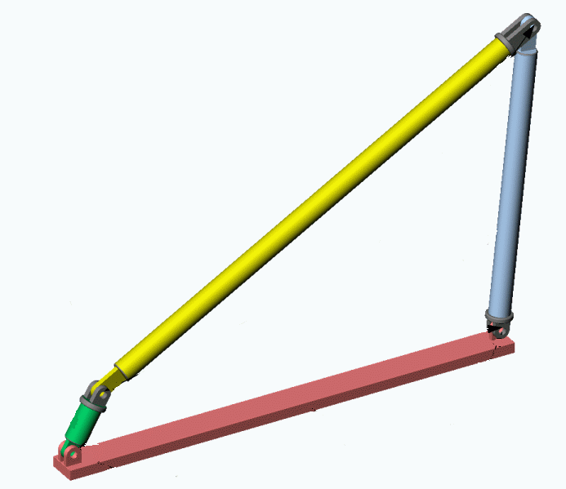
Four bar mechanism

Slide 12
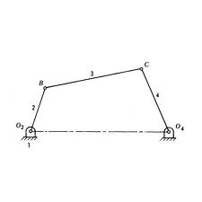
Two link free and two link fixed in femur and tibia

Slide 13
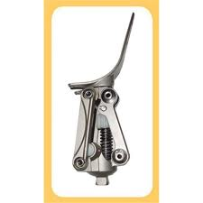
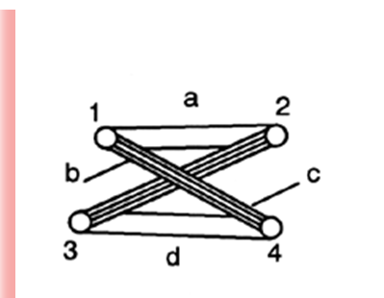
Parallel four bar mechanism were
chose to act as the knee joint.
To obtain the giat that simular the human giat

Slide 14
Design 4- bar mechanism ,and determining :the length of the links by three method
ICR(instantaneous center of rotation)
Synthesis
The optimization method.

Slide 15
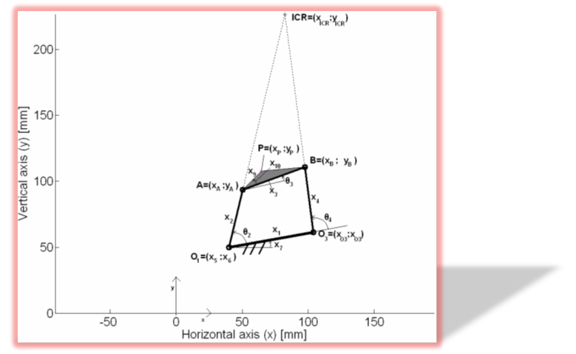
ICR(instantaneous center of rotation):
To obtain the links by one point.
:Synthesis
To obtain aspecific path for the link.
The optimization method:
One method that contral the motion of link in specific

Slide 16
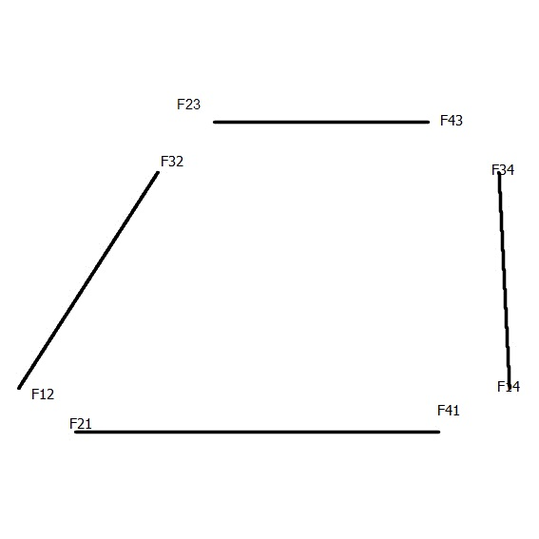
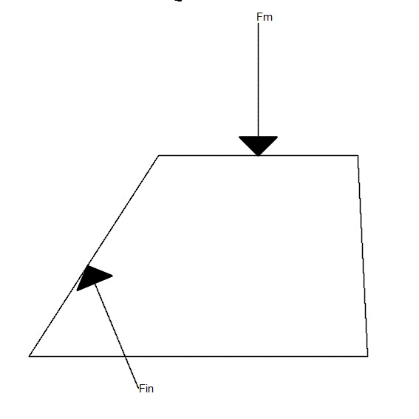
Design the Cross sections 4-bar

Slide 17
The force acting on each link is used to determine the cross section area of the links at which it can withstand the forces acting on it.

Slide 18
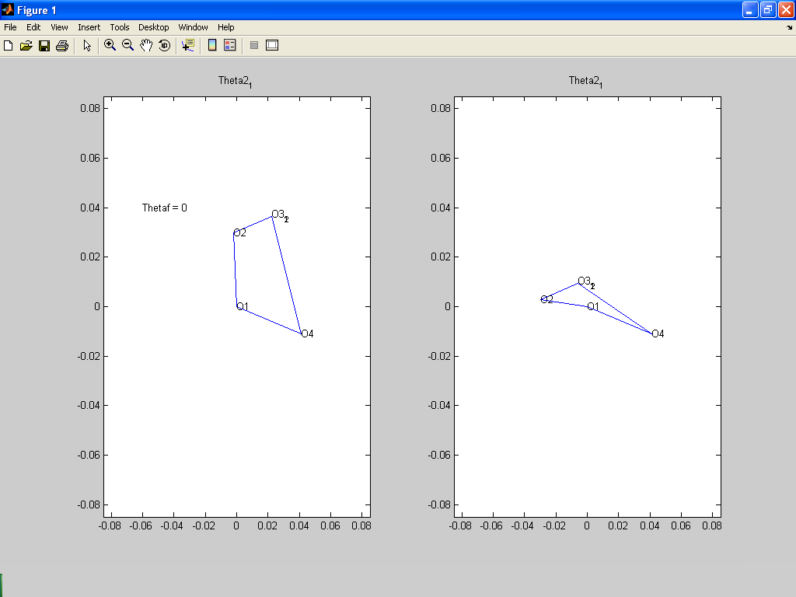
The matlab for determining the forces applied and showing of the motion of 4-bar mechanism

Slide 19
The input angle was the flexion-extension
Using loop equations
L₁sin (Ө₁) +L₂sin (Ө2) L3sin (Ө₃) +L₄sin (Ө₄) =0…. (1)
L₁cos (Ө₁)-L₂cos (Ө₂)-L₃cos (Ө₃) +L₄cos (Ө₄) =0…. (2)

Slide 21
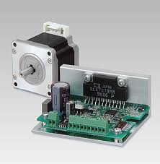
motors
    An electric motor is a device that converts electrical energy into mechanical energy.
    Stepper motors move one step at a time.

Slide 22
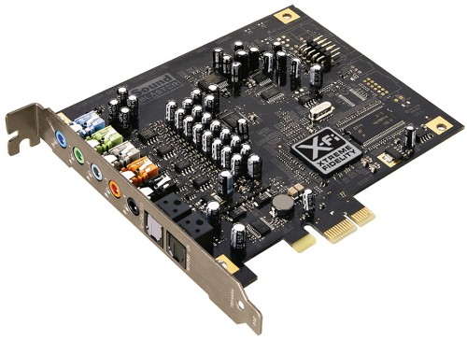
Controls and sensors

Slide 23
sensors
    Sensors are employed to measure walking phase and walking speed of patient wearing prosthetic.
    Tow sensors should be used in this project

Slide 24
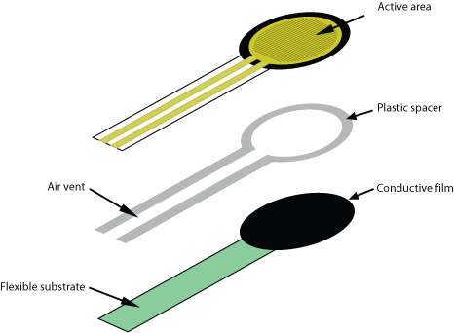
Force Sensing Resistors (FSR)
    Used to determine heel strike and toe off

Slide 25
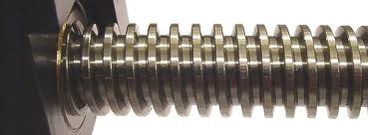
Power screw

Slide 26
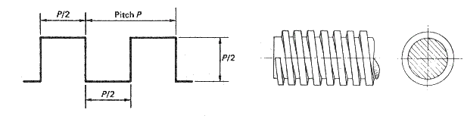
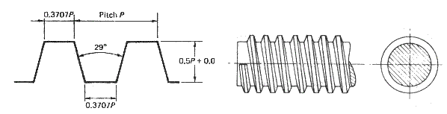
A power screw is a device used in machinery to change angular motion into linear motion
Power screw based on :
1-square thread :
2-acme thread :

Slide 27
square form is used in the project
because The friction is low and there is no radial forces imposed on the mating nuts. The square thread is the most efficient conventional power screw form.

Slide 28
    4-bar mechanism
    With power screw

Slide 29
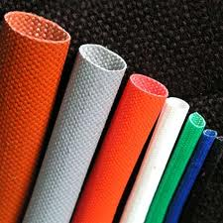
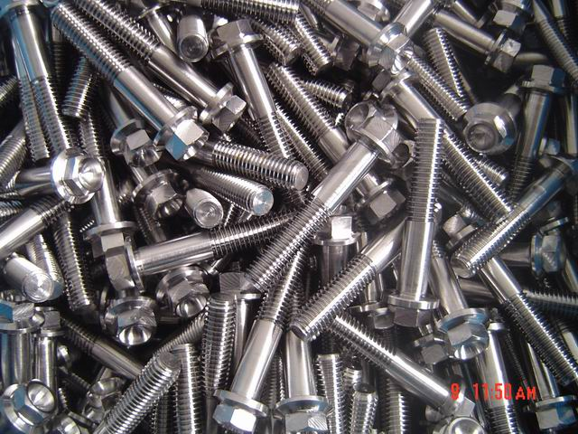
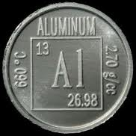
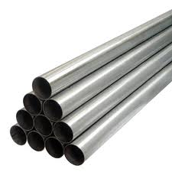
Materials

Slide 30
    There are four suggested material used in our project. Aluminum, titanium, stainless steel and fiber glass
    We decided to use the stainless steel in the knee joint part (the 4-bar mechanism because not toxic as aluminum and not so expensive as titanium and fiber glass
    It has good mechanical proprieties

Slide 31
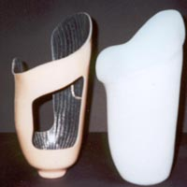
    The idea of use fiber glass in socket
    is to provide the patient with a socket
    that is light in weight, thin in design
    extremely strong and durable and
    non toxic material

Slide 32
Supervised by:
Dr. nidal farhat

Slide 33


Any Questions
Prepared By: ala’a maqboul
Drwesh azzam
Diala awaysa
Jehad yaha

Slide 34


