Slide 1
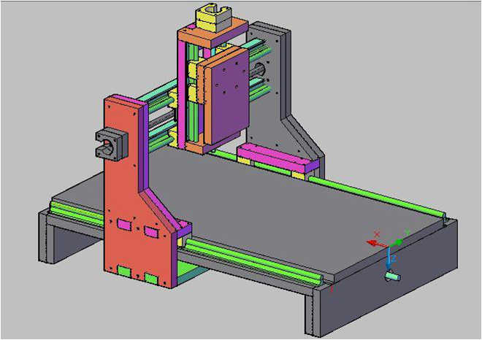
PCB Milling Machine
Amjad Qablawi
Jameel Nassar
Mahyoob Sarrawi
Alaa Zagha
Supervised by : Dr. Jamal Kharrousheh

Slide 2
Outline
Introduction
PCB laminates ,Drilling and Milling Operations
Electrical Components
Mach3 Software
Mechanical Components

Slide 3
Introduction
What is PCB Milling Machine ?
What is CNC ?
What is the aim of the project ?

Slide 4
Introduction
Objectives :
Reliable PCB’s with low cost
High accuracy
Safety
Flexibility
Fast (time saving )

Slide 5
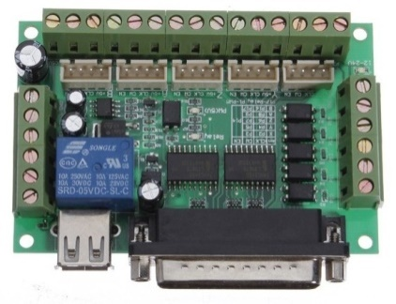


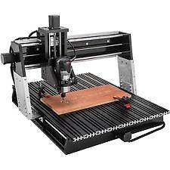
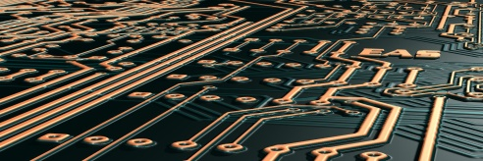
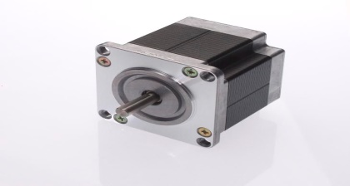
Introduction

Slide 6
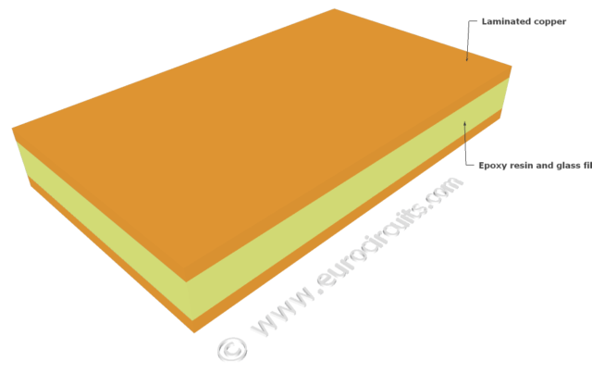
Content of the PCB:-
Two main components :
1_ Laminate
2_ Copper foils

Slide 7
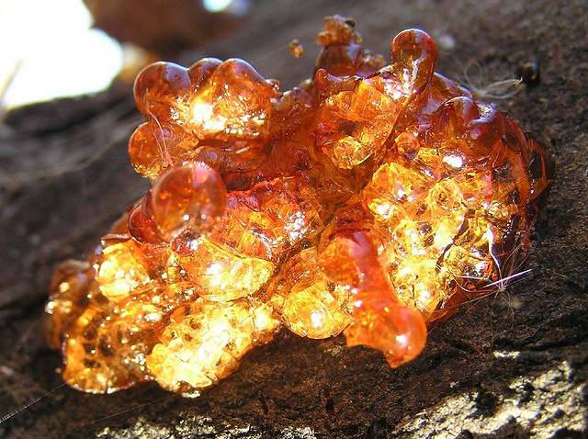
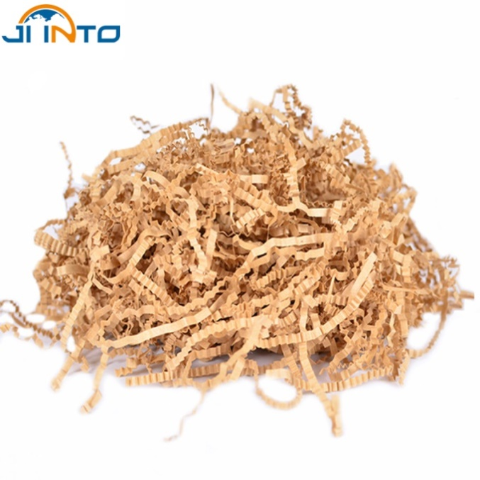
Content of PCB :-
Base materials :-
Laminates consist of :
Resins:
Phenol, Polyester,
epoxy and polyimide.
Fillers:
Paper and glass fiber.

Slide 8
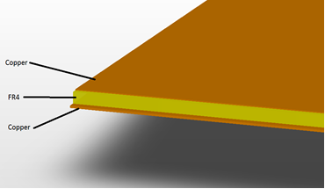
Copper foils:-

Slide 9
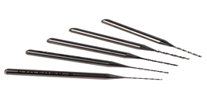
Tools dealing with PCB:-
Carbide bits .
Tungsten carbide .
Advantages of using them:-
Much harder than HSS.
Very durable.
Scratch resistance.
Keep it hardness against temperature.

Slide 10
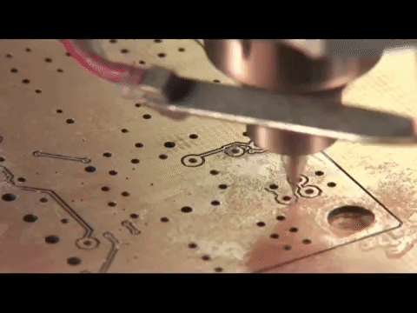
MECHANICAL OPERATION :-
The PCB fabrication process involves a number of mechanical operations:-
Milling.

Slide 11

MECHANICAL OPERATION :-
Drilling.
The quality of drilled holes depends on:
Quality of laminate and drill bit.
Machine accuracy.
Drilling techniques.

Slide 12
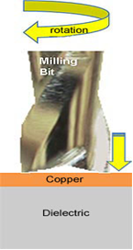
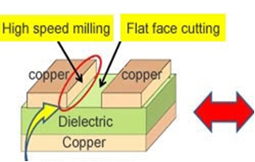
Drilling mechanism :-

Slide 13
Electrical component
Software
Micro controller
Power supply
Stepper motors
Driver

Slide 14
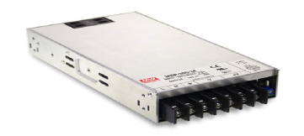
Electrical Component
The power supply is to feed the system with power . It converts 220 V AC to 24 V DC and 1.6-14 A DC .

Slide 15
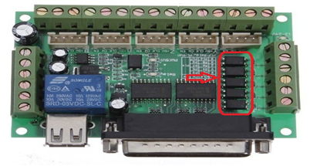
Electrical components
The Micro Controller :
To translate the orders from the Computer to the motors driver
24V DC

Slide 16
Electrical components
Drivers :
-The main function of the drive is to convert the step command input signals to patterns of currents in the motor winding.
-Reverse the direction of the motors .

Slide 17
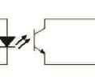
Electrical Components
Optocouplers
cct the coil

Slide 18
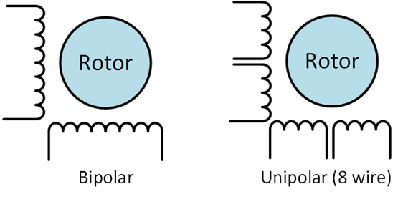
Electrical components
The stepper motor (Nema 23) :
We used the Bipolar one.

Slide 19
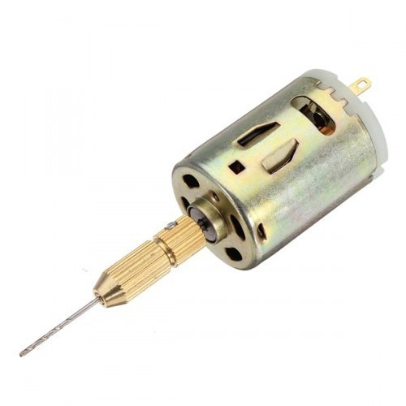
Electrical components
Spindle (the drill).
220V AC , manual control (on/off).
30,000 rev/min . 350W

Slide 20
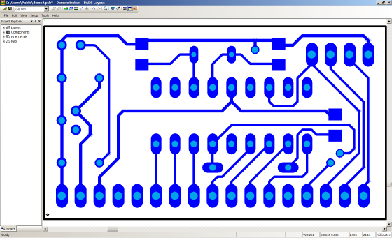
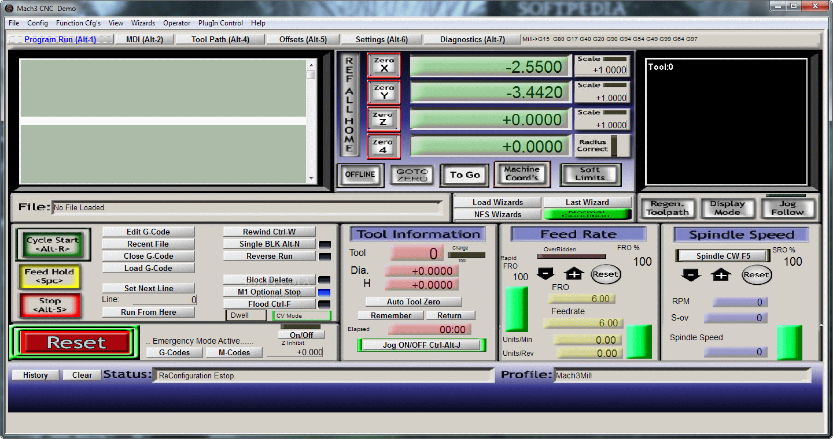
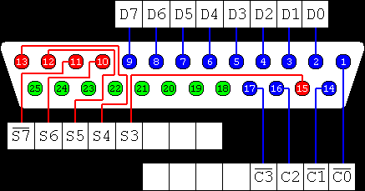
Software
cadsoft eagle pcb designer
mach3
parallel port

Slide 21
Software
What is Cadsoft eagle PCB designer?
With eagle we can do many things, starting from creating and designing and circuit and convert the the graphics to G-code.

Slide 22
Software
What is mach3?
Mach3 is a software package that runs on a pc and depends on his work on G-code

Slide 23
Software
What is G-code?
defined by instructions on where to move

Slide 24
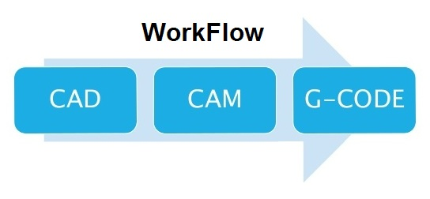
Software (pcb design )

Slide 25
Software
- CAD Software: Used to design the circuit. The output of CAD are drawings.
- CAM Software: CAM software analyzes the CAD drawing, takes input from the machinist or programmer, and outputs g-code for the machine controller.

Slide 26
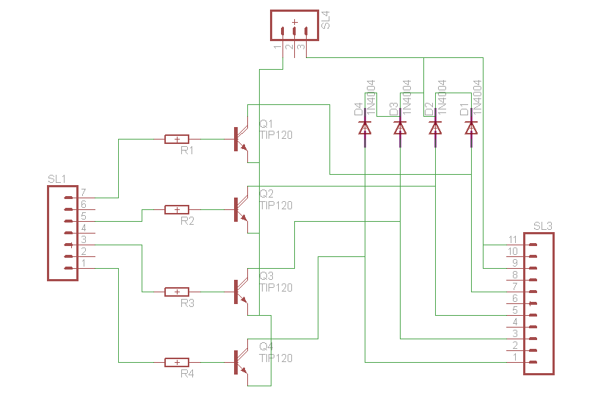
Software
Design schematic circuit

Slide 27
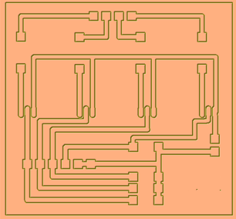
CopperCAM software

Slide 28
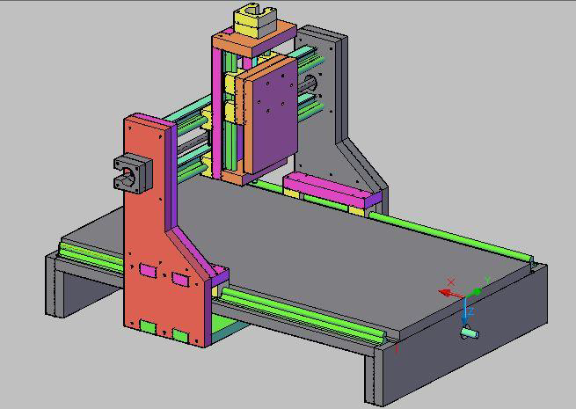
Mechanical Design
Frame

Slide 29
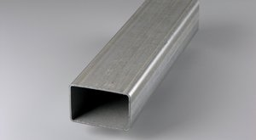
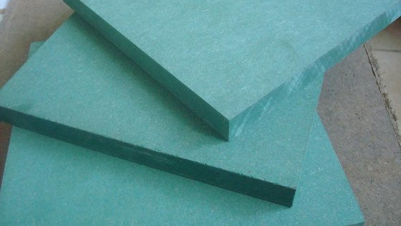
Mechanical Design
Galvanized steel
Galvanized steel
Green MDF (wood)

Slide 30
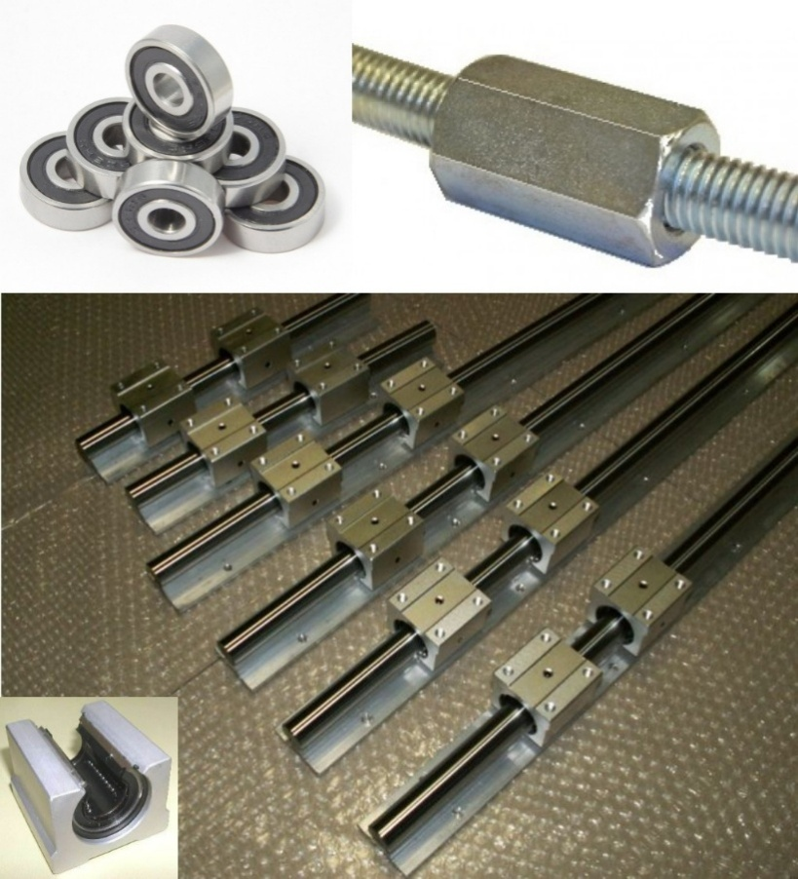
Mechanical Design
Transmission systems

Slide 31
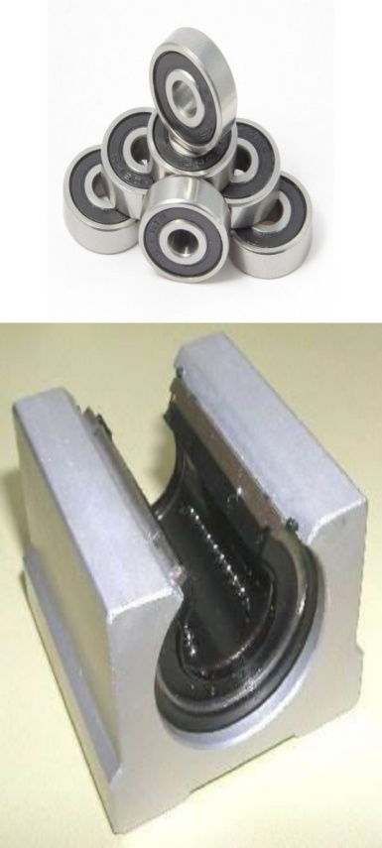
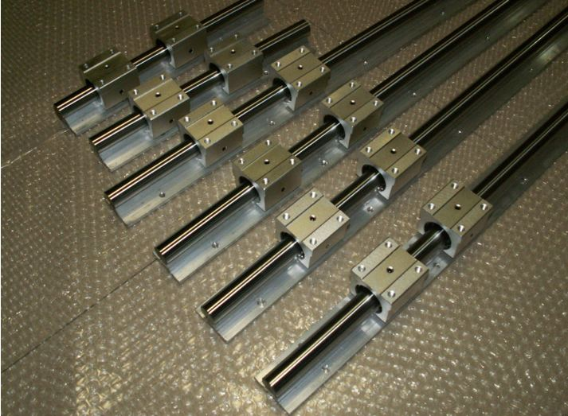
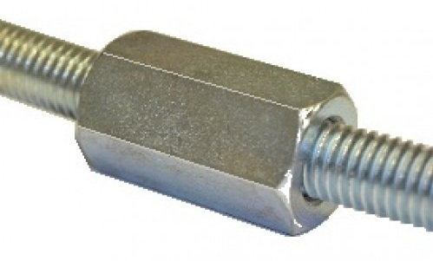
Mechanical Design
Bearings
Rails
Lead screw

Slide 32
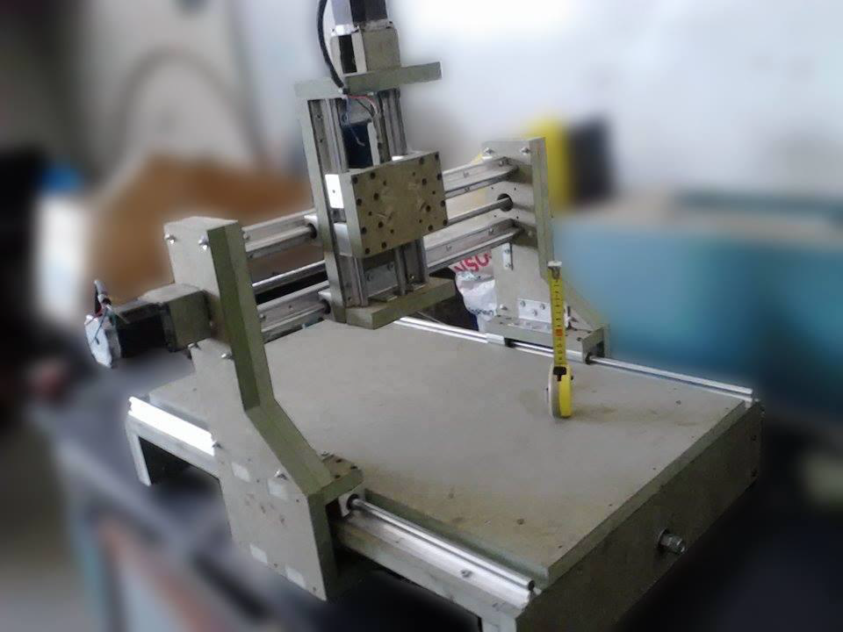
Mechanical Design
Rails
Y, Z & X rails

Slide 33
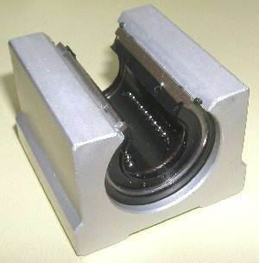
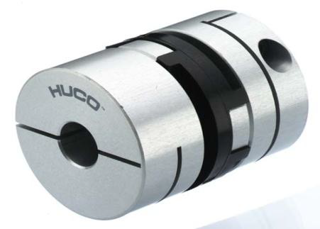
Mechanical Design
Bearings
Coupler

Slide 34
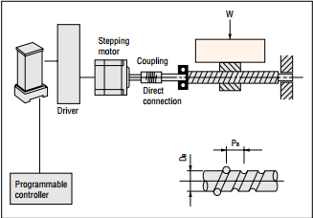
Mechanical Design

Slide 35
Total cost of the project and it’s feasibility:
Total price (NIS) | Pieces No. | The price of each piece | Pieces Name
300 | 3 | 100 | Stepper Motors
200 | 1 | 200 | Drilling motor (spindle)
2000 | 1 | 2000 | Project design
900 | 3 | 300 | stepper motor driver
350 | 1 | 350 | break out board
200 | 1 | 200 | Power supply
200 |  | 200 | Other costs
4150 |  |  | Total cost

Slide 36
Problems &Recommendation
Problems
Choosing the right mechanical design for the project
High prices of some components.
the mach3 free version doesn’t give all the benefits of the paid one .
Choosing the right driver circuits for the motors.
Difficult found Milling and Drilling tool.

Slide 37
Recommendation
Improve the mechanical design of the project
Using a vacuum or something like that to eliminate the tiny copper parts that still remaining on the PCB after cutting and milling.
Looking for a technique to change the PCB layers between upper layer and bottom layer automatically.
Ability of welding electronic parts foot.
Using laser instead of Drilling.

Slide 38
Thank All for your Attention

