Slide 1

SVC Based Flexible AC Transmission System (FACTS)
Prepared by : Thana’ Hamdan
Hiba Jad-Allah
Supervised by: Dr. Kamel Saleh

Slide 2
content:
Why PF correction
Ordinary methods of PF correction
Static variable compensation method and its advantages
Methodology and Simulation of SVC
Pf meter in hardwire and its results
Open loop control and its result
close loop control and its result

Slide 3
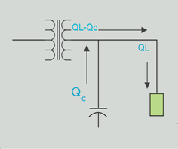
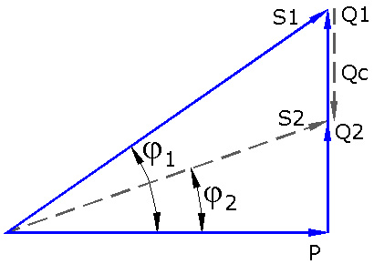


• Why PF correction ?

Slide 4
• Why PF correction ?
Until these goals are achieved :
Increase transmission efficiency
Increase voltage regulation
Reducing an apparent power (S) leads to reducing current
Reducing losses of electrical energy
Saving both of money and energy

Slide 5
• Methods of PF correction
1- Capacitor banks
The main disadvantage of this method its changes in a steps and not in smooth way , so it can’t be achieved a PF at some load
2- Synchronous Condenser
The main disadvantage of using this method is the high cost to be used in light load
3- Phase Advancer :
The main Disadvantage is that Using Phase advancer is not economical for motors below 200 H.P

Slide 6
• Static variable compensation method and its advantages
SVCs are part of the Flexible AC transmission system device family. This method uses only one capacitor bank and we control the PF by injected reactive power into the line other than controlling capacitance value.

Slide 7
Advantages of using SVC method:
Improved system transient and steady-state stability
Improved static and dynamic load
One capacitor bank only used
Cheaper than other methods
Reduced transmission losses
Simple controlling units

Slide 8
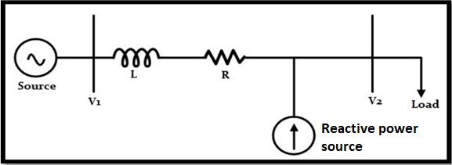
• Methodology and Simulation of SVC
SVC uses TSC (Thyristor Switched Capacitors) based on shunt compensation to controls the power flow in transmission system and improves the transient stability of power grids.
* shunt compensation:

Slide 9
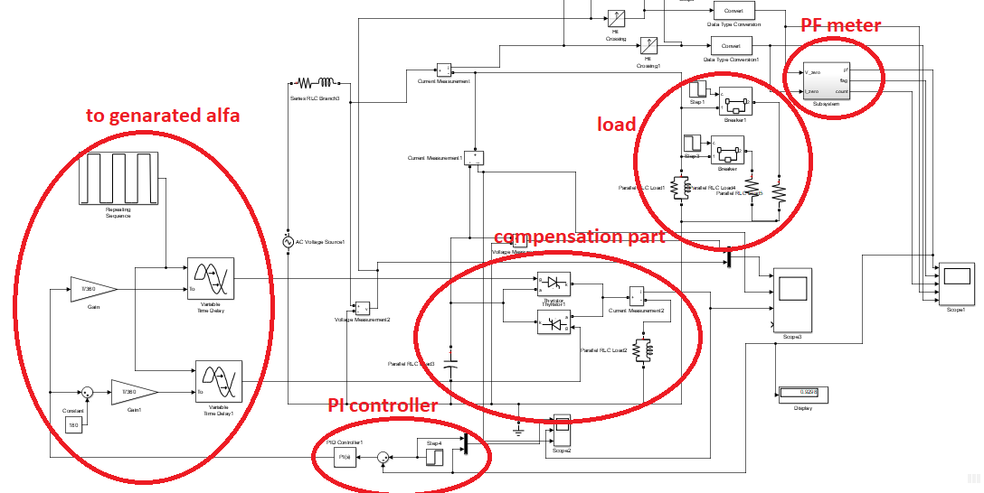
• Matlab simulation of the project

Slide 10
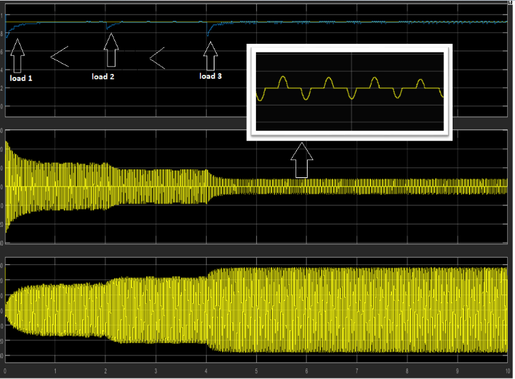

Slide 11
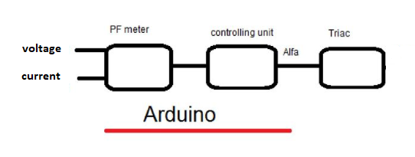
Hardwire
The project consist of two main parts:
1- pf meter
2- control unit

Slide 12
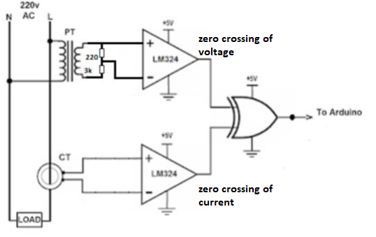
• PF meter

Slide 13
Zero crossing detector
when the input sine wave passes through zero and goes in positive direction, the output voltage gives negative pulse .Similarly, when the input voltage passes through zero and goes in the negative direction, the output voltage gives positive pulse , This was done using comparator .

Slide 14
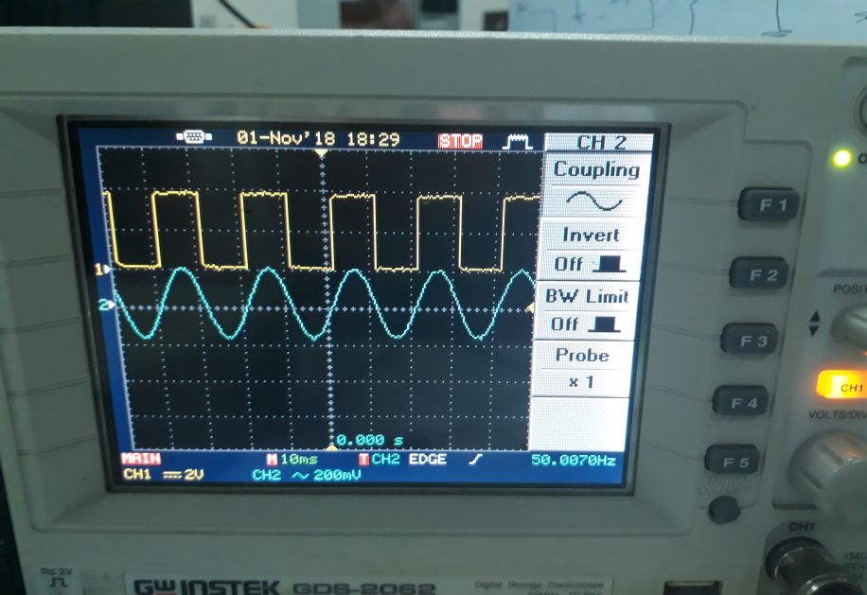
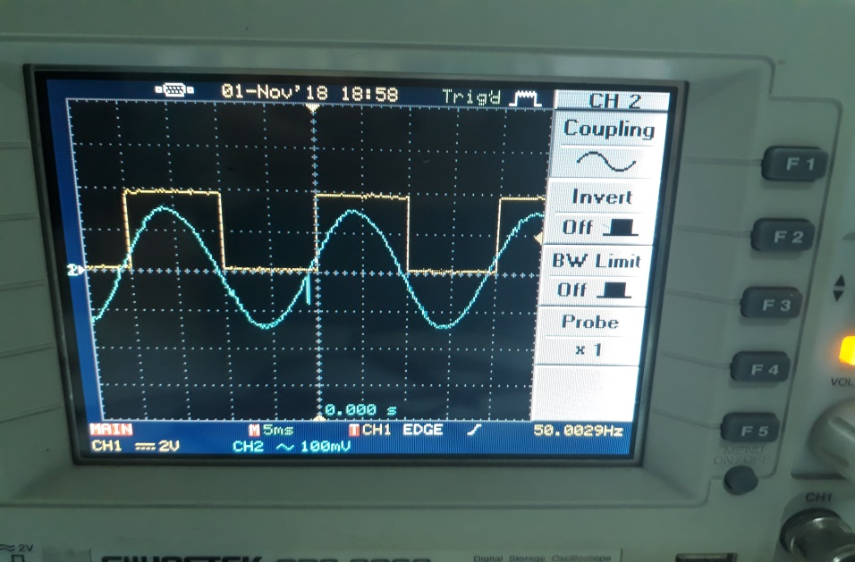
Result of zero crossing of voltage and current waveforms:
zero crossing of current zero crossing of voltage

Slide 15
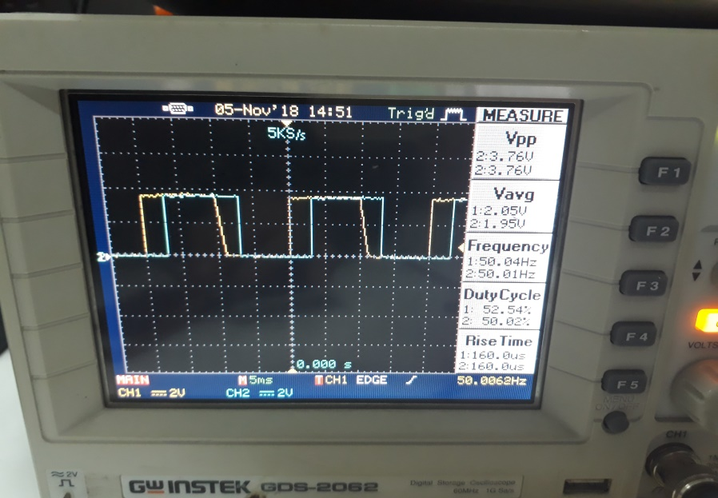
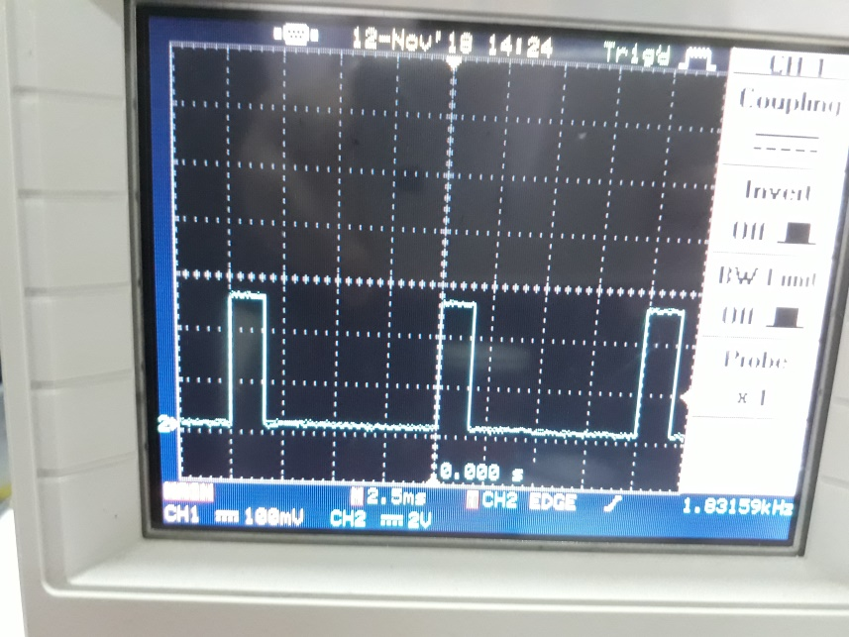
Figure 1 show the two outputs of zero crossing of current and voltage waveforms together
Figure 2 output of XOR that is the input for the Arduino microcontroller to calculate the power factor of the load.
Figure 1 Figure 2

Slide 16
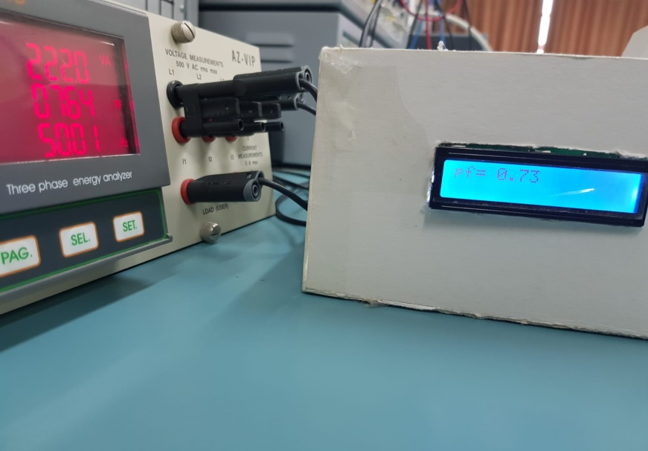
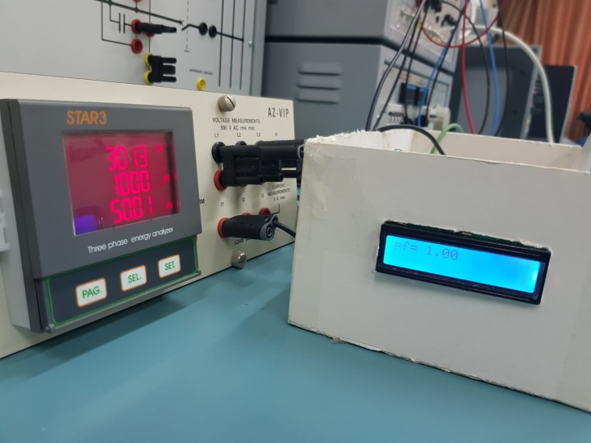
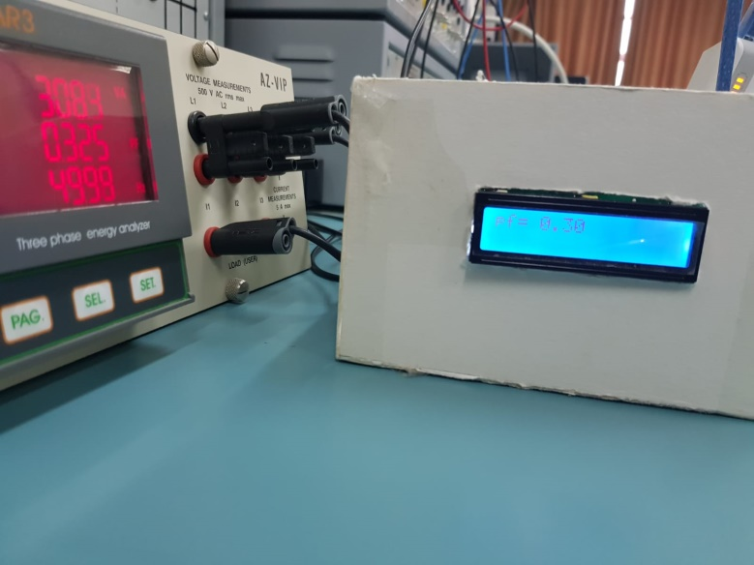
Some results measure the power factor for different loads

Slide 17


Slide 18
Control unit :
We know that the function of the control unit is to improve the power factor, by changing the firing angle of triac and We designed the control unit on two parts: 1) open loop
2) close loop .

Slide 19
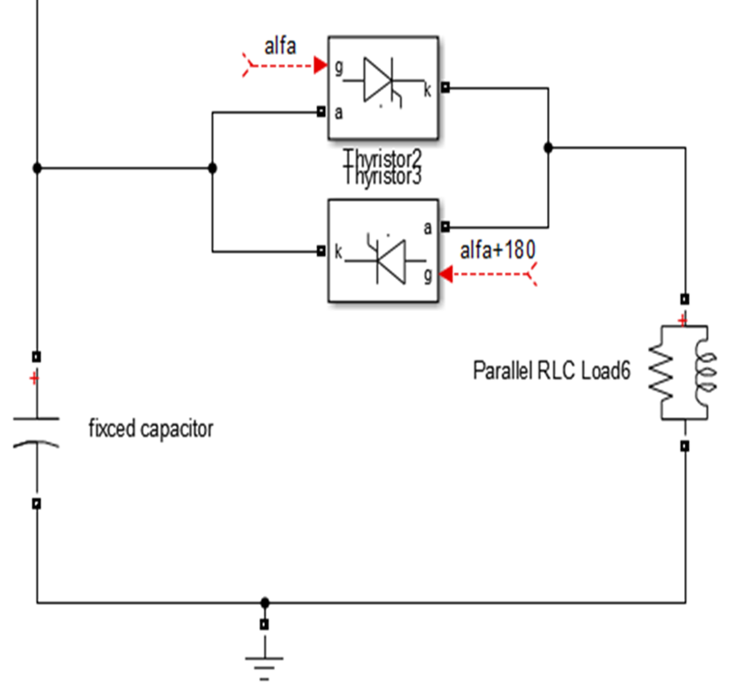
1) Open loop control:
Here in this part we used a circuit to control the power factor value. When we change the value of the variable resistance, the value of the angle is change

Slide 20
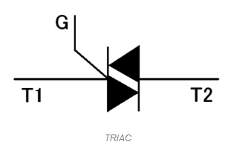
Triac:
consists of two thyristors connected in inverse parallel ,and this The most important part in this method, where we get the variable voltage by controlling the value of the firing angle

Slide 21
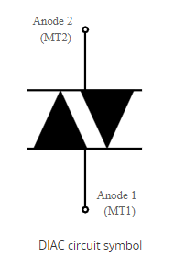
Diac:
- the DIAC, Diode AC bi-directional
switch is widely used with TRIACs to
improve operation of alternating current
power switching systems.

Slide 22
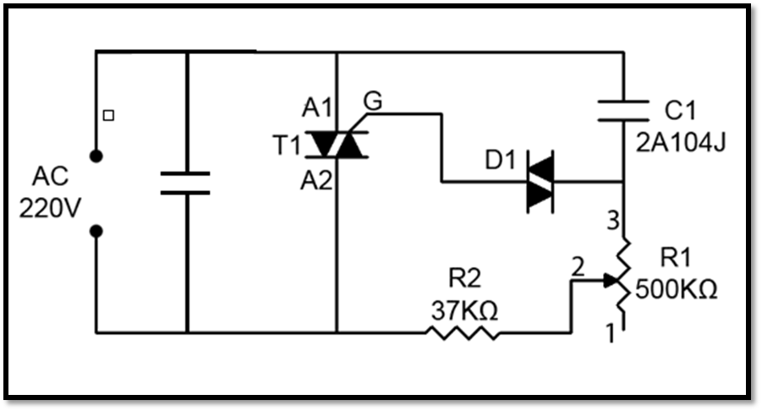
Control unit circuit:

Slide 23


Slide 24
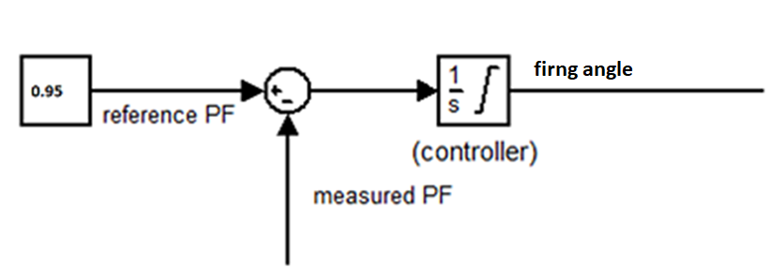
Close loop control :
The control unit will keep adjusting the value of firing angle until that the measured PF on the load exactly equal the reference PF under changing load .

Slide 25
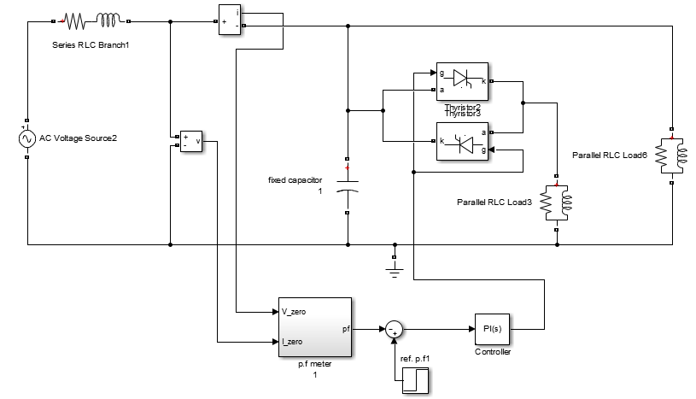
Close loop circuit:

Slide 26
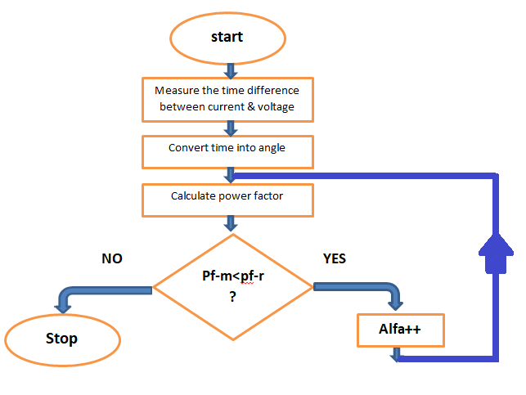
flow chart:

Slide 27
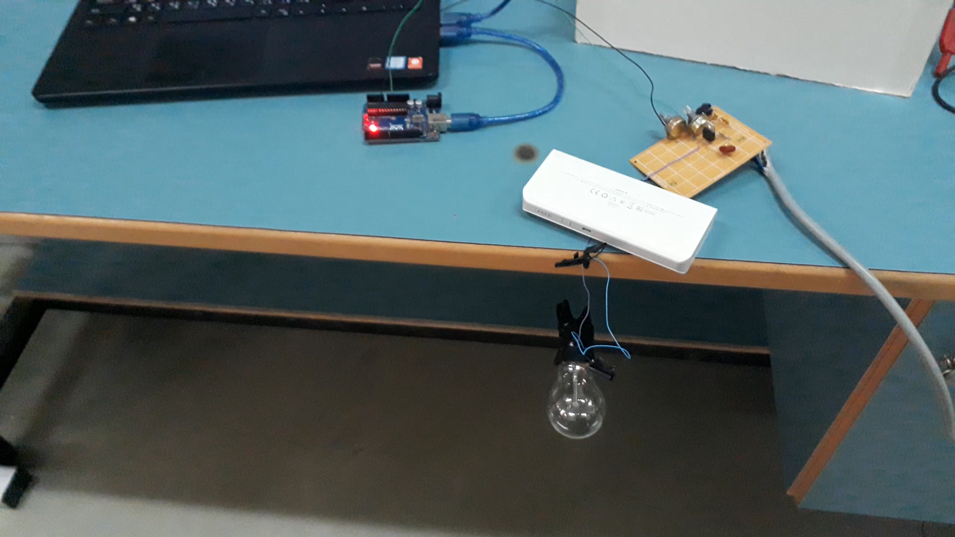

Slide 28


