Slide 1



Ameed zubaidi Anas jaim Nidal khalil

Slide 2
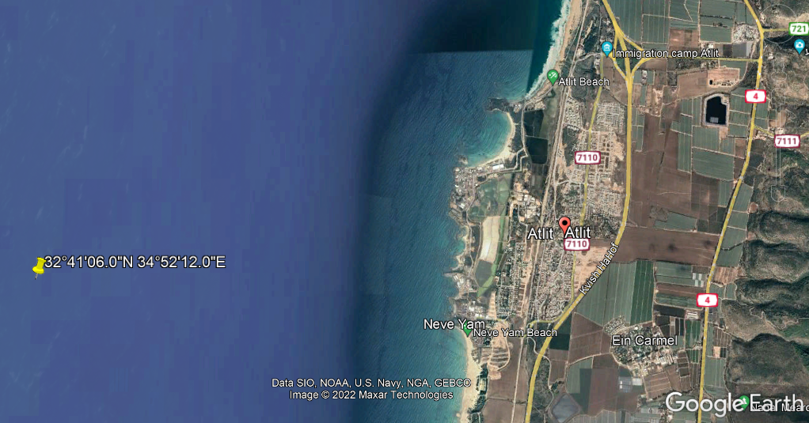
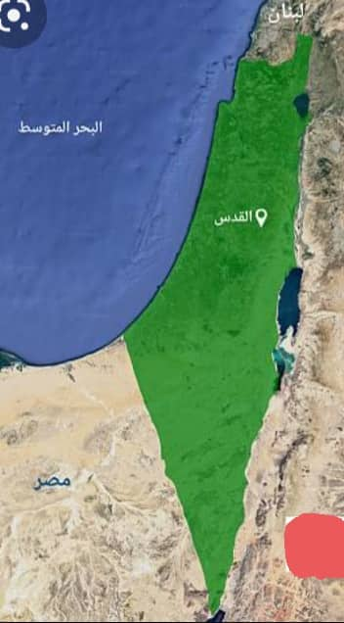
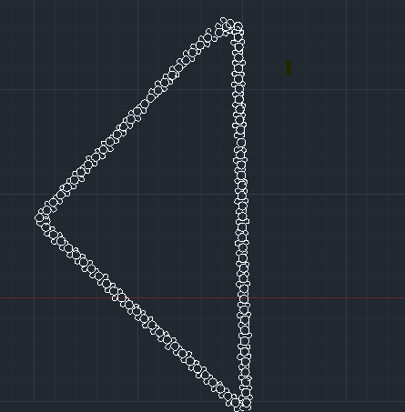
The Design and Construction of an Artificial Island in the Mediterranean Sea
Cells
Island Fill

Slide 3
Abstract:
Palestine is located at the heart of the World map. It looks like a bridge between the
three major continents, Asia, Africa, and Europe. Its location is very important
geopolitically and also for commerce between all parts of the World.
Therefore, Palestine should have a sea port that is located at a chosen area at the
Mediterranean Sea to serve all needed goals.
In this project, we will choose an area that is most adequate to accommodate the sea
Port needed. For various reasons we found that the sea port will consist of two parts,
One is the port and facilities at the sea shore itself. And the other is an artificial island
That should be constructed in front of that area and connected to it.
Our goal, in this project, is to study and design the proposed island and the best way
For its construction.
The suggested shape of the artificial island is Palestine shape even fits the available space, with surface area equal to 30000 m2 (3 hectare).
The island is located about 2500 m from the beach. To facilitate access to the island, ships and boats will be used as a mode of transportation because it's a cheap mode and to add. some fun and entertainment for visitors instead of using the bridge

Slide 4
Definition of An Artificial Island .
Artificial islands or man-made islands are defined as an island that has been constructed by people rather than formed by natural means
The Major Reasons The Creation Of Artificial Islands .
Advantages Of Artificial Island.
Disadvantages Of Artificial Island.

Slide 5
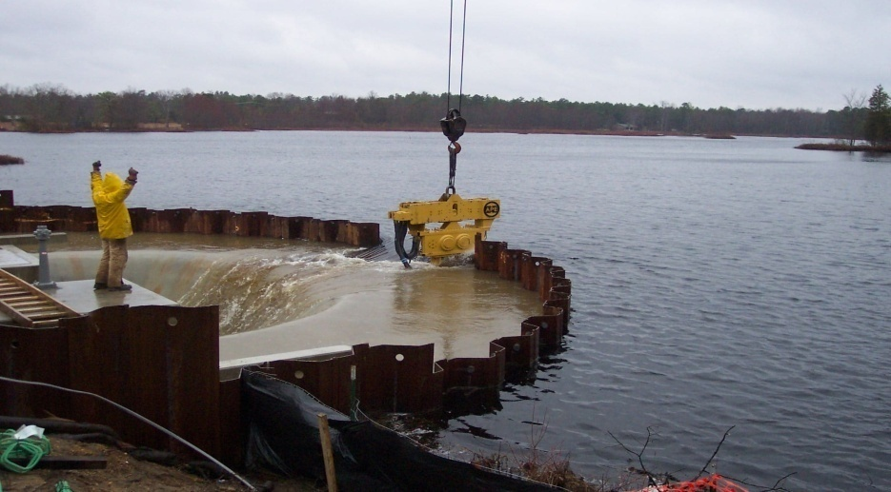
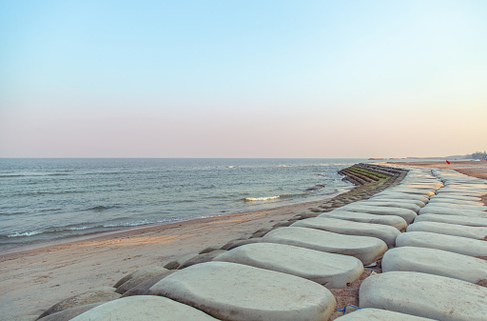
Methods of Construction .
1 . Large Diameter Steel Cellular Cofferdam Method
2. Sand Bags Method.

Slide 6
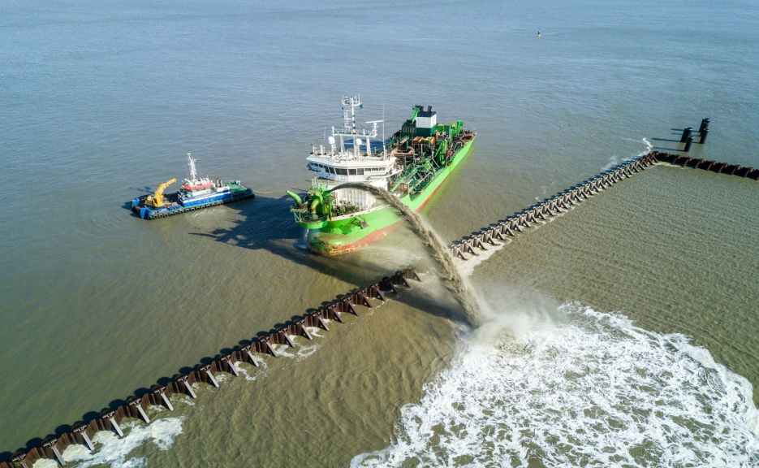
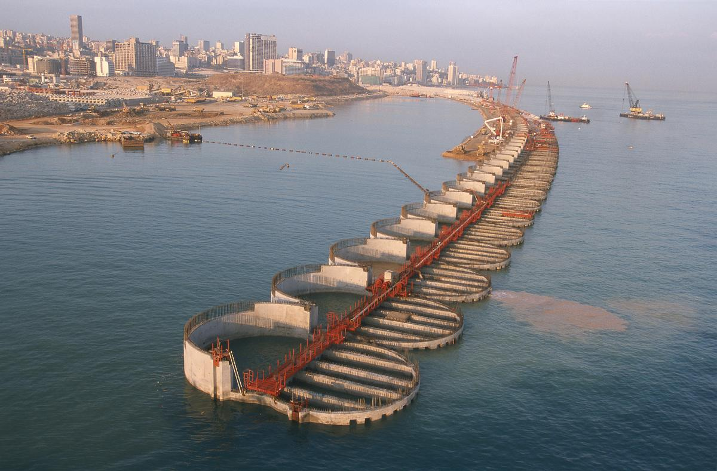
3 . Rain Bowing Method.
4 . Building By Caissons.

Slide 7
The construction method for each island is selected according to several factors
The depth of water.
The objective of building of the island and its area.
The height of the waves that hit on the structure.
Currents of the ocean.
Construction material available.
Environmental conservation.
Foundation conditions and earthquake risk.

Slide 8
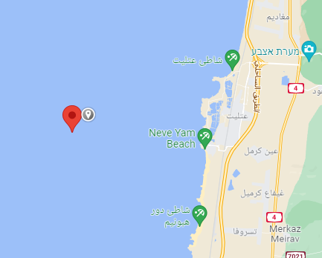
Location Of The Island

Slide 9
Project Description
The project located out of Atlit coast southern of Haifa, it is located on the 35th Line east of Greenwich Line, and on the latitude of (32°41'06.0"N 34°52'12.0"E) degrees of the equator.
Hydrographic Survey
Topographic Survey
Topographic Maps
Soil Investigation .

Slide 10
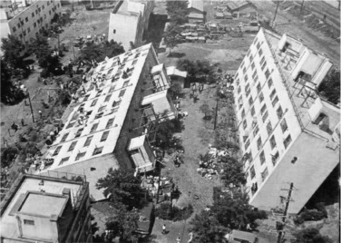
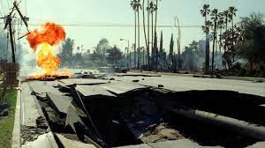
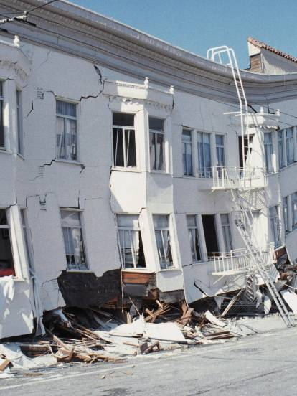
Liquefaction
Introduction .
Effects .
Bearing strength Loss Fire Spread Settlements Settlements.

Slide 11
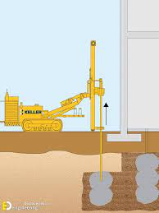
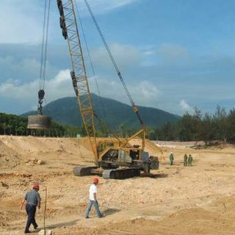
Mitigation
1. LOW Mobility Grouting .
2 .Dynamic Compaction .

Slide 12
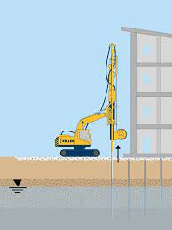
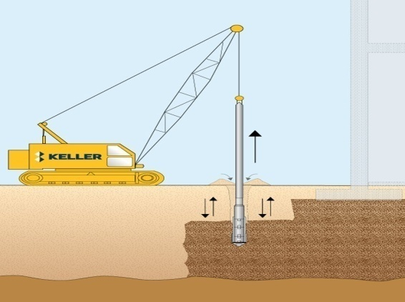
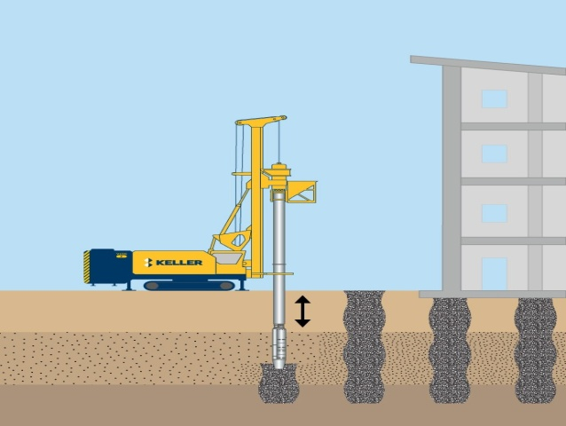
3 . Earthquakes Drains .
4 . Vibro Compaction.
5. Vibro Replacment .

Slide 13
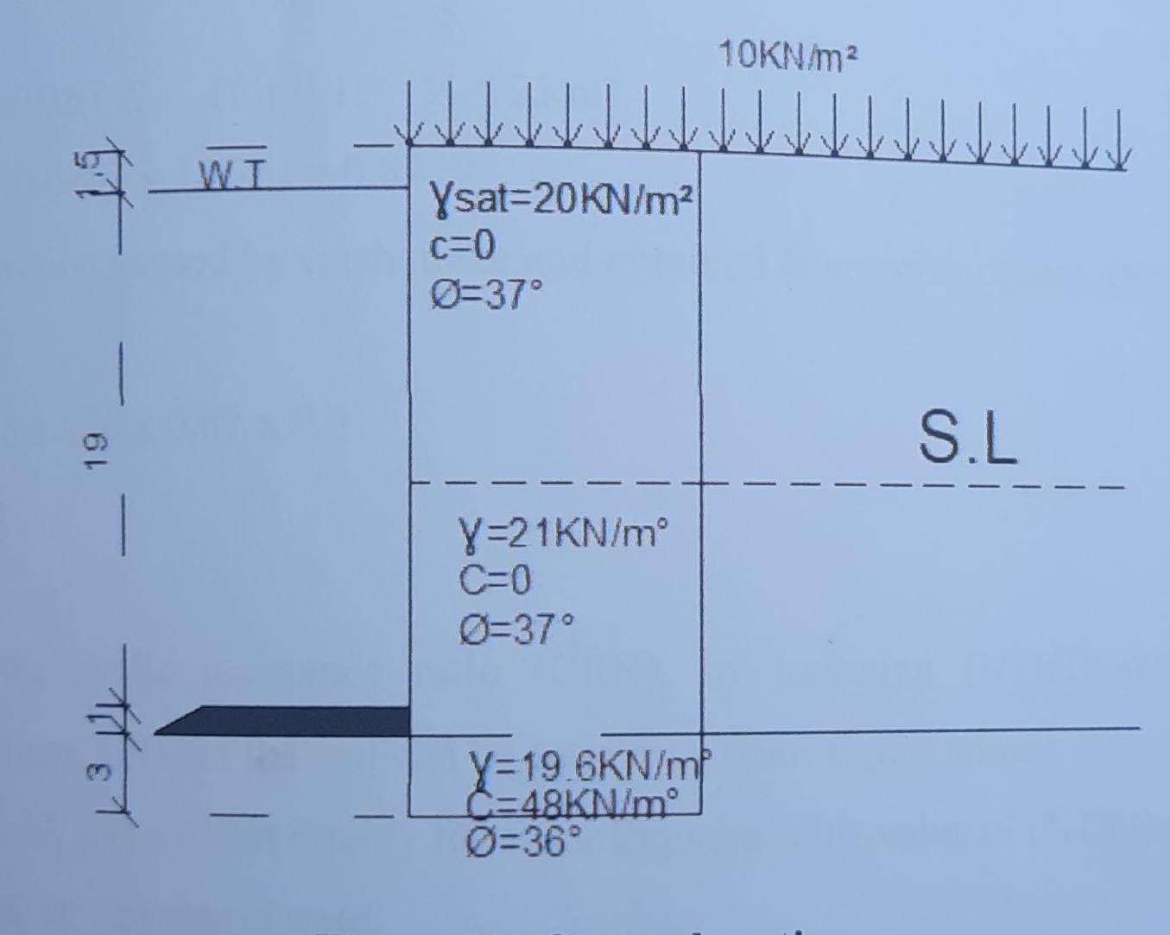
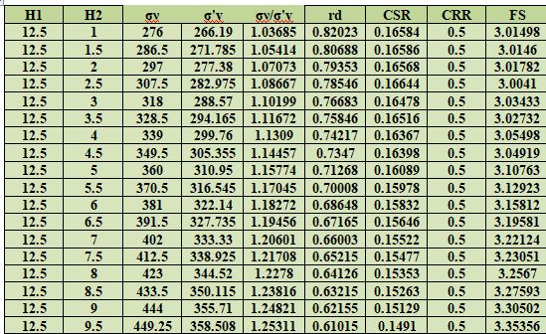
Liquefaction in This Project.
F = ma=(W/g) a=(Ɣ*z/g) amax = ϭ (a MAX/g)
H1 | H2 | H3 | σν | σ'v | σν/σ'v | rd | CSR | CRR | FS
12.25 | 9.25 | 0.5 | 459.05 | 363.4025 | 1.2632 | 0.5866 | 0.144494 | 0.5 | 3.46036
12.25 | 9.25 | 1 | 468.85 | 368.2975 | 1.27302 | 0.57325 | 0.142303 | 0.5 | 3.513631
12.25 | 9.25 | 1.5 | 478.65 | 373.1925 | 1.282582 | 0.5599 | 0.140033 | 0.5 | 3.570588
12.25 | 9.25 | 2 | 488.45 | 378.0875 | 1.291897 | 0.54655 | 0.137687 | 0.5 | 3.63143
12.25 | 9.25 | 2.5 | 498.25 | 382.9825 | 1.300973 | 0.5332 | 0.135267 | 0.5 | 3.696382
12.25 | 9.25 | 3 | 508.05 | 387.8775 | 1.309821 | 0.51985 | 0.132778 | 0.5 | 3.765698
H= 21.5 m
H = 24.5 m

Slide 14
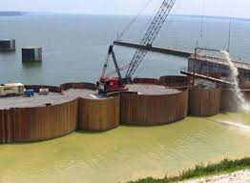
Methodology and Design
Steel cellular cofferdams .
Definition .
In this project the type of soil that used is sand with amount of gravel. The value of the
angle of friction and coefficient of permeability are 37° and 10-2 cm/sec respectively .

Slide 15
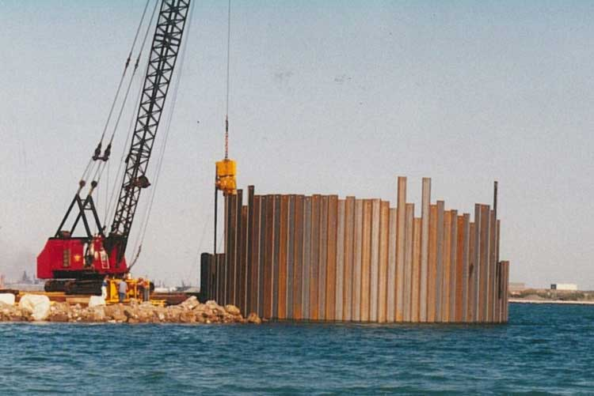
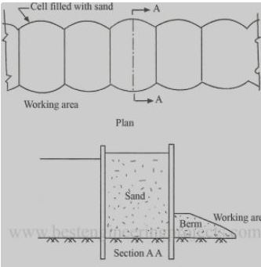
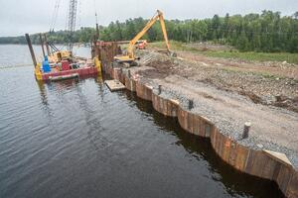
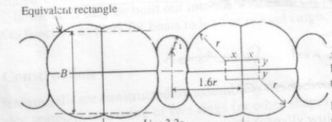
Types of Cellular Cofferdams
1. Circullar Cofferdams .
2. Diaphragm cofferdam .
3.Cloverleaf Cofferdam .

Slide 16
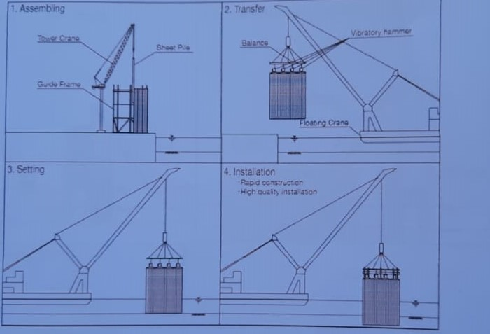
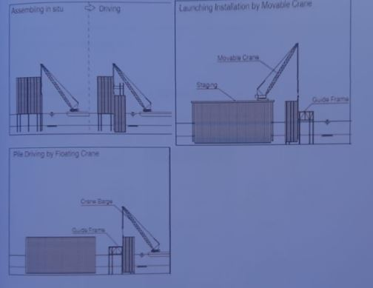
Construction methods .
1.Prefabriecation method .
2. In –situ method .

Slide 17
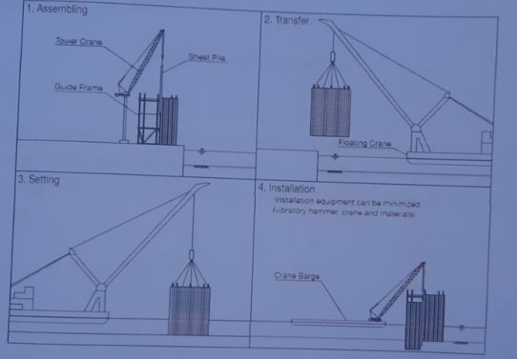
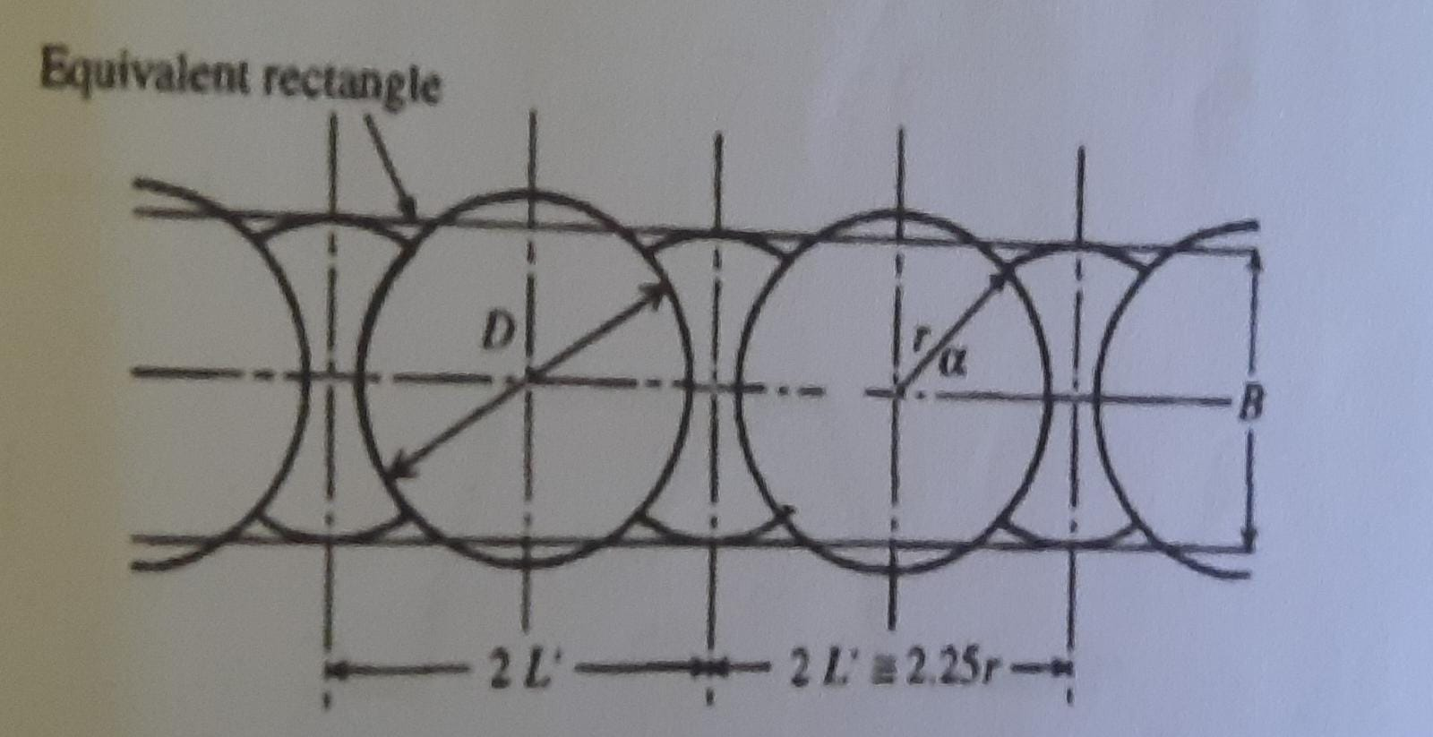
3. Semi- prefabrication method .

Slide 18
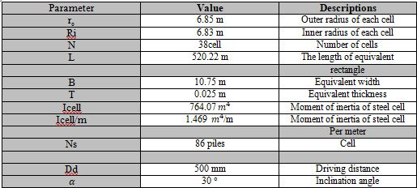

Slide 19
Thank You

