Slide 1
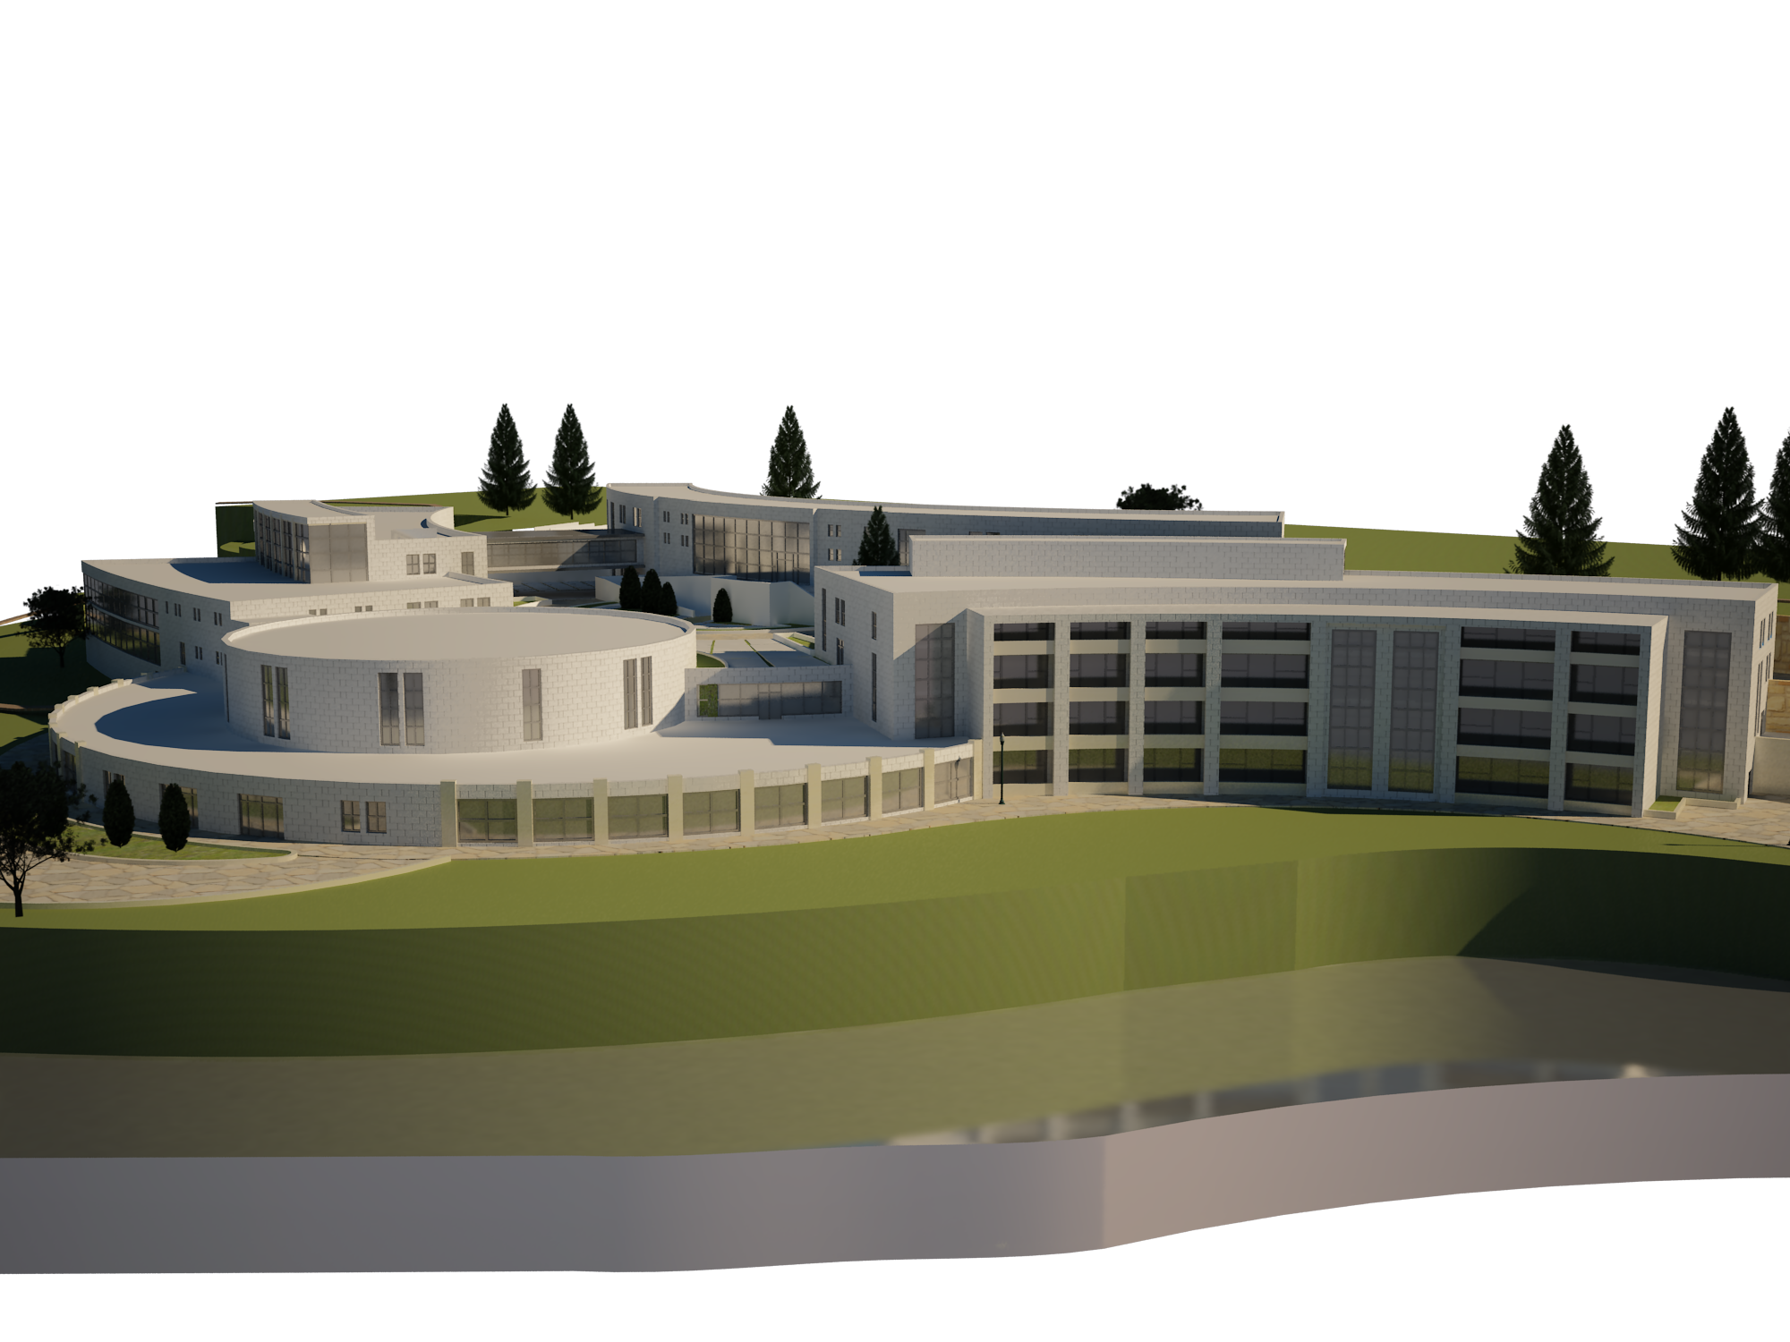


REHABILITATION CENTER FOR PHISICALLY DISABLED
An-Najah National University
Faculty of Building Engineering
May 2013

Slide 2
Prepared By :
Mohammad Nori - Iyad Hunnon- Iyad Abd-Alhafez
Graduation Project Tow
Supervised By :
Eng. Fadi.A.Fatayer
“This Project is a Partial Fulfilment for the Degree Bachelor of Science in Building Engineering”
An-Najah National University
Faculty of Building Engineering

Slide 3
OUTE LINE
Building Engineering
OPJECTIVE OF THIS STUDY.
PROJECT INFORMAION.
ARCHITECTURAL DESIGN.
STRUCTURAL DESIGN.
ELECTRICAL AND MECHANICAL DESIGN.
SAFTY AND HVAC SYSTEM DESIGN.
Graduation Project

Slide 4
OBJECTIVES OF THIS STUDY
Building Engineering
This project has the following objectives:
To avoid any problems that faced the previous projects during operating and maintenance stage by applying maintainability guideline during the design stage.
To build an integrated rehabilitation center, that have perfect Architectural, Structural, Mechanical, Electrical.
Graduation Project

Slide 5
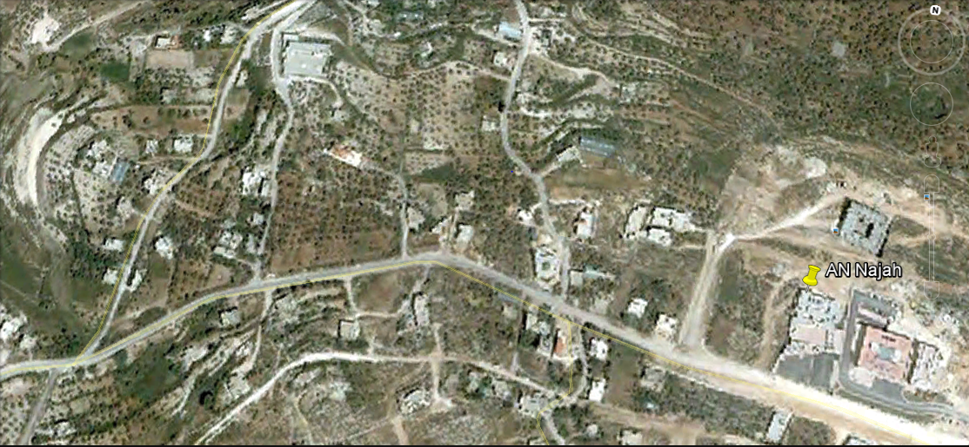
Project Information
Building Engineering
Location and site plan
Location
Graduation Project

Slide 6
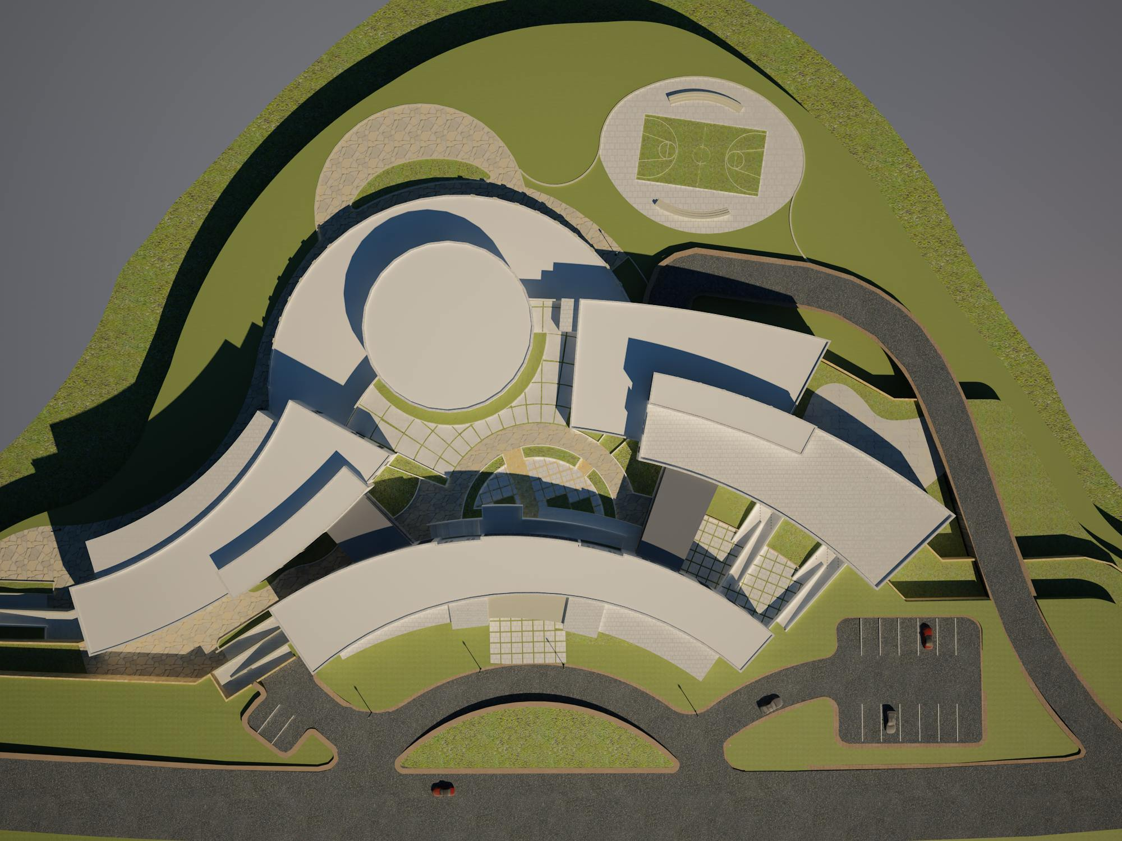
Project Information
Building Engineering
Location and site plan
Graduation Project

Slide 7
Architectural design
Building Engineering
GENERAL VIEW OF PROJECT
Graduation Project

Slide 8
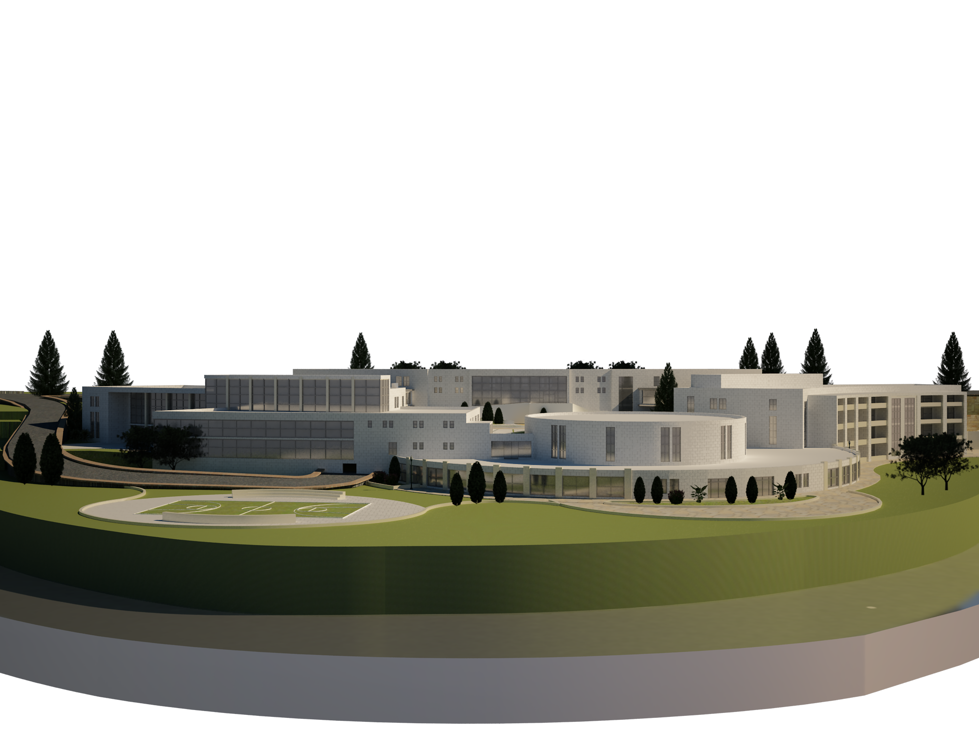
Architectural design
Building Engineering
GENERAL VIEW OF PROJECT
Graduation Project

Slide 9
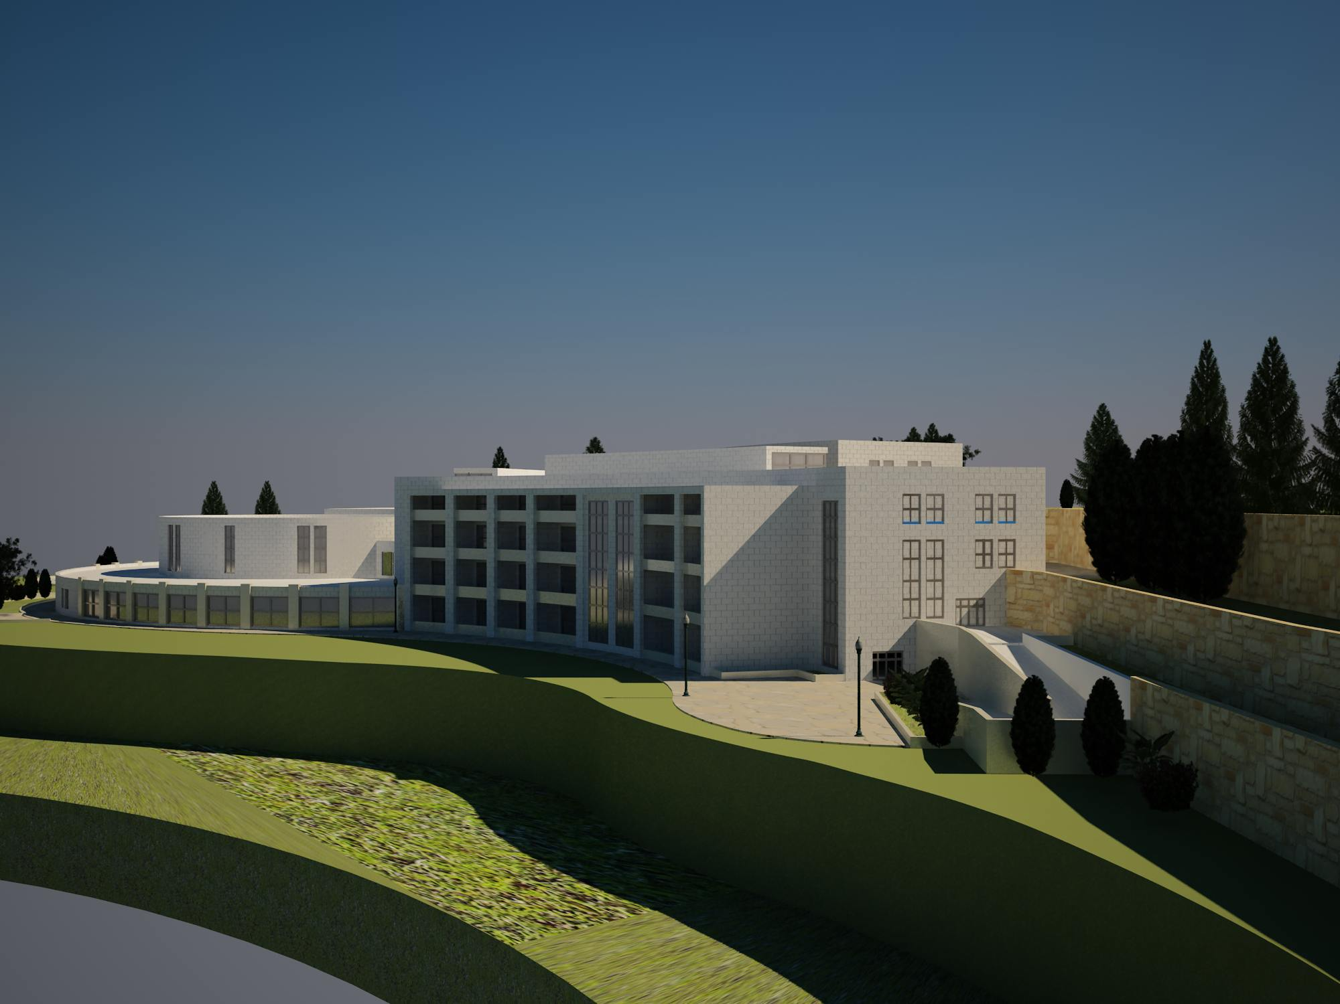
Architectural design
Building Engineering
GENERAL VIEW OF PROJECT
Graduation Project

Slide 10
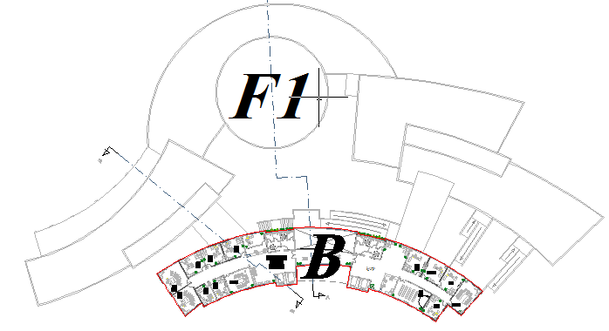
Architectural design
Building Engineering
FIRST FLOOR PLAN
Graduation Project

Slide 11
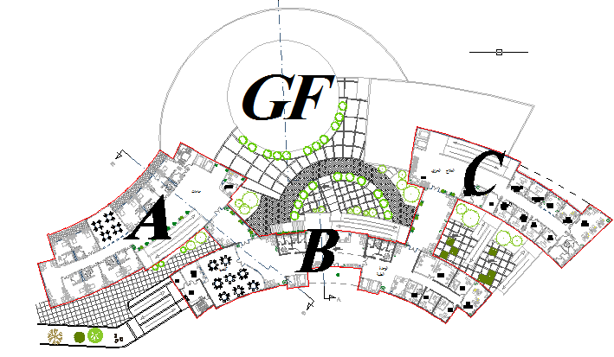
Architectural design
Building Engineering
GROUND FLOOR PLAN
Graduation Project

Slide 12
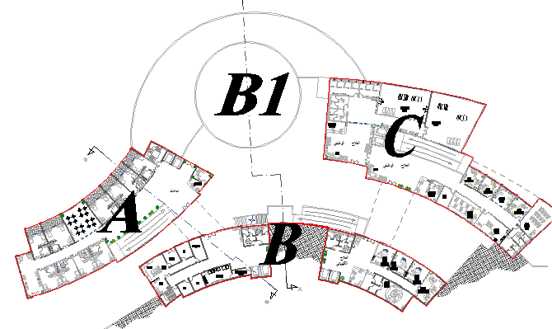
Architectural design
Building Engineering
BASEMENT ONE PLAN
Graduation Project

Slide 13
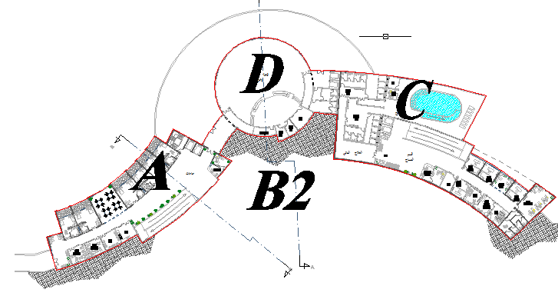
Architectural design
Building Engineering
BASEMENT TWO PLAN
Graduation Project

Slide 14
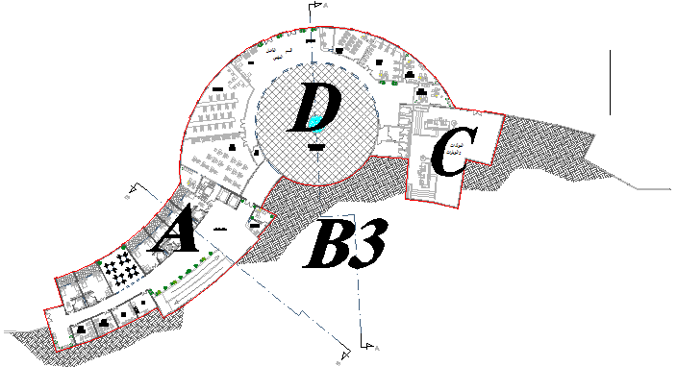
Architectural design
Building Engineering
BASEMENT THREE PLAN
Graduation Project

Slide 15
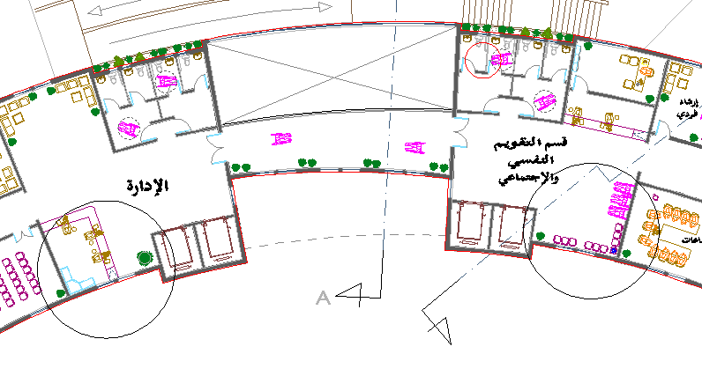
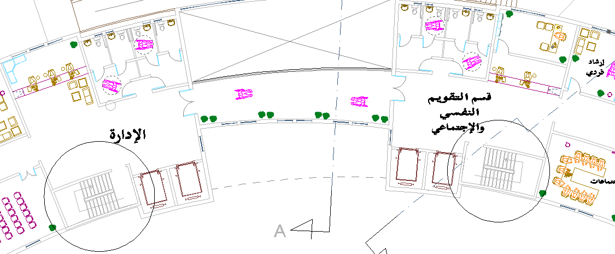
Architectural design
Building Engineering
Architectural Design Modifications in block B
No stairs in all floors
Graduation Project

Slide 16
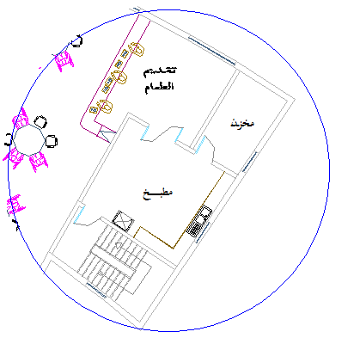
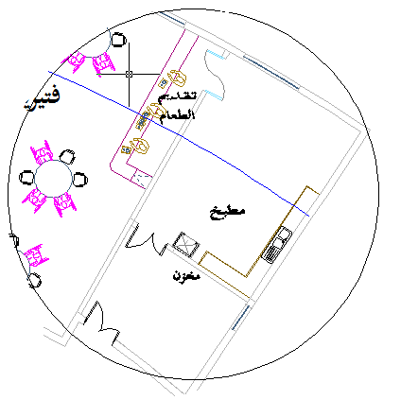
Architectural design
Building Engineering
Architectural Design Modifications
Storage and kitchen in ground floor
Graduation Project

Slide 17
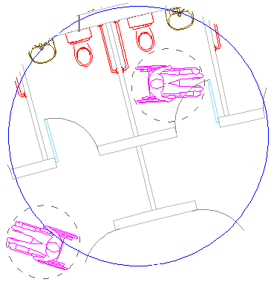
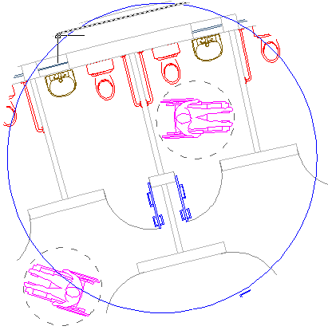
Architectural design
Building Engineering
Architectural Design Modifications
Location of bathroom door
Graduation Project

Slide 18
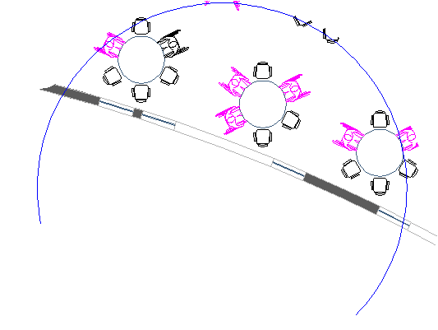
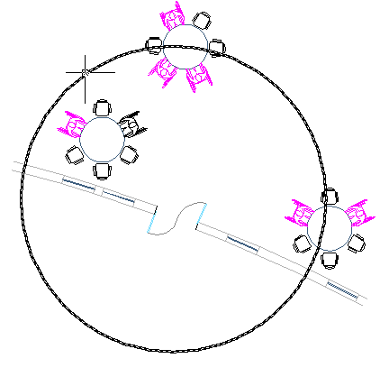
Architectural design
Building Engineering
Architectural Design Modifications
Door of cafeteria
Graduation Project

Slide 19
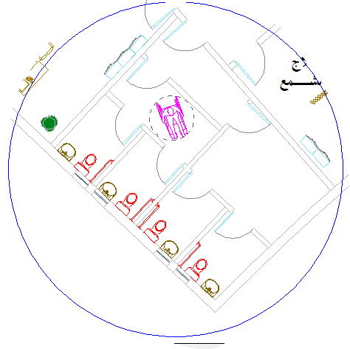
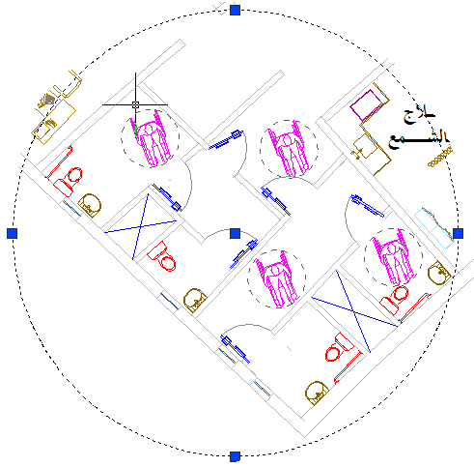
Architectural design
Building Engineering
Architectural Design Modifications in block C
Bathrooms
Graduation Project

Slide 20
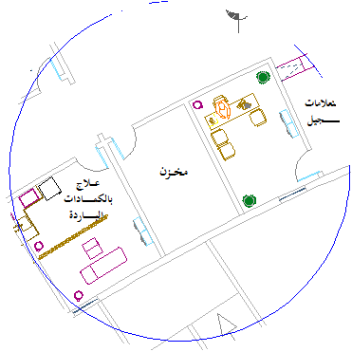
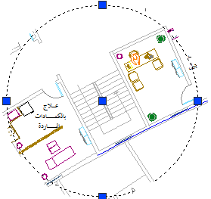
Architectural design
Building Engineering
Architectural Design Modifications in block C
Stairs
Graduation Project

Slide 21
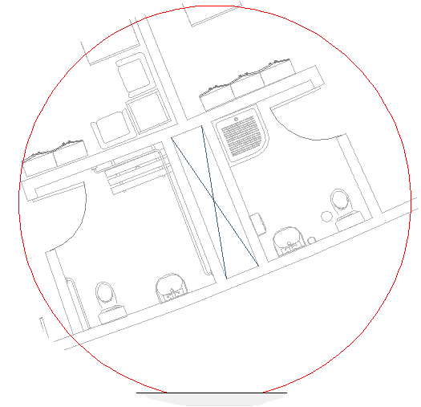
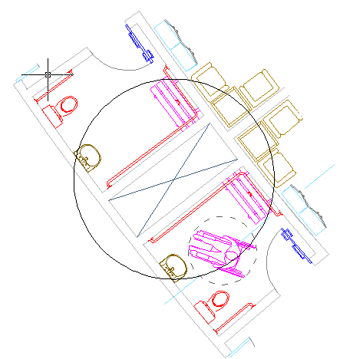
Architectural design
Building Engineering
Architectural Design Modifications in block A
Width of air shaft
Graduation Project

Slide 22
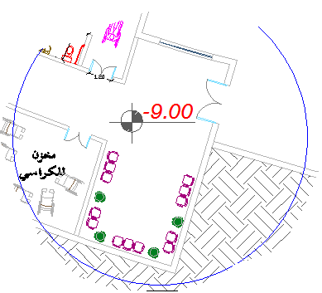
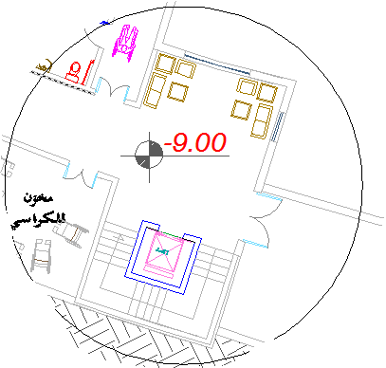
Architectural design
Building Engineering
Architectural Design Modifications in block A
Add stair and lift
Graduation Project

Slide 23
Architectural design
Building Engineering
Architectural Design Modifications in block A
Add stair and lift
Graduation Project

Slide 24
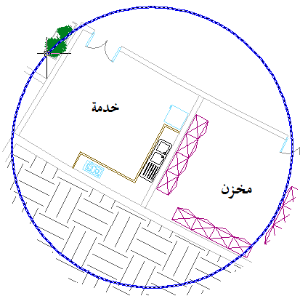
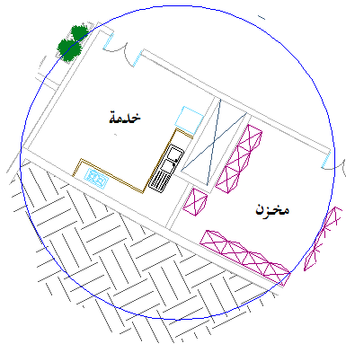
Architectural design
Building Engineering
Architectural Design Modifications in block A
Add air shaft in basement two and three
Graduation Project

Slide 25
Architectural design
Building Engineering
Architectural Design and maintenance and operations operations
Major concerns applied to plans to avoid any problem that effect to building in future.
These concerns divided into three stages, the first stage applied at 30% of the project ,the second one applied into 60% of the project and the third on applied into 90% of project.
Graduation Project

Slide 26
Architectural design
Building Engineering
Architectural Design and maintenance and operations operations
Major concerns applied to plans to avoid any problem that effect to building in future.
First stage 30% of project design
In this stage, all the important design areas will be reviewed with the client before the development of detailed drawings.
Graduation Project

Slide 27
Architectural design
Building Engineering
Architectural Design and maintenance and operations operations
Major concerns applied to plans to avoid any problem that effect to building in future.
Second stage 60% of project design
After 30% project design approval, all details are
prepared. A more detailed specifications are provided at this phase.
Graduation Project

Slide 28
Architectural design
Building Engineering
Architectural Design and maintenance and operations operations
Major concerns applied to plans to avoid any problem that effect to building in future.
Third stage 90% of project design
In this stage, the specifications as well as the construction drawings are packaged together.
Graduation Project

Slide 29
Architectural design
Building Engineering
Architectural Design and maintenance and operations operations
Major concerns at 30% of project that applied into plans
Orientation of the building and the wind load effect on the building envelops and interior spaces.
Windows are appropriate for the prevailing climate and orientation of the building.
Dimensions of the doors and windows accommodate movement of furniture.
Graduation Project

Slide 30
Architectural design
Building Engineering
Architectural Design and maintenance and operations operations
Major concerns at 60% of project that applied into plans
Design provides the kitchens and bathrooms with windows.
Basins of agriculture are located near from the facades.
Graduation Project

Slide 31
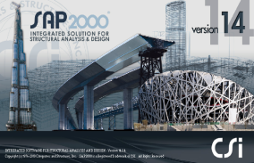
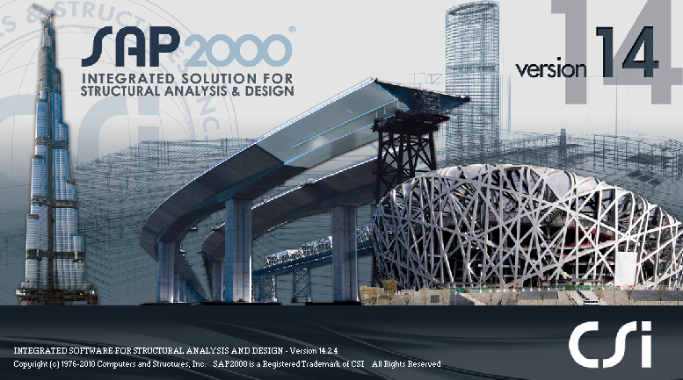
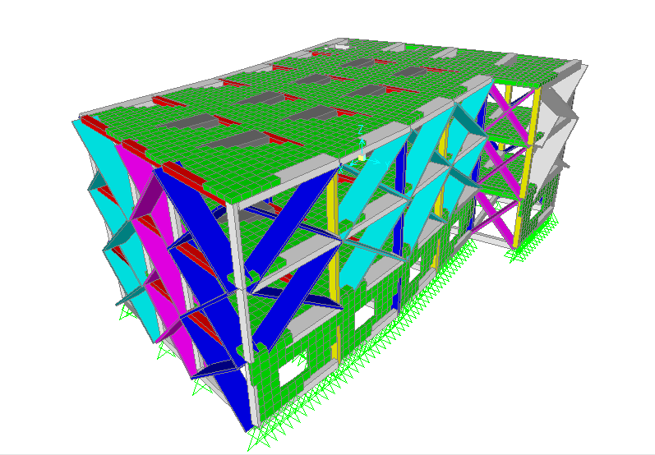
structural design
Building Engineering
The structural design was made by SAP program
3D modeling
Graduation Project

Slide 32
structural design
Building Engineering
Design Codes:
The structural design will be according to :
1) the American Concrete Institute code ACI 318-08 .
2) the seismic design according to UBC-97.
Design will include the following elements :
1) slab ( one way rib slab).
2) beam .
3) column .
4) shear wall.
5) footing.
Graduation Project

Slide 33
structural design
Building Engineering
Design data
Compressive strength of concrete (f\c)
beams
shear walls
columns
footing
f\c =28 Mpa
slabs
f\c =24 Mpa
2. Yielding strength of steel (fy)
steel for flexure , fy = 420 Mpa
shear reinforcement , fys = 420 Mpa.
3. Bearing capacity of soil= 2Kg/cm².
Graduation Project

Slide 34
structural design
Building Engineering
4. Unit weights of materials:
Unit weight (kN/m3) | Material
25 | Reinforced concrete
12 | Light weight block
27 | Masonry stone
18 | Sand
23 | mortar
12 | Tile
Graduation Project

Slide 35
structural design
Building Engineering
Methods of analysis:-
The ultimate design method
The working design method
Preliminary dimensions
Slab thickness= 35 cm
Beam dimension
Main beam internal→ (35*100) cm
Main beam external→ (35*90) cm
Main beam drop → (60*500) cm
Secondary beam→ (30*50) cm
Column dimension
Column dimensions were taken from plans
Column 1→ (40*30) cm
Column2→ (70*30) cm
Graduation Project

Slide 36
structural design
Building Engineering
Loads
Superimposed dead load= 4 KN/m²
Live load =5 KN/m²
Weight of external walls=28 KN/m
SAP MODEL
Graduation Project

Slide 37
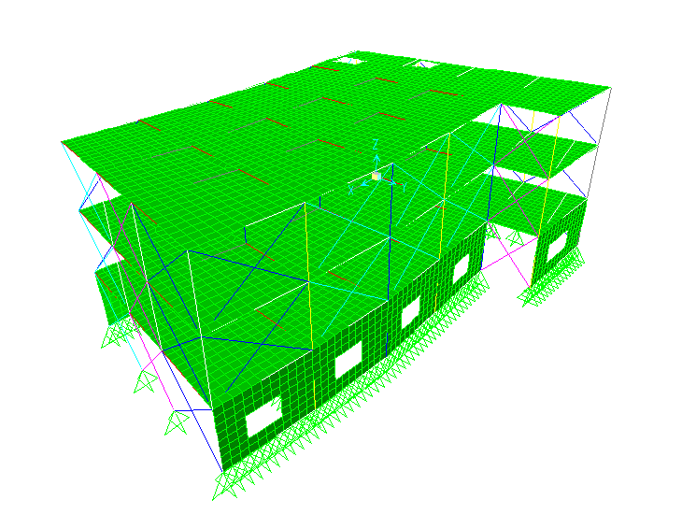
structural design
Building Engineering
Checks for SAP model
Compatibility check
Graduation Project

Slide 38
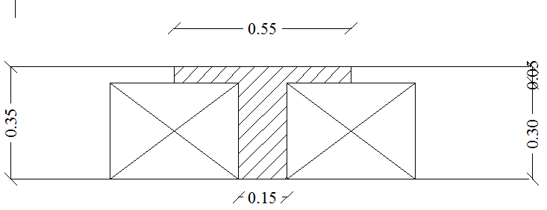
structural design
Building Engineering
Design
Slab design
Slabs are designed as one way ribbed slab with thickness =35cm
Graduation Project

Slide 39
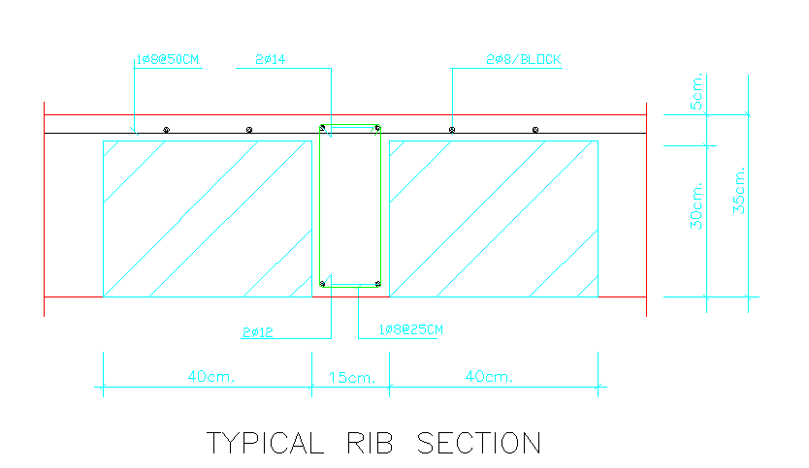
structural design
Building Engineering
Flexural design for slab
Graduation Project

Slide 40
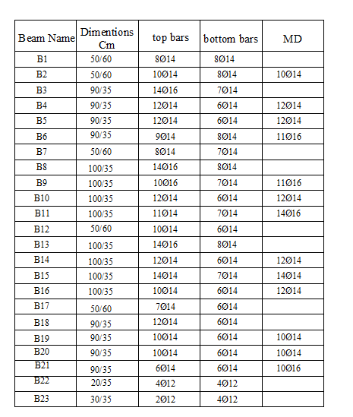
structural design
Building Engineering
Beams design
Graduation Project

Slide 41
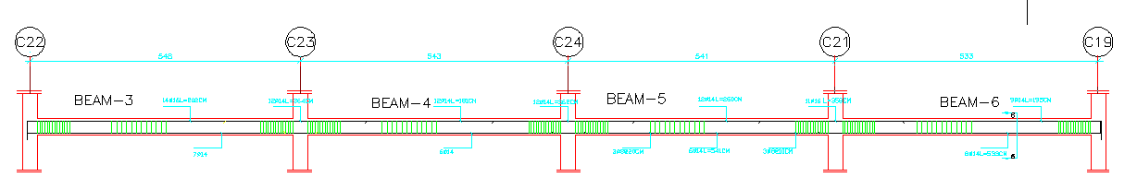
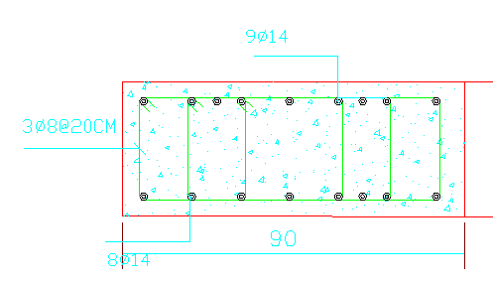
structural design
Building Engineering
Beams design
Details for main beam(35*90)
Graduation Project

Slide 42
structural design
Building Engineering
column design
Group | Dimension (mm) | ρ | Area of steel(mm²) | Number of bars
C1 | 300*400 | 1% | 1200 | 10 Ø 12
C2 | 300*700 | 1% | 2100 | 12 Ø 16
Graduation Project

Slide 43
structural design
Building Engineering
footing design
All footing are designed manually by working design method, reactions were taken from SAP model, all calculations were made by excel. the following table shows the design details of footings.
GROUP | TYPE | COLUMNS | PU | DIM(m)
F1 | ISOLATED | 6,5,3,8,14,23,1,24,25,26,20 | 1300 | 2.4*2.1*0.5
F2 | ISOLATED | 22 | 1600 | 2.6*2.0*0.5
F3 | COMPINED | (16,9),(17,10),(18,11) |  | 8.4*2.5*0.8
Graduation Project

Slide 44
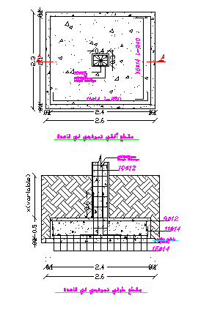
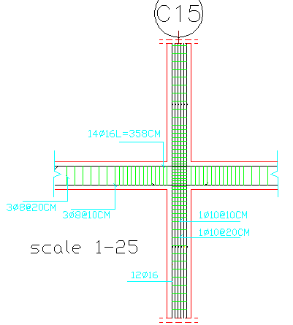
structural design
Building Engineering
Columns and footing design
Details of columns(col.2)
Graduation Project

Slide 45
structural design
Building Engineering
Shear wall design
ACI code 318 chapter 14 is used to design this shear wall ,all moment and forces are taken from SAP.
The cross section of shear wall is designed as three zones ,two on the sides of the shear wall which are designed for tension, the third is in the middle of the cross section which designed for axial loads.
Graduation Project

Slide 46
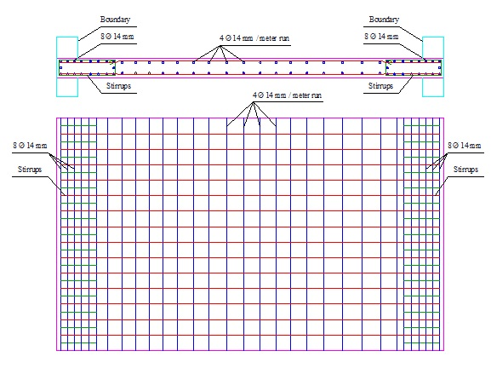
structural design
Building Engineering
Shear wall design
Graduation Project

Slide 47
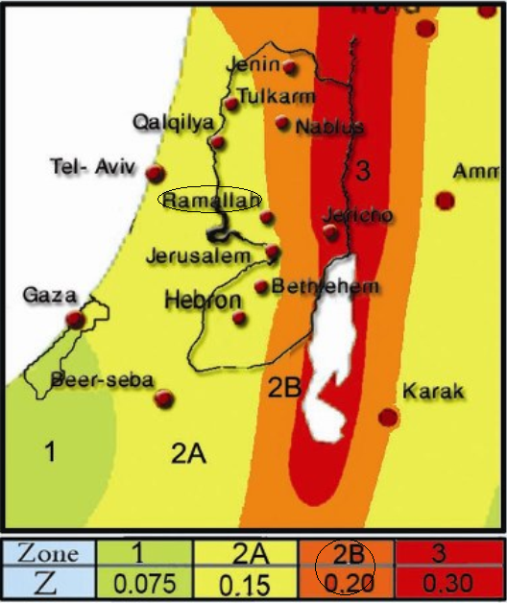
structural design
Building Engineering
Seismic analysis and design
The building frame system is assumed as (shear walls ,concrete, masonry) so the structural system factor equal(3.5) ,this factor was taken from seismic tables .
The soil in the building zone is rocky soil with allowable bearing capacity equals(2)Kg/cm²,according to the previous data about soil ;the soil profile is(Sc).
*The seismic coefficient (Ca)=0.24
*The seismic coefficient (Cv)=0.32
Graduation Project

Slide 48
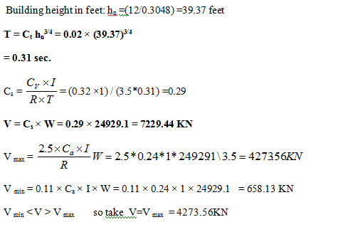
structural design
Building Engineering
*Seismic checks:
Base shear
Vs min<Vs<Vs max
Graduation Project

Slide 49
structural design
Building Engineering
Fundamental period of structure(T)
In this check period calculated manually was compared with period that results from SAP model from mode one.
Manual period= 0.31 sec
SAP period For First mode = 0.24 sec
Graduation Project

Slide 50
structural design
Building Engineering
Major concerns at 30% of project that applied into plans
provides expansion joints .
Graduation Project

Slide 51
structural design
Building Engineering
Major concerns at 60% of project that applied into plans
The results of the soils bearing capacity tests are taken into consideration in the design of the foundation system.
Graduation Project

Slide 52

electrical and mechanical design
Building Engineering
LIGHTING
DIALUX software was used to design the lighting system
Artificial lighting
Emergency lighting
Natural lighting
Graduation Project

Slide 53
electrical and mechanical design
Building Engineering
Lighting design
Natural lighting
All of illuminance value are reduced to the half to take into account the natural lighting
For artificial lighting
Technical values for design
illuminance value(Lx)
2. Work plane
Type of room | Luminance at work plan(lux)
الفحص | 500
ساونا | 200
انتظار | 150
الاخصائيين | 300
الممرات | 150
المطبخ | 300
غرفة الحاسوب | 300
قاعة المحاضرات | 300
Function | Height
Offices | Desktop-75cm
Corridors | 150cm
Graduation Project

Slide 54
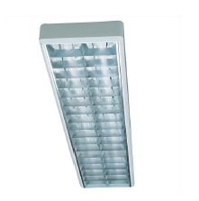

electrical and mechanical design
Building Engineering
Lighting design
Artificial lighting
Florescent lamp
GE LIGHTING 43036 T8 2x36W / 6 EB LL
DIAL 11 R2600/158 P8
BEGA 5127 2 TC-D 26W
Graduation Project

Slide 55
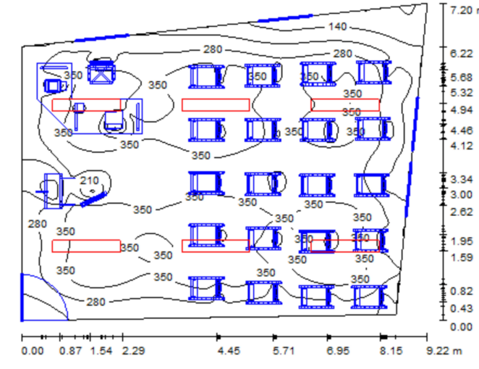
electrical and mechanical design
Building Engineering
Lighting design
Artificial lighting
SAMPLE:. Class room
Illumenance =300 lux
Work plane =75cm
DIAL 11 R2600/158
#of lamps=6 lamps
Laminar distributed
Graduation Project

Slide 56
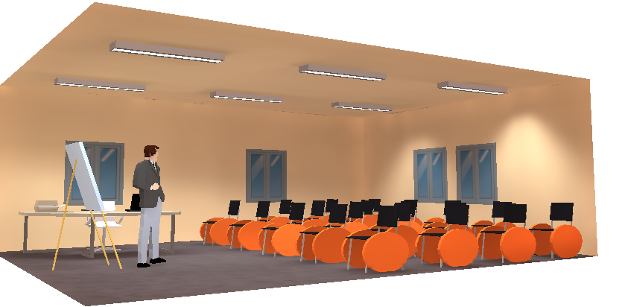
electrical and mechanical design
Building Engineering
Lighting design
Artificial lighting
SAMPLE:. Class room
Average illuminances[lx] = 305 lux
Graduation Project

Slide 57
electrical and mechanical design
Building Engineering
Lighting design
Emergency & information lighting
Emergency Escape Lighting
Emergency Escape Lighting were used in this building to ensure the general safety by ensuring all means of escape which can be safely and effectively used at all times by providing this lighting
Design of emergency lighting
At each intersection of corridors.
At each exit door.
On each staircase so that each flight of stairs receives direct light.
Graduation Project

Slide 58
electrical and mechanical design
Building Engineering
Major concerns at 60% of project that applied into plans
main board of circuit breakers is placed in a safe and visible location.
design provides for a sufficient number of luminaries to provide the required illumination intensity.
design provides for a circuit breaker for each power plug in kitchens as well as for all room light switches.
Graduation Project

Slide 59
electrical and mechanical design
Building Engineering
Major concerns at 60% of project that applied into plans
design provides for lighting switches adjacent to access points.
design provides for a sufficient number of power plugs to avoid the use of extension cords.
Graduation Project

Slide 60
electrical and mechanical design
Building Engineering
Mechanical design
Elevator design
Fire fighting & emergency stairs
Sanitation system
Clean water.
Grey water.
Black water.
Rain water.
Graduation Project

Slide 61
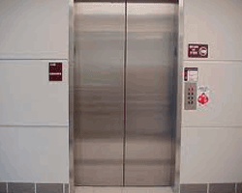
electrical and mechanical design
Building Engineering
A-Elevator design system
The design consists two things:
The type of the elevator
The number of the elevator
The type of the elevators
Hydraulic Elevator with 8 person capacity
Graduation Project

Slide 62
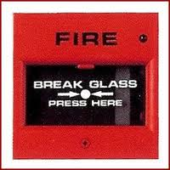
electrical and mechanical design
Building Engineering
B. Fire fighting & emergency stairs
Fire alarm system and fire protection system were designed for the building, since Saving lives is a primary consideration in the event of fire within buildings
Fire Alarm
1.Fire alarm systems manual.
2. Smoke detector
Graduation Project

Slide 63
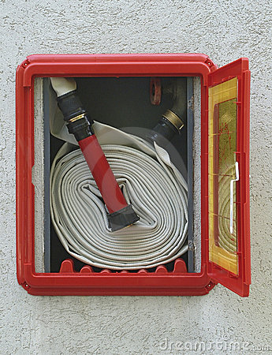
electrical and mechanical design
Building Engineering
B. Fire fighting & emergency stairs
protection system
fire hose system(hose wheel).
Sprinklers.
Graduation Project

Slide 64
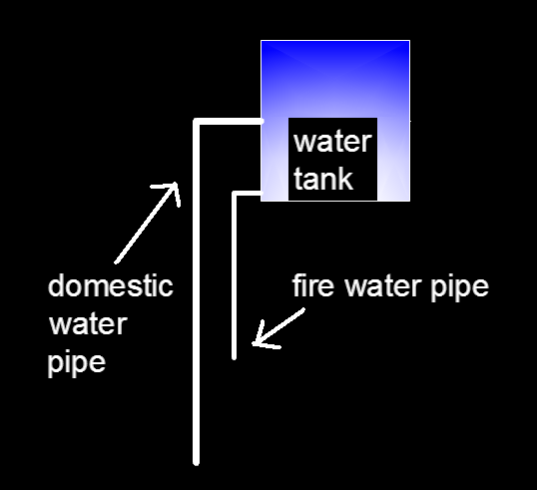
electrical and mechanical design
Building Engineering
B. Fire fighting & emergency stairs
protection system
The water which well be used for fire is from the domestic roof tank where the opining pipe of the fire water at the bottom of the tank and the pipe of domestic used is at the middle.
Graduation Project

Slide 65
electrical and mechanical design
Building Engineering
B. Fire fighting & emergency stairs
Fire emergency stairs
The basic stairs are also used as emergency stairs so the emergency stairs are tow interior stairs with not more than 30m between them, the stairs providing fire protected door.
Graduation Project

Slide 66
electrical and mechanical design
Building Engineering
Mechanical design
Sanitation system
Clean water
Grey water
Black water
Rain water
Graduation Project

Slide 67
electrical and mechanical design
Building Engineering
Sanitation system
Clean water
Feed water to buildings divided into two main sections:
cold water supply.
hot water.
(Gravity down feed system).
Graduation Project

Slide 68
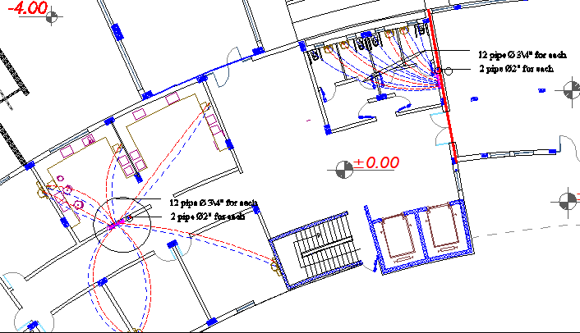
electrical and mechanical design
Building Engineering
Sanitation system
Clean water
Graduation Project

Slide 69

electrical and mechanical design
Building Engineering
Sanitation system
rainwater
Graduation Project

Slide 70
electrical and mechanical design
Building Engineering
Sanitation system
Drainage Systems.
Black water :WCS & kitchen sink
Grey water : lavatory
diameters of the pipes =4” (for stack)
Vent :to maintain the air pressure inside the drainage network
Graduation Project

Slide 71
electrical and mechanical design
Building Engineering
Major concerns at 60% of project that applied into plans
Design provides for manholes for maintaining and cleaning the sewage system, especially at the corners.
Design provides for two different drainage lines of waste water; one for gray water and one for hand washing.
Design provides for sufficient numbers of drainage traps at the roof.
Graduation Project

Slide 72
electrical and mechanical design
Building Engineering
Major concerns at 60% of project that applied into plans
Design provides for ventilating stacks to maintain both pressure and siphonage, and avoid foul air entering the space.
Design provides for shutoff valves for each hot and cold riser, as well as for all branches.
Graduation Project

Slide 73
hvac design
Building Engineering
HVAC system
Information design
Parameters | Winter | Summer
T_{in} | 22 C° | 24 C°
T_{out} | 6C° | 35 C°
Φ_{in} | 50 % | 65 %
Φ_{out} | 70 % | 65 %
W_{in} | 8.2 (g/Kg dry air) | 12.1(g/Kg dry air)
W_{out} | 4.7(g/Kg dry air) | 21(g/Kg dry air)
T_{un.} | 15.15 C° | 30.46 C°
T_{ground} | 13.3 C° | 38.7 C°
Graduation Project

Slide 74

hvac design
Building Engineering
HVAC system
Heating Load calculations by Ecotect
The maximumm heating load
Graduation Project

Slide 75
hvac design
Building Engineering
Major concerns at 60% of project that applied into plans
design provides for dividing the HVAC ducting distribution through valves for ease of maintenance.
design provides for a fan coil unit in the corridors at each floor level.
design provides for insulating all chilled water pipes to avoid any water leakages as well as condensation problems.
Graduation Project

Slide 76

Mohammad Nori
Iyad Hunnon
Iyad Abd-Alhafez

