Slide 1
Smart Glove for Sign Language
Smart Glove for Sign Language
Presented By:
ENG. AHMED AL-SADEQ
ENG. FAIQ ZEIDAN
Presented By:
ENG. AHMED AL-SADEQ
ENG. FAIQ ZEIDAN

Slide 2
Introduction
Breaking Barriers in Sign Language Communication
Approximately there’s 170 million people worldwide have speech impairments that impact clear communication.
Because there’s A lack of universal understanding creates a "silent wall" between users and the general public.
So we create A wearable solution that translates motion into speech in real time.
Our Vision: Creating an affordable, portable bridge for social and educational inclusion.

Slide 3
Problem & Objective
Sign language is a primary means of communication for individuals with hearing and speech impairments
communication barriers still exist between sign language users and the general public.
This project presents the design and implementation of an AI-based smart glove for real time sign language recognition.
Our project utilizes a wearable gloves equipped with flex sensors and inertial measurement units “IMU” to capture finger bending and hand motion data. Sensor readings are processed using an embedded ESP32 microcontroller, where a lightweight TinyML model performs gesture classification locally without the need for internet connectivity.

Slide 4
Project Overview
A supervised machine learning approach is adopted, in which sensors data is collected, preprocessed, and used to train a neural network capable of recognizing predefined sign language gestures.
The trained model is converted to a TensorFlow Lite format and deployed on the ESP32 for efficient real time inference.
Recognized gestures are transmitted wirelessly to a mobile application via Bluetooth Low Energy “BLE”,
where they are displayed as text and converted into speech. An additional application level processing layer is introduced to arrange recognized words into meaningful sentences.

Slide 5
Our project demonstrates the feasibility of integrating artificial intelligence, embedded systems, and TinyML to develop an efficient assistive technology solution. The Smart Glove offers a low cost, portable, and privacy preserving approach for sign language interpretation, with potential applications in daily communication, education, and social inclusion for the speech impaired community.

Slide 6
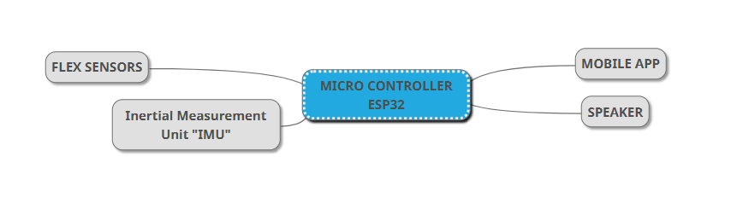
Block Diagram

Slide 7
Our project consists of two wearable smart gloves with sensor technology plays a key role in capturing hand gestures accurately.
Each glove contains multiple flex sensors and IMU integrated to measure different aspects of hand movement
With two ESP32 microcontroller, one of them acts as master receiving data wirelessly from the second glove

Slide 8
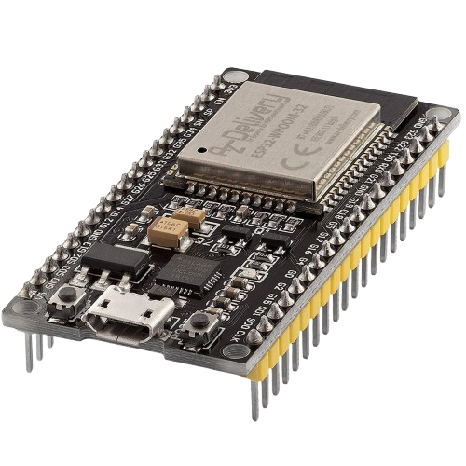
Components
ESP 32
We chose ESP 32 as the core processing unit of the system to use it because it offers several advantages such as:
Integrated Wi-Fi and Bluetooth Low Energy “BLE” eliminating the need for external communication modules.
High processing capability with a dual core processor suitable for real time sensor data handling.
Low power consumption making it ideal for wearable applications.
Large number of GPIO pins supporting analog, digital, I2C, SPI, and UART interfaces.
Built in support for ESP-NOW enabling fast and reliable wireless communication between the two gloves.

Slide 9
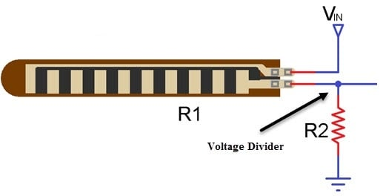
2- Flex Sensors
These sensors change their resistance when bent and are commonly used to measure finger curvature. The resistance variation is converted into voltage signals using voltage divider circuits, allowing the microcontroller to read finger positions.
Advantages of Flex Sensors:
Flexible and light weight makes it suitable for wearable gloves.
2. It provides continuous analog output allowing precise measurement of finger movement.
3. Easy to interface with microcontrollers using simple voltage divider circuits.
4. Low cost and low power consumption. Overall Flex sensors enable accurate detection of finger gestures, which is essential for sign language recognition.

Slide 10
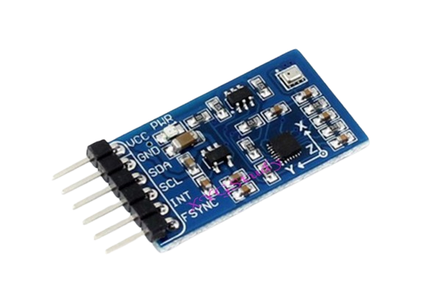
3- Inertial Measurement Unit “IMU”
IMUs combine accelerometers and gyroscopes in a single module
improving motion tracking accuracy through sensor fusion techniques.
The combination of these sensors enables the system to capture both static gestures “finger positions” and dynamic gestures “hand movement and orientation”.
Advantages of IMU:
It provides 6 degrees of movements consists of 3 axis for accelerometer and 3 axis for gyroscope. The accelerometer tracks linear acceleration such as gravity, while the gyroscope measures rotational movement.
High sensitivity and accuracy for motion tracking.
Communicate digitally via the I2C protocol, reducing noise compared to analog sensors.
Small size and low power consumption.
IMU data complements flex sensor data by capturing dynamic hand movements and rotations.

Slide 11
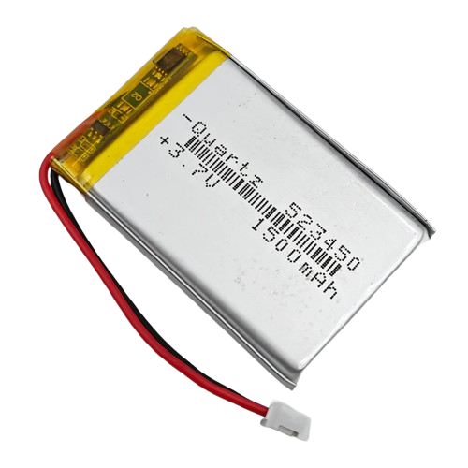
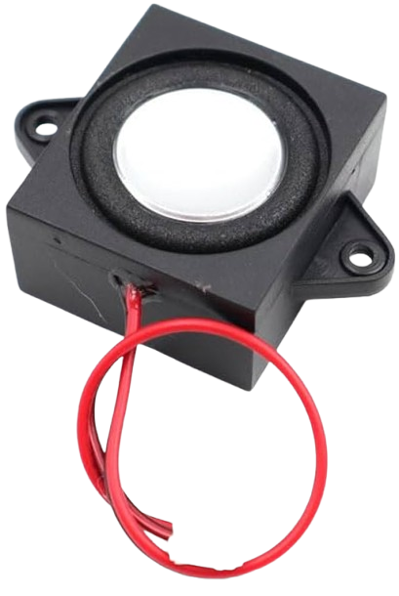
4- Lithium-Polymer (Li-Po) rechargeable battery
Each glove is powered by a 3.7V Lithium-Polymer (Li-Po) rechargeable battery, chosen for the following reasons:
High energy density relative to weight.
Compact size suitable for wearable devices.
Rechargeable and widely available.
Capable of supplying sufficient current for ESP32 operation.
Compatible with common charging ICs.
5- Speaker
Used as an output for the project and it receives the sentences from the mobile application after processing and then broadcasting them.

Slide 12
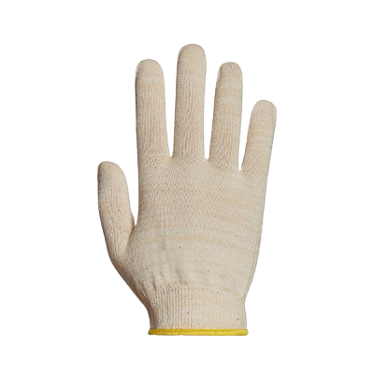
6- Spandex or Lycra Gloves
The best gloves for attaching the Flex sensors should be thin, flexible and breathable fabric, all these requirements are found in Spandex or Lycra.
7- Mobile Application Receives the data collected from Flex sensors and IMU then processing it to generate words and sentences then transfer the final result to the speaker.

Slide 13

Power Supply and Battery Management System
The smart glove is powered by a 3.7V lithium-polymer rechargeable battery integrated into each glove.
Buck-Boost Converter
Because the battery voltage varies between 3.0V and 4.2V, a high-efficiency buck-boost DC-DC converter is employed to generate a regulated 3.3V supply for the ESP32 microcontroller and all connected sensors.
Switching regulators were selected over linear regulators to minimize power losses and extend battery lifetime.

Slide 14
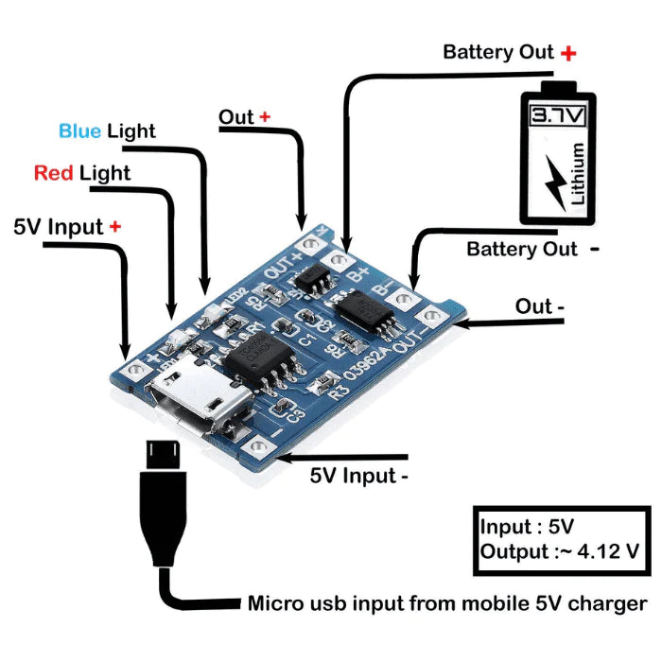
Battery charging is achieved using a TP4056-based charging module powered from a standard 5V USB input. The charger incorporates dedicated protection circuitry against over-charge, over-discharge, over-current, and short-circuit conditions to ensure safe operation.
The estimated system current consumption ranges from 230 to 320 mA during active use, resulting in an expected operating time of approximately 5–7 hours when using a 1500 mAh battery.
Through the implementation of power saving techniques such as deep-sleep modes, adaptive sampling, and wireless duty cycling, the operating time can be extended beyond 8 hours.

Slide 15
System Architecture
Step
Step
Step
Data Acquisition
Wireless Communication
Data Processing Pipeline
Each ESP32 collects analog data from flex sensors and digital motion data from the IMU using the I2C protocol. Sampling is performed at a fixed rate to
ensure consistency.
ESP-NOW is used for
inter glove
communication due to its low latency and
power efficiency.
Bluetooth Low Energy is used for communication with the mobile
application.
Sensor data undergoes filtering, feature
extraction,
normalization,
and classification
using machine learning models.

Slide 16
Data Processing Pipeline
Local Processing on ESP32
Inter Glove Data Synchronization
Data Transmission to Mobile Application
Mobile Application Data Processing
01
02
03
04
05
Output Generation
Each ESP32 performs initial data processing to reduce noise and minimize wireless bandwidth usage
Wireless communication between the two gloves is achieved using ESP-NOW protocol. Each data packet includes a timestamp to allow synchronization between left and right hand data. The master ESP32 aligns incoming packets and merges them into a single feature vector representing both hands.
Master ESP32 operates as a BLE server. The mobile application connects as a BLE client and subscribes to a custom characteristic used for streaming gesture data.
The mobile application receives BLE packets and processes them

Slide 17
Data Collection and Preparation Methodology
1
Definition of Gesture Classes
Defining the gesture classes to be recognized by the system.
Word-based gesture classification scenario such as: Hello, Thanks, Yes,
Each class is recorded multiple times to ensure dataset diversity.
2
Glove Preparation for Data Recording
The glove is prepared with the following hardware components:
10 Flex Sensors Provide analog readings corresponding to finger bending
2 IMU Sensors Each IMU provides: Accelerometer (AccX, AccY, AccZ) Gyroscope (GyroX, GyroY, GyroZ)
The total number of sensor values per sample is: 10 Flex + 12 IMU = 22 values per sample
3
Code Development for Data Acquisition
1. Read all 22 sensor values at a fixed sampling rate
2. Apply basic filtering to reduce noise
3. Transmit the sensor readings via Serial communication
4. Format the output in a structured, comma-separated format (CSV-compatible)
4
Data Recording on Computer
The transmitted serial data is captured on a computer using serial monitoring tools. The data is saved as CSV files, where: 1. Each row represents one sample
2. Each column corresponds to a specific sensor value
3. An additional column is used to store the gesture label

Slide 18
Data Collection and Preparation Methodology
5
Repeated Data Collection
To improve dataset robustness and variability, data recording is repeated multiple times while:
6
Data Cleaning
The collected dataset is cleaned to remove inconsistent or invalid samples:
7
Data Normalization
To ensure uniform scaling across all sensors,1. Minimum and maximum values are calculated for each sensor 2. All values are scaled to a range between 0 and 1 using min–max normalization This step improves machine learning performance and training stability.
8
Dataset Preparation for Training
Shuffling the data randomly 2. Splitting the dataset into training and testing subsets 3. Formatting the data according to the requirements of the selected ML framework
9
Model Training and Conversion to TinyML
A machine learning model is trained using the prepared dataset. After achieving satisfactory performance: 1. The trained model is saved 2. The model is converted into a TinyML-compatible format 3. The optimized model is deployed either on the ESP32 or within the mobile application

Slide 19

Artificial Intelligence Methodology and
System Implementation
The integration of AI enables the system to
automatically learn gesture patterns from sensors data and perform accurate real time classification. We will discuss the data acquisition, preprocessing, model design, training, TinyML deployment, and system level integration.
Problem Formulation
The Smart Glove system addresses a supervised learning classification problem.
The objective is to map multidimensional sensor data obtained from the glove to a predefined set of sign language gestures. Let:
X ∈ R^22 be the input feature vector representing sensor readings.
Y ∈ (1,2,...,C) be the gesture class label.
The goal is to learn a function f(X) = Y that minimizes classification error while maintaining low computational complexity suitable for embedded systems.

Slide 20
Sensor Data Acquisition and Feature Representation
Sensor Configuration:
The glove integrates multiple sensors to capture hand motion and orientation consists of:
Ten flex sensors to measure finger bending angles.
Two Inertial Measurement Units (IMUs), each providing three-axis accelerometer and gyroscope data.
Feature Vector Construction Each gesture instance is represented by a 22-dimensional feature vector composed of 10 flex sensor values and 12 IMU values.
This representation preserves both static finger posture and dynamic hand movement information.
Gesture data is collected in real time while the user performs predefined sign language gestures wearing the glove.
For each gesture instance the ESP32 microcontroller samples all sensor values and transmits them to a host computer for storage. Each gesture class contains 100–200 samples stored in CSV format, ensuring sufficient variability and robustness.

Slide 21
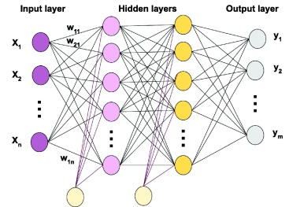
Data Preprocessing
All sensor readings are normalized using Min–Max scaling to ensure uniform feature scaling. Gesture labels are encoded numerically, and the dataset is split into training (80%) and testing (20%) subsets.
Machine Learning Model Design
A lightweight Multi-Layer Perceptron “MLP” neural network is selected due to its suitability for embedded systems and tabular sensor data. The network consists of an input layer with 22 neurons, two hidden layers (32 and 16 neurons), and an output layer corresponding to the number of gesture classes.

Slide 22
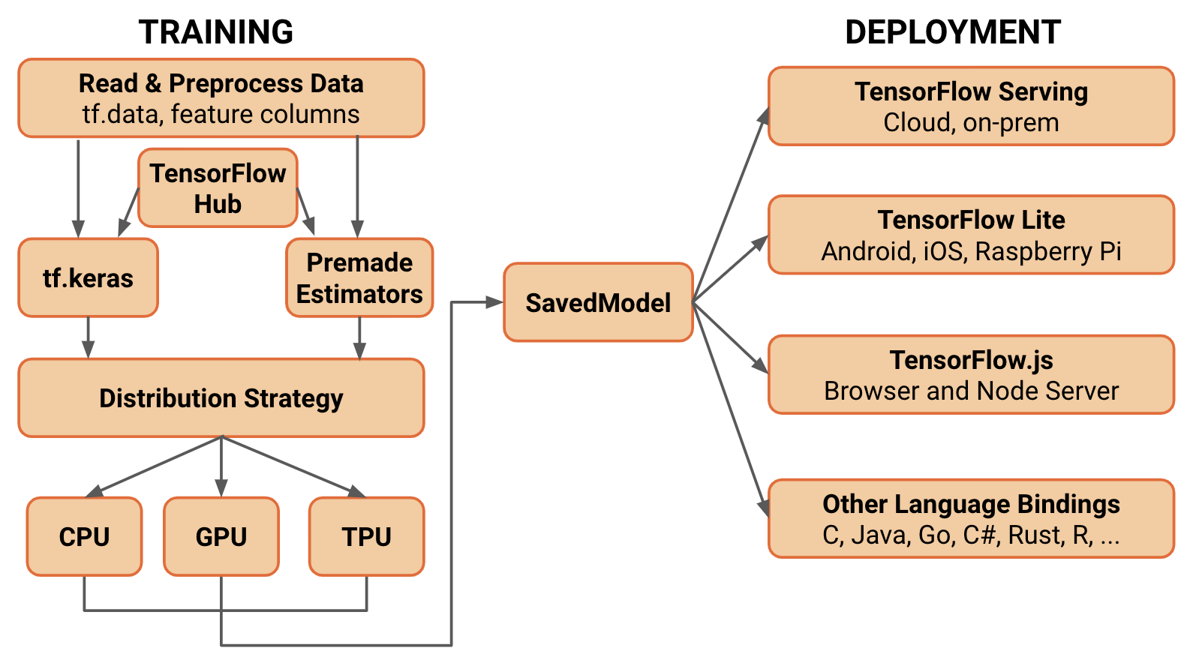
Model Training and Evaluation
The model is trained offline using TensorFlow/Keras with categorical cross entropy loss and the Adam optimizer. Model performance is evaluated using classification accuracy on the testing dataset.
TinyML Deployment on ESP32 The trained model is converted to TensorFlow Lite format, quantized to INT8 precision, and embedded into the ESP32 firmware as a C array. During operation, the ESP32 performs sensor sampling, normalization, inference, and gesture classification in real time.
Communication and Application-Level Processing The predicted gesture is transmitted to a mobile application via Bluetooth Low Energy “BLE”.
The application displays the recognized word and send it back to the glove to converts it to speech.
Sentence Formation and Contextual Processing Recognized words are buffered and processed using rule-based natural language techniques to generate grammatically correct sentences, improving communication effectiveness.

Slide 23
Results and Analysis
We faced a lot of difficulties while simulating our project including the lack of simulation programs and the existing programs are missing some components
So we used TinkerCad and used Arduino UNO as process unit instead of ESP 32 and we didn’t find the IMU and speaker so we used LCD screen to display the results, overall we obtained promising results.

Slide 24
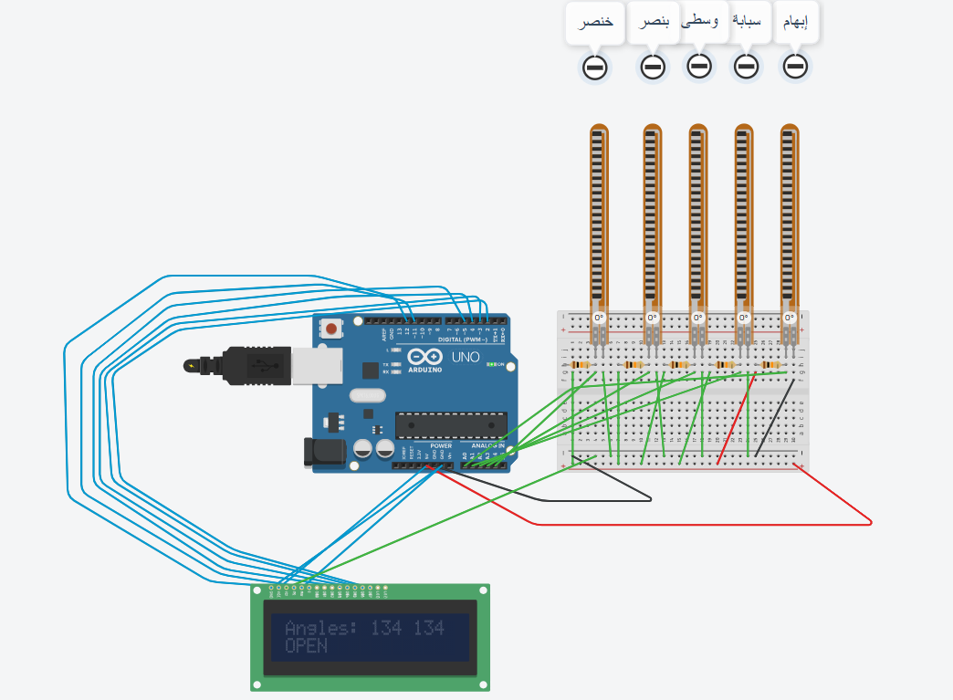
Simulation Circuit Diagram

Slide 25
some results from the circuit we build

Slide 26
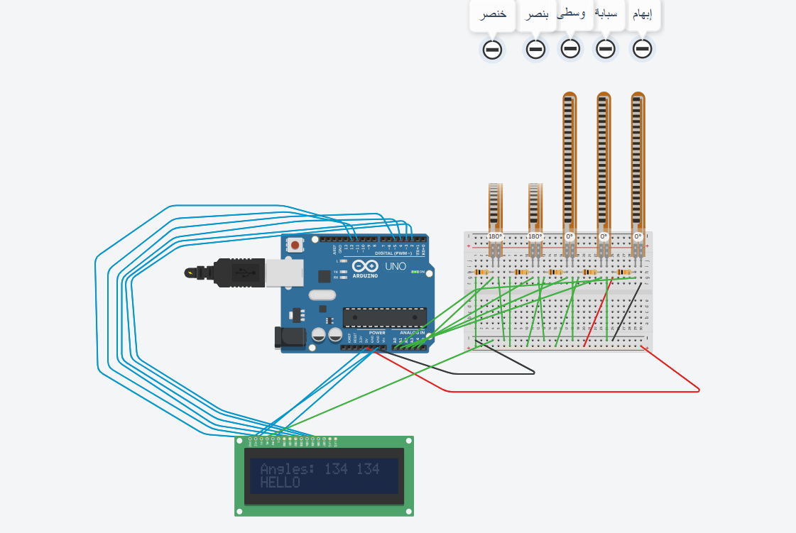
some results from the circuit we build

Slide 27
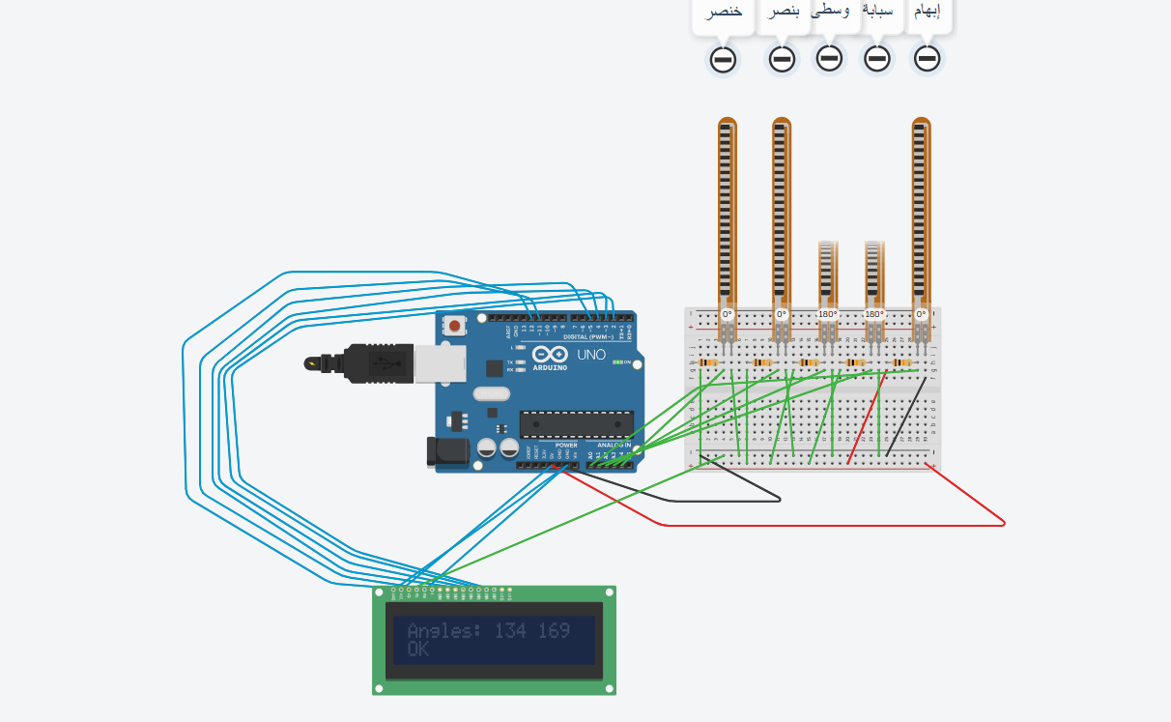
some results from the circuit we build

Slide 28
Flex Sensors
Estimated Cost:
63 NIS per pcs
Flex Sensors : 630
IMU : 114
ESP32: 96
Lithium-Polymer Battery : 48
TP4056-based charging module: 60
TOTAL: 948 NIS
IMU
Flex Sensors
IMU
57 NIS per pcs
Lithium-Polymer Battery
ESP32
Lithium-Polymer Battery
24 NIS per pcs
ESP32
48 NIS per pcs

Slide 29
Standards and Constraints
Engineering Standards
Embedded Systems Standards
modular design, efficient resource utilization, and real-time operation.
Software Quality Standards
Software development practices are guided by ISO/IEC 25010, which defines quality characteristics such as reliability, efficiency, maintainability, and usability.
Wireless Communication Standards
Bluetooth Low Energy (BLE) communication follows Bluetooth SIG specifications (Bluetooth 5.0), ensuring low power consumption, secure data transmission, and compatibility with modern mobile devices.
Artificial Intelligence and Ethical Standards
The AI component is developed in accordance with ethical AI principles, emphasizing transparency, fairness, and user safety. The system is designed to operate offline, preserving user privacy by preventing unauthorized data sharing.
Assistive Technology Standards
The project aligns with international assistive technology guidelines, including World Health Organization (WHO) recommendations, ensuring accessibility, inclusiveness, and usability for individuals with hearing or speech impairments.

Slide 30
Standards and Constraints
System Constraints
Hardware Constraints
The ESP32 microcontroller has limited processing power, memory, and storage capacity. These limitations restrict the complexity and size of the machine learning model, necessitating the use of lightweight TinyML architectures and quantized models.
Power Consumption Constraints
As the glove is a wearable device, power consumption is a critical constraint. All components, including sensors, microcontroller, and wireless communication modules, are selected to minimize energy usage and extend battery life.
Sensor Accuracy and Noise
Flex sensors and IMUs are subject to noise, drift, and calibration errors. These factors may affect data quality and classification accuracy, requiring preprocessing and normalization techniques to mitigate their impact.
Dataset Constraints
The performance of the AI model is directly influenced by the size and diversity of the collected dataset. Limited data samples or restricted user diversity may reduce generalization capability.
Real Time Processing Constraints
The system must perform gesture recognition in real time. This requirement limits computational latency and imposes strict timing constraints on data acquisition, preprocessing, and inference stages.
Future Work

Slide 31
Future Work
Expanding the gesture dataset
implementing advanced deep learning models for improved generalization
incorporating adaptive calibration techniques for different users.
Additional applications may extend to educational tools for learning sign language, healthcare communication aids, and human computer interaction systems where gesture based input is required.

Slide 32
THANK YOU
for your for your attention. We are happy to answer your questions

Slide 33
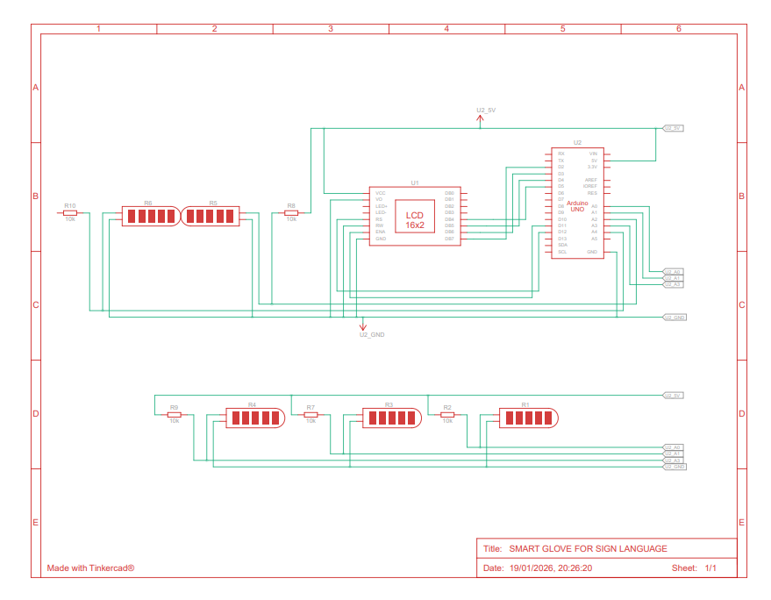
Simulation Schematic Diagram of the Circuit

