Slide 1
V5 Game Engine
By Mofeed Arafat

Slide 2



What is game engine?
A software that helps creating video games
Examples (Unity, Unreal Engine, CryEngine..)

Slide 3




What is our project ?
Its a framework library created with native C++
Its a core engine without GUI (GUI for future)
We used 3Ds max as external editor
Cross-platform (Android, iOS, Win, Mac and Linux)
Models
V5
Engine
C++ Game

Slide 4
How it works ?
Our engine created with native C++
CMake allows the developer to build on his/her favorite IDE
Game
Sound
Physics
Input
Occlusion
Culling
Texture
Packer
Index
Optimizer
Scene
Mesh
Gfx Core
DirectX
openGL

Slide 5
How it works ?
DirectX, openGL well known APIs
DirectX for Windows, Xbox and windows phone
openGL for windows, mac, linux, iOS and android
Windows, mac, linux and iOS tested
Game
Sound
Physics
Input
Occlusion
Culling
Texture
Packer
Index
Optimizer
Scene
Mesh
Gfx Core
DirectX
openGL

Slide 6
How it works ?
Graphics core
Shader, Render Target, Index Buffer, Vertex Buffer, Textures, Queries, Capabilities, Statistics, Render States and API calls
*FreeImage library used to load textures formats
Game
Sound
Physics
Input
Occlusion
Culling
Texture
Packer
Index
Optimizer
Scene
Mesh
Gfx Core
DirectX
openGL

Slide 7
How it works ?
Mesh contains 3D object and animation data
Scene is octree that holds game objects in 3D space
*Assimp Library used to support (43 file format)
(.fbx, .x, .3ds, .obj, .dxf) and more
Game
Sound
Physics
Input
Occlusion
Culling
Texture
Packer
Index
Optimizer
Scene
Mesh
Gfx Core
DirectX
openGL

Slide 8
How it works ?
Index Optimizer will optimize rendering and reduce draw calls
Draw calls are the most expensive calls
After years of research our approach combining between analysis and streaming meshes
Game
Sound
Physics
Input
Occlusion
Culling
Texture
Packer
Index
Optimizer
Scene
Mesh
Gfx Core
DirectX
openGL

Slide 9
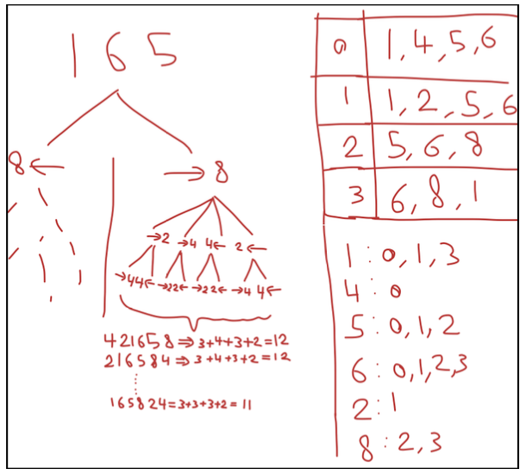

Slide 10
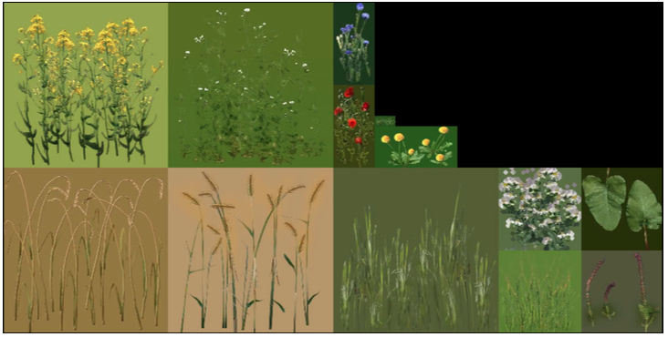
How it works ?
Texture Packer sorts Textures in one big texture pages, this will reduce expensive set texture operations on GPU
Support streaming (which can help in open large world games)
Game
Sound
Physics
Input
Occlusion
Culling
Texture
Packer
Index
Optimizer
Scene
Mesh
Gfx Core
DirectX
openGL

Slide 11
How it works ?
Occlusion culling reduces draw heavy draw calls by testing visibility (with occlusion queries)
After research our we came up with new technique that split screen to parts and test every part to adapted depth
Umbra Occlusion culling is commercial software
Game
Sound
Physics
Input
Occlusion
Culling
Texture
Packer
Index
Optimizer
Scene
Mesh
Gfx Core
DirectX
openGL
Notes:
No preload requirement
Umbra build large voxels tree and create a database before loading

Slide 12
How it works ?
Input helps developer to handle input events
touch screen (multi-touch location and state)
Mouse (location, buttons and scroll)
Keyboard
Game
Sound
Physics
Input
Occlusion
Culling
Texture
Packer
Index
Optimizer
Scene
Mesh
Gfx Core
DirectX
openGL

Slide 13
How it works ?
We used well known *Bullet Physics library which is very well optimized
Support various shapes
SIMD
Soon will support openCL
Game
Sound
Physics
Input
Occlusion
Culling
Texture
Packer
Index
Optimizer
Scene
Mesh
Gfx Core
DirectX
openGL

Slide 14
How it works ?
Sound allows developer to load sound files and play it (in 3D stereo)
Emitter and receiver location can be specified
R-L channels, volume and speed can be specified
*openAL, ogg libraries used (.wav, .ogg)
Game
Sound
Physics
Input
Occlusion
Culling
Texture
Packer
Index
Optimizer
Scene
Mesh
Gfx Core
DirectX
openGL

Slide 15
How it works ?
2 types Mobile and desktop window
Starting point where developer can write game class
Game
Sound
Physics
Input
Occlusion
Culling
Texture
Packer
Index
Optimizer
Scene
Mesh
Gfx Core
DirectX
openGL

Slide 16
What is our target ?
Compete other engines (Unity, Unreal ..)
Unity started with 5 developers
Unity wins the usability and loses performance
WE CAN DO IT !

Slide 17
Future work
Support GUI
Tablet drawing helper/viewer
Mobile controller
Scripting language
More optimization for open world games

