Slide 1

AN-Najah National University
Faculty of Engineering & Information Technology
Building Engineering Department
Group members:
Zaid Bozeyeh Bara Kabaha
Mahmoud Soleiman Mohammad Ameen
Supervisor Name: - Haitham Sawalha
Design of a Rehabilitation Center for People
with Special Needs in Nables city.
1

Slide 2
Table of Contents
1
Introduction
2
Site analysis
3
Architectural aspects
4
Structural aspects
5
Environmental aspects
6
Mechanical aspects
7
Electrical aspects
8
Quantity surveying
2

Slide 3
Introduction
In most of the designs for buildings in our community, the special needs category was ignored. In the west bank we have approximately 1500 people with special need , the project idea came to serve largest possible number of them .
3

Slide 4
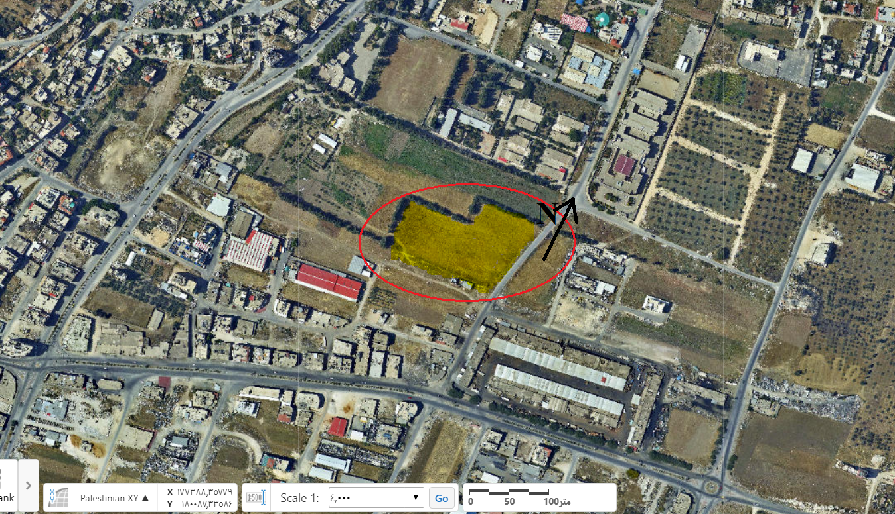
Site analysis
Location : It is located in East of Nables city near the Hesgham Hejawi Collage
and Shaikh Khalefa Training Center.
Site Area : 19000 m².
4

Slide 5
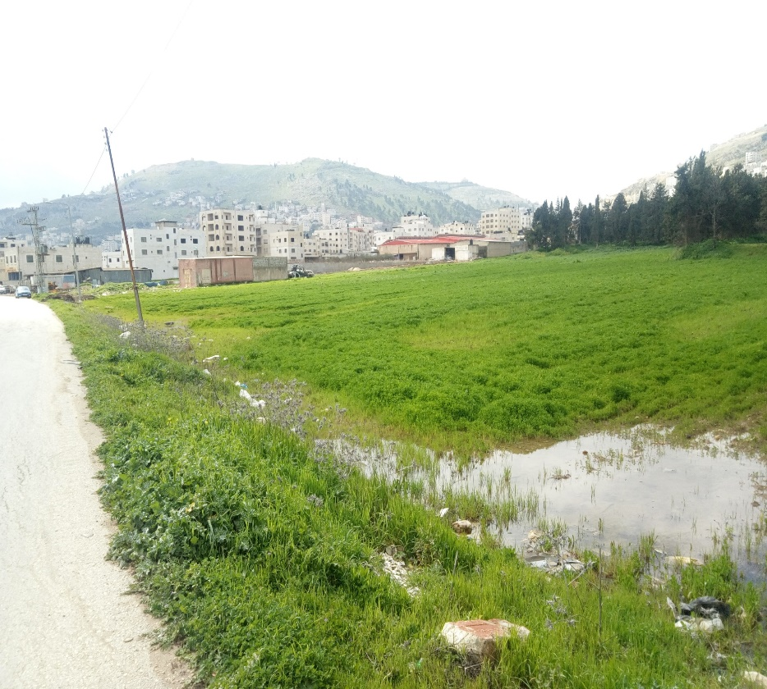
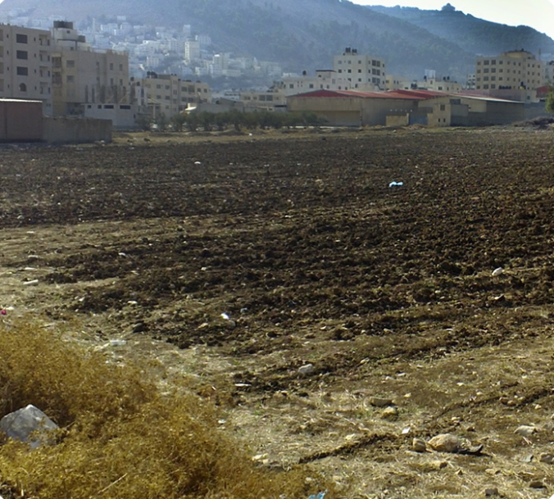
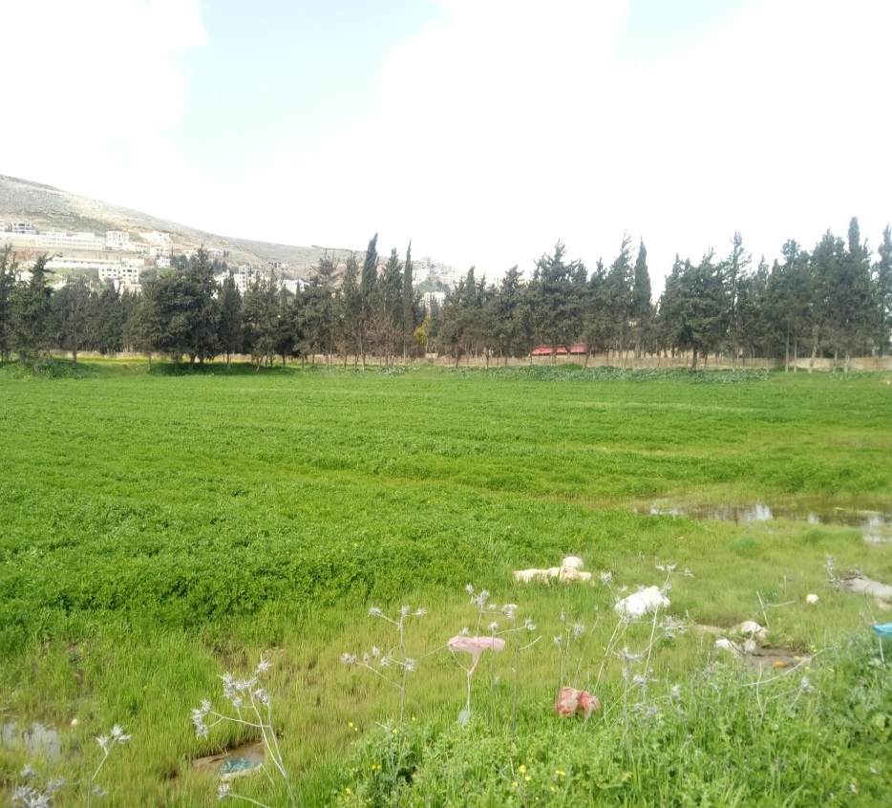
Site analysis
5

Slide 6
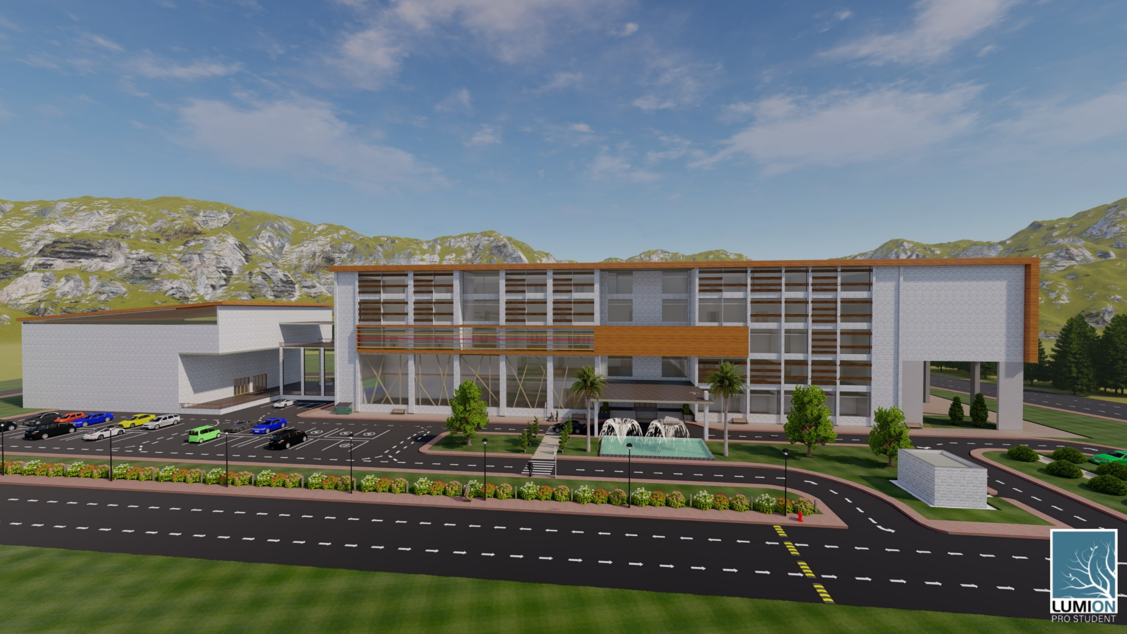
Architectural aspects
6

Slide 7
Architectural aspects
Project Description
First floor
5700 m2
second floor area
7000 m2
Third floor area
5200 m2
Forth floor area
5200 m2
Ground floor area
6700 m2
Basement
2300 m2
- 5 floors, in addition to basement
as a parking
- serves 800 people
- Total area of the building equals
to 32100 m2
7

Slide 8
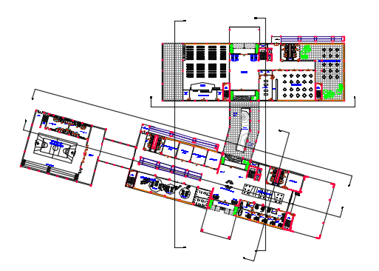
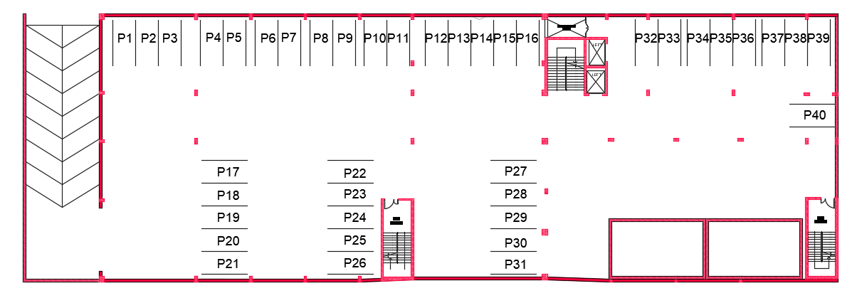
Architectural aspects
Project plans
Basement Floor plan
Ground Floor plan
8

Slide 9
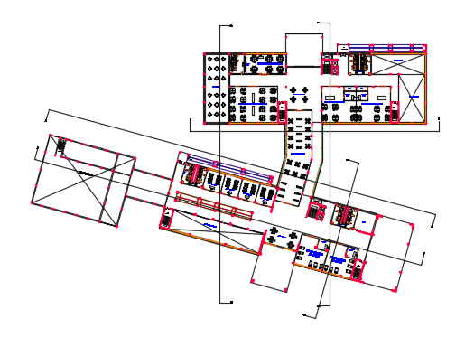
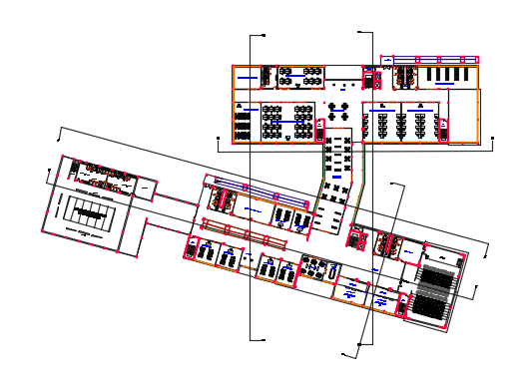
Architectural aspects
Project plans
First floor plan
Second floor plan
9

Slide 10
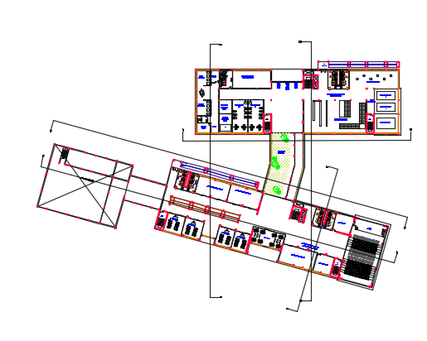
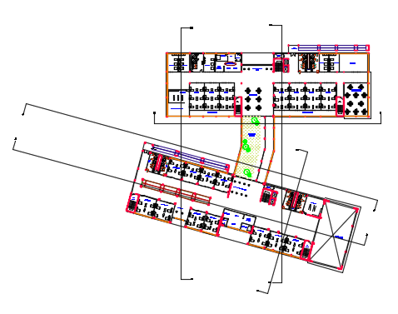
Architectural aspects
Project plans
Third floor plan
Fourth floor plan
10

Slide 11
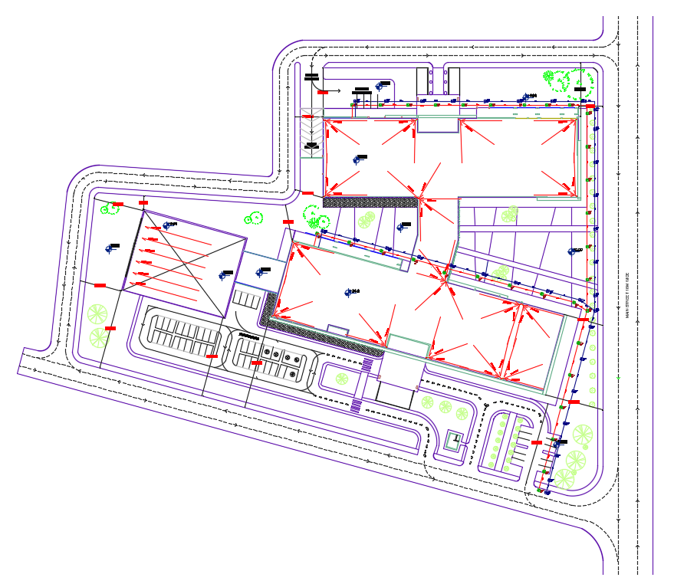
Architectural aspects
Project plans
Site plan
11

Slide 12
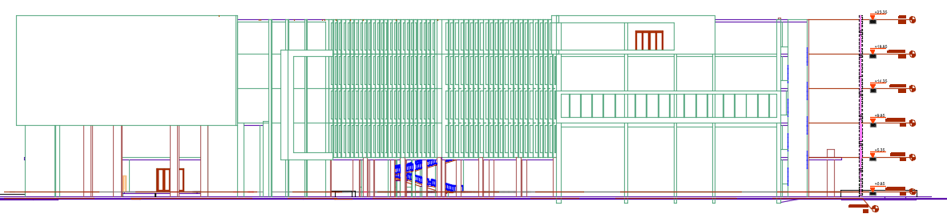
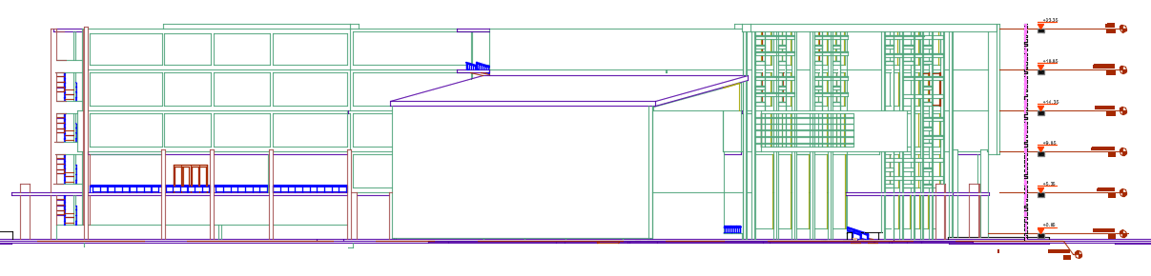
Architectural aspects
Project Elevations
East elevation
West elevation
12

Slide 13
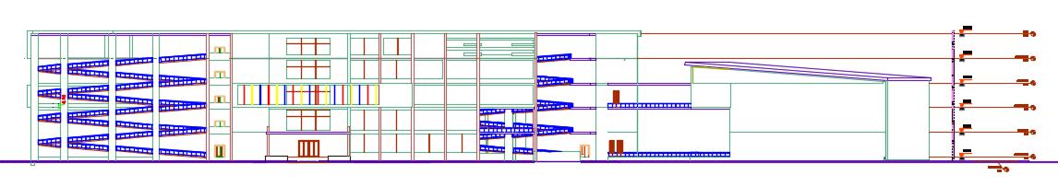
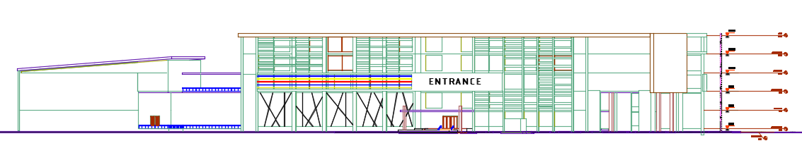
Architectural aspects
Project Elevations
North elevation
South elevation
13

Slide 14
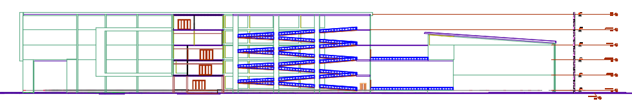
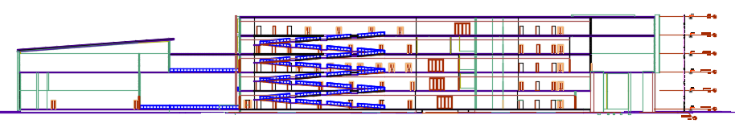
Architectural aspects
Project Sections
Section A-A
Section B-B
14

Slide 15
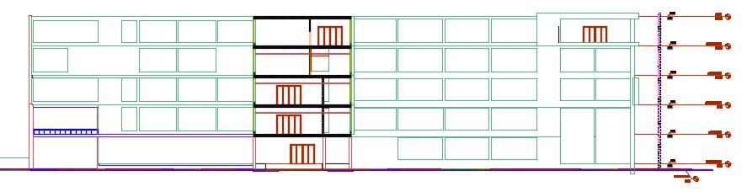
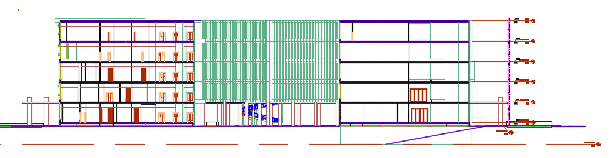
Architectural aspects
Project Sections
Section C-C
Section D-D
15

Slide 16
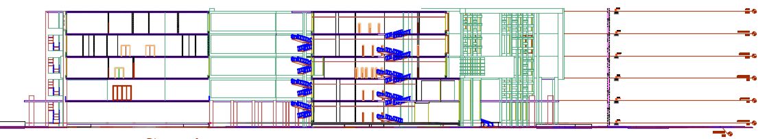
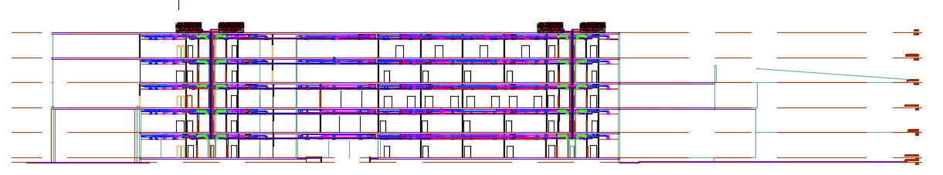
Architectural aspects
Project Sections
Section E-E
Section F-F
16

Slide 17
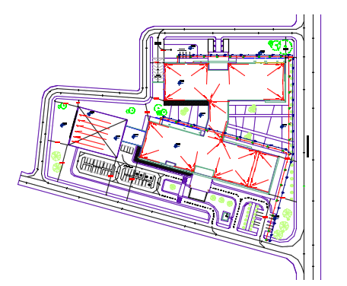
Architectural aspects
Parking
Width : for normal people 2.5m , for special needs 3.5m
Number of parking : 89 parking spaces shown in basement and site plan
Interior Parking in Basement plan
Exterior Parking in Site plan
17

Slide 18
Structural aspects
Structural Elements
Mat foundation
Shear walls
Columns
Slabs
Beams
Stairs and Ramps
Retaining walls
Water tanks
18

Slide 19
Structural aspects
General Information
Materials:
Concrete with compressive strength f`c=28 MPa.
Yield Strength of Steel Fy= 420 MPa.
Bearing capacity of soil = 150 KN/m².
Loads:
Live load = 5 𝐾𝑁/m².
SI.Dead load = 4 𝐾𝑁/m²
External wall load = 26 KN/m
Standards/Codes:
→ The American concrete institute code ACI 318-08
for reinforced concrete design
→ The Uniform Building Code -UBC-97
for seismic design and its load combinations
19

Slide 20

Structural aspects
Seismic analysis:
Seismic zone : 2B with (Z = 0.20) .
Soil profile : SD.
Acceleration-dependent seismic coefficients Ca=0.28.
Velocity-dependent seismic coefficients Cv= 0.40.
Importance factor I=1.
Force reduction factor R=5.5
20

Slide 21
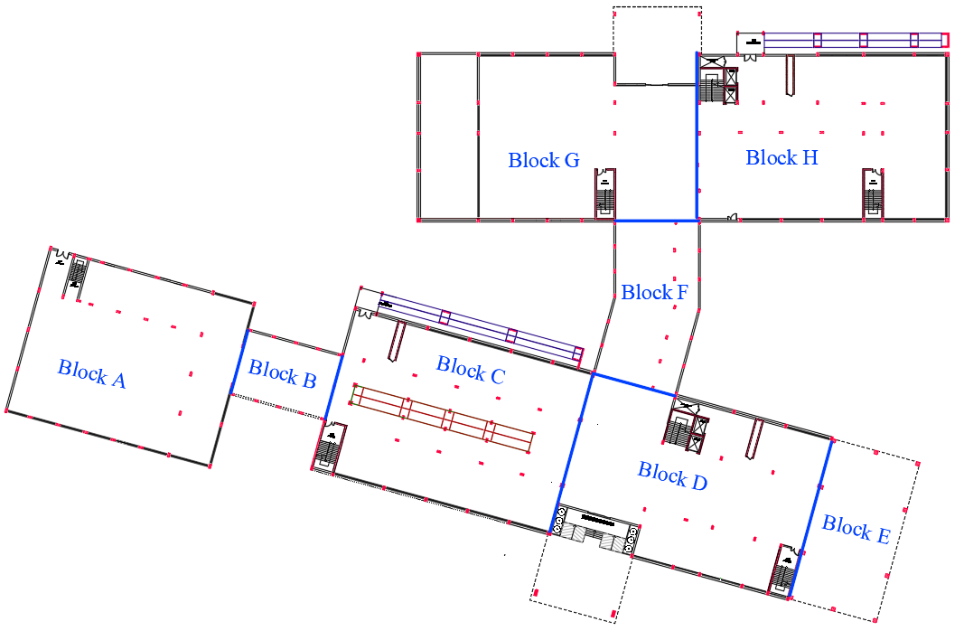
Structural aspects
Due to the size of the building, the building will be divided it into eight parts to create an expansion joints.
21

Slide 22
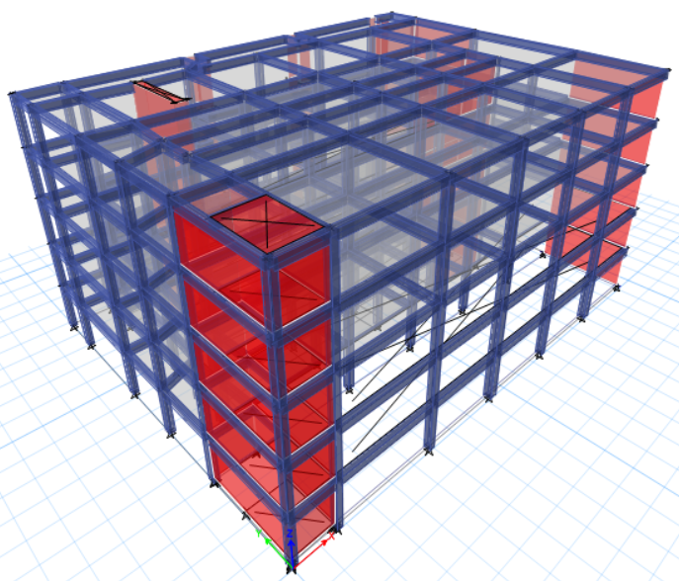
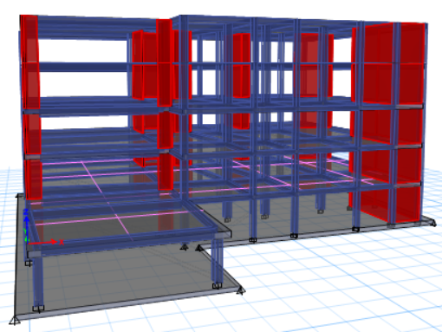
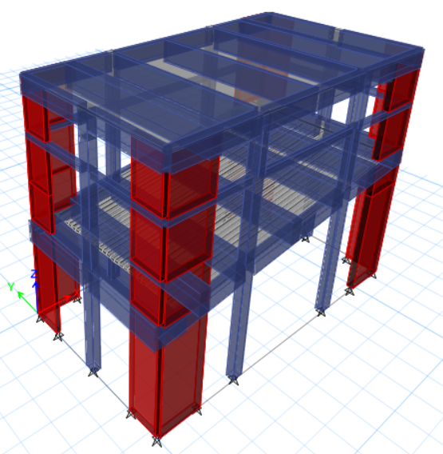
Structural aspects
ETABS Model
ETABS Model for Block C
ETABS Model for Block D
ETABS Model for Block E
22

Slide 23
Structural aspects
ETABS Checks
To ensure that the calculation is done correctly from ETABS; some checks are required :
ETABS Checks
Compatibility check
Internal force check
Deflection check
Drift check
Period check
Equilibrium check
(MPMR) check
Base Shear check
23

Slide 24
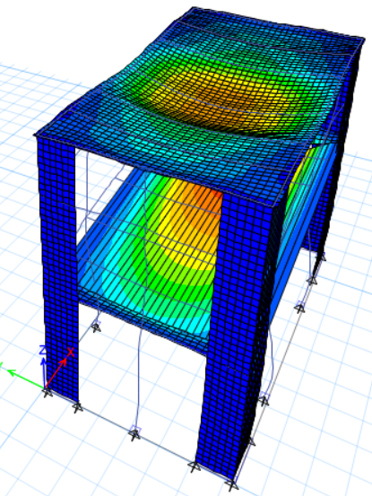
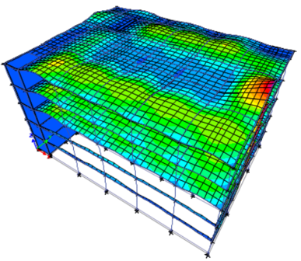
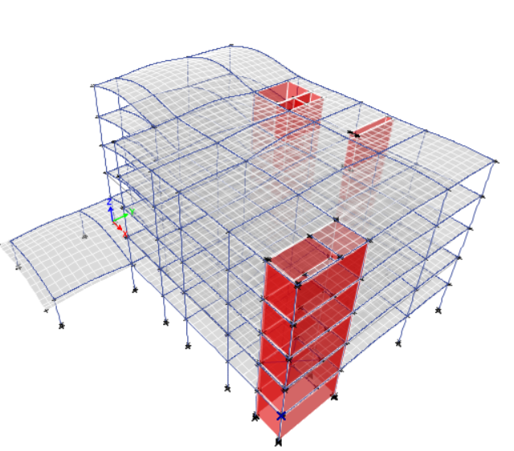
Structural aspects
ETABS Checks
Compatibility check
The whole structural elements move as one body
3D model for Block C
3D model for Block D
3D model for Block E
24

Slide 25
Structural aspects
ETABS Checks
Equilibrium check
This check done for Dead, SID and Live load within difference less than 5 %.
Table 1: Equilibrium check with error %
 | Dead load | Live load | SID load
For Block C | 3.61% | 0.02% | 2.35%
For Block D | 4.45% | 0.04% | 1.02%
For Block E | 0.02% | 0.01% | 0.01%
Internal force check
This check done for columns, beams and slabs within difference less than 10 %.
Table 2: Internal force check with error %
 | Column | Beam | Slab
For Block C | 6.52% | 4.21% | 16.80%
For Block D | 8.07% | 15.34% | 10.39%
For Block E | 4.77% | 1.89% | 5.64%
25

Slide 26

Structural aspects
ETABS Checks
Deflection check
Table 3: Deflection check
Max deflection
 | ETABS | Limit
For Block C | 17.7 mm | 37.5 mm
For Block D | 37 mm | 60 mm
For Block E | 61.5 mm | 62.5 mm
Long-term deflection limit = L/240
Period check
ETABS in x and y- Axes should not exceed UBC code limit
T _{method A} =Ct${ (hn)}^{3/4}$
Table 4: Period check
T _{limit} = 1.4 * T _{method A}
 | T Method A | 1.4 x T Method A | T ETABs x-axis | T ETABs y-axis
Period for Block C | 0.504 sec | 0.7056 sec | 0.686 sec | 0.572 sec
Period for Block D | 0.504 sec | 0.7056 sec | 0.691 sec | 0.521 sec
Period for Block E | 0.504 sec | 0.7056 sec | 0.686 sec | 0.572 sec
26

Slide 27
Structural aspects
ETABS Checks
Drift check
ΔM (Drift) =0.7 * R * Δ _{s}
Drift limitation = 2 % times the story height.
Table 5: Drift check for Block C
Story | Height | Displacement in X- axis | Displacement in Y- axis | Drift X | Drift Y | Delta X | Delta Y | Delta Limit
0 | 0 | 0 | 0
1 | 4500 | 1.52 | 1.27 | 1.52 | 1.27 | 5.86 | 4.9 | 90
2 | 4500 | 4.03 | 3.28 | 2.5 | 2.01 | 15.5 | 12.64 | 90
3 | 4500 | 7.41 | 5.46 | 3.38 | 2.18 | 28.53 | 21.03 | 90
4 | 4500 | 10.88 | 7.97 | 3.47 | 2.51 | 41.88 | 30.7 | 90
5 | 4500 | 13.97 | 10.27 | 3.09 | 2.3 | 53.77 | 39.54 | 90
27

Slide 28
Structural aspects
ETABS Checks
Modal mass participate ratio check (MPMR) check
The MMPR check according to UBC code must be greater than 90% to use response spectrum analysis.
Table 6: MPMR check for Block C
Case | Mode | Period | UX | UY | UZ | Sum UX | Sum UY | Sum UZ
 |  | sec
Modal | 1 | 0.64 | 0.7 | 0.04 | 0 | 0.7 | 0.04 | 0
Modal | 2 | 0.5 | 0.04 | 0.73 | 0 | 0.74 | 0.76 | 0
Modal | 3 | 0.38 | 0.02 | 0 | 0 | 0.76 | 0.76 | 0
Modal | 4 | 0.36 | 0 | 0 | 0 | 0.76 | 0.77 | 0
Modal | 5 | 0.29 | 0 | 0 | 0 | 0.76 | 0.77 | 0
Modal | 6 | 0.28 | 0 | 0 | 0 | 0.76 | 0.77 | 0
Modal | 7 | 0.27 | 0 | 0 | 0 | 0.76 | 0.77 | 0
Modal | 8 | 0.24 | 0 | 0 | 0 | 0.76 | 0.77 | 0
Modal | 9 | 0.21 | 0 | 0 | 0 | 0.76 | 0.77 | 0
Modal | 10 | 0.17 | 0.15 | 0.01 | 0 | 0.91 | 0.78 | 0
Modal | 11 | 0.16 | 0 | 0.03 | 0 | 0.91 | 0.81 | 0
Modal | 12 | 0.15 | 0.01 | 0.07 | 0 | 0.92 | 0.88 | 0
Modal | 13 | 0.15 | 0 | 0 | 0 | 0.92 | 0.88 | 0
Modal | 14 | 0.14 | 0 | 0.01 | 0 | 0.93 | 0.89 | 0
Modal | 15 | 0.13 | 0 | 0 | 0 | 0.93 | 0.89 | 0
Modal | 16 | 0.13 | 0 | 0.02 | 0 | 0.93 | 0.91 | 0
28

Slide 29
Structural aspects
ETABS Checks
Base Shear check
For this check make sure base shear from response spectrum cases equal or more than base shear from equivalent static method through modifying scale factor.
Table 7: Base Shear check for Block C
Axis | Period T (sec) | Period limit (sec) | Period use (sec) | Weight (kN) | V manual | V ETABs | Old S.F | new S.F
X-axis | 0.641 | 0.7056 | 0.641 | 117687.8 | 13352.75 | 9957.92 | 1783 | 2390.85
Y-axis | 0.499 | 0.7056 | 0.499 | 117687.8 | 14978.45 | 11031.3 | 1783 | 2420.98
Table 8: Base Shear check for Block D
Axis | Period T (sec) | Period limit (sec) | Period use (sec) | Weight (kN) | V manual | V ETABs | Old S.F | new S.F
X-axis | 0.691 | 0.7056 | 0.691 | 112592.9 | 11850.3 | 8807.4 | 1783 | 2399.03
Y-axis | 0.521 | 0.7056 | 0.521 | 112592.9 | 14330 | 9039.3 | 1783 | 2826.59
Table 9: Base Shear check for Block E
Axis | Period T (sec) | Period limit (sec) | Period use (sec) | Weight (kN) | V manual | V ETABs | Old S.F | new S.F
X-axis | 0.686 | 0.7056 | 0.686 | 30239.2 | 3205.852 | 3027.064 | 1783 | 1888.31
Y-axis | 0.572 | 0.7056 | 0.572 | 30239.2 | 3844.78 | 2025.312 | 1783 | 3384.78
29

Slide 30
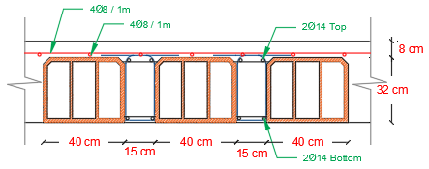
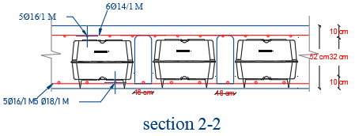
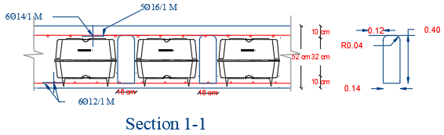
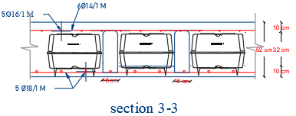
Structural aspects
Design of structural elements
1. Slabs:
30

Slide 31
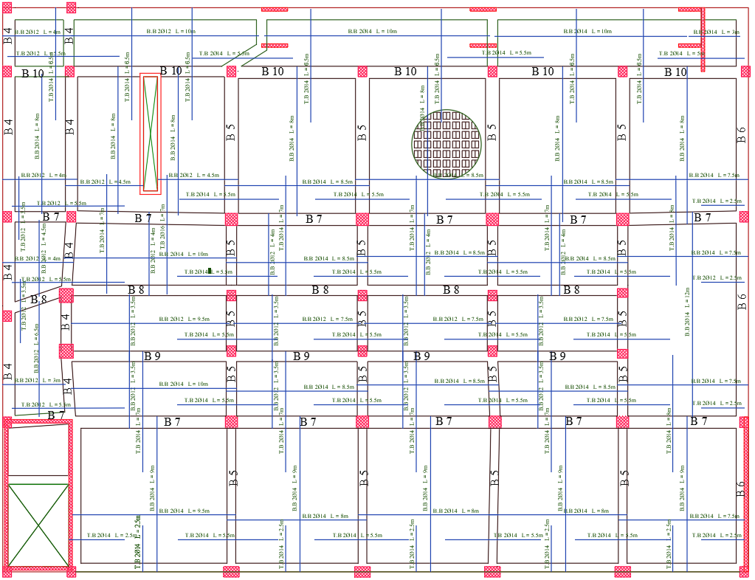
Structural aspects
Design of structural elements
1. Slabs:
31

Slide 32
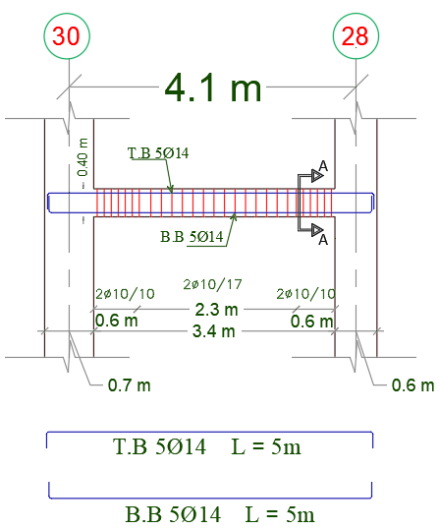
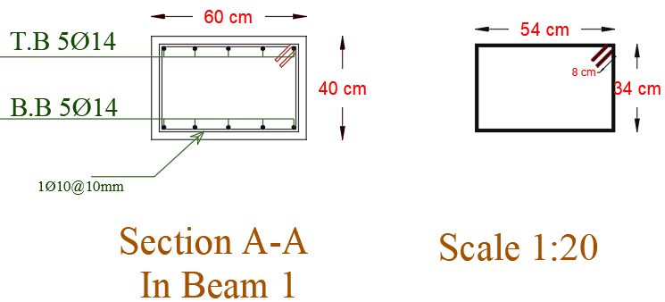
Structural aspects
Design of structural elements
2. Beams:
Table 10: Beam located in Block C
Section Name | material | Type
Frame 1 | Concrete 28Mpa | Hidden Beam
Frame 2 | Concrete 28Mpa | Hidden Beam
Frame 3 | Concrete 28Mpa | Drop and Hidden Beam
Frame 4 | Concrete 28Mpa | Drop and Hidden Beam
Frame 5 | Concrete 28Mpa | Drop and Hidden Beam
Frame 6 | Concrete 28Mpa | Drop and Hidden Beam
Frame 7 | Concrete 28Mpa | Hidden Beam
Frame 8 | Concrete 28Mpa | Hidden Beam
Frame 9 | Concrete 28Mpa | Hidden Beam
Frame 10 | Concrete 28Mpa | Drop and Hidden Beam
32

Slide 33
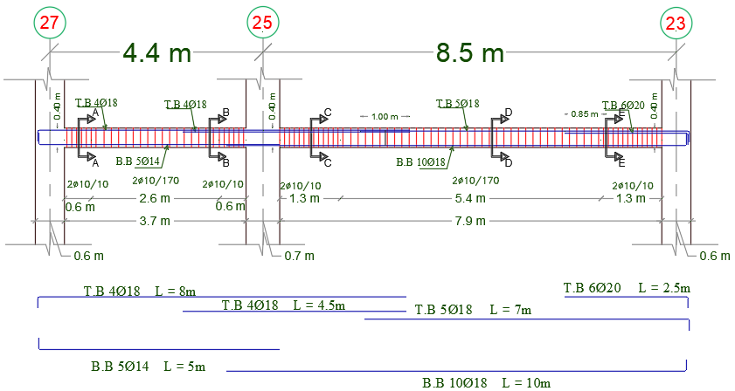
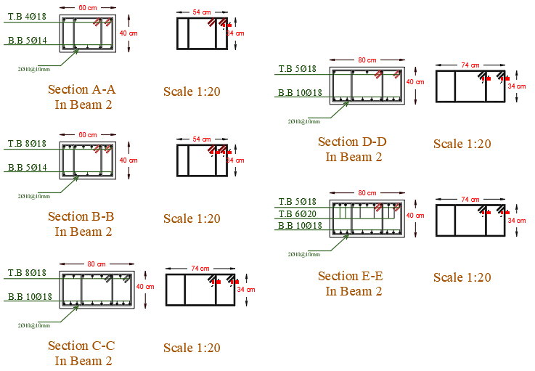
Structural aspects
Design of structural elements
2. Beams:
33

Slide 34
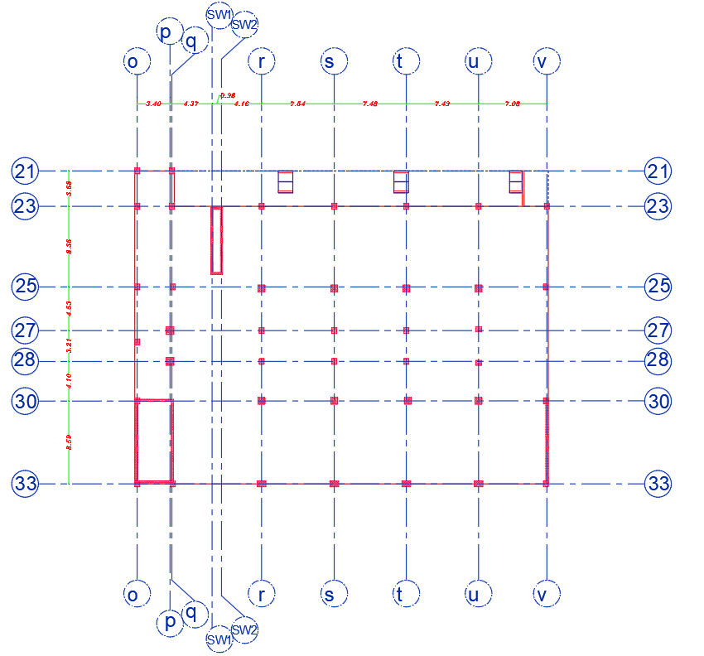
Structural aspects
Design of structural elements
3. Columns:
34

Slide 35
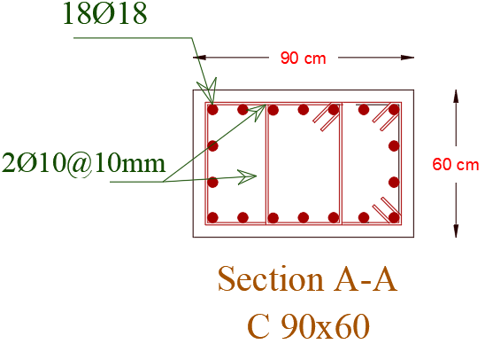
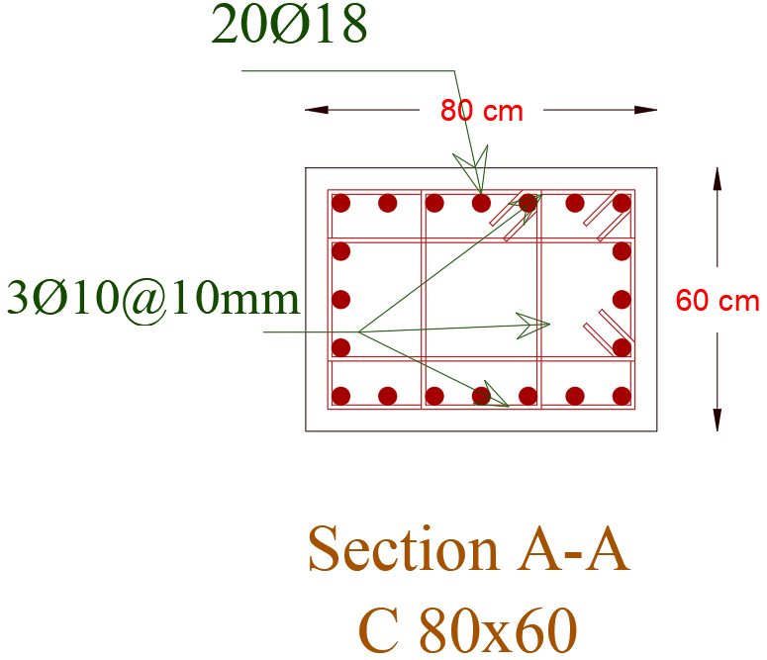
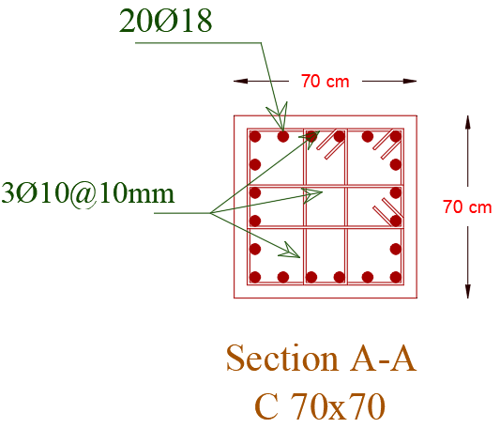
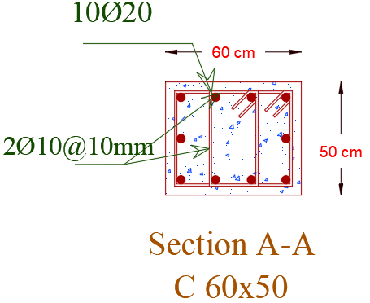
Structural aspects
Design of structural elements
3. Columns:
Table 11: columns located in Block C
Section Name | material | bars | stirrups
 |  |  | both sides area | central area
Column 900*600 | Concrete 28Mpa | 18ф20 | 2Ф10@100mm | 2Ф10@160mm
Column 800*600 | Concrete 28Mpa | 20ф18 | 3Ф10@100mm | 3Ф10@150mm
Column 700*700 | Concrete 28Mpa | 20ф18 | 3Ф10@100mm | 3Ф10@150mm
Column 600*500 | Concrete 28Mpa | 10ф20 | 2Ф10@100mm | 2Ф10@100mm
35

Slide 36
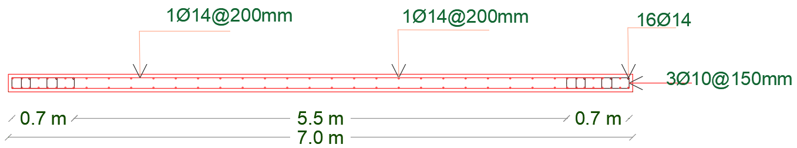
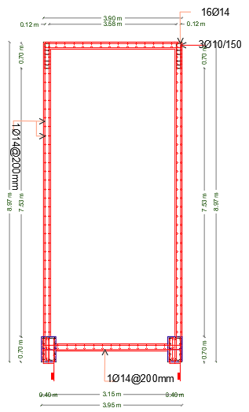
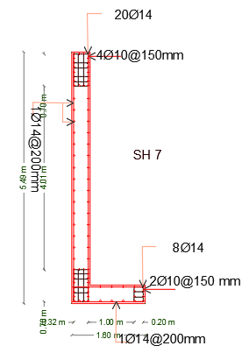
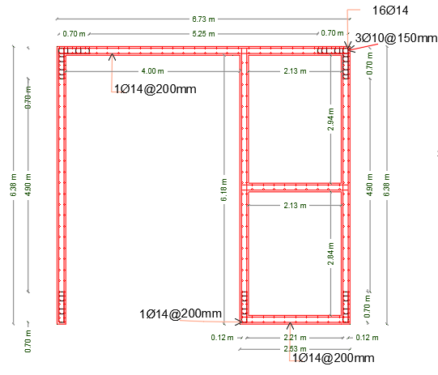
Structural aspects
Design of structural elements
4. Shear walls:
36

Slide 37
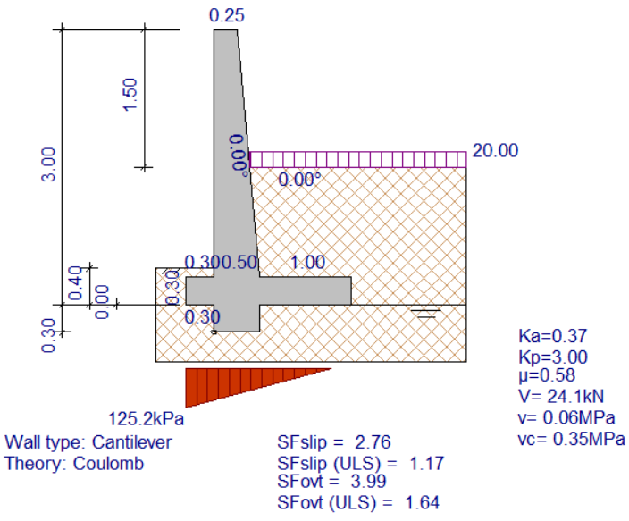
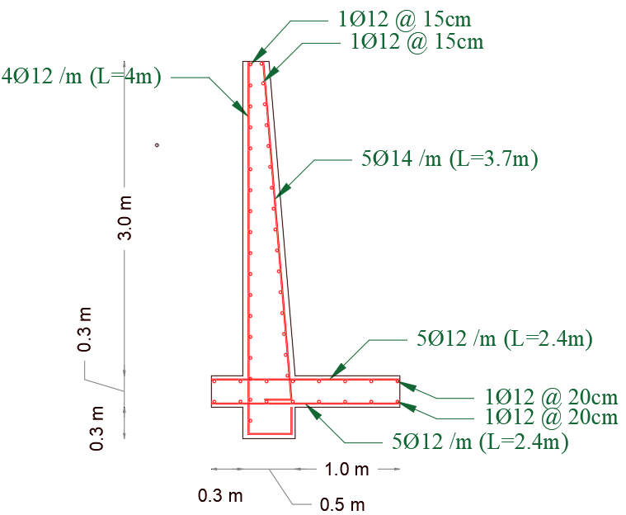
Structural aspects
Design of structural elements
6. retaining wall:
37

Slide 38


Structural aspects
Design of structural elements
7. Mat foundation:
Top reinforcement |  | Bottom reinforcement
in X-axis | in Y-axis | in X-axis | in Y-axis
1Ф25 @ 200 mm | 1Ф25 @ 150 mm | 1Ф25 @ 150 mm | 1Ф25 @ 150 mm
38

Slide 39


Structural aspects
Design of structural elements
7. Mat foundation:
Top reinforcement |  | Bottom reinforcement
in X-axis | in Y-axis | in X-axis | in Y-axis
1Ф25 @ 200 mm | 1Ф25 @ 150 mm | 1Ф25 @ 150 mm | 1Ф25 @ 150 mm
39

Slide 40




Structural aspects
Design of structural elements
8. Stairs:
40

Slide 41


Structural aspects
Design of structural elements
9. Ramps:
41

Slide 42

Structural aspects
Design of structural elements
10. Water tank:
42

Slide 43
Environmental aspects
Material properties
Thermal behavior and
solar radiation
Acoustical design
Daylighting factor
Shading design
Ventilation
43

Slide 44





Environmental aspects
Material properties
External Wall
Roof material
Internal wall
Glass type
44

Slide 45





Environmental aspects
Material properties
External Wall
Roof material
Internal wall
Glass type
45

Slide 46




Environmental aspects
Daylight Factor (DF)check:
For Fourth Floor:
Before Modification
After Modification
46

Slide 47



Environmental aspects
Thermal behavior and solar radiation:
Cooling load and heating load
Amount of Energy consumption in the building
Before Treatment
48

Slide 48


Environmental aspects
Thermal behavior and solar radiation:
After Treatment
49

Slide 49


Environmental aspects
Thermal behavior and solar radiation:
solar radiation for East Elevation
Before
50

Slide 50



Environmental aspects
Thermal behavior and solar radiation:
Solar radiation for East Elevation
After
51

Slide 51





Environmental aspects
Thermal behavior and solar radiation:
solar radiation for South Elevation
$X= \frac{H }{\tan{Ɵ}}$=$\frac{0.75 }{\tan{(72.4)}}$ = 25 cm
52

Slide 52



Environmental aspects
Ventilation and wind direction:
53

Slide 53



Environmental aspects
Shadow analysis:
In this project we solve the shading effects in summer and winter semester at three part of day (8:00 AM, 12:00PM, 4:00PM) as can see:
Shading in summer at 8:00AM
Shading in winter at 8:00AM
54

Slide 54




Environmental aspects
Shadow analysis:
Shading in winter at 12:00PM
Shading in summer at 12:00PM
Shading in winter at 4:00PM
Shading in summer at 4:00PM
55

Slide 55




Environmental aspects
Acoustical design:
STC (Sound Transmission Class )
Internal partition
56

Slide 56


Environmental aspects
Acoustical design:
STC (Sound Transmission Class )
External Wall
76 - 80 dBA
Where the outdoor background noise level is between 76 dBA and 80 dBA, then the OITC should be not less than 50
57

Slide 57

Environmental aspects
Acoustical design:
IIC (Impact insulation Class )
FLOOR
IIC ratings for floor-ceiling assemblies above core learning spaces should be at least IIC-45 and preferably IIC-50 (measured without carpeting on the floor).
58

Slide 58




Environmental aspects
Acoustical design:
Auditorium
Class room
Reverberation time (0.8- 1.20 s)
Reverberation time (0.45-0.85 s)
 | SABINE
FREQ. | RT(60)
100Hz | 1.14 sec
125Hz | 1.14 sec
160Hz | 1.10 sec
200Hz | 1.06 sec
250Hz | 1.02 sec
315Hz | 1.03 sec
400Hz | 1.03 sec
500Hz | 1.04 sec
630Hz | 1.07 sec
800Hz | 1.10 sec
1000Hz | 1.12 sec
1250Hz | 1.13 sec
1600Hz | 1.14 sec
2000Hz | 1.15 sec
2500Hz | 1.14 sec
3150Hz | 1.11 sec
4000Hz | 1.07 sec
5000Hz | 1.00 sec
6300Hz | 0.91 sec
8000Hz | 0.84 sec
 | SABINE
FREQ. | RT(60)
63Hz | 0.56 sec
125Hz | 0.59 sec
250Hz | 0.49 sec
500Hz | 0.60 sec
1kHz | 0.68 sec
2kHz | 0.69 sec
4kHz | 0.60 sec
8kHz | 0.43 sec
16kHz | 0.42 sec
59

Slide 59


Environmental aspects
Acoustical design:
Class room
Auditorium
Articulation loss(AL) :
Articulation loss(AL) :
Recommendation AL for class room = < 7 %
Recommendation AL for Auditorium = < 7 %
Frequency | Articulation Loss
400Hz | 3.09
500Hz | 3.09
630Hz | 3.09
800Hz | 3.09
1000Hz | 3.09
1250Hz | 3.09
1600Hz | 3.09
2000Hz | 3.09
2500Hz | 3.09
61

Slide 60
Mechanical aspects
Water system
Fire fighting system
Drainage system
HVAC System
60

Slide 61

Mechanical aspects
HVAC System
VRF system is used in this project
The below table give design capacity ,flow rate ,number of fan for all project.
63

Slide 62




Mechanical aspects
HVAC System
TOSHIBA selected company
  Out door unit
  Fan coil unit
62

Slide 63


Mechanical aspects
HVAC System
  Diffuser
  Grilles
63

Slide 64

Mechanical aspects
HVAC System
  Duct diameter for class room
  Table give Duct velocity, diameter and volumetric flow rate for fan coil and diffuser.
64

Slide 65

Mechanical aspects
HVAC System
Diffuser and mechanical ventilation for ground floor
65

Slide 66

Mechanical aspects
HVAC System
Diffuser and mechanical ventilation for first floor
66

Slide 67

Mechanical aspects
HVAC System
Diffuser and mechanical ventilation for second floor
67

Slide 68

Mechanical aspects
HVAC System
Diffuser and mechanical ventilation for third floor
68

Slide 69

Mechanical aspects
HVAC System
Diffuser and mechanical ventilation for fourth floor
69

Slide 70


Mechanical aspects
Water system
The consumption of water based on ASHREA code = 43.1m³.
 | Diameter (in)
Vertical | 2''
Horizontal | 1.5''
Meter | 2''
Branch | 3/4''
71

Slide 71


Mechanical aspects
Drainage system
type of pipes | Pipes Diameter (in) | Slope %
horizontal (sewer) | 2" | 2
horizontal (sewer) | 4" | 1
vertical (stack) | 4" | 0
vertical (vent) | 4" | 0
72

Slide 72



Mechanical aspects
Drainage system
Calculation of pipes diameter for drainage water (waste water):
73

Slide 73


Mechanical aspects
Drainage system
74

Slide 74

Mechanical aspects
Fire fighting system
Heat Detector
Smoke Detector
Fire Extinguisher
(CO2)
House station
Sprinkler
Fire fighting For Fourth plan
75

Slide 75

Mechanical aspects
Escape route for first floor
75

Slide 76
Electrical Design
Distributions of Sockets
Lighting System
Loudspeakers
76

Slide 77


Electrical Design
Lighting System:
DIALux program was used to design lighting system in project.
Arlight company used to selection luminaires .
77

Slide 78
Electrical Design
Lighting System:
First Floor
Room name | Uniformity | Required | Lux | Required | UGR
 |  | Uniformity |  | Lux
store | 0.7 | 0.4 | 134 | 100 | 16.4<25
massage training | 0.62 | 0.6 | 345 | 300 | 17.4<19
trainer room | 0.63 | 0.6 | 306 | 300 | 13.4<19
tutorial room | 0.71 | 0.6 | 369 | 300 | 16<19
corridor bath | 0.57 | 0.5 | 122 | 100 | 13.3<25
baths | 0.78 | 0.5 | 160 | 150 | 10 < 25
corridor | 0.18 | 0.4 | 127 | 100 | 21<25
Ground Floor
Room name | Uniformity | Required | Lux | Required | UGR
 |  | Uniformity |  | Lux
children play area | 0.74 | 0.33 | 334 | 300 | 20.9 < 22
secretary | 0.63 | 0 | 121 | 100 | 15.7 < 19
Archive | 0.64 | 0 | 103 | 100 | 14.4 < 25
offices | 0.6 | 0.33 | 177 | 150 | 16.9 < 19
printing | 0.64 | 0 | 104 | 100 | 15.1 < 19
human resources | 0.74 | 0.33 | 169 | 150 | 12.8 <19
volunteer unit | 0.74 | 0.33 | 170 | 150 | 12.7< 19
research unit | 0.74 | 0.33 | 170 | 150 | 12.6<19
financial unit | 0.74 | 0.33 | 171 | 150 | 12.6<19
director & meeting | 0.68 | 0.66 | 380 | 300 | 16.3<19
pharmacy | 0.73 | 0.33 | 306 | 300 | 16<19
product shop | 0.73 | 0.33 | 132 | 100 | 17.8<19
souvenir shop | 0.72 | 0.33 | 173 | 150 | 18 < 22
corridor bath | 0.57 | 0.5 | 122 | 100 | 13.3<25
baths | 0.78 | 0.5 | 160 | 150 | 10 < 25
corridor | 0.18 | 0.4 | 127 | 100 | 21<25
Inquiry | 0.71 | 0.5 | 186 | 150 | 17.1<19
Second Floor
Room name | Uniformity | Required | Lux | Require | UGR
 |  | Uniformity |  | Lux
activity room | 0.4 | 0.33 | 419 | 400 | 18.8<19
tutorial room | 0.71 | 0.6 | 300 | 369 | 16<19
praying | 0.53 | 0.33 | 151 | 150 | 14.6<22
abolition | 0.42 | 0.33 | 114 | 100 | 13.9<22
back stage | 0.43 | 0.33 | 99 | 75 | 18.7<22
staff offices | 0.6 | 0.33 | 197 | 150 | 15.2<19
meeting | 0.69 | 0.66 | 340 | 300 | 16.3<19
corridor | 0.18 | 0.4 | 127 | 100 | 21<25
corridor bath | 0.57 | 0.5 | 122 | 100 | 13.3<25
baths | 0.78 | 0.5 | 160 | 150 | 10 < 25
78

Slide 79
Electrical Design
Lighting System:
Third Floor
Fourth Floor
Room name | Uniformity | Required Uniformity | Lux | Required Lux | UGR
mobility training | 0.69 | 0.6 | 587 | 500 | 18.5<19
vip lounge | 0.48 | 0.4 | 69.7 | 50 | 19.1<22
tutorial room | 0.71 | 0.6 | 300 | 369 | 16<19
staff offices | 0.6 | 0.33 | 197 | 150 | 15.2<19
corridor bath | 0.57 | 0.5 | 122 | 100 | 13.3<25
baths | 0.78 | 0.5 | 160 | 150 | 10 < 25
light room | 0.71 | 0.33 | 129 | 100 | 19.4<22
speak training | 0.67 | 0.33 | 523 | 500 | 20<22
corridor | 0.18 | 0.4 | 127 | 100 | 21<25
Room name | Uniformity | Required Uniformity | Lux | Required Lux | UGR
bed room | 0.64 | 0.4 | 141 | 100 | 15.1<22
laundry | 0.68 | 0.33 | 304 | 300 | 18.1<22
corridor bath | 0.57 | 0.5 | 122 | 100 | 13.3<25
baths | 0.78 | 0.5 | 160 | 150 | 10 < 25
corridor | 0.18 | 0.4 | 127 | 100 | 21<25
living | 0.46 | 0.1 | 124 | 100 | 18.4<22
bed room | 0.73 | 0.4 | 145 | 100 | 15.3<22
baths | 0.7 | 0.5 | 165 | 150 | 10 < 25
79

Slide 80


Electrical Design
Lighting System:
80

Slide 81
Electrical Design
Distributions of Sockets
The power of sockets is estimated by 400 Watt for normal socket.
The power of Sockets is estimated by 2400 Watt for special load socket.
#Floor | #Socket | Power (KW)
ground | 37 | 20.8
First | 28 | 15.2
Second | 55 | 26
Third | 45 | 22
Fourth | 83 | 41.2
Total | 242 | 125.2
81

Slide 82


Electrical Design
Distributions of Sockets
82

Slide 83
Electrical Design
Calculation for drop voltage
Drop voltage: The drop voltage should not exceed a certain value (usually 1%)
The cross sectional area for cable that use in lighting is 1.5 mm².
Name
S2.D.B.G
S1.D.B.G
Name | power | I _{L} (Amp) | ρ (Ω.m) | L (m) | R(Ω) | drop voltage | % drop voltage
L1 | 421.9 | 2.02 | 1.68*10⁸ | 44.4 | 0.50 | 1.01 | 0.46
L2 | 429.6 | 2.44 | 1.68*10⁸ | 79 | 0.88 | 2.16 | 0.98
L3 | 429.6 | 2.44 | 1.68*10⁸ | 69 | 0.77 | 1.89 | 0.86
L4 | 257.4 | 1.46 | 1.68*10⁸ | 52.3 | 0.59 | 0.86 | 0.39
L5 | 458.4 | 2.60 | 1.68*10⁸ | 62.4 | 0.70 | 1.82 | 0.83
L6 | 624 | 3.55 | 1.68*10⁸ | 48.6 | 0.54 | 1.93 | 0.88
L7 | 312 | 1.77 | 1.68*10⁸ | 73.4 | 0.82 | 1.46 | 0.66
L8 | 312 | 1.77 | 1.68*10⁸ | 57.4 | 0.64 | 1.14 | 0.52
L9 | 214.8 | 1.22 | 1.68*10⁸ | 144.2 | 1.62 | 1.97 | 0.90
L10 | 214.8 | 1.22 | 1.68*10⁸ | 130 | 1.46 | 1.78 | 0.81
L11 | 179 | 1.02 | 1.68*10⁸ | 112.4 | 1.26 | 1.28 | 0.58
L12 | 220.8 | 1.25 | 1.68*10⁸ | 101.8 | 1.14 | 1.43 | 0.65
L13 | 400.4 | 2.28 | 1.68*10⁸ | 80.6 | 0.90 | 2.05 | 0.93
L14 | 420 | 2.39 | 1.68*10⁸ | 58.7 | 0.66 | 1.57 | 0.71
83

Slide 84
Electrical Design
Drop voltage calculation
Drop voltage: The drop voltage should not exceed a certain value (usually 1%)
The cross sectional area for cable that use in sockets is 2.5 mm².
Name
S1.D.B.G
S2.D.B.G
Name | I load (Amp) | I actual | ρ (Ω.m) | L (m) | R(Ω) | drop voltage | % drop voltage
P1 | 8.00 | 2.40 | 1.72*10⁸ | 62.2 | 0.43 | 1.03 | 0.47
P2 | 10.00 | 3.00 | 1.72*10⁸ | 55.4 | 0.38 | 1.14 | 0.52
P3 | 10.00 | 3.00 | 1.72*10⁸ | 68.5 | 0.47 | 1.41 | 0.64
P4 | 12.00 | 12.00 | 1.72*10⁸ | 24.1 | 0.17 | 1.99 | 0.90
P5 | 10.00 | 3.00 | 1.72*10⁸ | 45.4 | 0.31 | 0.94 | 0.43
P6 | 8.00 | 2.40 | 1.72*10⁸ | 40.5 | 0.28 | 0.67 | 0.30
P7 | 8.00 | 2.40 | 1.72*10⁸ | 44.9 | 0.31 | 0.74 | 0.34
P8 | 8.00 | 2.40 | 1.72*10⁸ | 42.1 | 0.29 | 0.70 | 0.32
P9 | 12.00 | 12.00 | 1.72*10⁸ | 26.4 | 0.18 | 2.18 | 0.99
P10 | 6.00 | 1.80 | 1.72*10⁸ | 36.3 | 0.25 | 0.45 | 0.20
P11 | 12.00 | 12.00 | 1.72*10⁸ | 16.1 | 0.11 | 1.77 | 0.81
84

Slide 85

Electrical Design
Circuit breaker
Name | selection I _{CB} (Amp) | selection cross sectional area (mm²)
M.D.B.G | 500 | 500
M.D.B.F1 | 80 | 35
M.D.B.F2 | 100 | 50
M.D.B.F3 | 100 | 50
M.D.B.F4 | 160 | 70
85

Slide 86

Electrical Design
Circuit breaker
Name | I _{CB} (Amp) | selection I _{CB} (Amp) | I cable (Amp) | selection cross sectional area (mm²)
S1.D.B.G | 38.6032 | 40 | 44.39 | 6
S2.D.B.G | 56.442 | 63 | 64.91 | 25
Name | I _{CB} (Amp) sockets | Selection I _{CB} (Amp) | I cable (Amp) | selection cross sectional area (mm²) | I _{CB} (Amp) lighting | Selection I _{CB} (Amp) | I cable (Amp) | selection cross sectional area (mm²)
S1.D.B.G | 23.46 | 25 | 26.979 | 6 | 15.1432 | 16 | 17.415 | 4
S2.D.B.G | 46 | 50 | 52.9 | 25 | 10.442 | 16 | 12.008 | 2.5
86

Slide 87


Electrical Design
Loudspeakers
The converge angle for loudspeakers = 111֠
Coverage area = 13 m²
87

Slide 88

Electrical Design
Loudspeakers
88

Slide 89

Systems integration
False Ceiling for Ground floor
93

Slide 90

Systems integration
False Ceiling for First floor
92

Slide 91

Systems integration
False Ceiling for Second floor
91

Slide 92

Systems integration
False Ceiling for Third floor
90

Slide 93

Systems integration
False Ceiling for Fourth floor
89

Slide 94
Cost Estimation
The total cost of block C was found to be 9,535,846 NSI, which equals 2 ,724,527 $.
The cost of establishing one square meter is equal to 1907.17 NIS, which equals 545 $.
The total area of the project reached 32100 m²
Depend on this information the total cost of this project equal 61,220,157 NIS which equals 17,491,473 $.
 |  | Materials Cost |  | Laber Cost |  | Equipment
Work Items No. | Description / Detials | Total Cost (NIS) |  | Total Cost (NIS) |  | Total Cost (NIS) |  | Total Cost (NIS)
Total cost for Block C in project |  |  |  |  |  |  |  | 9,535,847
Total unit cost for Block C in project |  |  |  |  |  |  |  | 1,907.17
1.1 | Earth works | 5,200 |  | 360 |  | 138,500.00 |  | 144,060
1.2 | Structural Works | 3,112,253 |  | 816,976 |  | - |  | 3,929,229
1.3 | Finishing Works | 2,353,987 |  | 623,889 |  | - |  | 4,249,966
1.4 | Mechanical Works | 173,716 |  | 35,650 |  | - |  | 1,169,516
1.5 | Electrical Works | 26,815 |  | 16,260 |  | - |  | 43,075
94

Slide 95
Thank you
for listening
95

